Slide 1
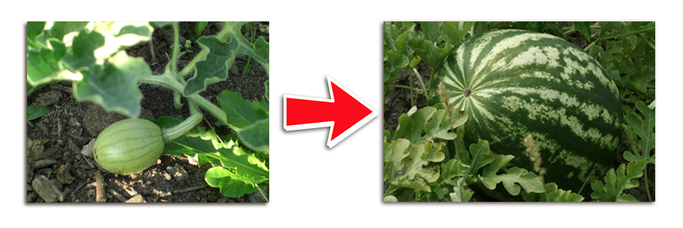
Mitosis in Watermelons
Watermelons grow from small to large through the process of Mitosis.

Slide 2
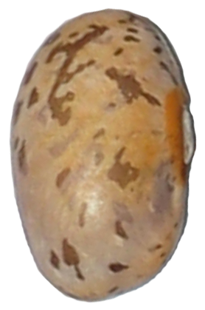
Interphase
Chromosomes begin to duplicate
Each bean represents 1 chromosome. Watermelons have 22 chromosomes
Nucleus

Slide 3
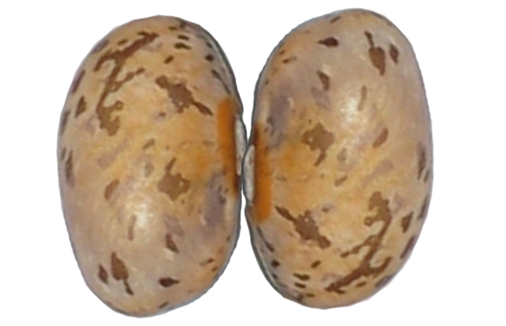
Prophase
Each chromosome now has a duplicate
Each pair is called a “Sister Chromatid”
Spindle fibers start to form
Nuclear envelope breaks down

Slide 4
Metaphase
Chromosomes line up in the middle
Spindle fibers are attached

Slide 5
Anaphase
Sister Chromatids separate

Slide 6
Telophase
“Cytokinesis”
The division of the cytoplasm to form two new cells
Each cell has a complete set of 22 chromosomes.
Both cells are genetically identical.
Nuclear membrane re-forms
Cell plate forms to divide the 2 daughter cells

Slide 7
Meiosis in Seeded Watermelons
Male flowers produce pollen and sperm (male gamete).
Female flowers produce eggs inside the ovule (female gamete).
When pollen carrying sperm from the male flower reaches the ovule of the female flower, a watermelon fruit begins to form
Meiosis takes place in the flower of a watermelon plant to produce gametes.

Slide 8
Prophase I
DNA coils making chromosomes
Homologous chromosomes pair in synapsis
Crossing-over occurs
Tetrads (4) form

Slide 9
Metaphase I
The nuclear membrane disappears
Spindle forms
Fibers attach

Slide 10
Anaphase I
Spindle fibers shorten and move homologous chromosomes to opposite sides

Slide 11
Telophase I
Nuclear membrane reforms around the daughter nuclei
Chromosomes are still attached to a common centromere
Nuclear membrane re-forms
Each chromosome consists of 2 sister chromatids which are not identical due to crossing over

Slide 12
Prophase II
Nuclear envelopes break down
New spindle forms

Slide 13
Metaphase II
New spindle fibers form and attach to each side of the centromere

Slide 14
Anaphase II
Spindle fibers contract
Sister chromatids move toward opposite poles

Slide 15
Telophase II
Nuclear envelopes reform around the daughter chromosomes
Chromosomes unwind
4 haploid cells result

Slide 16
Meiosis in Seedless Watermelons
Diploid Flower cross pollinates with a tetraploid flower
Resulting in a triploid offspring which is sterile and does not produce seeds.

