Slide 1
Food, Land & People: Integrating Science and the Common Core

Slide 2
How much time per week do you spend on science instruction?
Poll Everywhere

Slide 3
Integrating Science and Literacy
Research shows that the amount of instructional time devoted to science in kindergarten through grade 5 has declined significantly. One way to address this inequity is through thoughtful integration. Integrating science and literacy supports student achievement in both disciplines. Both reading and scientific inquiry are concerned with thinking processes; both are an effort to construct meaning. ( Fries-Gaither & Shiverdecker)
Scientific Inquiry experiences have a positive effect on vocabulary enrichment, increased verbal fluency, enhanced ability to think logically, and improved concept formation and communication skills. (Ostlund)

Slide 4
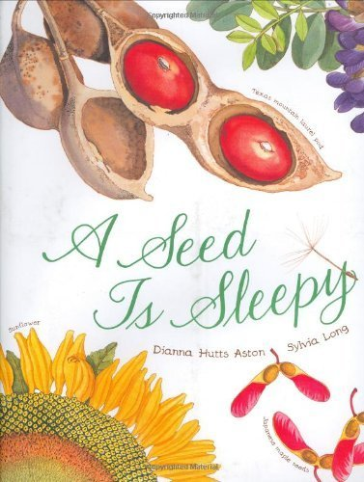
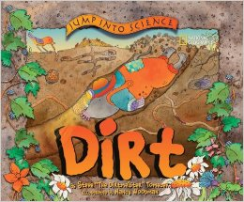
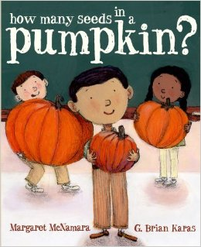
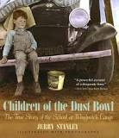
Integrating Science and Literacy
Benefits of informational texts: * Builds background knowledge and supports content learning * Exposes students to specialized vocabulary * Prompts discussions and comprehension strategies
Common Core State Standards recommend a 50/50 split between expository (writing that explains) and narrative (writing that tells a story) texts.
Avoid books that perpetuate stereotypes, misconceptions, inaccuracies, and anthropomorphism

Slide 5
Integrating Math and Science
Understanding math concepts is essential to students being able to answer scientific questions.
Numbers are the language of science.

Slide 6
Integrating Math and Science
“Research indicates that an integrated approach to learning aligns with the way the brain naturally processes and internalizes new information. Since mathematics and science are integrated in the world outside the classroom, and technology has become a natural extension of this integration, it seems only logical that these areas are studied together inside the classroom.” -Diane Ronis

Slide 7
What is Agriculture?

Slide 8
What is Agriculture?
“The science, art or practice of cultivating the soil, producing crops, and raising livestock and in varying degrees the preparation and marketing of the resulting products.”

Slide 9
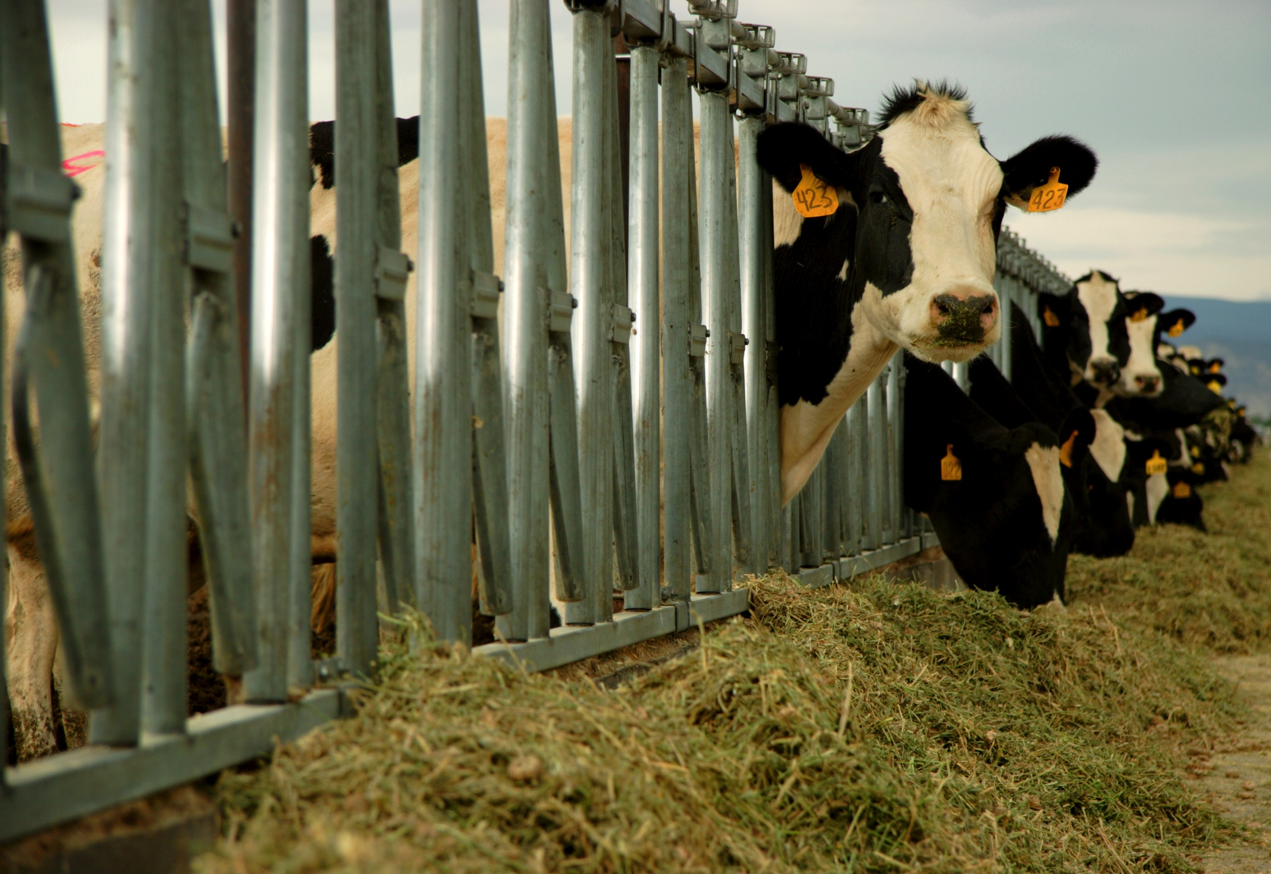
What is Agriculture?
Farming is the actual production of food and fiber derived from plants and animals. Farmers must understand economics, business, and the science involved in getting their products to market. The science involved in agriculture includes the knowledge of ecosystems, soil, water, weather, chemistry, and plant and animal biology.

Slide 10
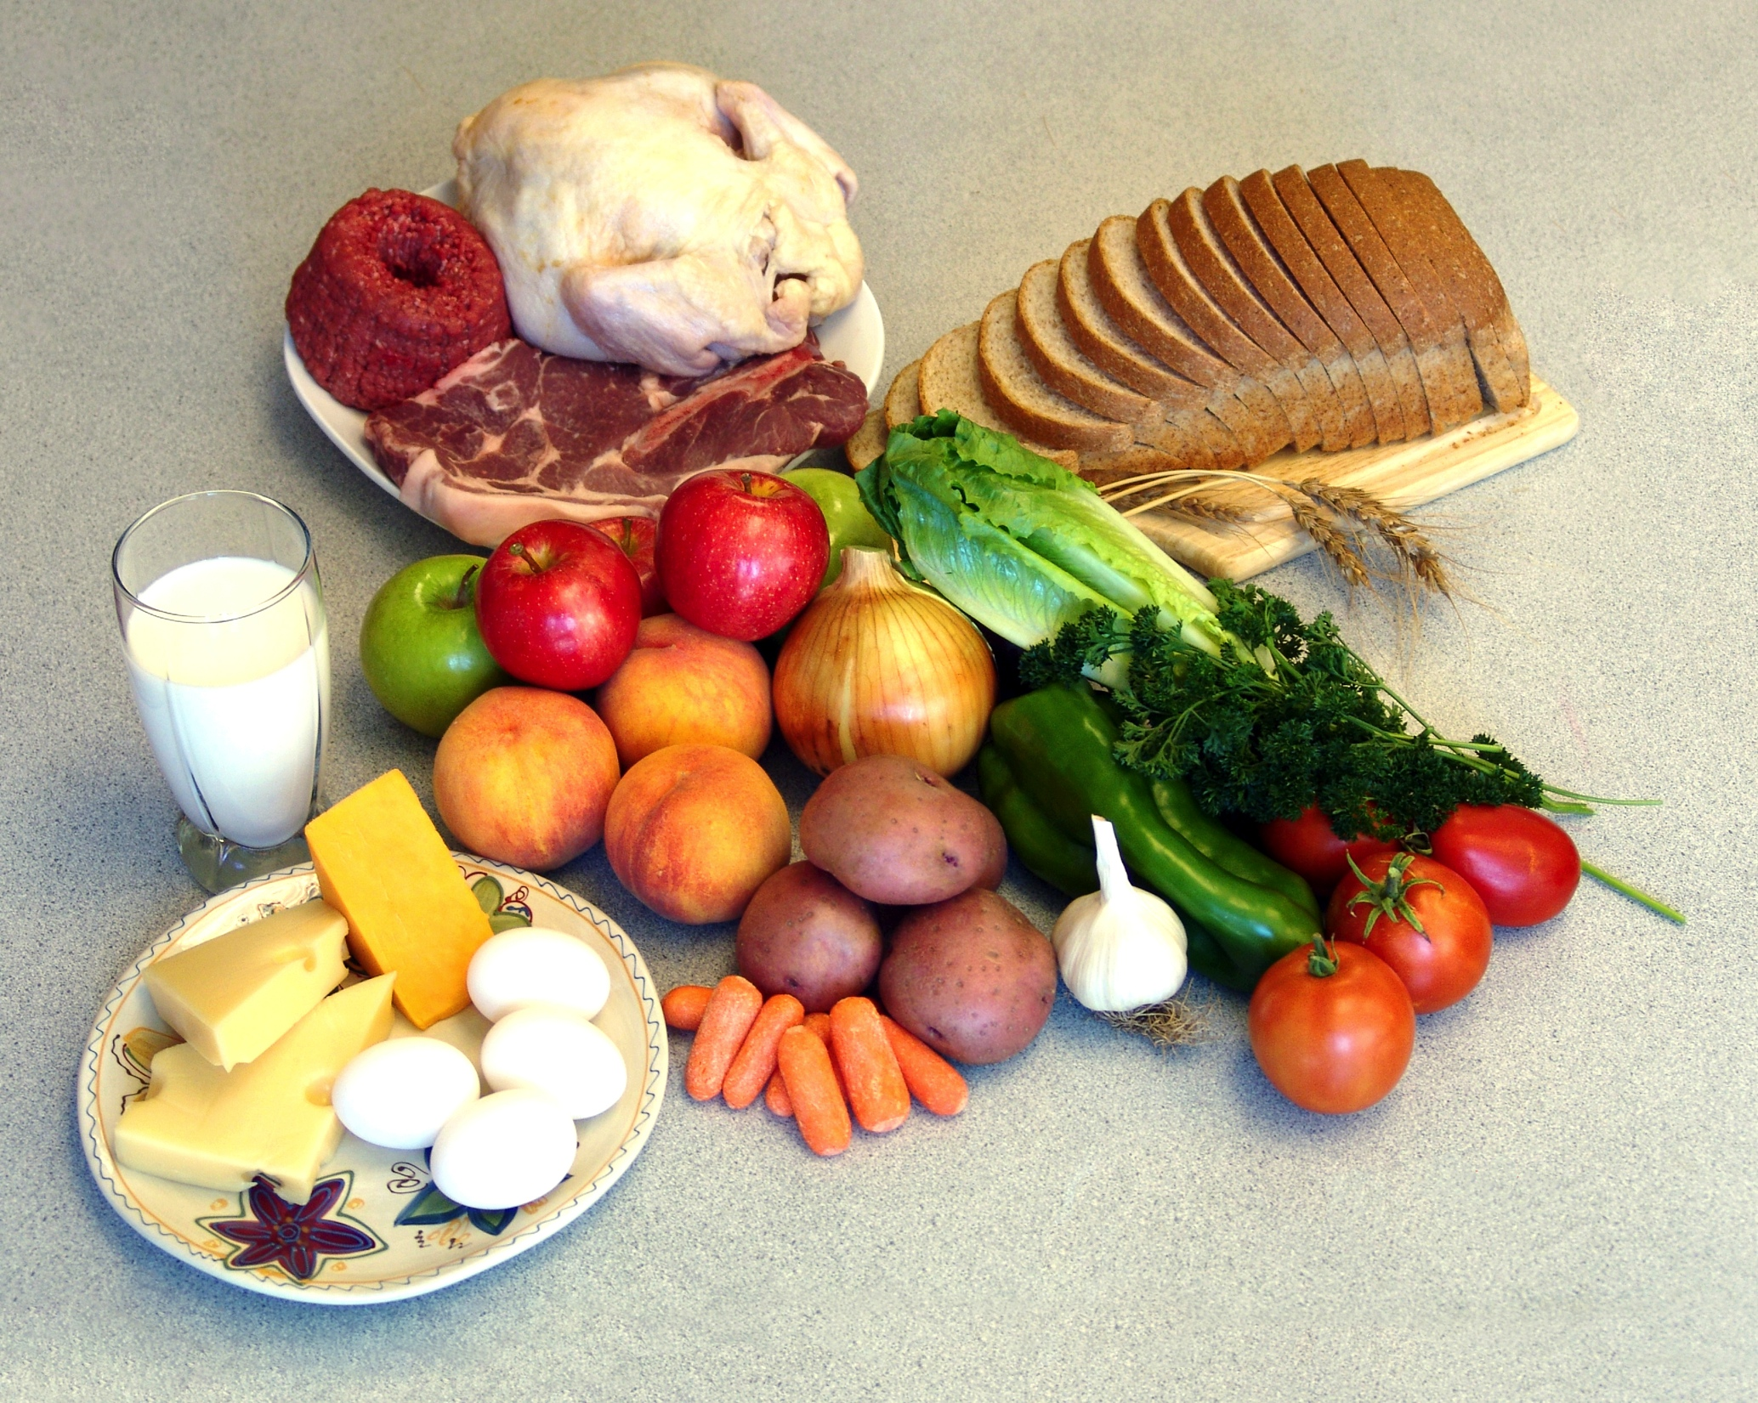
What is Agriculture
Food is made from the products taken from the farm. Products, like corn, may be consumed immediately or processed into a different product like corn chips, soda, peanut butter, detergents, or medicines. The food industry includes processing and distributing food.

Slide 11
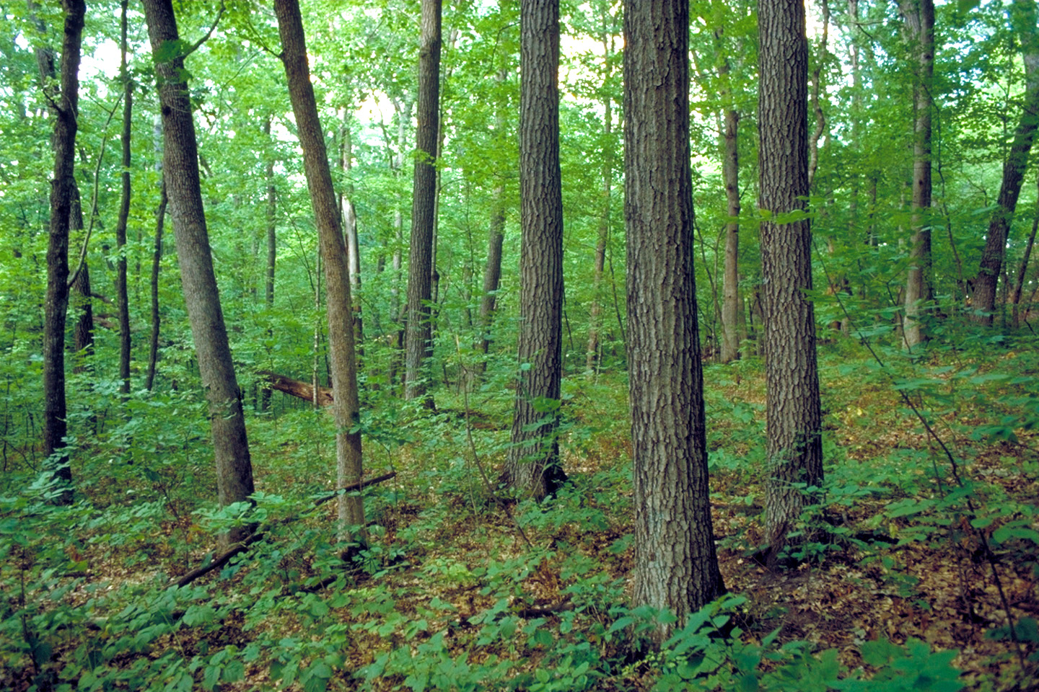
What is Agriculture?
Forestry, in the context of agriculture, is the cultivation of trees. Agriculturally, privately owned farms are really forests that are grown to provide paper, paint, furniture, lumber and numerous other wood products.

Slide 12
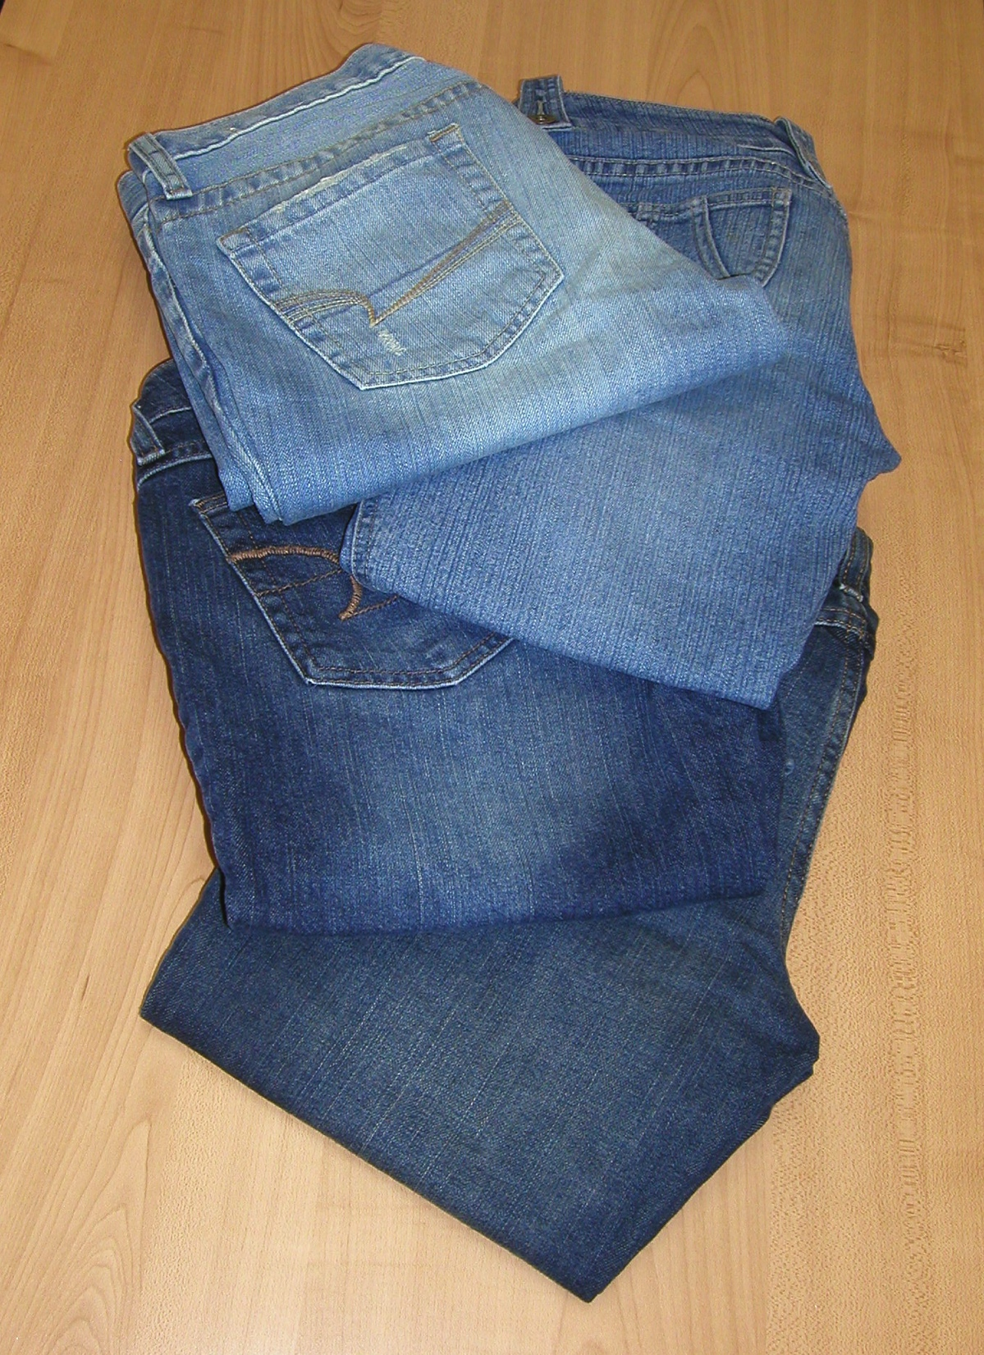
What is Agriculture?
Fabric is also produced on the farm. The two most important fibers produced on the farm are wool and cotton. These fibers are made into yarn or thread and then woven into fabric or cloth, then finally made into gloves, socks, suits, coats, and other products like blankets, carpets, and curtains.

Slide 13
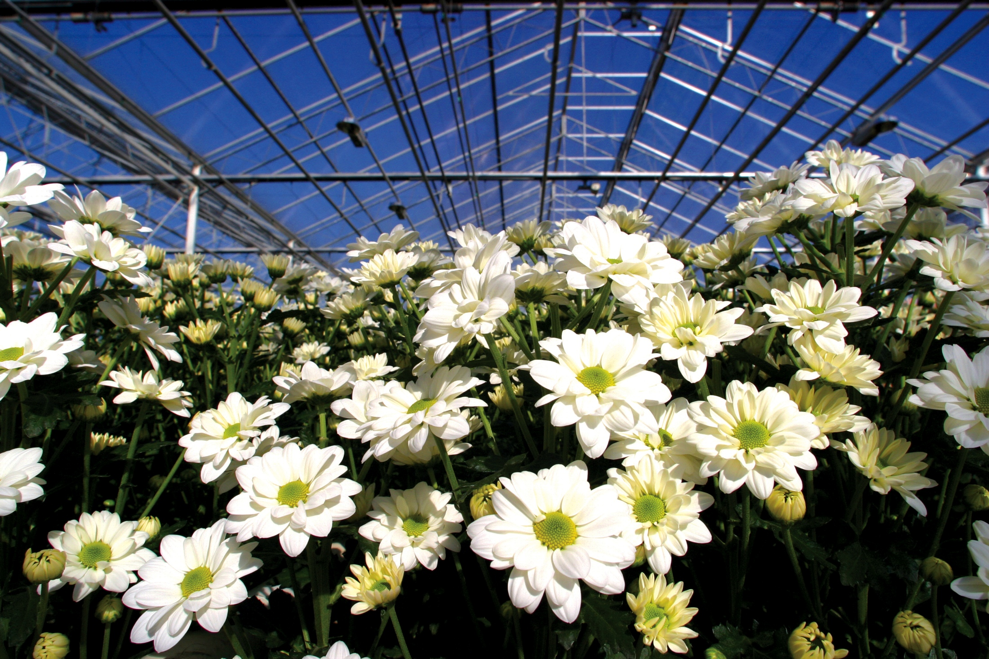
What is agriculture?
Flowers are part of the “green industry” which includes turf or sod, nursery plants, and floral crops. The primary use of these crops is for special occasions, land beautification, and to reduce soil erosion.

Slide 14
What is Agriculture?
“People who work in agriculture are also responsible to care for living things. What is produced through the crops and animals raised is what sustains and gives us the comforts of life.” -Diane Edwards 2nd grade teacher Monte Vista Elementary South Jordan, Utah
World Without Farmers – One Hungry Planet
Utah Projected Population Change

Slide 15
Agriculture fits into Utah core standards.
Agriculture…Where Does it Fit?
Agriculture is a natural fit in the areas of science, social studies, and nutrition.
Agricultural concepts can be used as a basis for reading, writing, language and math activities.

Slide 16
We are all connected to agriculture.
Students can see the relevant connections in their daily lives as they explore the sources of their food, clothing, and many of the products they use in their daily lives.
“Agriculture provides a context to discuss the interrelationships between nature and human needs.”

Slide 17
Agriculture provides an authentic learning context.
Agricultural topics are easily transferred to students’ everyday lives.
The study of agriculture lends to authentic learning experiences, concrete examples, and hands-on activities.
Agriculture is a powerful context for experiential learning.

Slide 18
One of the goals of the common core standards is to “help solidify students’ progression to higher-level math [thinking], through real-world applications and conceptual understanding, not just procedural knowledge.”
Using familiar things (connecting to previous experiences) is essential to setting-up inquiry and PBL learning that leads to problem solving.
Goal for the day: Use agricultural content to contextualize your teaching and learning of core subjects.

