Slide 1
Farming, It’s a Fact
Utah.agclassroom.org

Slide 2
An acre is about the size of a football field.
Notes:
Romney Stadium GS Parking and Entry Procedures - Event Services ...eventservices.usu.edu

Slide 3
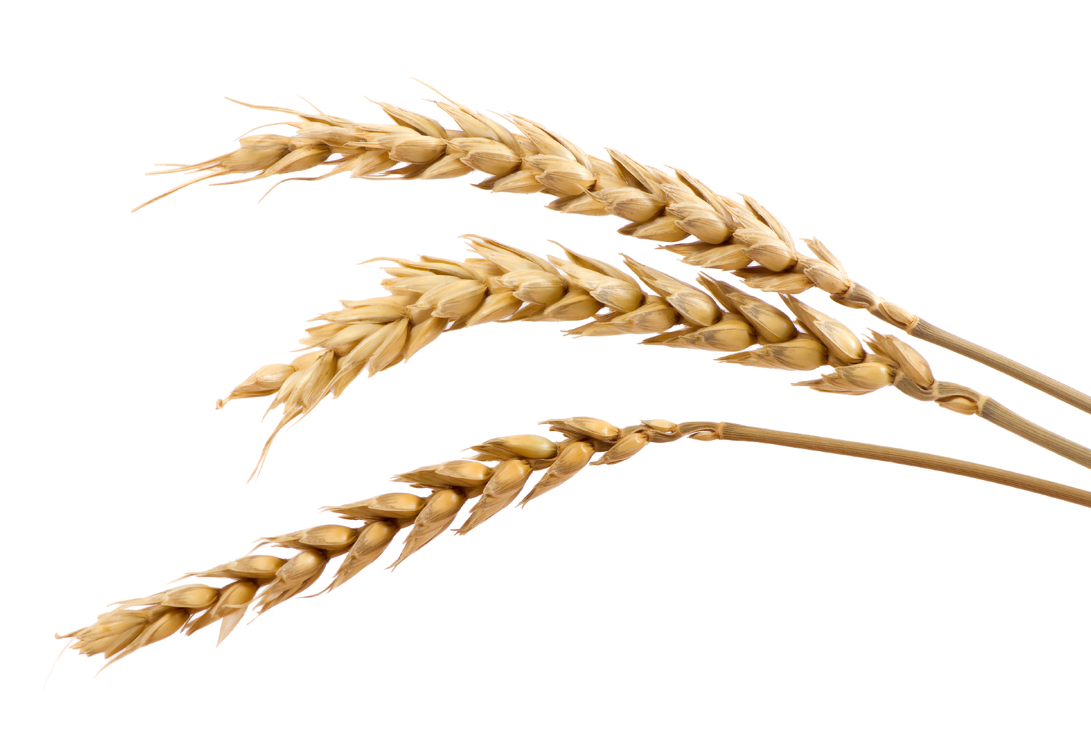
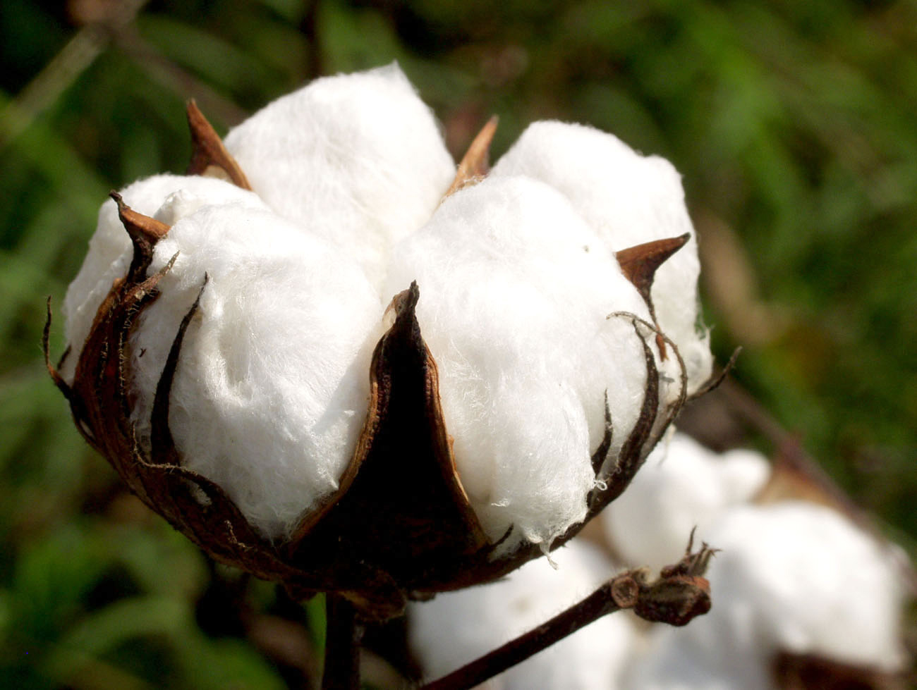
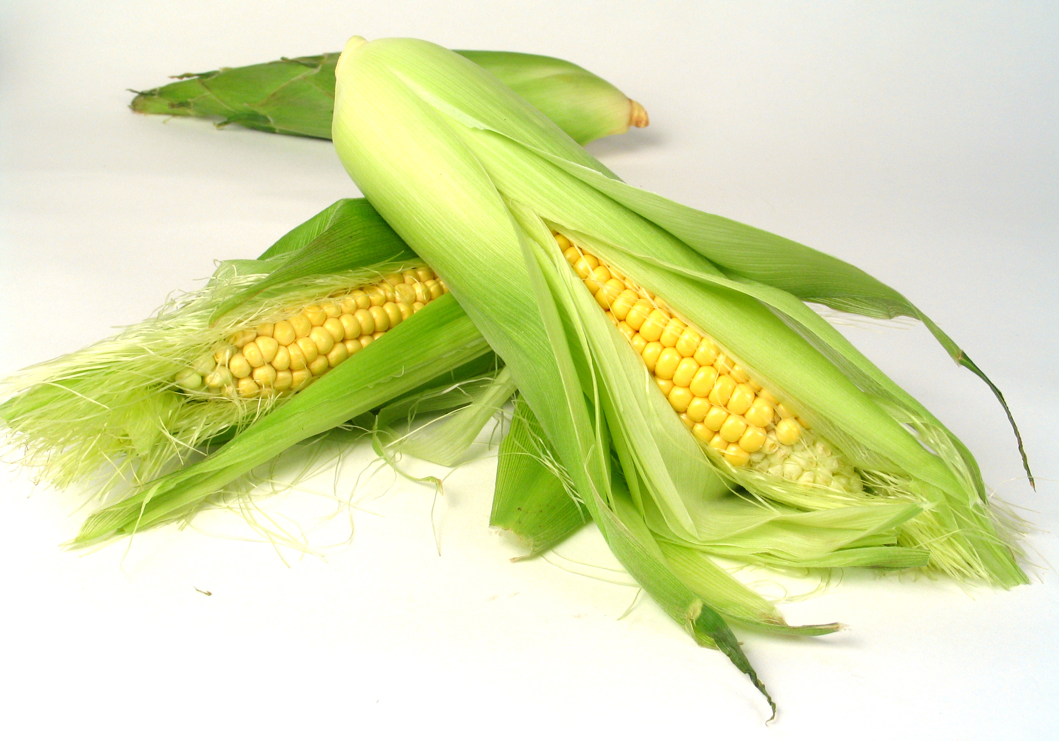
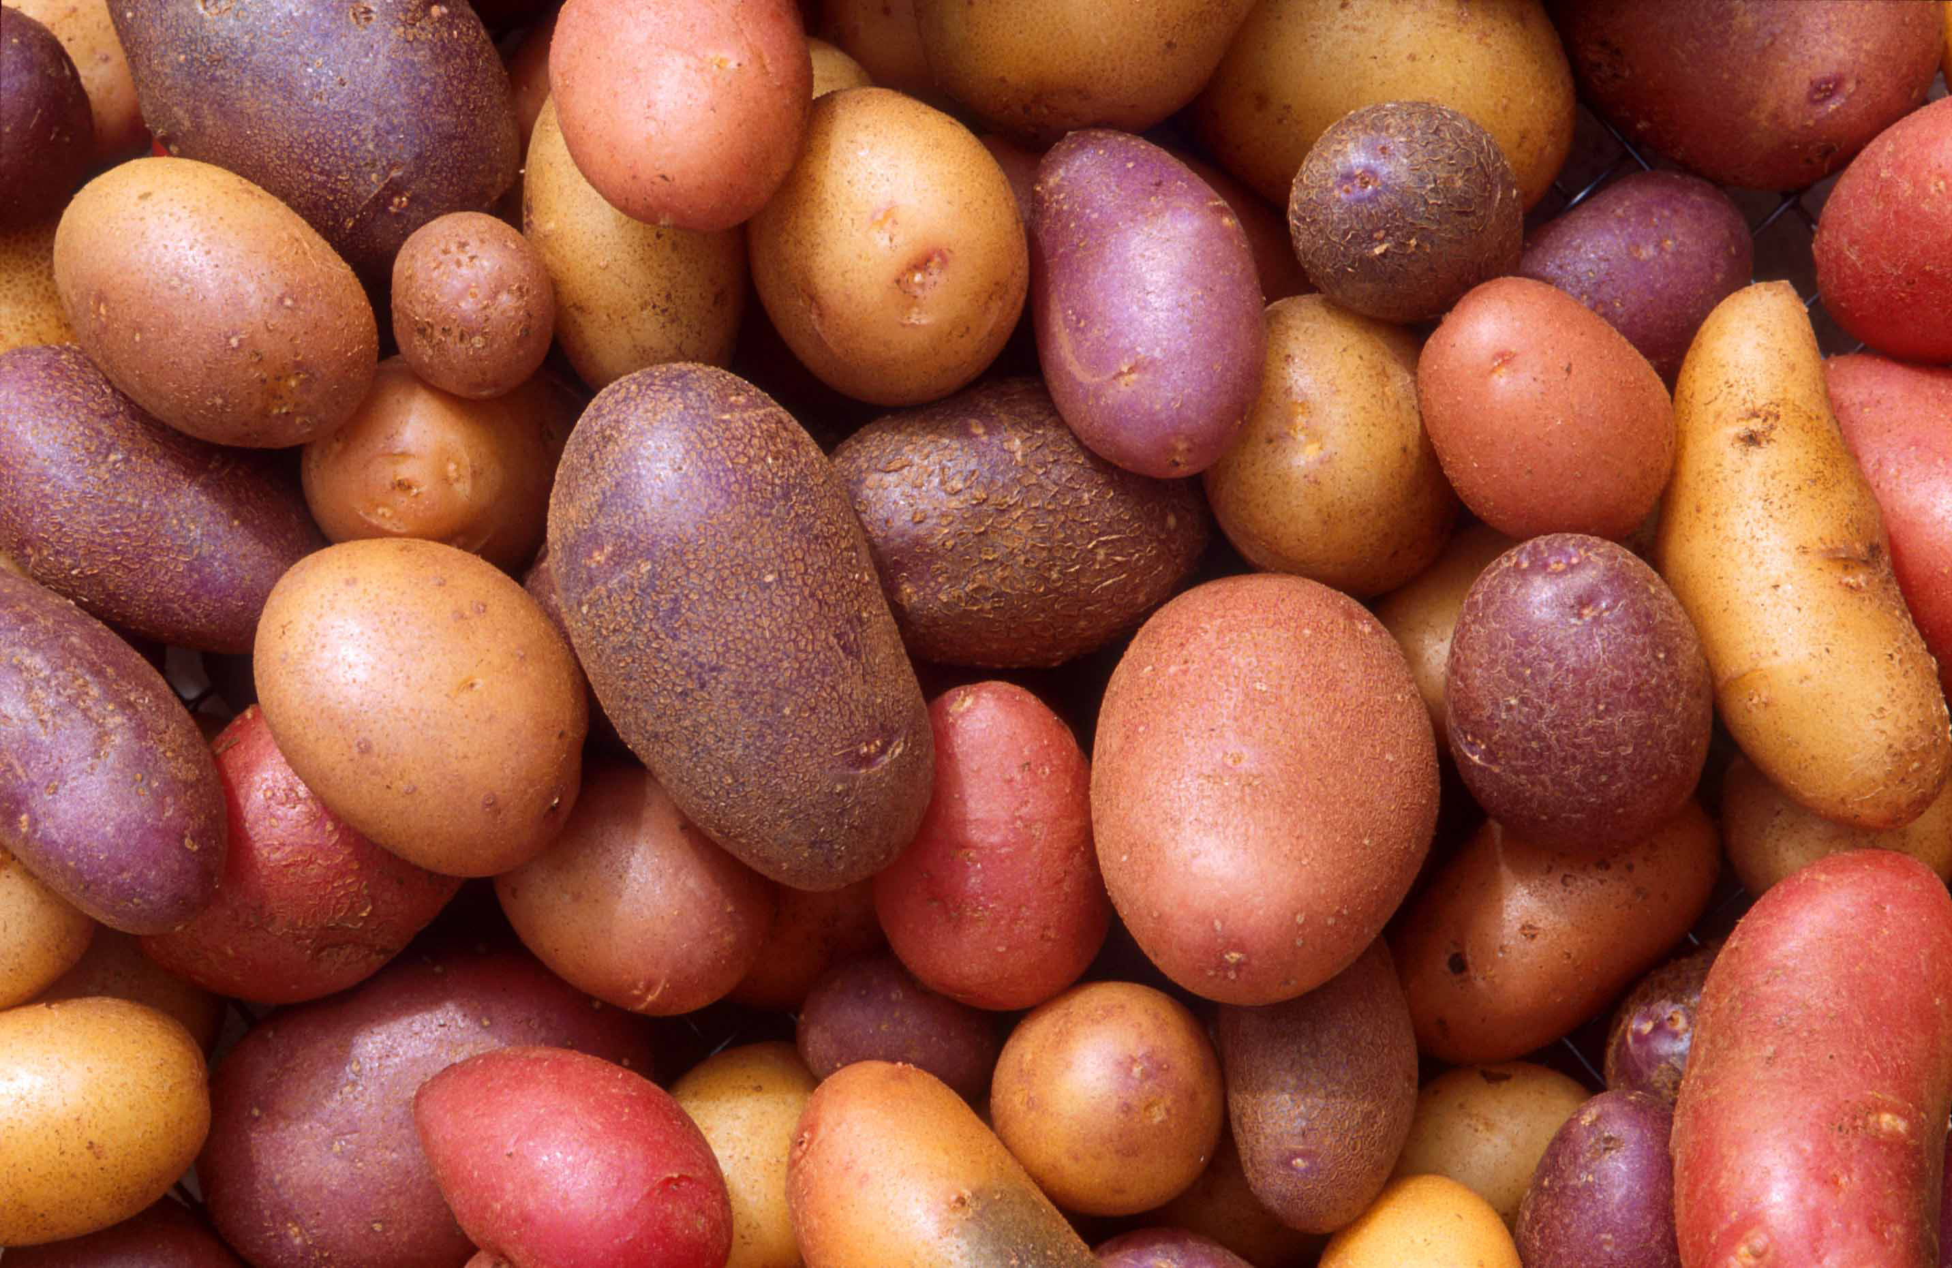
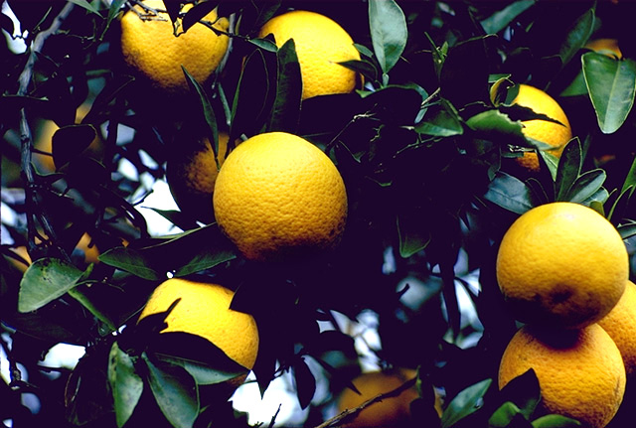
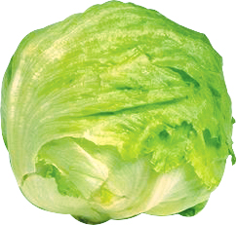
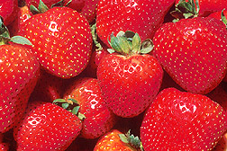
What Does One Acre of Land Produce?
821 pounds of Cotton 2,784 pounds of Wheat
11,500 pounds of Sweet Corn
39,500 pounds of Potatoes
31,000 pounds of Oranges
35,600 pounds of Lettuce
50,000 pounds of Strawberries

Slide 4
How Are You Connected to Agriculture?
Personal Care Products: shampoo, soap, cosmetics, lotions, fingernail polish, toothpaste
Construction: lumber, paint, drywall, tool handles, particle board
Health Care: pharmaceuticals, surgical structures, ointments, latex gloves, x-ray film
Entertainment: film, strings for musical instruments
Manufacturing: adhesive, lubricants, solvents, detergents, polymers
Transportation: biofuels including ethanol and biodiesel, lubricants, antifreeze, tires, upholstery, packing materials
Printing: paper, ink, film
Sports: uniforms, baseball bats, leather equipment and balls, shoes
Notes:
Vegetarians, vegans, others who “protest” use of animals: Do they know this?

Slide 5
What’s on America’s Dinner Table?
Fresh Fruits 124.5 lbs.
Milk 20 gallons
Flour & Cereal Products 174.7 lbs.
Eggs 250 Eggs
Red Meats 103.6 lbs.
Fats and Oils 82.8 lbs.
Fresh Vegetables 187.1 lbs.
Rice 20.4 lbs.
Poultry and Meat 80.8 lbs.
Cheese 33.5 lbs.
Notes:
Photo Source: How to Have Better Dinner Conversations with Your Family (NY Metro ...www.nymetroparents.com

Slide 6
Farmers are Stewards of the Land…
Careful stewardship by America’s food producers has resulted in a 50% decline in erosion of cropland by wind and water since 1986.
Conservation tillage, crop rotation, and contour farming are all ways that farmers reduce erosion.
Farmers, ranchers, and other landowners help protect the environment and provide habitat for wildlife.

Slide 7
Number of people fed annually by one farmer
Notes:
America’s farmers are the world’s most productive. Today, each U.S. farmer produces food and fiber for 168 people in the United States and abroad.

Slide 8
Feeding 9 Billion: What is a Billion?
If you had $1 million and spent $1,000 every day, how many years would it take to spend your money?
2.7 years
If you had $1 billion and spent $1,000 every day, how many years would it take to spend your money?
2,740 years
Notes:
Feeding 9 Billiion

Slide 9
Who Pays the Least for Food?
Of the 10% of disposable income that Americans spend on food each year, 51% is for food eaten at home and 49% is for food eaten away from home.
U.S. 10%
New Zealand 15%
Venezuela 20%
India 30%
Guatemala 40%
Kenya 47%
Notes:
U.S. figure is for food consumed at home and away from home. Figures for all other countries are for food consumed at home. As food consumed at home is less expensive, the gap between these countries and the U.S. would be even greater if food consumed away from home was not added.
Source: USDA – ERS (5-year average, 2007-2011 data)

Slide 10
States that produce the most food and have the highest farm-gate sales:
Rank | State | $ in Thousands
1 | California | $44,738,132
2 | Iowa | $31,985,370
3 | Nebraska | $24,465,882
4 | Texas | $22,726,067
5 | Minnesota | $20,580,696
6 | Illinois | $19,649,939
7 | Kansas | $16223,254
8 | Wisconsin | $12,110,055
9 | Indiana | $12,052,964
10 | North Carolina | $11,706,602
Notes:
Source: U.S. Department of Agriculture, National Agricultural Statistics Service (2013)

Slide 11
What is the U.S. share of world production?
Soybeans 32%
Beef and Veal 19%
Cotton 13%
Corn 36%
Eggs 8%
Wheat 8%
Milk 15%
Notes:
Should U.S. worry about feeding the word?
Corn for biofuels: Worldwide = 8%; U.S. = 40%

Slide 12
How Many Farmers?
3.2 million farm operators
969,672 women
99,734 farmers of Spanish, Hispanic, or Latino origin
44,629 African American
58,475 American Indian
Notes:
Average age of farmer? 57 in U.S.

Slide 13
How Many Farms?
Notes:
Farms
• In 1935, the number of farms in the United States peaked at 6.8 million. Today, there are 2.1 million farms dotting America’s rural landscape. Texas had the most farms (247,500) in 2012, followed by Missouri (106,000), Iowa (92,200), and Kentucky (85,500) Oklahoma (85,500) .
• Total land in farms was estimated at 914 million acres in 2012 (decrease of 3 million acres since 2011). Since 1987, the average size of U.S. farms has hovered around 455 acres.
Sources: Census of Agriculture (2009); ERS – ARMS Survey; USDA – NASS

Slide 14
What is USDA’s budget?
The USDA’s budget in 2013 was $155 Billion

Slide 15
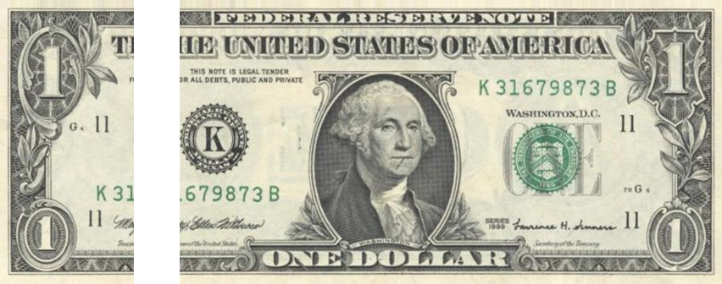
Where Does Your Food Dollar Go?
17¢ FARM
83¢ OFF-FARM
Farm Cost, (breakdown of 16¢):
15.6% purchased feed
17.7% fertilizer, seed, crop-protecting chemicals
14.3% capital upkeep and replacement
10.9% farm labor
8.5% interest and property taxes
5.0% fuel, electricity
9.8% purchased livestock
3.3% marketing, storage, transportation
10.4% miscellaneous
Off-Farm Costs (breakdown of 84¢):
Marketing expenses associated with processing
Wholesaling
Distributing
Retailing of food products

Slide 17
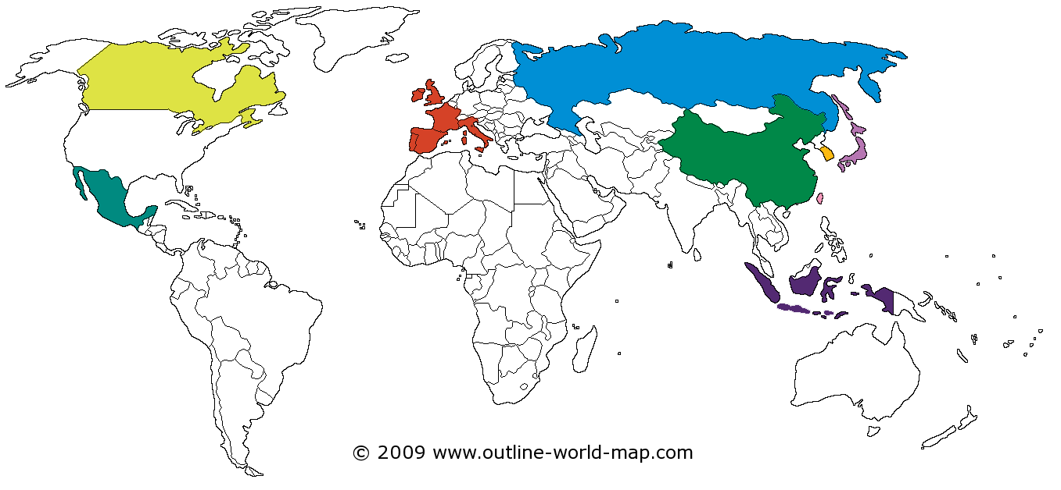
Who Imports U.S. Farm Products?
In billions:
China $24.6
Canada $21.9
Mexico $19.4
Japan $13.2
European Union $12.6
South Korea $6.9
Taiwan $3.5
Indonesia $2.9
Philippines $2.7

Slide 18
Producing More Milk With Less Food
A typical cow weighs 1,500 pounds and produces 73 pounds of milk per day. A cow converts roughage and grains not consumed by people into high energy food.
One day’s production for a high producing cow is 100 pounds of 4% milk. This yields:
5 pounds of butter
11.6 gallons of milk
10 pounds of cheese
Did You Know?
The pounds of feed (grain, forage, etc.) a cow needs to eat to produce 100 pounds of milk has decreased by more than 40% on average in the last 30 years.
One day’s consumption for a high producing cow is 15 pounds of grain and concentrated feed, 35 gallons of water, 40 pounds of hay silage.

Slide 19
What is Agriculture?
Farms
Food
Fabric
Forestry
Flowers

Slide 20
Aquaculture and Silviculture
Aquaculture is the production of aquatic animals and plants under controlled conditions for all or part of their life cycle.
The top five states for aquaculture sales are: Washington, Mississippi, Alabama, Louisiana and California.
The number of aquaculture farms in the U.S. totals 3,093.
Silviculture is a branch of forestry dealing with management and cultivation of forest trees. About one-third of the U.S. (750 million acres) is covered with trees.
Careful management allows regular harvest of timber without harming air quality, water quality, and wildlife habitats.

Slide 21
Nursery and Greenhouse Production
Typical Greenhouse Crops
Aquatic plants
Floral, foliage and vegetable plants, including tomatoes
Mushrooms, herbs and seeds
Transplant seedlings and bulbs
Typical Nursery Crops
Cut and live Christmas trees
Fruit and nut plants for outdoor/landscape use
Ornamental plants and trees with woody stems
Ornamental vines
Turfgrass sod and other groundcovers

Slide 22
Pizza Comes from America’s Farms and Ranches
Top producing states for pizza ingredients:
Onions: California, Georgia, Texas
Tomato Sauce (fresh tomatoes): California, Florida
Mushrooms: Pennsylvania, California
Pizza Dough (Winter Wheat): Kansas, Montana, Colorado
Sausage (from hogs): Iowa, Minnesota, North Carolina
Pineapple: Hawaii
Spinach: California, Arizona
Green Peppers: California, Florida
Mozzarella Cheese (Dairy Products): California, Wisconsin, New York

