Slide 1
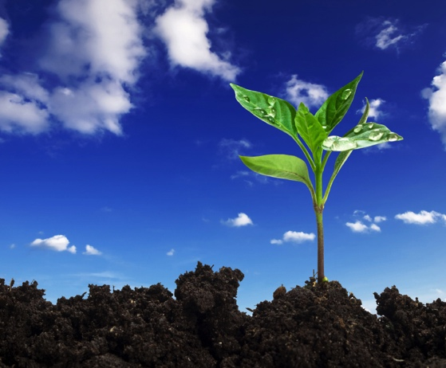
Exploring Living and Nonliving Things

Slide 2
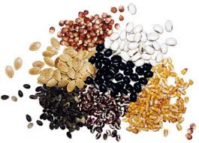
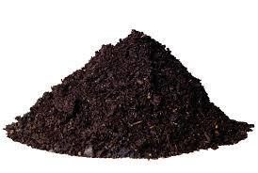
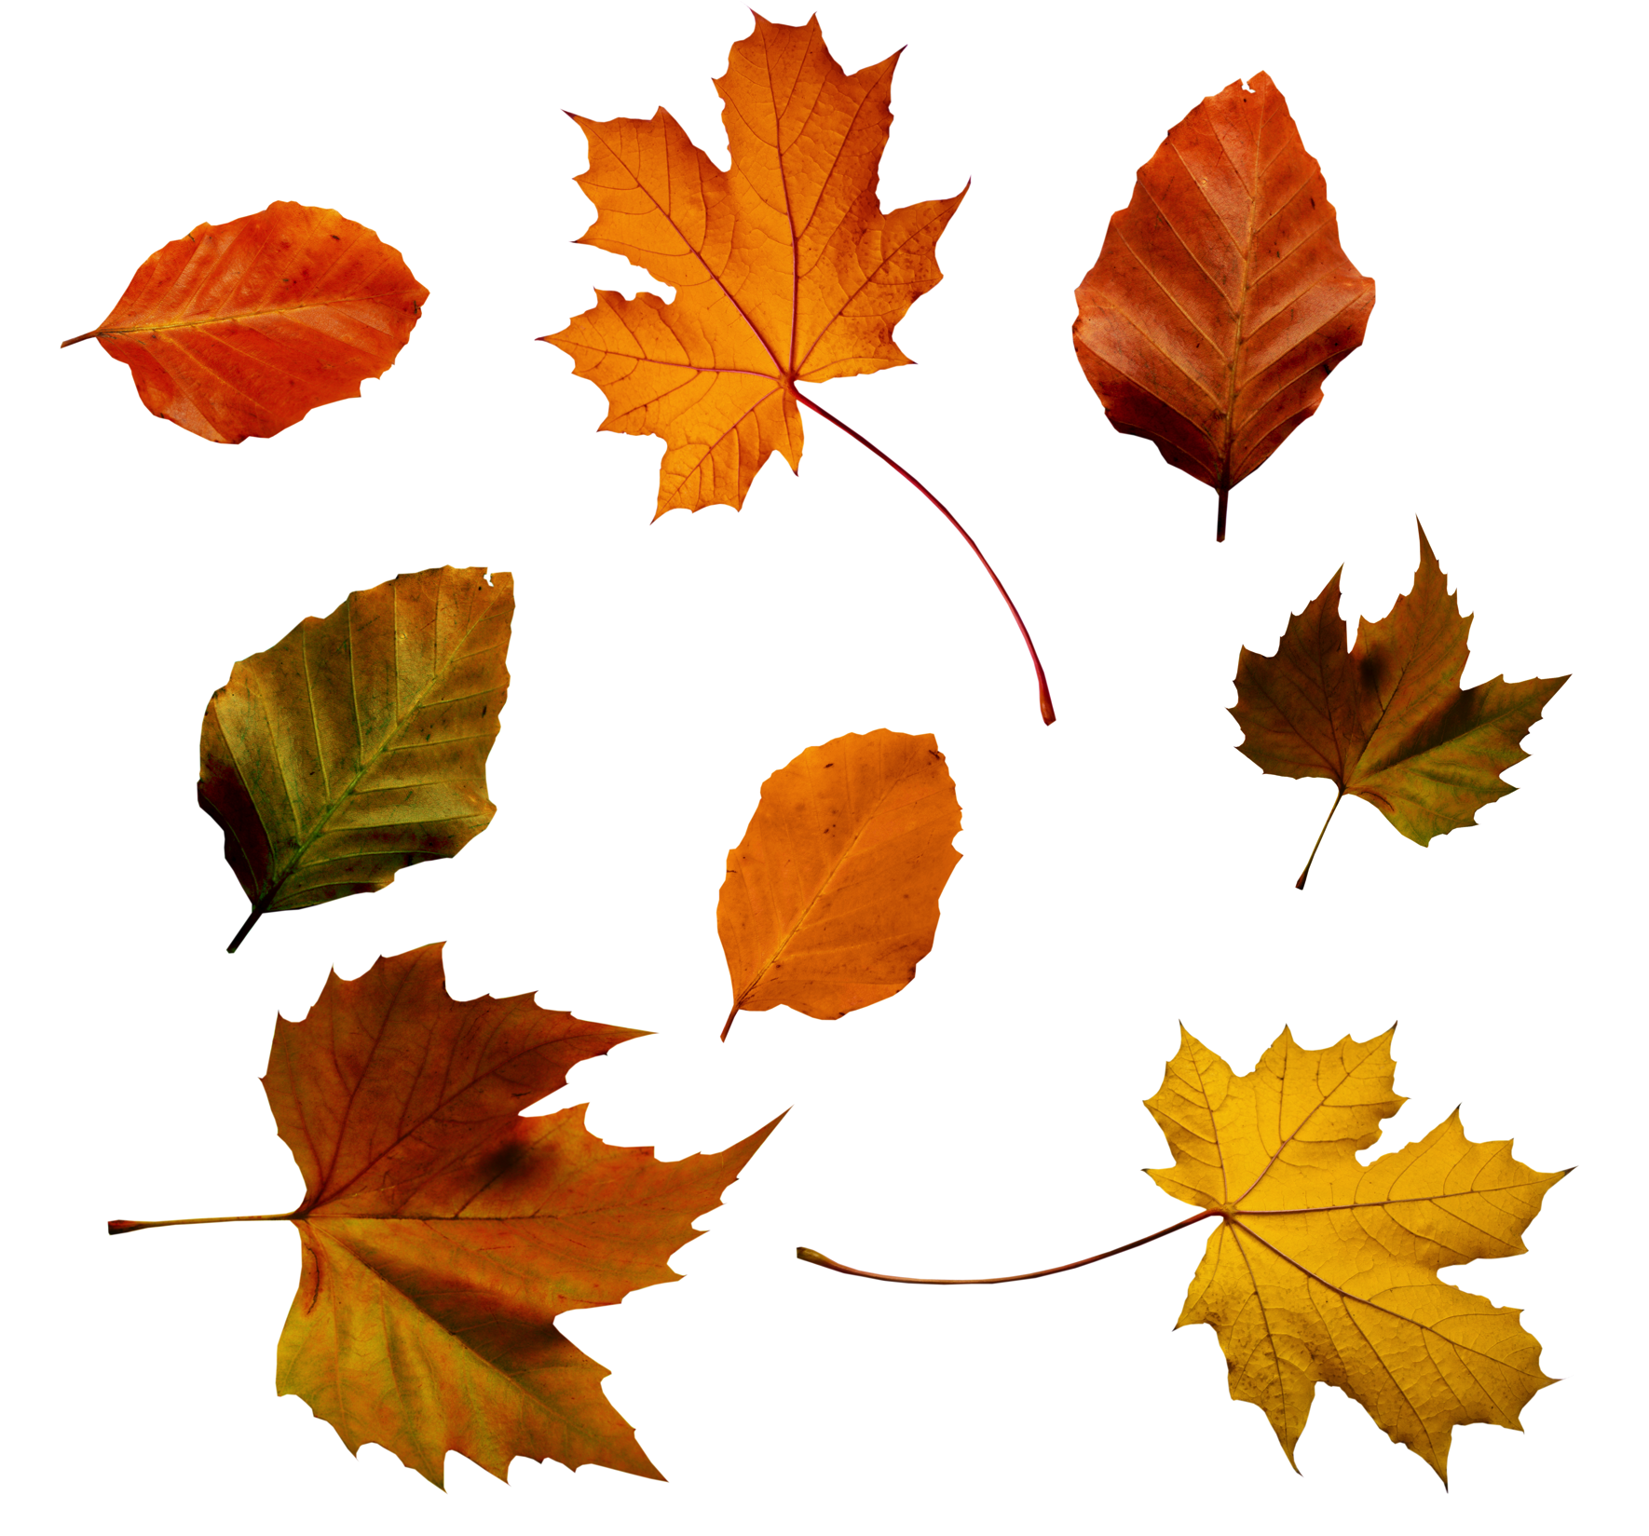
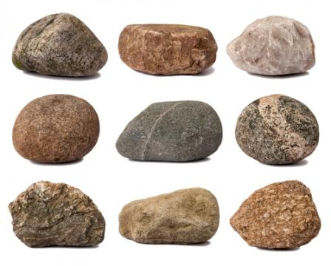
Exploring Texture in the Garden
LIVING THINGS GROW, MOVE, AND REPRODUCE. NONLIVING THINGS DO NOT.

Slide 3
Exploring Texture in the Garden
ROCKS
LIVING OR NONLIVING?

Slide 4
Exploring Texture in the Garden
ROCKS
LIVING OR NONLIVING?
Rocks do not grow, move on their own, or reproduce.
Rocks are nonliving.

Slide 5
Exploring Texture in the Garden
SOIL
LIVING OR NONLIVING?

Slide 6
Exploring Texture in the Garden
Exploring Texture in the Garden
Soil
Living or nonliving?
A large part of soil is made up of nonliving small pieces of rock—sand, silt, and clay particles.
Living things such as insects, fungi, and bacteria can be found in soil.
Almost any handful of soil will contain both living organisms and nonliving elements.

Slide 7
Exploring Texture in the Garden
SEeds
Living or nonliving?

Slide 8
Exploring Texture in the Garden
SEEDS
LIVING OR NONLIVING?
Seeds are living, but they do not show the characteristics of living things until they germinate.
Seeds need water and the proper temperature to germinate and grow.

Slide 9
Exploring Texture in the Garden
Plant Parts
Living or nonliving?

Slide 10
Exploring Texture in the Garden
Plant Parts
Living or nonliving?
Plants and plant parts continue living for some time after they have been picked.
They will eventually die because they no longer have a source of nutrients and water.

Slide 11
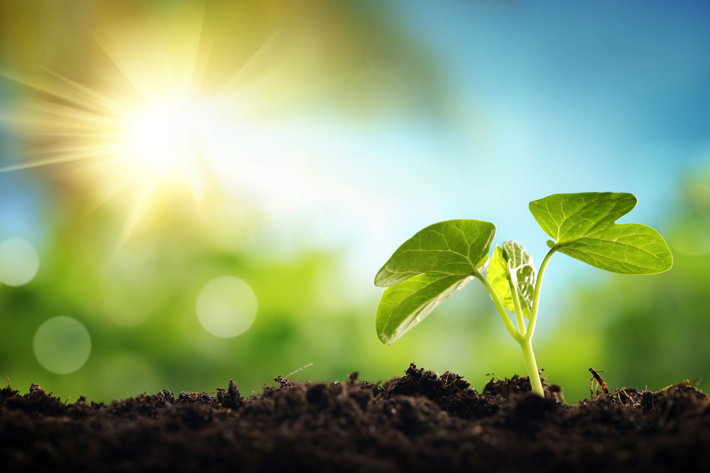
Utah AITC School Garden Center
The Utah AITC School Garden Center offers practical information about gardening with children and provides engaging lesson plans and activities that integrate gardening themes into core curriculum.

Slide 12
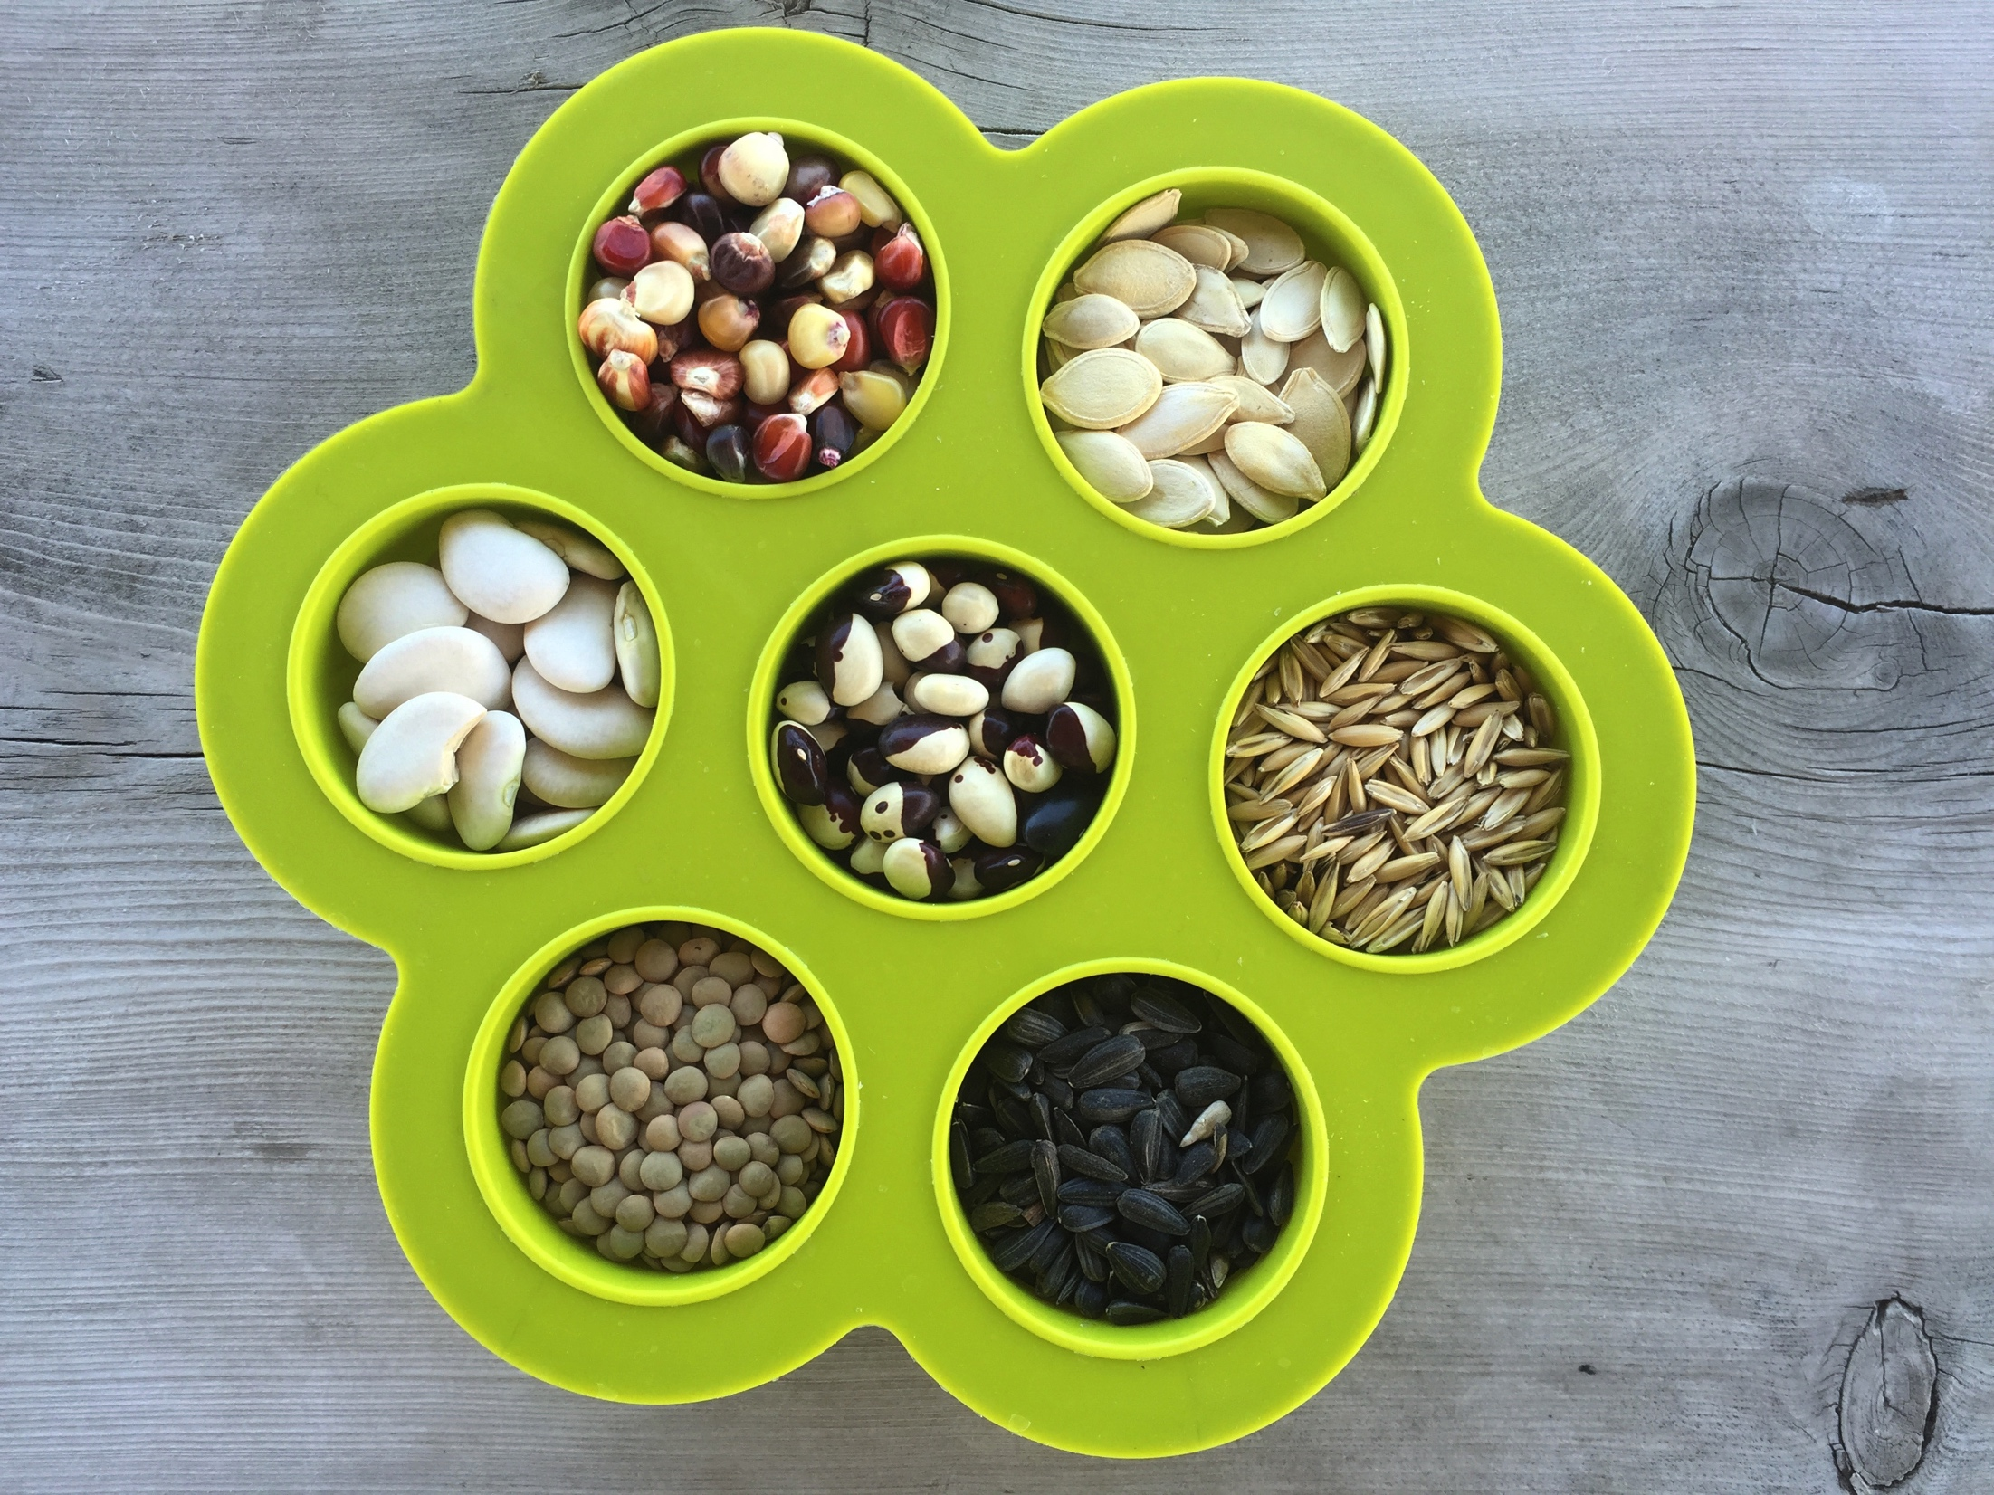
Growing Plants in Science and Literature, More Than an Empty Pot
On the outside of a seed is the seed coat. Its purpose is to protect the seed.
On the inside is the embryo (what will become the new plant) and food for the embryo, the cotyledon.
When the seed receives the proper amount of warmth and moisture, it will begin to germinate.
The cotyledons provide food for the embryo until it grows new leaves. The leaves will then use the energy from the sunlight to carry out photosynthesis, making food for the plant.

Slide 13
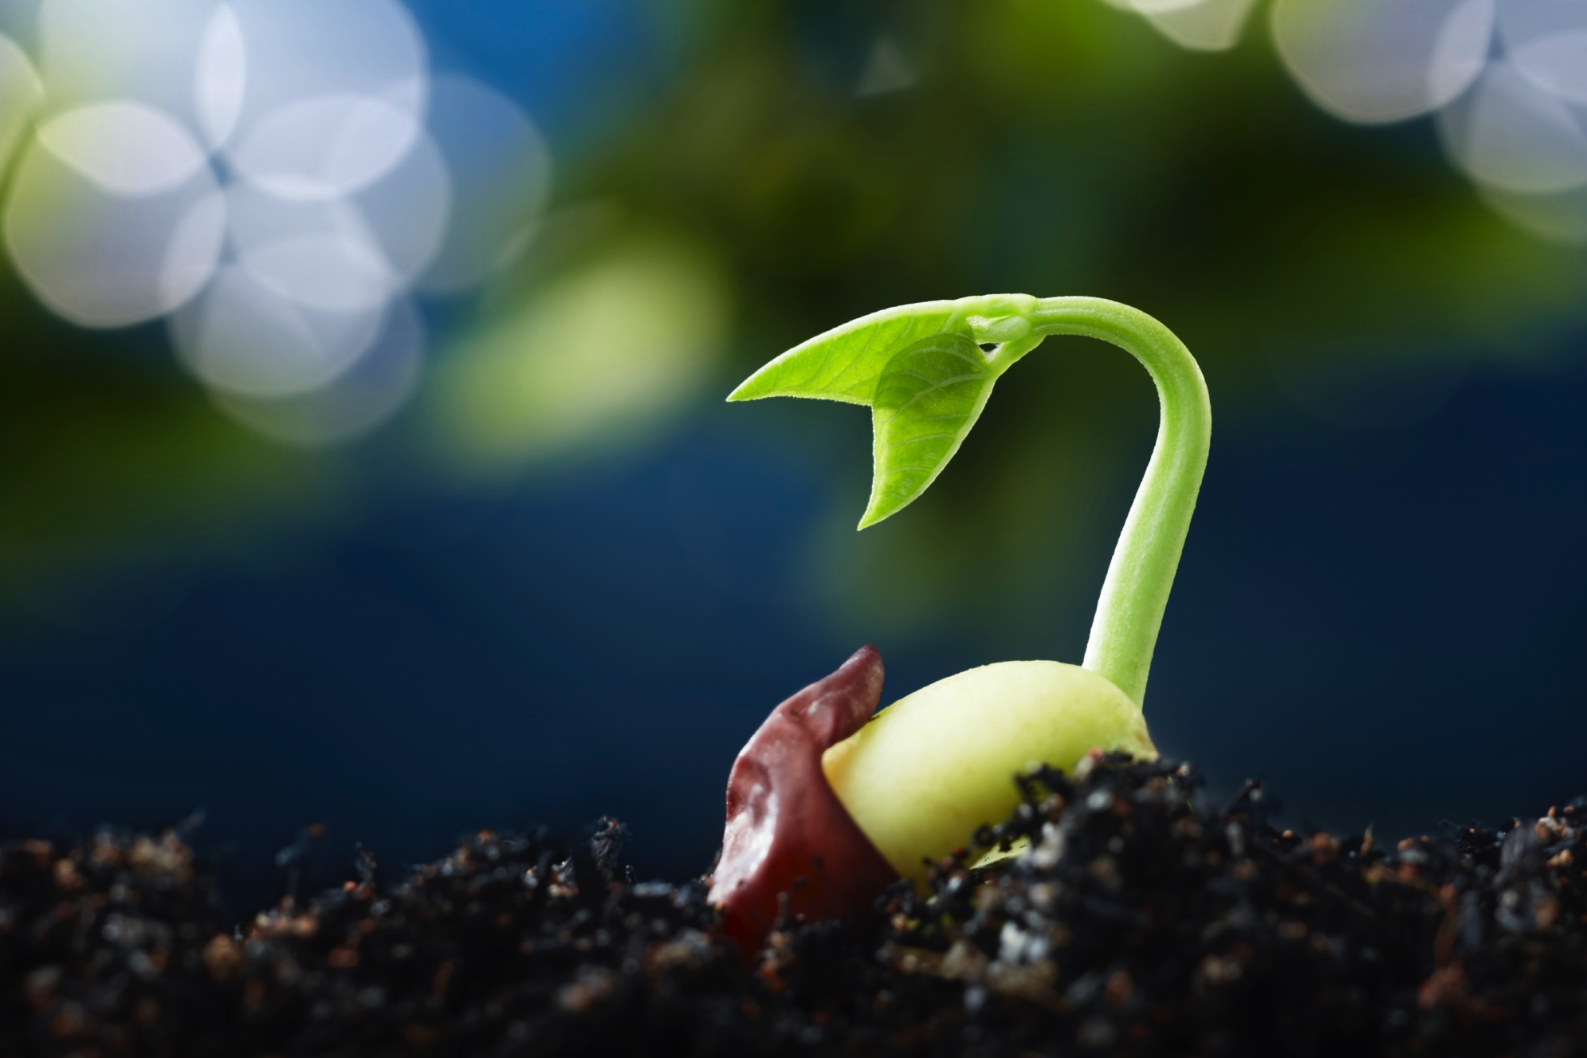
Growing Plants in Science and Literature, More Than an Empty Pot
What Does a Seed Need to Germinate?
Most seeds are dormant until they receive warmth and moisture.
When a seed receives the correct amount of moisture and the proper temperature, it will begin to germinate, which means it becomes active and sprouts.

Slide 14
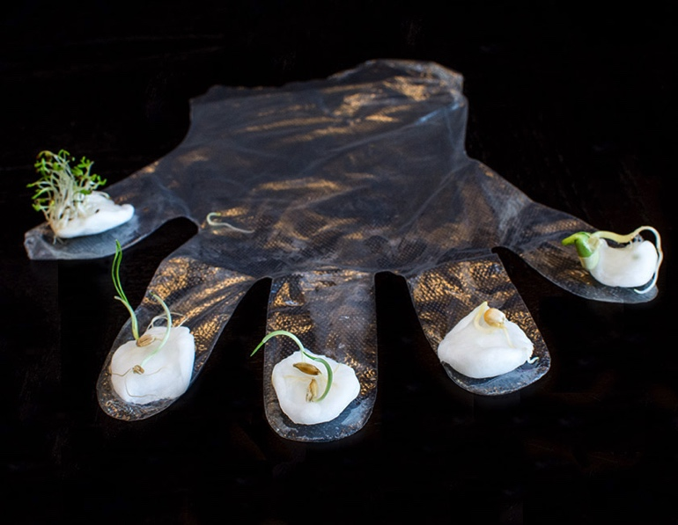
Growing Plants in Science and Literature, More Than an Empty Pot
Farming in a Glove
Soybeans, corn, alfalfa, wheat, and oats
3-5 days to germinate

Slide 15
Growing Plants in Science and Literature, More Than an Empty Pot
What Does a Plant Need to Grow?
Water
Light
Nutrients
Air
Space

Slide 16
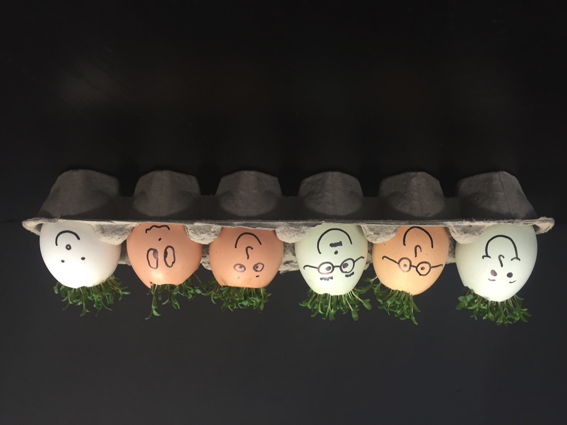
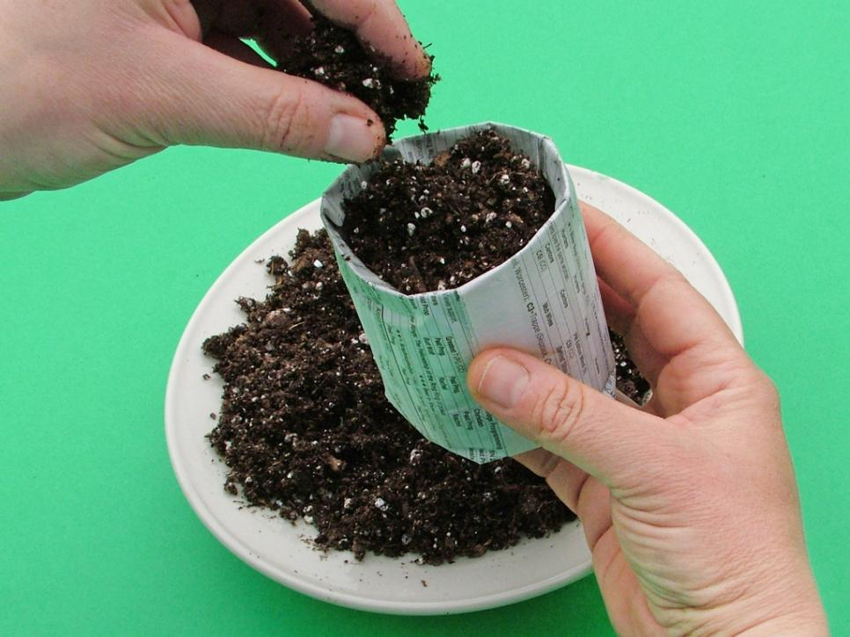
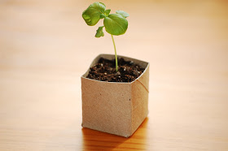
Growing Plants in Science and Literature, More Than an Empty Pot

Slide 17
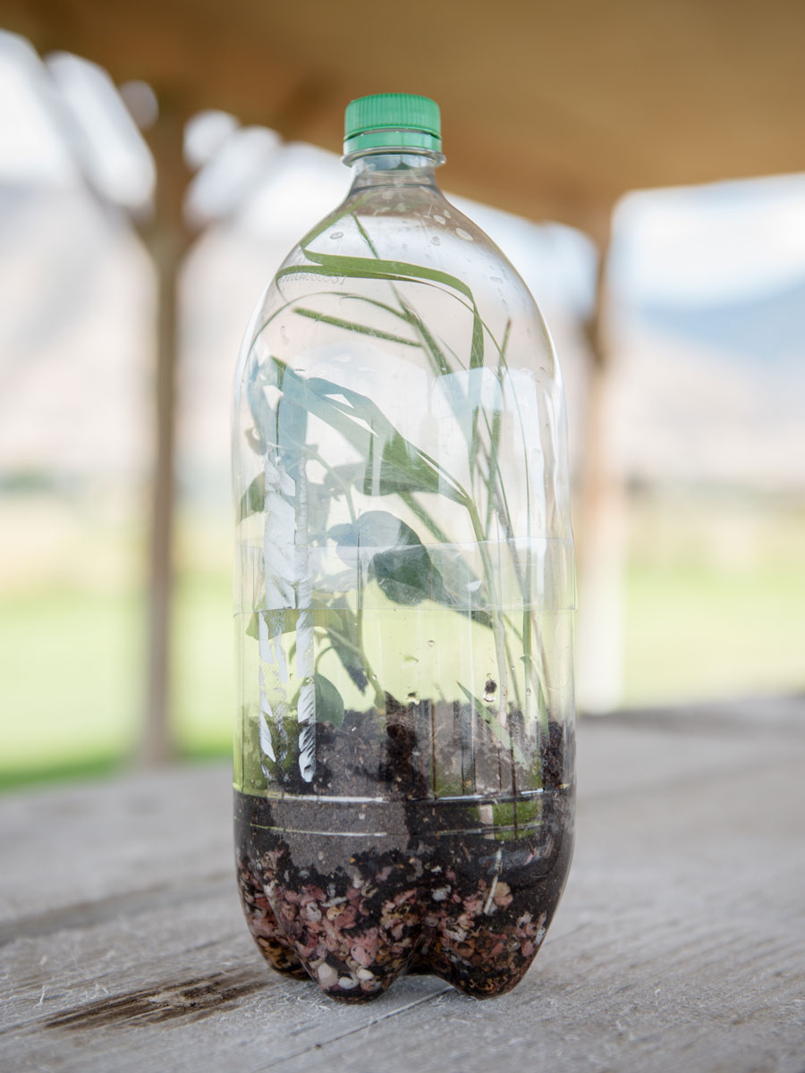
Terrariums: A Look at the Living and Nonliving World
Organisms like plants and animals depend on living and nonliving things in their environment.
The interaction of sun, soil, water, and weather impacts plant growth and survival.

Slide 18
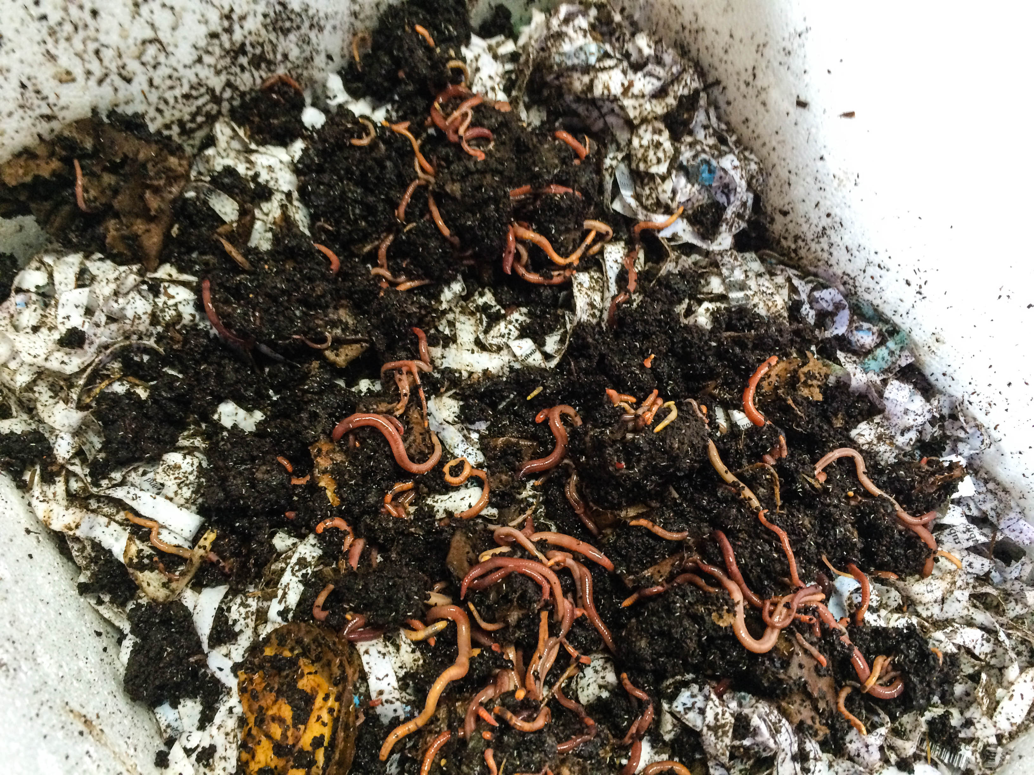
Vermicomposting
Worms live in soil and help change bits of dead plants and animals into nutrients that plants can use.
Worms eat organic matter and turn them into castings—also known as worm poop—that are nutrient rich and useful to plants.
Worms also help aerate and loosen the soil so that the roots of plants can more easily develop underground.

