Slide 1
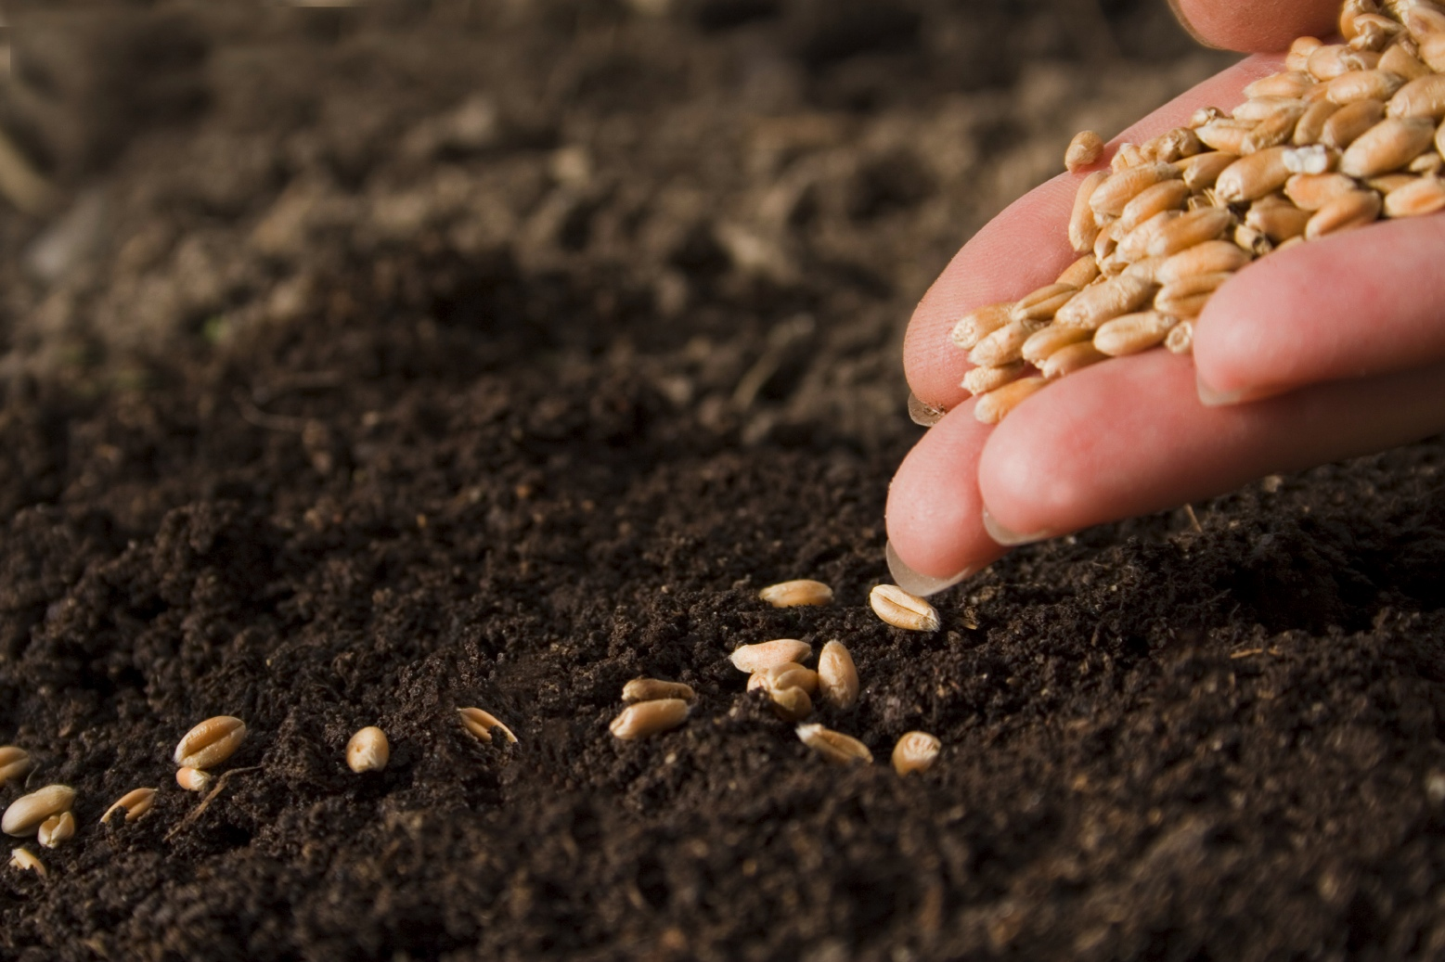
Dirt: Secrets in the Soil

Slide 2
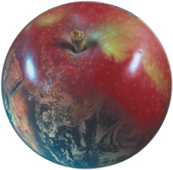
How Much is Dirt Worth?

Slide 3
How Much is Dirt Worth?
Soils produce our food. They are essential to our survival.

Slide 4
How Much is Dirt Worth?
Soils produce our food. They are essential to our survival.
Good soils are a limited, nonrenewable resource.

Slide 5
How Much is Dirt Worth?
Soils produce our food. They are essential to our survival.
Good soils are a limited, nonrenewable resource.
It takes an average of 100 to 500 years to make 1 inch of topsoil.

Slide 6
How Much is Dirt Worth?
Soils produce our food. They are essential to our survival.
Good soils are a limited, nonrenewable resource.
It takes an average of 100 to 500 years to make 1 inch of topsoil.
It costs the farmer more to produce good crops on poor soil. That means higher prices in the grocery store.

Slide 7
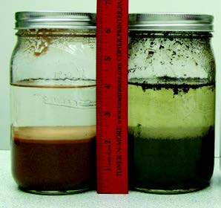
Types by Texture
Soil is made up of 4 components—air, water, organic matter, and mineral matter.
Determining soil types helps us know when and how to plant and water crops.
Soil texture refers to the size of the particles that make up the soil. The relative proportion of sand, silt, and clay particles in a soil defines its soil texture.

Slide 8
Sand, Silt, and Clay
Sand | large particles | settles in 1 minute | coarse and gritty | water moves through quickly
Silt | medium particles | settles in 3-4 hours | smooth, soft, and slick | holds water
Clay | tiny particles | settles in 3-7 days | sticky | difficult for water to flow through

Slide 9
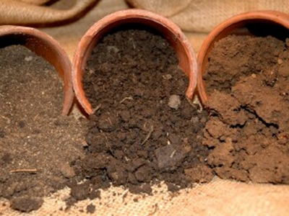
Soil Permeability
Sand, silt, and clay are inorganic materials.
The best kind of soil for plants allows water to move through slowly enough that some of it stays in the soil for plants to use.
Humus acts like a sponge to help the soil capture water and is formed when plants and animals die.
Humus helps soil store more water, prevents erosion, and produces better crops.

Slide 10
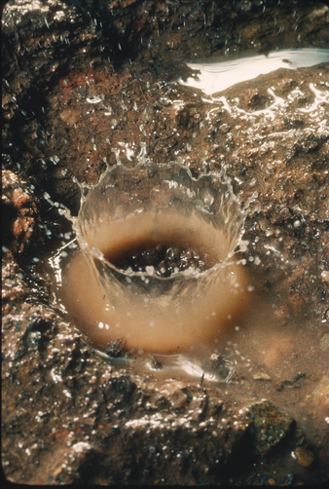
Keeping Soil in its Place
Erosion is the loosening, transportation, and relocation of soil particles from one place to another and occurs primarily due to the action of wind and water.
The rate and extent of erosion are determined by soil type and condition, slope of the land, plant cover, land use, and climate.
Raindrop splash erosion is the first stage of the water erosion process followed by sheet, rill, and gully erosion.

Slide 11
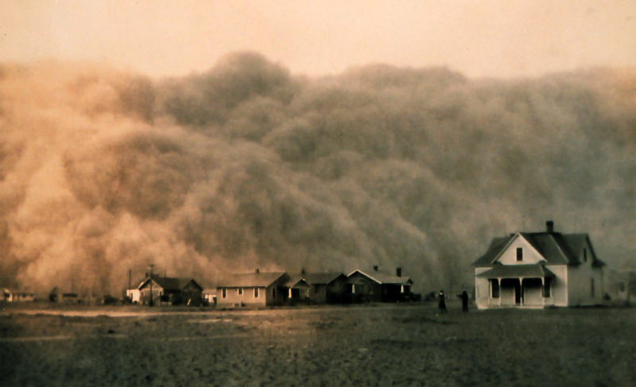
Dark Days
The Dust Bowl refers to the time during the 1930s when drought, prairie winds, and poor land use practices made farming nearly impossible.
The dust bowl region of the United States includes parts of Texas, Oklahoma, New Mexico, Colorado, and Kansas.

Slide 12
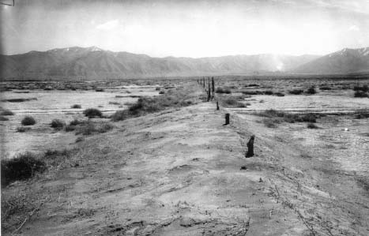
Dark Days
The west had its own areas of dust storms and soil erosion in the 1930s that caused the same economic and ecological problems as the ones occurring in the Great Plains.
The Grantsville dust bowl was caused from overgrazing, fires, plowing, and drought.
From the time the Tooele Valley was settled it was one of the most popular winter grazing areas in the west.
Slowly, overgrazing caused the range to become almost barren.

Slide 13
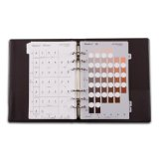
Color in the Garden
The Munsell Soil Color Charts is a book of soil colors based on the soil classification system used by scientists for describing soils.
This book is used worldwide by agronomists, biologists, archeologists, geologists, zoologists, to document soil colors.
Over the centuries, humans have used soil colors to serve as pigments in bricks, pottery, and art work.
These artifacts from the past give us an idea of how early people lived and work.

Slide 14
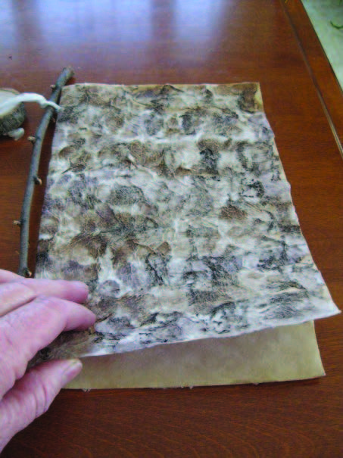
Color in the Garden
General rules about soil color:
Black, Black/Brown: Soil that has high organic matter content and nutrients for plants. These are deep soils formed mainly of materials transported by water, ice, or gravity.
Gold/yellow: Soil from certain sandstones.
Taupe: Clayey soils with lower organic matter content. Soils formed mainly in residual materials from ancient sea beds.
Red: Soil with high iron content
Cream: Soil with high amounts of lime or formed with wind-blown silty material.
Notes:
Utah has over 1300 different soil types. Each soil has its own unique characteristics. Soils in Utah have been put into general groups with dominant soil characteristics. Yellow, brown, or red – iron; black – organic matter; white – lime; green - copper

Slide 15
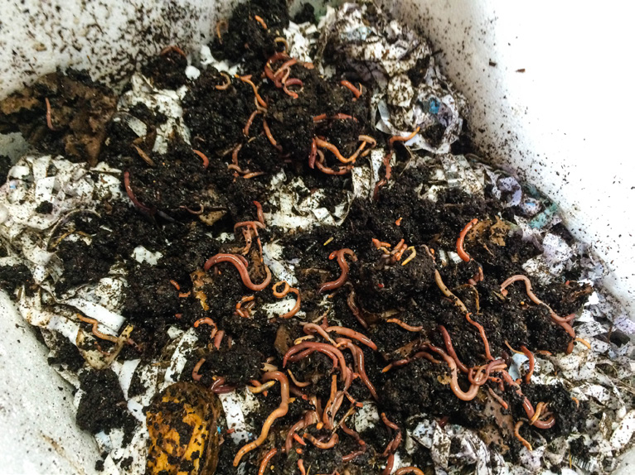
Vermicomposting
Worms live in soil and help change bits of dead plants and animals into nutrients that plants can use.
Worms eat organic matter and turn it into castings—also known as worm poop—that are nutrient rich and useful to plants.
Worms also help aerate and loosen the soil so that the roots of plants can more easily develop underground.

