Slide 1
What does the word agriculture mean? In a simple word, it means...
Farming
But it also means so much more!

Slide 2
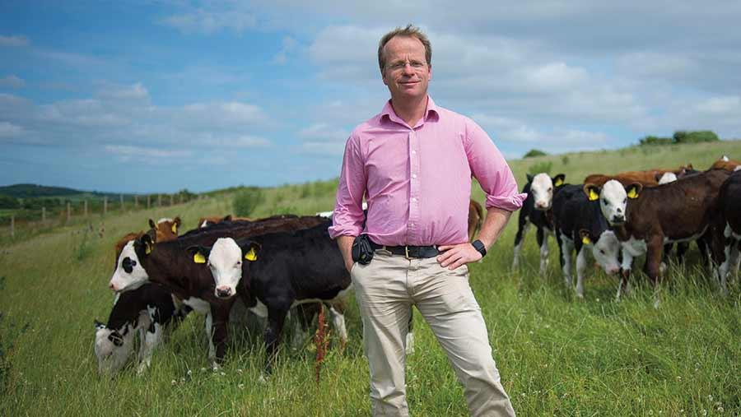
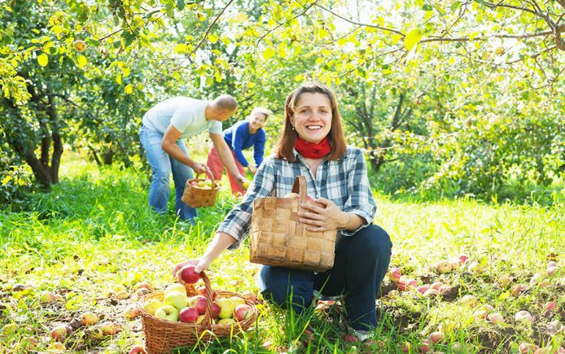
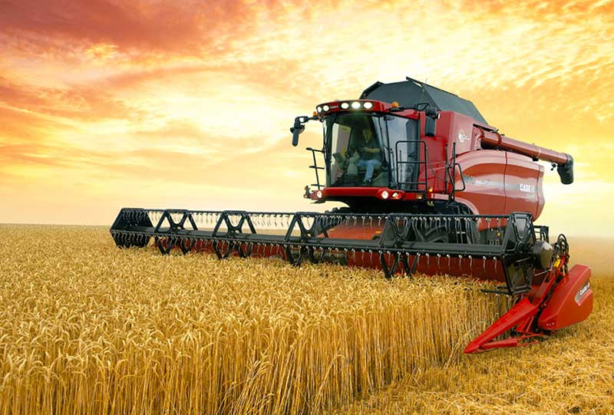
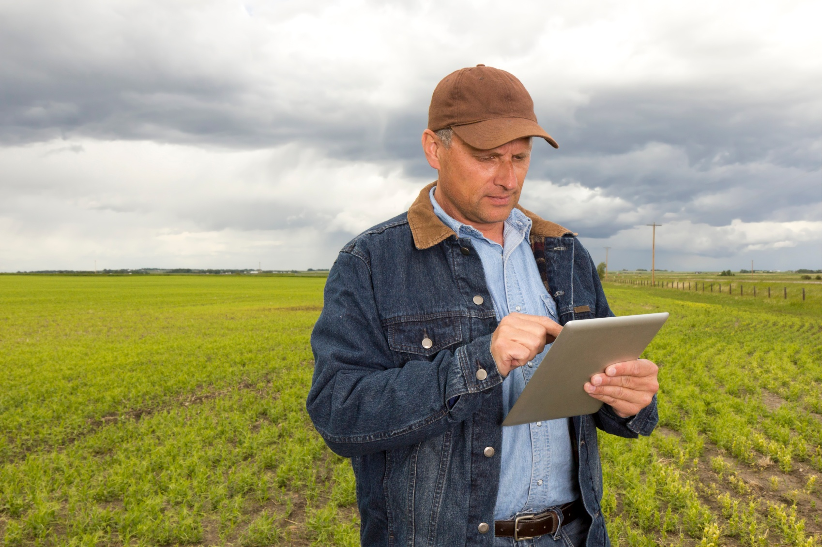
Which of these are agriculture?
All of them!

Slide 3
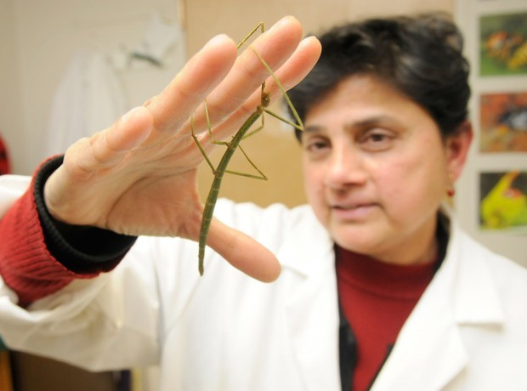
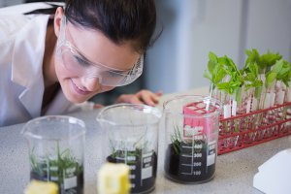
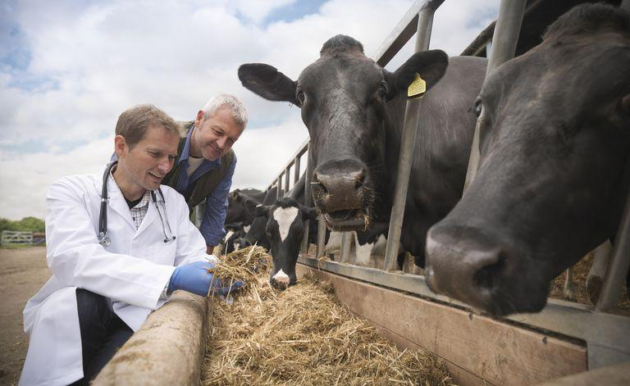
How about these?
Are they agriculture?
Yes!

Slide 4
Do you need agriculture every day in order to survive?
Yes No Maybe

Slide 5
Have you ever stopped to think about how food gets into the grocery store? Where does it come from? What careers are involved?

Slide 6
When you go to the grocery store to pick up groceries, the food exists because of __________who carefully manage natural resources, in order to grow the raw ingredients.
Factories Stores Farmers

Slide 7
It can be very expensive to purchase seed or animals and take care of them until they are ready to harvest. Sometimes a farmer needs a loan from a:
Banker University Store

Slide 8
Before planting crops, a farmer needs to test the soil to check for nutrients and to determine which fertilizers are necessary.
The farmer needs the services of a:
Food Scientist Soil Scientist Veterinarian

Slide 9
When farmers plant their fields, they sometimes use tractors with GPS systems. Who creates these tractors?
Engineers Scientist Grocers

Slide 10
A couple of months after planting, the plants are growing, but the farmer notices holes in the leaves. These may be the result of an insect. Who can help identify the problem?
Entomologist Nutritionist Wildlife Biologist

Slide 11
The crop is ready to harvest, and the farmer needs it delivered it to the processing plant. The farmer needs a:
Truck Driver Agronomist Banker

Slide 12
The processor will turn the wheat, corn, meat, vegetables, fruit, etc. into bread, burgers, chips, pies, and many other products. Who develops these food products?
Soil Scientist Food Scientist Veterinarian

Slide 13
We need to know that our food is safe. Who works with food services, restaurants, and federal agencies to make sure the food is safe?
Veterinarian Dietitian Food Safety Specialist

Slide 14
Some farmers raise animals, such as pigs and cattle, which we eat. Who creates feed that is nutritionally sound for the animals?
Animal Nutritionist Butcher Veterinarian

Slide 15
Who works with farmers to diagnose, treat, and help prevent diseases and disabilities in the animals?
Animal Nutritionist Butcher Veterinarian

Slide 16
Some farmers raise fruits and vegetables in greenhouses. Who works mostly with nursery or greenhouse crops to make sure they will grow well for the farmer?
Turf Scientist Florist Horticulturist

Slide 17
Once farmers harvest their crops or animals, where are they taken to be processed for us to buy them?
Grocery Store Factory Another farm

Slide 18
When foods are being processed, they are also packaged in attractive boxes or packages and advertised. Who creates these boxes and ads?
The farmer Lawyers Graphic Artists

Slide 19
After the food is processed, it is ready to be sold to consumers. Who runs the warehouses or stores where we buy the food?
Grocers Scientists Engineers

Slide 20
Sometimes, the public needs to be informed about issues important to protecting our food system. Who keeps us informed?
Teachers Agriculture Journalists Bankers

Slide 21
All of these careers are possible because the people doing them were educated. Who is responsible for educating others to prepare them for a career?
Teachers Lawyers Bankers

