Slide 1
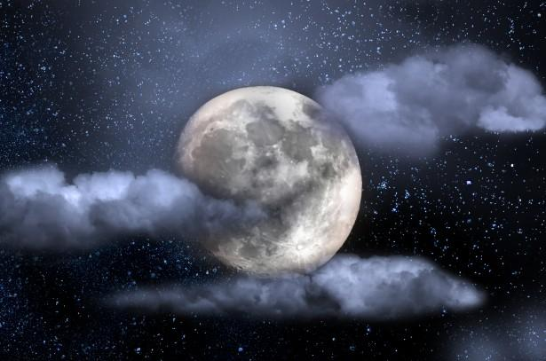
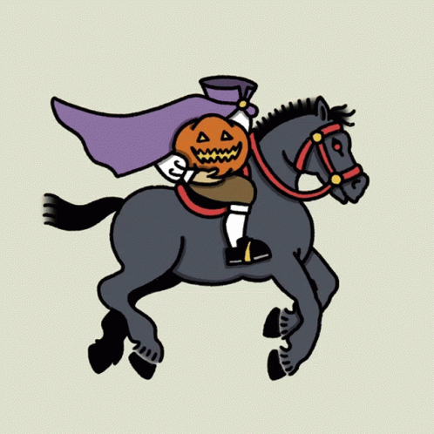

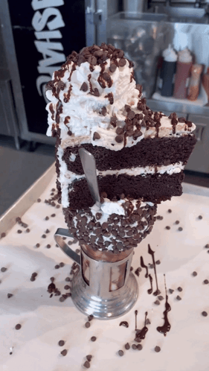
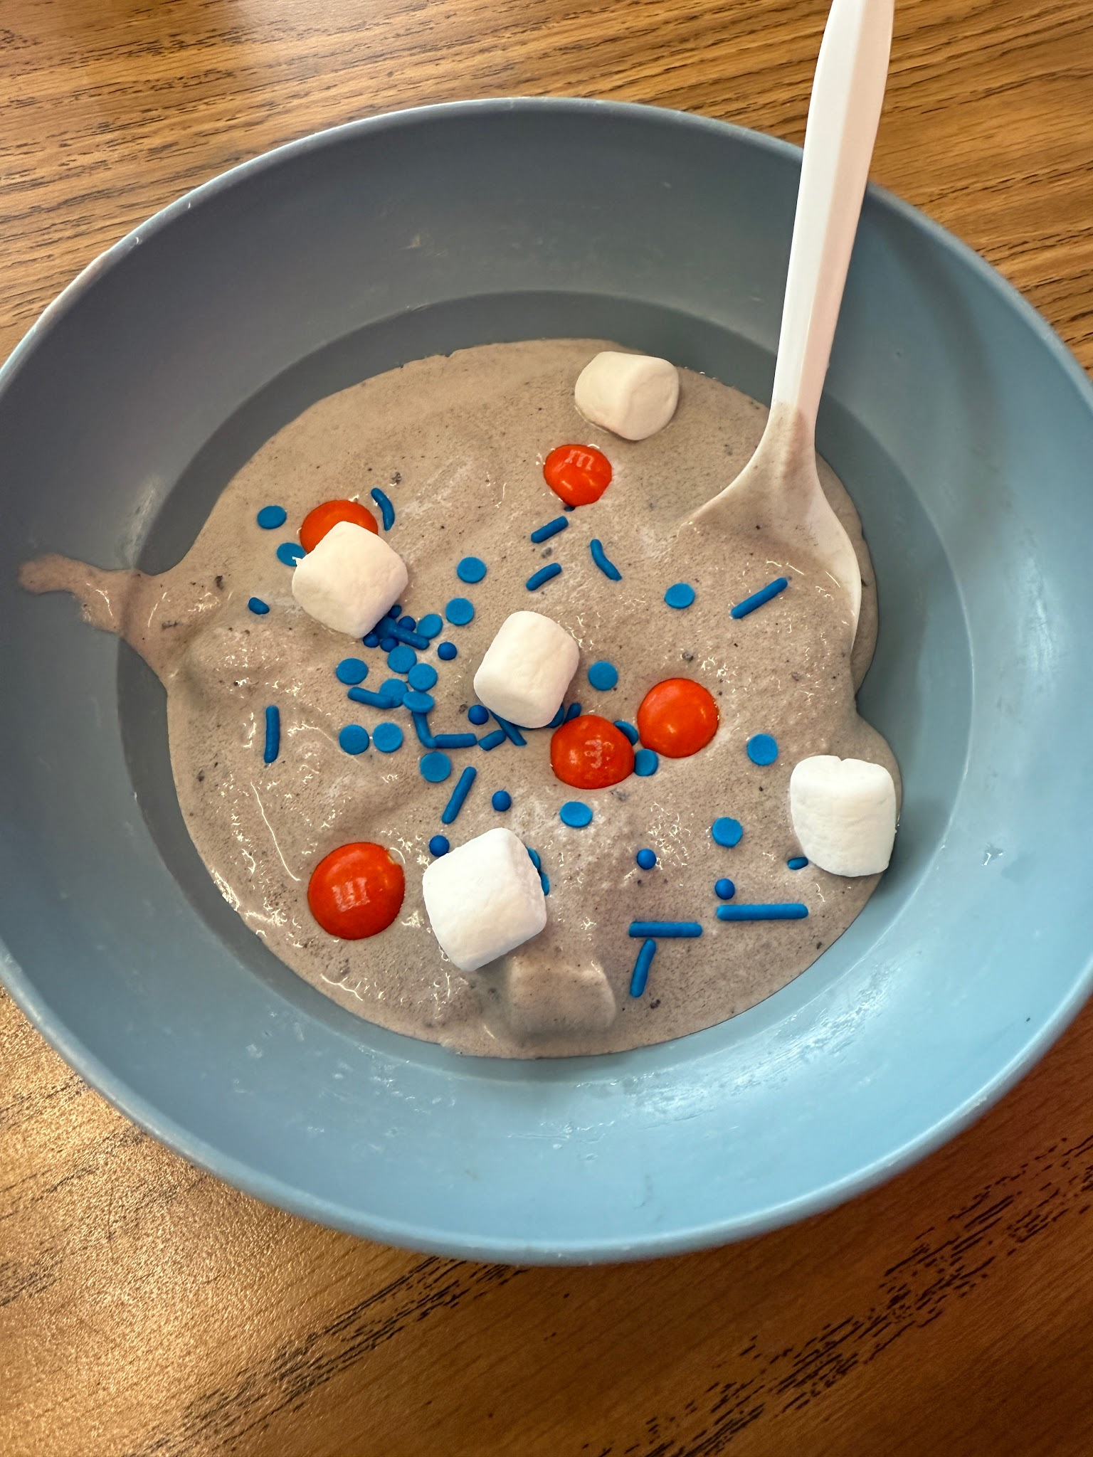
SLEEPY HOLLOW SCOOP
by: Miss Meyers’ 3rd Grade Class
At Ichabod Crane Primary School !

Slide 2

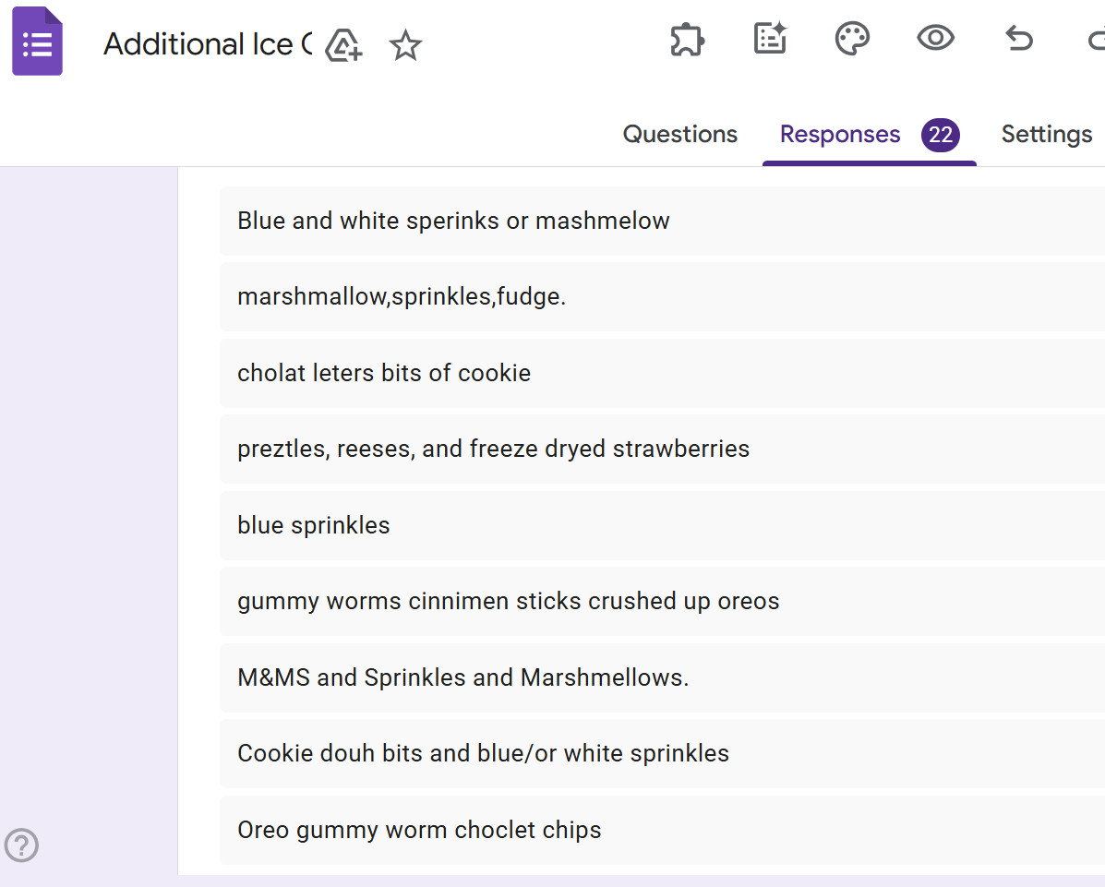
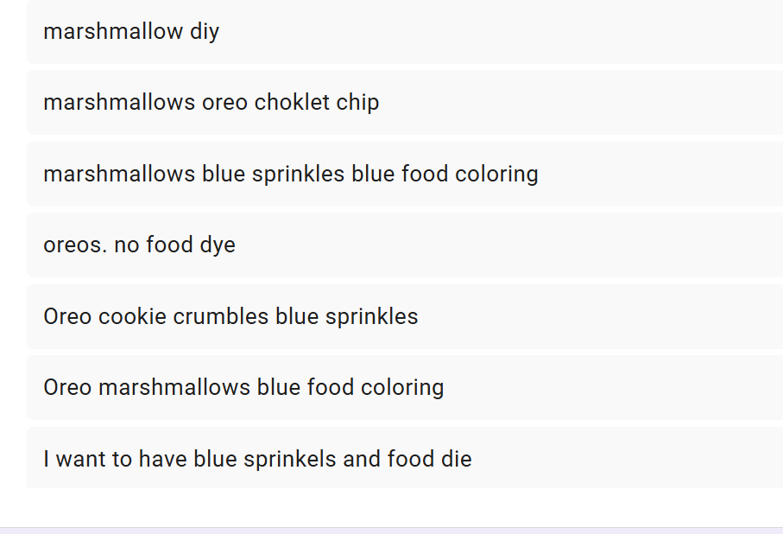
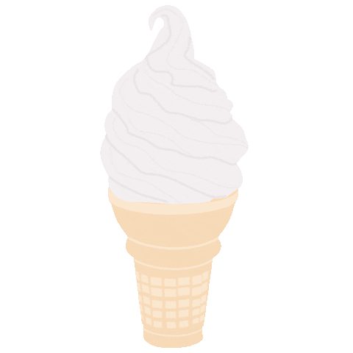
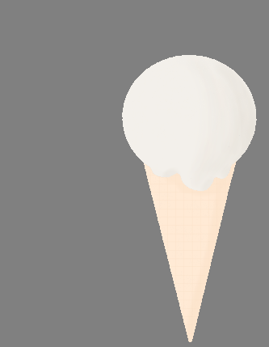
First, we voted on toppings to put in the ice cream.We put the ones that were voted the most in the ice cream like marshmallows and oreos.

Slide 3

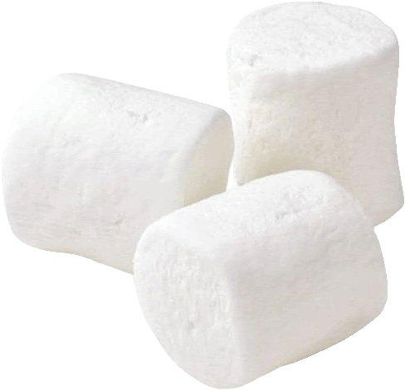



.
These are our results of what we want!
.

Slide 4
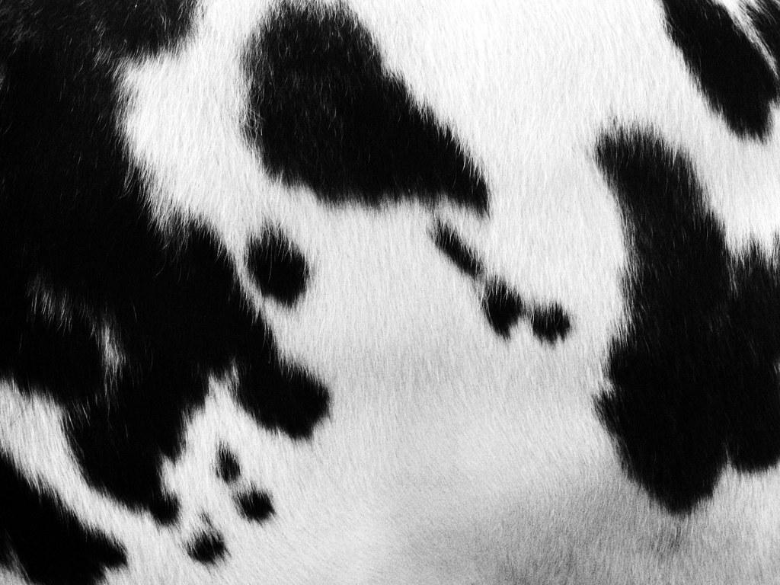
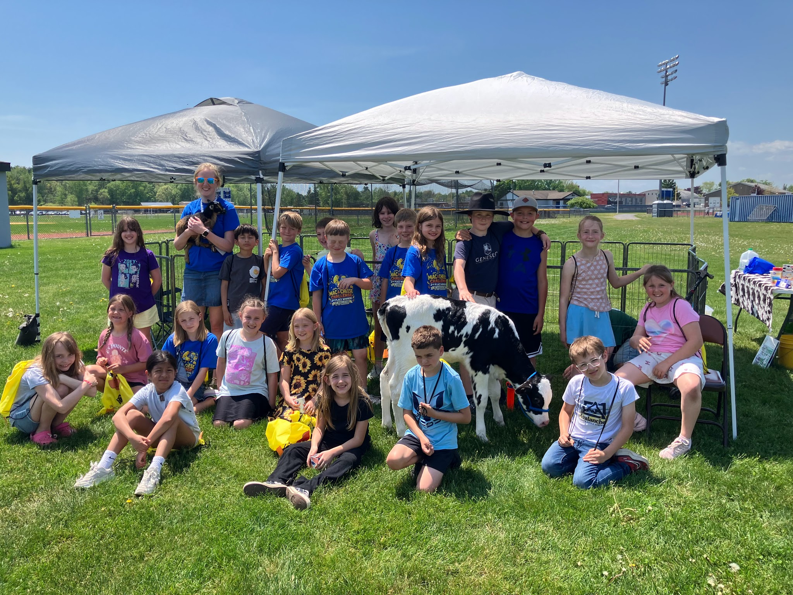
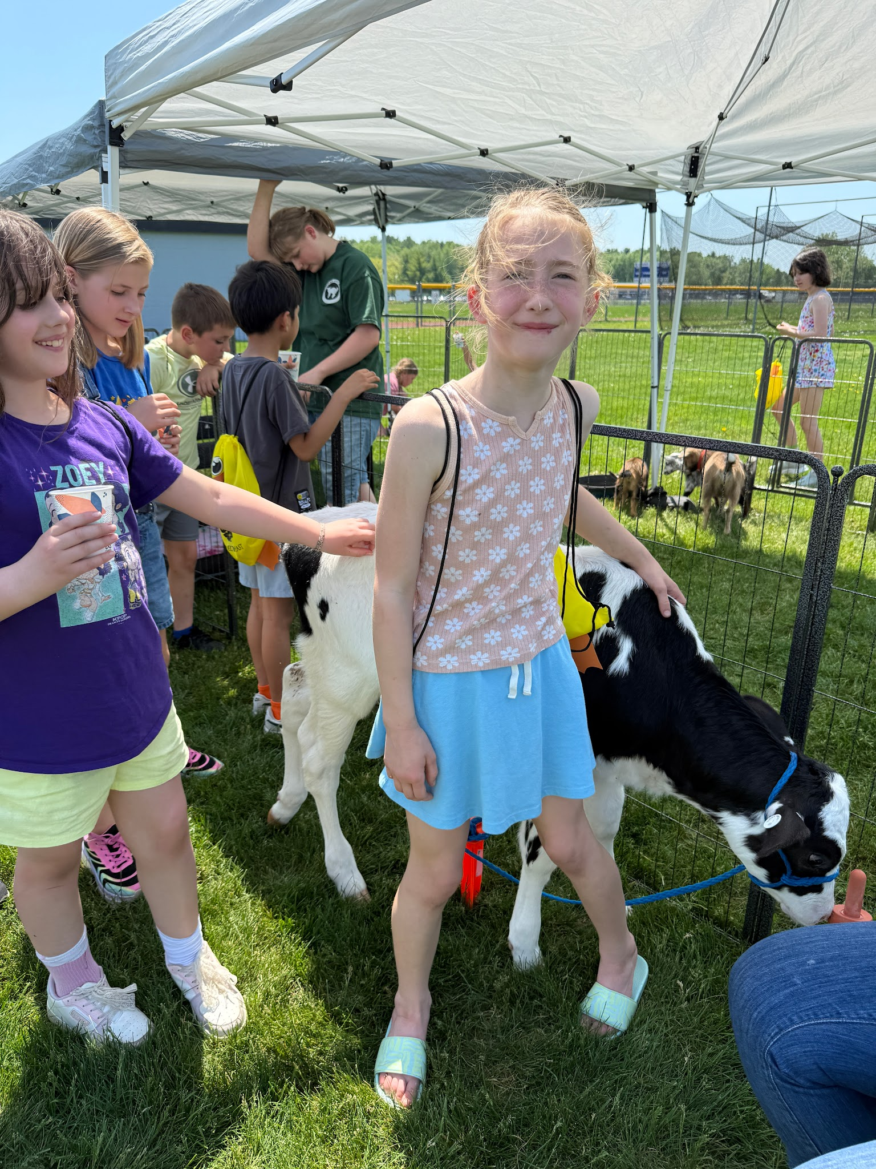
Before making ice cream we went out for Ag Day and had lots of fun! We Met Lucky the calf and a baby goat named Oreo.

Slide 5

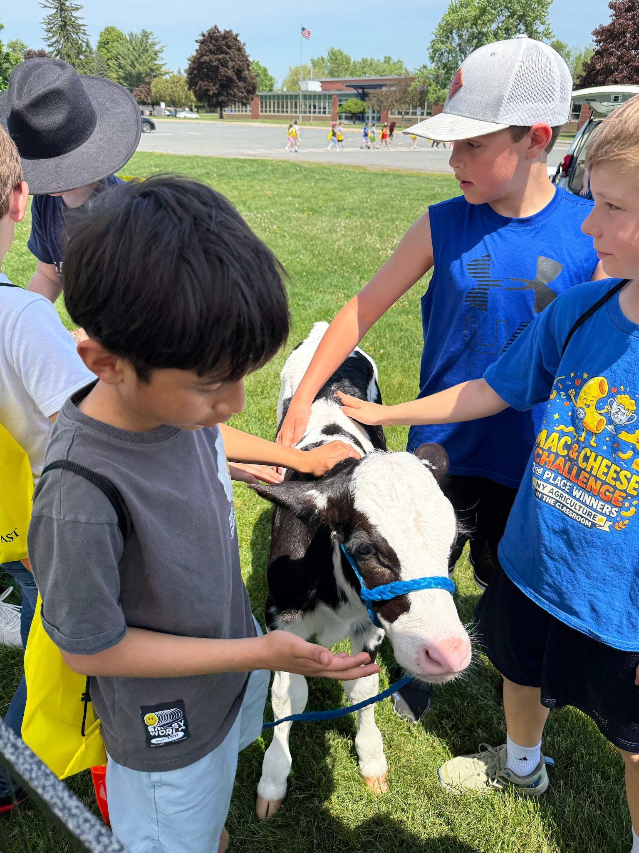
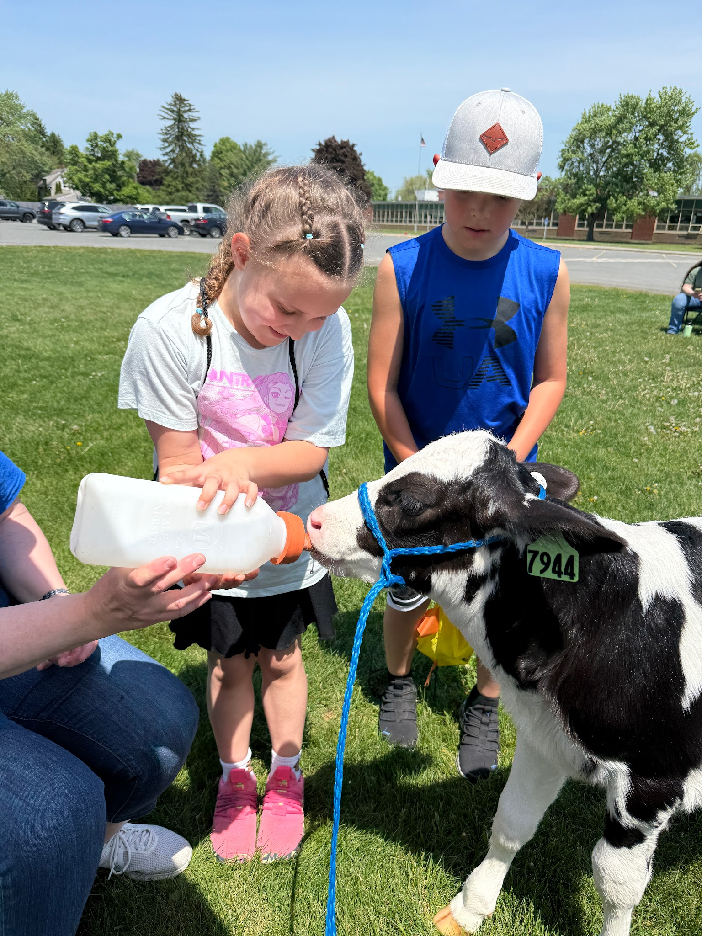
.
We fed Lucky and learned more about cows!! Dairy is good for bones, teeth and muscles!!

Slide 6

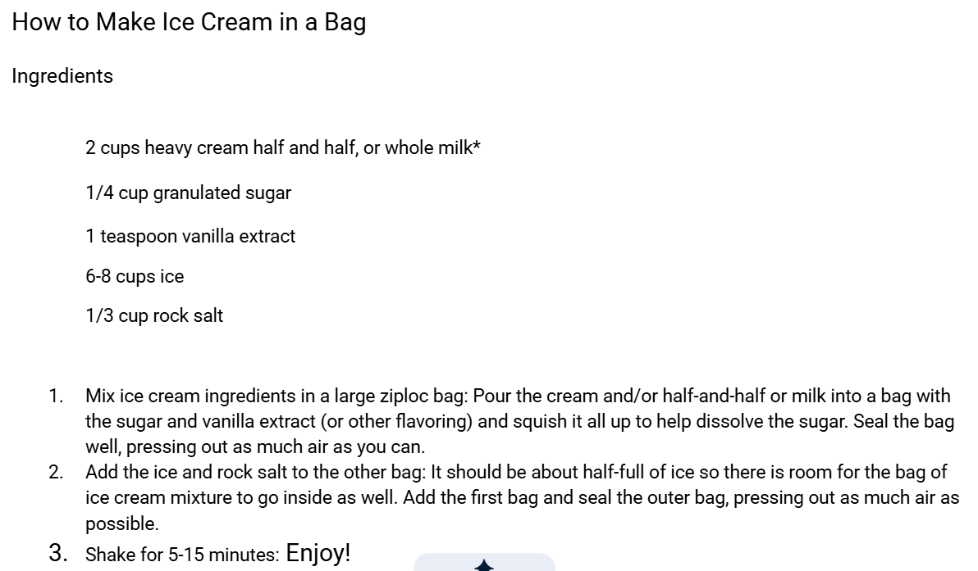
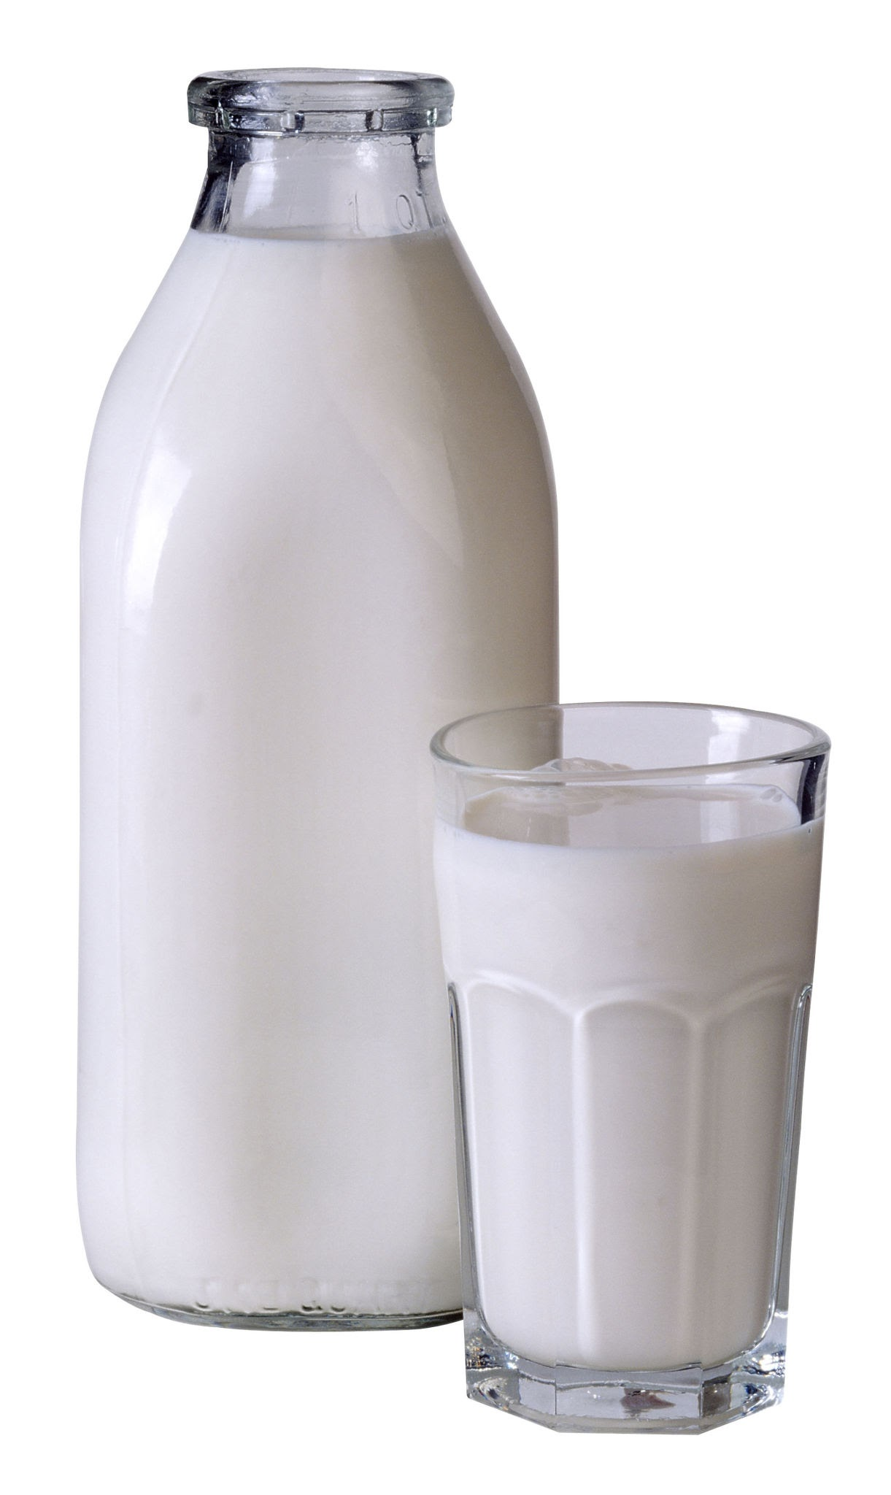
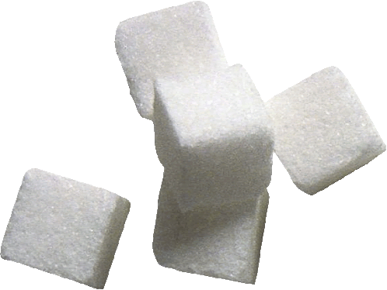
We tried out making ice cream in a bag! The ingredients are here.You have to shake it! When we were shaking the bag we had to play with the ice to get it to one of the sides because it was still liquidy. We did it over the trash so if it spills it will be fine and fall in !

Slide 7
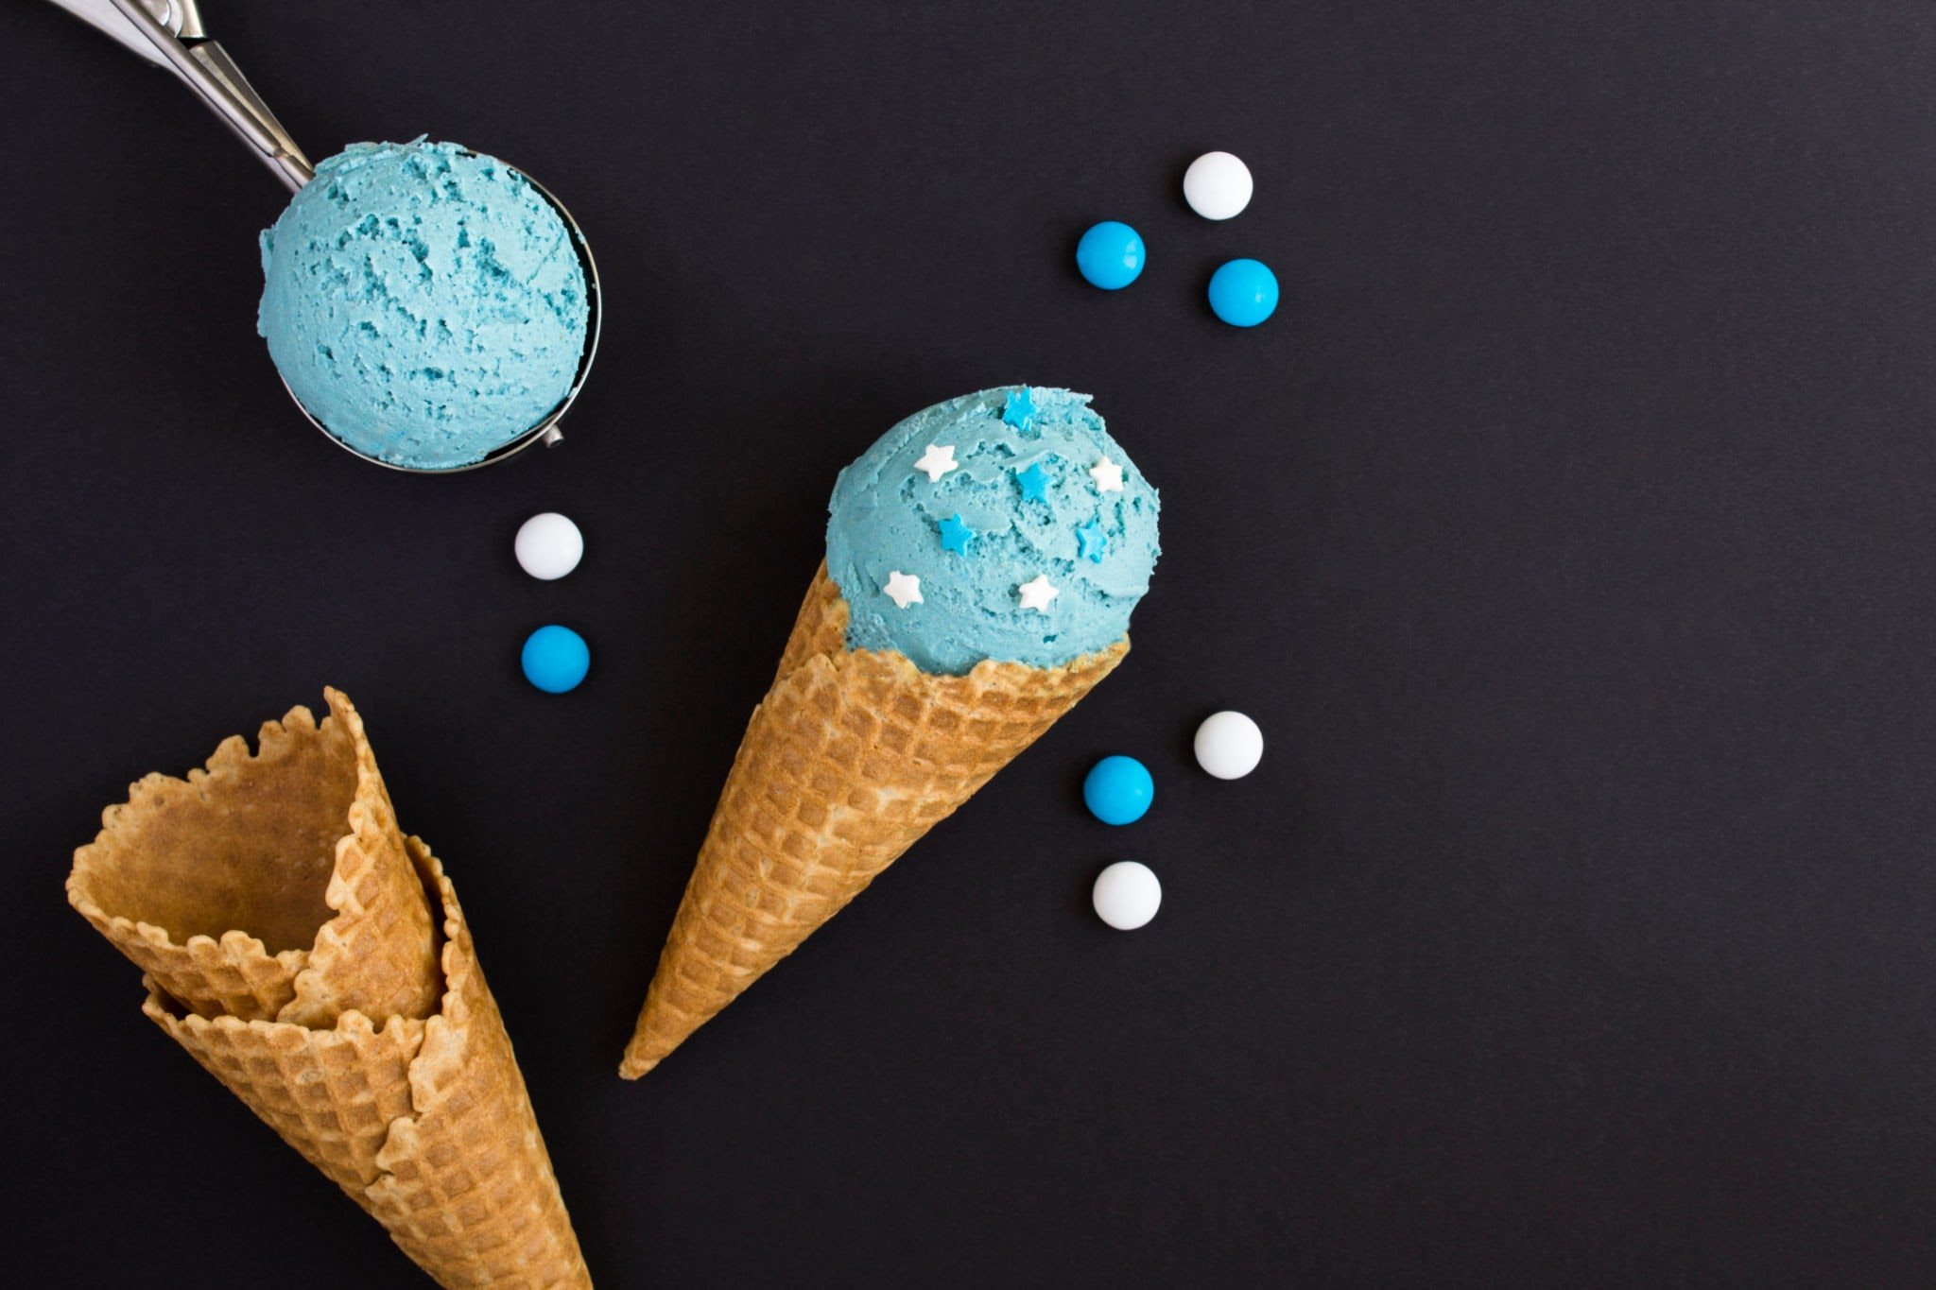

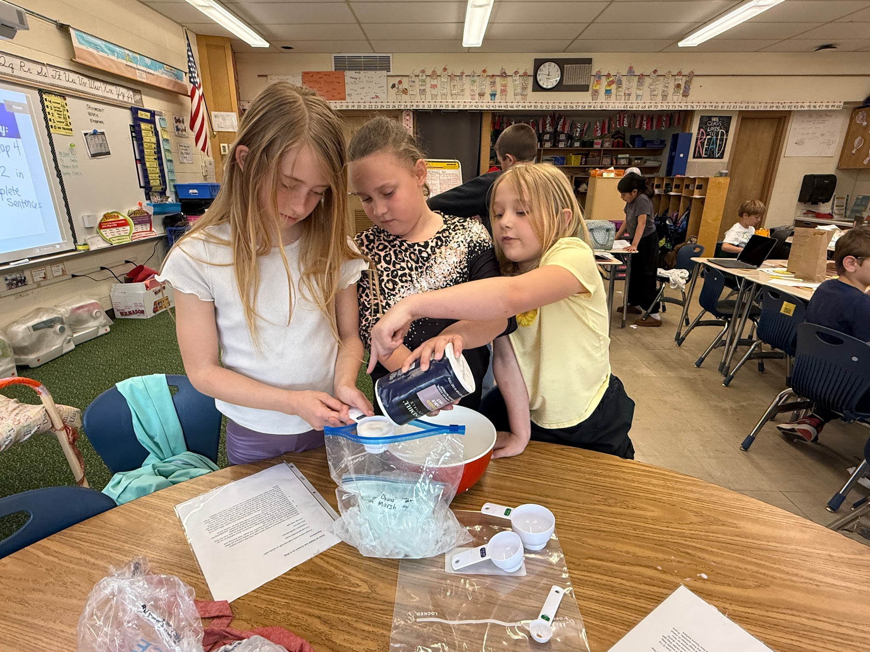
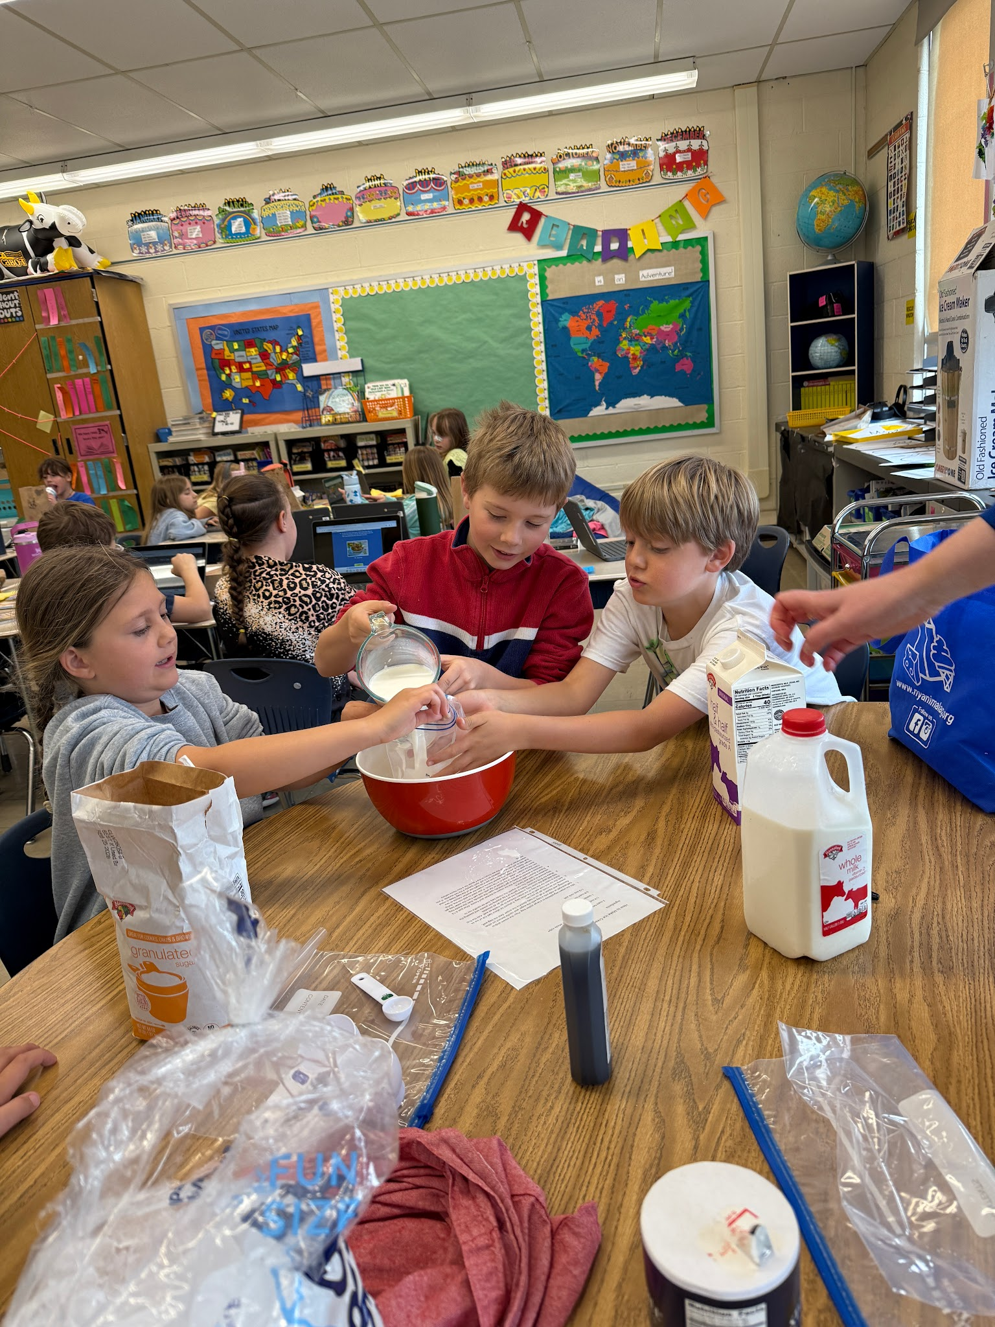
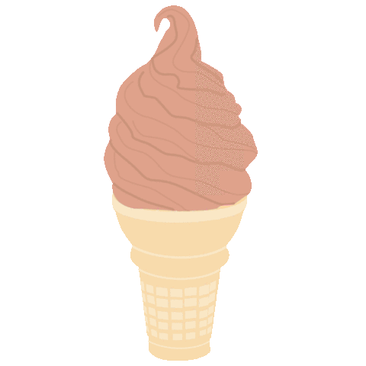
Making process
We made the ice cream in a bag with ice and salt and then put the
Smaller bag in the big one with the cream, andada vanilla,
sugar and milk,
Half and Half, then shook it over the
Trash so it did not
Spill for 15 min

Slide 8

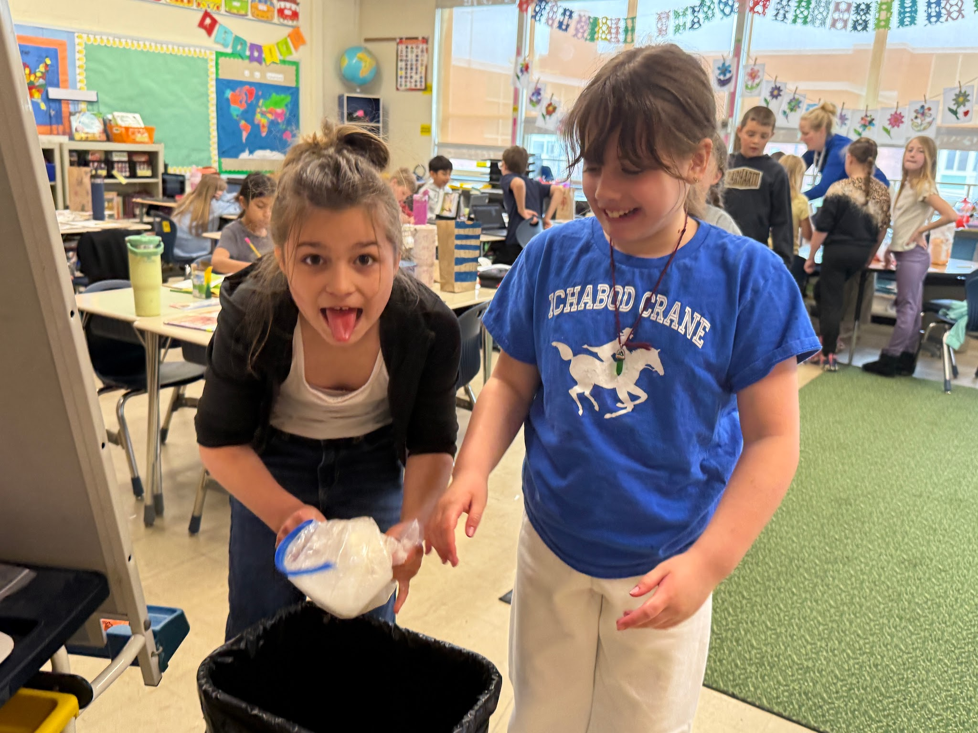
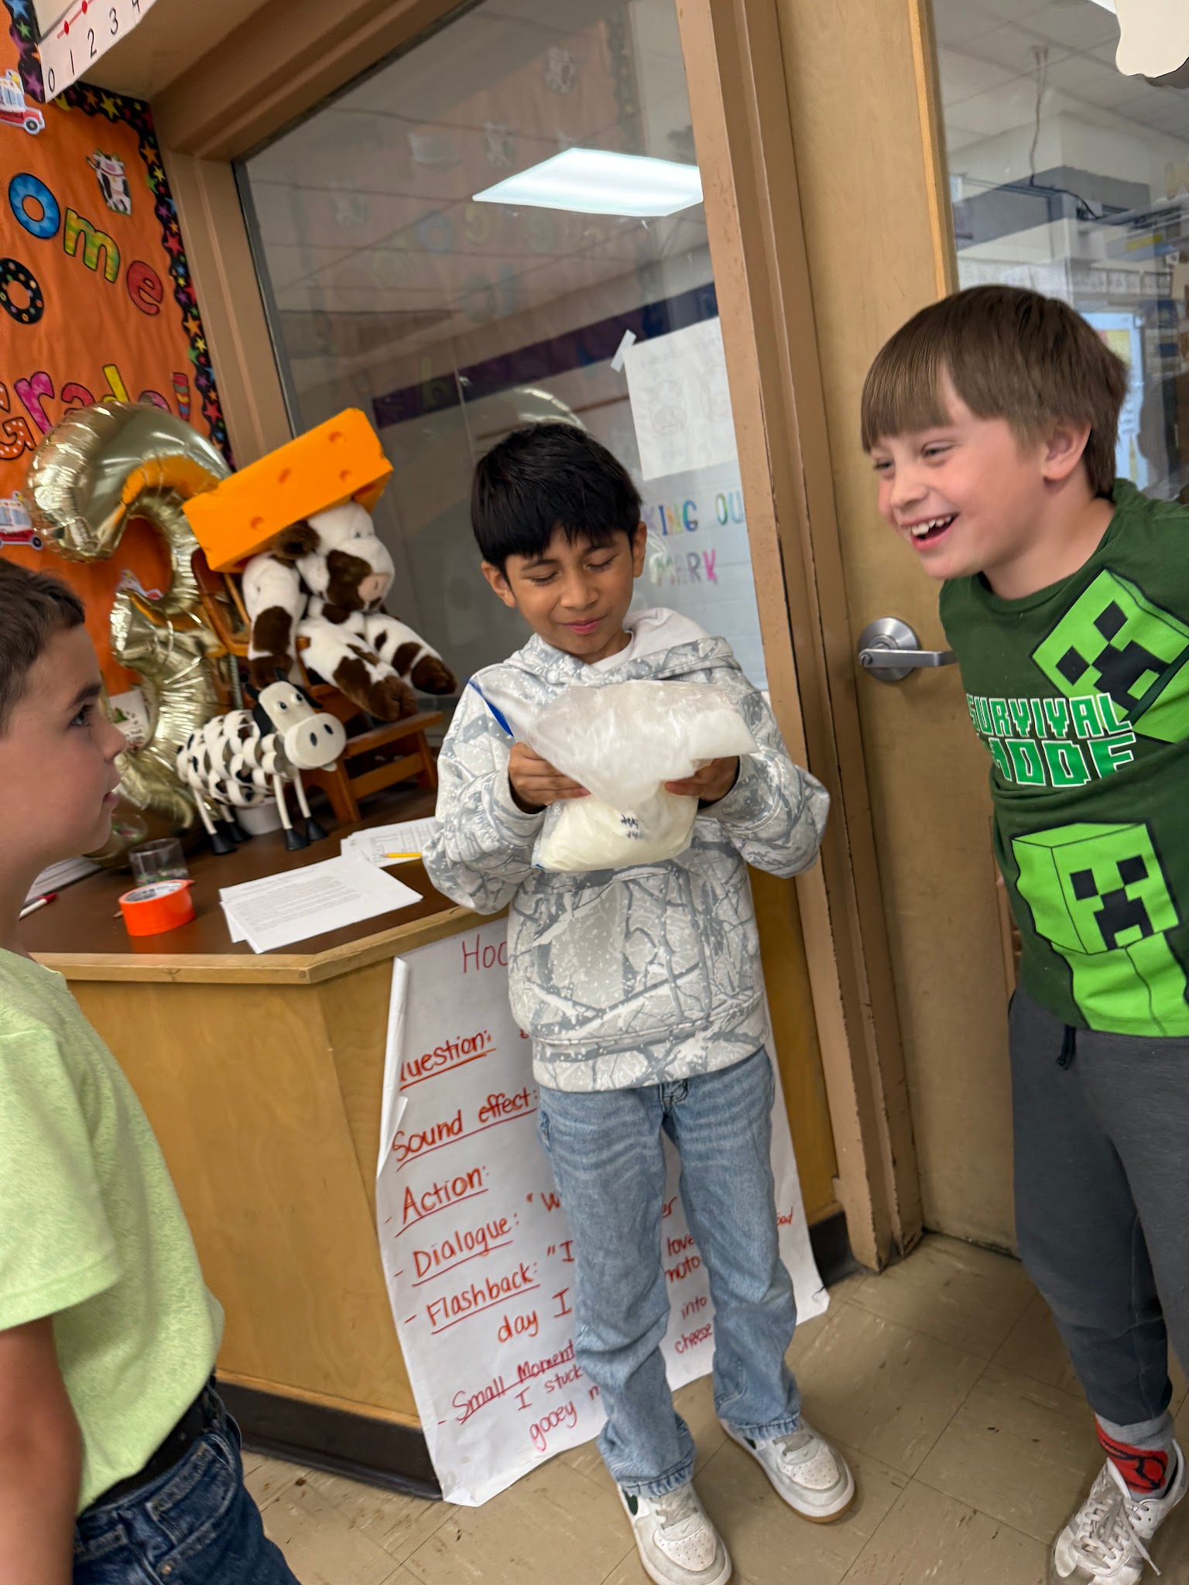

Didn't work out that well but still really yummy! We shaked the bag with the ice and salt! It leaked a little, but that's okay! It was kind of soupy.
We did 3 types. One with crushed oreos, blue coloring and marshmallow,One without marshmallow. The blue food coloring didn't really work out well… It kinda turned green when it mixed with the vanilla ice cream.

Slide 9
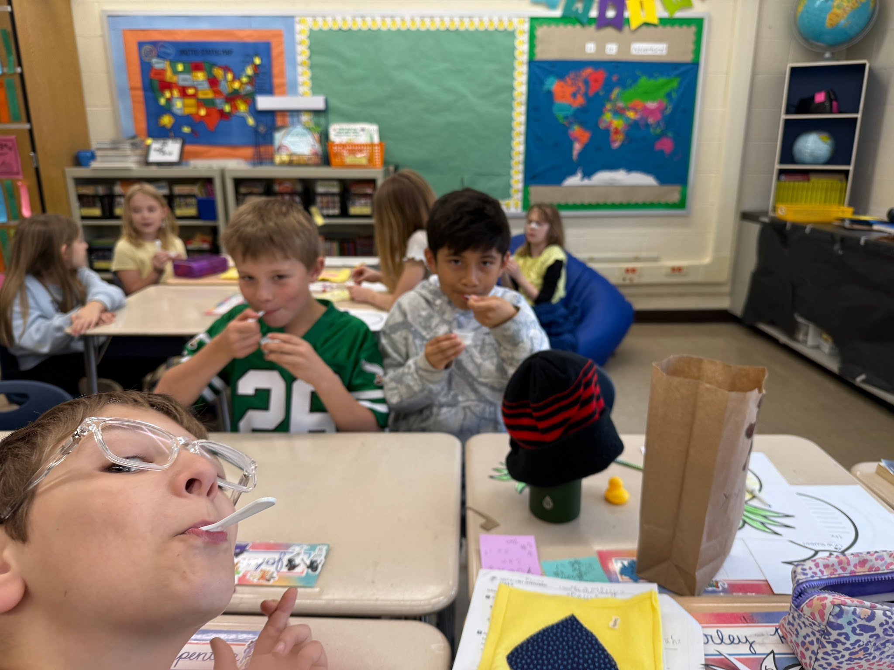
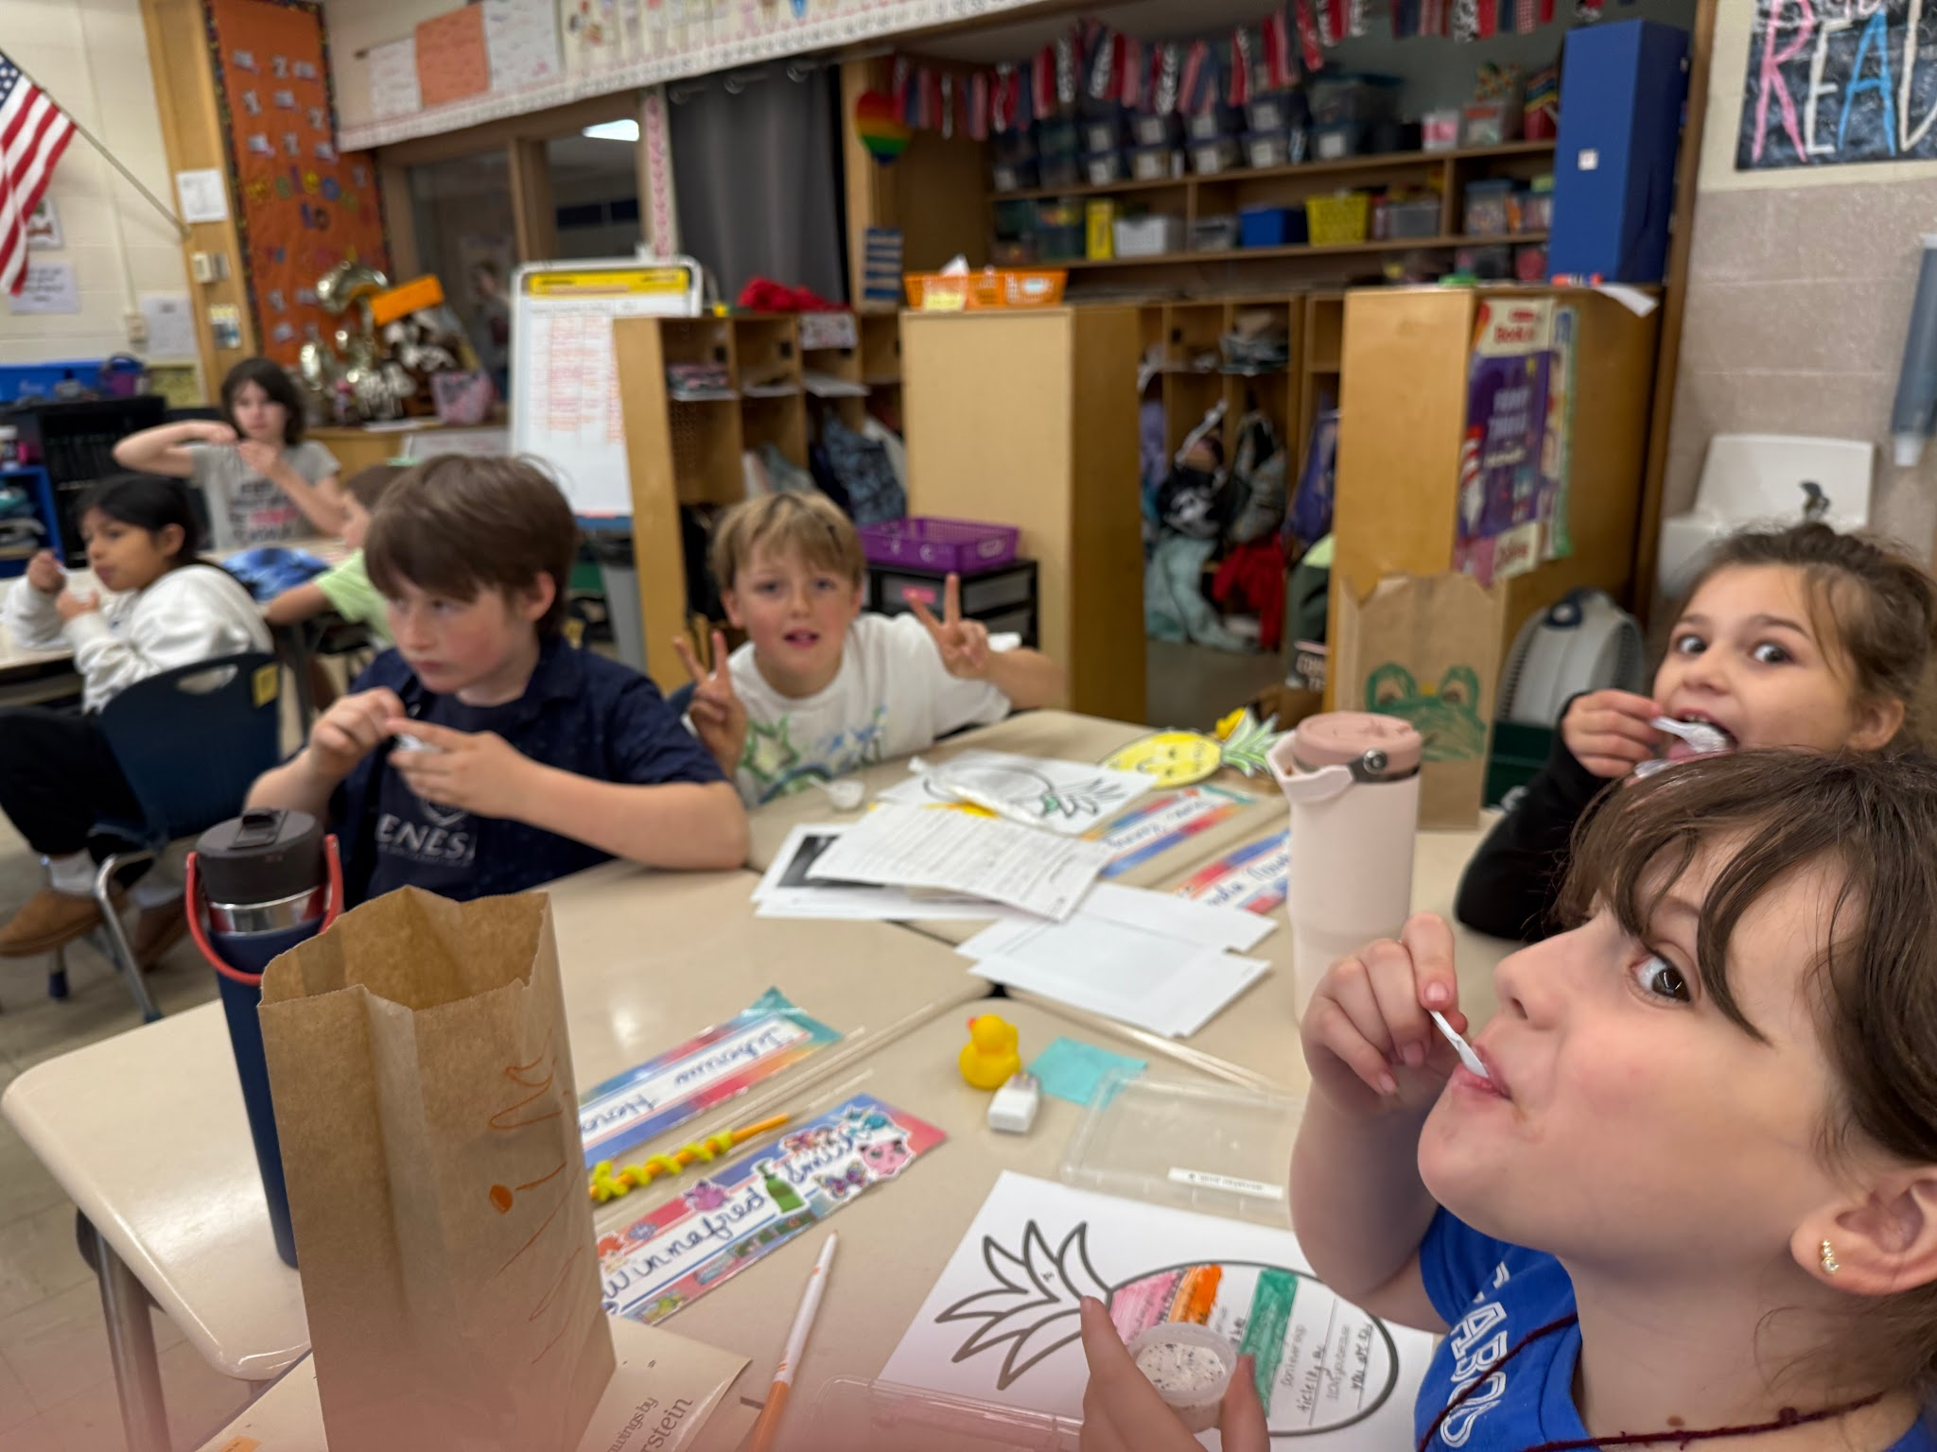
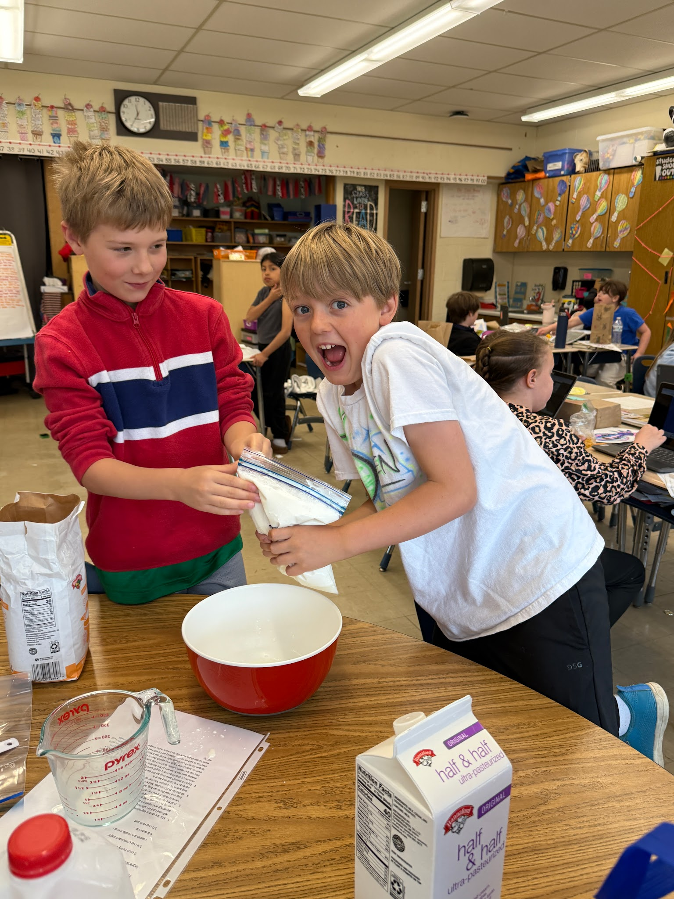
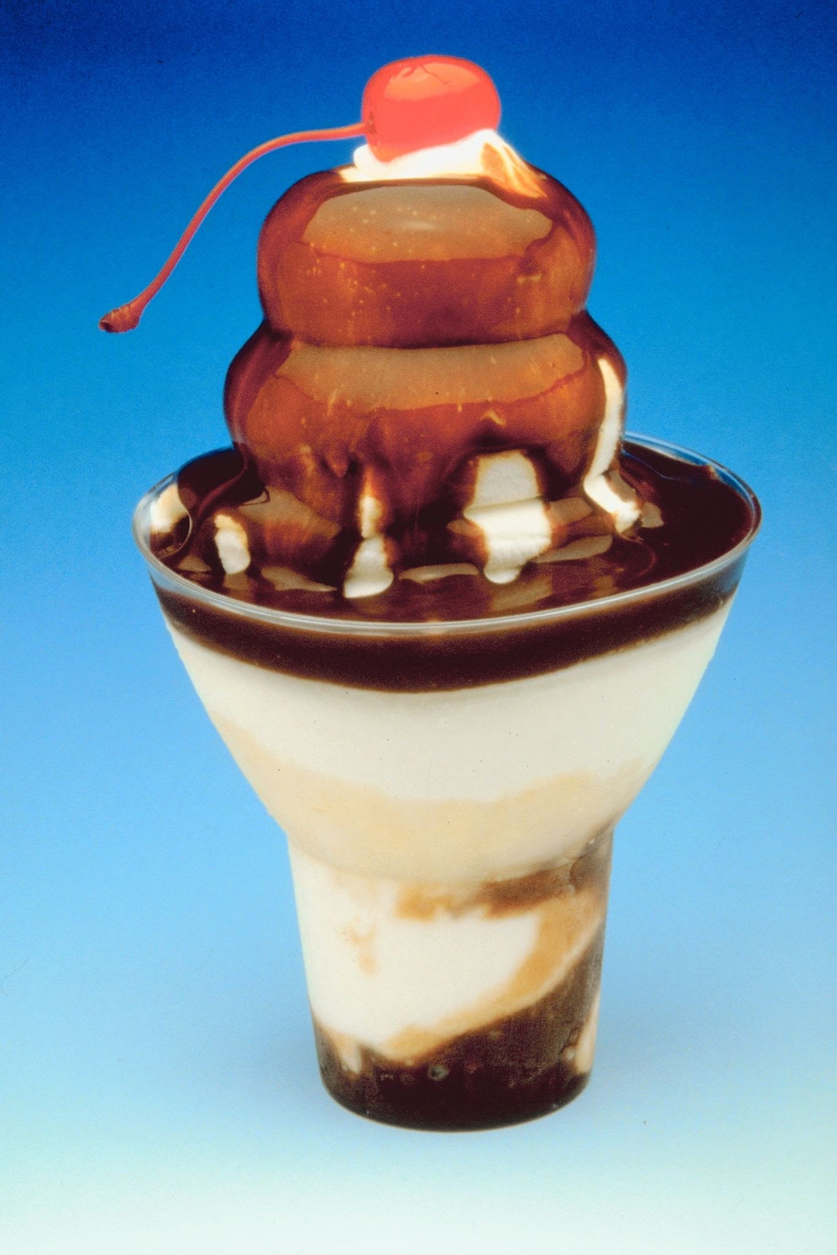
Our class pics
We taste tested the bag ice cream and it was YUM! But there is better ice cream!!It was soupy!IT WAS GREAT!!!

Slide 10
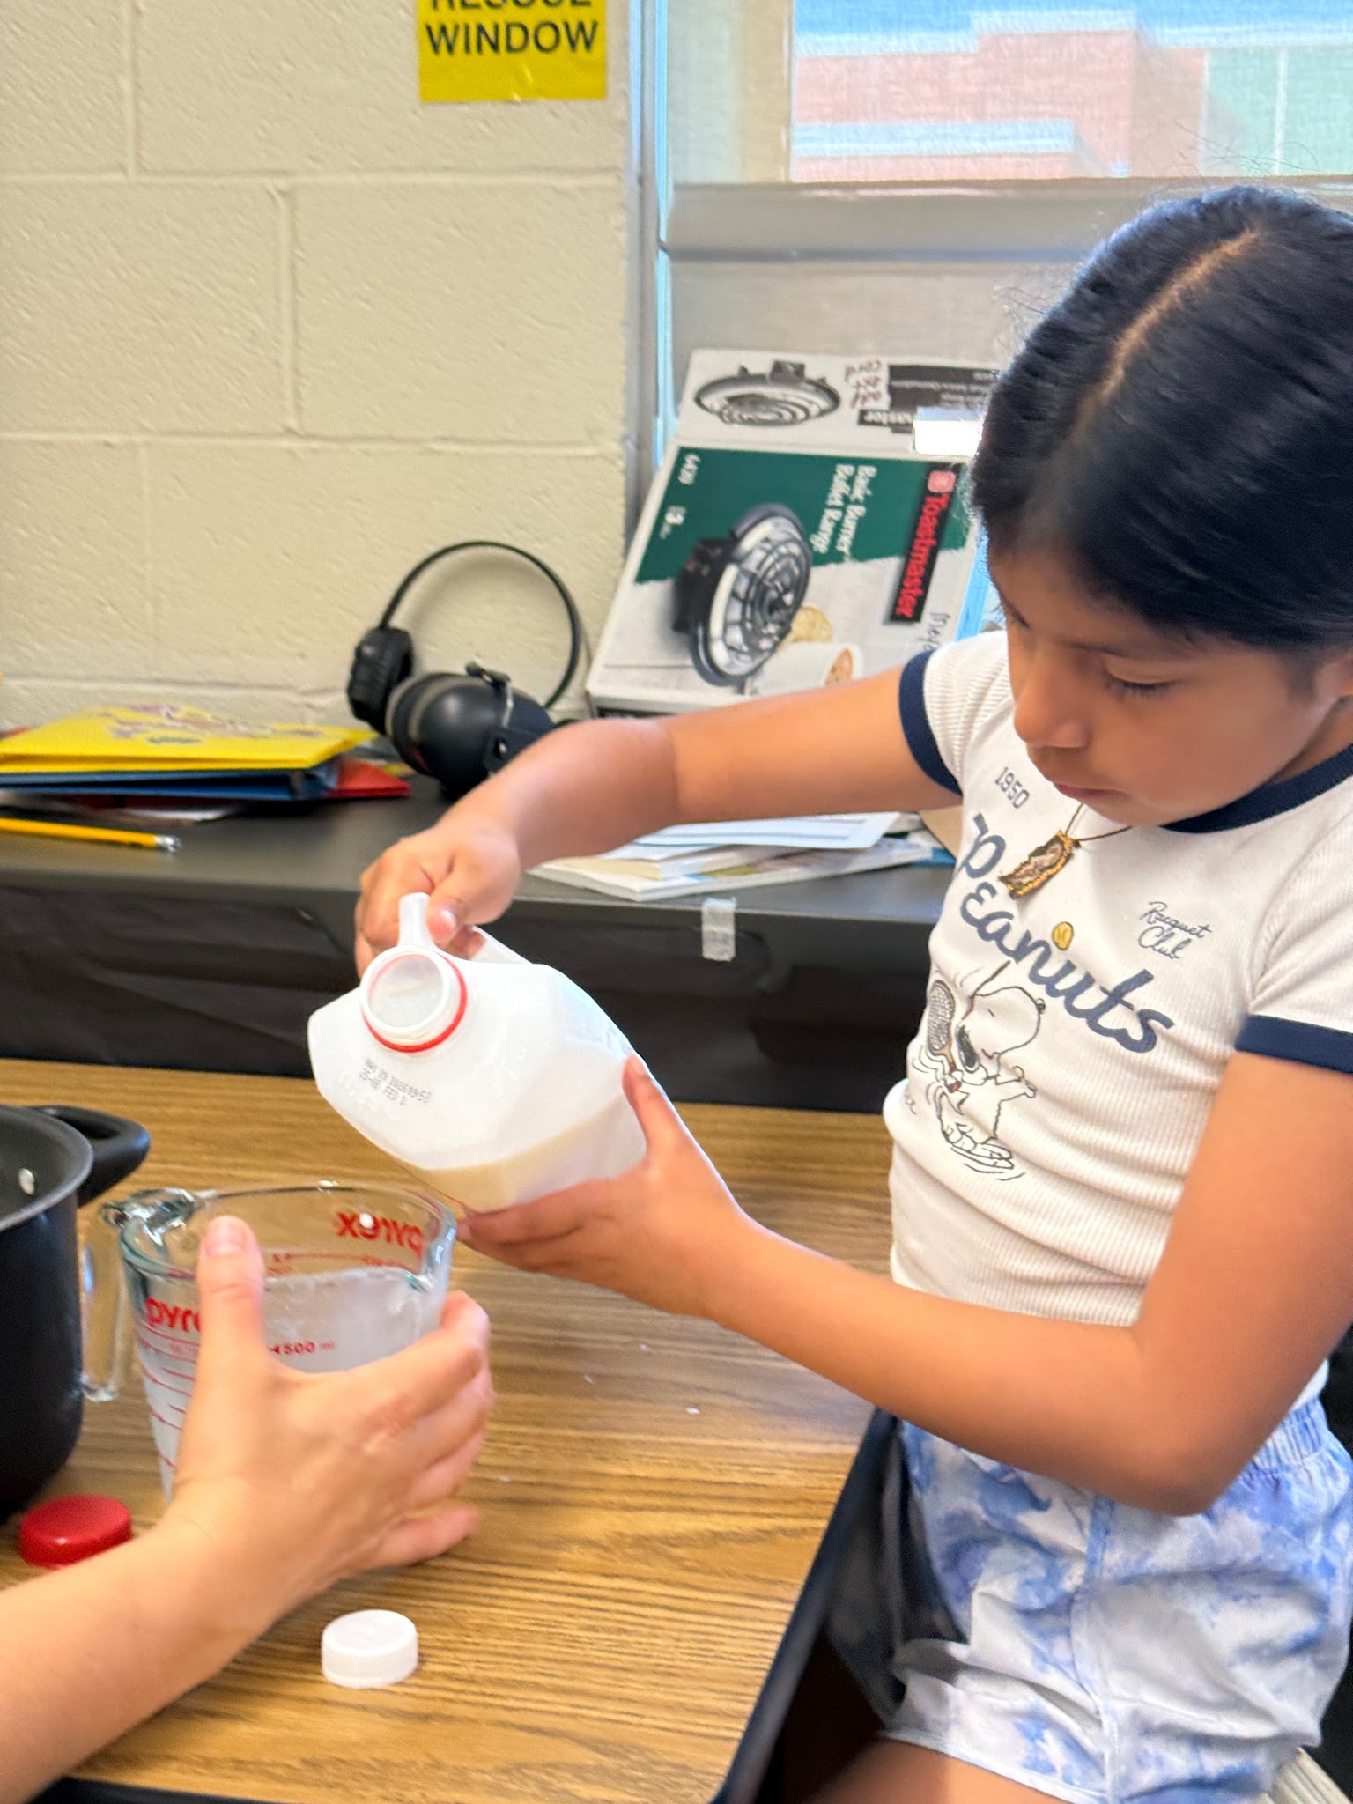
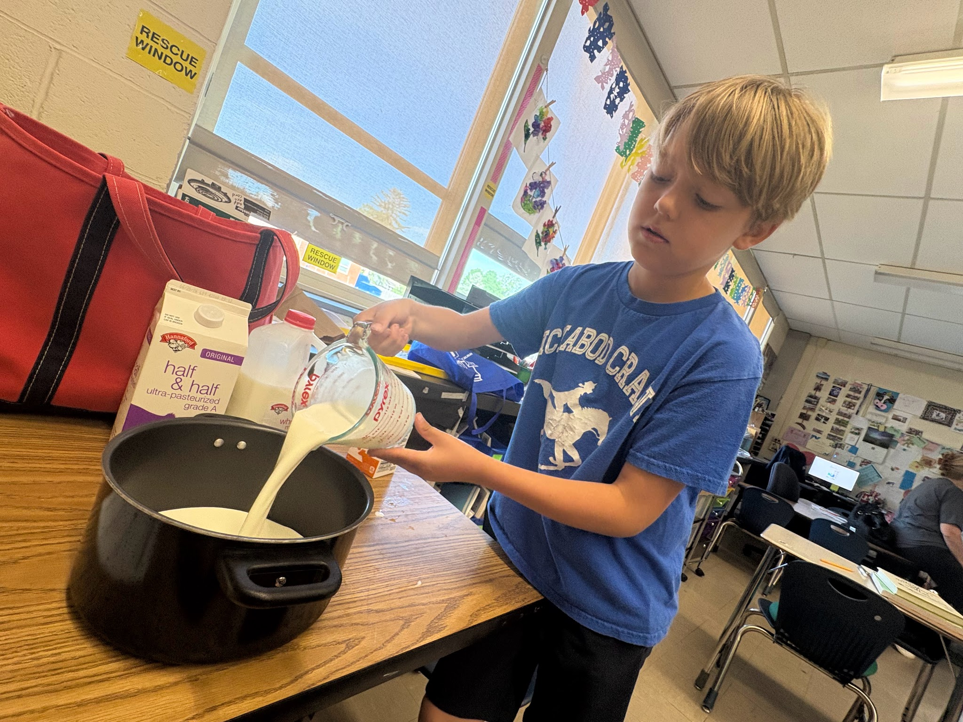
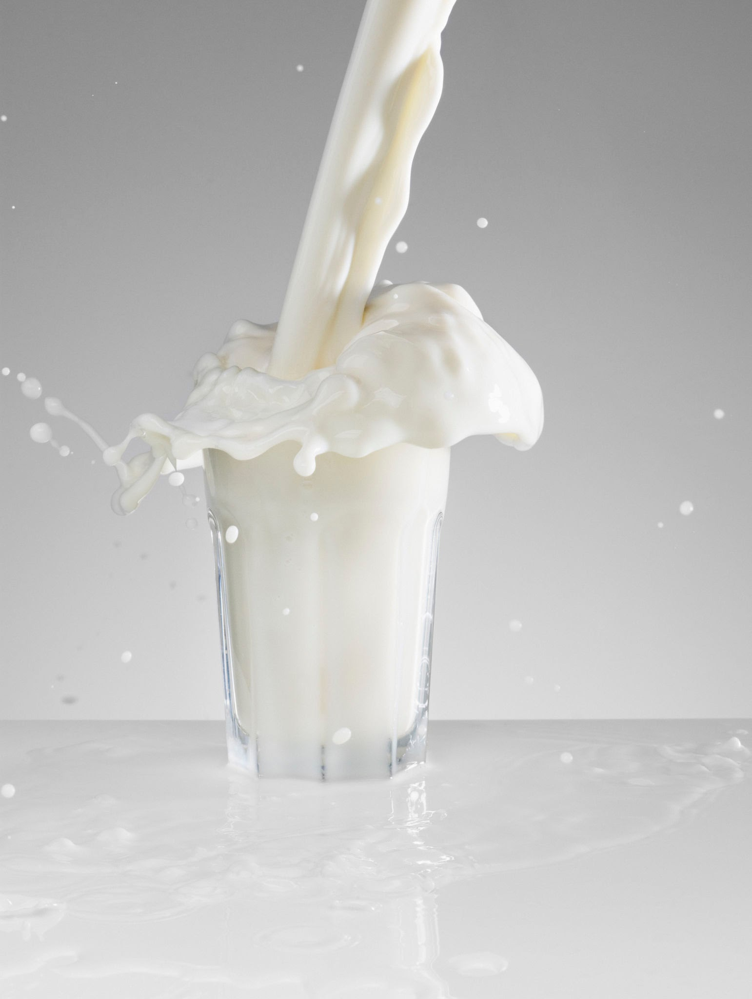
We also did make ice cream in a ice cream maker! We made the custard. That's the beginning of the ice cream! At the end we are going to put the MIX- INS. Here we are adding milk and cream.

Slide 11
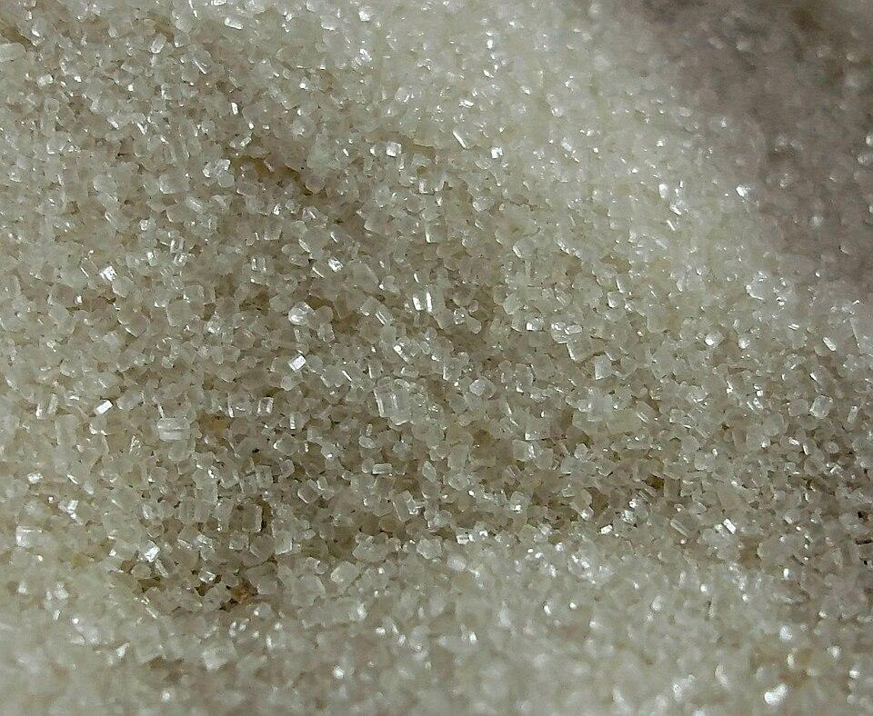
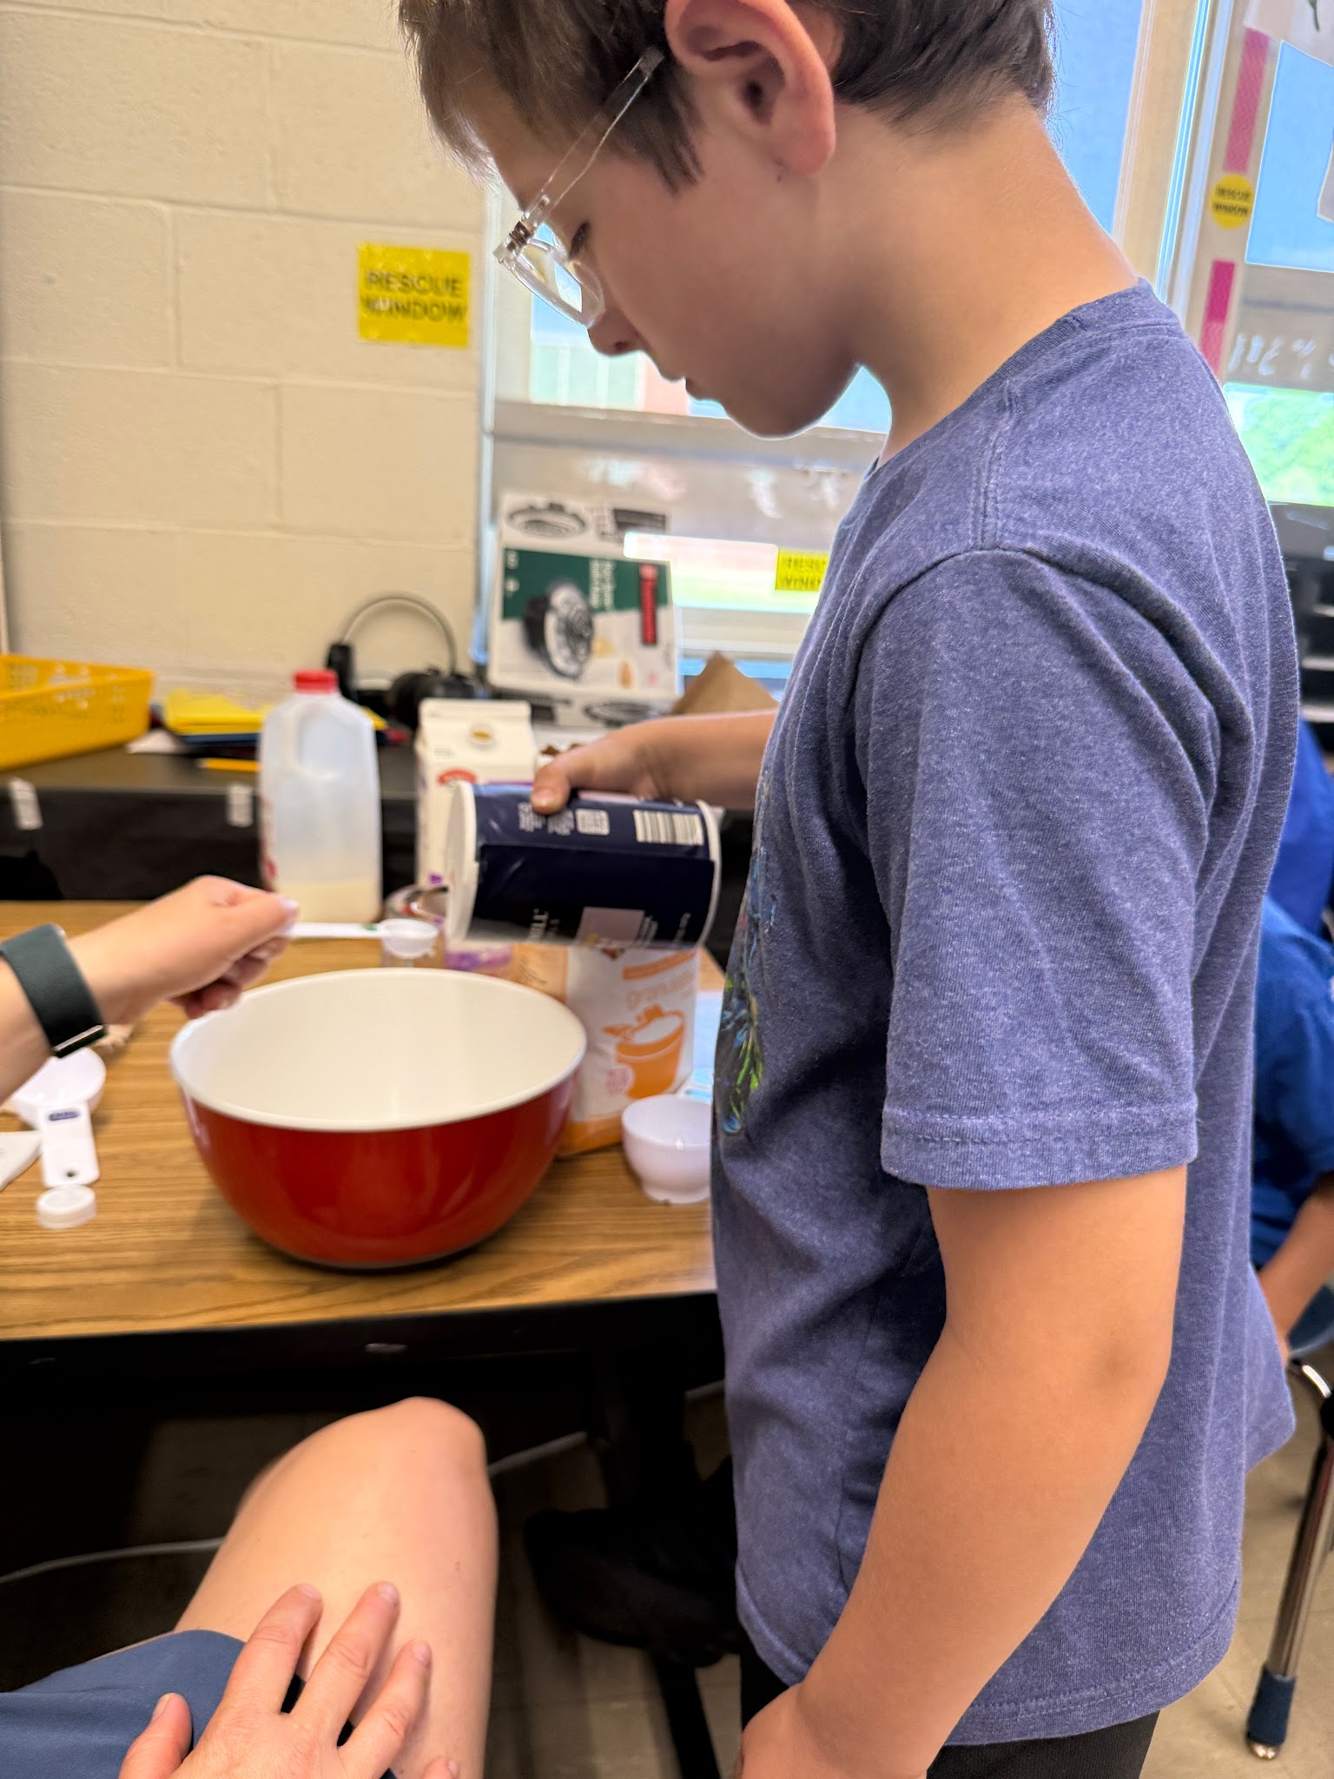
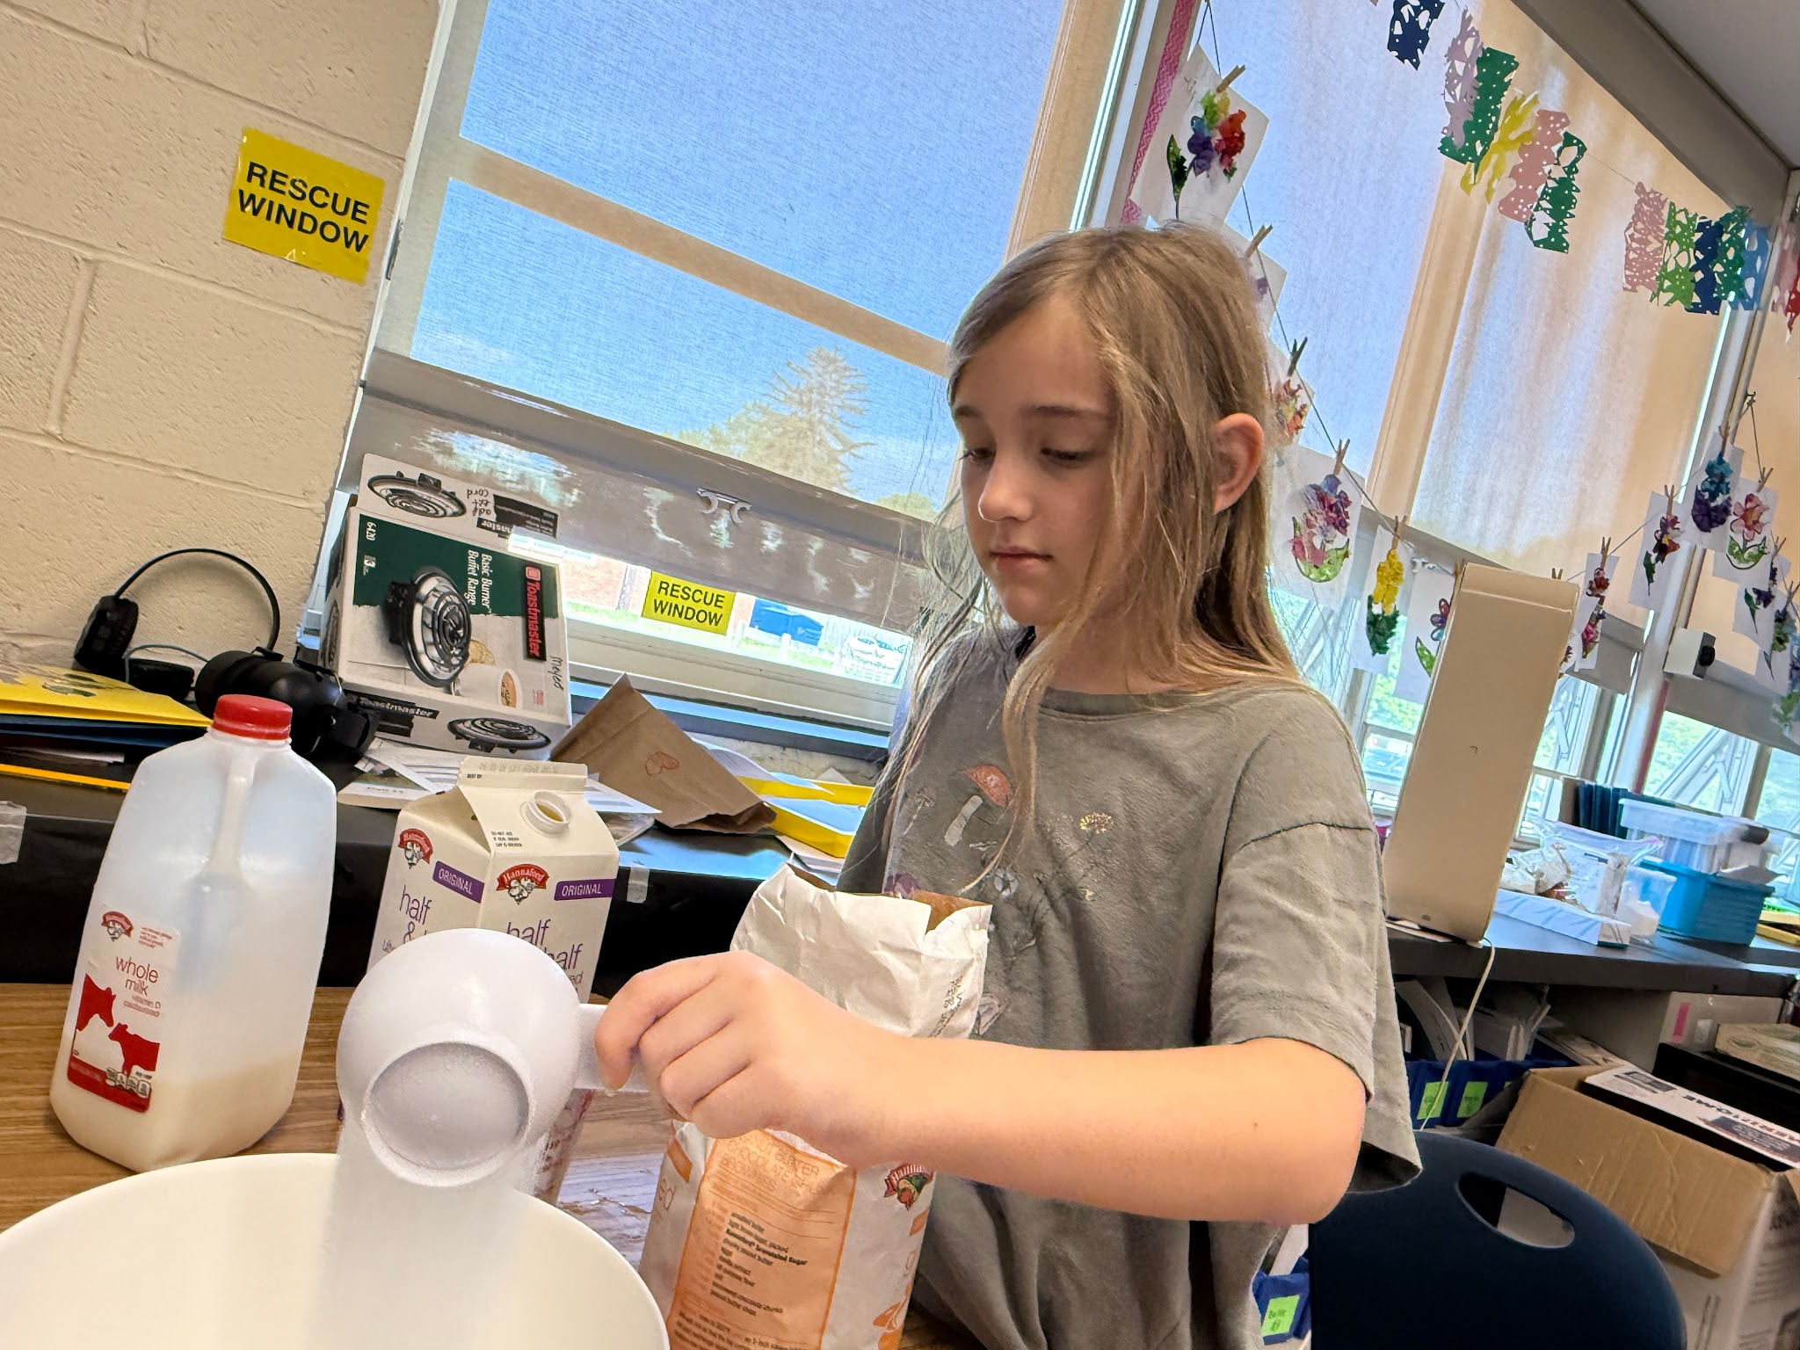
We added sugar , milk, half and half, and vanilla! Then we simmered it then put it in the fridge .

Slide 12
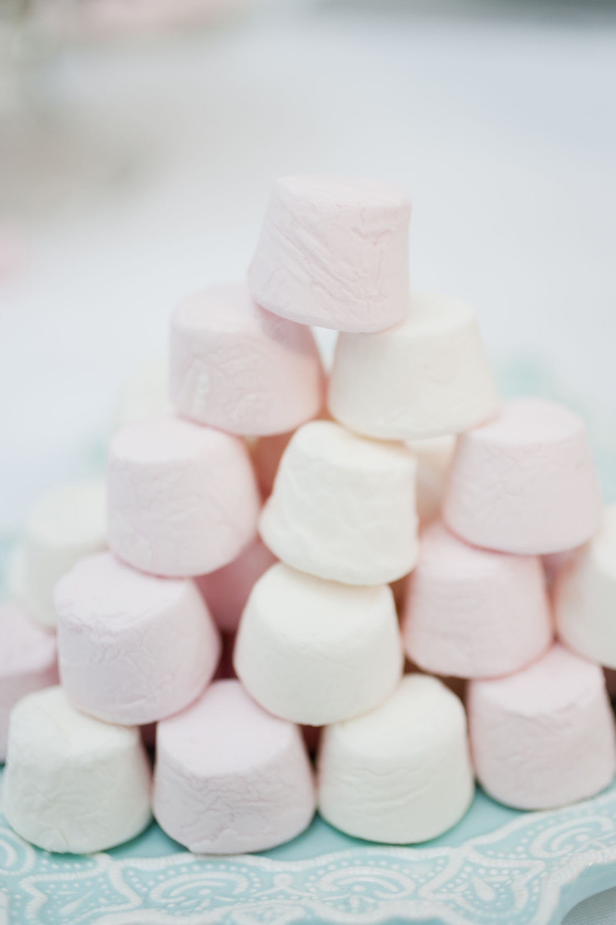
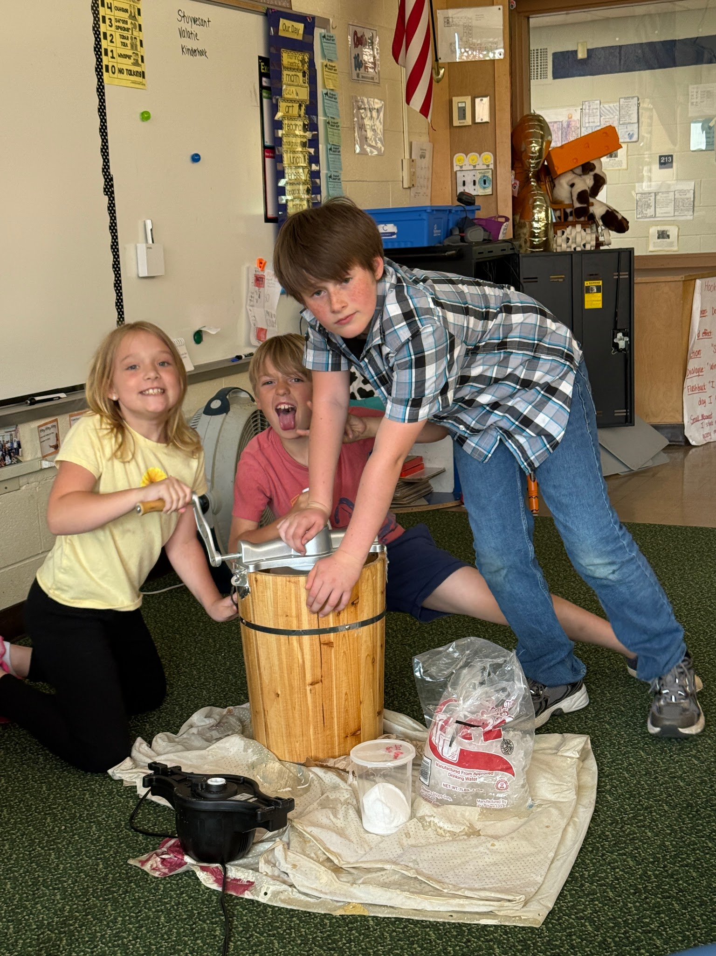
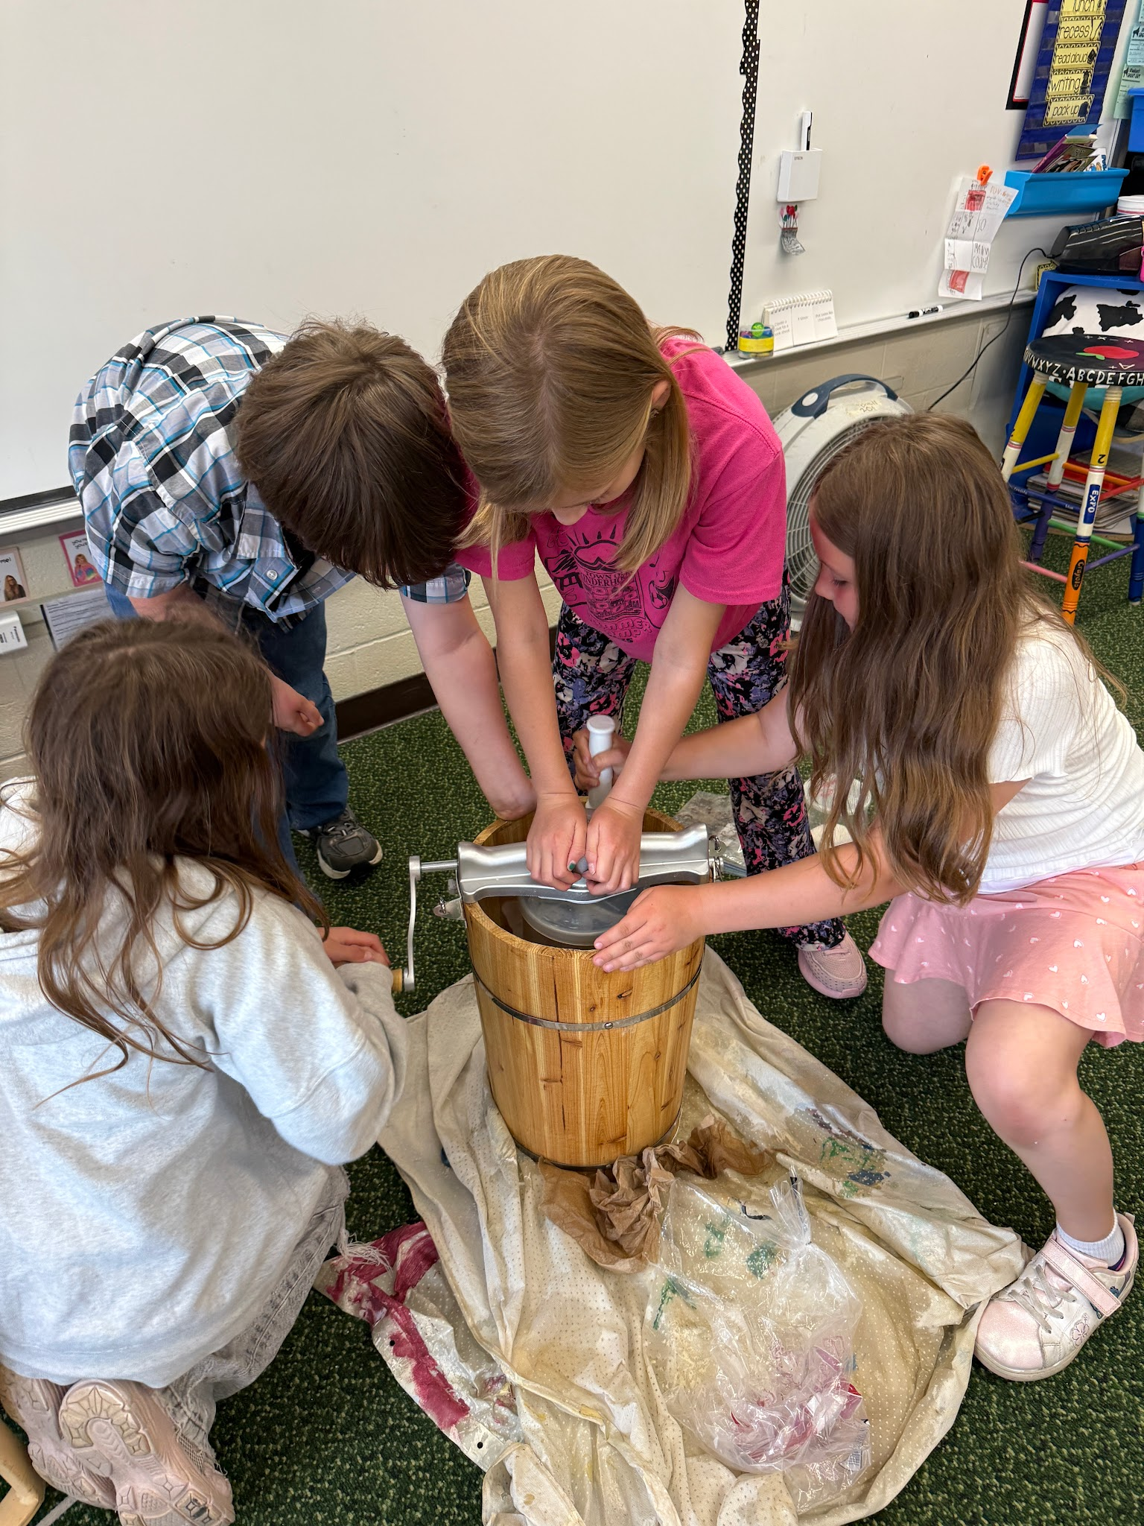
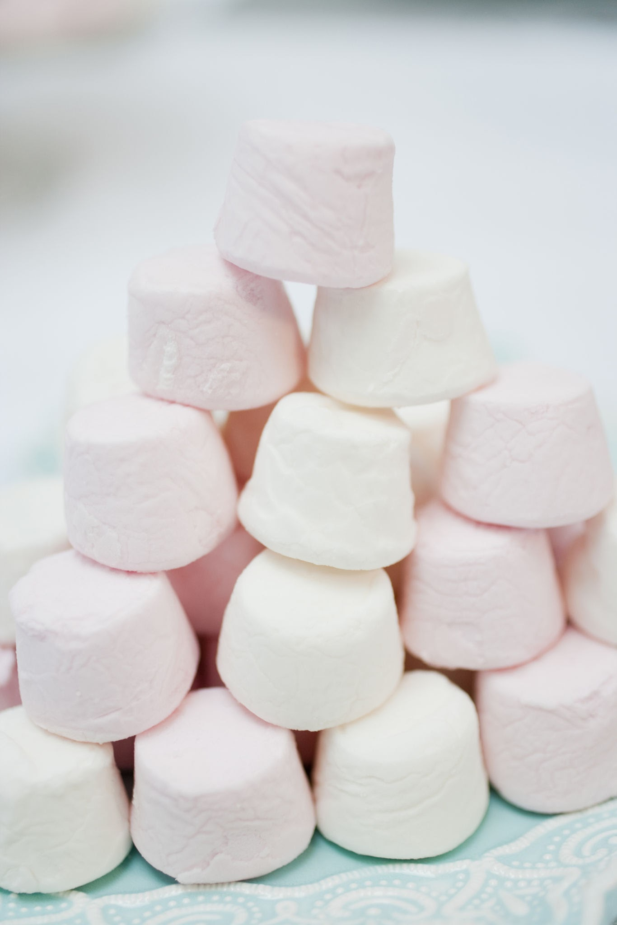
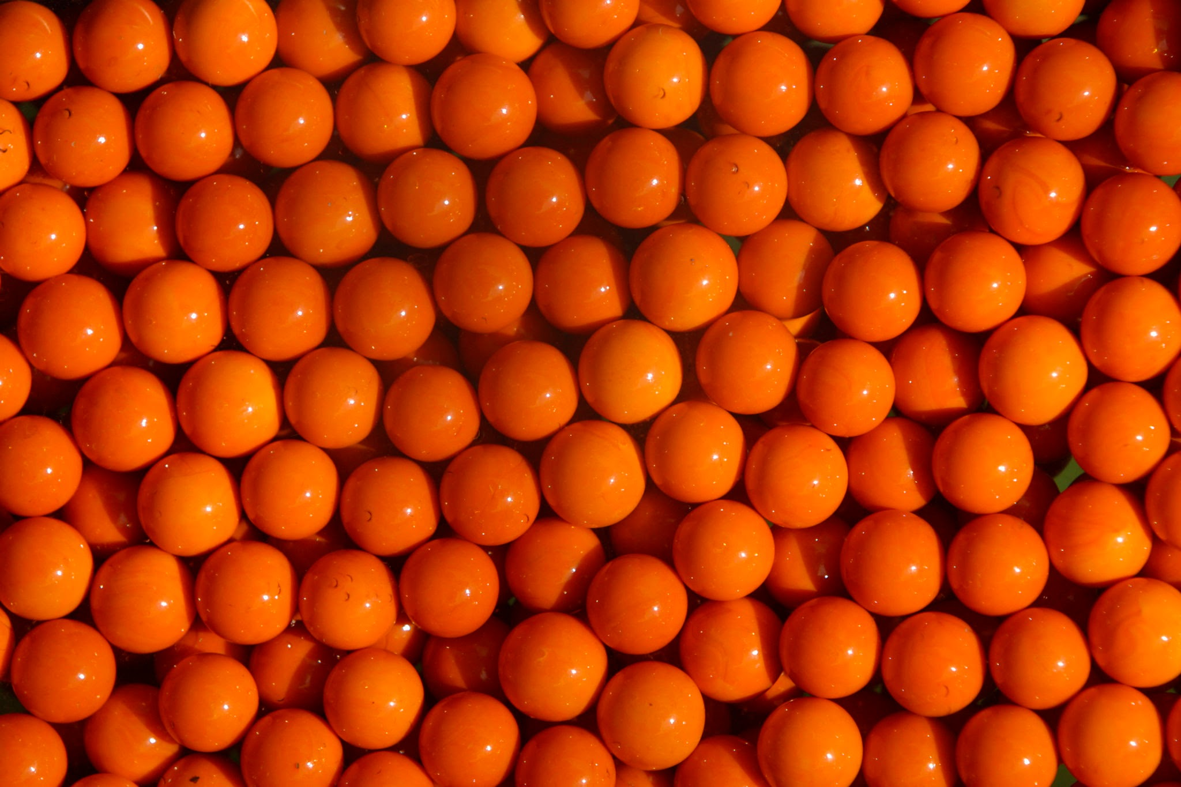
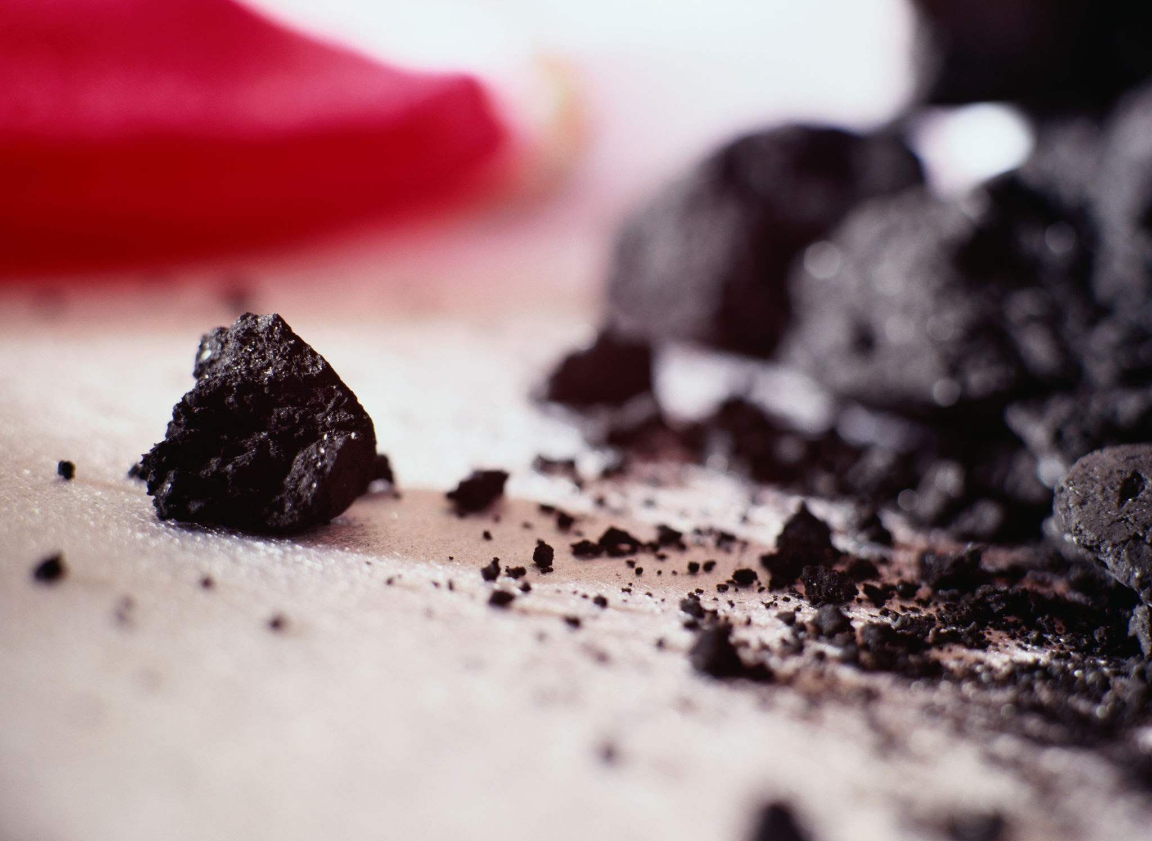
Ice cream maker
We used an ice cream maker and it took so long to finish! I bet a lot of arms were tired and hurting after we all were done spinning!

Slide 13
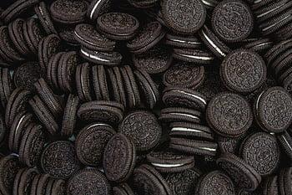
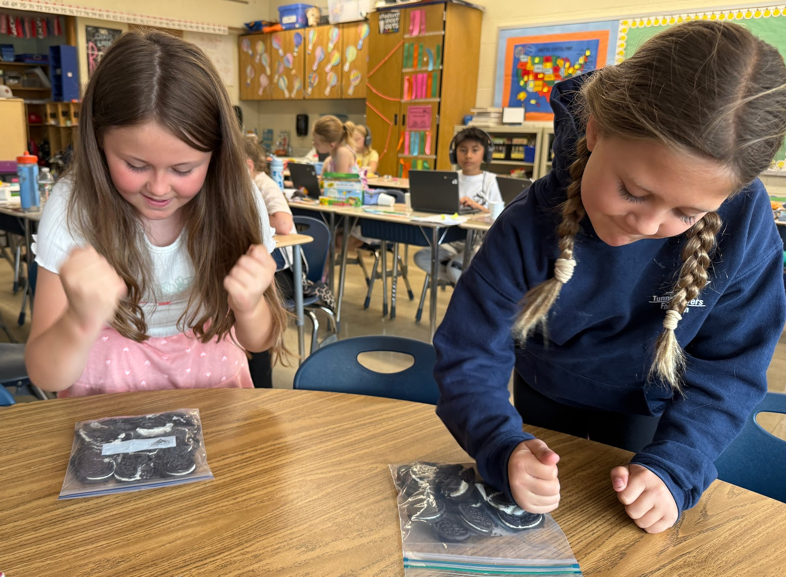
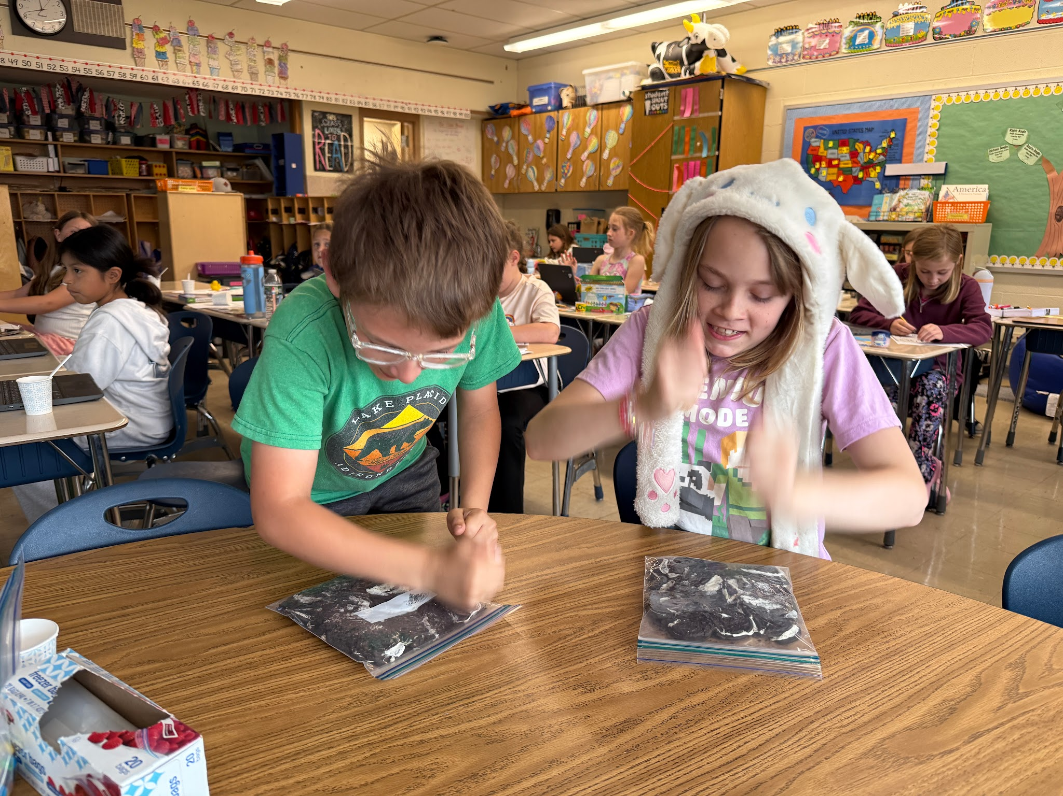
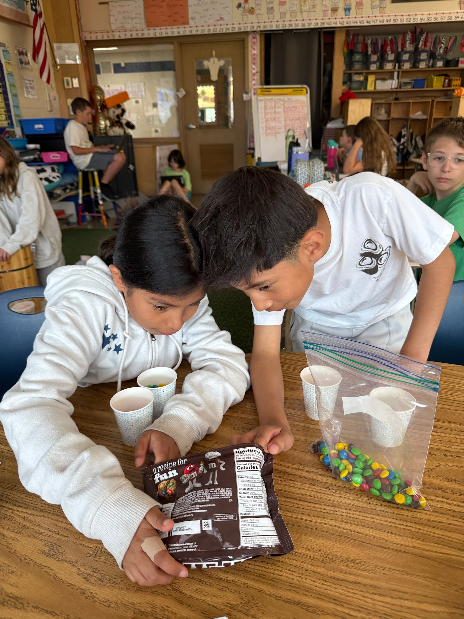
We crushed up Oreos to put in the ice cream to make it night time and the dirt road.
We took all the orange M&MS
To put in it for pumpkins!

Slide 14
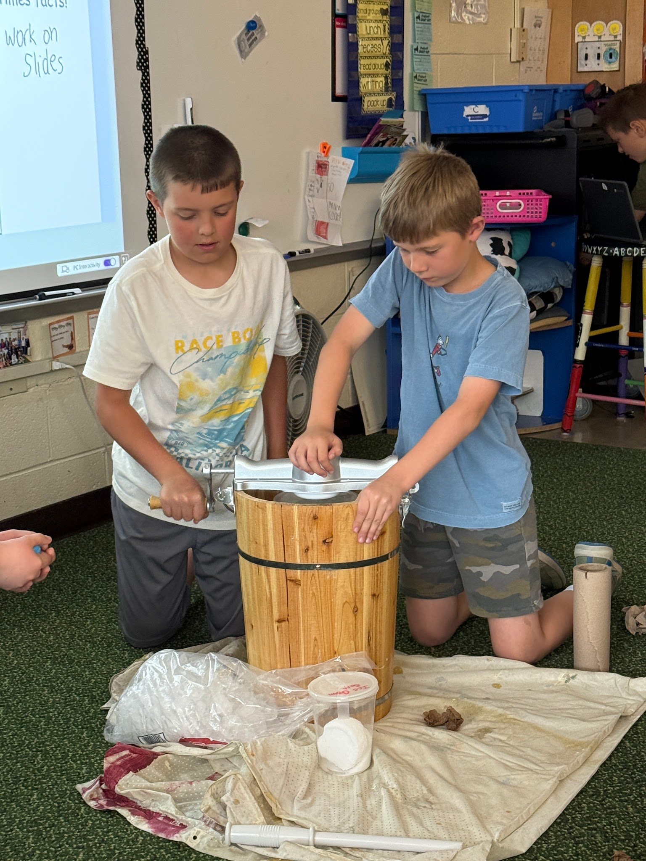
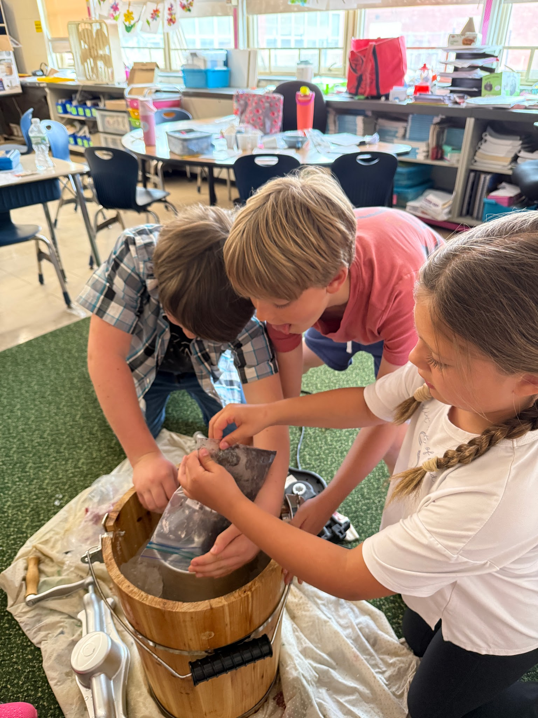
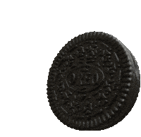
We put toppings on like crushed oreos.The Oreos made the blue food coloring not show up, so we took it out of our recipe. We were disappointed, but it looked like night time!
The ice cream was great! HOORAY!

Slide 15
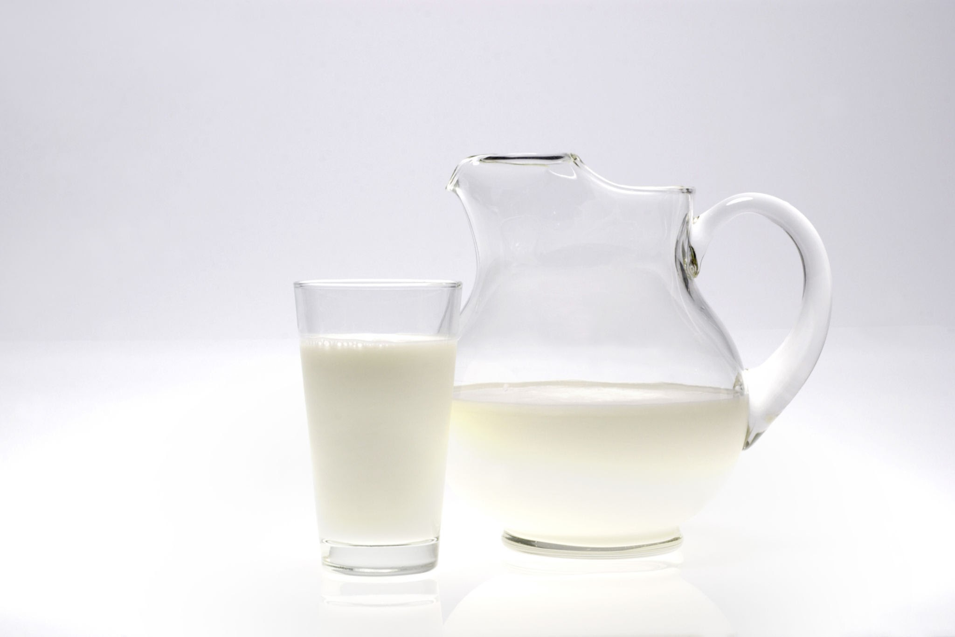
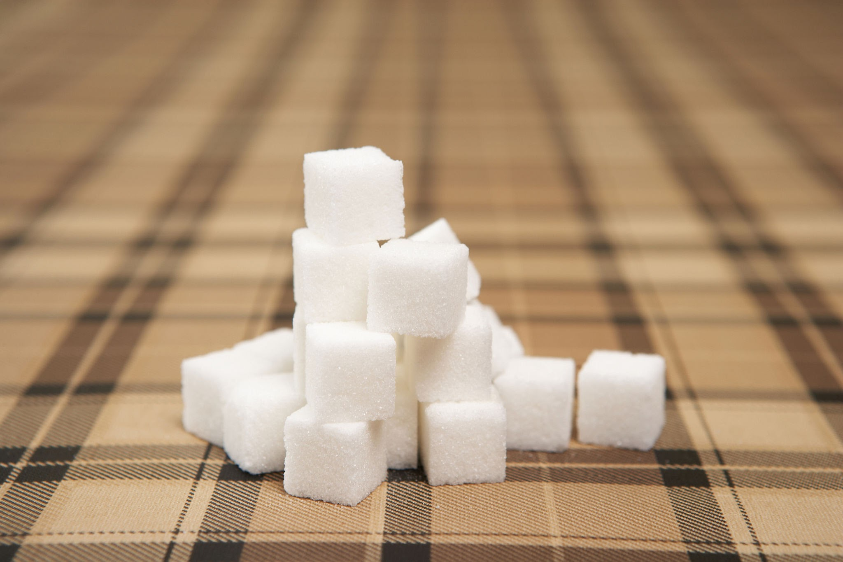
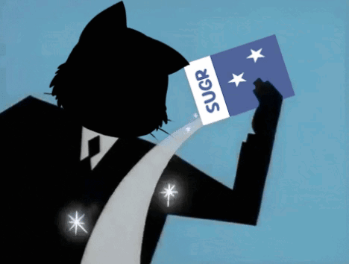
Ingredients
Base Vanilla ice cream
4 cups milk
3 cups half and half
5 cups heavy whipping cream
3 cups sugar
2 tablespoons vanilla extract
1 half teaspoon salt
Makes approximately 3.5 quarts
Toppings
1 package of Oreos
3 cups mini marshmallows
½ cup blue sprinkles
½ cup orange M&Ms
For ice cream machine
2 bags of ice
1 pound rock salt

Slide 16


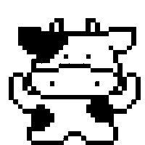
Directions
Pour the milk, half and half and heavy whipping cream into a pan
Bring slowly up to boiling point but DO NOT LET IT BOIL!!!!!!!!!!!
While it is heating, ad sugar, salt and vanilla extract.
Allow this to cook for 15 minutes.
Remove from heat and chill mixture in refrigerator overnight.
Pour mixture into canister of ice cream maker, put lid and crank handle on
Add most of ice and salt to outside barrel, add more as necessary
Turn the ice cream machine handle until the mixture starts to solidify
In 15-20 minutes pour in crushed oreos, continue stirring
Once mixture is ice cream consistency, remove from maker and add sprinkles, marshmallows, and M&Ms

Slide 17






.
We are eating the ice cream
It's so yummy this is the one we made in the ice cream machine it is a lot more smooth and less soupy than the bag type.
SO GOOD
AND SOFT!

Slide 18



ICHABOD CRANE
Ichabod Crane is the name of our school. We made this ice cream about Ichabod to represent our school! We added mix ins for yumminess and each mix in says a part of the story! Our school is in Kinderhook which is where Jesse Merwin taught! He looked like Ichabod Crane. Then Washington Irving made the book Sleepy Hollow based off of Jesse Merwin!

Slide 19


We put orange M&MS on the top because in the story SLEEPY HOLLOW the Headless Horseman throws a pumpkin at Ichabod! And the M&MS look like pumpkins !

Slide 20



WE also put oreos in it to be the dirt road Ichabod ran on! Also for it to be night time! The Headless Horseman was chasing Ichabod on the dirt road at night!

Slide 21


The marshmallows are the ghosts Ichabod is imagining. When Ichabod was walking through the forest he was imagining that there were ghosts following him and watching him!

Slide 22








SLEEPY HOLLOW SCOOP
We got the name SLEEPY HOLLOW SCOOP because Sleepy Hollow is where The Legend of Sleepy Hollow takes place,plus,we love the story! And of course,we found the word scoop to represent ice Cream. We got the ideas for the name from our school name Ichabod Crane Central and The Legend Of sleepy Hollow.

Slide 23




Sleepy Hollow Scoop will give you a spook!
.

