Slide 1


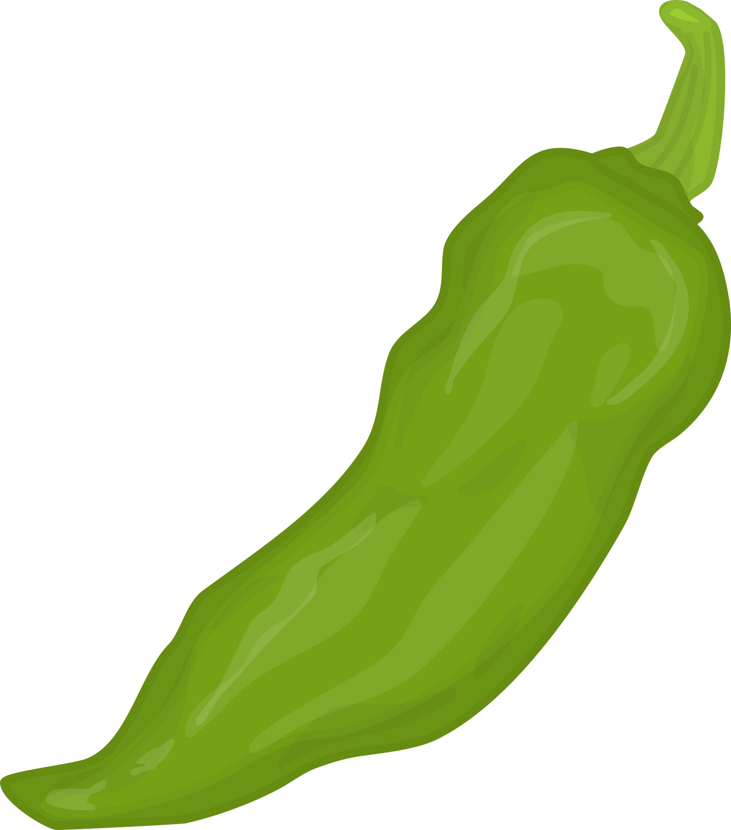





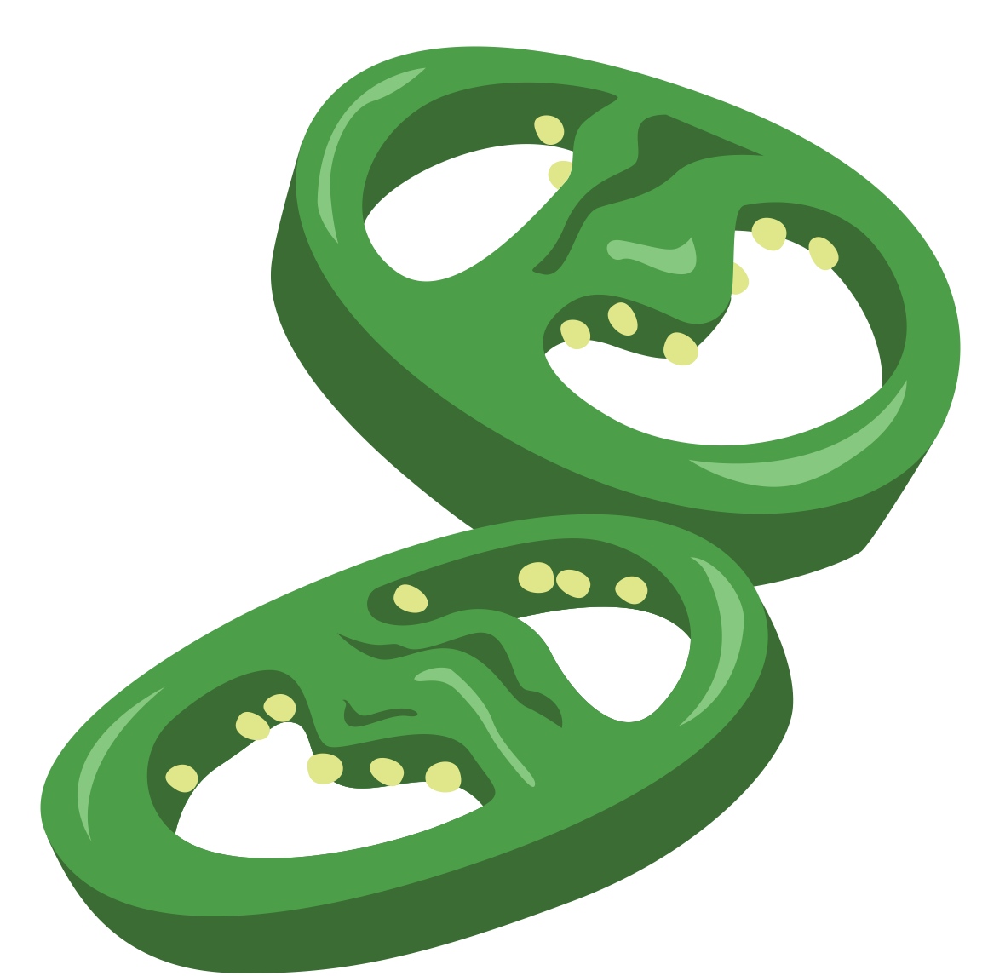

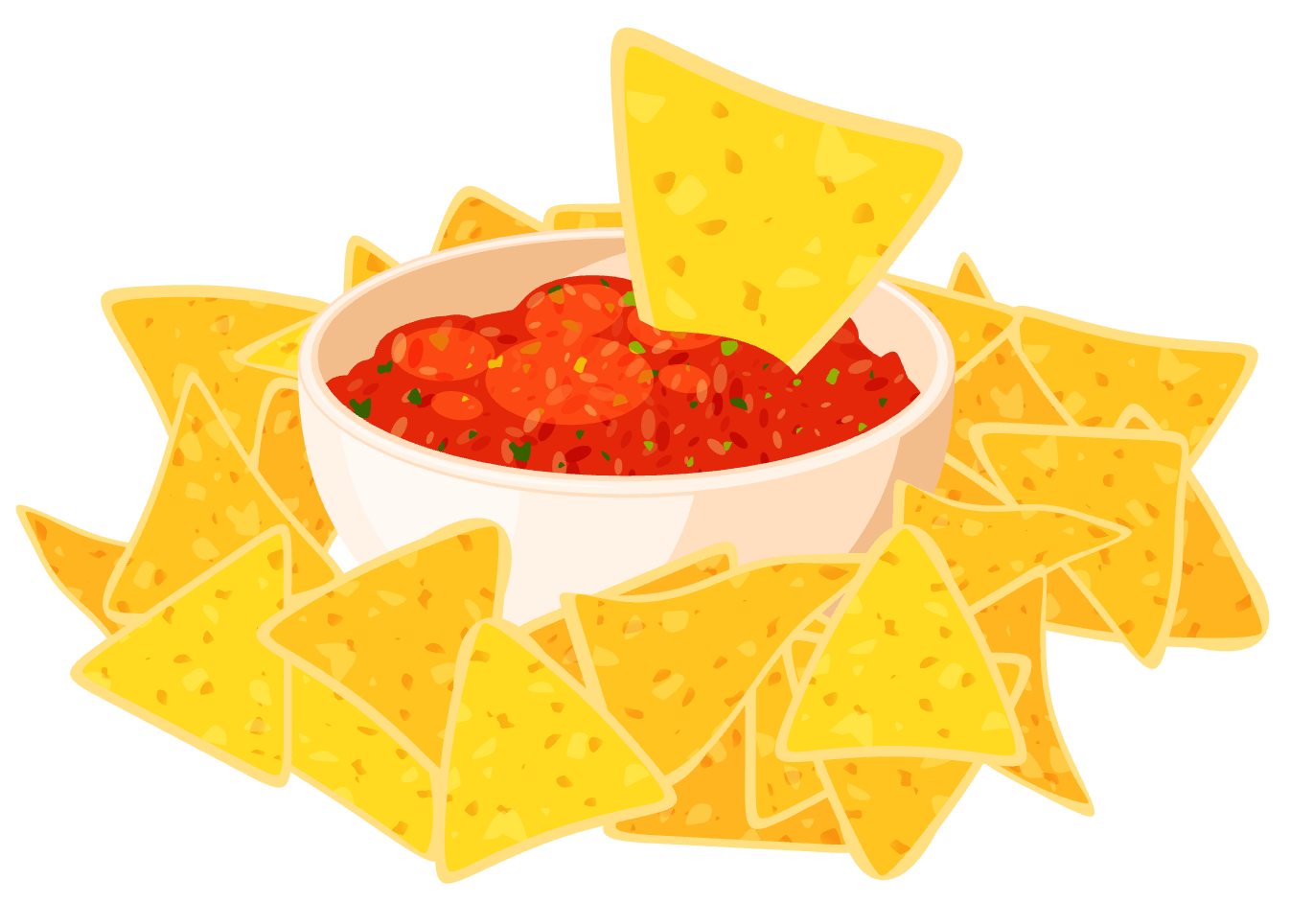

www.nmaitc.org
Seeds to Salsa
The NM Chile Ag Magazine
Agricultural Literacy Project

Slide 2





Part 1
Introduce and promote
Who are we and why are we here?
Introduce presenters and promote FFA/4-H/other
Show off items to gain interest and attention
(Ex.pictures, projects, something you are proud of)
Share YOUR experience and WHY they should join when they’re old enough.

Slide 3


Part 1
What is Agriculture?
A G R I C U L T U R E
IT’S A BIG WORD.
What does it mean?
Any good guesses?

Slide 4
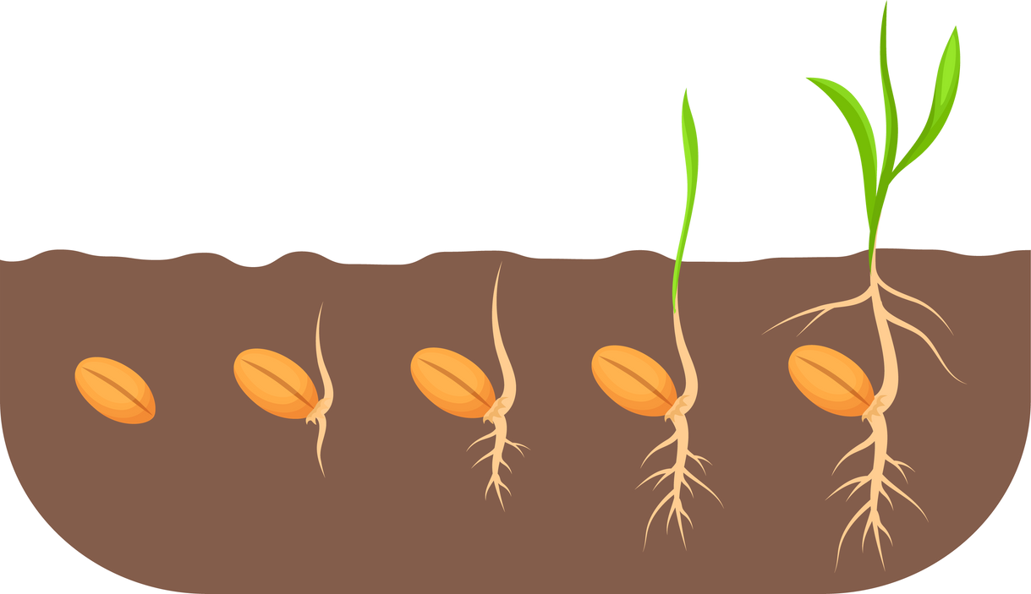
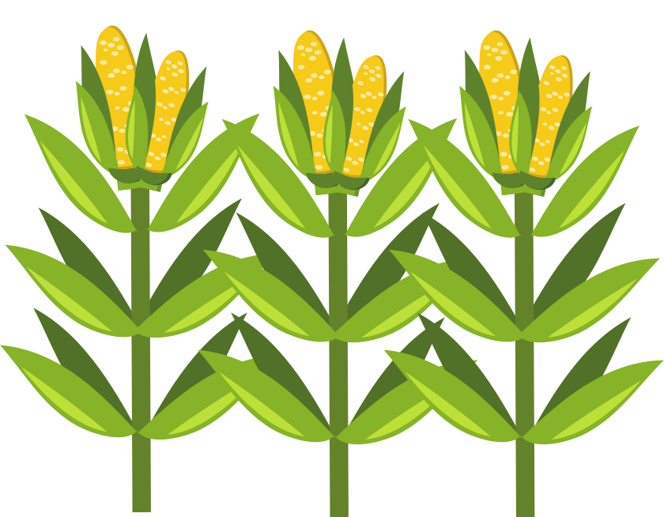
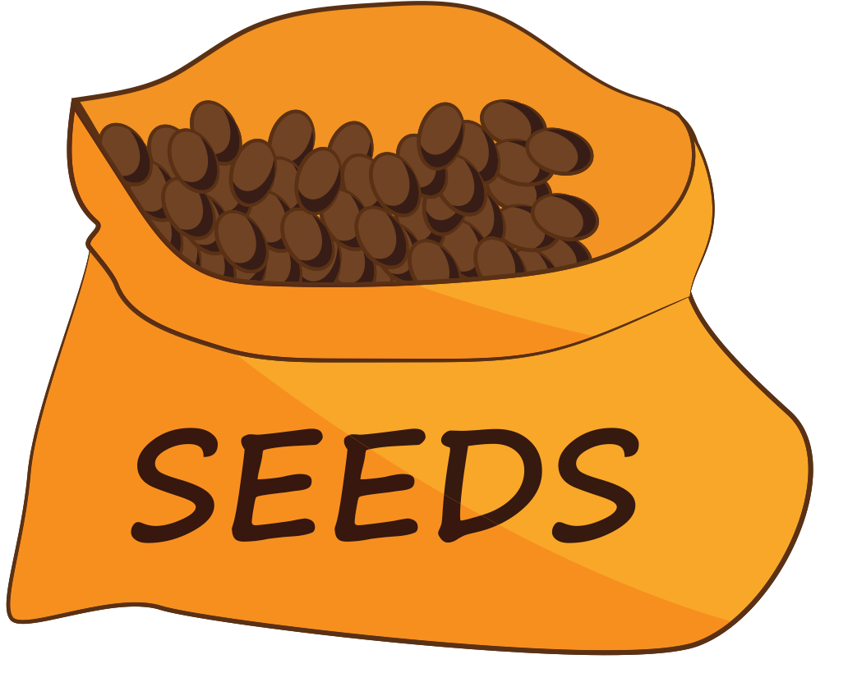
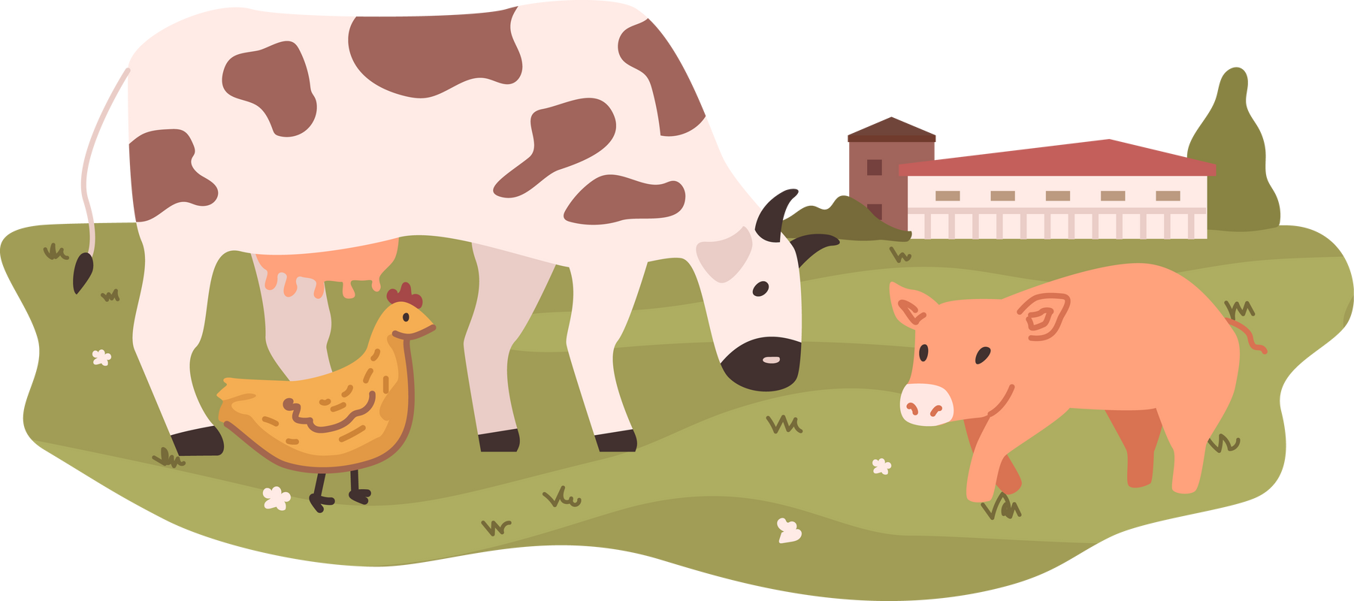
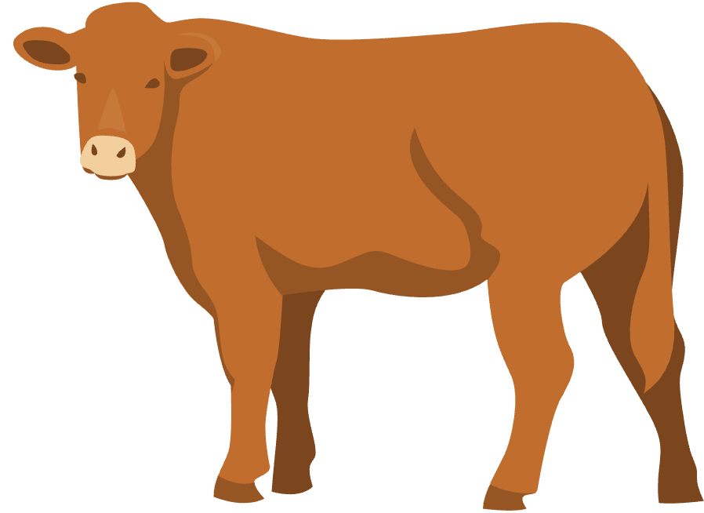
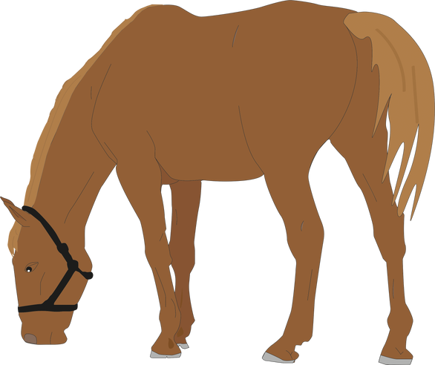
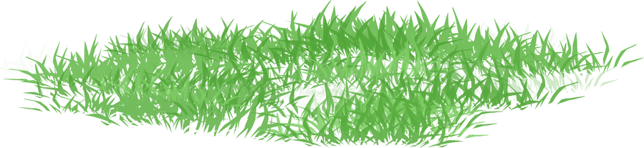
Part 1
What is Agriculture?
Agriculture is the growth and production of our PLANTS and ANIMALS.
Plants
Farmers call those CROPS.
Animals
Farmers and ranchers call them LIVESTOCK.
*Provide with a good or service.

Slide 5

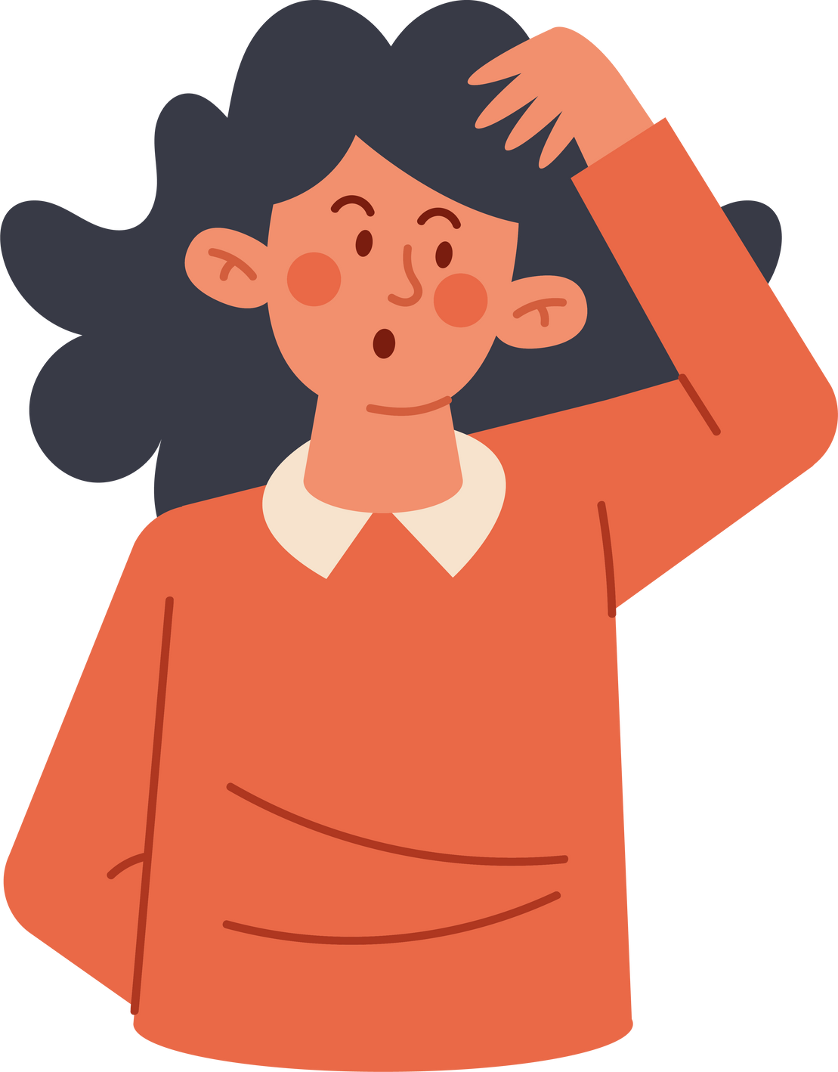
Part 1
What is Agriculture?
How do we use agriculture in our daily lives?
Let’s figure it out together!
Any good guesses?

Slide 6
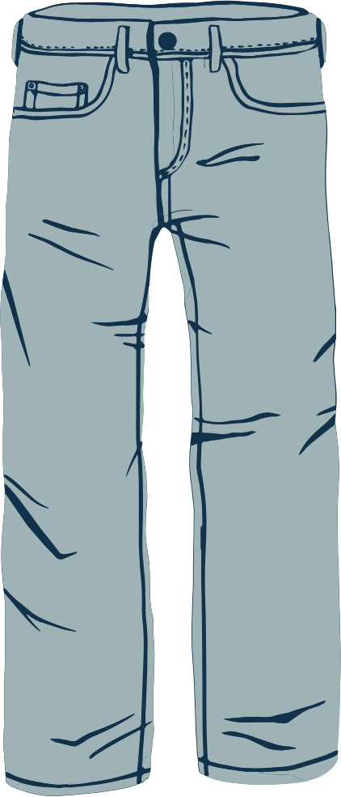


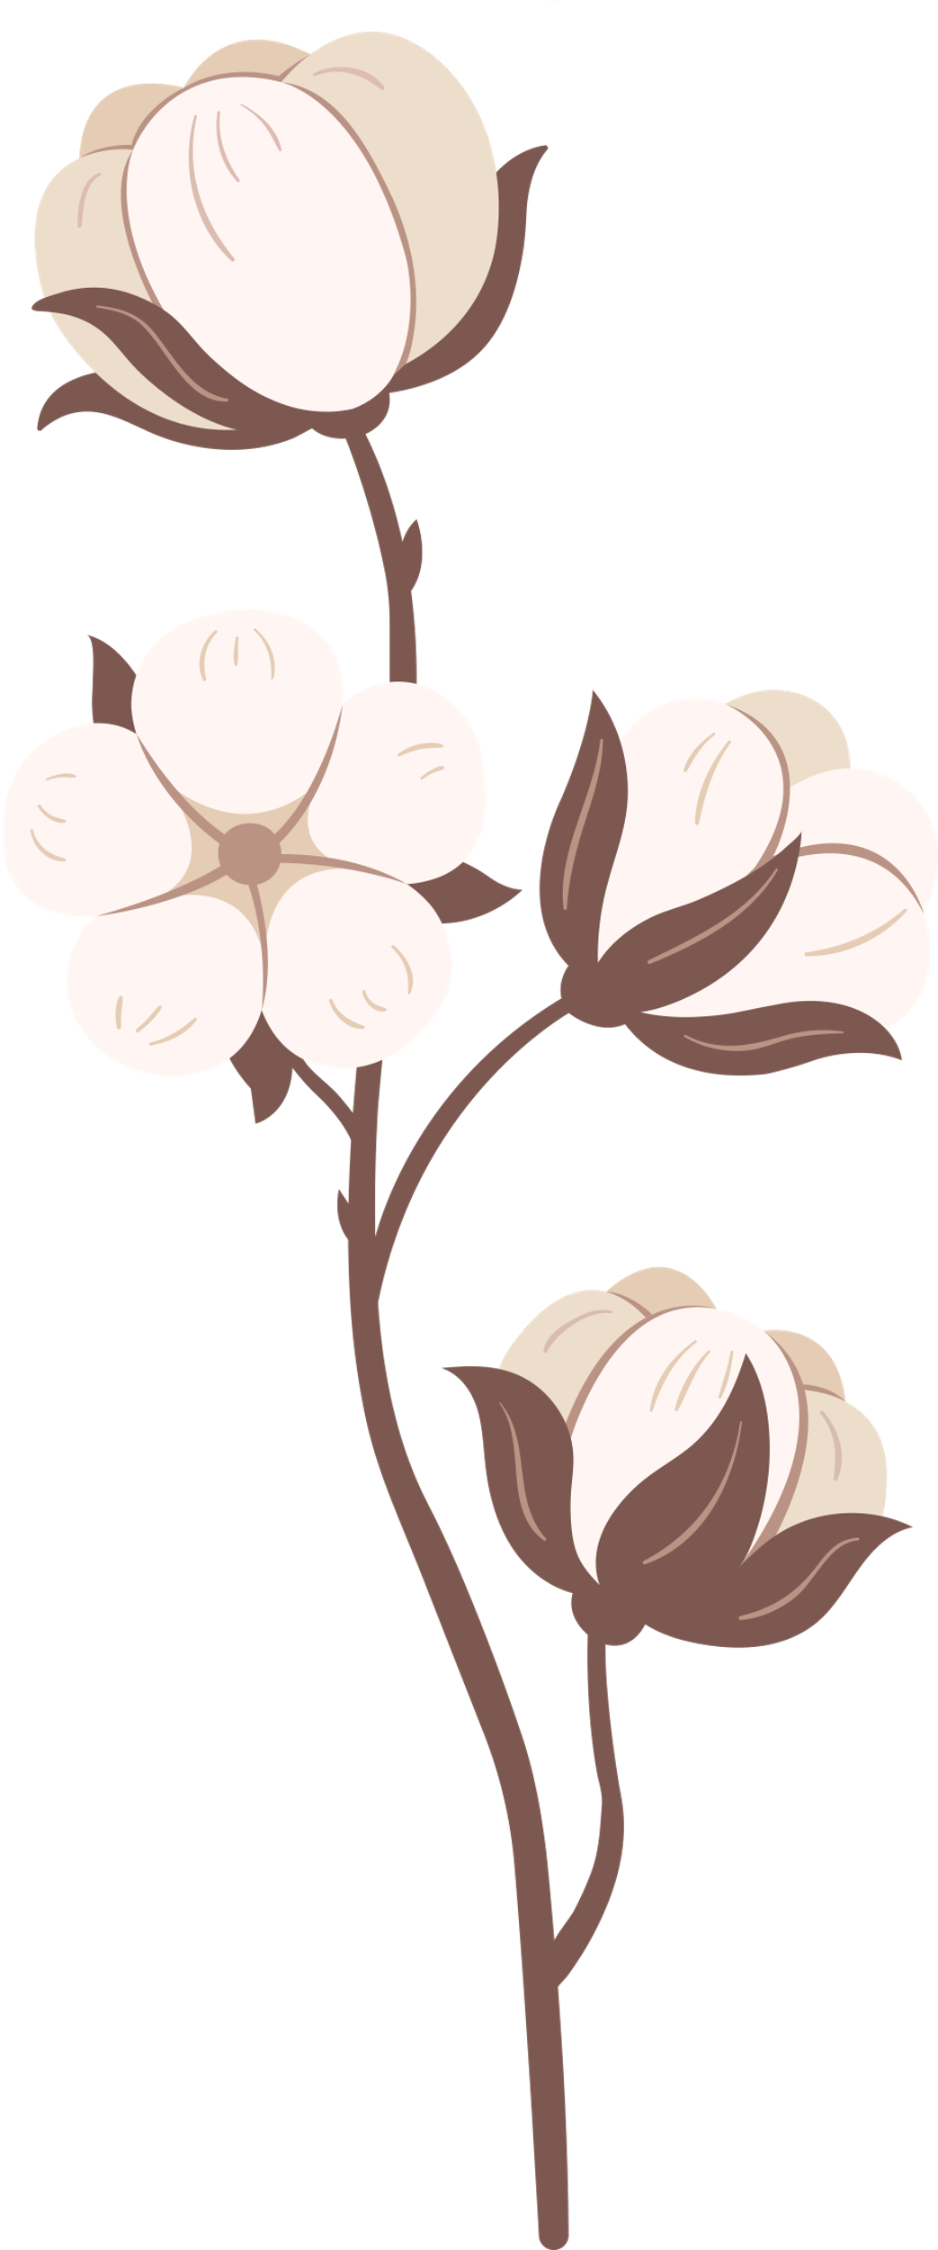
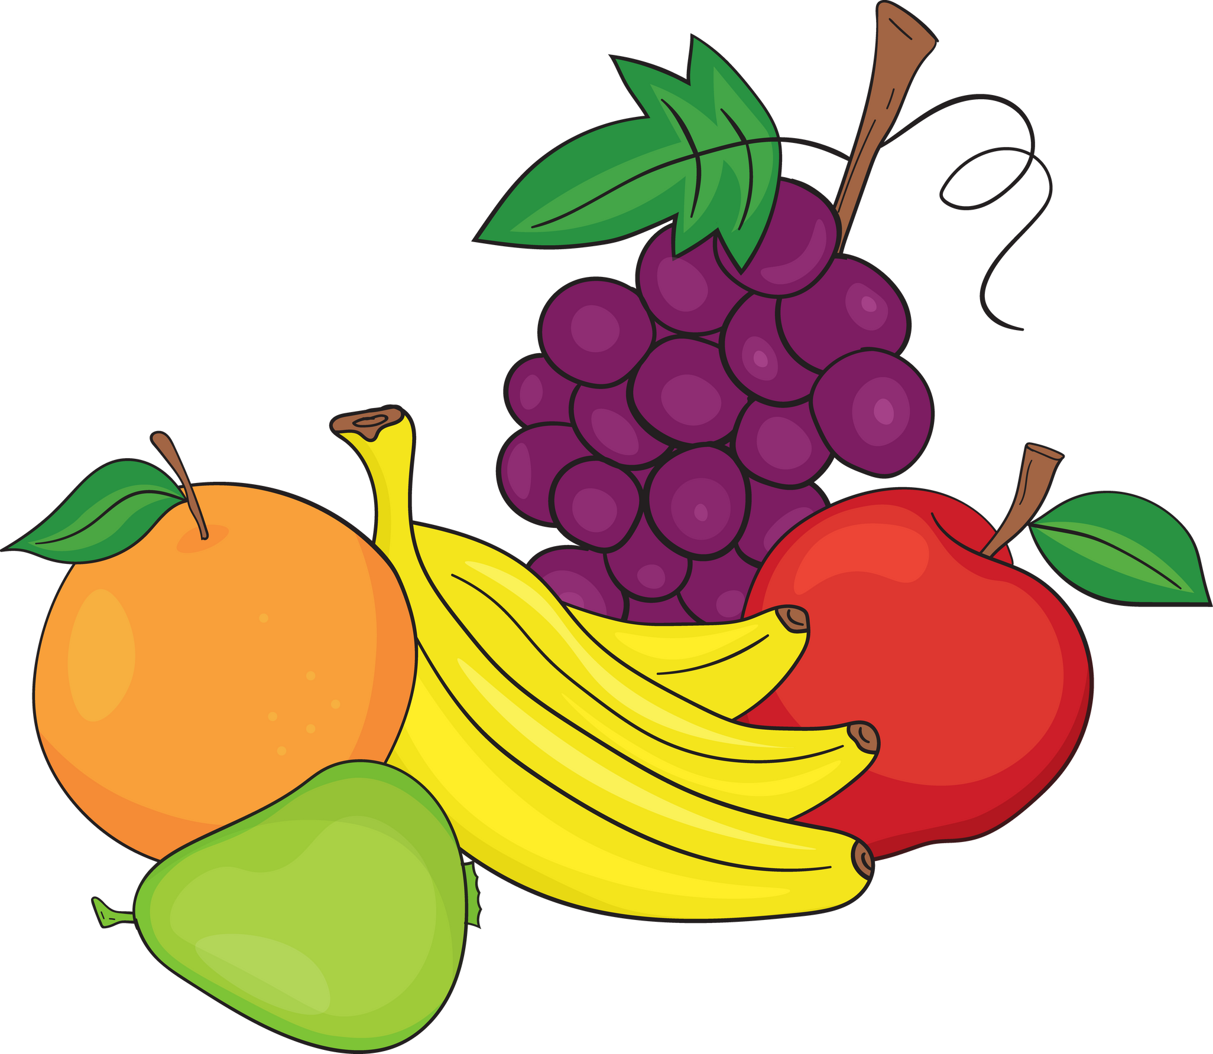


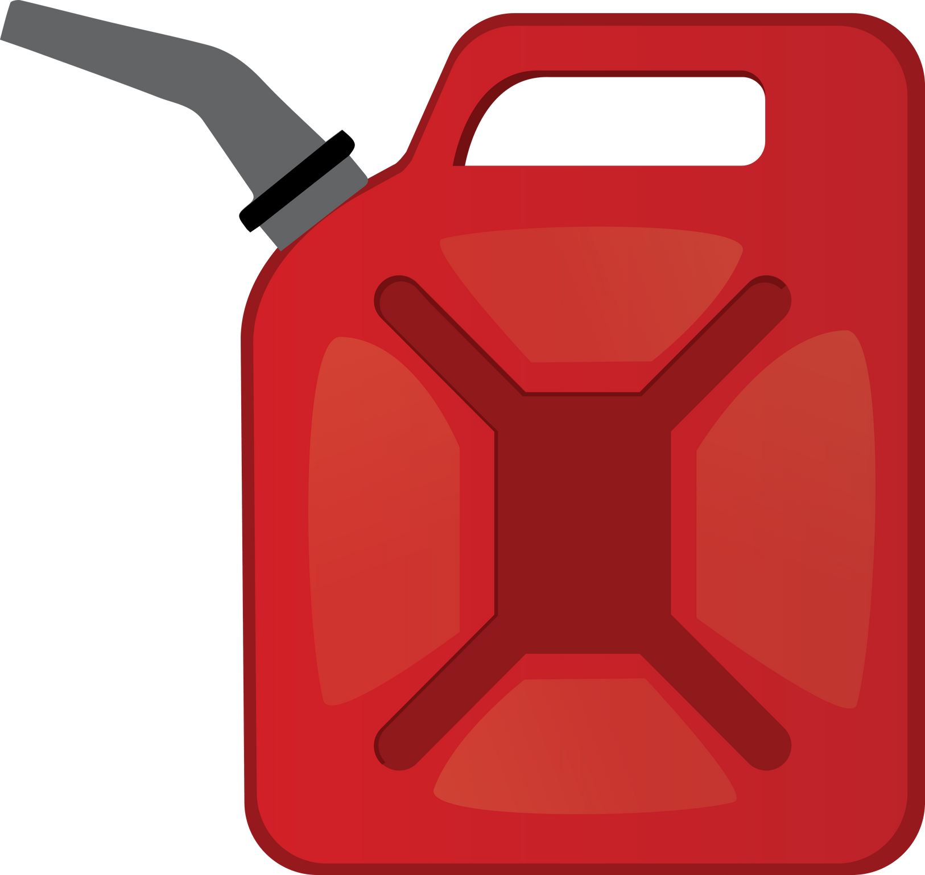

Part 1
Have you used agriculture today?
HINT: Did it come from a PLANT or an ANIMAL?
Have you had anything to eat today?
What are your clothes made of?
Do you see anything made from trees?
Have you ever had to take medicine?
How did you get to school today?
(Ex. bus, car, bike,etc.)
You use agriculture every day!

Slide 7

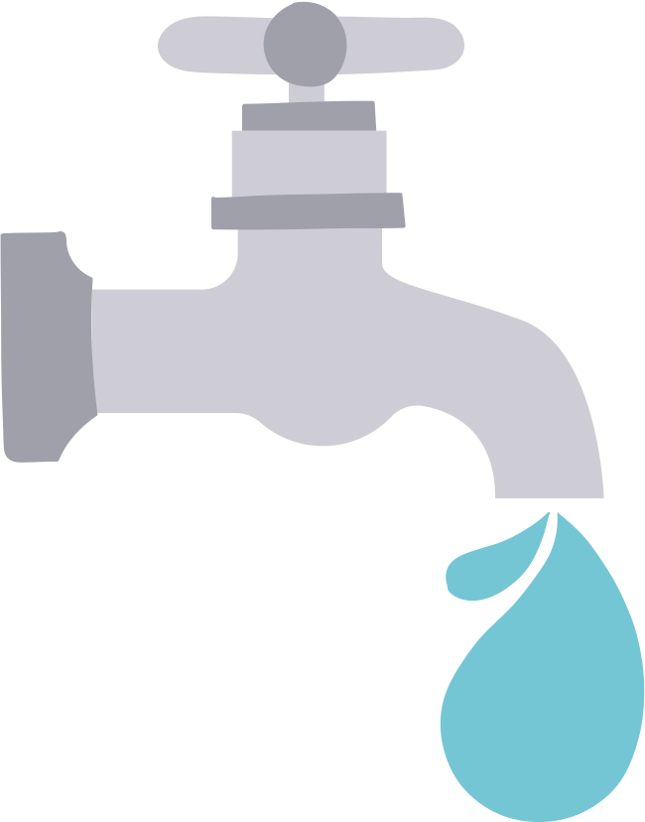

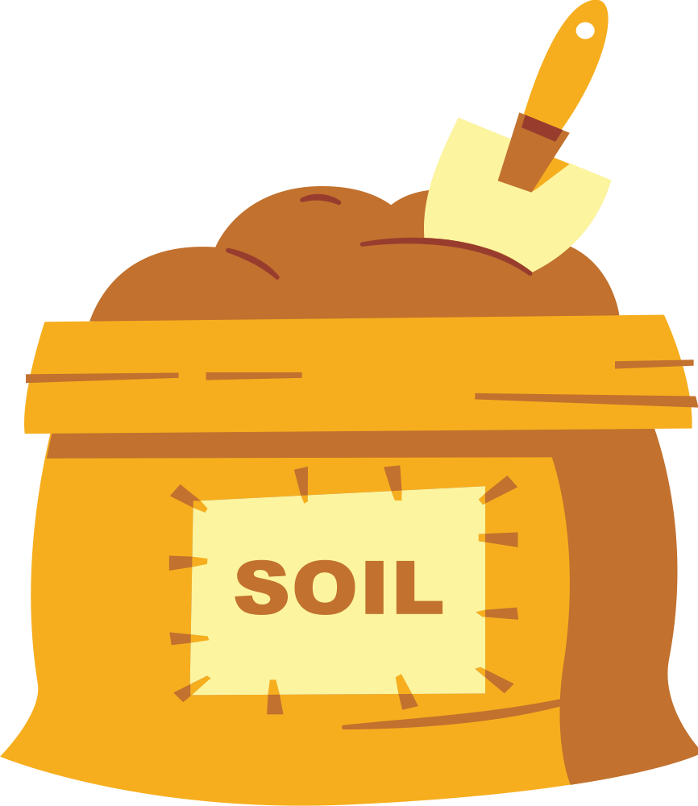


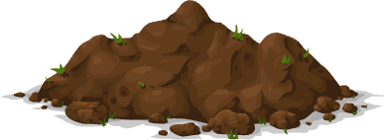

Part 2
What natural resources do plants need
to grow?
Why are each of these important for plants?

Slide 8
Part 2
What is a
fruit and what is a vegetable?
It’s important to know the difference.

Slide 9
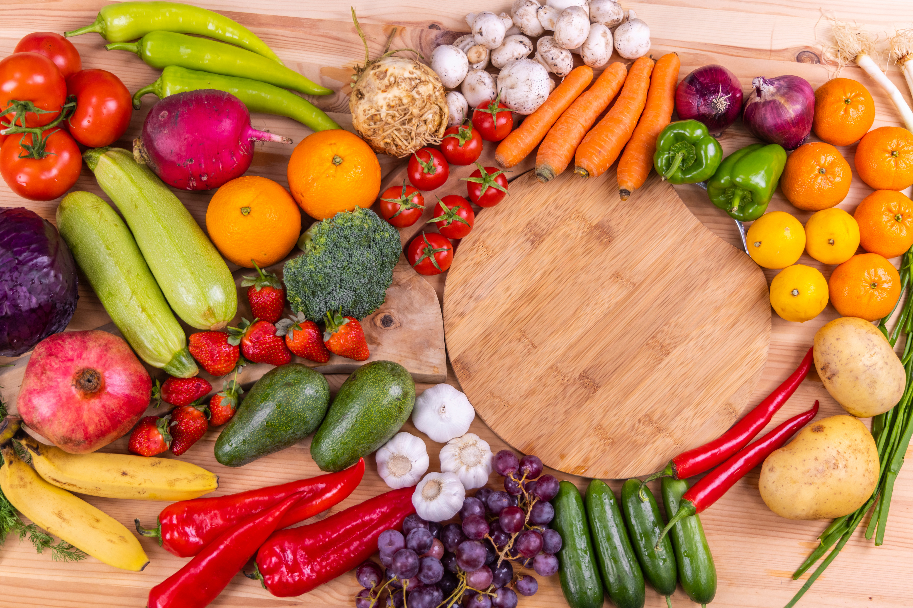
Part 2
When can we call it a fruit and when can we call it a vegetable?
What do YOU consider a fruit? What do YOU consider a vegetable?

Slide 10
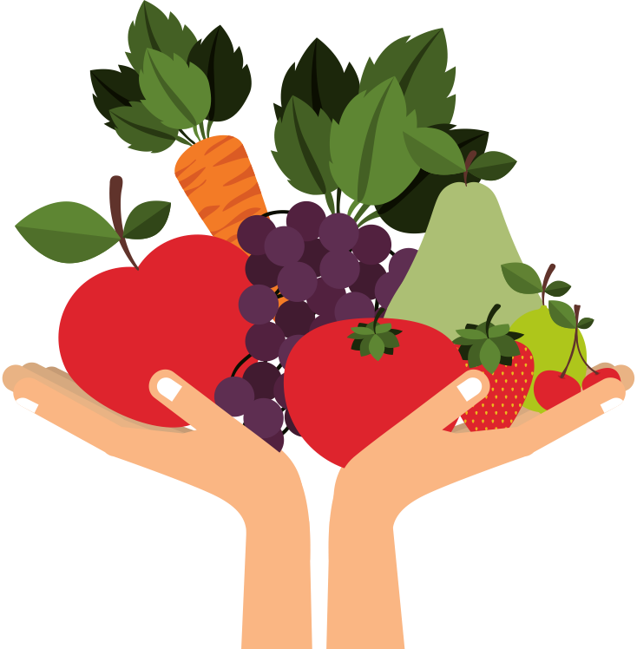
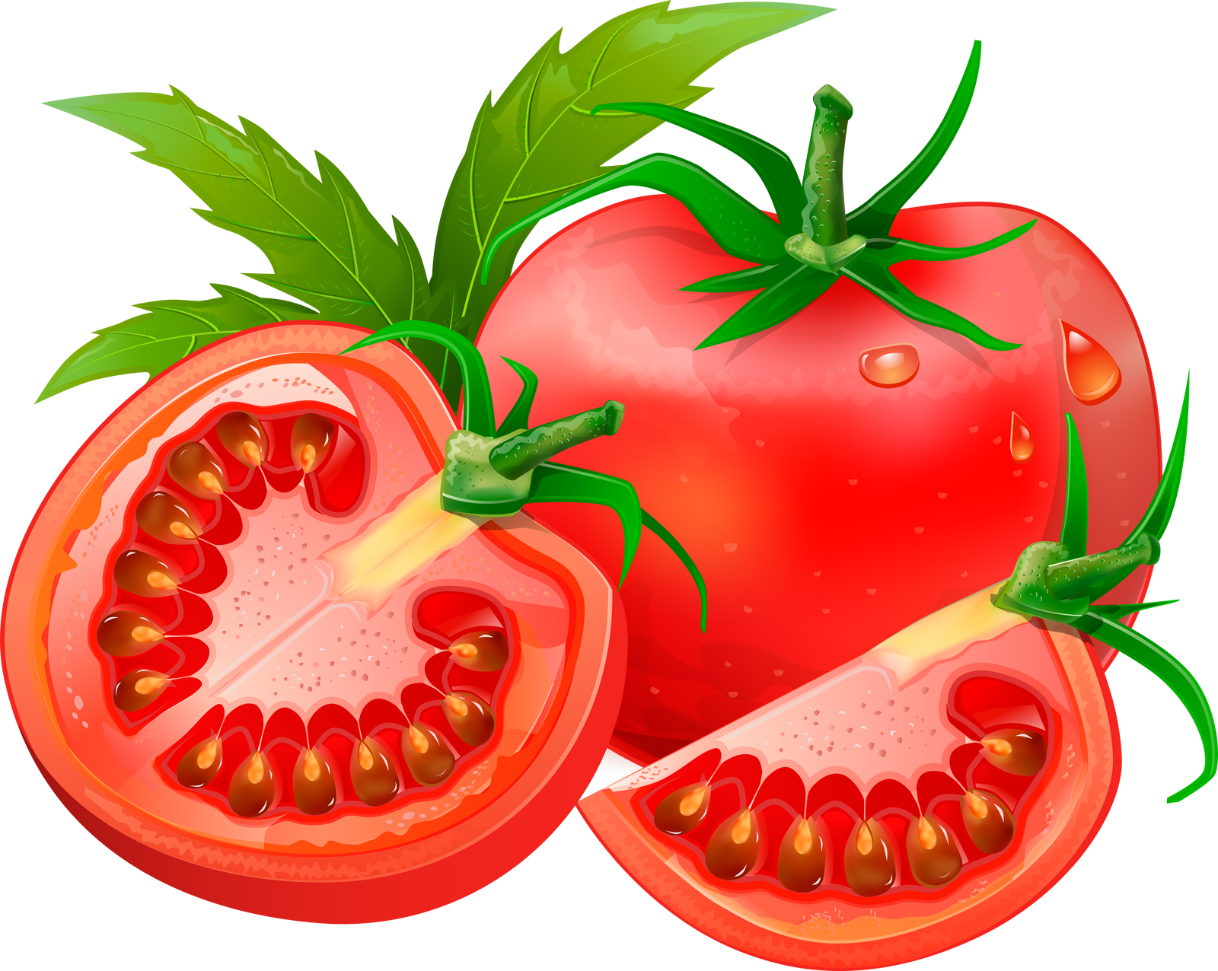
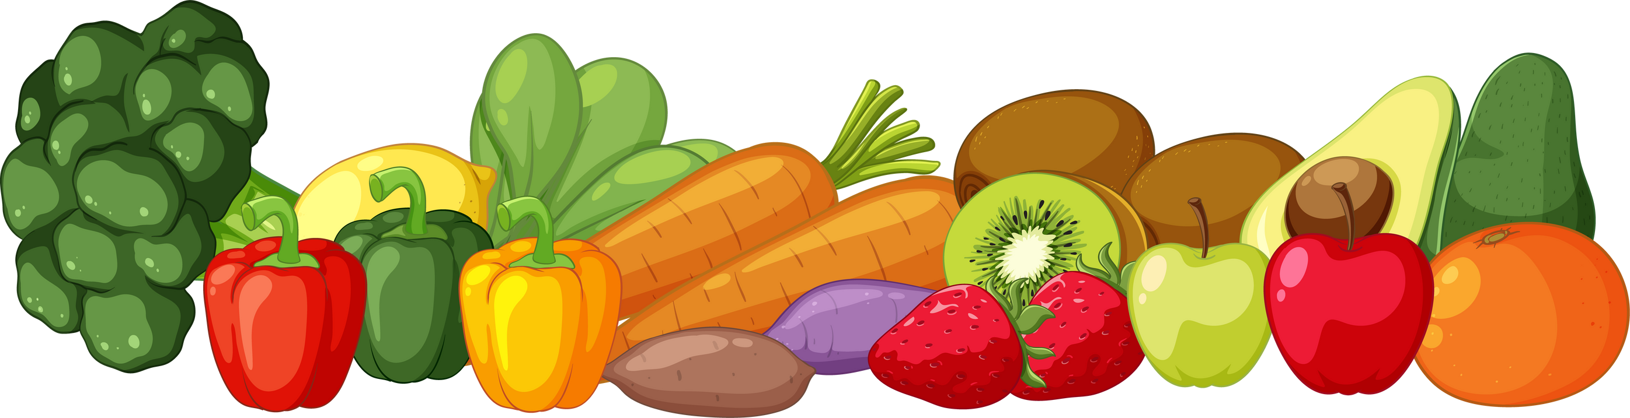


Botanical (PLANT) Definitions:
The fruit part of a flowering plant contains the seeds.
Ex.Chile peppers come from a flowering plant and contain the seeds so they CAN BE classified as a fruit.
Vegetables are the part of a plant that is edible.
Since we eat chile peppers, they CAN ALSO BE classified as a vegetable.
But there is more!
Part 2
Can you think of an example of a fruit that contains seeds and IS SWEET to eat?

Slide 11
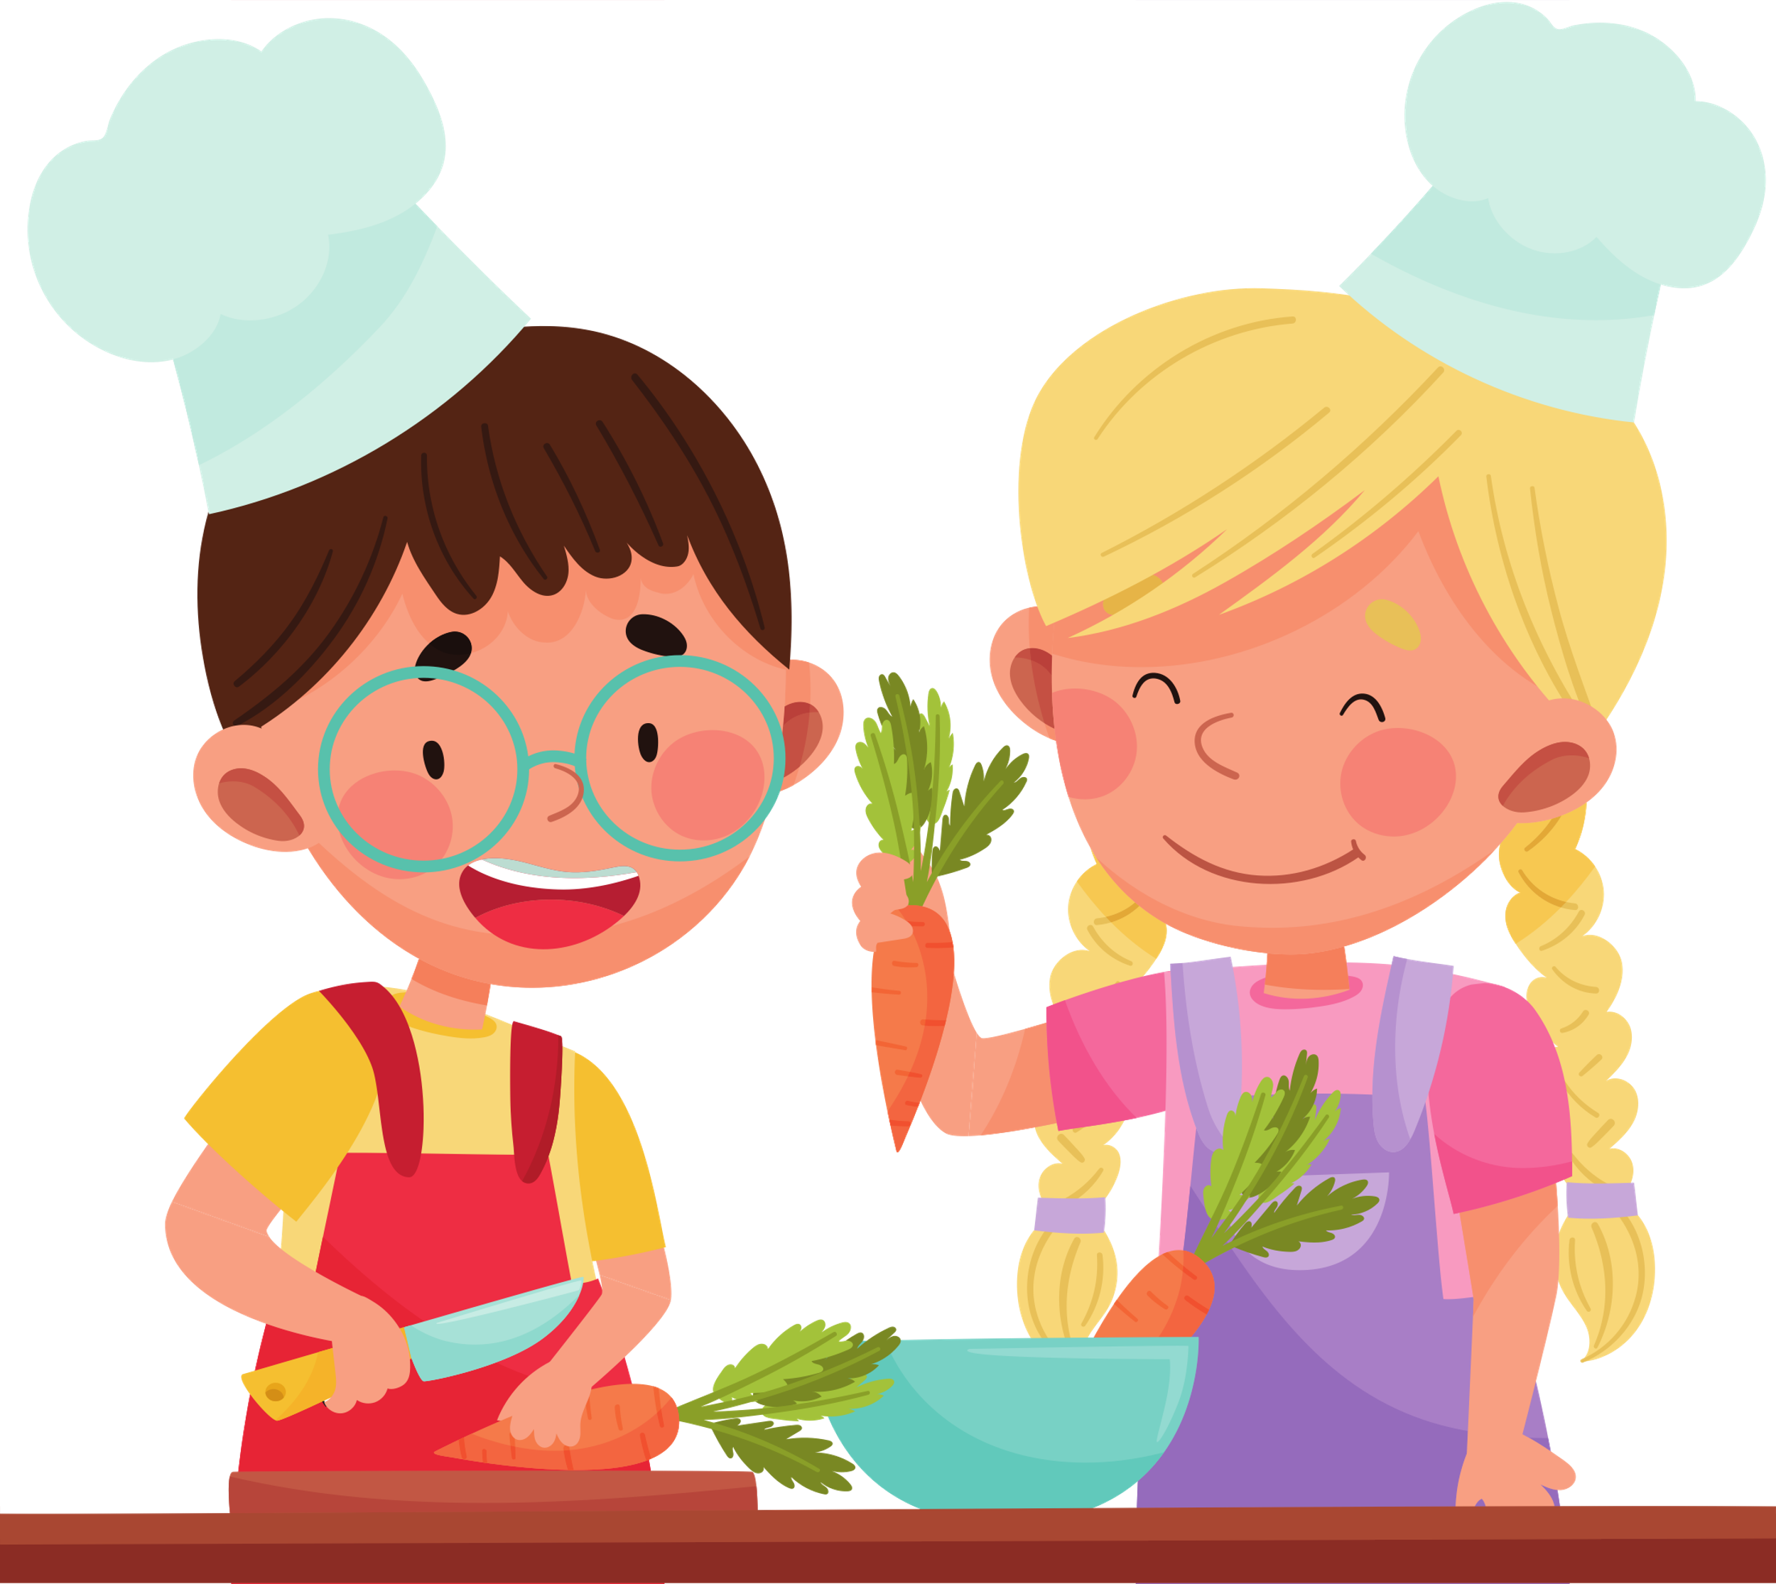
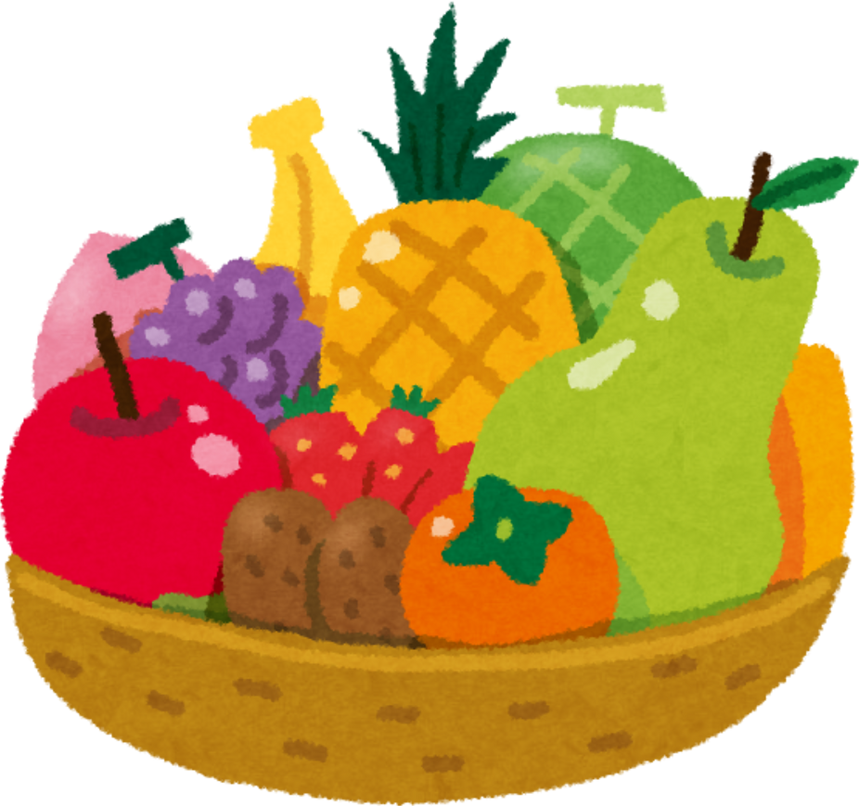
Part 2
Culinary (COOKING) Definition:
Fruit and vegetables are classified in cooking by HOW they are used. When cooking, fruits tend to be used in sweet dishes while vegetables tend to be used in savory or spicy dishes. Since chile peppers are often used in savory or spicy cooking, we could classify them, according to the culinary definition, as a vegetable.
Savory or
Spicy= vegetable
Sweet=fruit

Slide 12
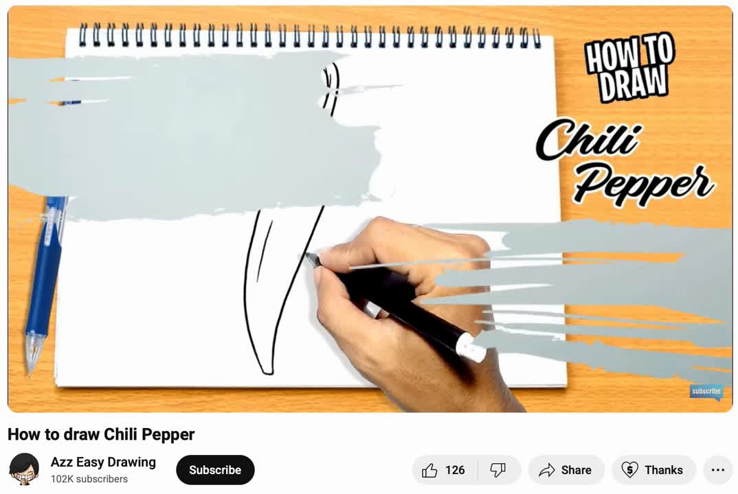
Quick
Draw
Break
Get out a piece of paper and a drawing utensil.
CONTEST!!! “Bragging rights for the best draw in the west!”
Follow Along - Draw a Chile Pepper

Slide 13
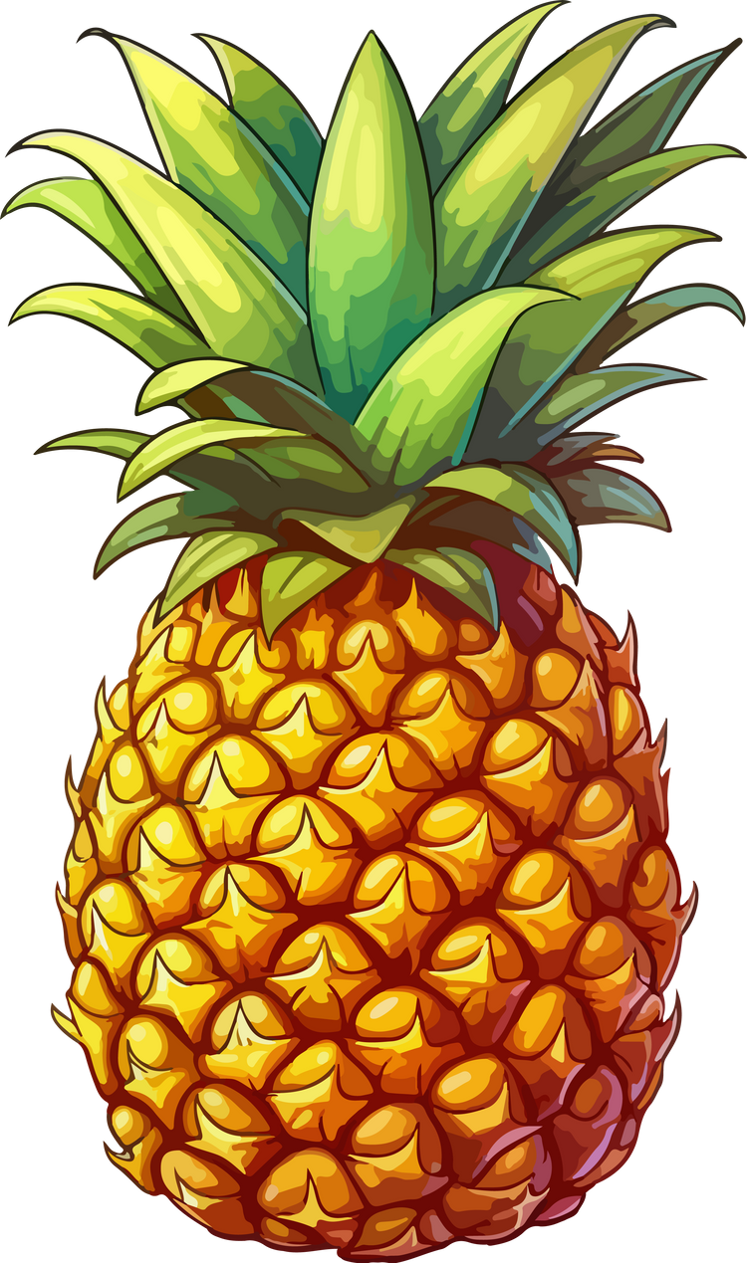
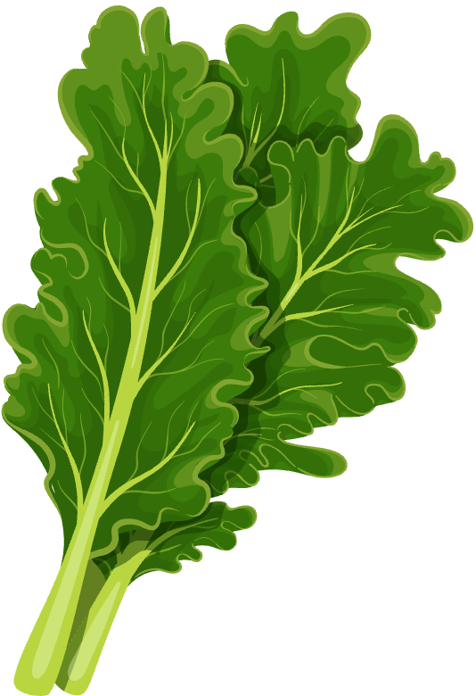
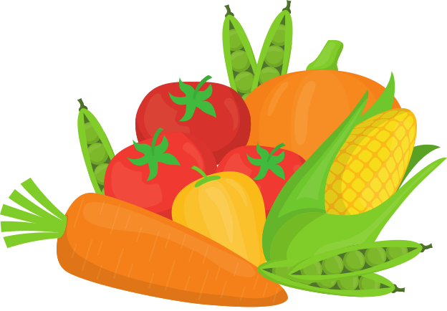

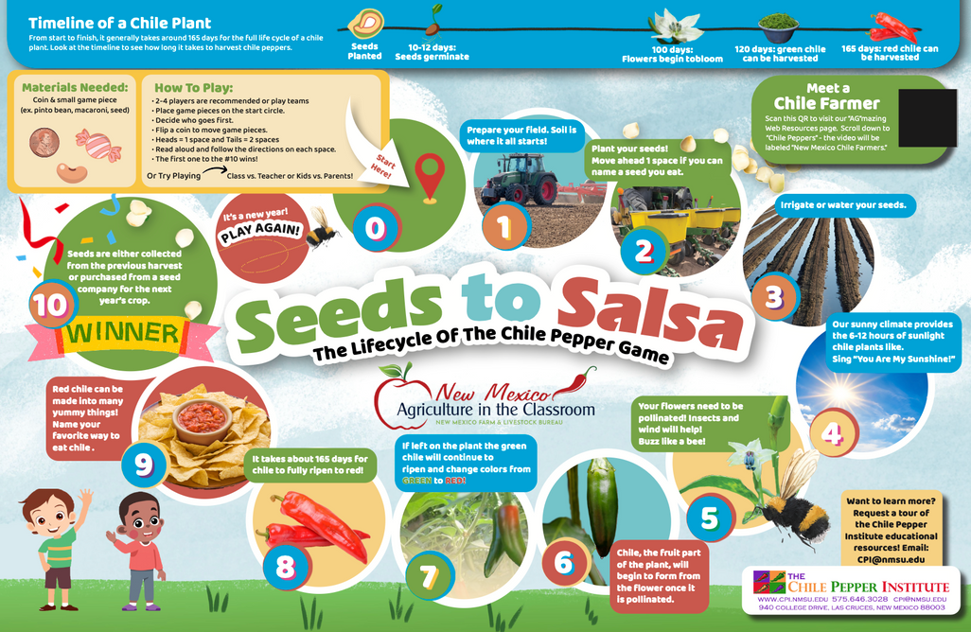


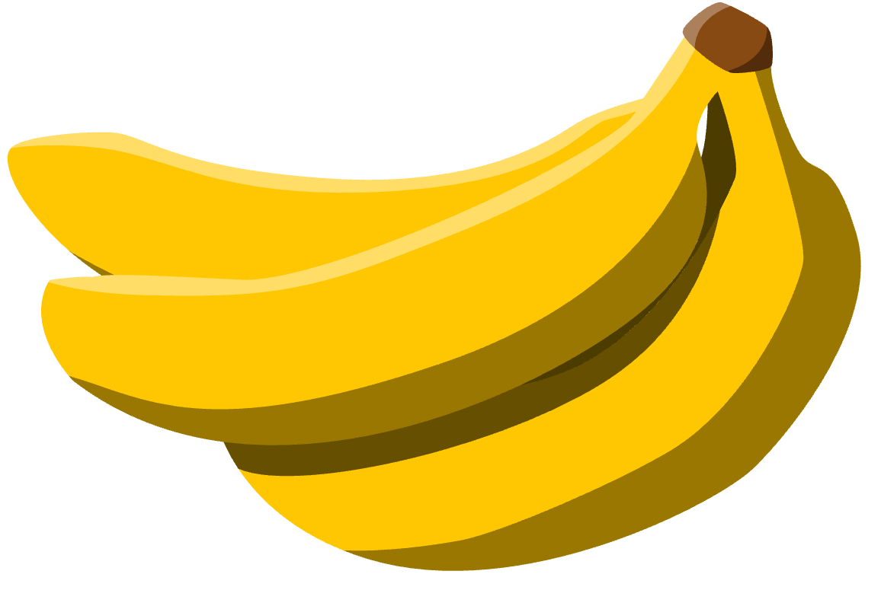
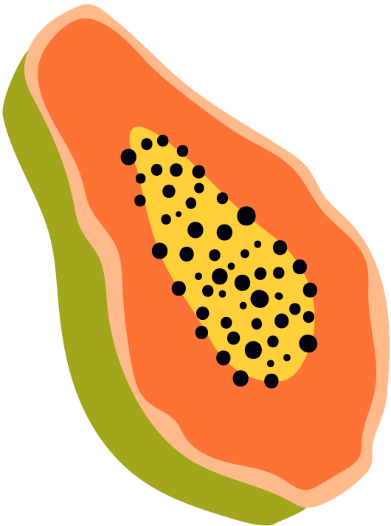
Part 3
time to Play
and read
Be respectful, and have your listening ears are ON.
K-2
Chile Game
Chile Bracelet

Slide 14
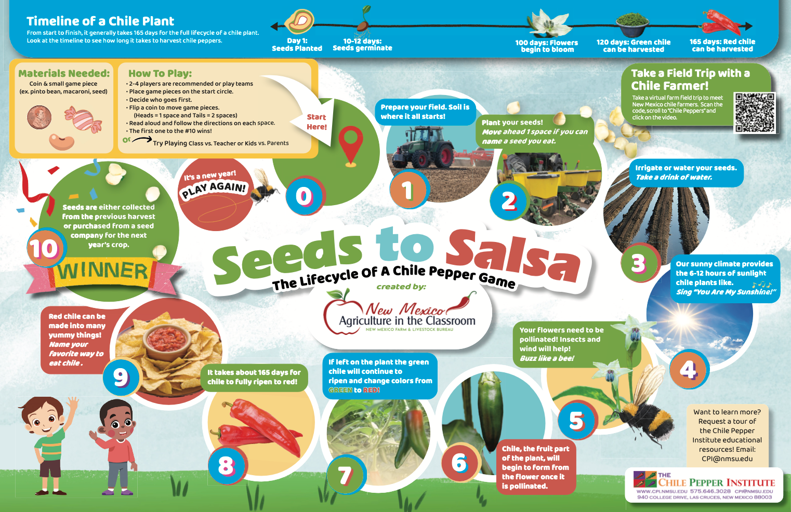

Slide 15
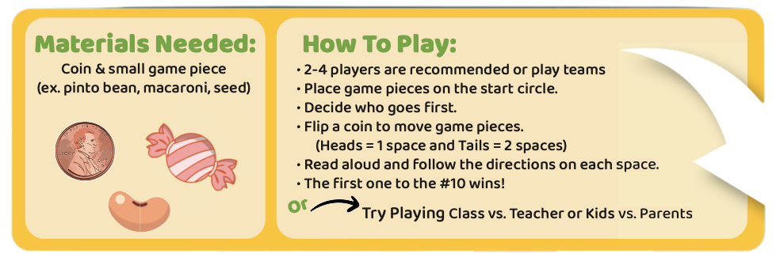


Slide 16
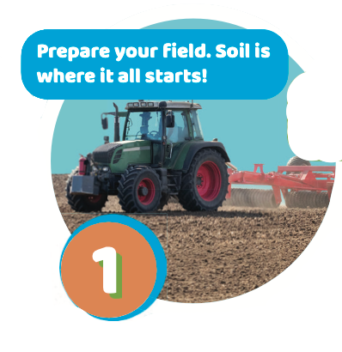

Slide 17
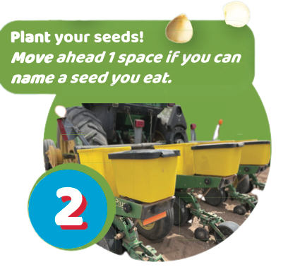

Slide 18
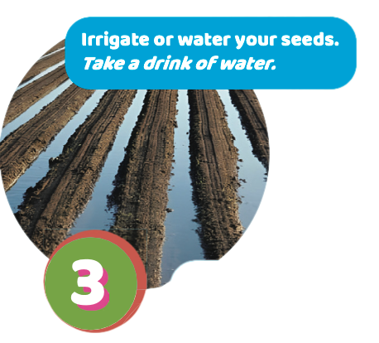

Slide 19
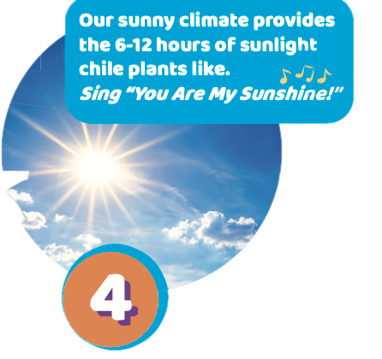

Slide 20
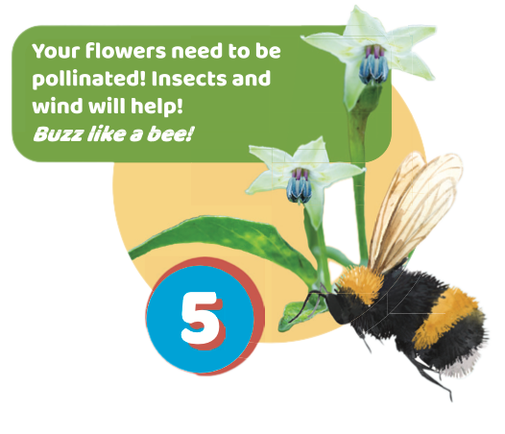

Slide 21
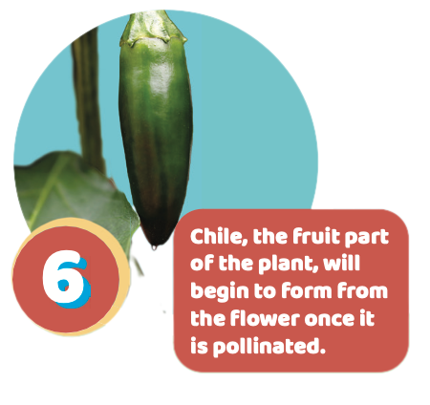

Slide 22
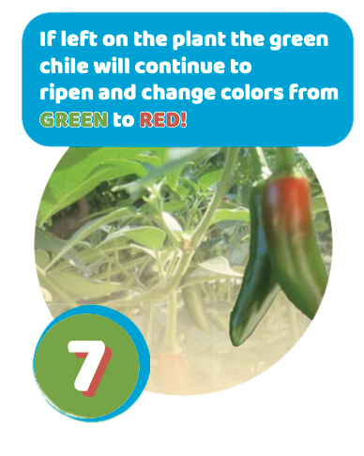

Slide 23
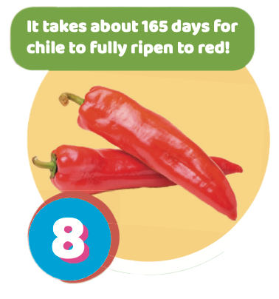

Slide 24
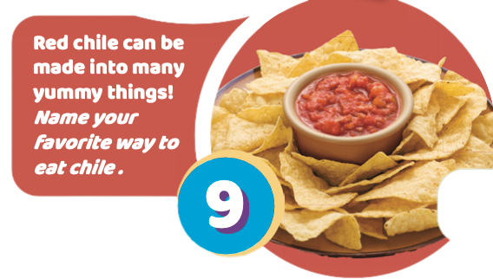

Slide 25
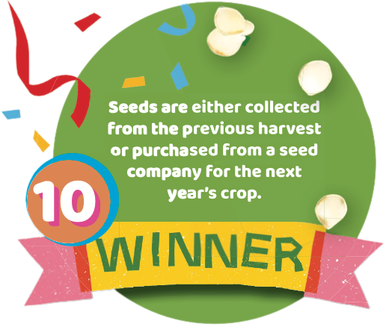

Slide 26
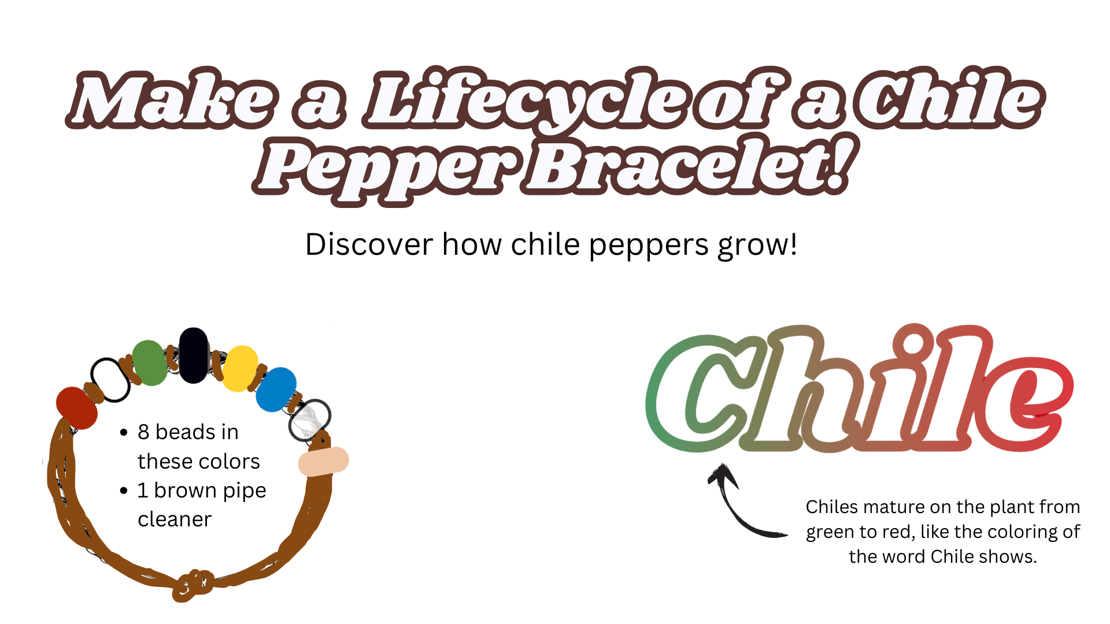

Slide 27
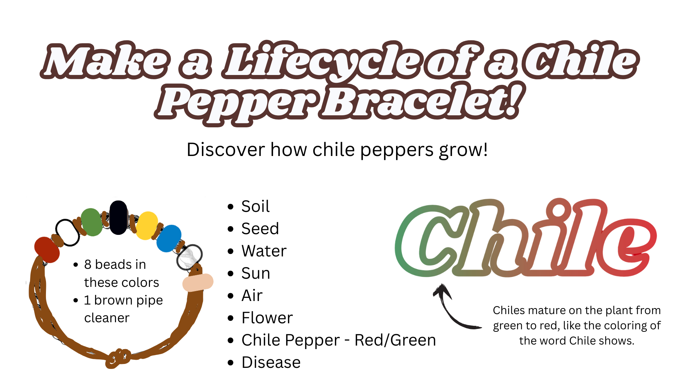

Slide 28
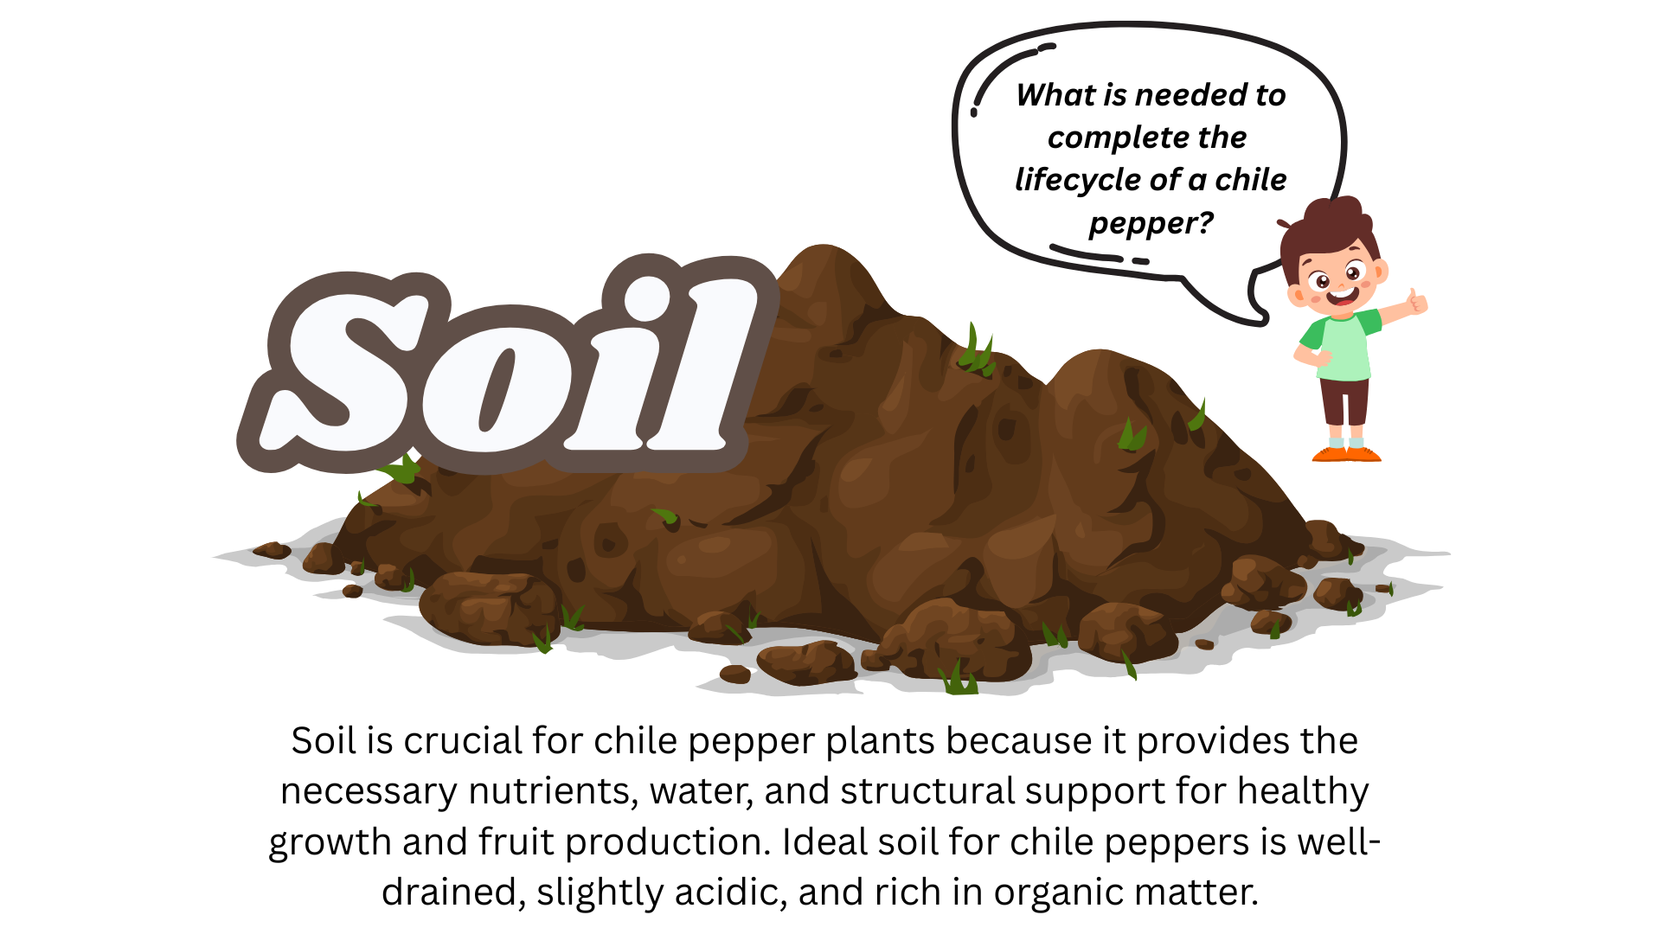

Slide 29
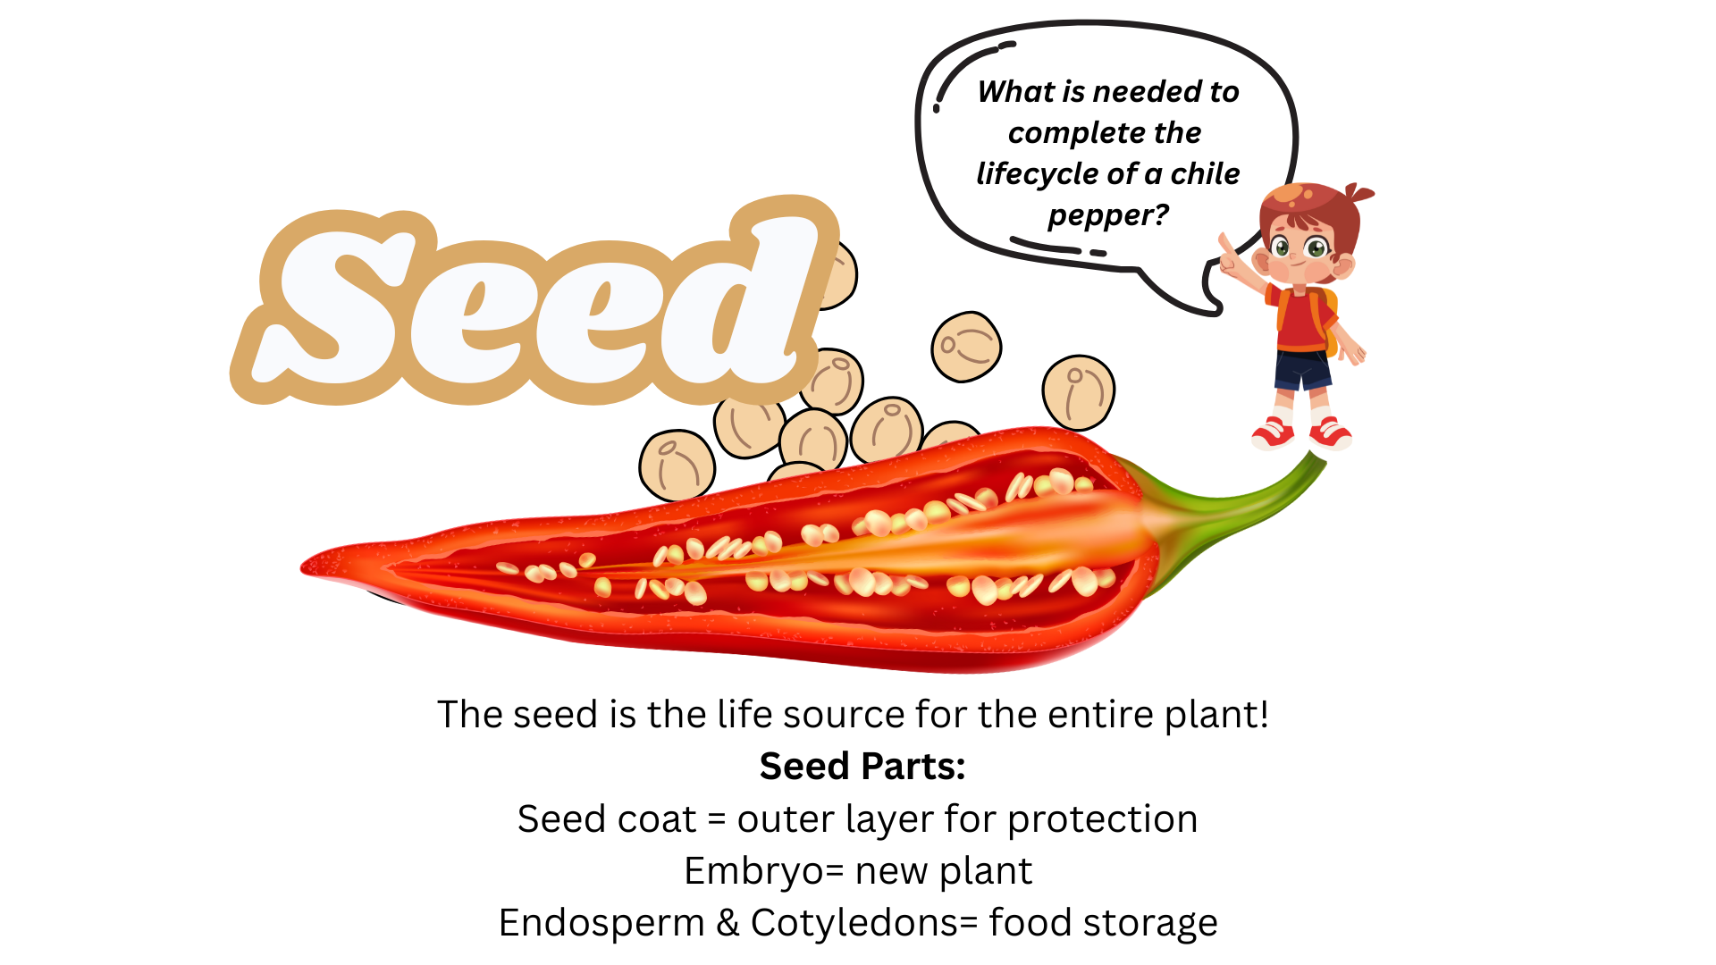

Slide 30
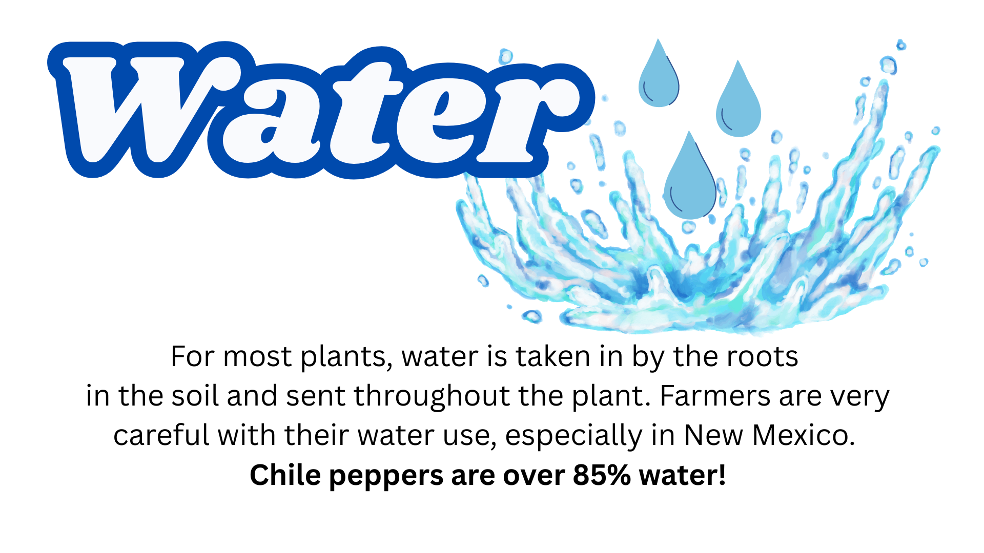

Slide 31
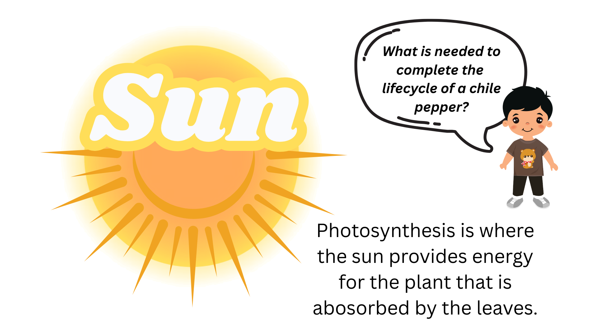

Slide 32
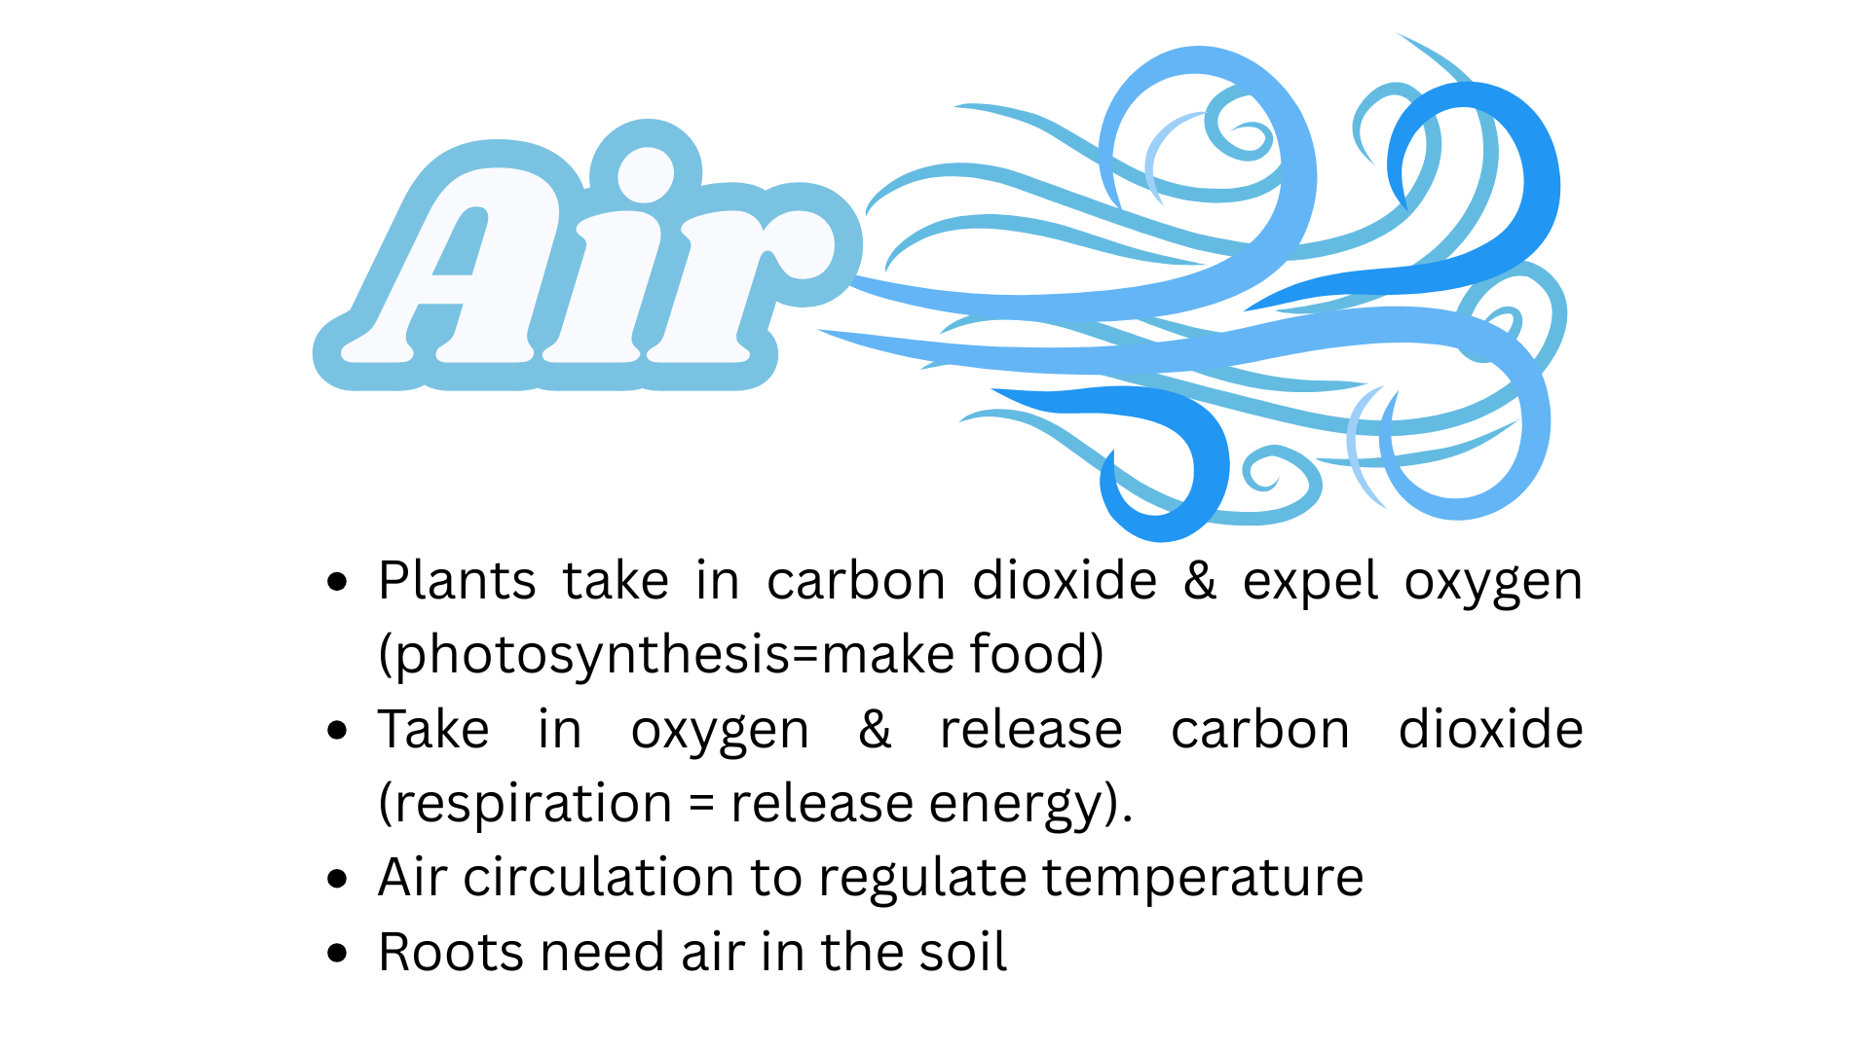

Slide 33


Slide 34


Slide 35


Slide 36

Part 6
www.nmaitc.org
Wrap-Up & REview
Name a way that you use agriculture.
Is a chile pepper a fruit or a vegetable?
What do farmers and ranchers call their plants and animals?
What natural resources are used to grow plants?
What did you learn about chile peppers that you didn’t know before?

Slide 37





Meet 2 New Mexico Chile Farm Families
Don Hartman
The Viramontes Family

Slide 38



Read the Ag Magazine to learn more about our AGmazing NM Chile peppers!

Slide 39
The
End
www.nmaitc.org
We love farmers
who grow our foods
Thanks for learning with us!

