Slide 1
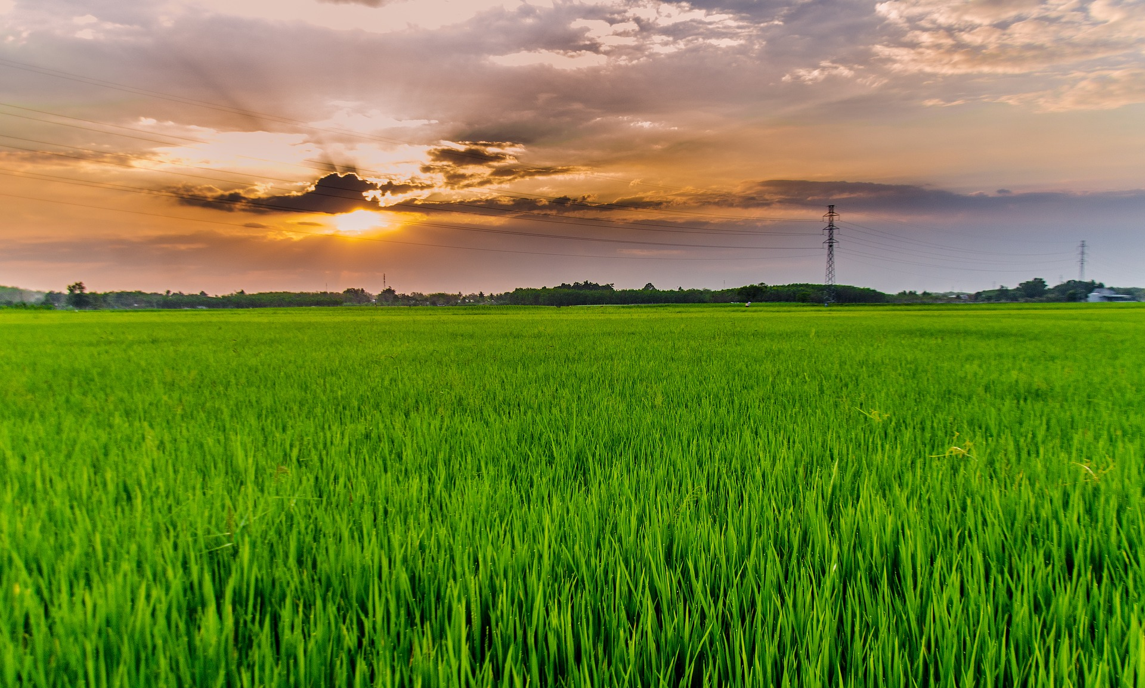
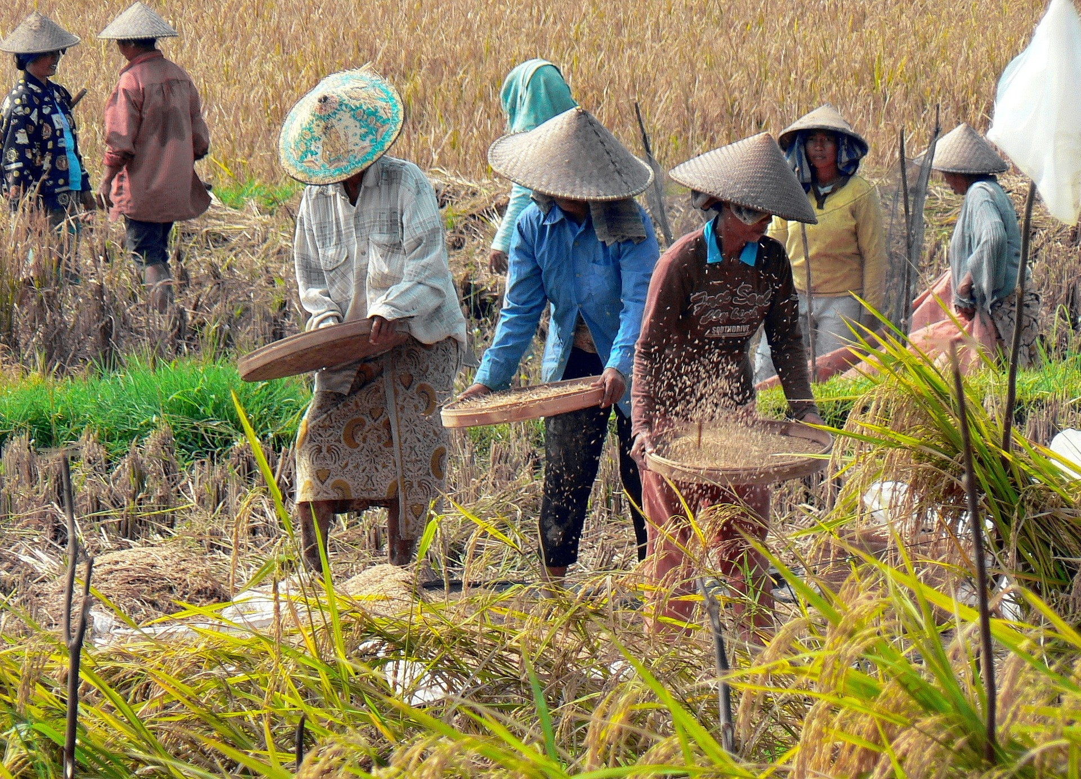
Growing Rice
A Food That Feeds
The World
A presentation by

Slide 2
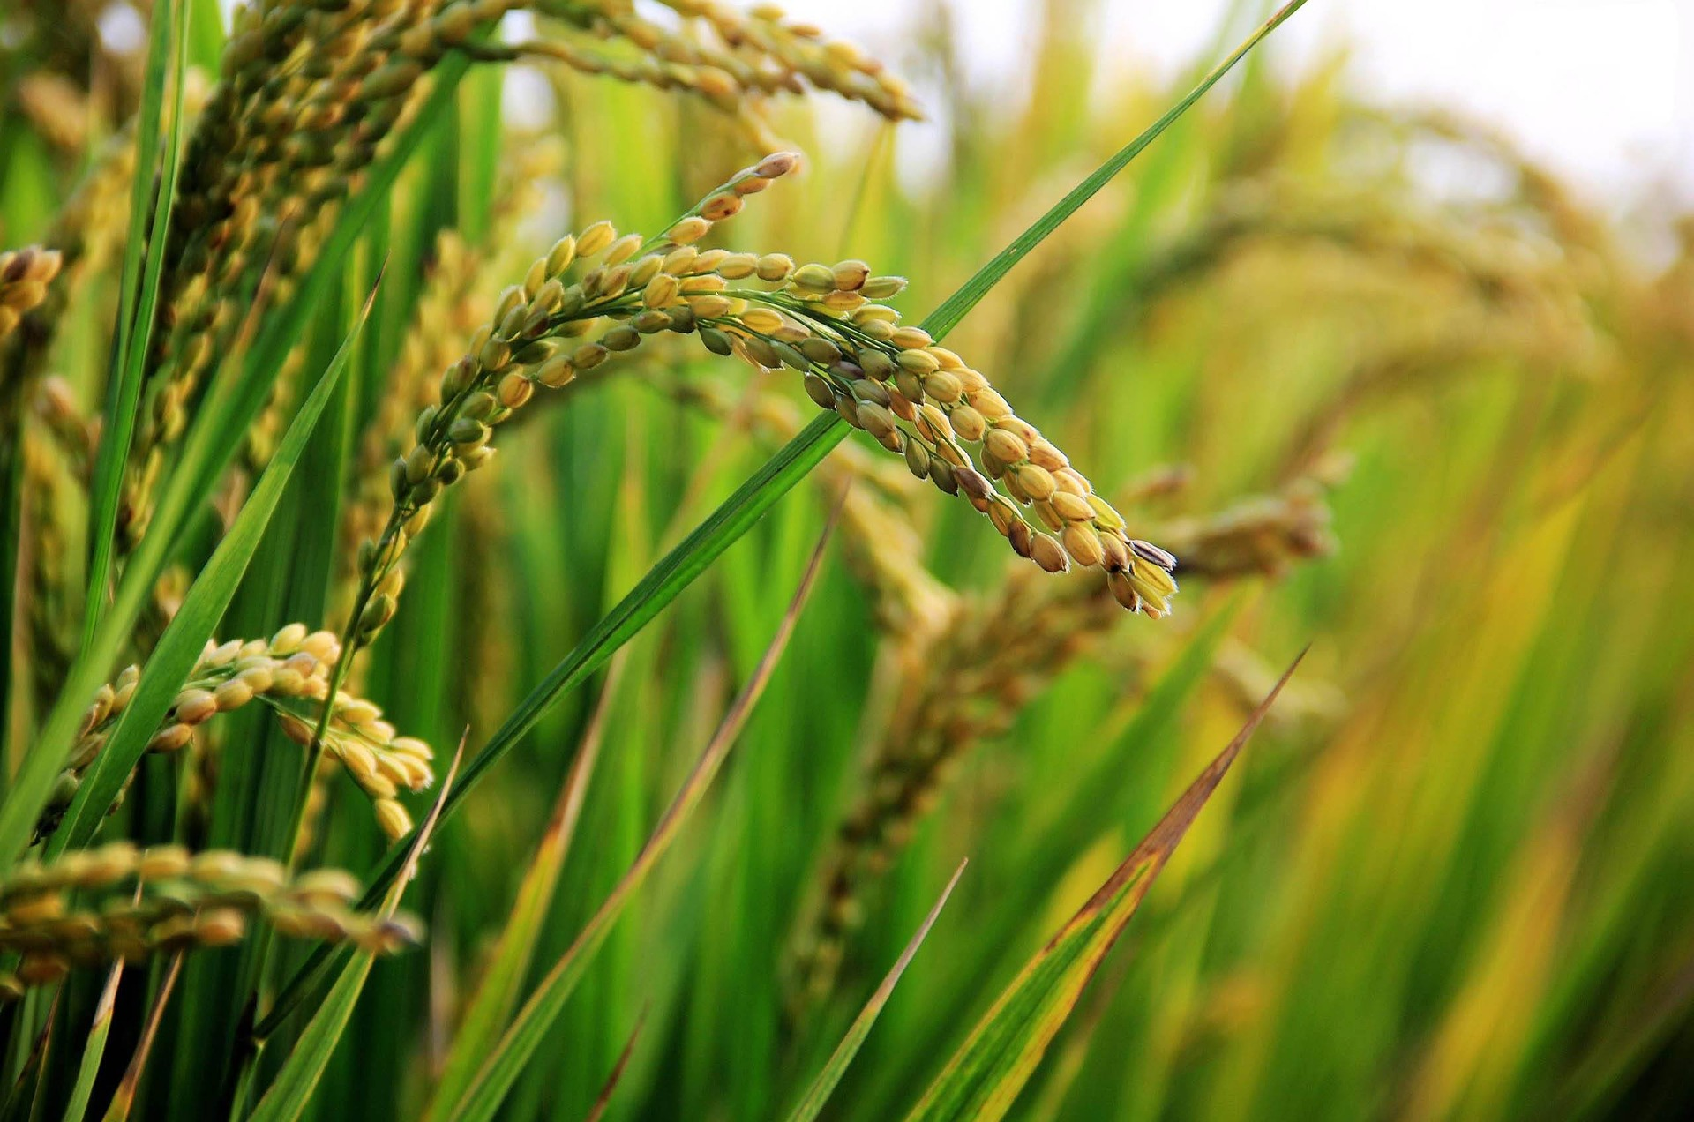
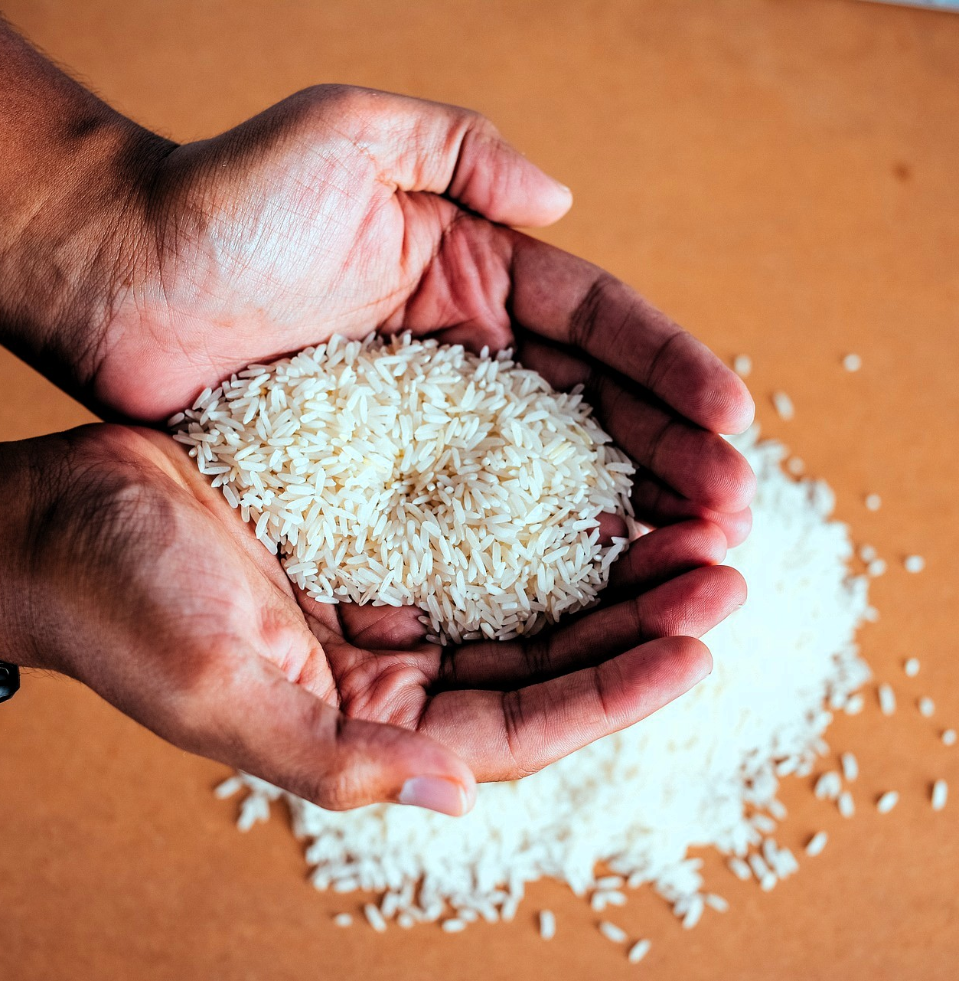
People Eat Rice All Around the World
Rice is one of the most important crops in the world. Rice is grown in more than one hundred countries, on 395 million acres of land. (Picture 395 million football fields.) More than 700 million tons of rice are grown in the world each year.
Rice is a staple food. A staple food is a food that people eat almost everyday as a large part of their diet. More than half the people in the world – 3.5 billion people – depend on rice for their daily meals.

Slide 3
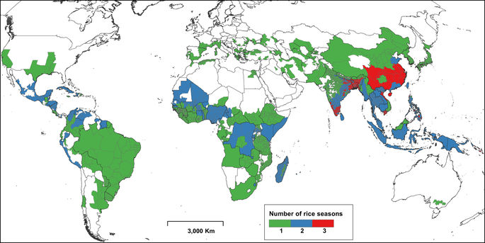
Rice is Grown on Every Continent (except Antarctica)
Nine out of 10 people who eat rice every day live on the continent of Asia in countries such as China, India, Japan, and Indonesia. But many people in Africa and South America eat rice daily also.
The areas on this map in color are the places where rice is grown in the world.
In the United States, rice is grown in Arkansas, Texas, Louisiana, Mississippi, Missouri, and California. When you eat rice, it most likely has been grown in one of these states.

Slide 4
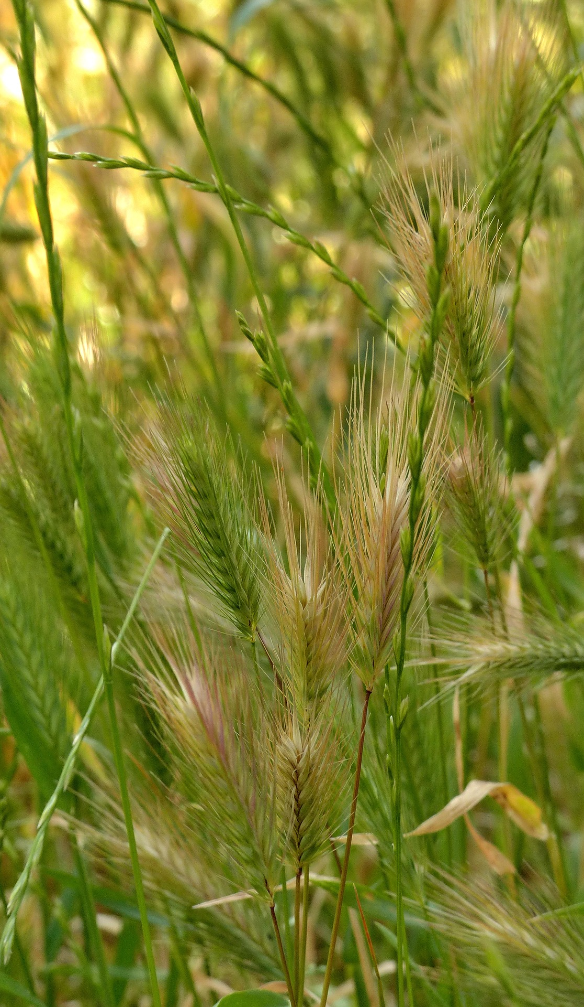
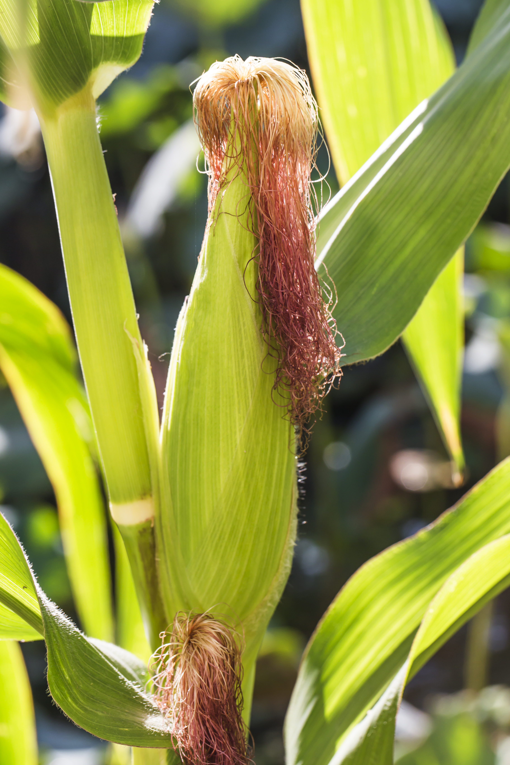
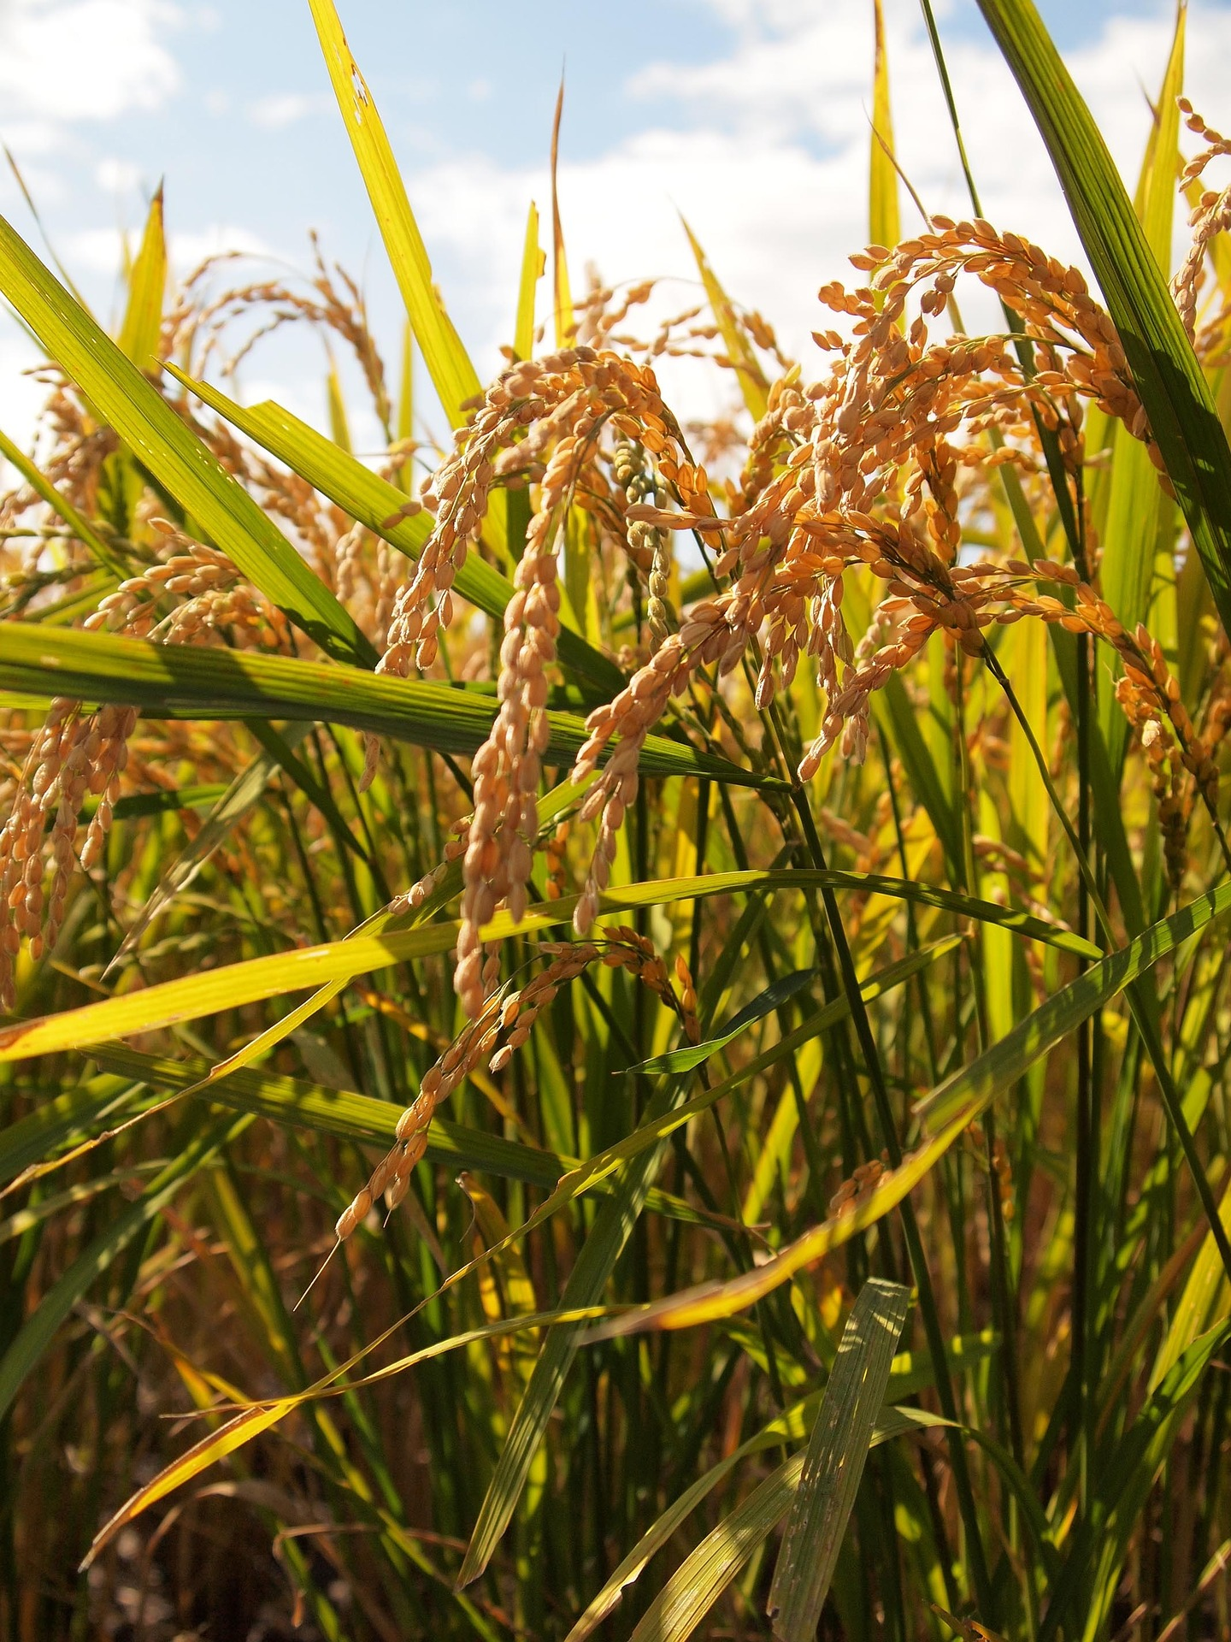
Mighty Grains
Other major staple foods of the world in addition to rice are corn and wheat. Wheat is the staple food of the United States. Americans eat wheat in bread, cookies, cake, and cereal. What is your staple food?
Rice, wheat, and corn are all grains. Grains are plants that produce seeds that can be eaten. Grains are also called cereals. Wheat, rice, and corn are the most commonly grown grains. Other important grains include barley, oats, rye, millet, and sorghum.
Grains come from grass plants. Grasses are different from most other plants we eat because they are not pollinated by bees or other insects, they are pollinated by the wind.
RICE
WHEAT
CORN

Slide 5
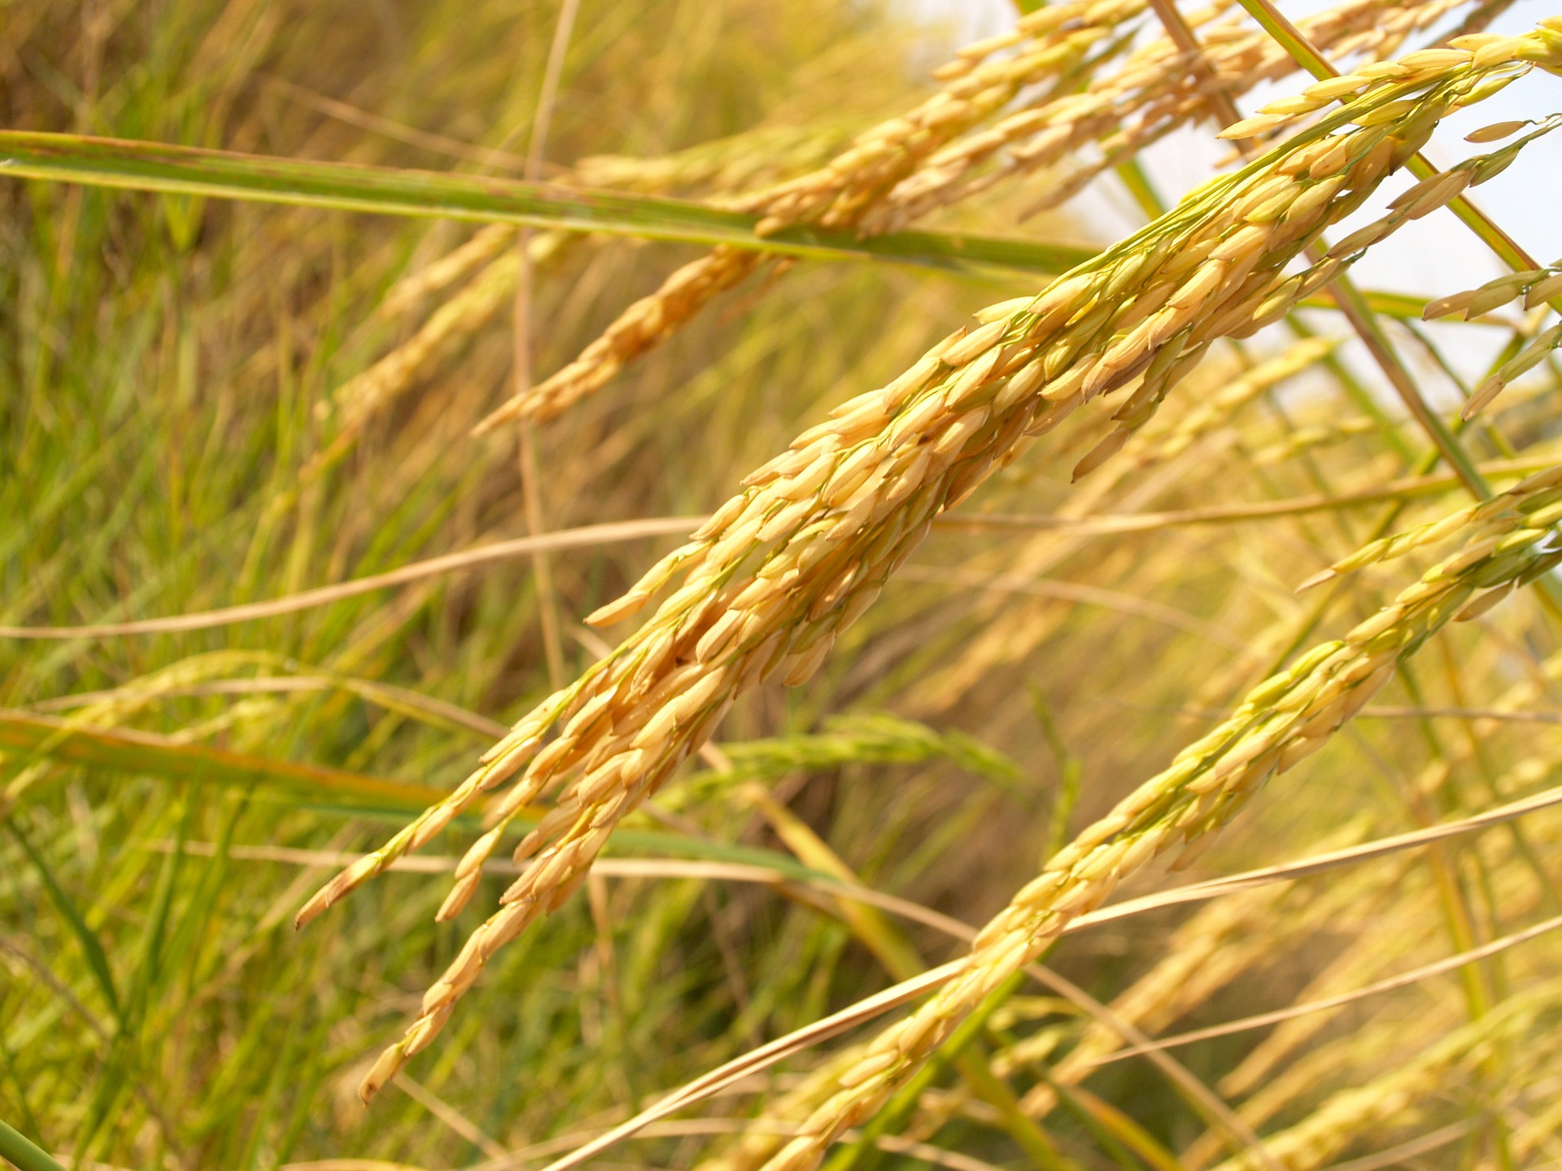
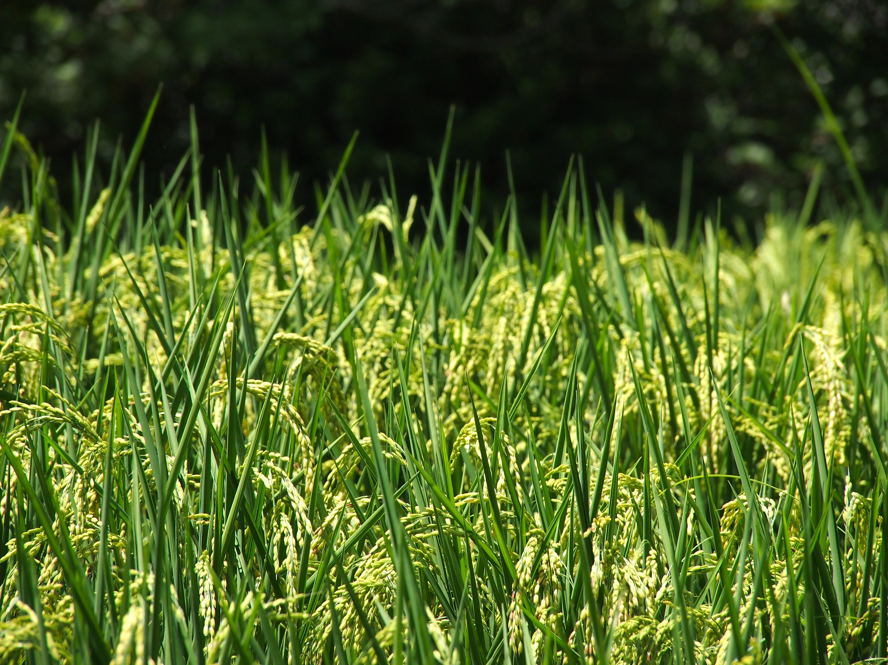
What’s the Right Climate for Rice? Sunny!
Rice plants grow in warm weather. The temperature must be at least 75 degrees. And rice plants take a long time to grow. It takes four to five months for a plant to grow from seed to harvest.
So rice can only be grown in places that have warm weather for a large part of the year. You cannot grow rice in New Jersey.
When you eat rice, you are eating the seed of the rice plant.

Slide 6
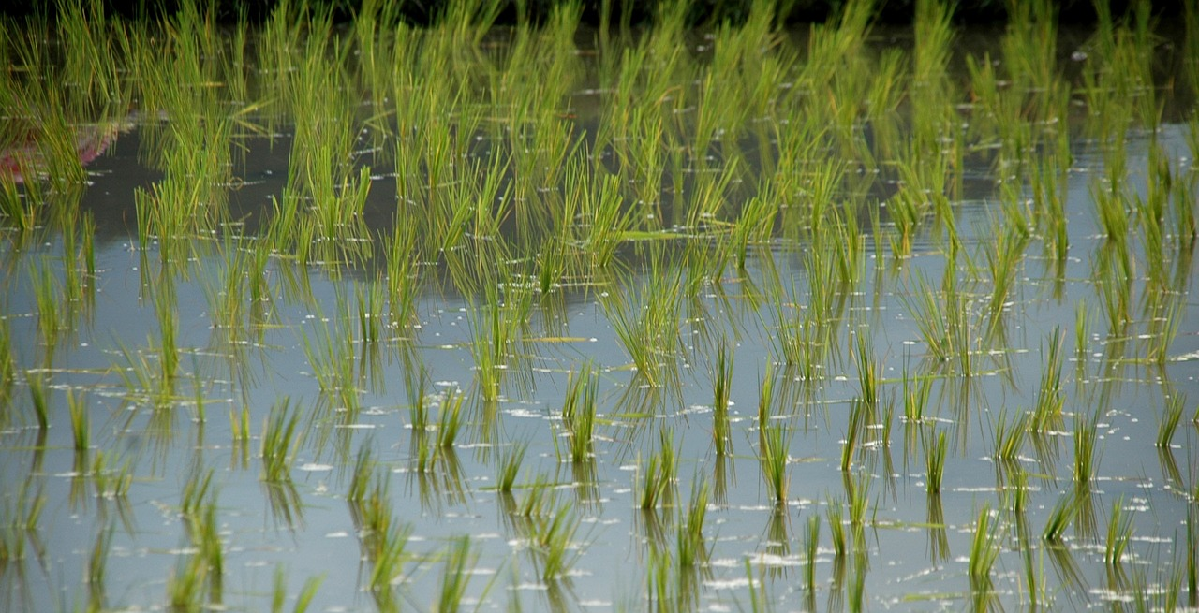
A Plant That Likes Wet Feet
Rice grows differently than many other crops. First, rice plants like clay soil, not the fertile silt soil most crops prefer. The small, sticky particles of clay are packed together so tightly that it is difficult for water to run through them.
But that’s fine, because rice plants like to grow in water. Farmers flood rice fields for most of the growing season.
The rice plants will grow in the water until they reach about three feet high. The flooded field also keeps weeds from crowding out the rice plants. Farmers drain the fields and let the rice plants dry out before they harvest the rice.

Slide 7
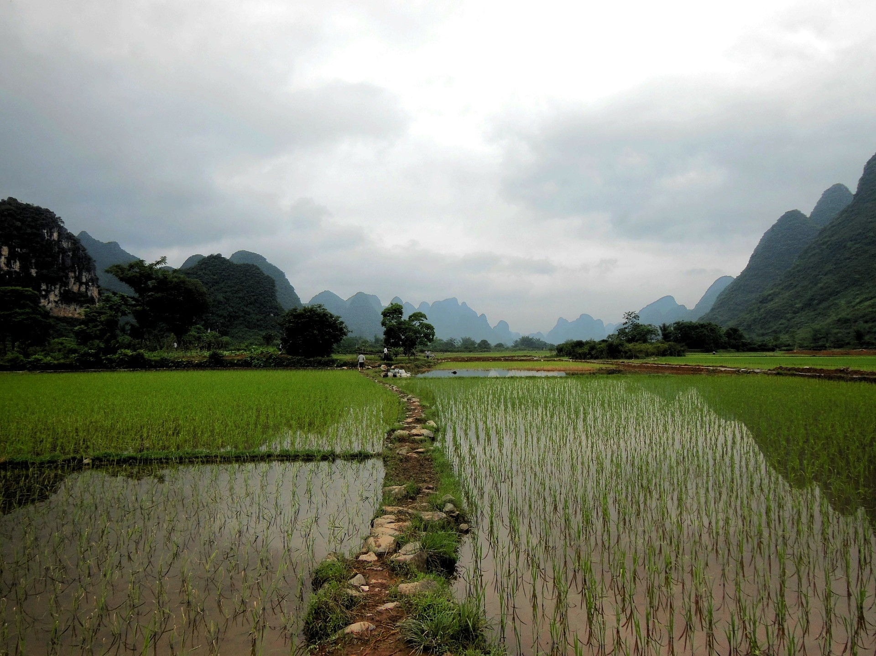
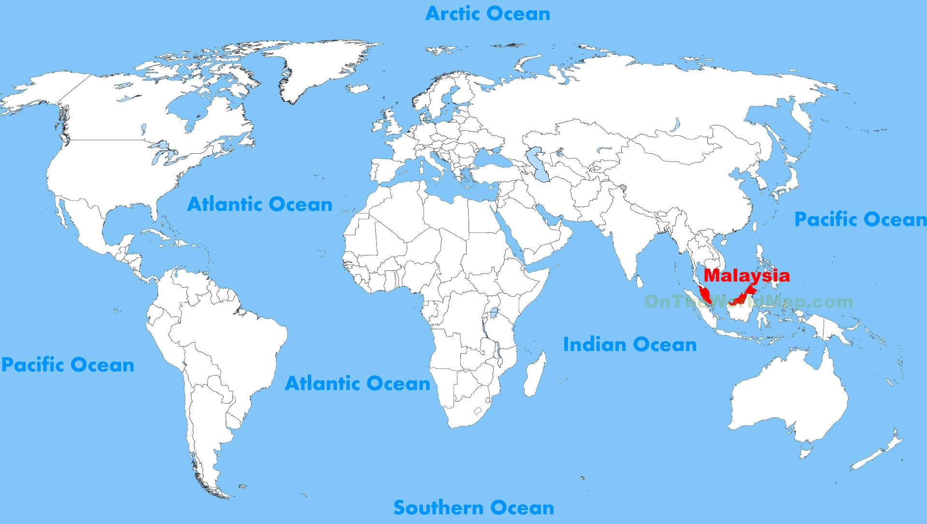
A Rice Field is Called a Paddy
The place where rice is grown is not called a field, it is called a paddy. The picture you see here is of a flooded rice paddy. It definitely looks different than farm fields in New Jersey.
The origin or beginning of the word ‘paddy’ comes from the country of Malaysia, shown in red on this map. In the Malaysian language, the word ‘padi’ means rice that has just been harvested. That word has now become an English word meaning rice field.
Map courtesy of ontheworldmap.com

Slide 8
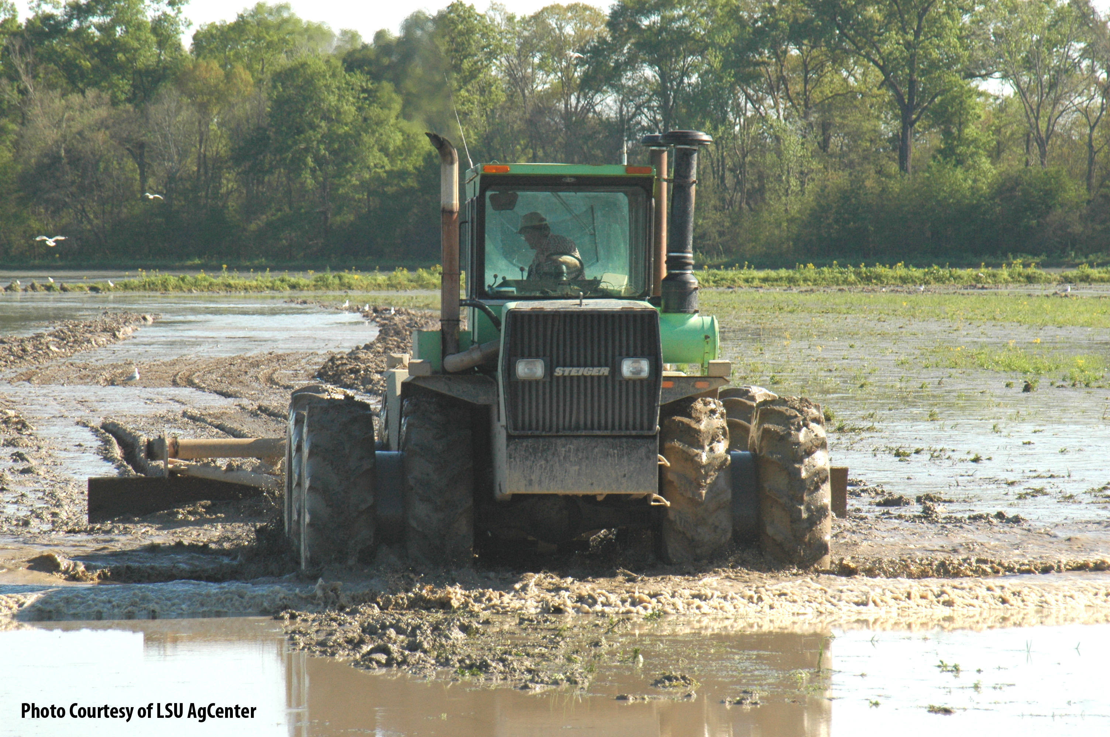
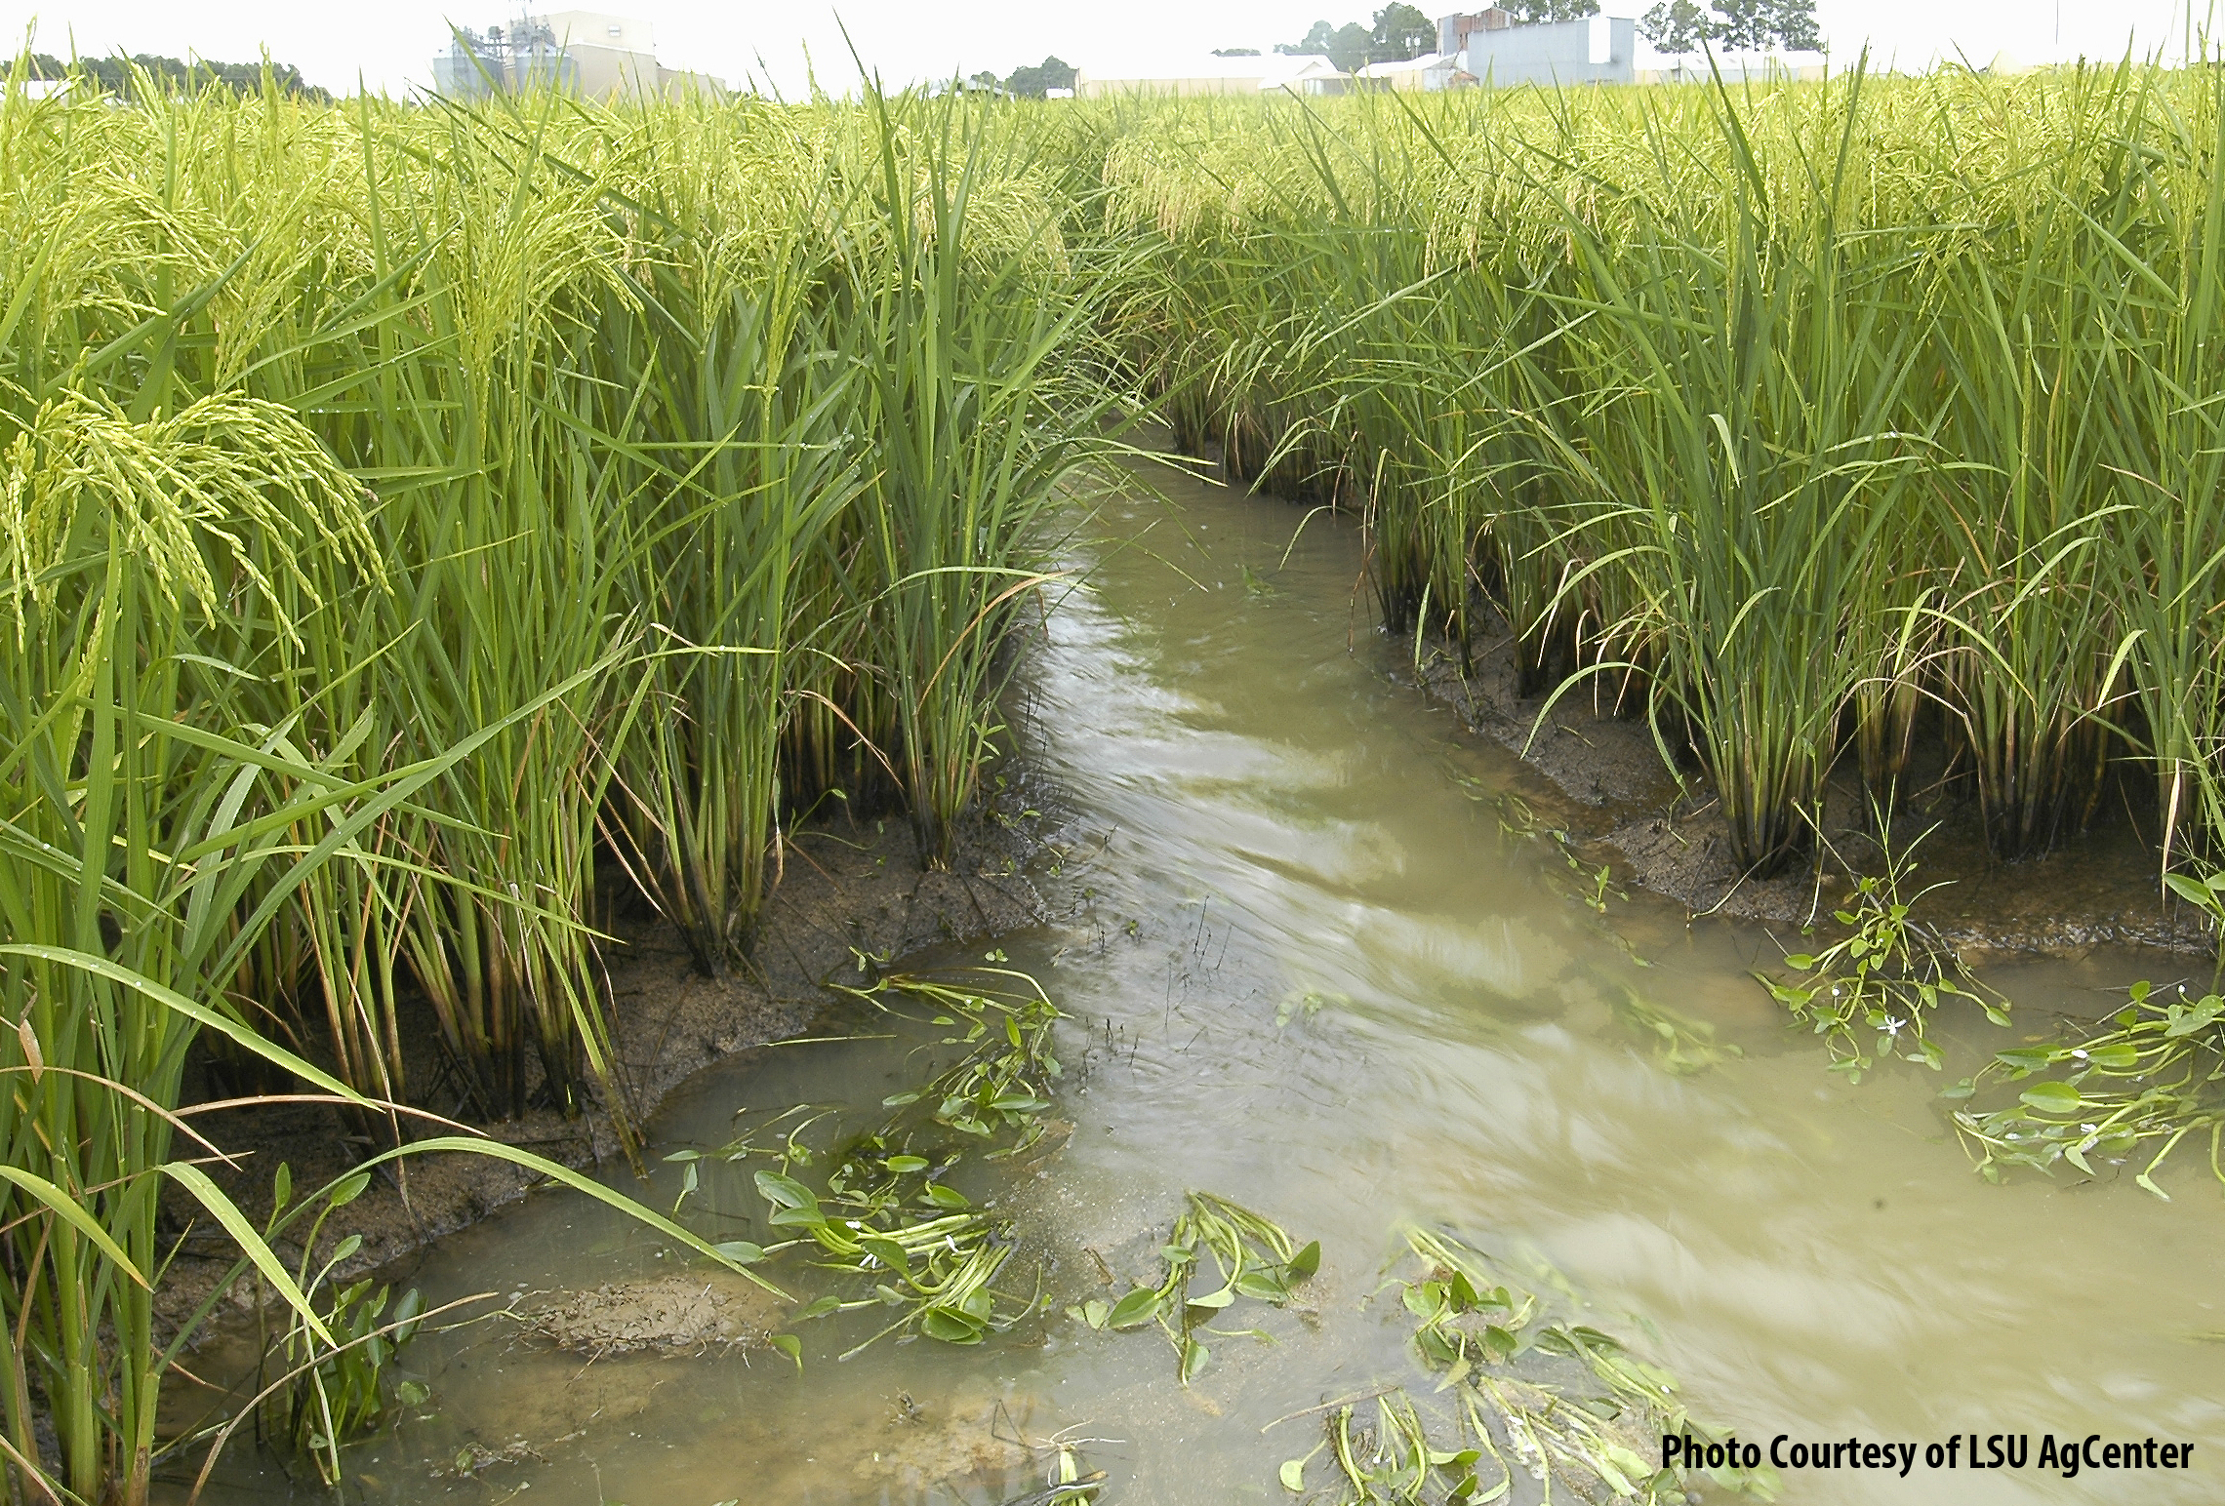
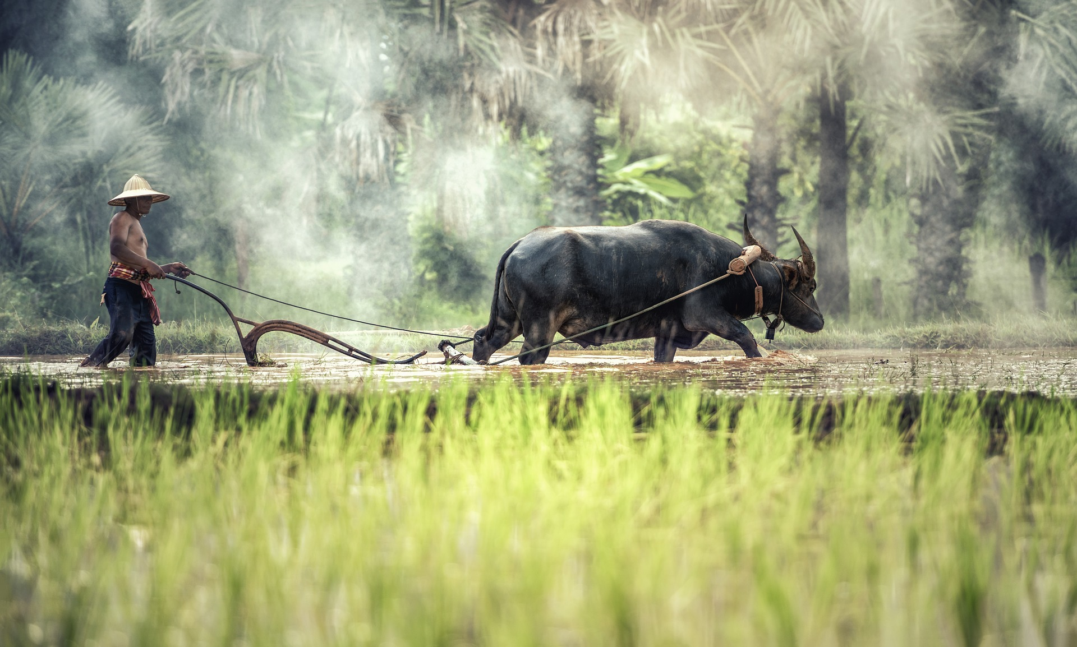
So that the fields can be flooded and drained easily, rice paddies have to be flat – or level.
Farmers can use tractors to level the fields, but in many parts of the world, farmers use water buffaloes to pull the leveling tools.
Farmers cut channels in the paddies that they can close to keep the water in while the rice grows and open to drain the water from the paddy before harvest.

Slide 9
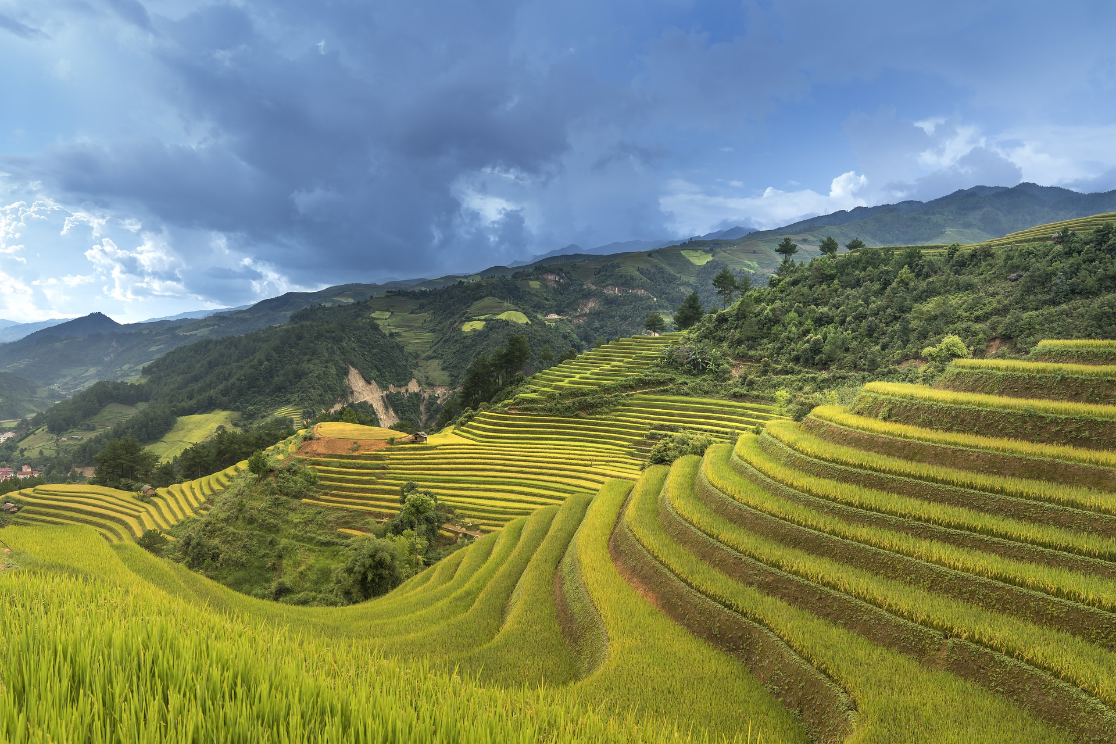
Rice in the Mountains
When rice is grown in the mountains, farmers carve flat areas called terraces on the hillsides to make a level rice paddy. Then these areas can be flooded without all the water running downhill.

Slide 10
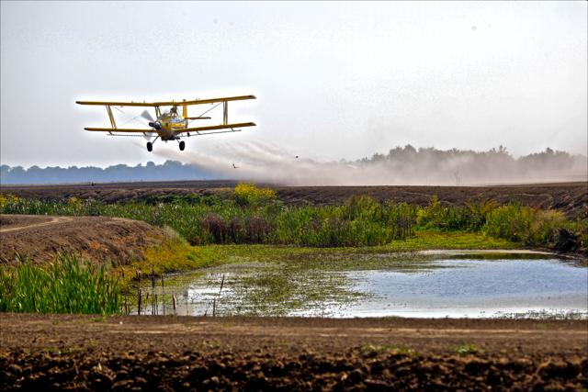
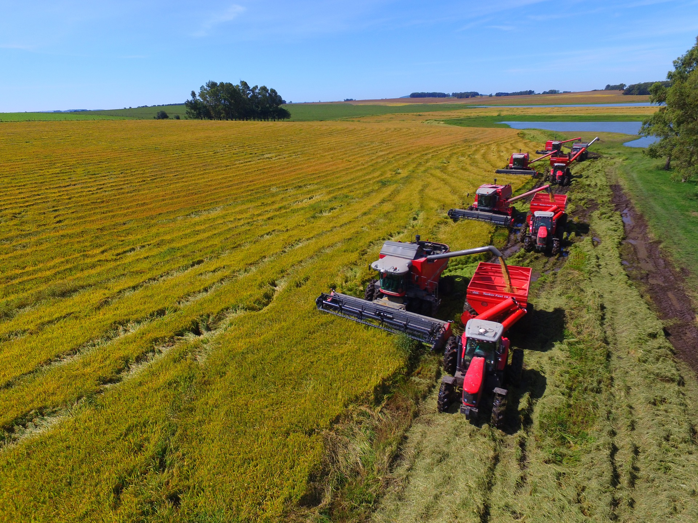
Rice is Grown By Machine
Machines are used to grow rice in the United States. Airplanes are sometimes used to spread the rice seed into the paddies. Large machines called combines are used to harvest the rice.
Photo courtesy USA Rice
When the rice is almost ready to harvest, the tops of the plant begin to droop and the stems turn yellow. Then the farmers drain the water from the paddies. As the fields dry, the rice ripens and harvesting begins.

Slide 11
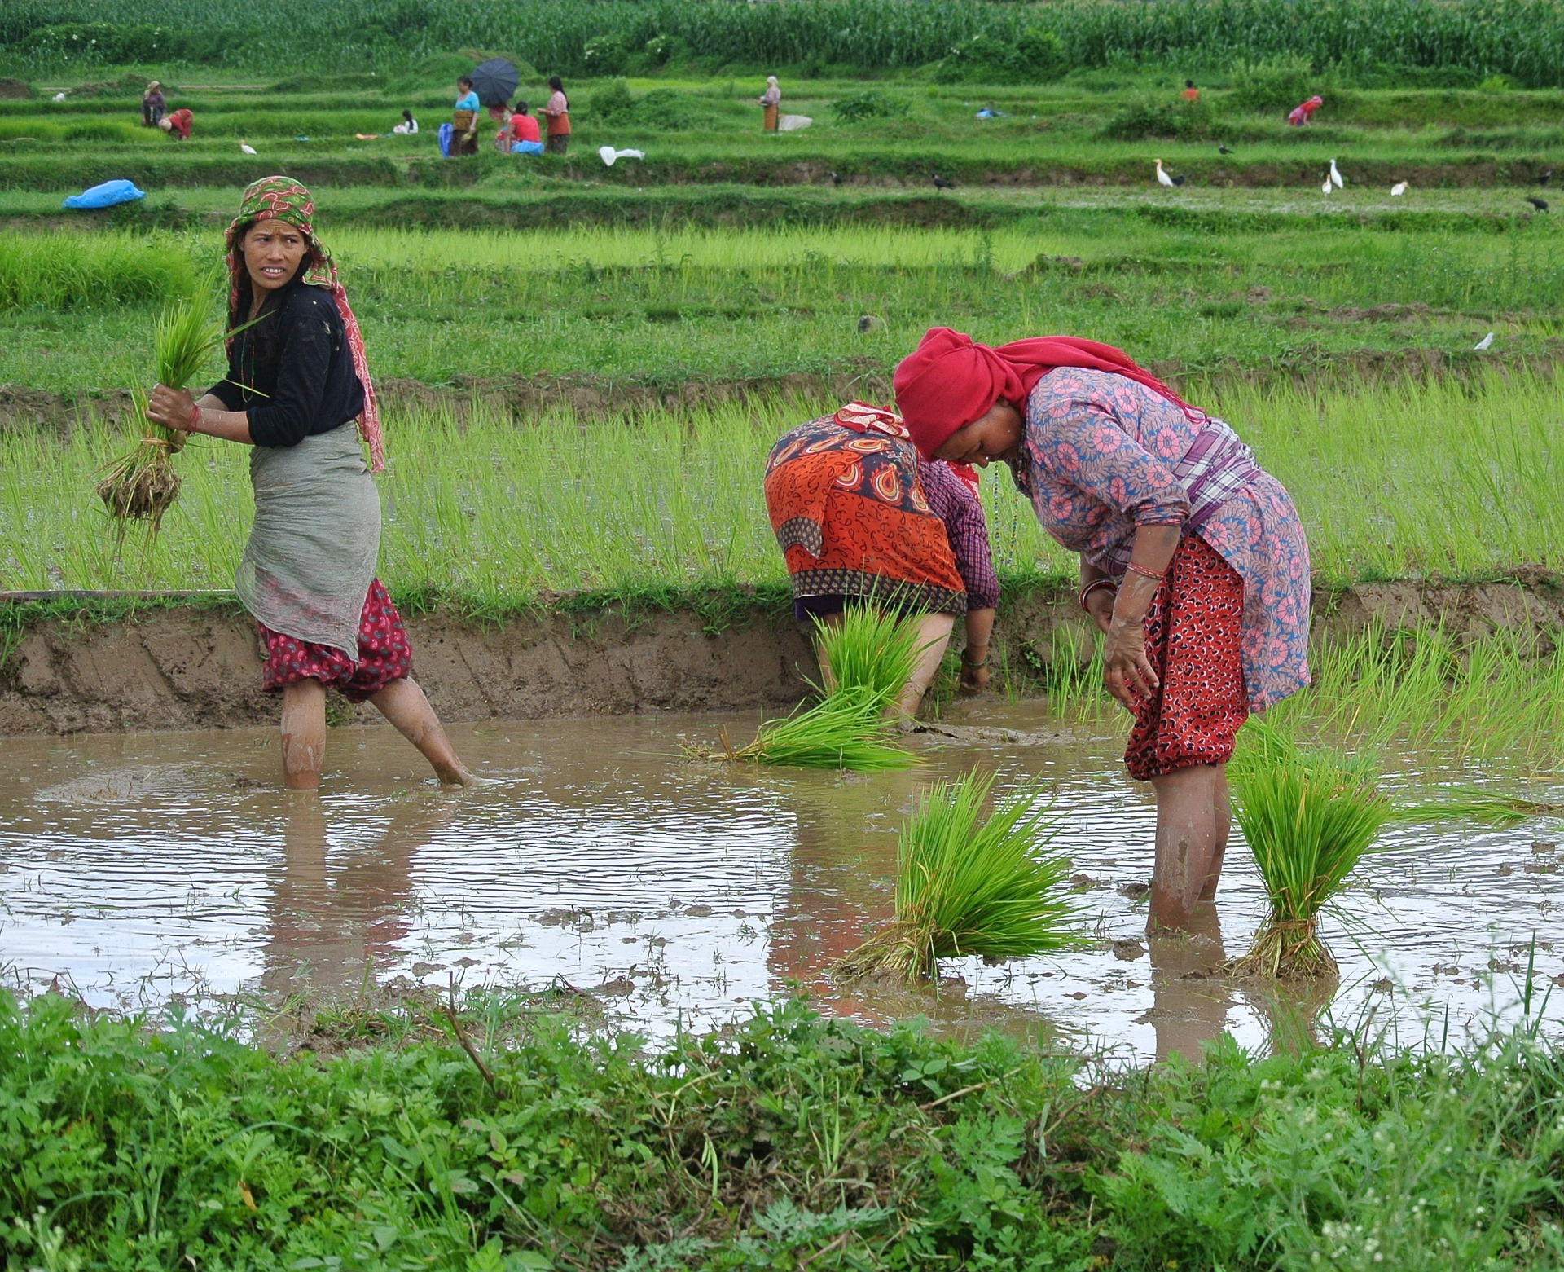
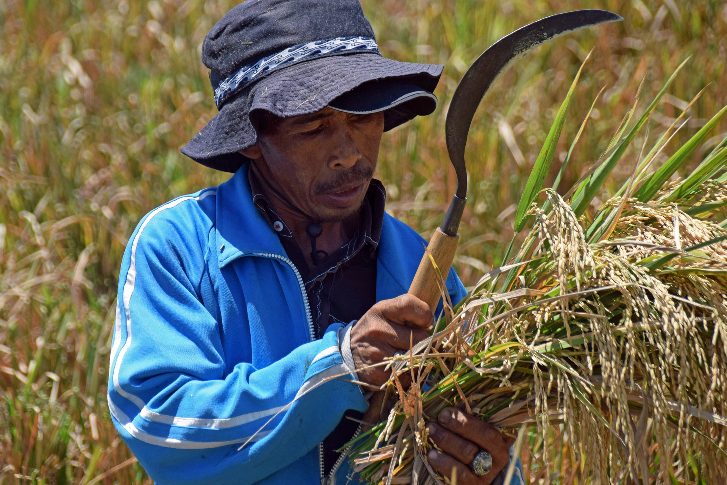
Rice is Grown By Hand
In many places in the world, rice is still grown by hand. Young rice plants are transplanted by hand into paddies from smaller nursery beds.
Farmers use a sharp tool called a sickle to harvest rice by hand. A sickle has a short wooden handle and a curved metal blade.
It is hard work to harvest rice by hand.

Slide 12
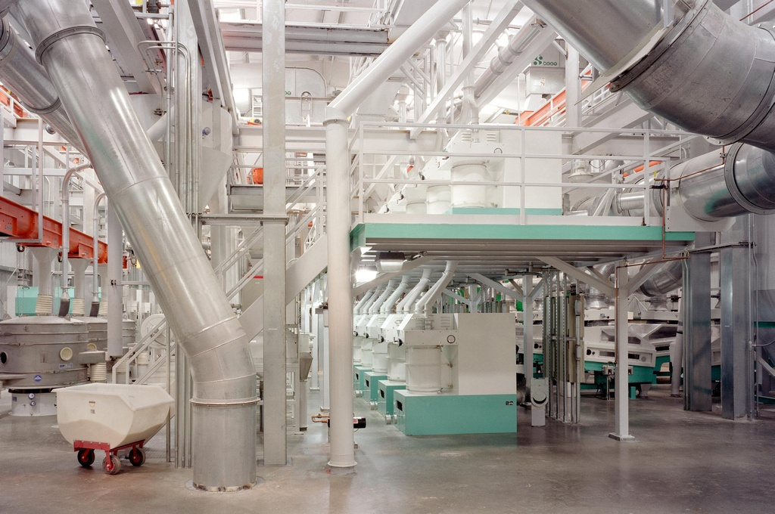
From Harvest to Table
After harvest, the rice is removed from the stems of the plant. The stems are wrapped into bundles called bales to feed to animals The rice is sent to a mill for processing.
At the mill, the outer layer or hull of the rice is removed. What is left is called brown rice. Brown rice is a whole grain that gives you fiber and several vitamins and minerals.
Photo courtesy USA Rice

Slide 13
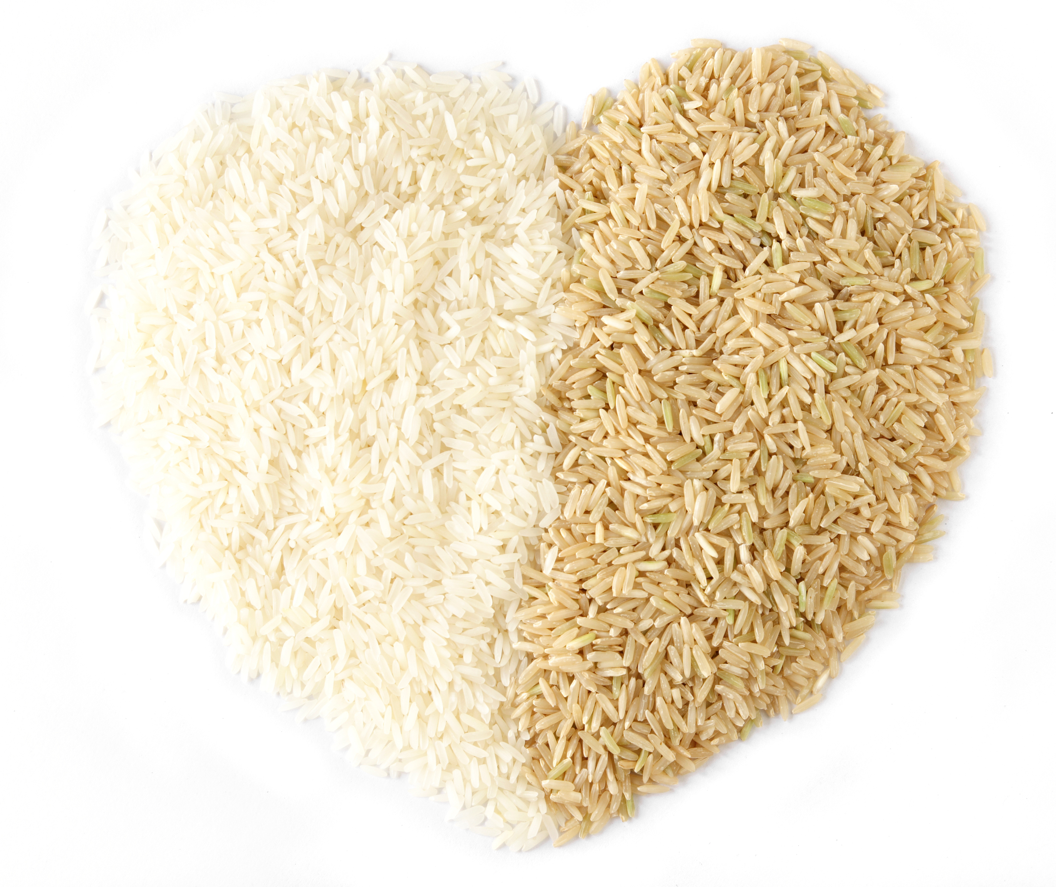
Brown Rice
Or
White Rice?
Brown rice is often changed into white rice at the mill, by removing its hard, outer layers. White rice has fewer vitamins and minerals than brown rice.
Although brown rice is more nutritious, most people eat white rice. White rice can be stored for a long time without being refrigerated – sometimes up to 10 years! White rice also takes less time to cook than brown rice.

Slide 14
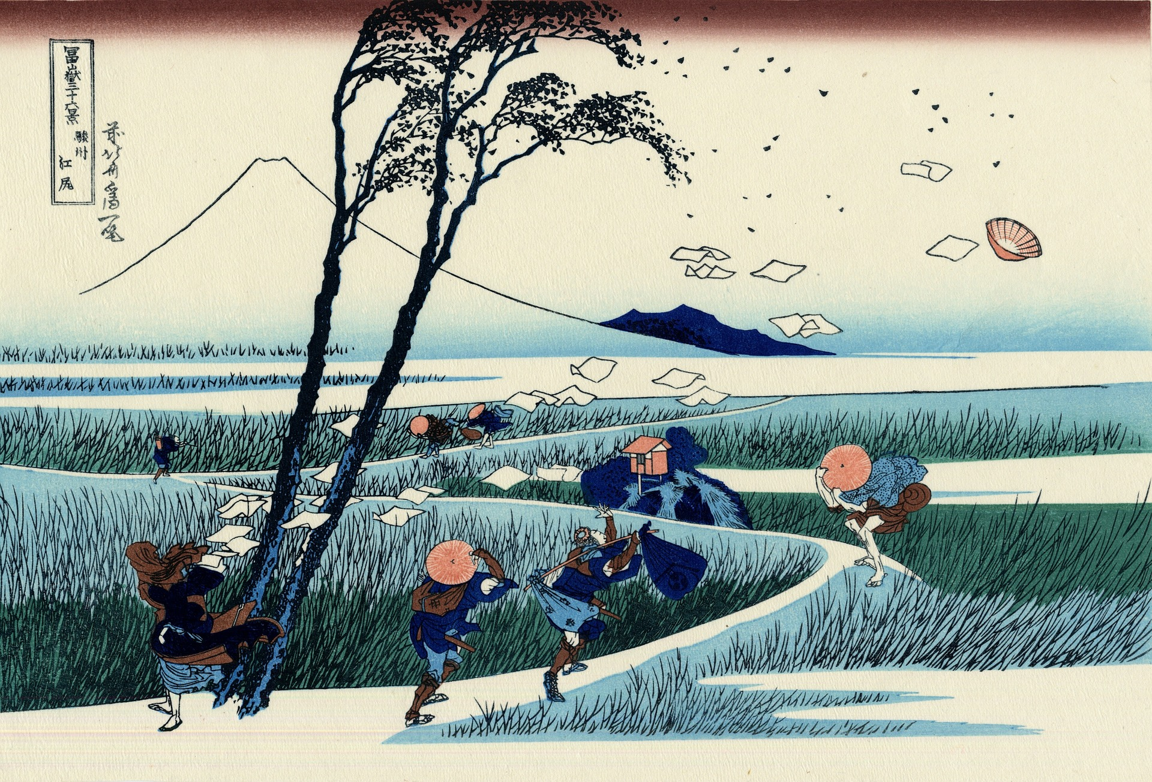
The Long History of Rice
Scientists believe that rice was first farmed more than 10,000 years ago in a region in the middle of China called Sichuan. They have found tools used to farm rice there that date back thousands of years. This area is perfect for farming rice – it is warm and rainy, and crops can be grown there for six months of a year.
Rice farming then gradually spread to India, the Middle East, Europe, South America, and then to United States.
Rice farming in California began during the Gold Rush of the mid-1800s, when thousands of Chinese immigrated to the state to work. They began farming rice as they had in their home country.

Slide 15
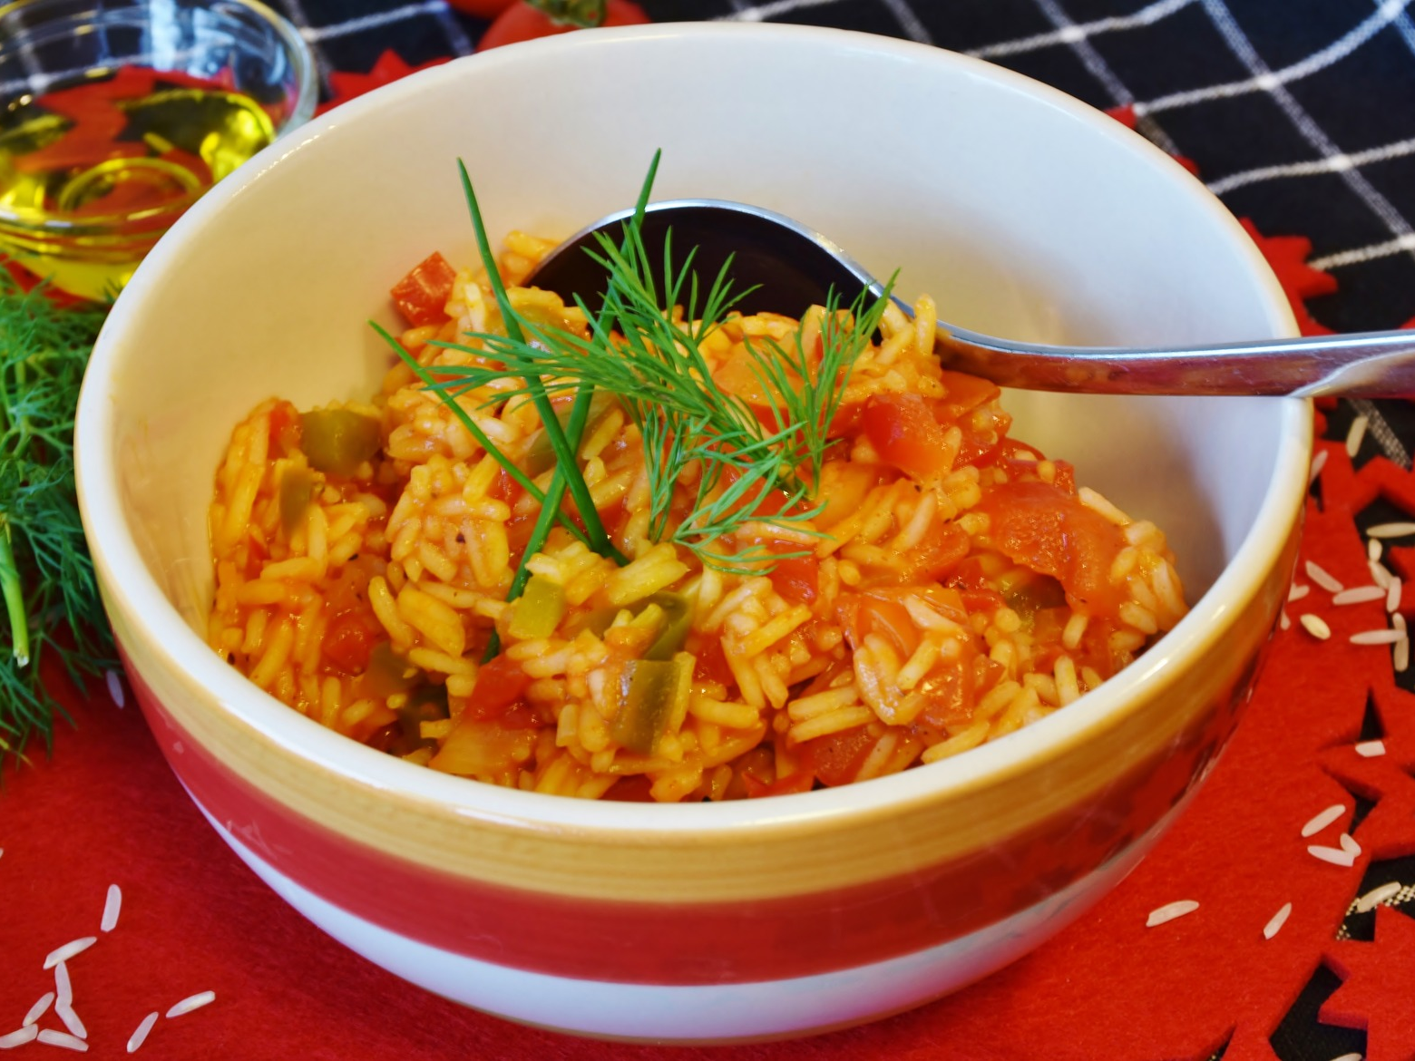
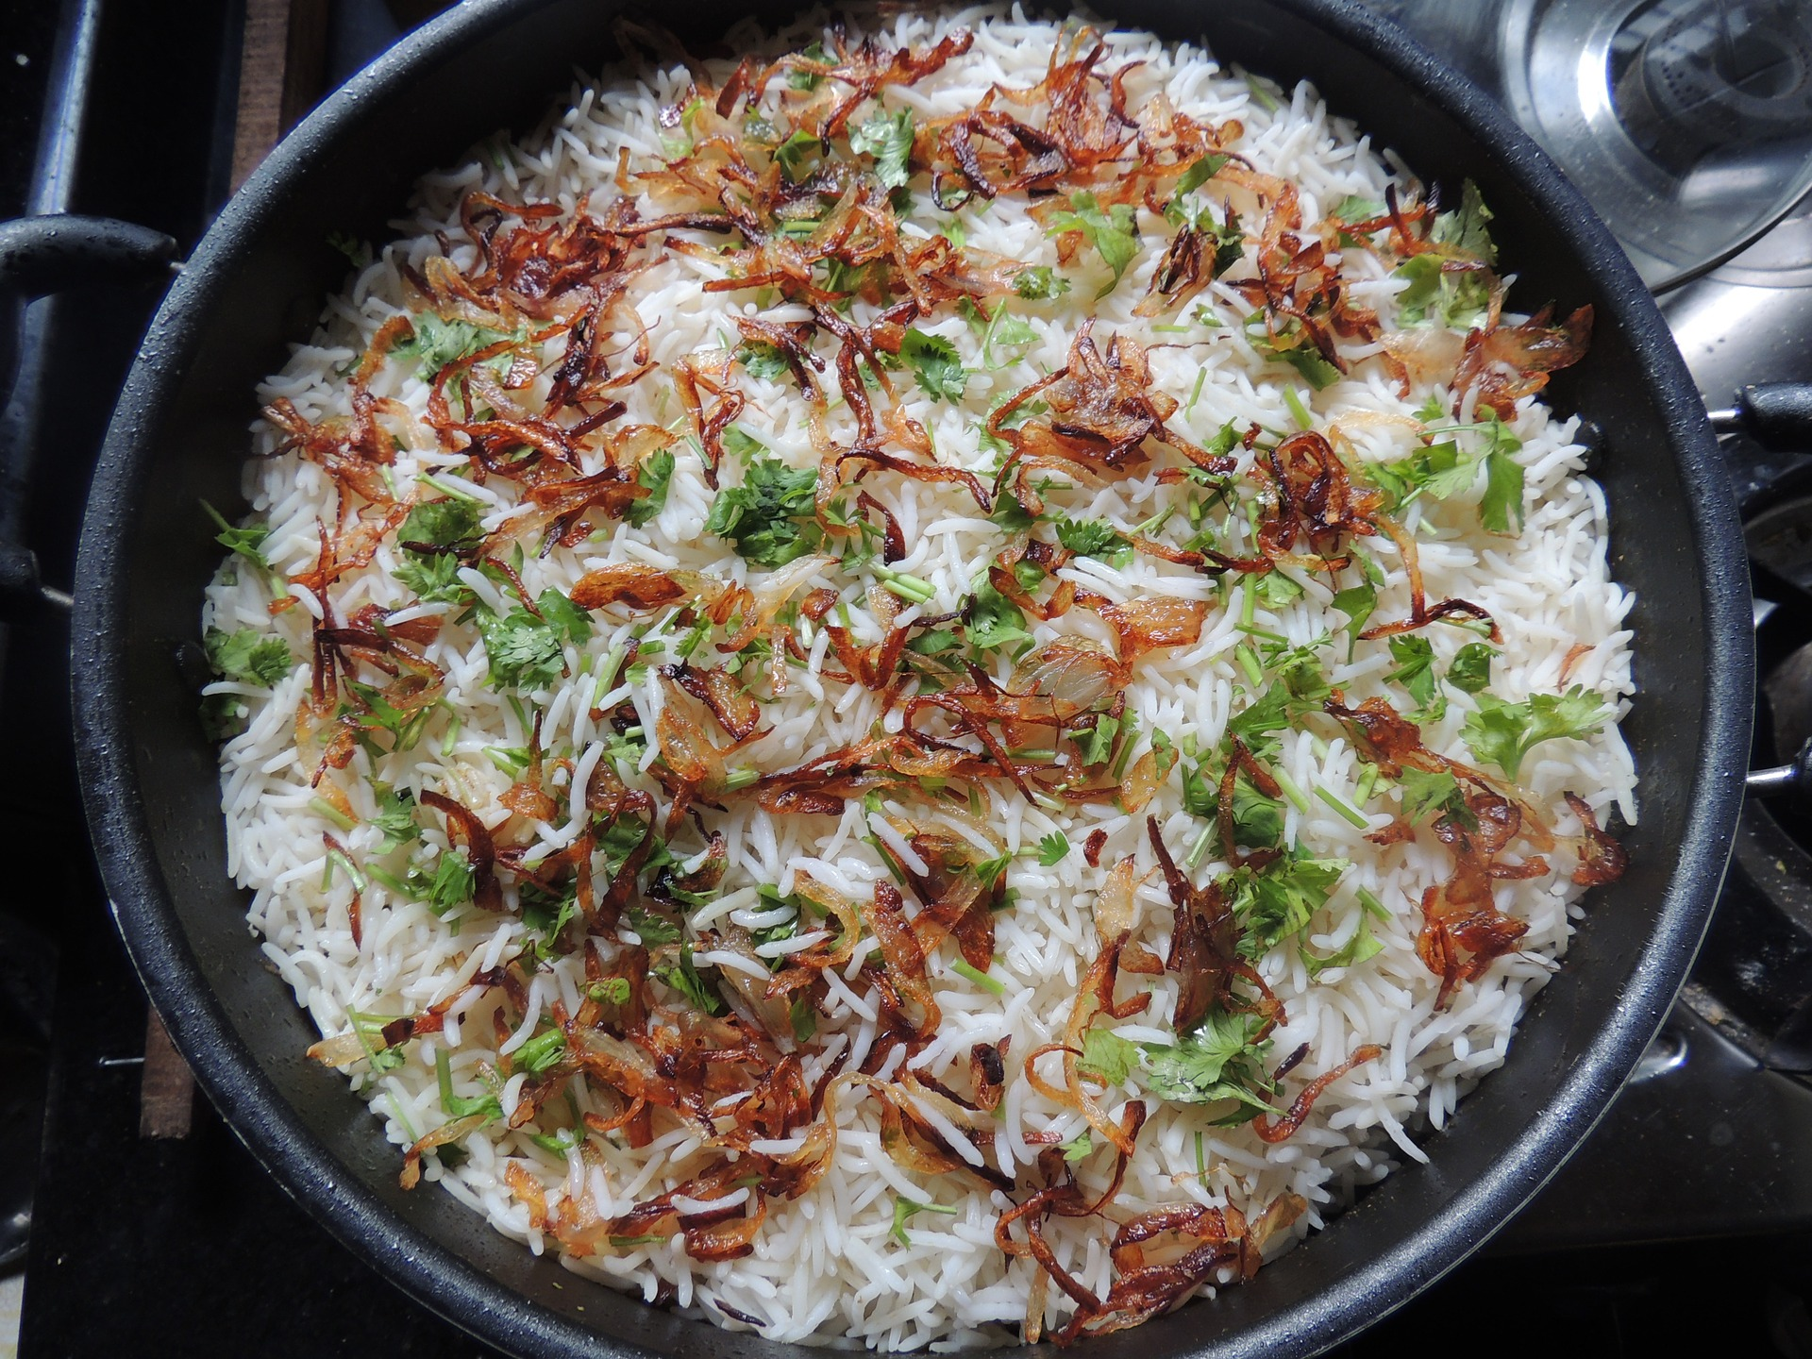
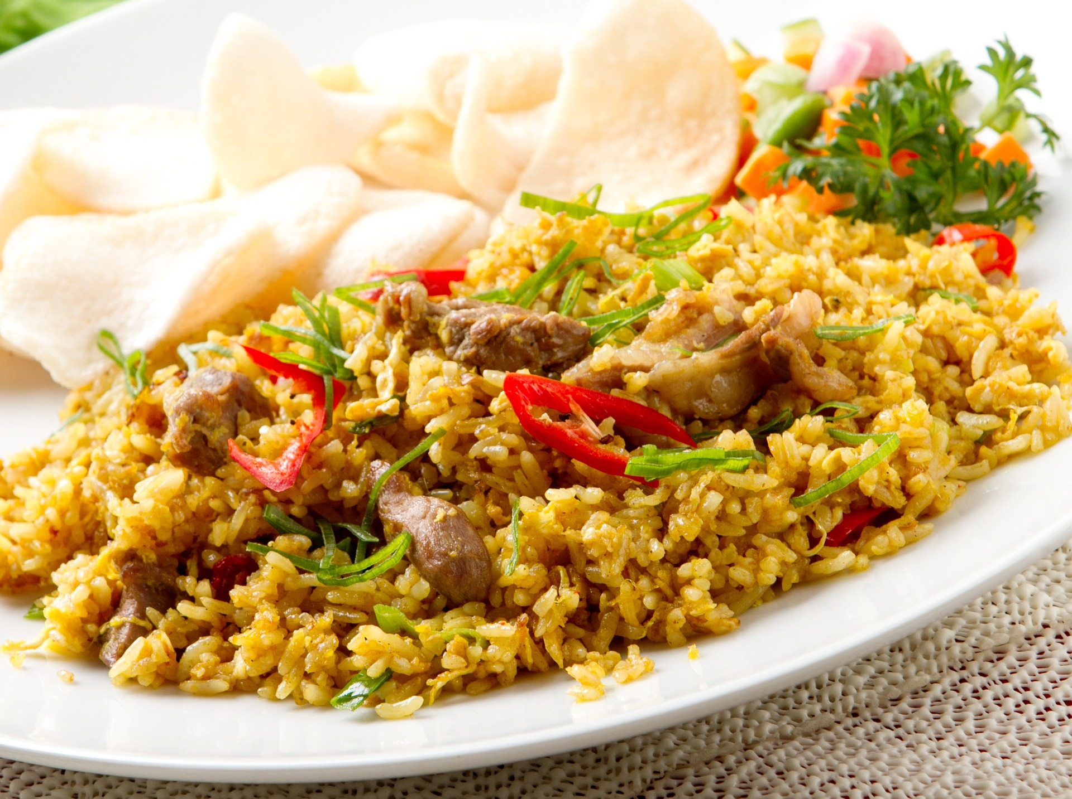
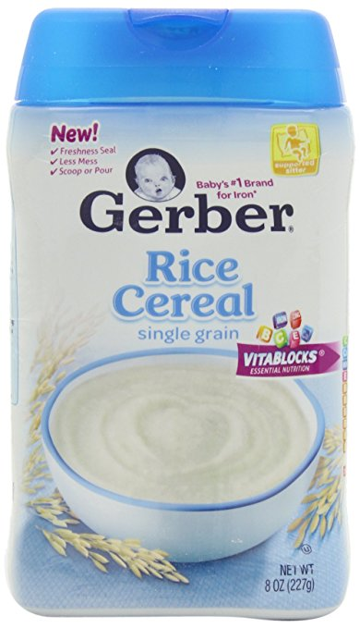
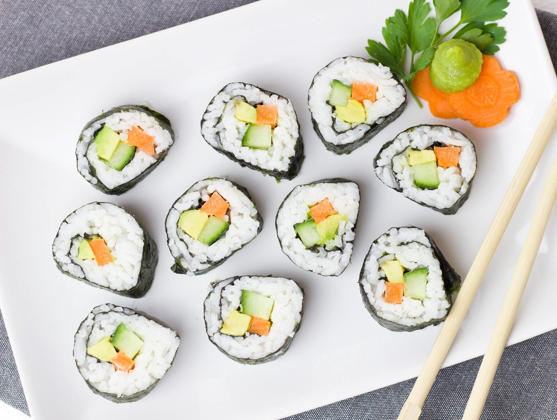
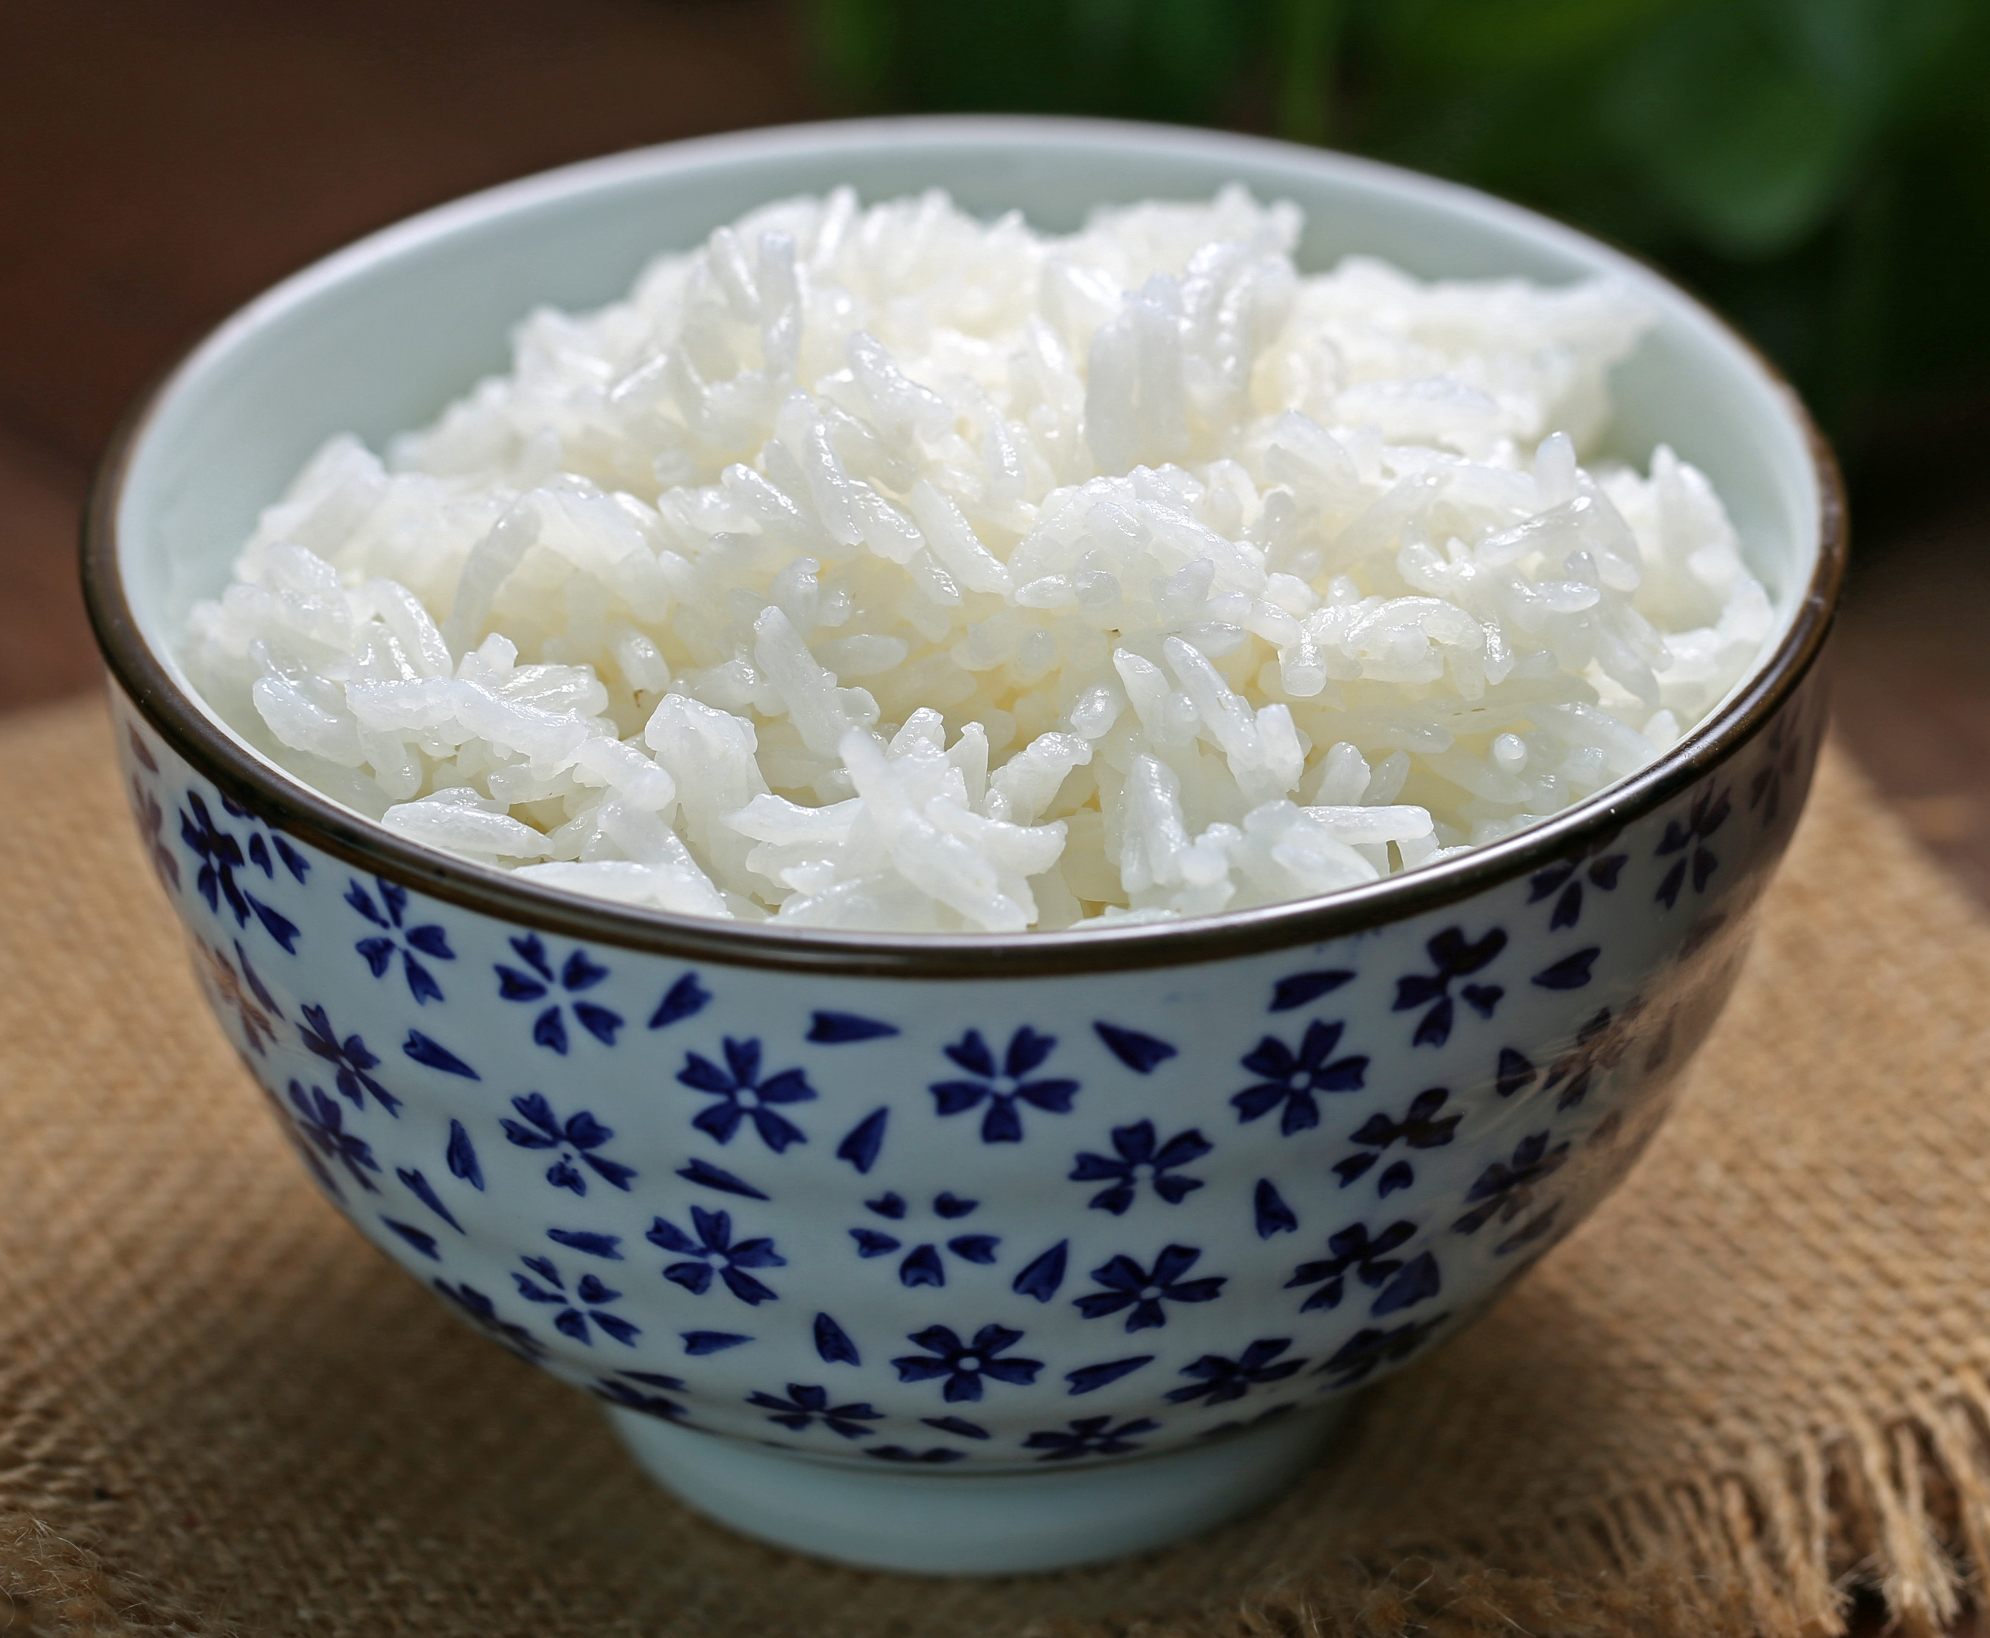
White rice is packed with carbohydrates which give your body energy. It also is a good source of minerals your body needs and is low in fat.
How do you like your rice?

