Slide 1
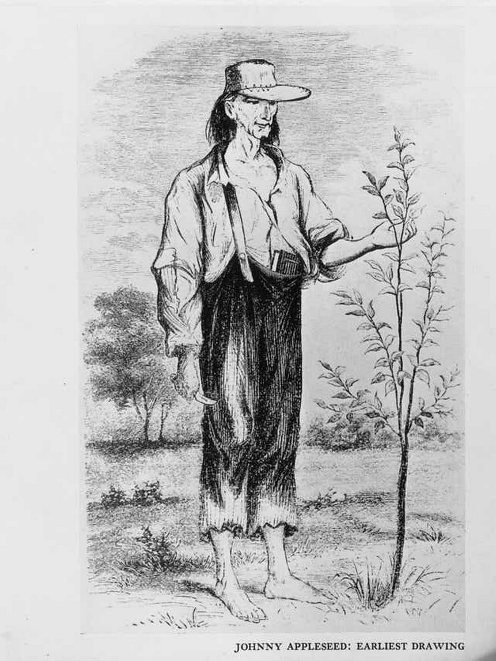
The Myth of Johnny Appleseed
Nobody Ate His Apples
Courtesy Wikipedia

Slide 2
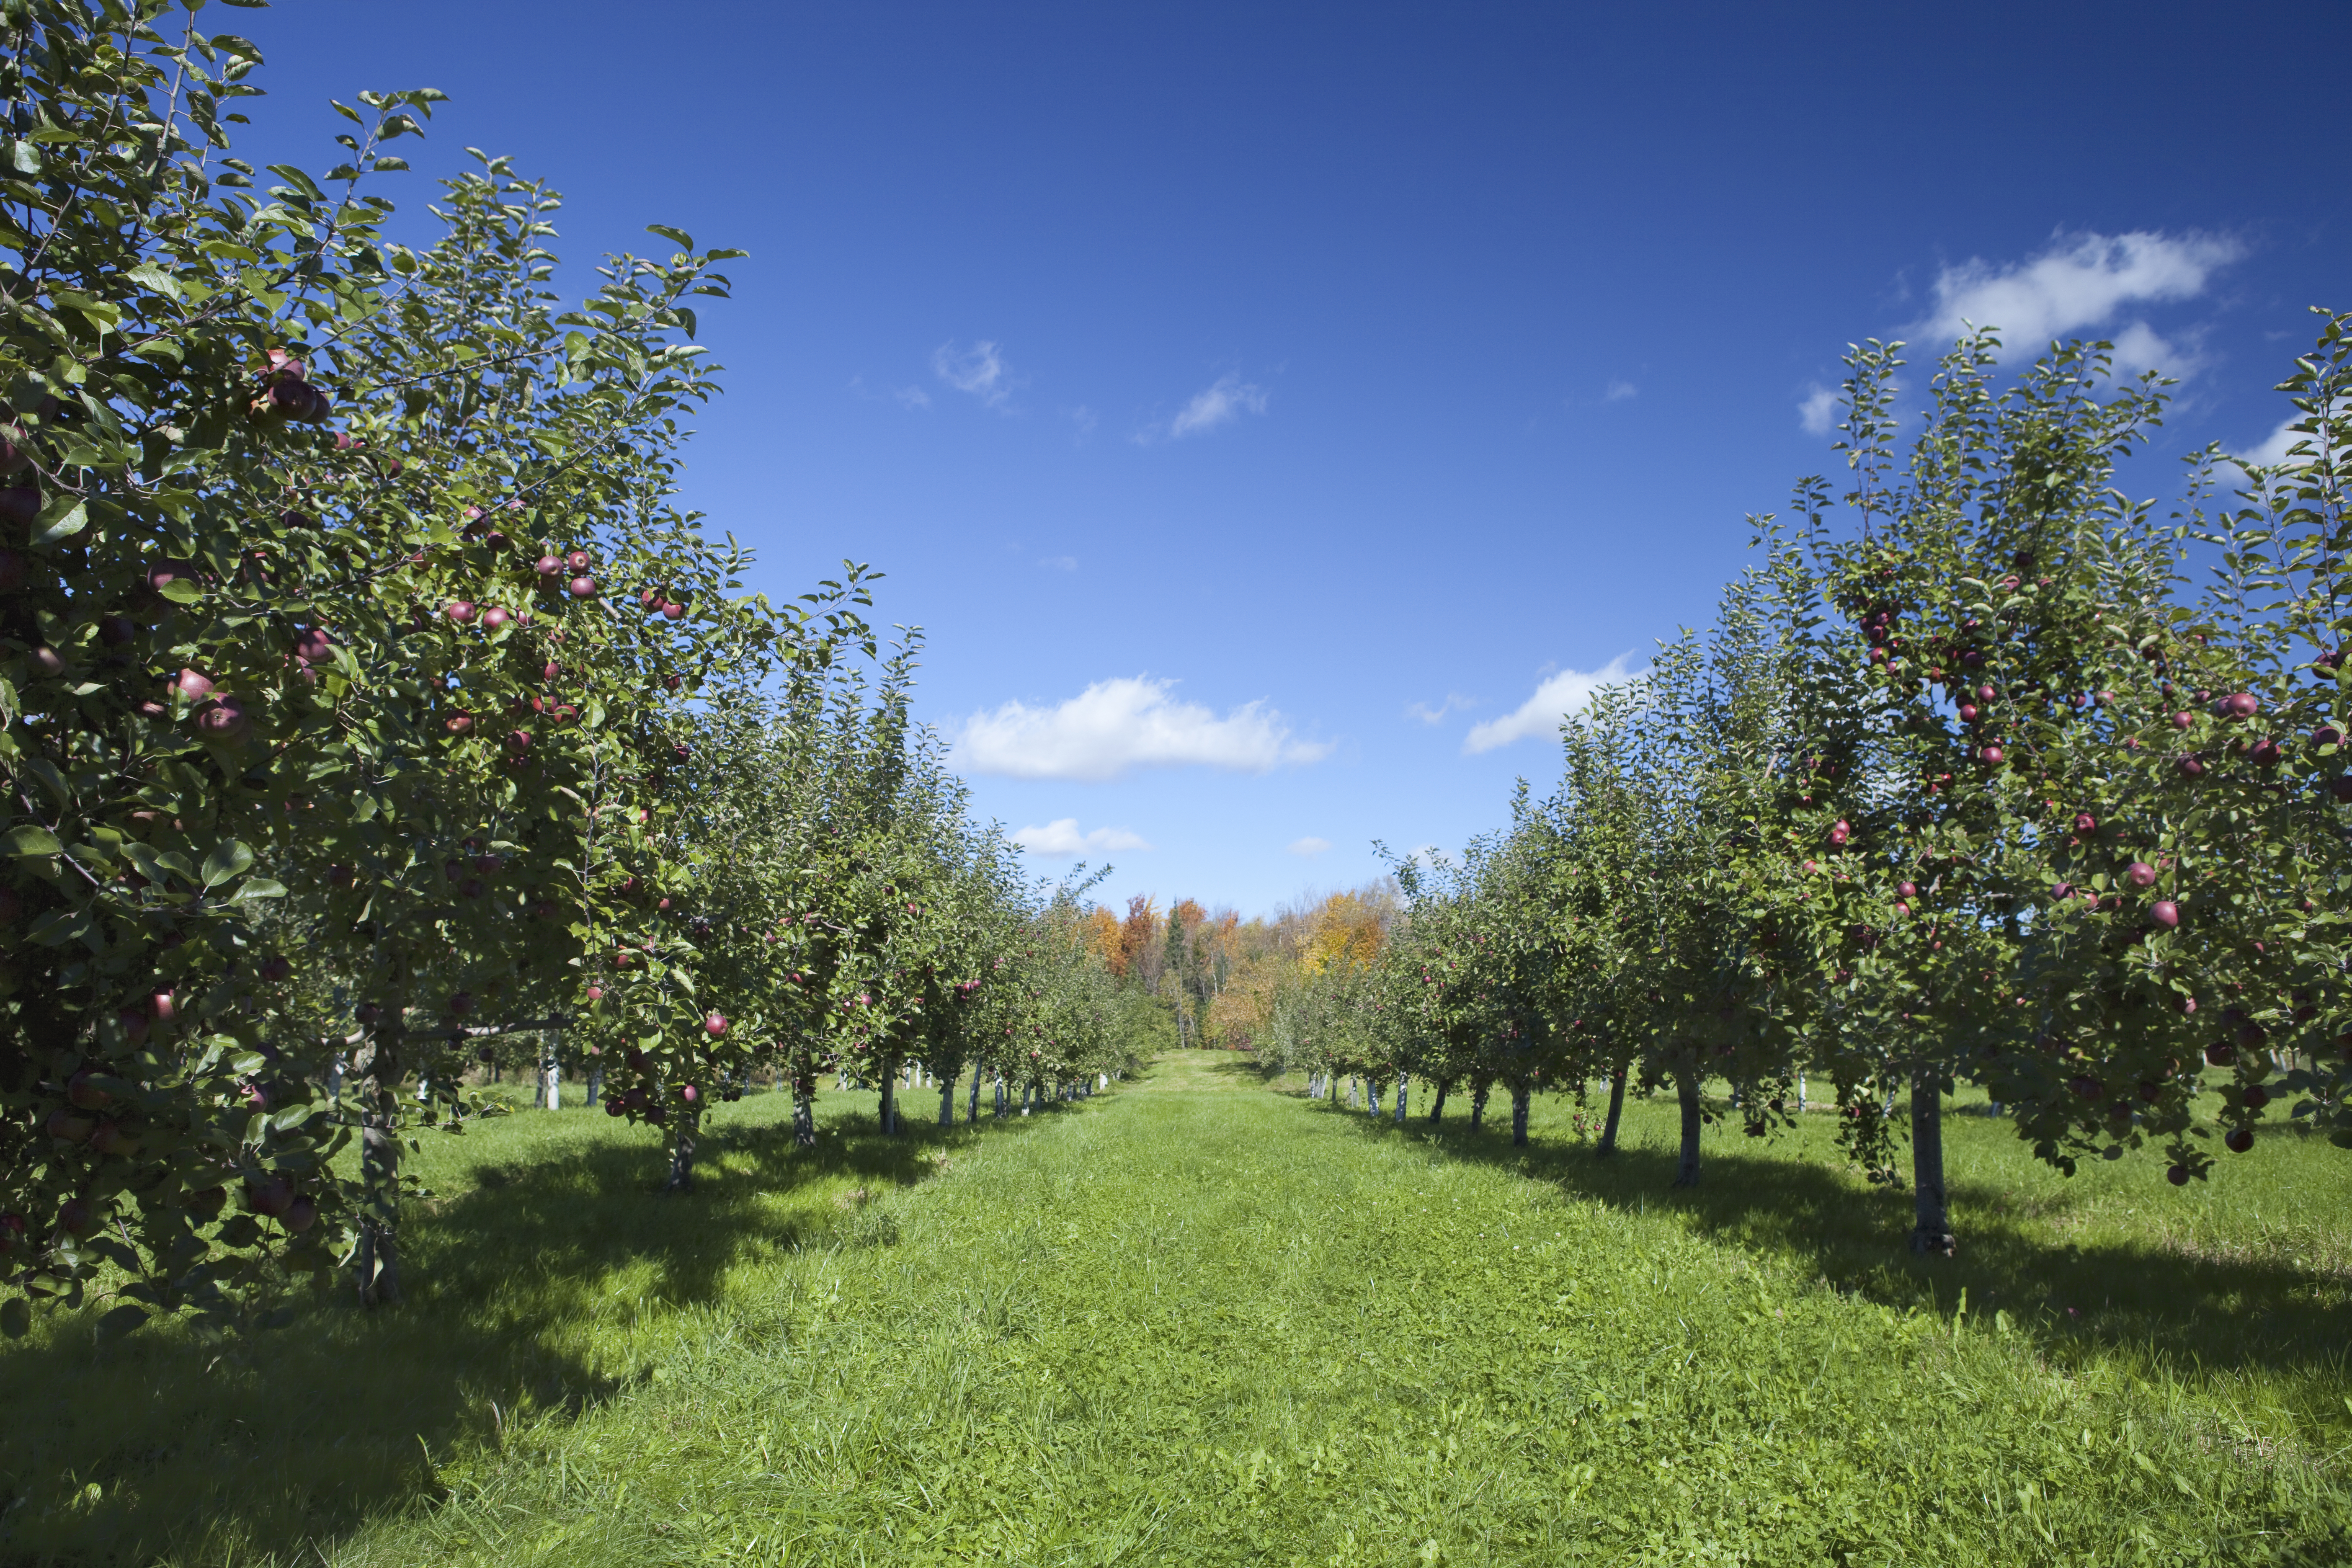
Johnny Appleseed was a clever nurseryman
John Chapman was born in Leominster, MA in 1774. In his early 20s, he headed for the western frontier, which was then western Pennsylvania and eastern Ohio.
Johnny Appleseed was a nurseryman. He collected free apple seeds from cider mills and initially squatted on land to plant apple tree seedlings. Later he purchased land. He had a knack for predicting where settlers would travel, and sold his seedling apple trees for 6.5 cents.
Johnny Appleseed was not poor.
He owned 1,200 acres of land when he died in Indiana in 1845.

Slide 3
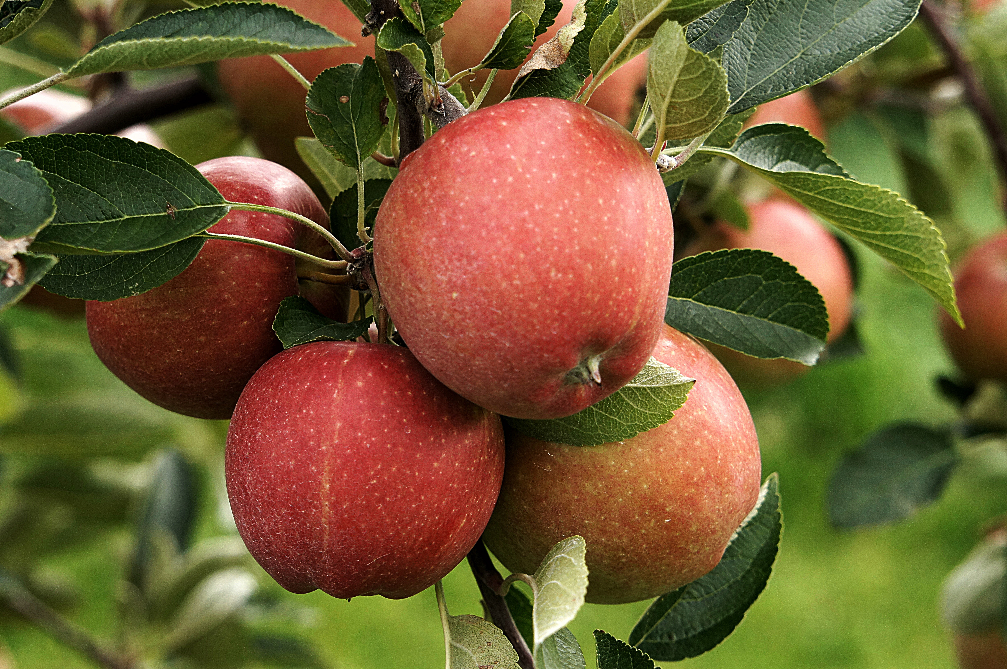
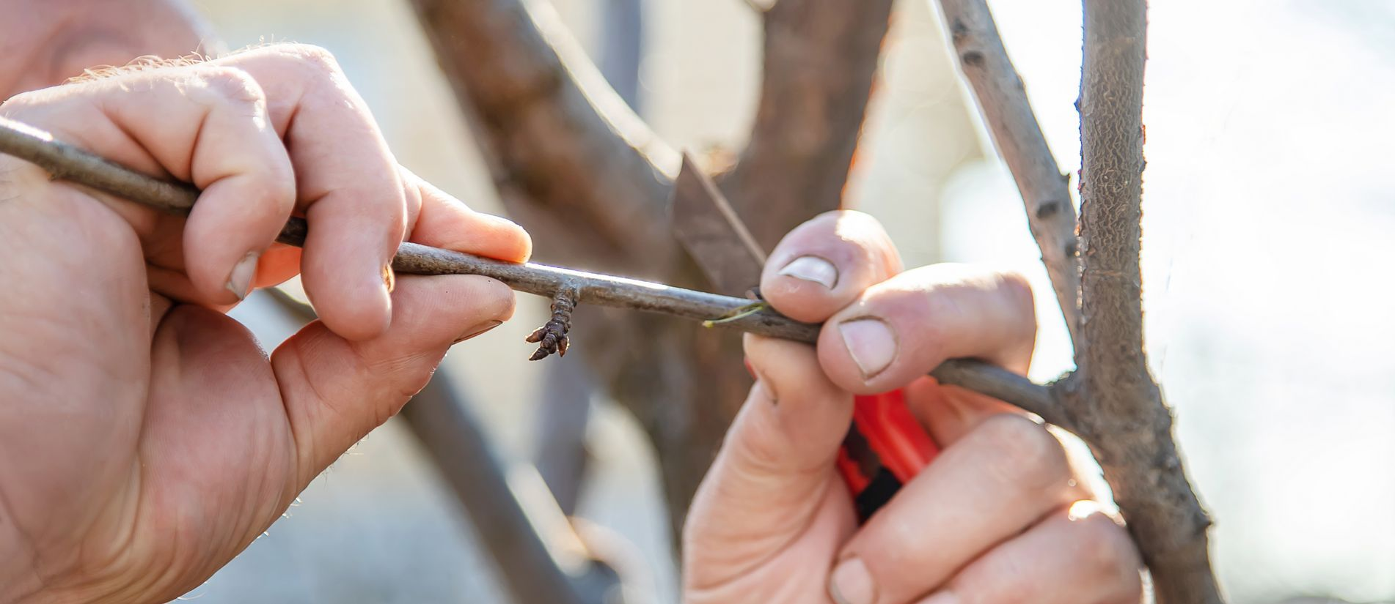
Apples are heterozygous – they do not grow “true to seed.”
If you plant an apple seed, the resulting plant will not be a copy of its parent. Apple seedlings are genetically different and usually inferior to their parent trees.
Fruits that do not grow true to seed:
Apples Blueberries Grapes Pears Strawberries Bananas Mangoes
The apples we eat are propagated by grafting. Only by grafting can growers produce trees that are genetically identical to one another.
To create a graft, a nurseryman inserts a shoot or twig from one tree into a slit on the trunk or stem of another tree.

Slide 4
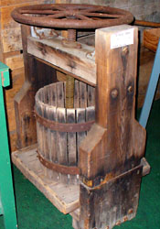
Nobody ate Johnny Appleseed’s apples
The seed tree apples that Johnny Appleseed grew were usually so bitter they were called “spitters.”
People on the frontier in Pennsylvania, Ohio, and Indiana used apples grown from Johnny Appleseed’s seeds to make hard cider.
On the frontier, water and milk were typically unsanitary. Hard cider, with its 8% alcohol content, was the most trusted beverage. Even children drank it.
Prohibition ended the widespread custom of making and drinking hard cider. After prohibition, the apple’s image was rehabilitated into the healthy fruit we eat today.

Slide 5
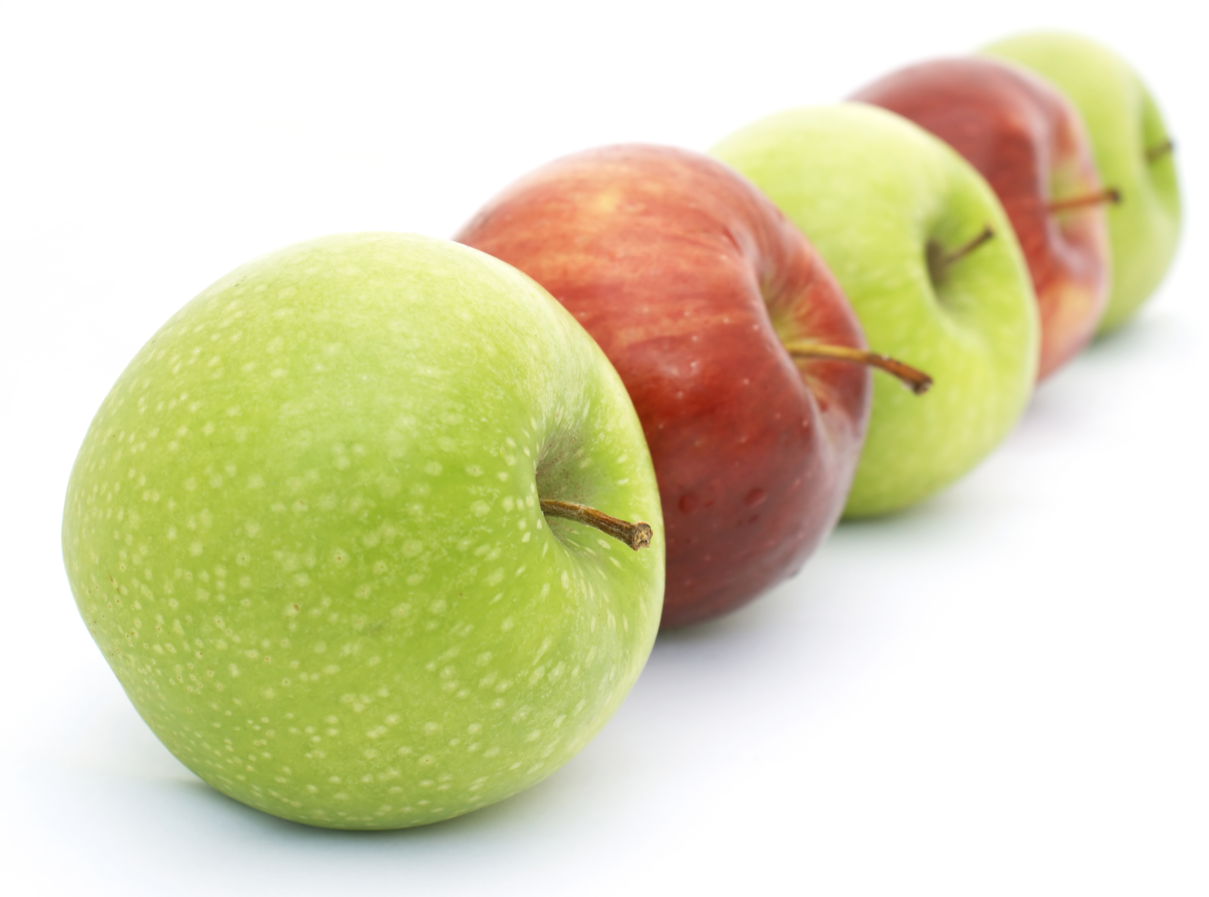
Every now and then, an edible apple appears by chance
The first McIntosh apple appeared as a sapling at a farm in Canada in 1812.
The first Red Delicious apple appeared as a sapling at a farm in Iowa in 1872.
The first Golden Delicious apple appeared as a sapling at a farm in West Virginia in 1912.
Grafting is an ancient art believed to have been started by the Chinese in 2000 B.C. Settlers brought grafted trees with them to America. There was a nurseryman selling grafted trees on the border of Pennsylvania and Ohio at the same time Johnny Appleseed was selling his seed trees.
In modern times, new apple varieties are created by cross-breeding. For example, the Empire apple was developed at Cornell University in the 1940s. Its parents are the Red Delicious and the McIntosh.

Slide 6
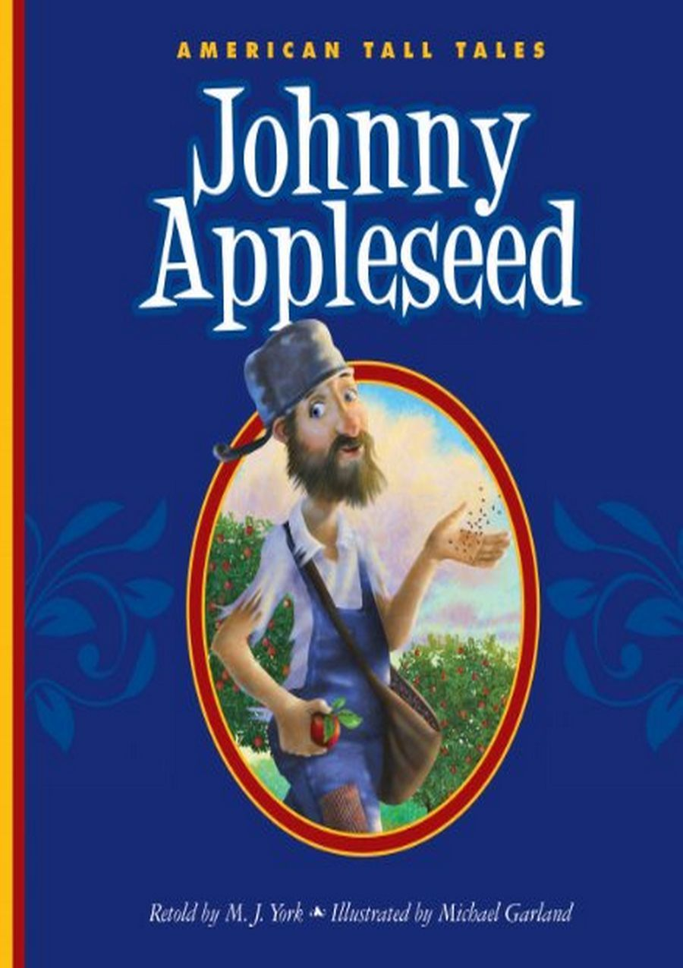
What is true about Johnny Appleseed?
He dressed in rags.
He was a vegetarian and a friend to animals.
He often slept outside and did not have a fixed address.
He shared his knowledge of medicinal herbs.
(Although he did plant dog fennel, now known as a noxious, invasive weed.)
He was friends with Native Americans.
He was a missionary for the New Church of Jerusalem (aka Swedenborgian Church) and often read the Bible to frontier families who hosted him.
He believed grafting was against God’s way.

Slide 7
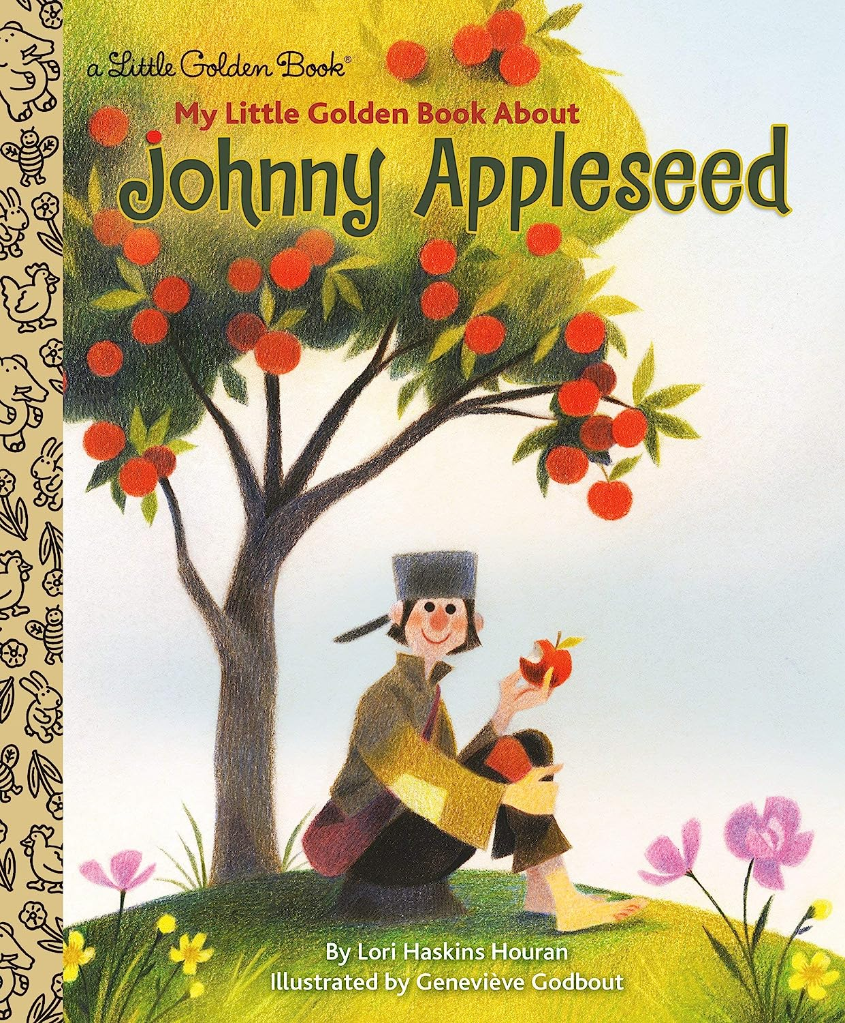
The surprise winner of a survey for accuracy of 15 children’s books about
Johnny Appleseed published since 2000:
My Little Golden Book
About Johnny Appleseed
by Lori Haskins Houran
published in 2017
“The apples that grew on Johnny’s trees were mostly ‘spitters.’ That meant they were too sour to eat! Settlers used them to make cider and vinegar.”
Most children’s books on Johnny Appleseed either do not mention what the apples were used for or they say the apples were used for eating and making applesauce and pies.

Slide 8
Sources
The Real Johnny Appleseed Brought Apples – and Booze – to the American Frontier
By Natasha Geiling
smithsonian.com
November 10, 2014
The Botany of Desire, A Plant’s Eye View of the World
By Michael Pollan
Random House
2001

