Slide 1
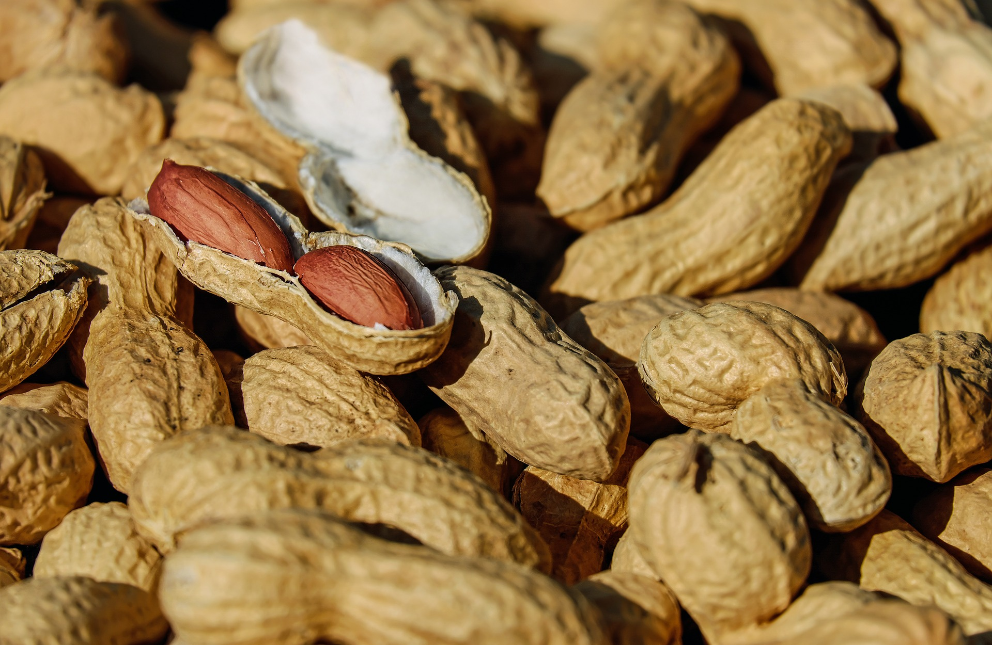
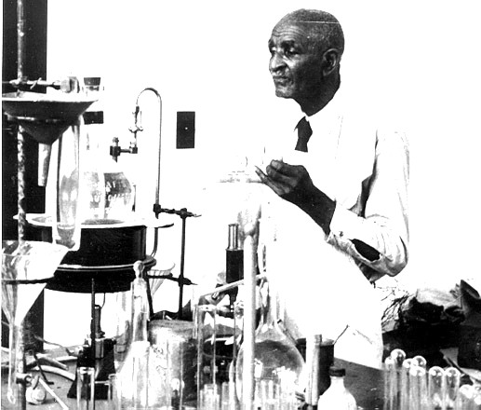
The Peanut Wizard
Photo courtesy of Tuskegee University, Tuskegee, AL
The Life of
George Washington Carver
A presentation by

Slide 2
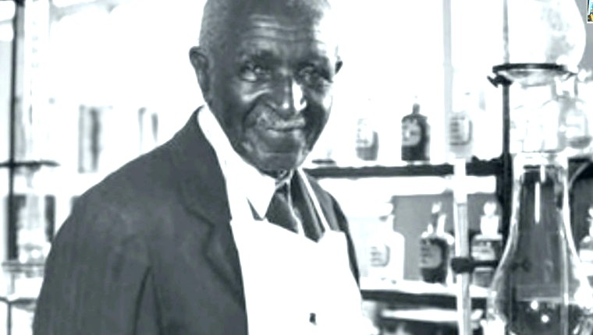
George Washington Carver was a world-famous scientist and teacher. He loved learning about plants. His research on peanuts, sweet potatoes, and soybeans helped poor farmers in the southern United States to grow better crops and eat better food.
George Washington Carver was born about 150 years ago. After he died, a monument erected at his boyhood home in Missouri was the first monument in the United States to honor an African American
This is his story.
Photo courtesy of Tuskegee University, Tuskegee, AL

Slide 3
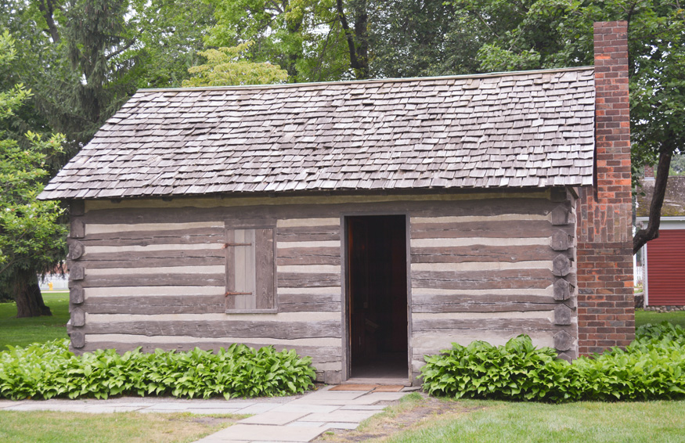
A Sad Beginning
George Washington Carver was born in Missouri in 1864. He was born a slave. That means George, his mother Mary, and his older brother Jim were considered the property of Moses and Susan Carver. A slave is forced to work for his owner without pay.
Shortly after George was born, he and his mother were kidnapped by slave robbers. Moses Carver paid a man to search for Mary and George, but only baby George was returned to the Carvers. His mother was never found.
A year later, slavery was declared illegal in the United States and all the slaves were freed. Moses and Susan Carver continued to care for George and his brother Jim.
This is a replica, or copy, of the slave cabin where George lived with his mother Mary and brother Jim.
Photo courtesy of George Washington Carver
National Monument

Slide 4
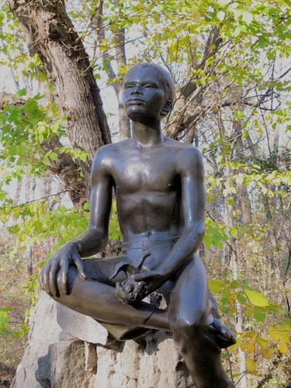
The Young Plant Doctor
As a child, George was fascinated by plants. He created a secret plant hospital in the woods where he took sick plants and experimented to make them better. He soon knew so much that neighbors called him the Plant Doctor and asked him for help with their plants.
The Carvers realized that George was a very curious and intelligent child. They taught him everything they could and then hired a tutor for him.
Soon George decided that he needed to go to school. But even though the slaves were free, African Americans were not allowed to go to school with white children. There was no school for African American children near George’s home. When George was 11, he left the Carvers and moved to another town to attend school.
There are no pictures of George when he was a small boy. This is a statue of him at the Carvers’ old farm, which is now a national monument.
Photo courtesy of
George Washington Carver
National Monument

Slide 5
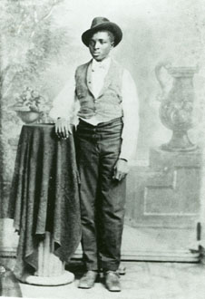
A Boy Follows His Dream
For the next 10 years, George followed his dream of getting a good education by moving from town to town to go to better schools. He lived with friendly people who took him in, and earned money by cooking, washing clothes, and doing whatever jobs people needed done. He went to high school in Kansas.
Next George decided he wanted to go to college. But the first college he wanted to go to would not let him attend when they found out he was an African American. He finally became the first African American student at Iowa State University, where he studied agriculture.
George Washington Carver when he was about 13 years old.
Photo courtesy of George Washington Carver
National Monument

Slide 6
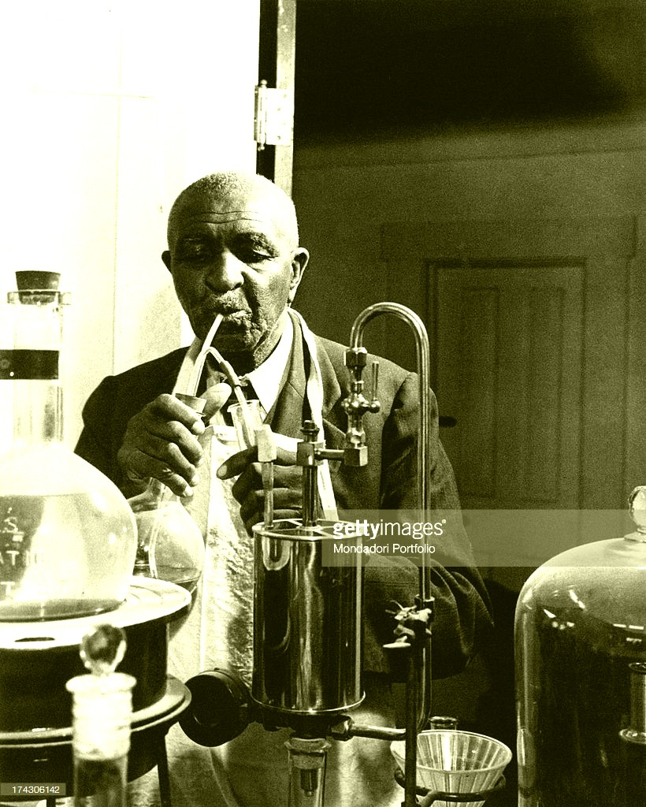
A Move to Alabama
After he graduated from Iowa State University, George Washington Carver accepted a job teaching at a new college for African American students in Alabama, called the Tuskegee Institute. He also was the school’s director of agriculture research. Agriculture is another word for farming.
In Alabama, George saw poor African American farmers near his school struggling to make a living. These farmers planted cotton every year, and their crops were not growing well. The farmers could barely make enough money to survive.
Photo courtesy of Tuskegee University, Tuskegee, AL

Slide 7
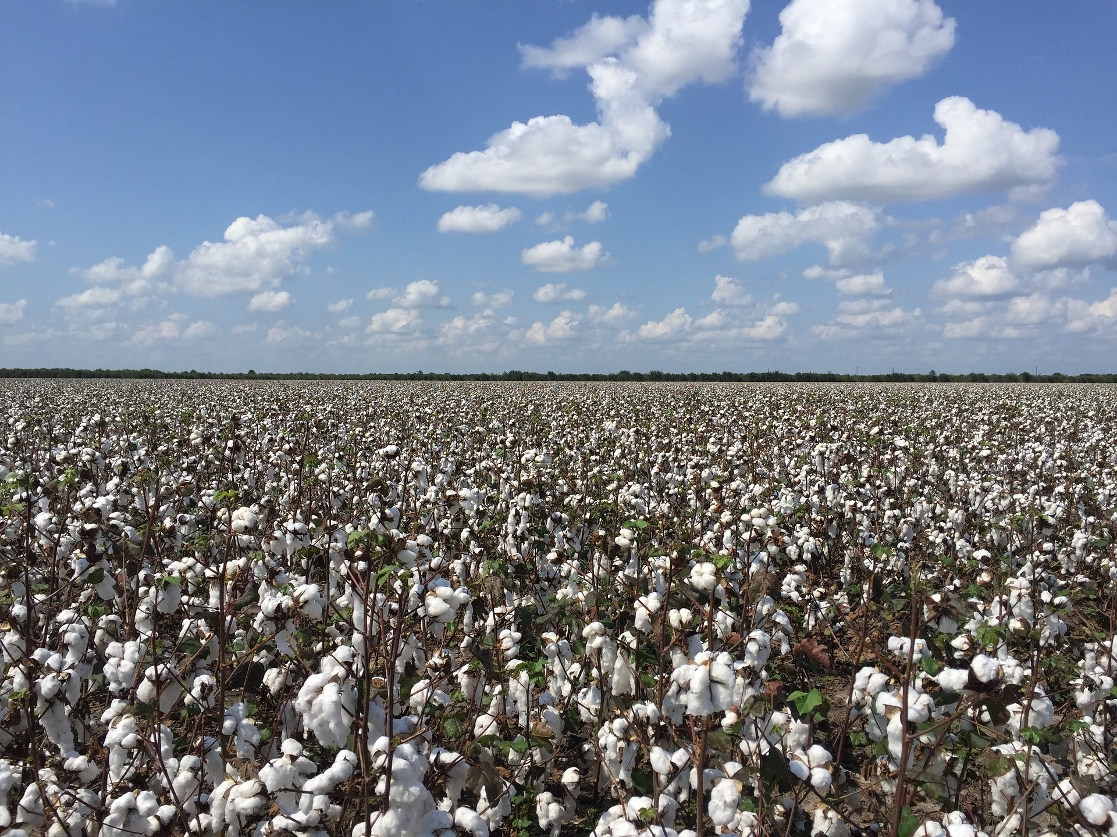
The Cotton Problem
George knew that cotton plants soaked up large amounts nitrogen from the soil to help them grow. Nitrogen is a nutrient that all plants need. The only way to grow cotton in the same field every year was to add nitrogen back into the soil with fertilizer. But the poor farmers in Alabama did not have money to buy fertilizer. With less and less nitrogen in the soil every year, the farmers’ cotton did not grow very well.
George told the farmers they should plant peanuts instead of cotton. Peanuts belong to a special family of plants called legumes. That’s pronounced lay-goom. Legumes can do something that no other plants can do – they can put nitrogen back into the soil!

Slide 8
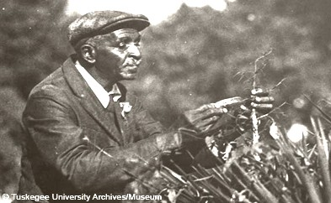
Nature’s Free Fertilizer
George taught the poor farmers in Alabama how to use peanut plants as free natural fertilizer. Instead of planting cotton every year, he told them to plant cotton one year, and then plant peanuts the next year, so that the peanut plants would put important nitrogen back into the soil. This way of switching crops every other year is now called crop rotation.
But George still had one problem. At that time, peanuts were mostly used to feed animals. People called them “monkey nuts.” Farmers did not want to plant peanuts because they were afraid no one would buy them.
Photo courtesy of Tuskegee University, Tuskegee, AL
The family of plants called legumes includes peanuts, peas, lentils, and all types of beans, especially soybeans. George Washington Carver’s favorite legume was the peanut.

Slide 9
What Can You Do With A Peanut?
George knew that peanuts were not only good for the soil, but that they would be a good, inexpensive source of protein for poor people to eat. So George went back to his laboratory to do some research on peanuts.
George invented more than 100 ways to use peanuts. He created recipes for all kinds of food made from peanuts, including pancake flour, cheese, mock chicken, milk, coffee, and candy. He also made cooking oil, shampoo, soap, glue, medicine, ink, paint, dye, and wallboard from peanuts.
In 1921, George went to Washington, D.C. to talk to Congress about all the ways that peanuts could help farmers. He was given the nickname “The Peanut Wizard.”

Slide 10
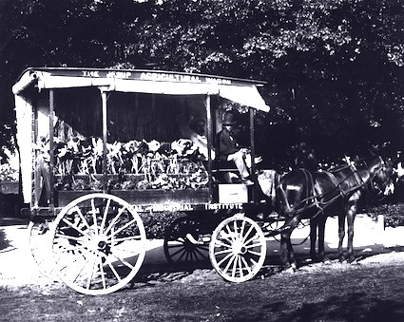
A School on Wheels
George Washington Carver also wanted to help poor farming families grow healthier food for themselves. He created a school on wheels, and toured the countryside, talking to farmers. He encouraged them to plant vegetable gardens for fresh, cheap food. He told them to plant sweet potatoes, because they grew well in the South, did not cost much, and were very nutritious.
“The primary idea of all my work,” he said, “was to help the farmer and fill the poor man’s empty dinner pail.”
Photo courtesy of Tuskegee University, Tuskegee, AL

Slide 11
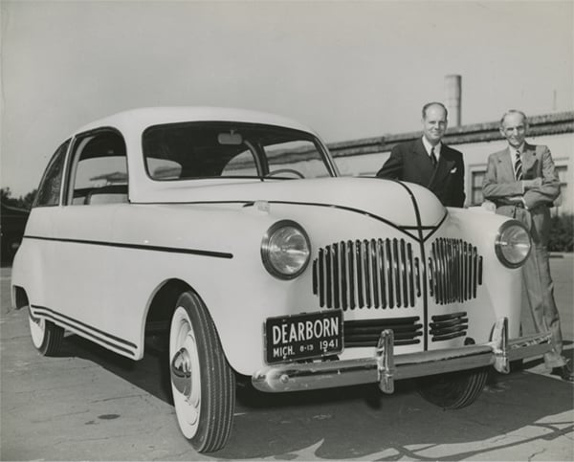
Don’t Forget the Soybean!
George Washington Carver also did a lot of research on another legume – the soybean. He discovered that it also was an important source of protein and oil. He helped develop soybeans as a major crop in the United States. And he even worked with his friend Henry Ford to make a car out of soybeans!
In 1908, Henry Ford made the first inexpensive automobile by producing his Model T car on an assembly line. He started the Ford Motor Company.
Henry Ford was also very interested in agriculture and wanted to explore using crops such as soybeans to produce plastics, paint, fuel, and other products. In 1942, his company built a car with a plastic body made from soybeans. This is a picture of it.
But all production of American cars stopped when World War II began. When the war was over, the soybean car project was abandoned.
Photo from the Collections of The Henry Ford

Slide 12
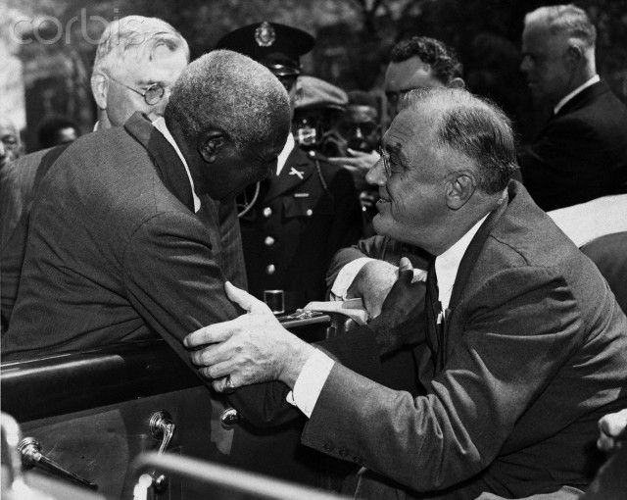
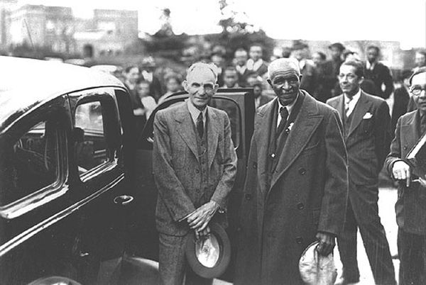
World-famous Scientist
George Washington Carver became famous around the world. He traveled and gave speeches about his research. His friends included the light bulb inventor Thomas Edison, as well as the car maker Henry Ford. President Theodore Roosevelt admired his work and sought his advice on agriculture. George continued to work at the Tuskegee Institute in Alabama all his life, and he was buried there after his death in 1943.
That same year, President Franklin Roosevelt created the George Washington Carver National Monument at George’s birthplace in Diamond, Missouri. This was the first national monument dedicated to an African American.
George Washington Carver and President Franklin Roosevelt
Photos courtesy of Tuskegee University, Tuskegee, AL
George Washington Carver and Henry Ford

Slide 13
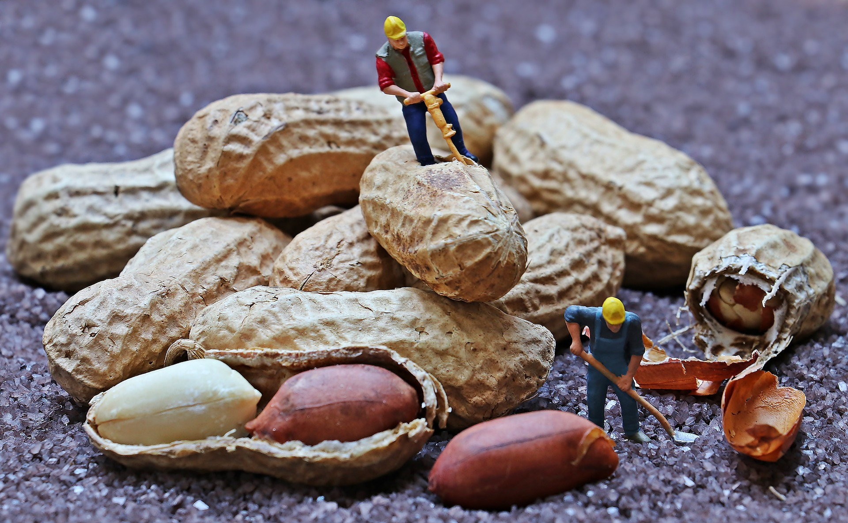
Peanuts Today
George Washington Carver is responsible for the start of the peanut industry in the United States. Today we eat peanuts, peanut butter, and peanut butter candies and cookies. Peanuts are also made into imitation milk, cheese, and ice cream. Animals are fed peanut meal to give them protein.
Parts of peanuts are used to make many other things, such as wallboard, fireplace logs, and paper. Peanuts are also often used to make cleaners, ink, axle grease, shaving cream, face cream, soap, linoleum, rubber, cosmetics, paint, explosives, shampoo, and medicine.

Slide 14
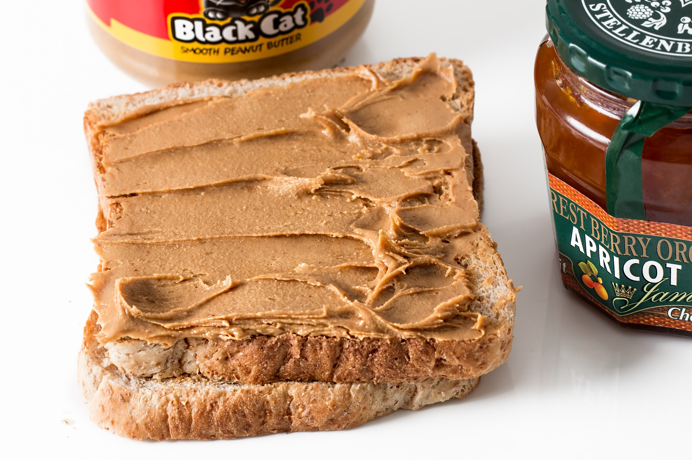
So, What About Peanut Butter?
Although George Washington Carver invented hundreds of uses for peanuts, he did not invent peanut butter. That was invented by Dr. John Harvey Kellogg, the creator of Kellogg’s cereals, who patented a process for creating peanut butter from raw peanuts in 1895.
Americans eat three pounds of peanut butter per person every year. That's about 700 million pounds, or enough to coat the floor of the Grand Canyon! The average American child will eat 1,500 peanut butter sandwiches by the time he or she graduates from high school.

Slide 15
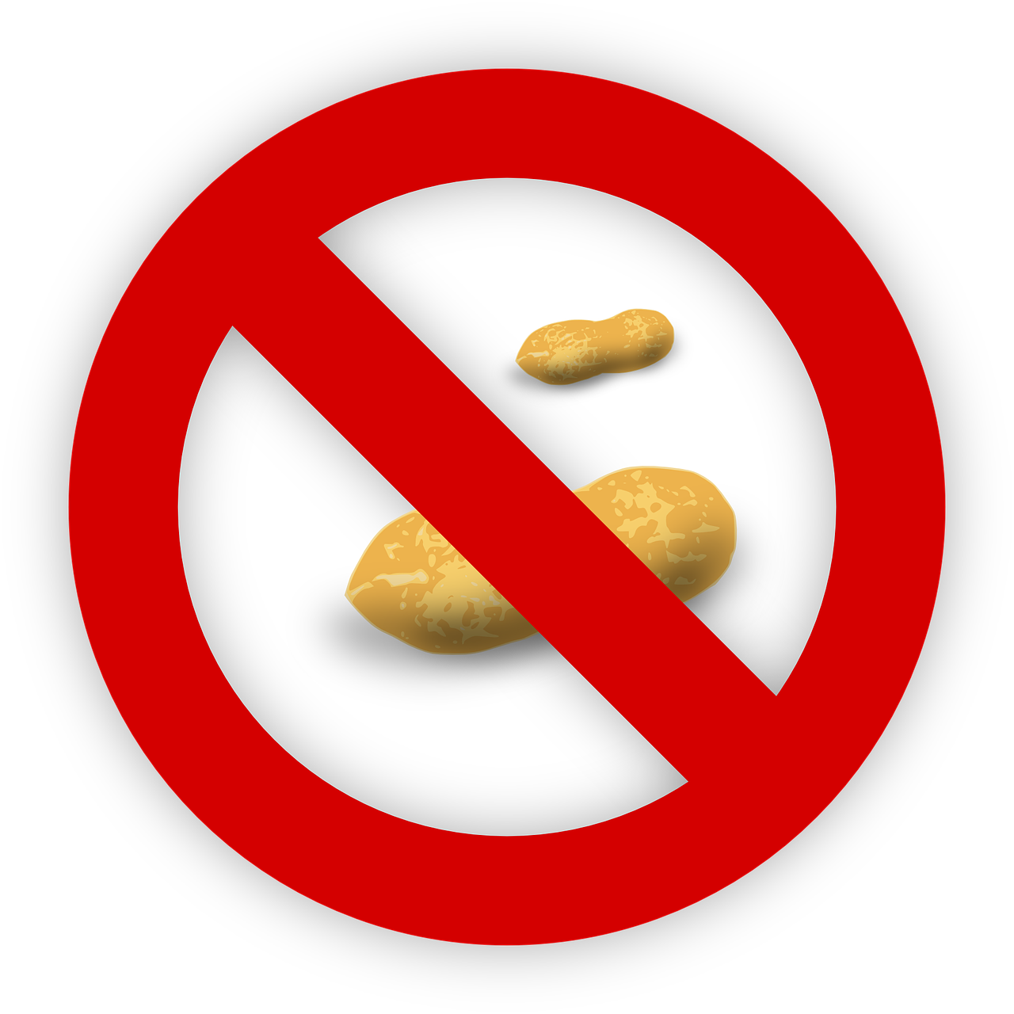
Peanuts: Not For Everybody!
Not everyone can eat peanuts. Some people have a peanut allergy, which means they can get very sick if they eat or touch peanuts. Your cafeteria may have a ‘peanut free’ table where students with a peanut allergy can enjoy lunch without worrying about being near peanuts or peanut butter.

Slide 16
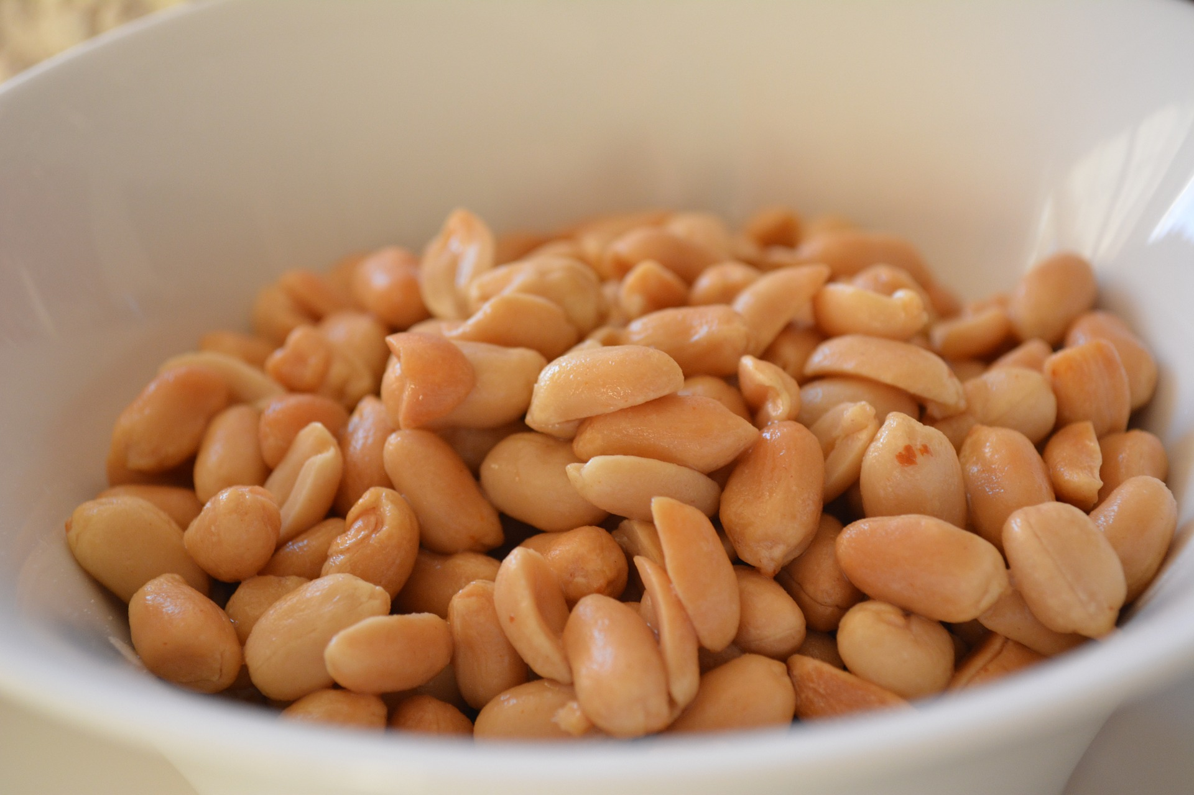
Peanut Power
The United States is the third largest grower of peanuts in the world, behind China and India. In the United States, peanuts are grown in 10 states, but Georgia, Texas, and Alabama grow the most.
There are about 7,000 peanut farmers in the United States and the average farm is 100 acres. So, how are peanuts grown?

Slide 17
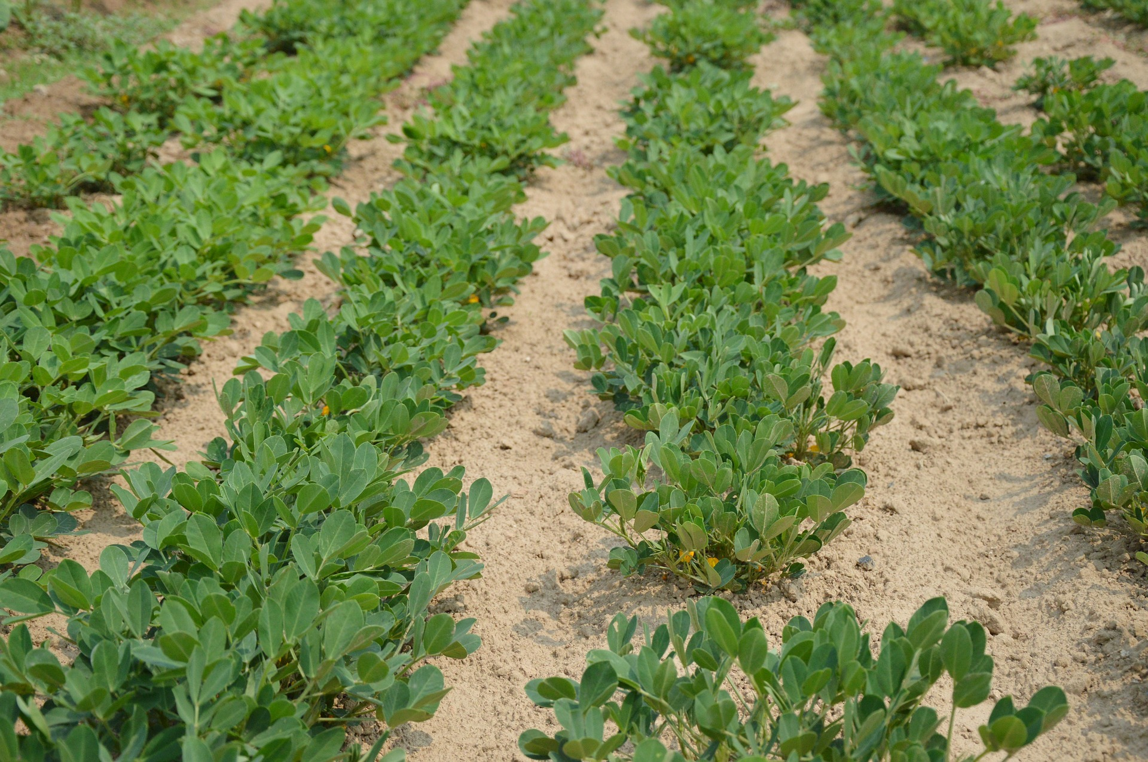
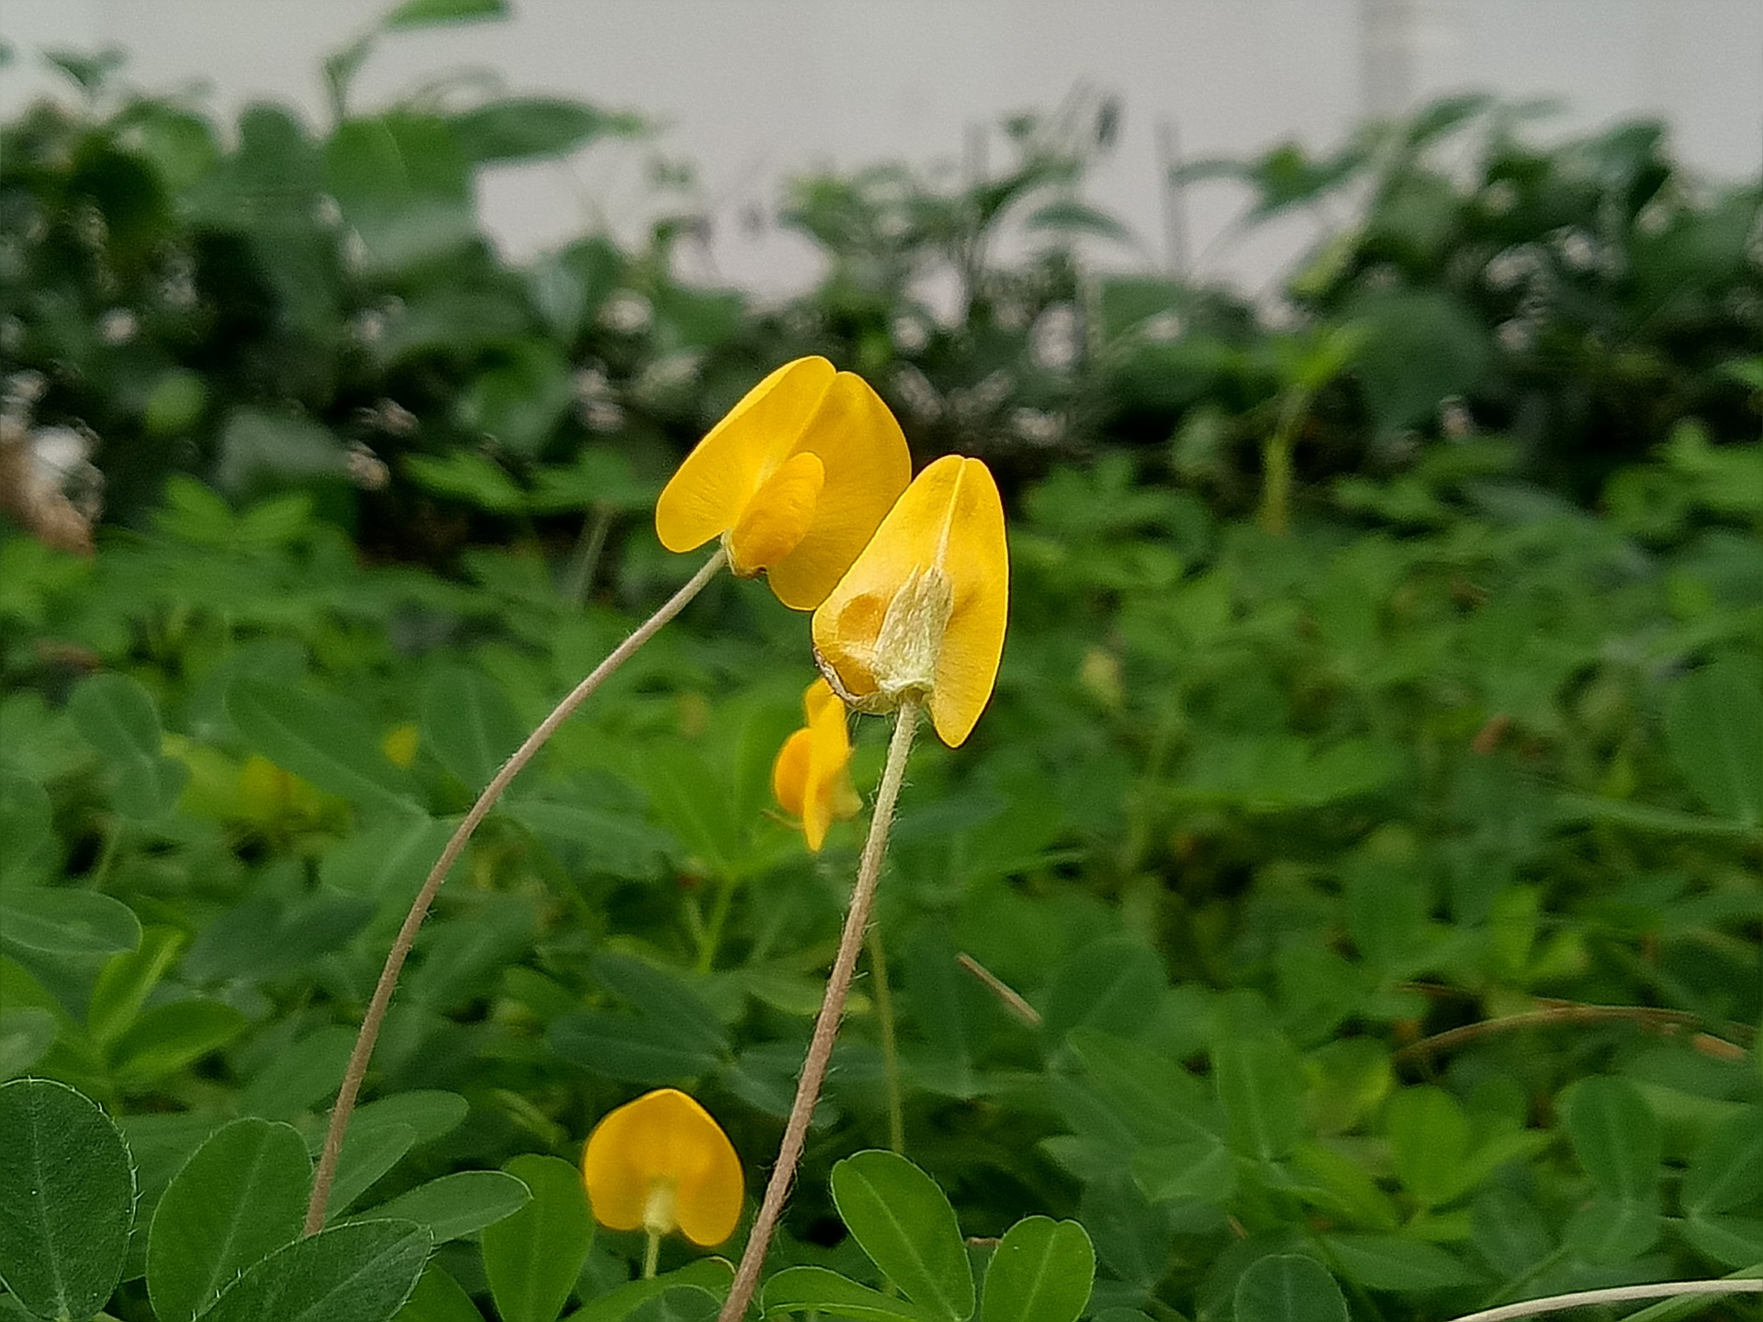
The Life of a Peanut
Farmers plant peanut seeds in late April or early May. The peanut plants appear in about 10-14 days.
Peanut plants need four to five months of warm weather to produce peanuts, which are the seeds of the plant.
In about 40 days, flowers appear on the peanut plant.
The flowers immediately begin to bend toward the ground. This is where the peanut plant’s life cycle gets very interesting!
Unlike most plants, a peanut plant produces flowers above the ground, but its fruit – the peanut seeds and shell – grows underground.

Slide 18
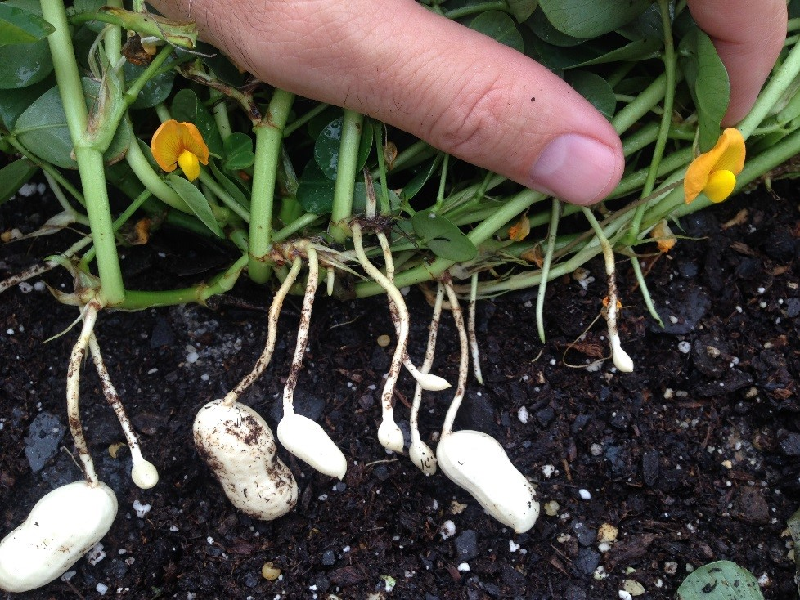
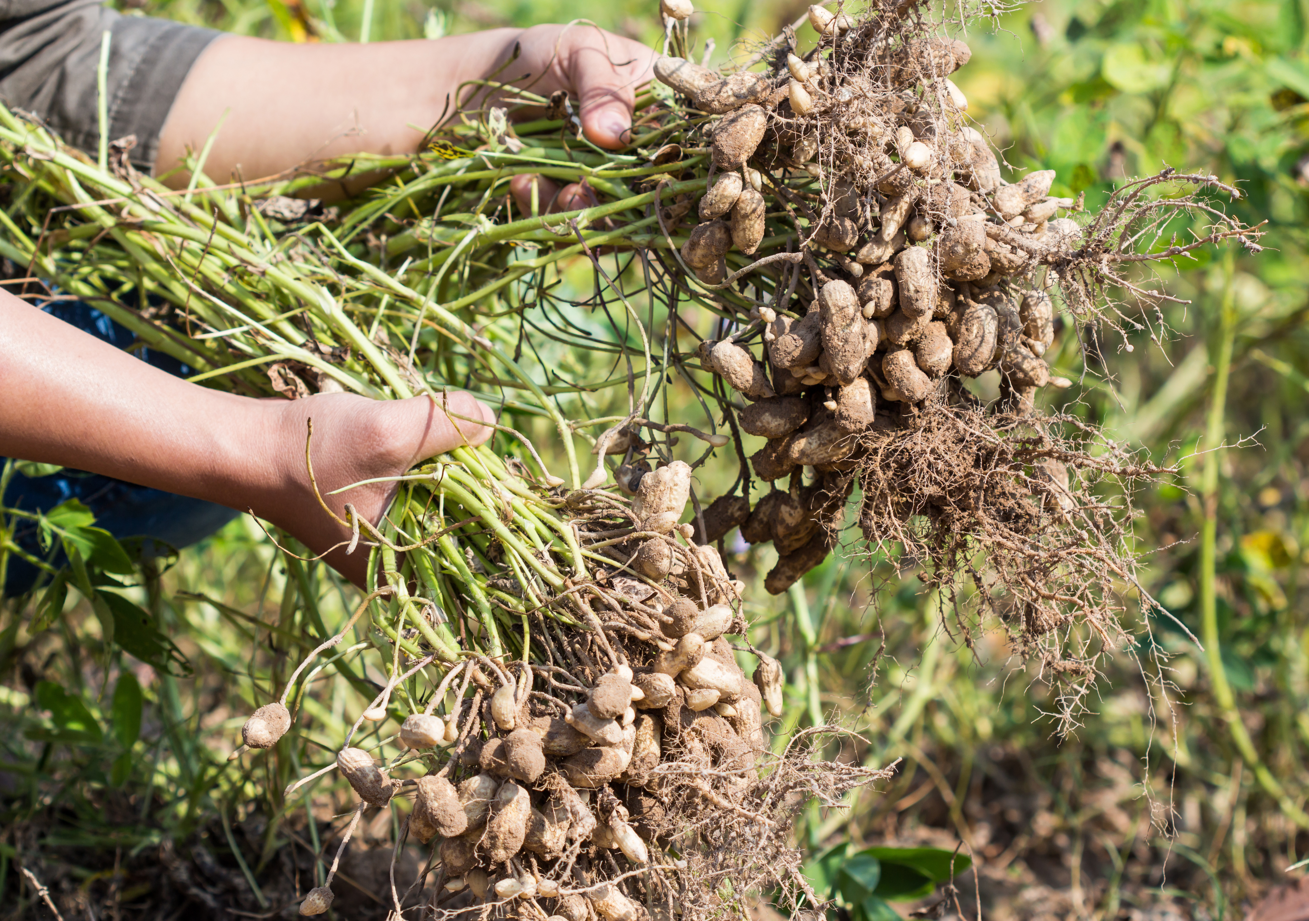
Flower Above,
Peanut Below
Peanut flowers can pollinate themselves. They don’t need help from pollinators such as bees. After pollination, the petals fall off and the center of the flower, where the seeds will grow, begins to grow larger. This part of the flower is called the ovary.
The stem that held the flower begins to get longer and grow away from the rest of the plant until it finally hits the ground. Touchdown! This stem is called a peg.
When the peg touches the ground, the ovary is pushed into the soil. The seeds form underground, inside the shell that protects them.
Photo by Barry Tillman, Associate Professor, University of Florida
One peanut plant can produce up to 40 peanut shells, with two to four peanuts inside each.

Slide 19
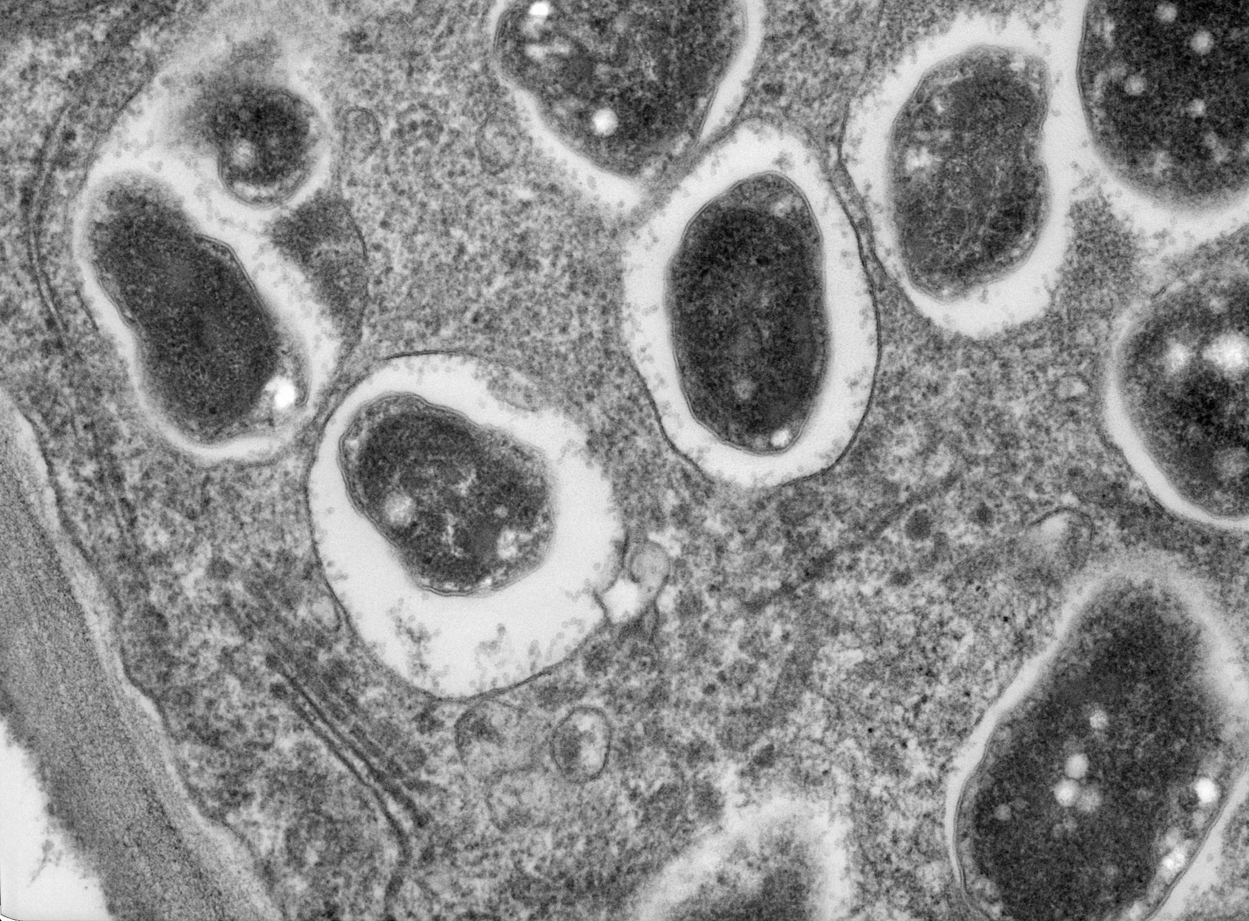
Peanuts: The Perfect Plant Food!
Why are peanuts a great fertilizer for other crops? Remember, all plants need nitrogen to grow. Some plants, like cotton and tomatoes, need lots of nitrogen. There is a lot of nitrogen in the air around us, but most plants can’t get nitrogen from the air. Plants must get nitrogen from the soil. Only legume plants like peanuts can capture the nitrogen in the air and put it back in the soil. They do that with help from tiny living things in the soil called bacteria.
Bacteria are so small you can’t see them with just your eyes. You need a strong microscope to see them. This picture shows what bacteria look like under a microscope. The bacteria that team up with peanuts are called rhizobia.

Slide 20
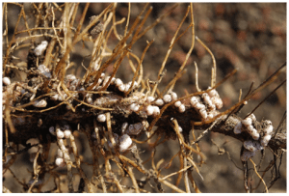
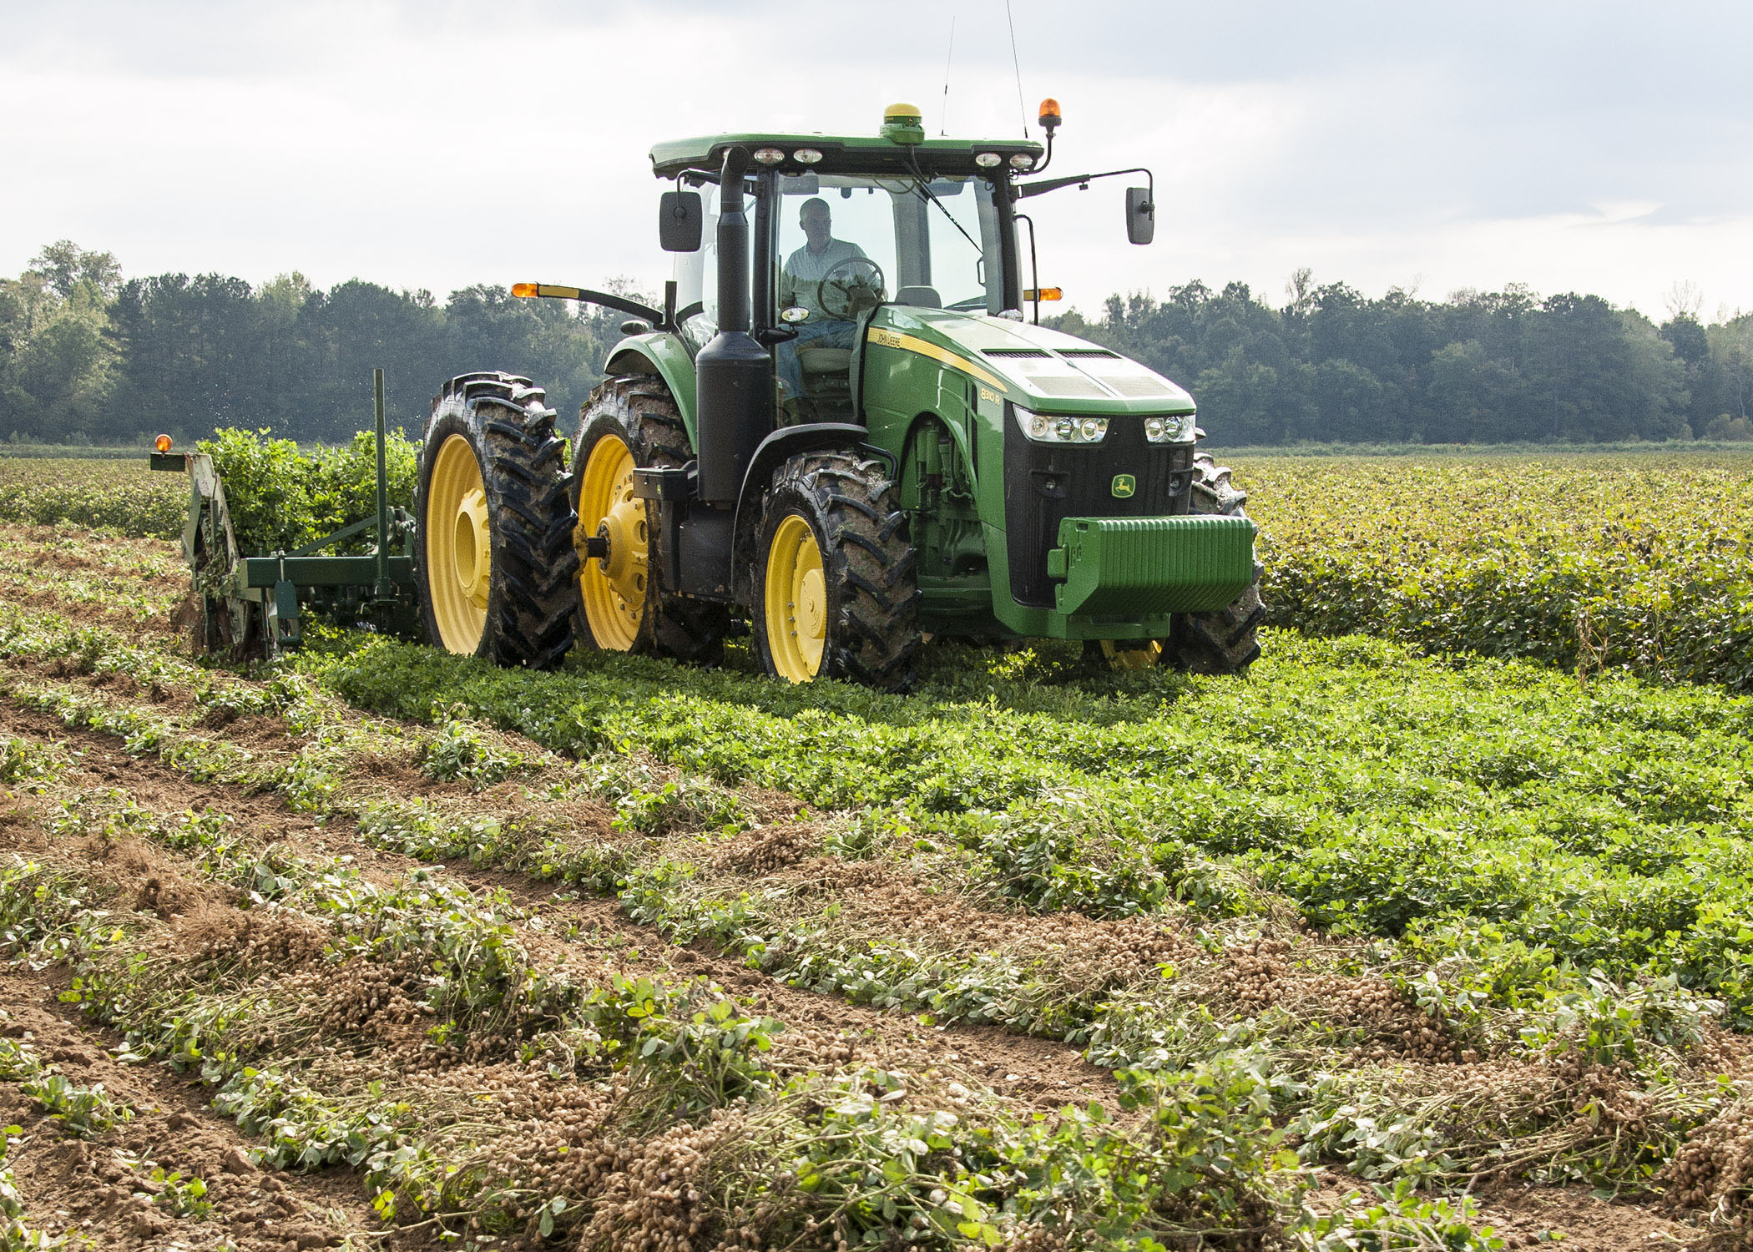
Look! Lumpy roots!
A peanut plant that needs nitrogen grows lumps on its roots. These lumps are called nodules. The bacteria that is in the soil move to live in the nodules. Together, the bacteria and the peanut plant pull nitrogen from the air. The entire peanut plant – leaves, stem and roots – becomes filled with nitrogen.
Photo by Scotty Real, dudegrows.com
When farmers dig the peanuts from underground, they leave the rest of the plant in the fields. All of the nitrogen stored in the plant eventually goes back into the soil Now the fields are ready for another crop that needs nitrogen.
Photo by MSU Ag Communications/Scott Corey

