Slide 1
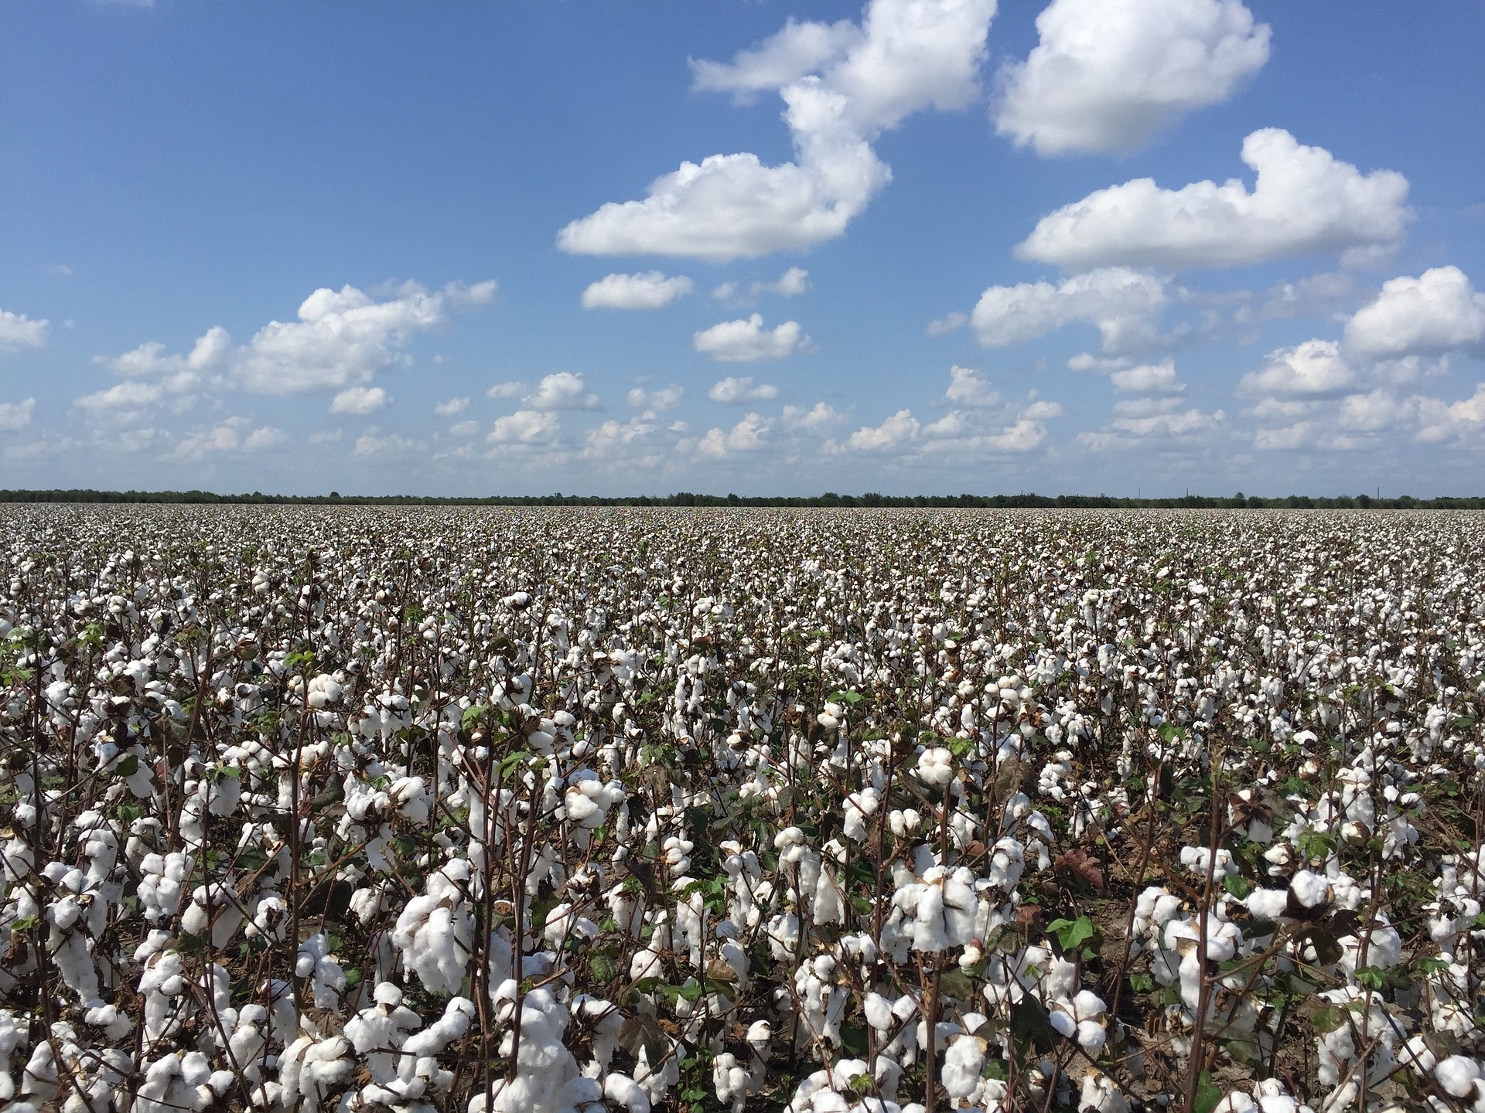
From Dirt To Shirt
How Cotton Grows
A presentation by

Slide 2
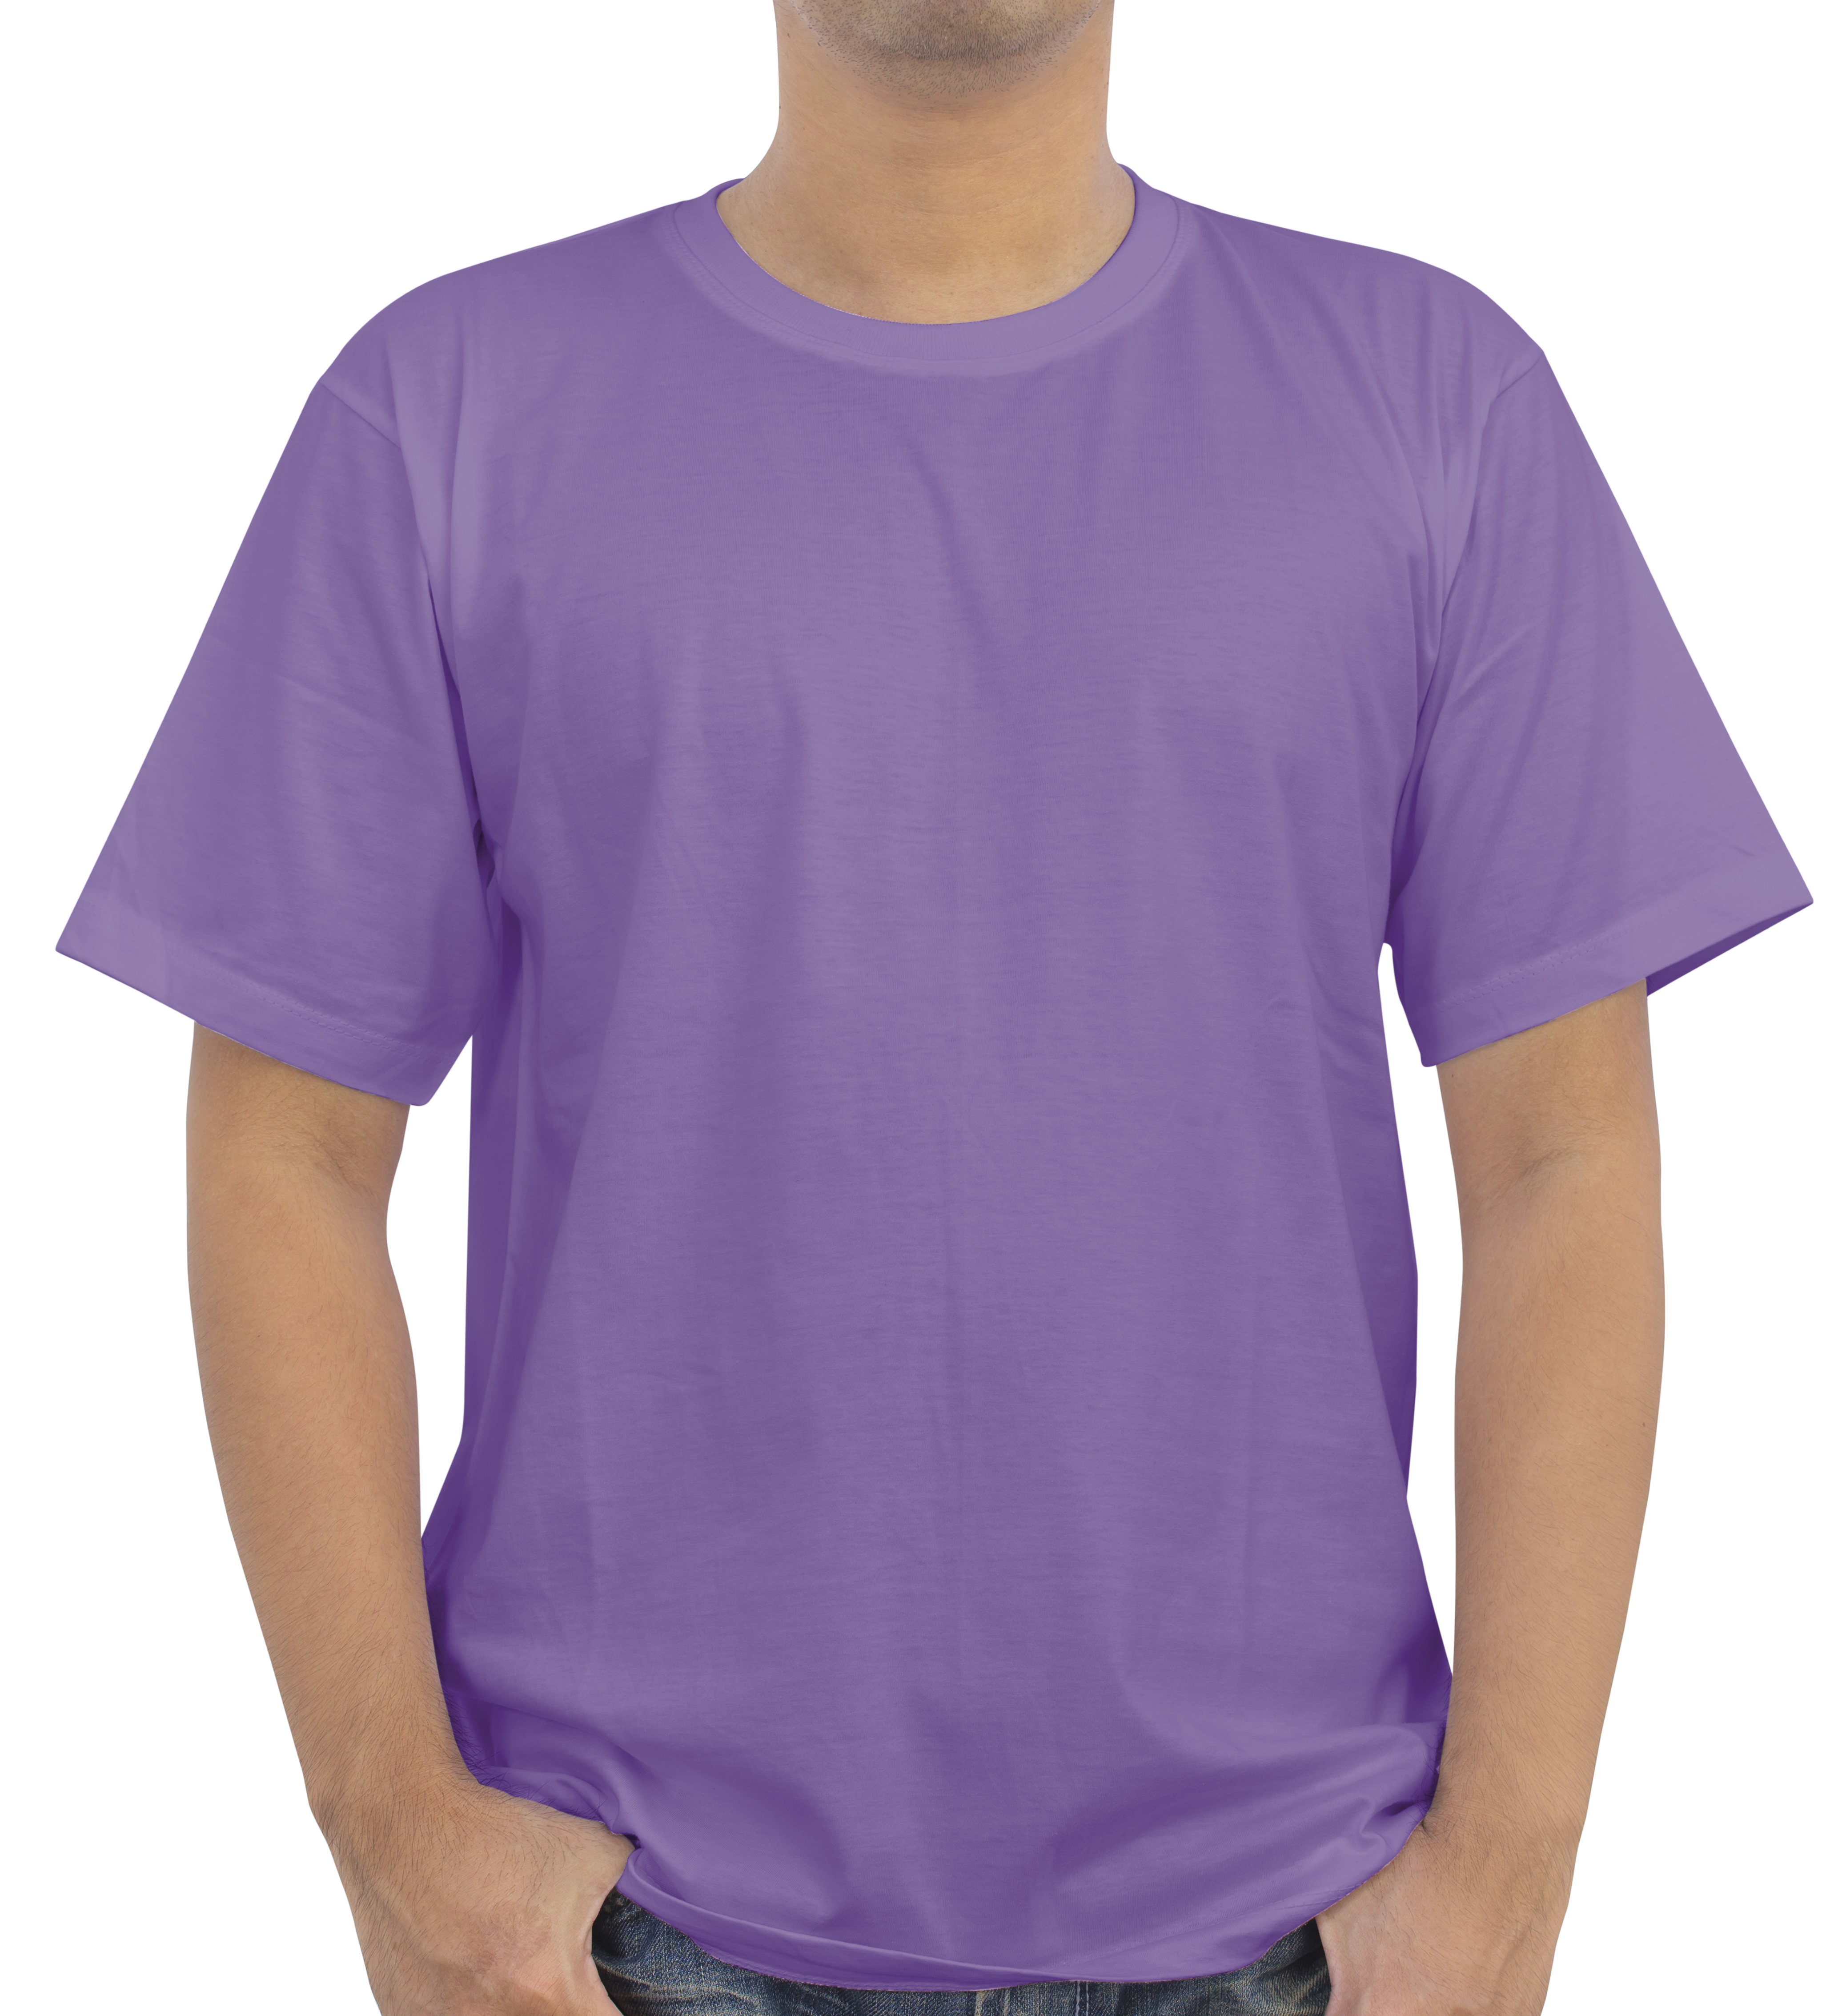
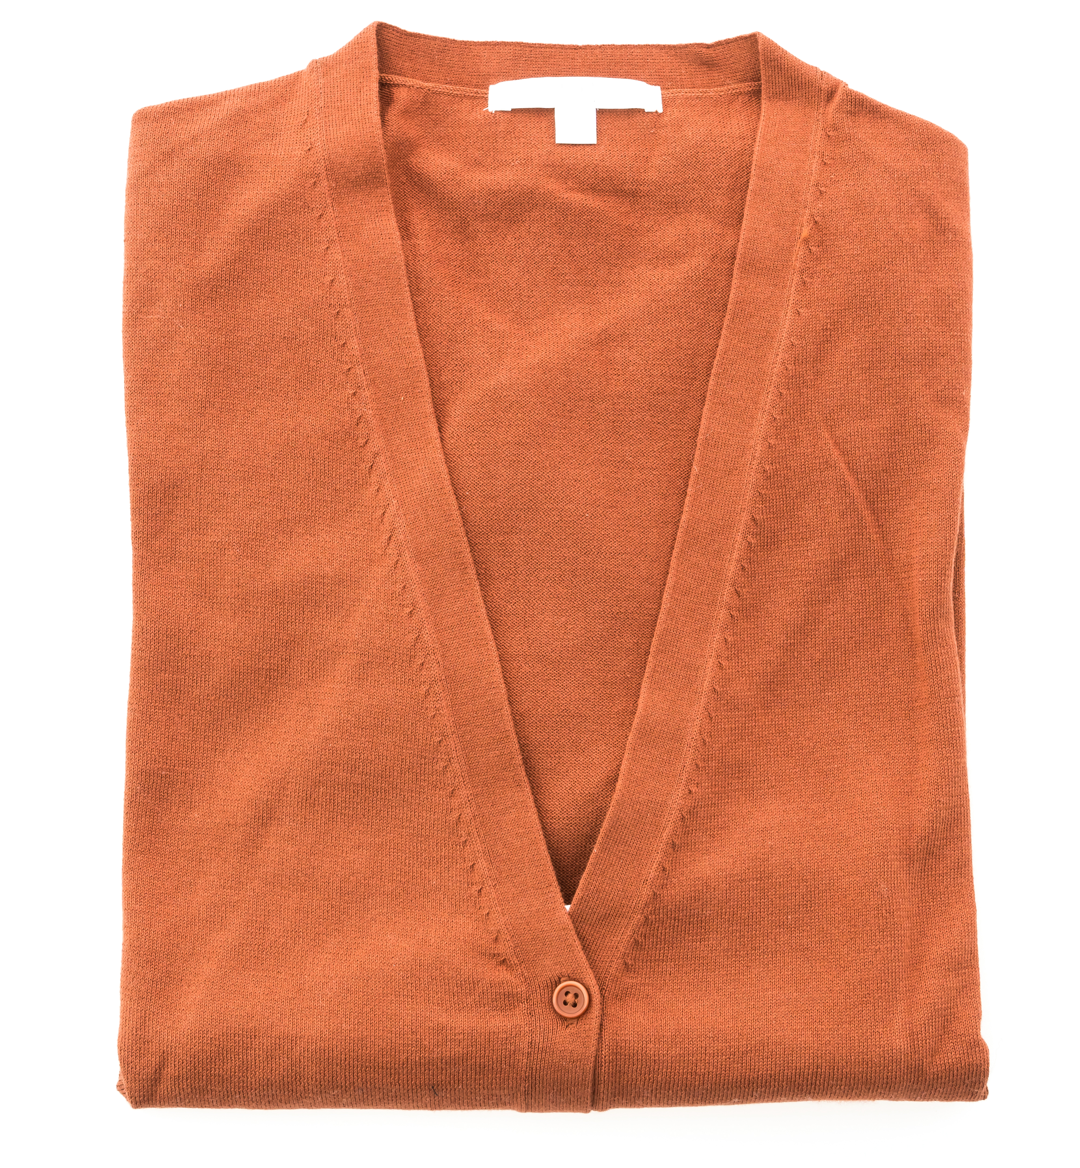
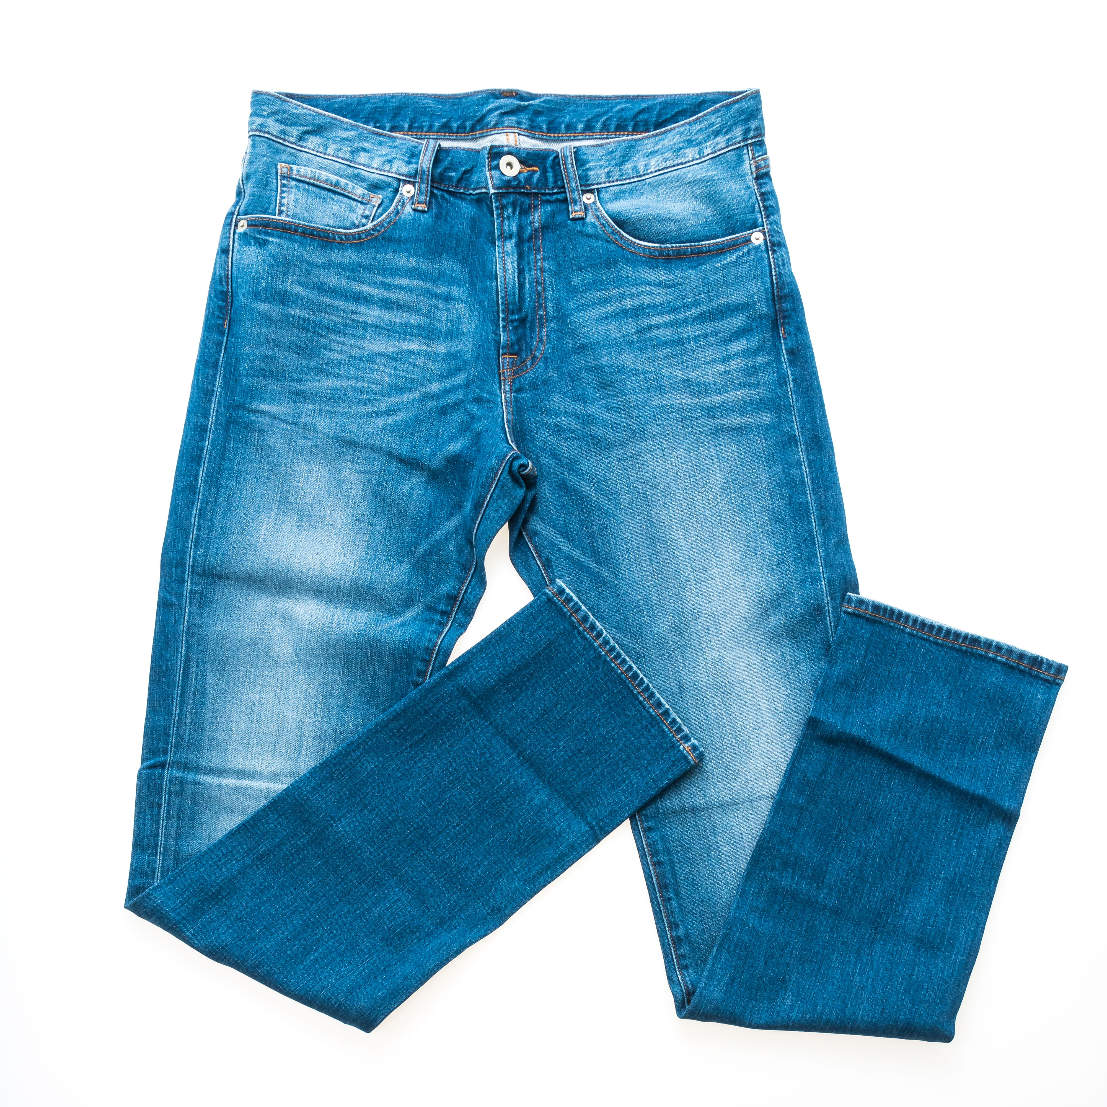
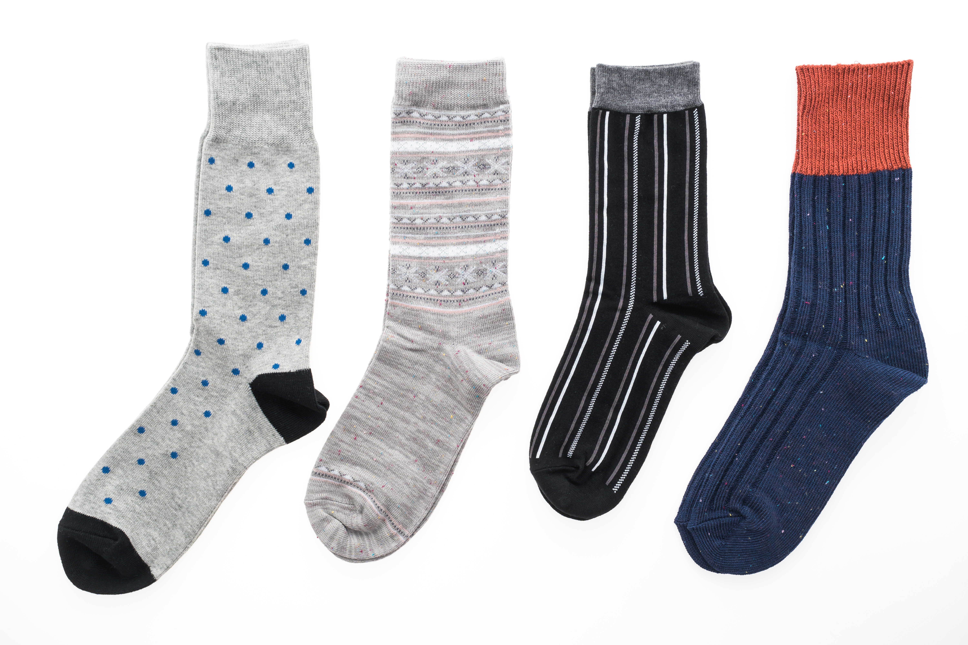
What is cotton? You can find cotton everywhere. It is used to make many of the clothes we wear.

Slide 3
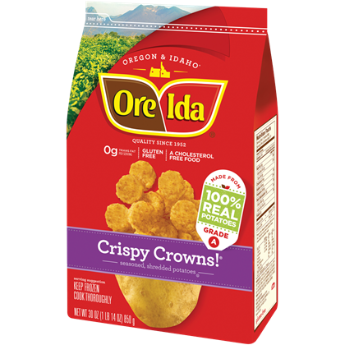
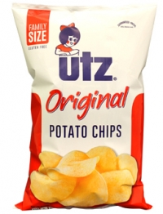
Oil from the cotton seed is used in many of the foods we eat.

Slide 4
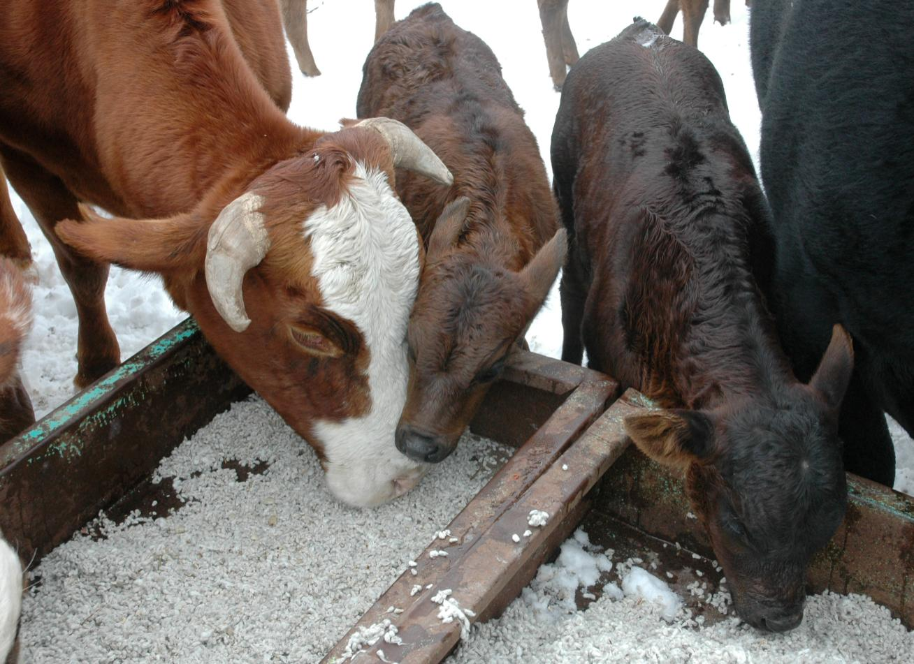
Cotton seed is food for many farm animals.
Texas A&M AgriLife Extension Service photo

Slide 5
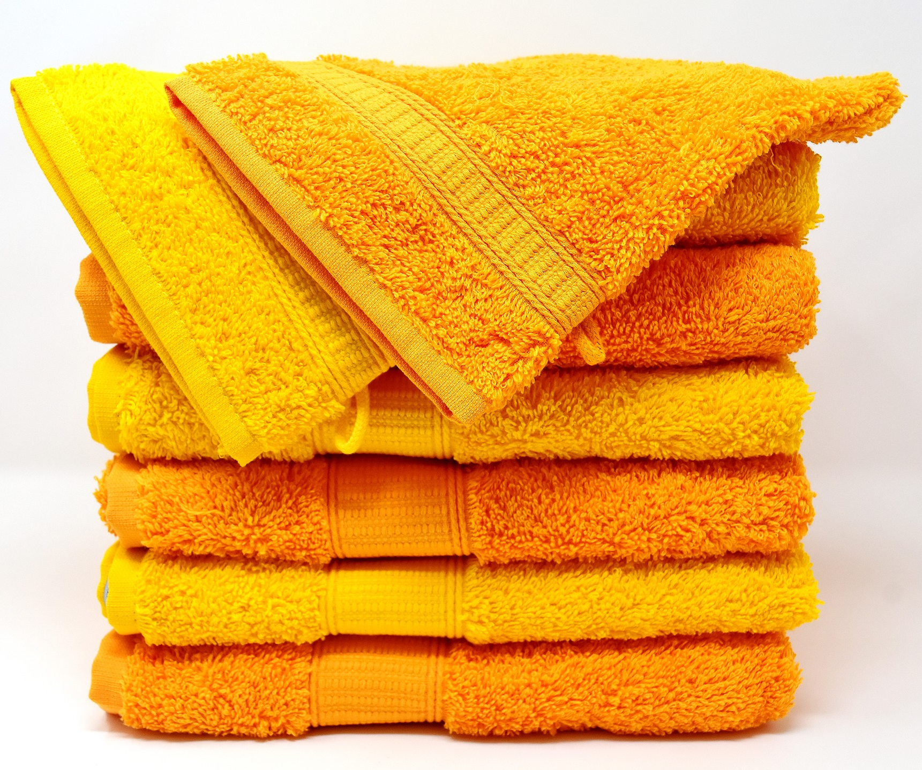
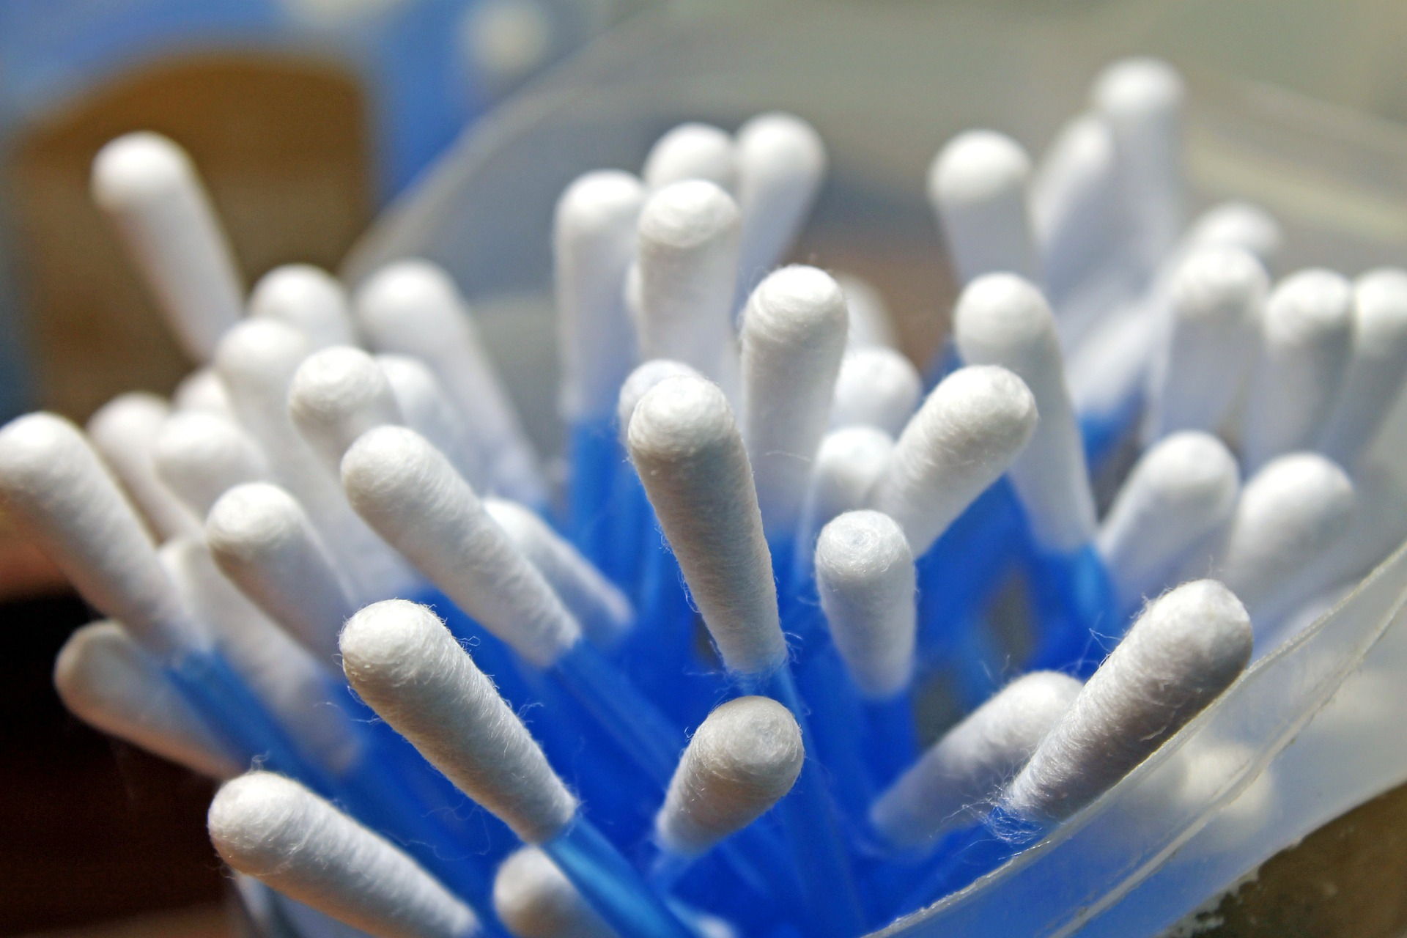
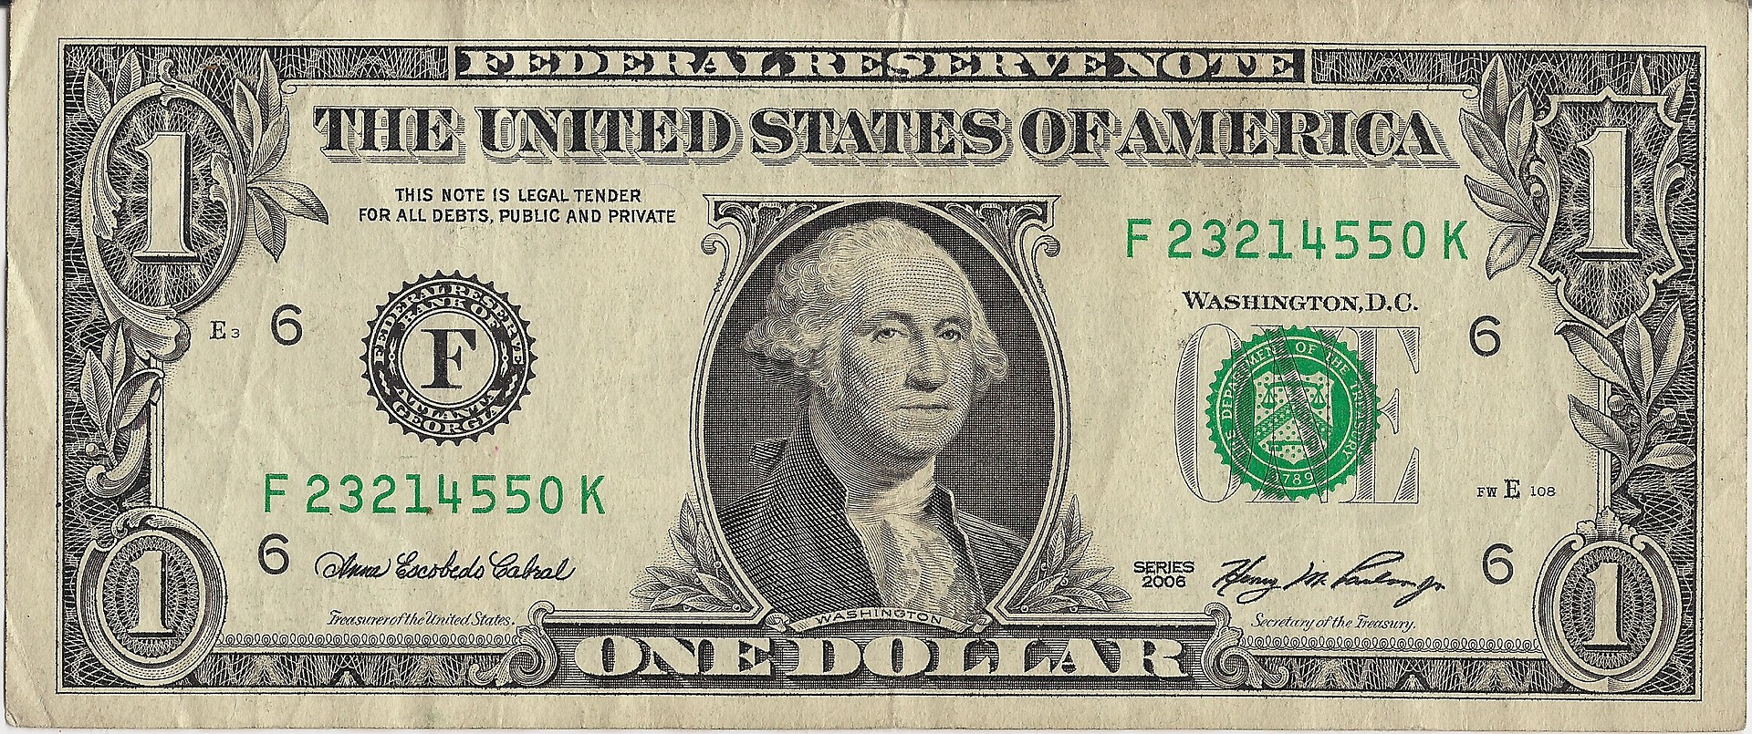
Cotton is used to make many ordinary things we use every day.
Even 'paper' money is mostly made of cotton.

Slide 6
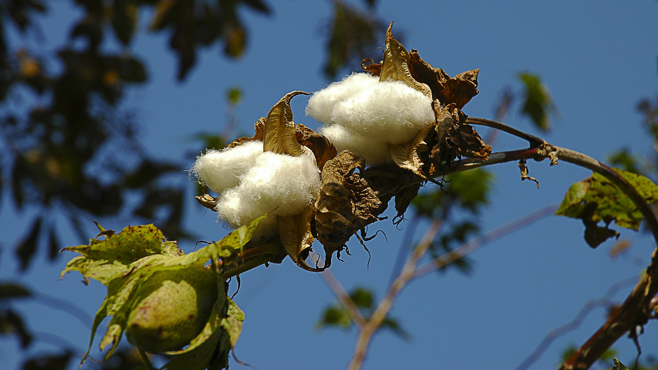
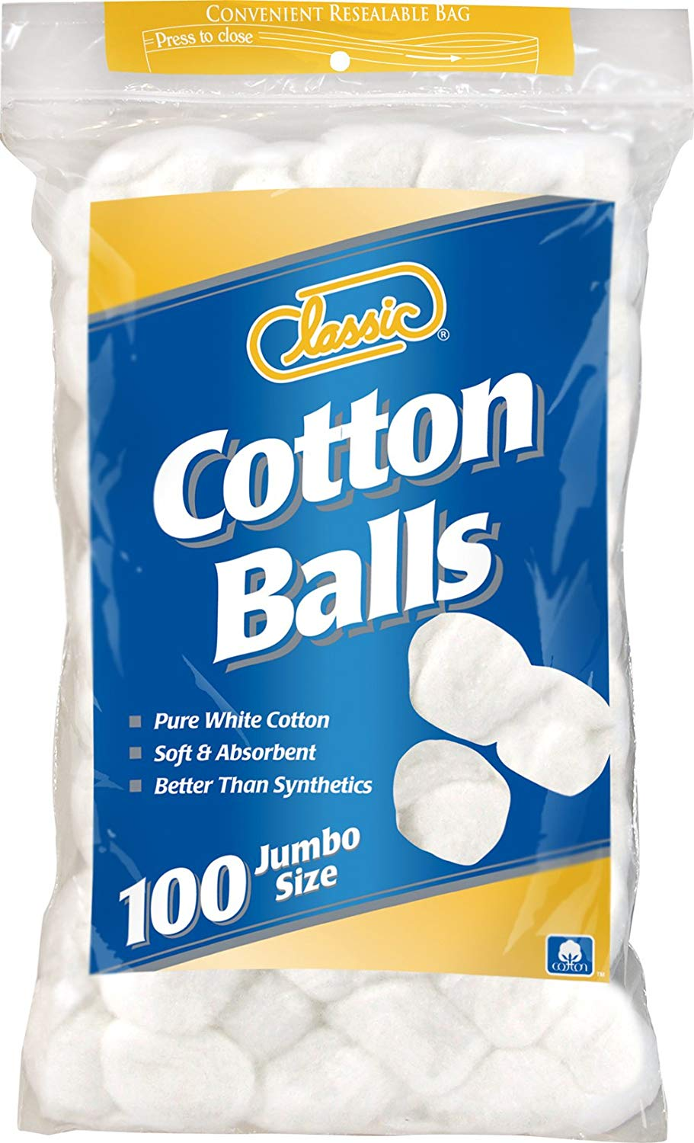
Cotton Is A Plant
The cotton we use every day comes from a plant. We use two parts of the cotton plant. Cloth is made from the fluffy white substance that looks like cotton candy. The white part of the plant is called a boll. The bolls protect the seeds of the cotton plant. The seeds are made into cottonseed oil which is used to make some of the food we eat. Cotton seeds are also fed to farm animals.

Slide 7
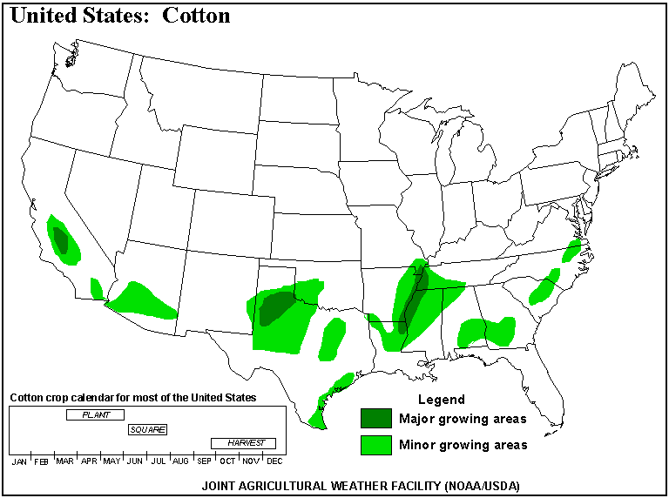
Cotton is a crop that likes warm weather
Cotton needs a warm climate to grow. Much of the world's cotton is grown on farms in the southern part of the United States. The areas shaded in green on this map show that cotton is grown across 14 states from Georgia to Texas to California.

Slide 8
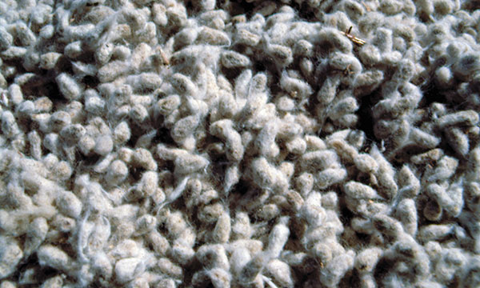
Start With the Seeds
When cotton seeds are first picked from the bolls, they are covered with a fluff called linter. Linter is used to make paper and plastics. Cottonseed oil is removed from the inside of cotton seeds.
Cotton seeds are covered with a fluff called linter when they are first picked.
Photo courtesy National Cotton Council
Cotton seeds are a shiny brown when cleaned.

Slide 9
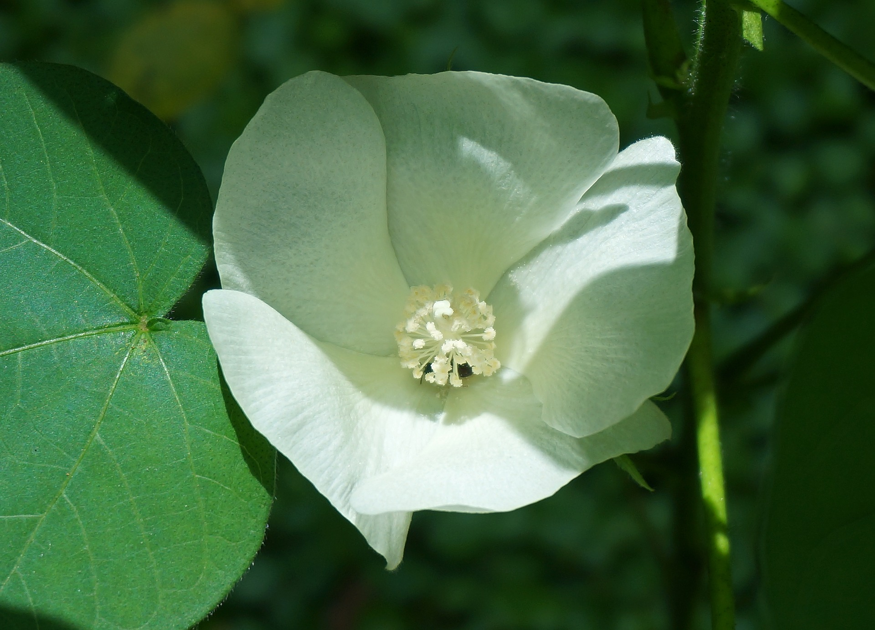
How Cotton Grows
It takes a long time for cotton to grow from a seed to a plant with fluffy white bolls. It takes between five and six months before farmers can harvest the cotton they have planted.
After the cotton seed is planted, a small green plant appears. The cotton plant above is just a few weeks old. In about two months flower buds appear. Three weeks later, the cotton flowers bloom. The petals change color from white to yellow, and then from pink to red.

Slide 10
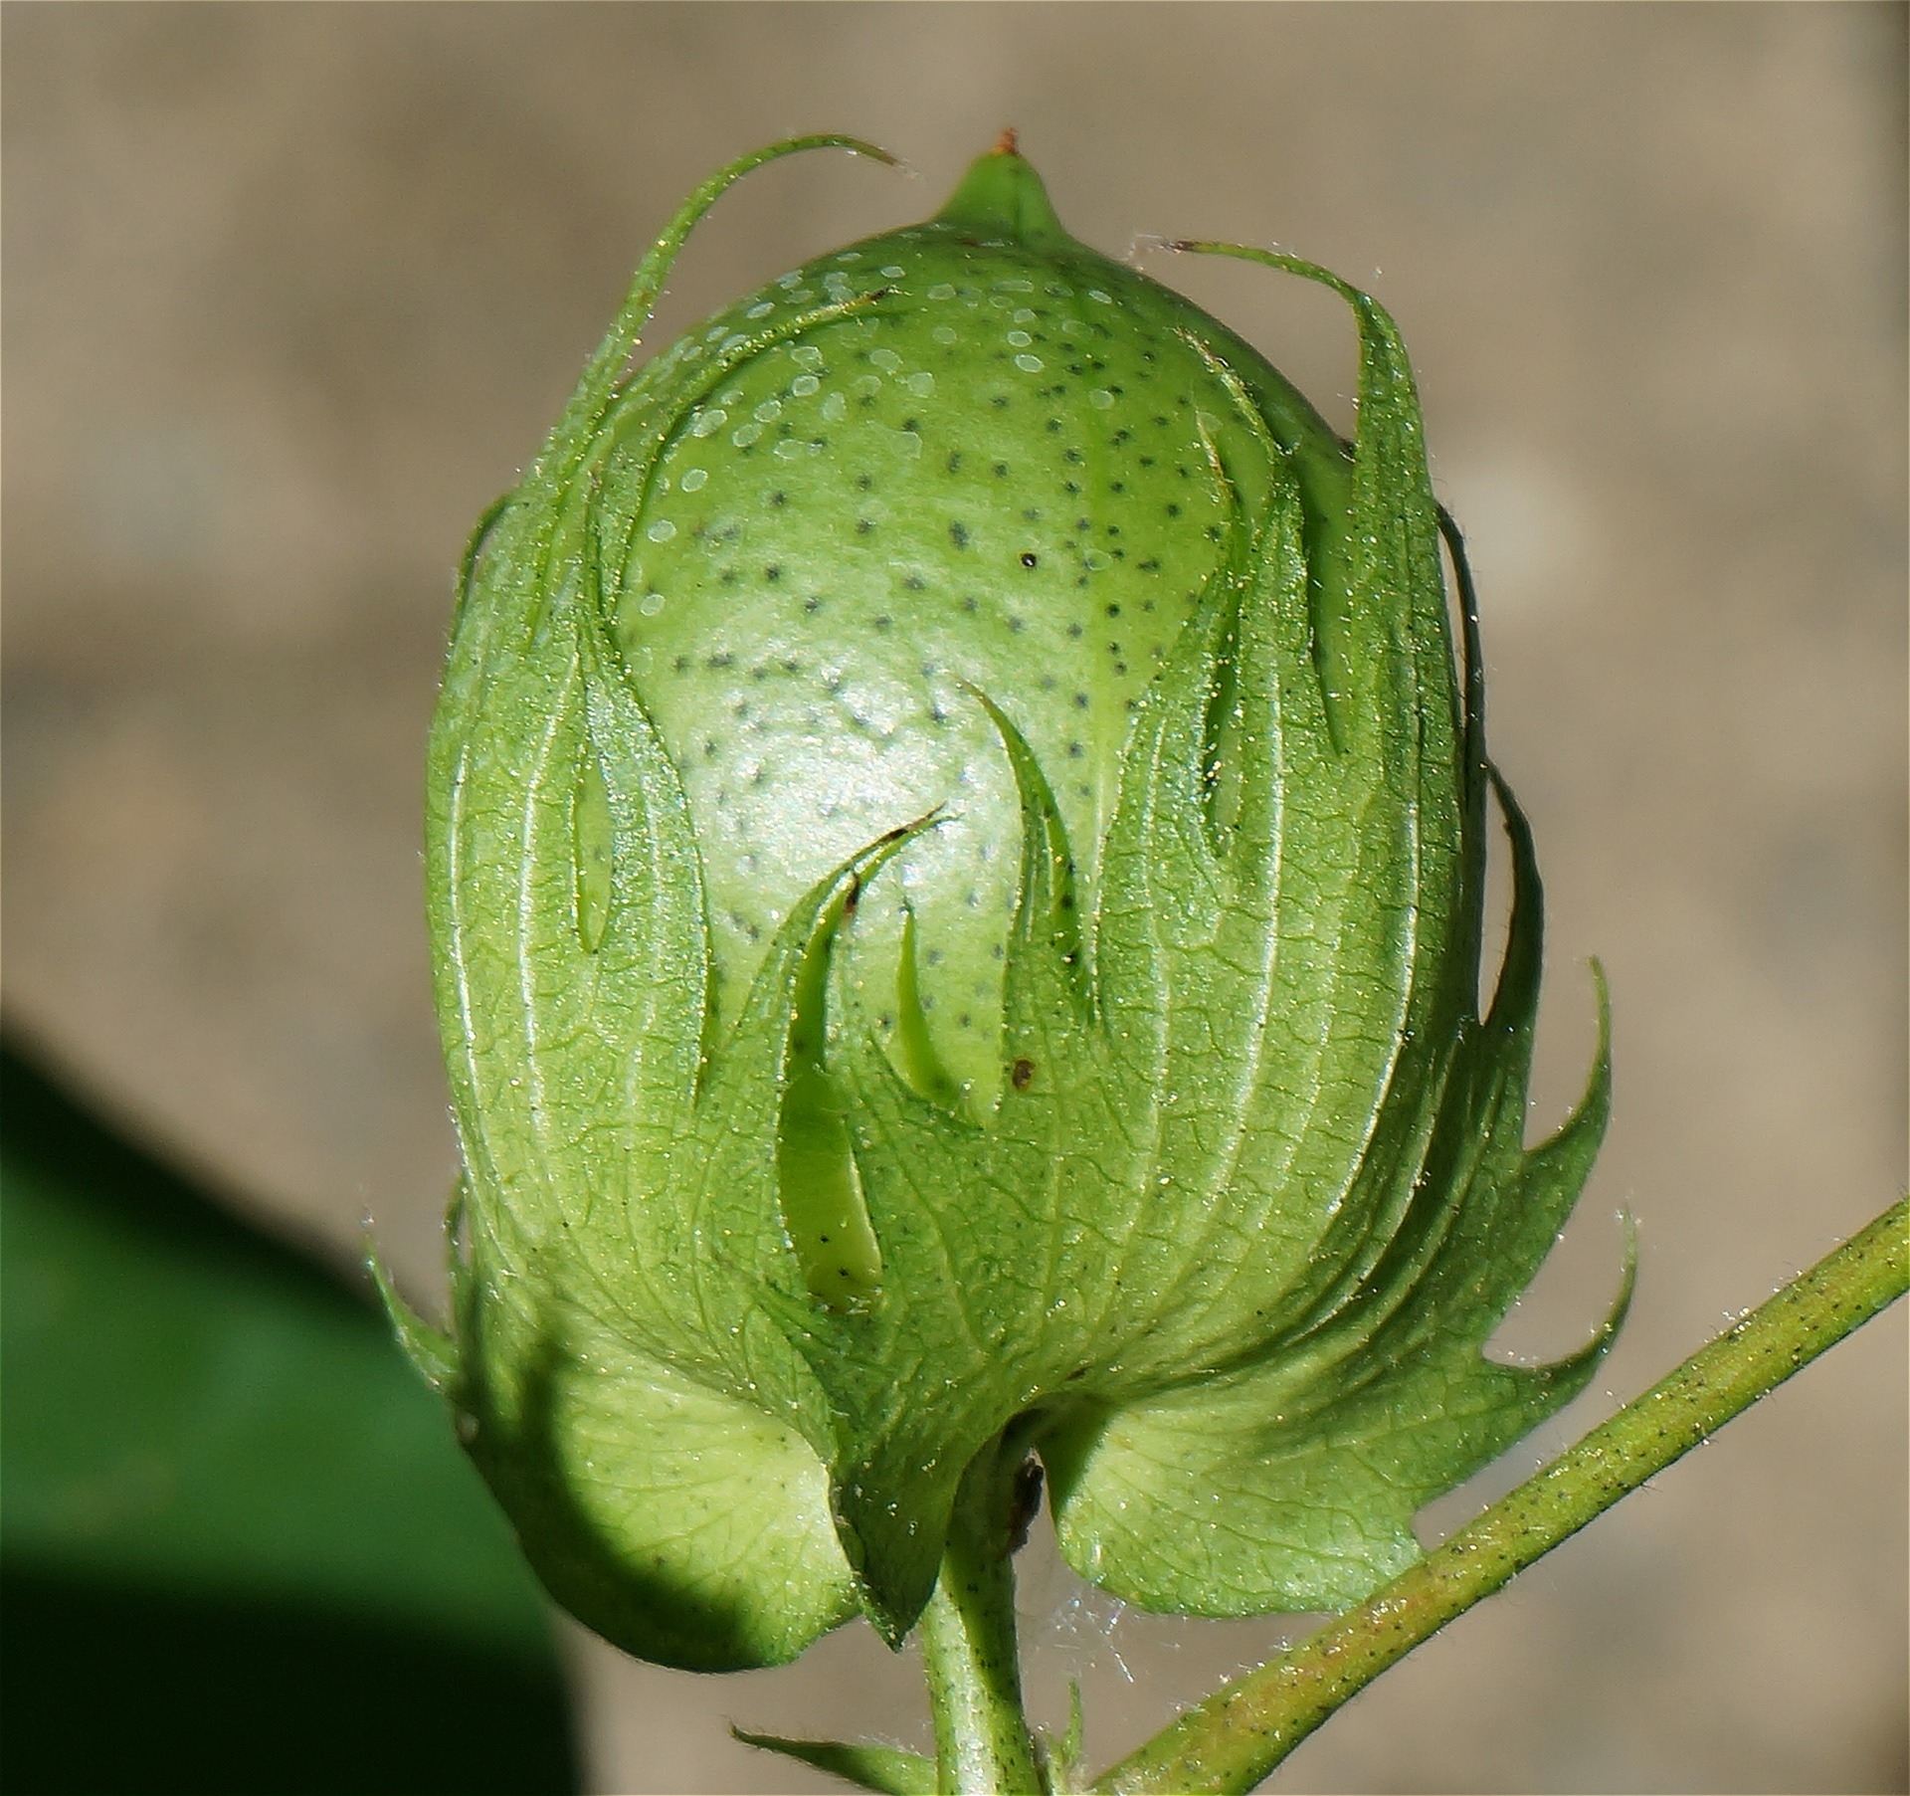
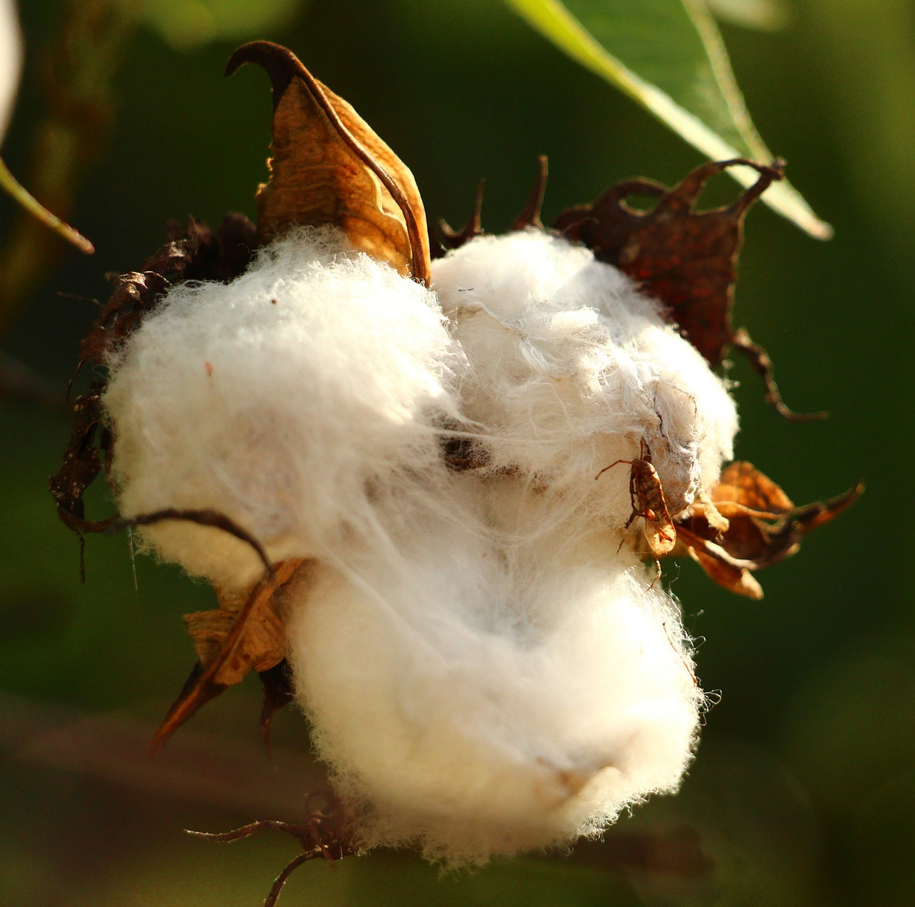
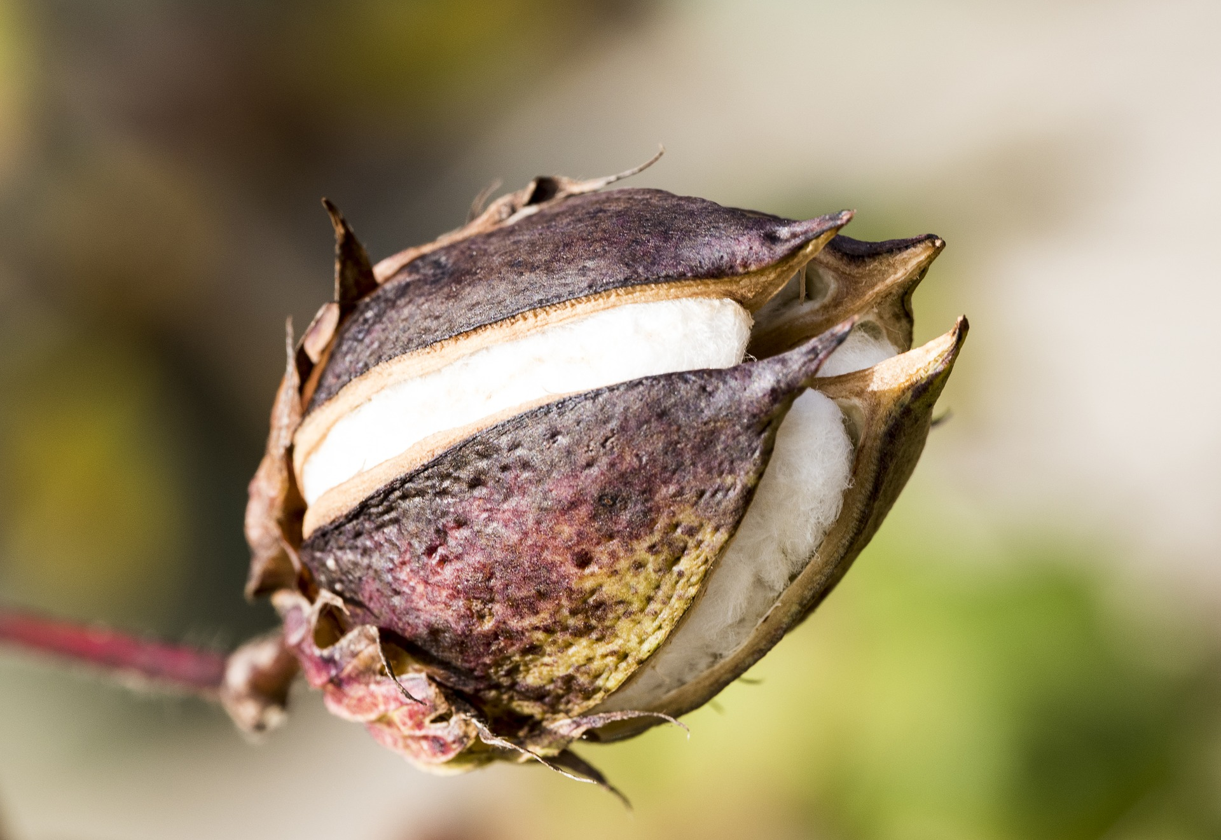
The Boll Is Very Important
Next, the flowers drop off, leaving green pods called bolls. Inside the boll, moist fibers grow around the new seeds. The boll begins to turn brown. The white fibers continue to expand inside the boll until finally they split the boll and burst out. We have cotton!

Slide 11
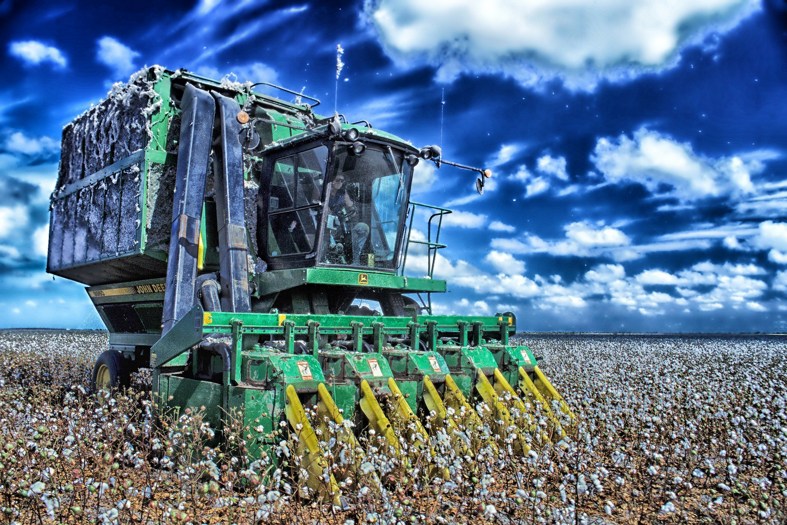
A Cotton Harvest
Once the cotton appears on the plant, it is time to harvest. Machines move through the fields, stripping the cotton from the plants.

Slide 12
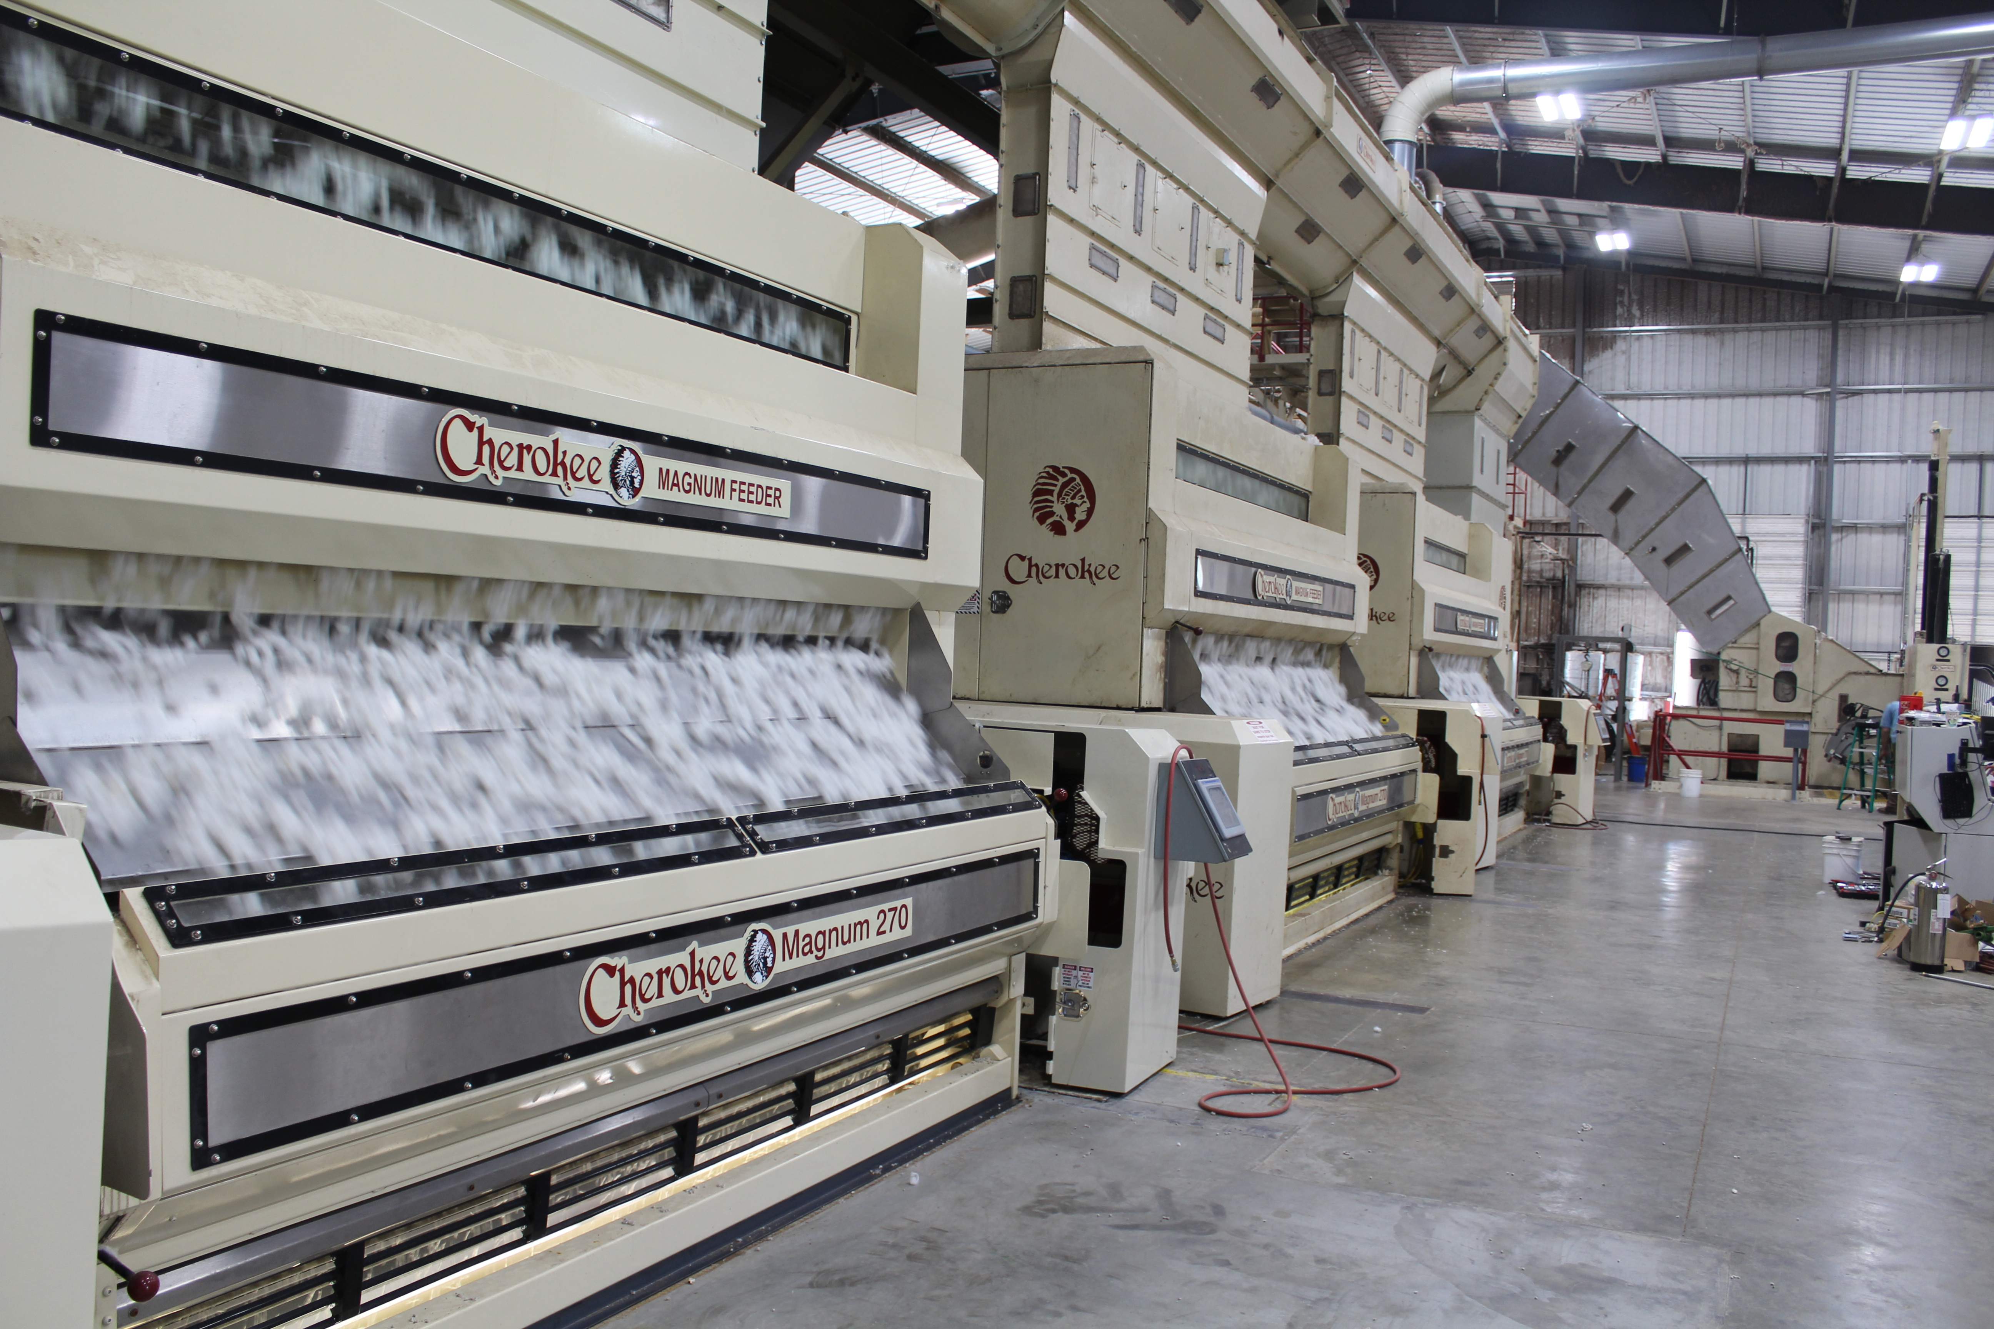
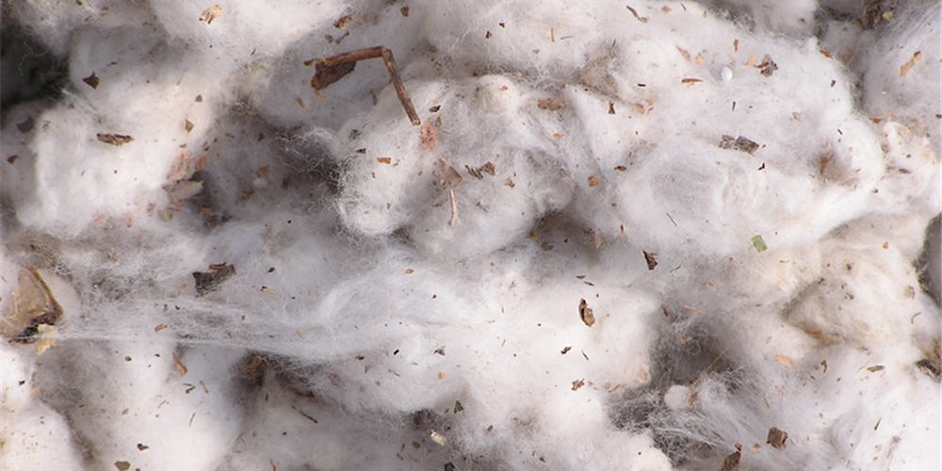
Time to Separate the Seeds
It is very difficult to remove the cotton seeds from the bolls. Before a machine was invented to do this, the job of removing seeds from cotton by hand took a long time. Now the seeds are removed from the cotton by a machine called a gin, which combs the seeds out.
Photo courtesy Charles Parson Interiors
A cotton gin cleans the freshly picked cotton.
Photo courtesy National Cotton Council

Slide 13
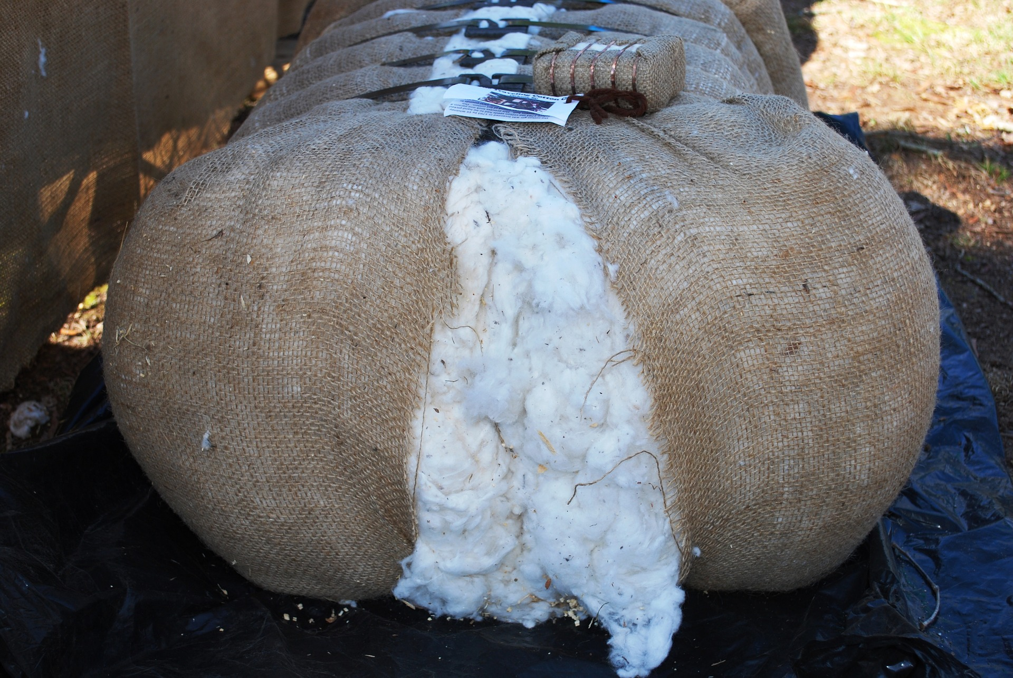
Bales of Cotton
The seedless cotton is pressed into huge rectangles called bales. Each bale weighs 500 pounds. One bale of cotton can be turned into fabric to make 215 pairs of jeans. Cotton farmers in the United States grow about 17 million bales of cotton each year. The U.S. is the world's third biggest cotton producer, behind China and India.

Slide 14
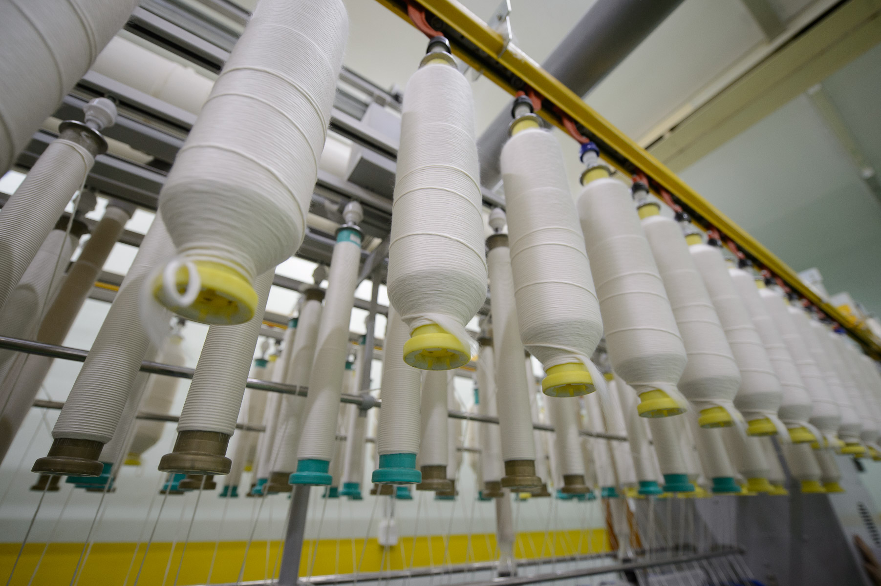
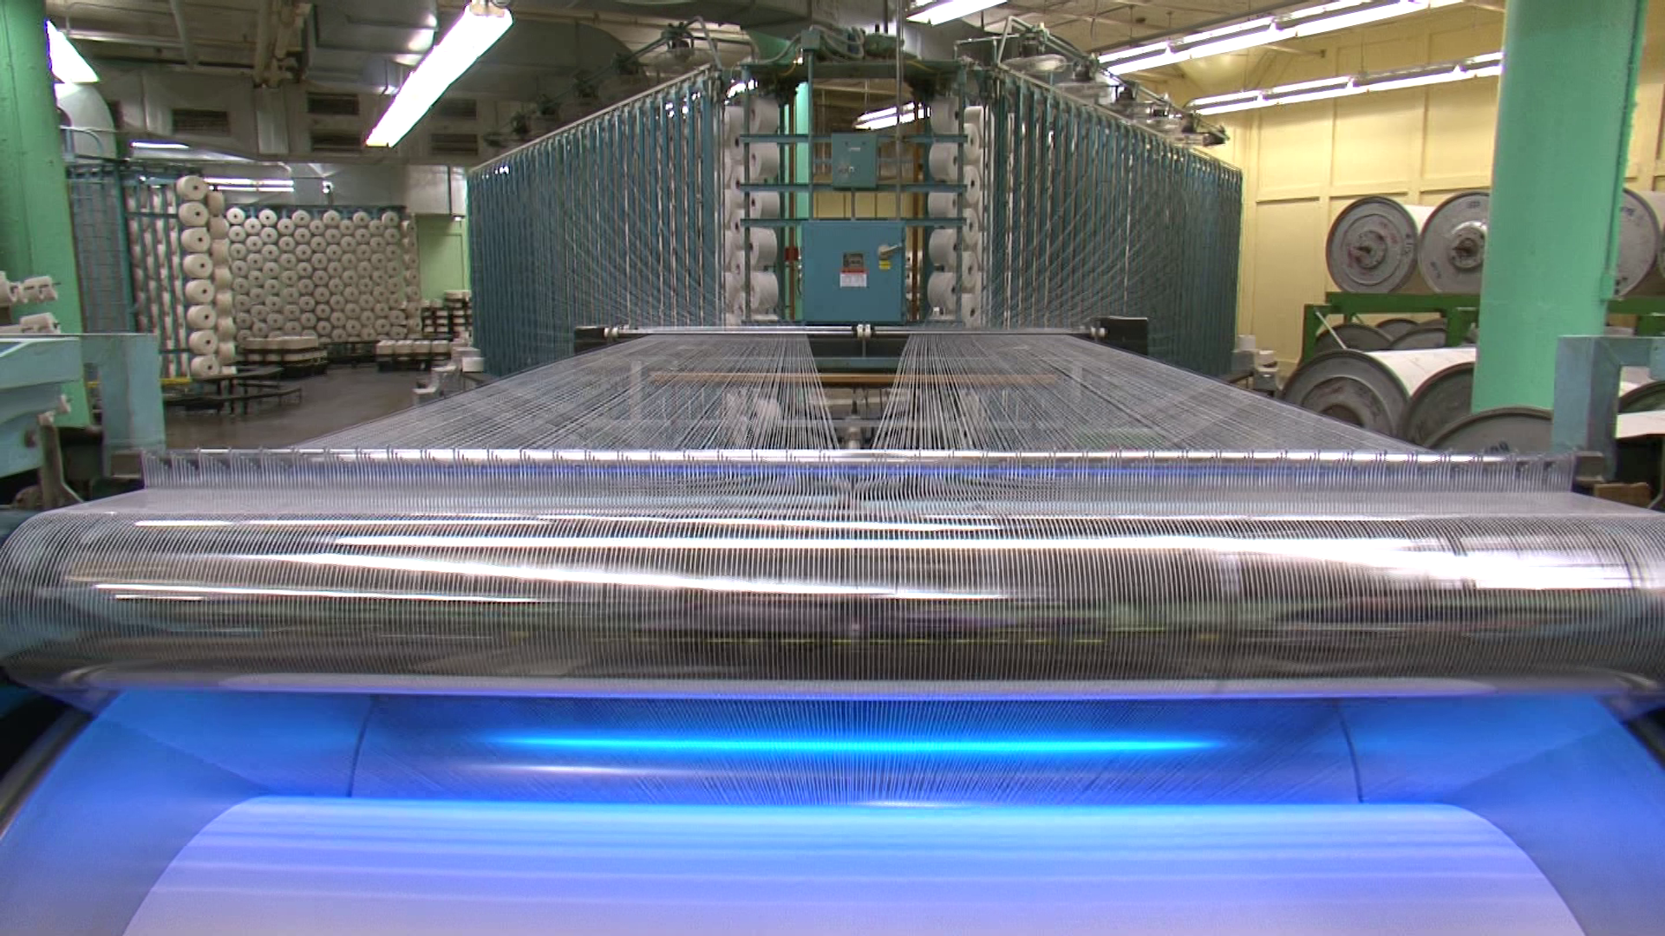
Now To The Mill
The bales of cotton are trucked to factories, which are called textile mills. There the cotton fiber is cleaned, combed, and spun into thread on a three different machines. The thread is then woven into cloth on machines called looms. The machines use the same “over and under” weaving process that you may have learned in school.
Photos courtesy National Cotton council

Slide 15
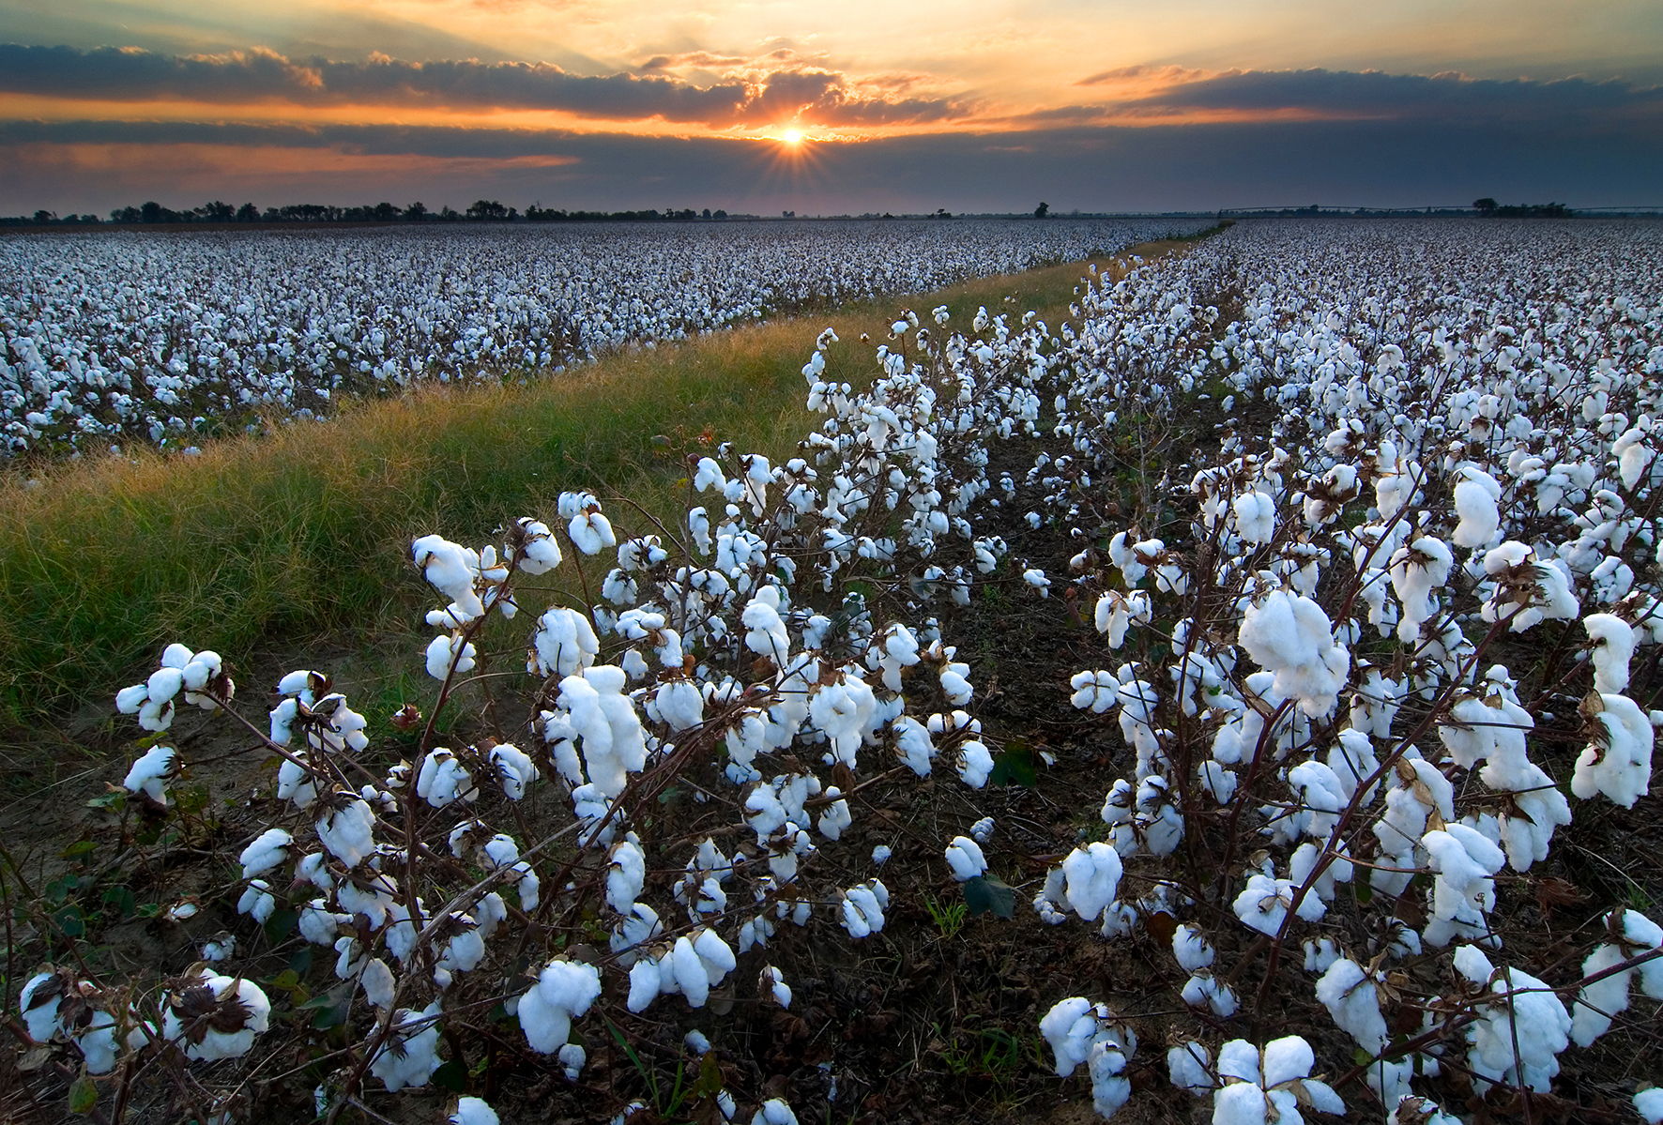
From A Seed In The Dirt, To Your Favorite T-shirt
That's the story of cotton - one important plant that we use in so many ways. Take a look around you. Can you find anything that is made from cotton?
Photo courtesy Charles Parson Interiors

