Slide 1
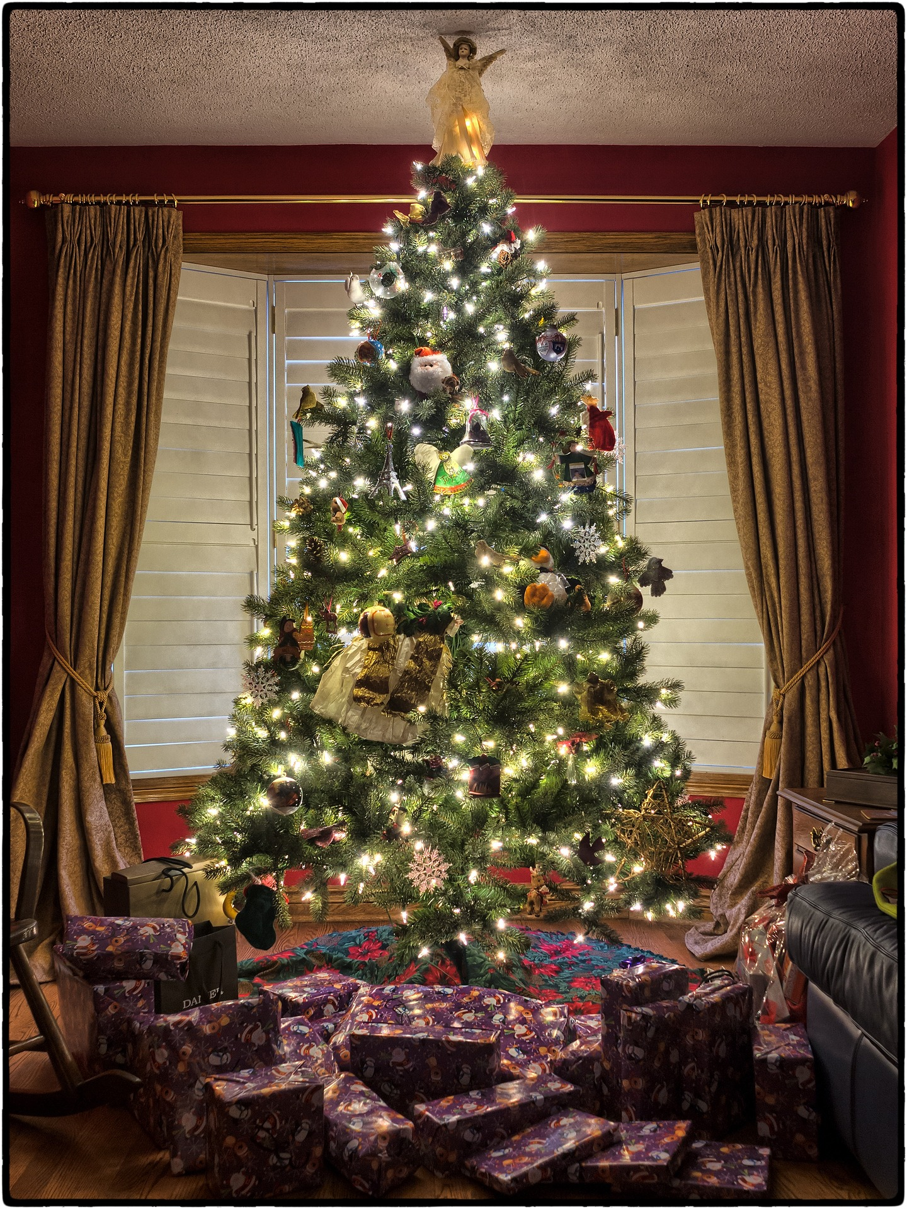
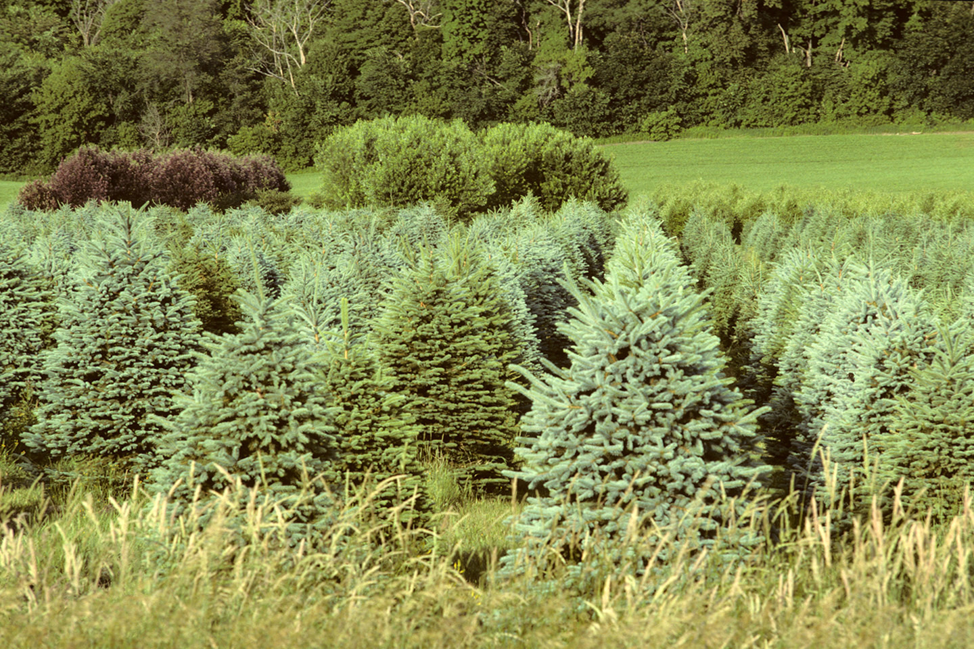
Christmas Trees Are Grown on Farms
A presentation by

Slide 2
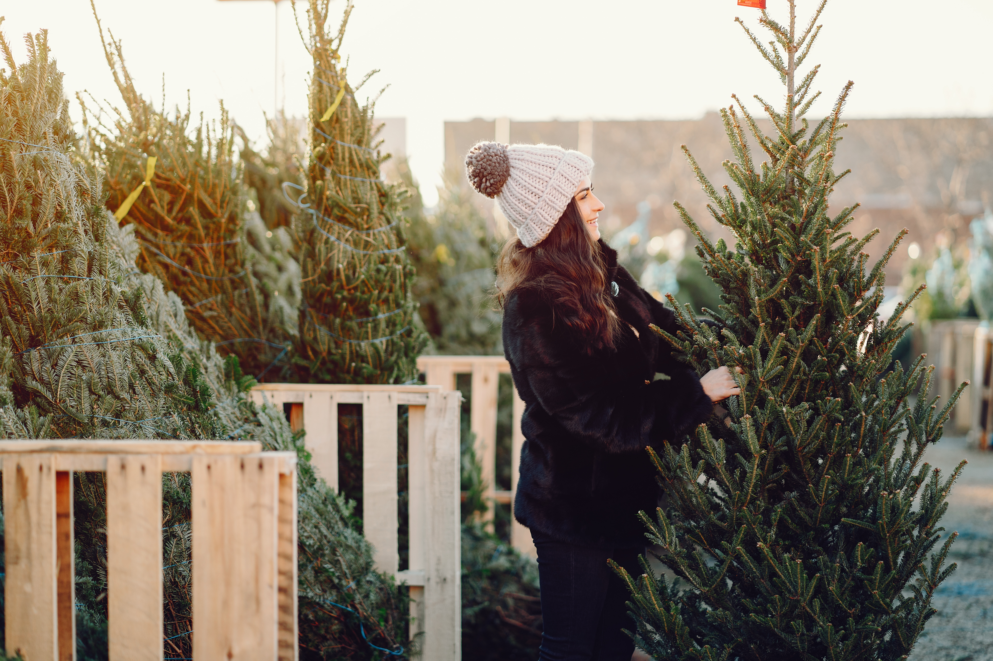
A Busy Time for Tree Buying
Around Thanksgiving, we start to see live evergreen trees for sale everywhere, waiting for people to buy them and take the home to decorate as Christmas trees.
In the United States alone, about 25 million trees are sold each year.
Where do all those trees come from?
All those trees are grown on farms - Christmas tree farms!

Slide 3
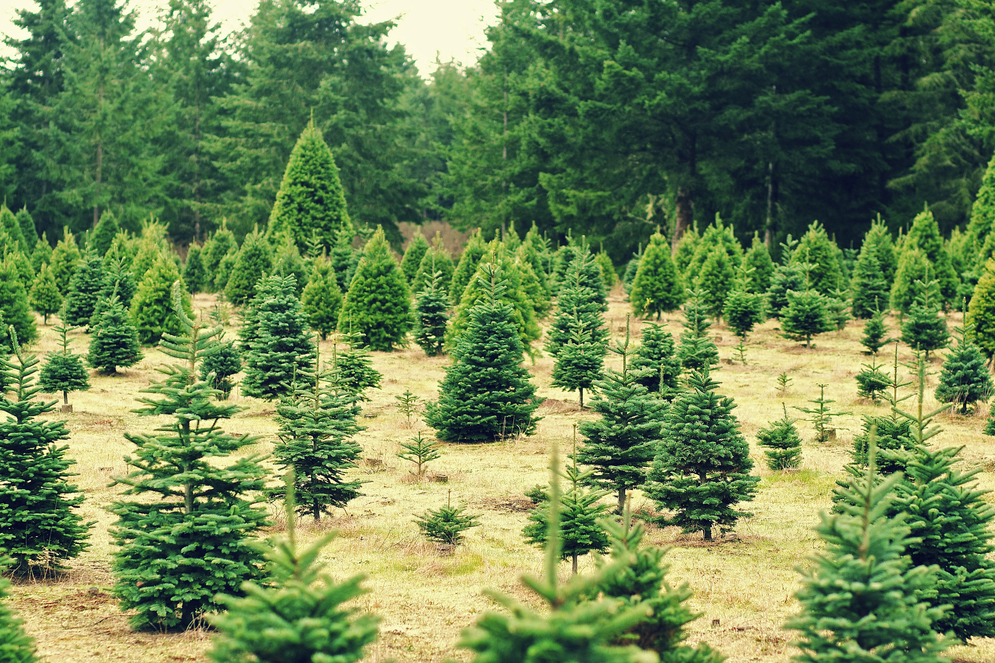
Tree Farms All Over New Jersey
In New Jersey, there are 639 Christmas tree farms that spread over on 5,300 acres.
Remember, an acre is about as big as one football field. That’s a lot of Christmas tree fields!
These farms all over the state sell about 85,000 live trees each year.

Slide 4
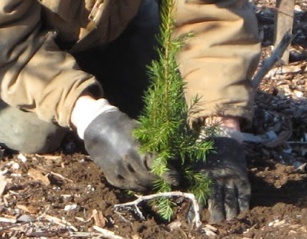
Baby Trees Are Planted By Hand
Farmers buy baby trees from specialized tree nurseries. These young trees are about four years old and about 14 inches high.
New Jersey farmers usually plant the new small trees by hand, using a shovel or other tool to dig the holes for the tree roots.
Christmas trees are often grown in places that are not ideal for growing other other crops. You will often find Christmas trees growing on land with a lot of hills or with rocky soil.
Photo courtesy Jones Family Farms

Slide 5
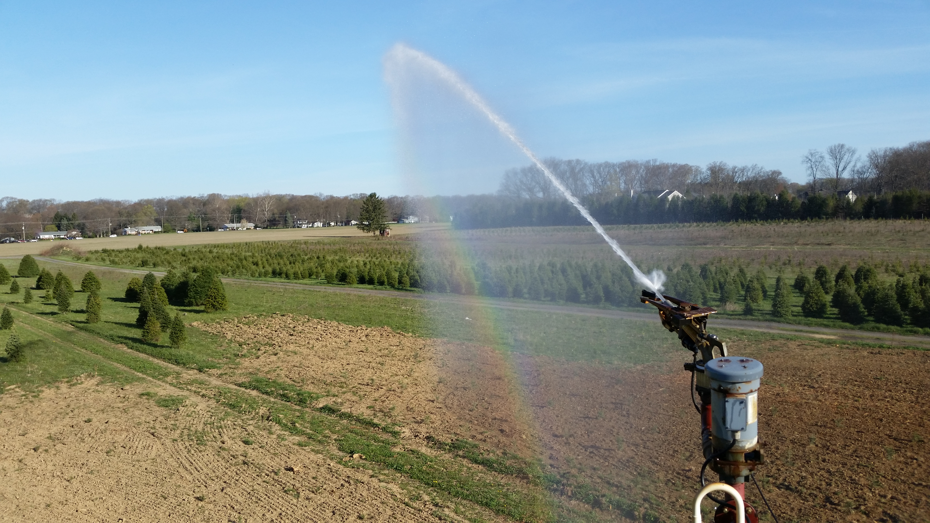
Be Patient! Trees Grow Slowly
Even though their trees are only sold at the end of each year, Christmas tree farmers are busy all year long. And they must be patient! It takes 6 to 8 years for a tree to grow big enough to become a Christmas tree. The first year after planting, a tree will grow about 8 inches. After that, the trees will grow about 15 inches each year.
Of the 1,200 trees planted in an acre field, about 120 will not survive to become Christmas trees. Farmers must constantly check the trees for weeds and for insect and animal pests. The trees must be watered like other crops when there has been little rain.
This Christmas tree field is being watered or irrigated.

Slide 6
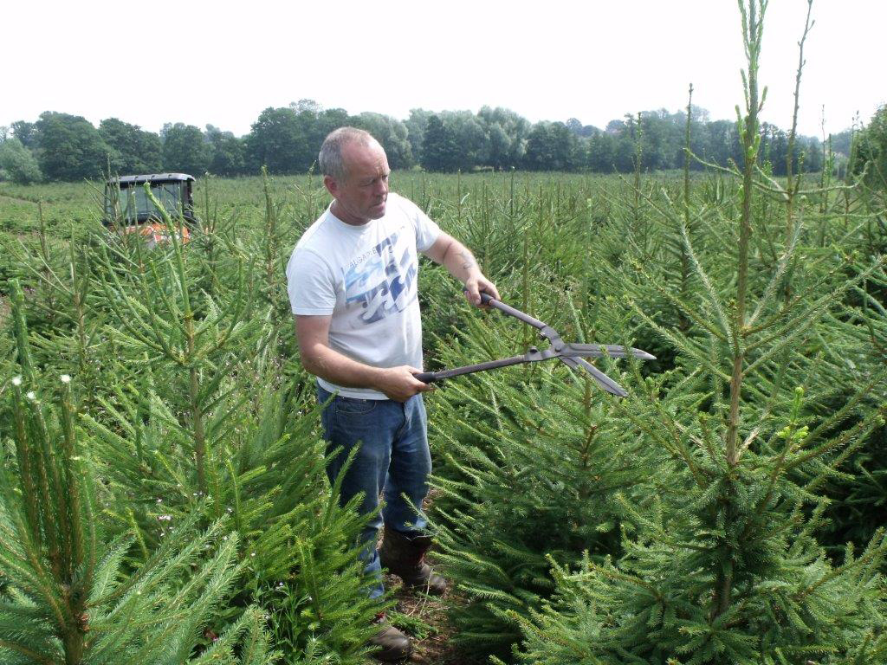
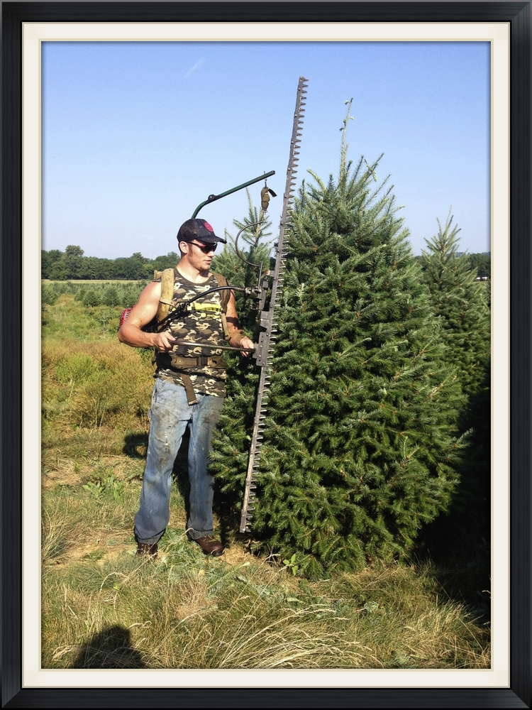
Trees Must Be Cut Into A Cone Shape
Christmas trees don’t growth into a Christmas tree shape all by themselves. When the trees are 3-4 feet high, farmers begin the shear the trees.
Once each summer, when trees have finished growing for the year, farming crews go through the fields of trees, using very sharp knives or hedge clippers to shear the trees into the classic cone shape.
Photo courtesy Unangst Tree Farms

Slide 7
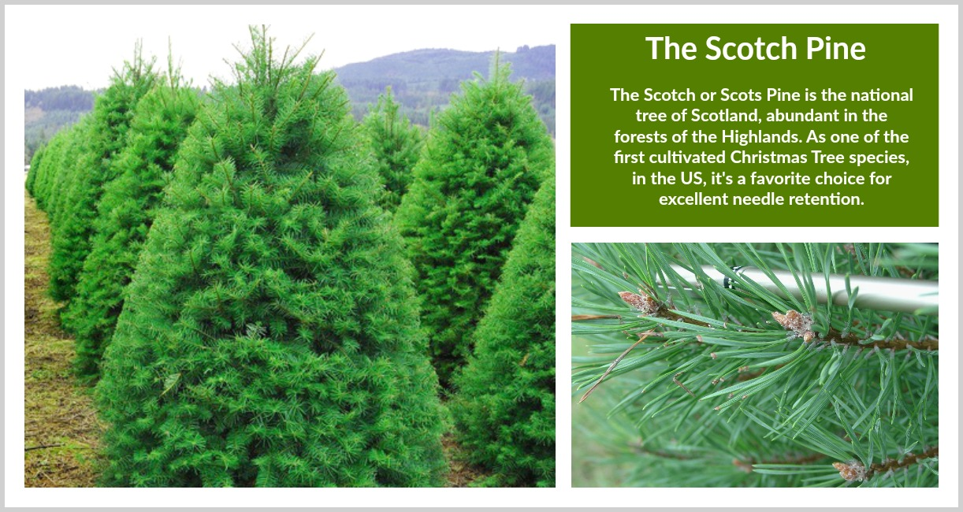
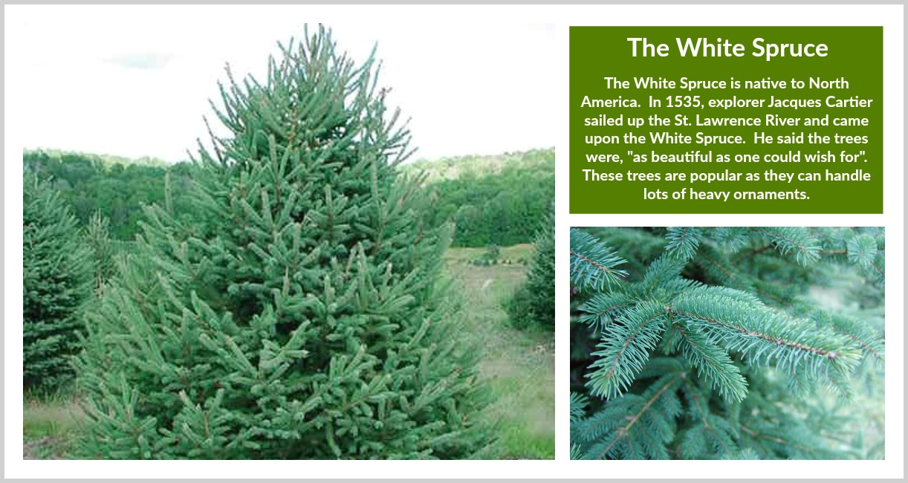
There are many different types of evergreen trees that are grown for Christmas trees, including fir, pine, and spruce.
Different varieties have different types of needles. Some needles are short and sharp. Some are long and soft. The needles of different varieties are also spaced differently on the branches.
Douglas
Fir
Scotch
Pine
White
Spruce
Photos courtesy New Jersey Christmas Tree Growers Association

Slide 8
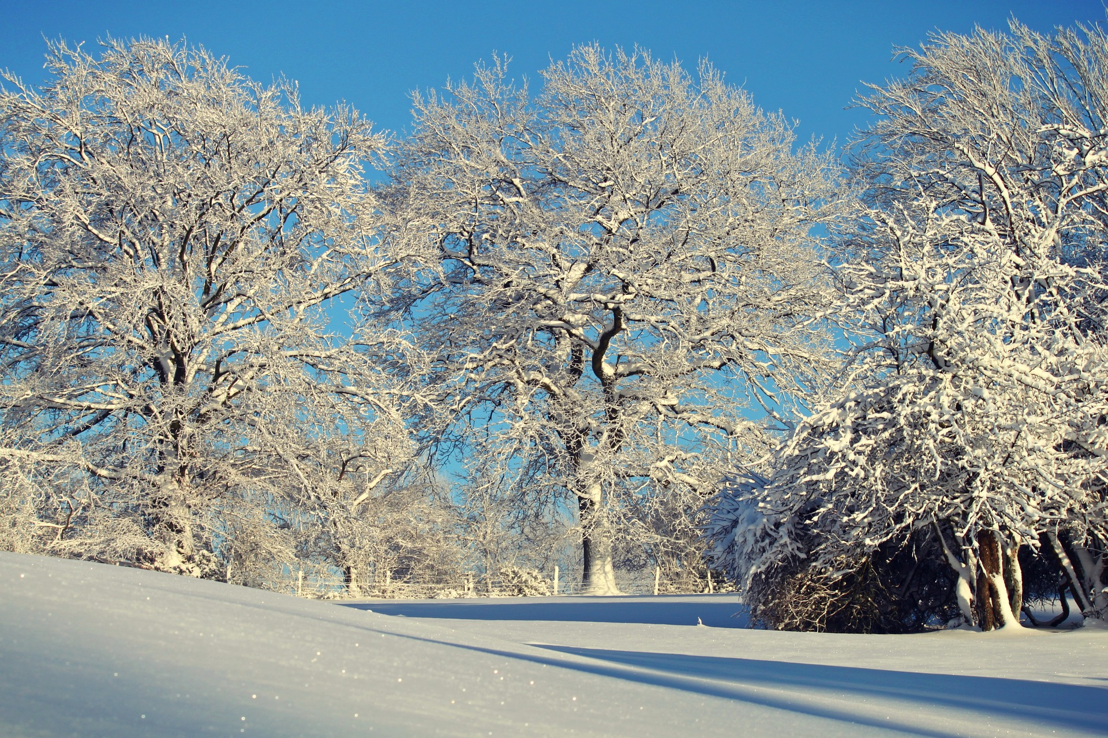
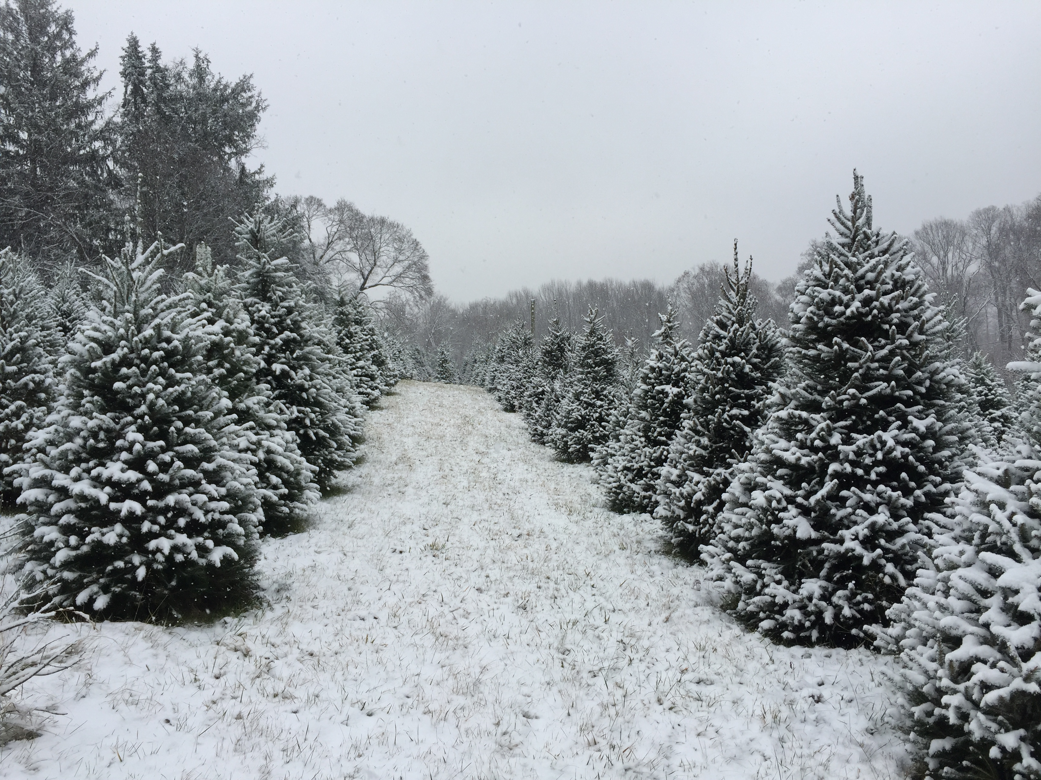
Christmas trees are called evergreen trees because they stay green all year, unlike the trees whose leaves change color in autumn and fall off branches. Trees that stand bare in the winter are called deciduous trees. Evergreen trees are called coniferous trees. They are also called conifers.
The needles are actually the leaves of the evergreen tree. The thin shape of the needles helps the tree survive all year. Heavy snow in winter slides off the thin needles. And the needles are covered with a waxy coating that helps the tree hold onto water when the weather is dry.

Slide 9
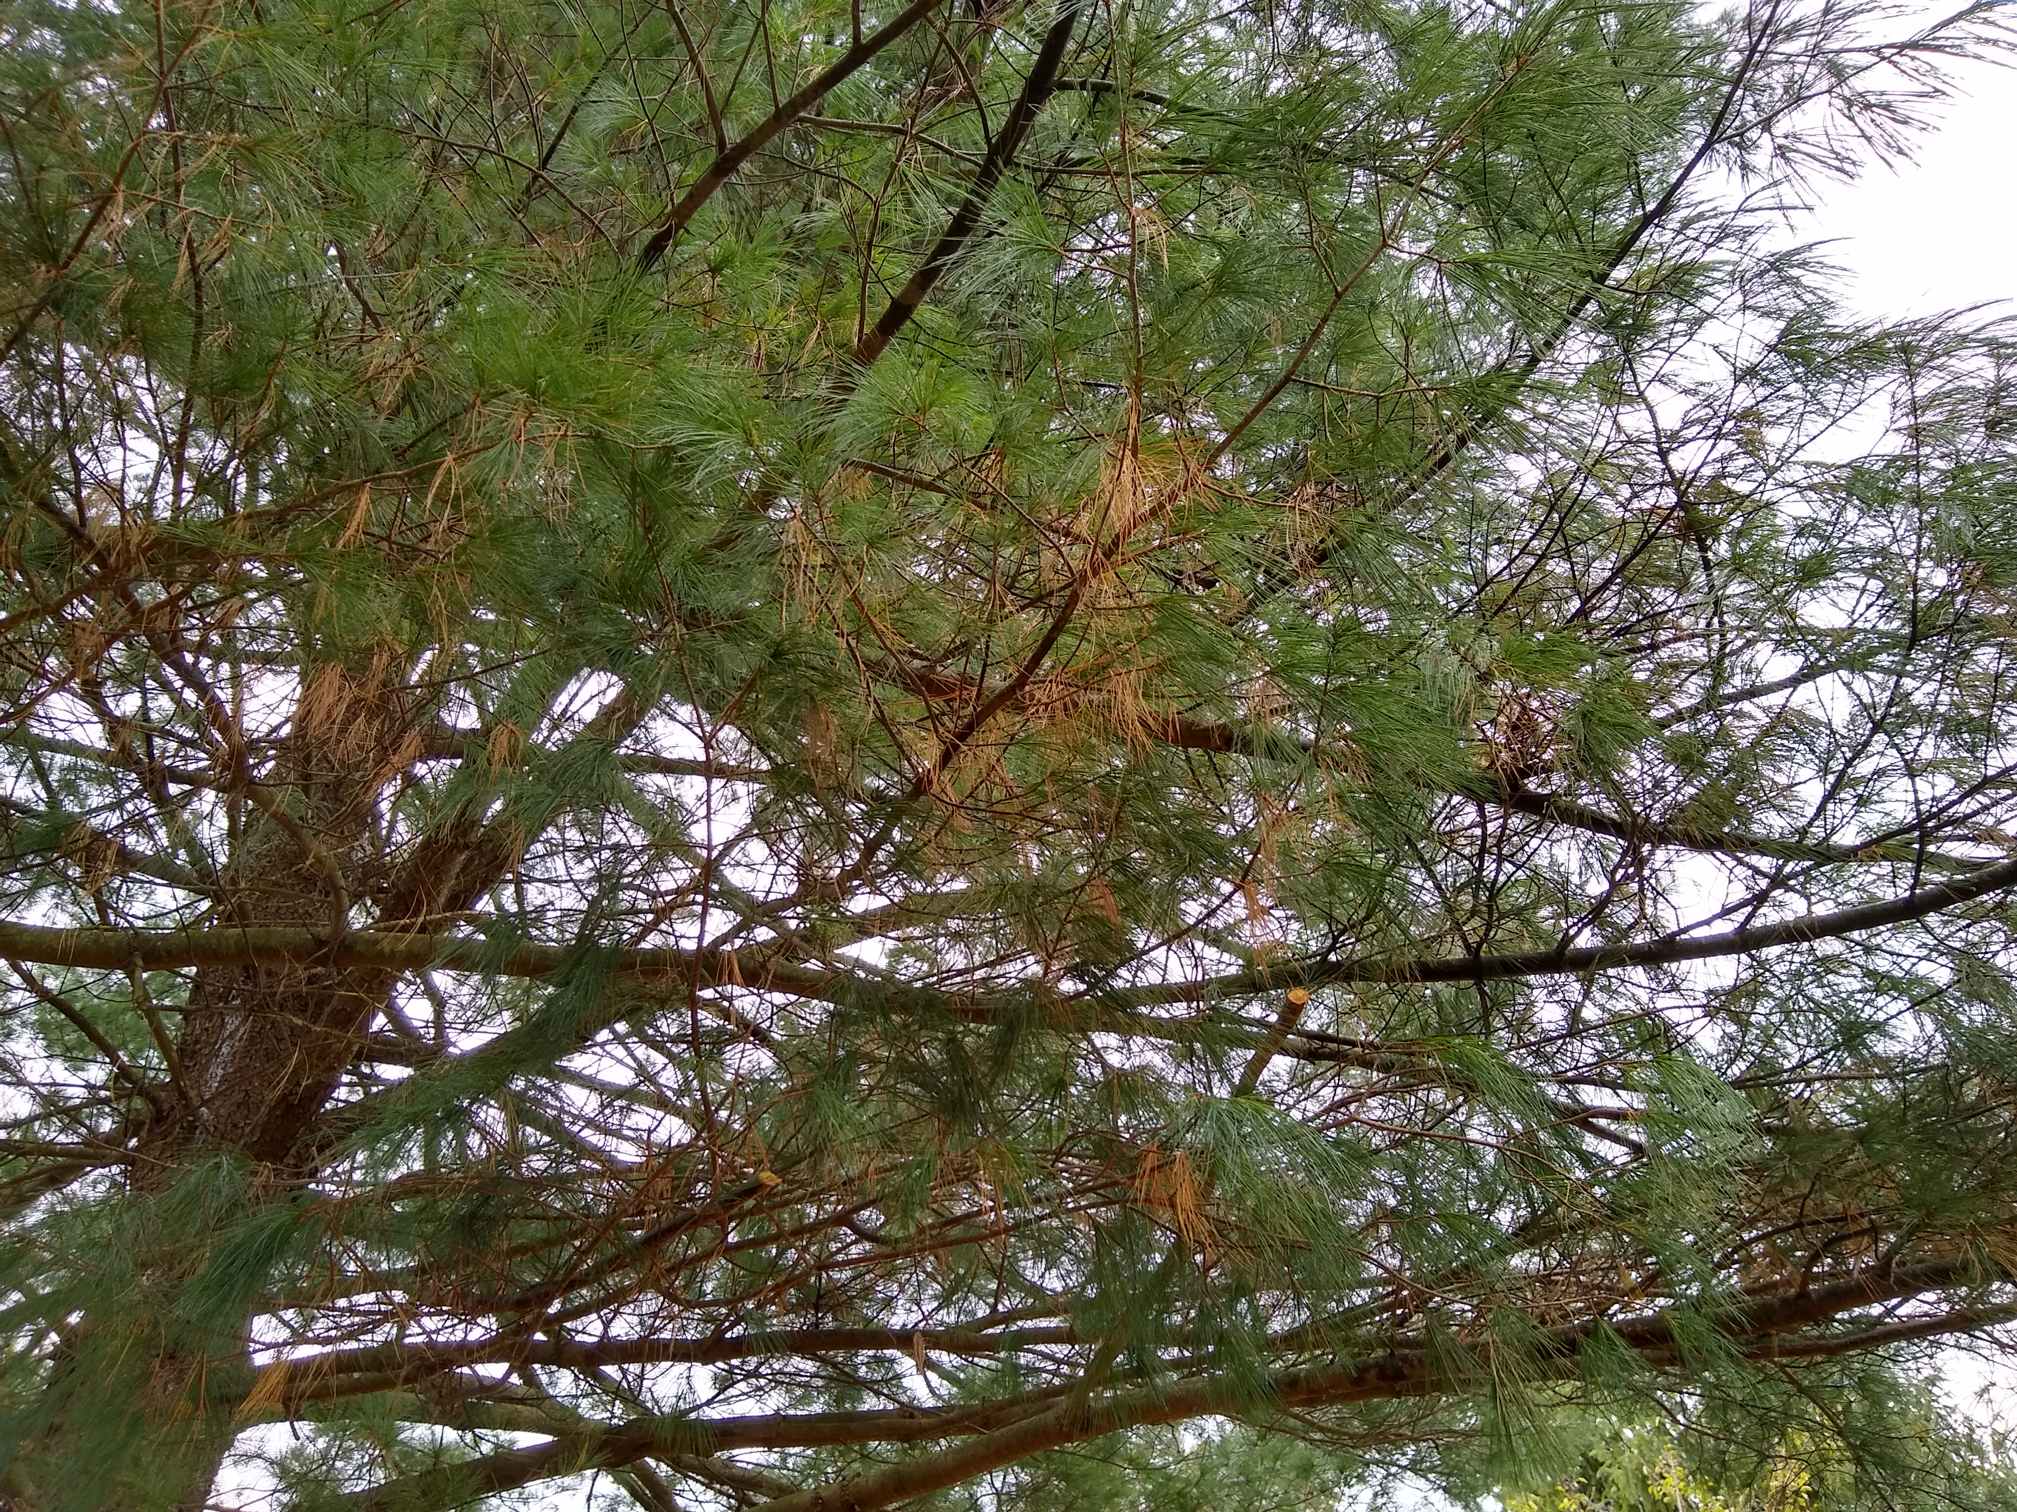
Needles Work Like Leaves
Needles do the same job for the coniferous tree that leaves do for other trees.
They take in carbon dioxide from the air and use the energy of the sun and the water pumped up from the roots to make the food the tree needs to survive and grow.
When the needles of a conifer get old, they do turn brown and fall to the ground. But an evergreen tree never loses all its needles at one time, so it always looks green.
Can you see the brown needles on this pine tree?

Slide 10
Male and Female Cones
Evergreen trees are called conifers because they grow cones instead of flowers. These cones have the same job as flowers - to make new seeds. Every conifer has male and female cones. The male cones make the pollen. Male cones are usually smaller and much smoother than female cones.
Female cones are where the new seeds will be made once pollination happens.
Male cones
Female cones

Slide 11
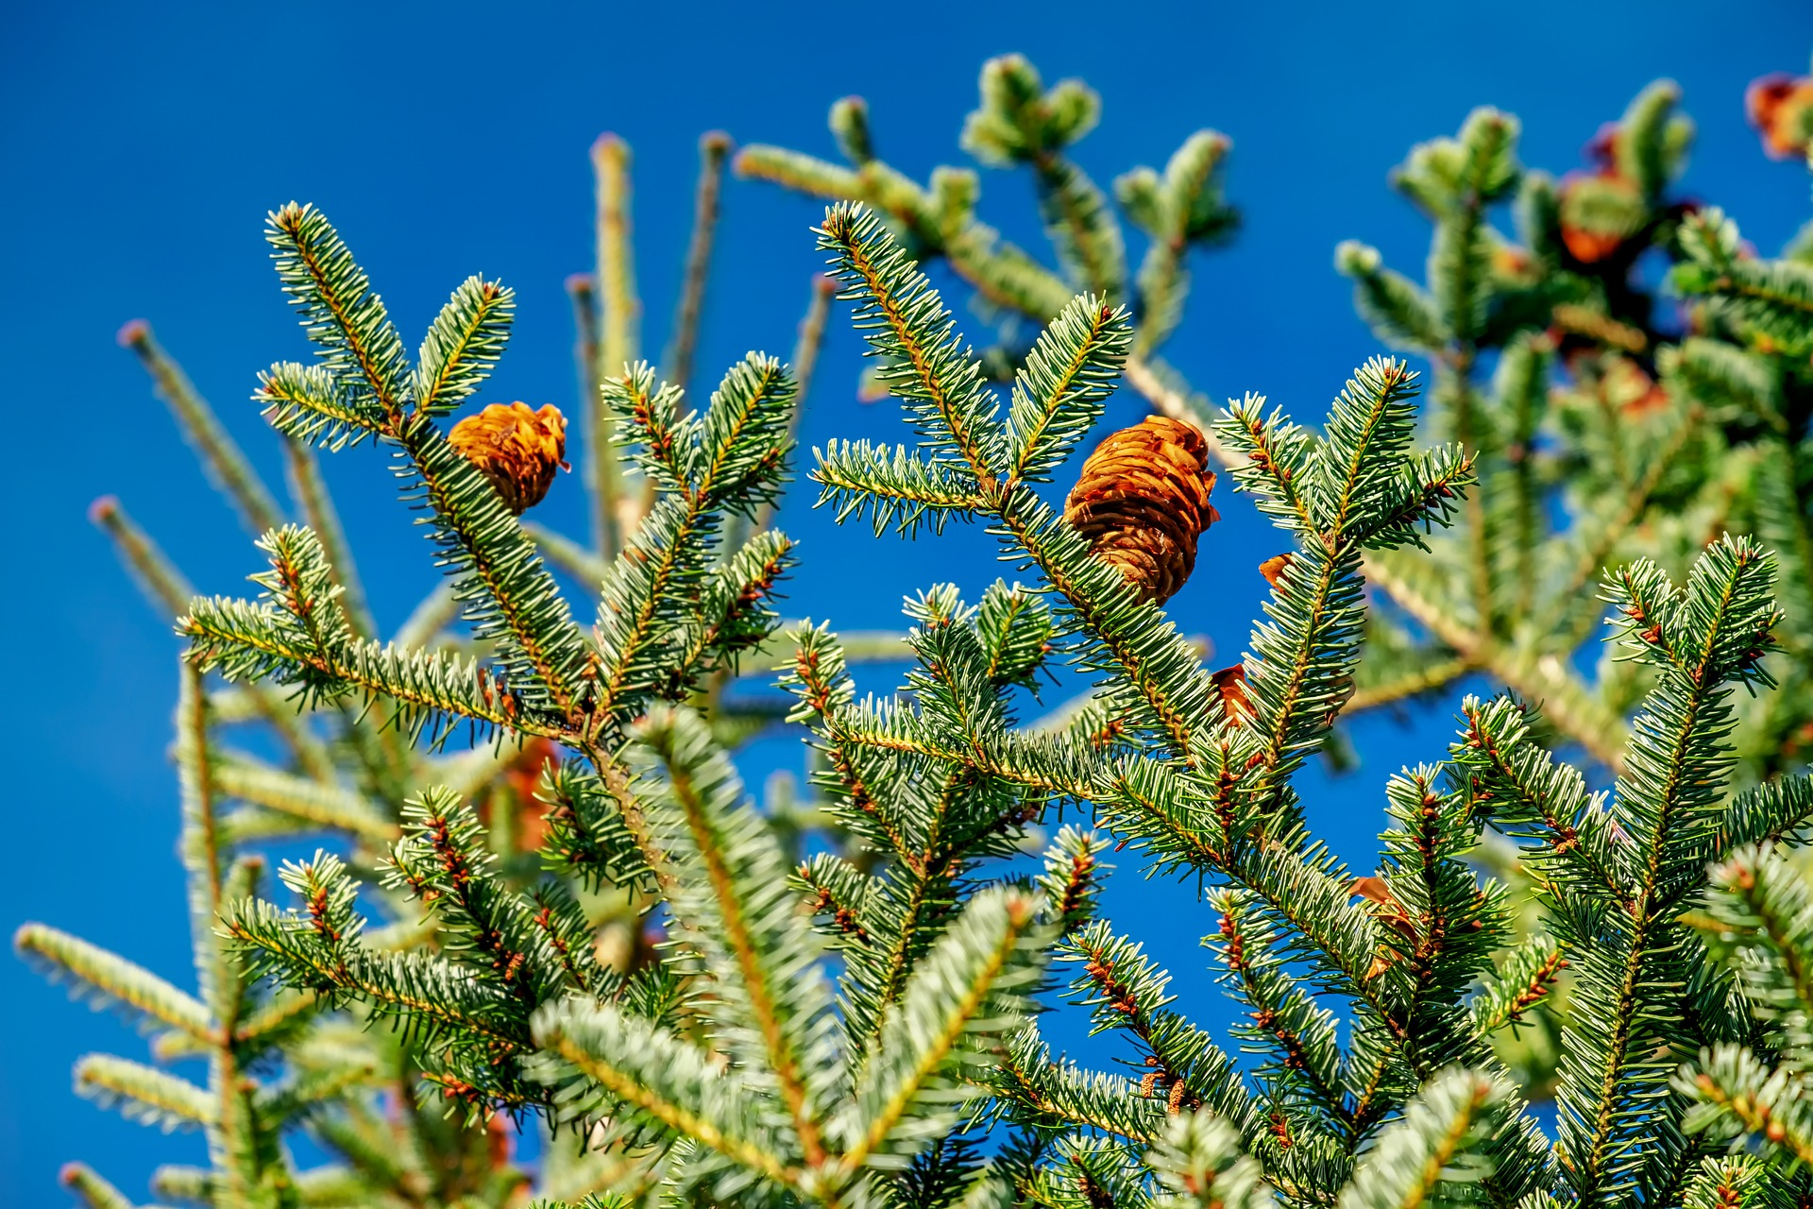
Pollination By Wind
Evergreen trees are pollinated by the wind. Male cones grow on the trees in spring and are filled with lots of pollen. When the wind blows, a cloud of pollen will blow from the male cones and land on the female cones, which will then begin to make seeds.
Male cones grow at the bottom at a tree and female cones grow at the top. This is to prevent a tree from pollinating itself. Female cones that are pollinated by pollen from a different tree produce seeds that are stronger and more likely to survive.

Slide 12
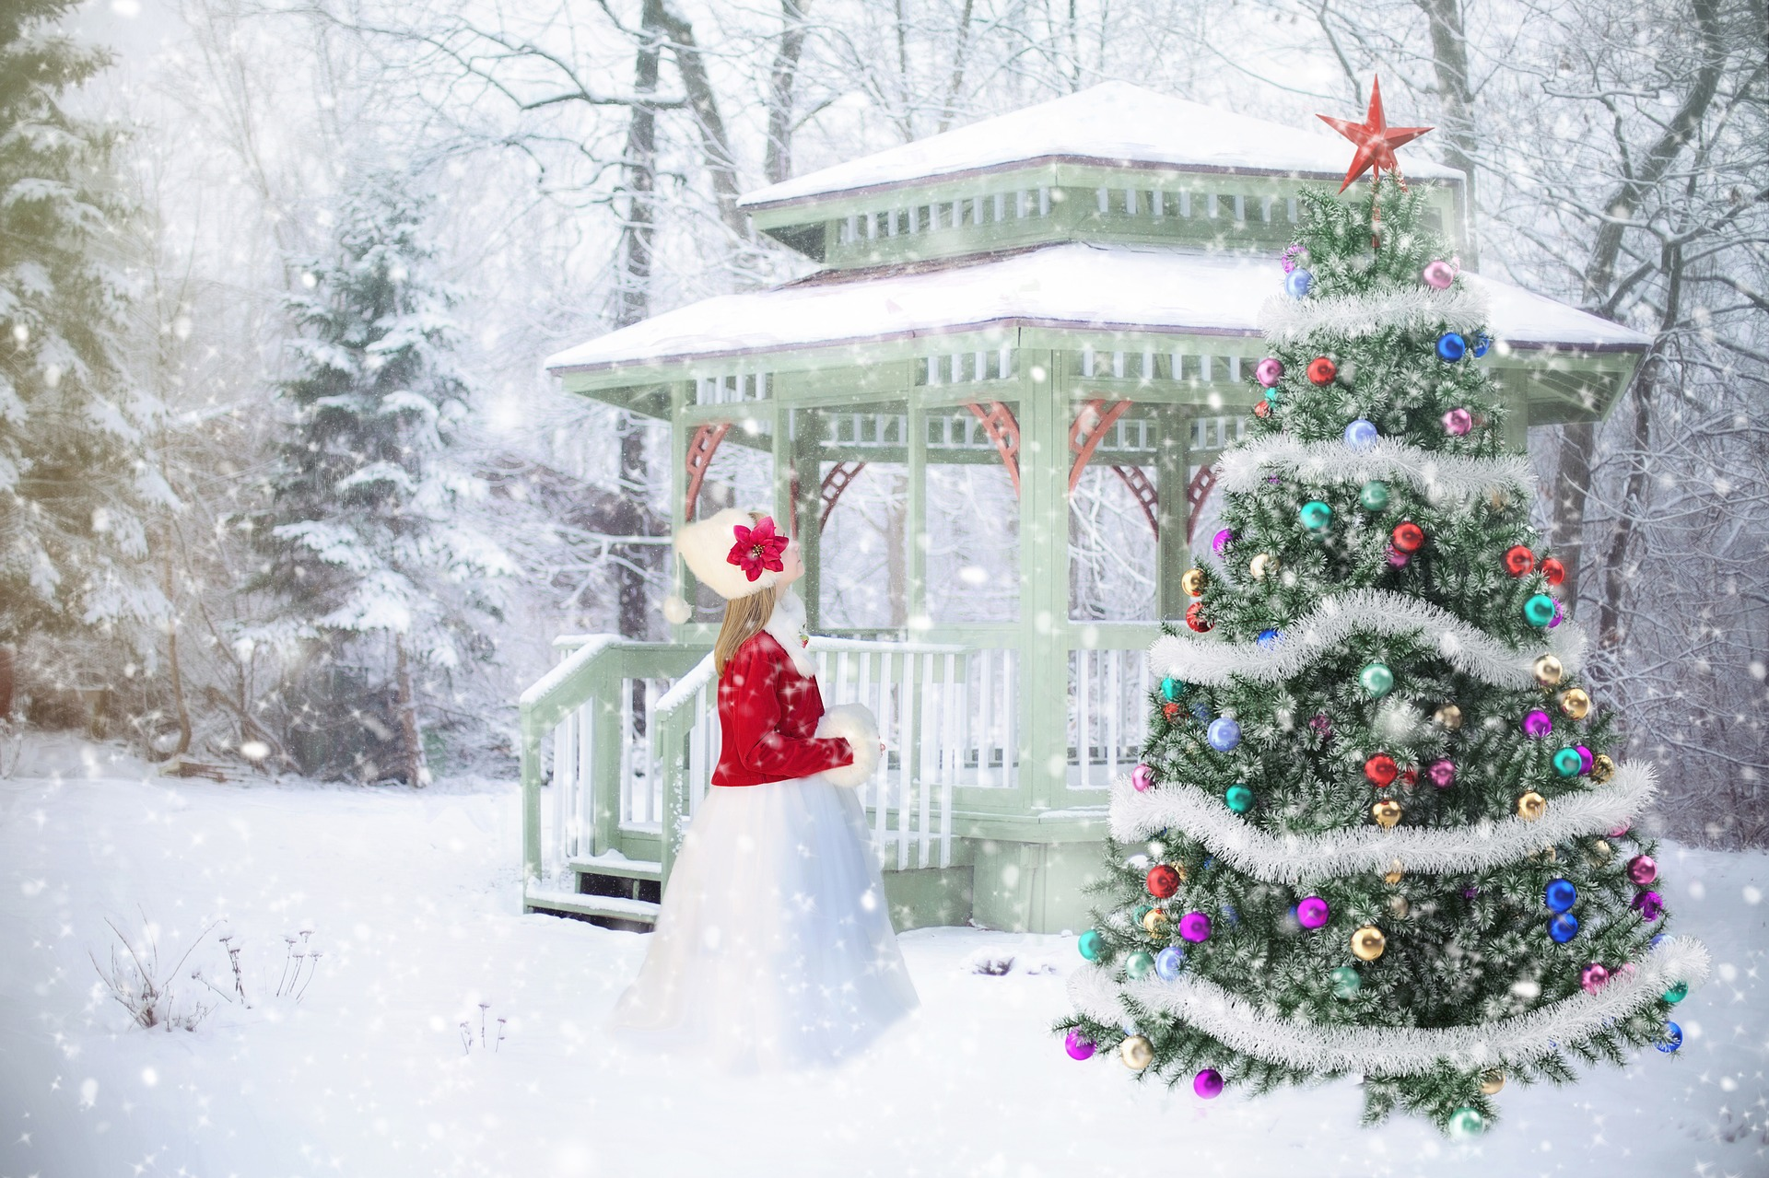
A Christmas Tree History
People have been decorating Christmas trees for a very long time. Germans are believed to be the first to bring trees into their homes to decorate in the 1500s.
German immigrants then brought the tradition of decorating trees to America in the 1700s. The first official record of a Christmas tree on display was in the 1830s by the German settlers in Pennsylvania.
By the late 1800s, Christmas trees had become very popular. But the only place to get a Christmas tree was to go into the woods or forest and cut one down.
By the early 1900s, people grew worried that the forests would be ruined if too many trees were cut down for Christmas.
One newspaper editor complained that the yearly practice of cutting down trees for Christmas “threatens to strip our forests.”

Slide 13
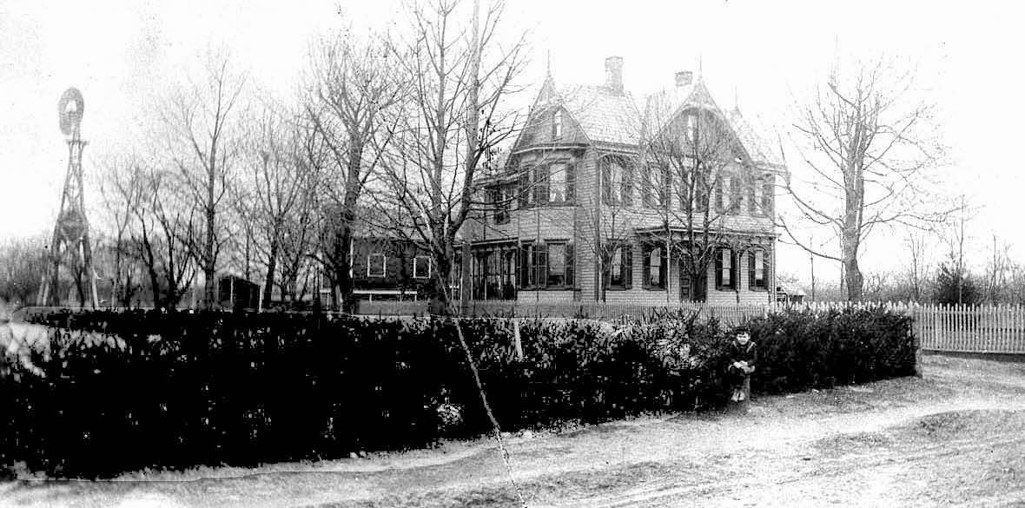
The First Ever Christmas Tree Farm Was in New Jersey
The first Christmas tree farm was planted in 1901 right here in New Jersey! A farmer named W.V. McGaillard planted 25,000 Norway spruce trees on his farm in Hamilton near Trenton in Mercer County.
Seven years later, Mr. McGaillard invited people to come to his farm and cut down their own Christmas trees. He sold his trees for $1 each. Customers could arrange to have their trees delivered by a horse-drawn wagon.
More and more tree farms were started, and now all Christmas trees are grown on farms.
Photo courtesy: Tom Glover, Hamilton Township Public Library Local History Collection
This photo shows the McGaillaird home in Hamilton, NJ, site of very first Christmas tree farm.
The house is now a funeral home. The photo is from about 1900.

Slide 14
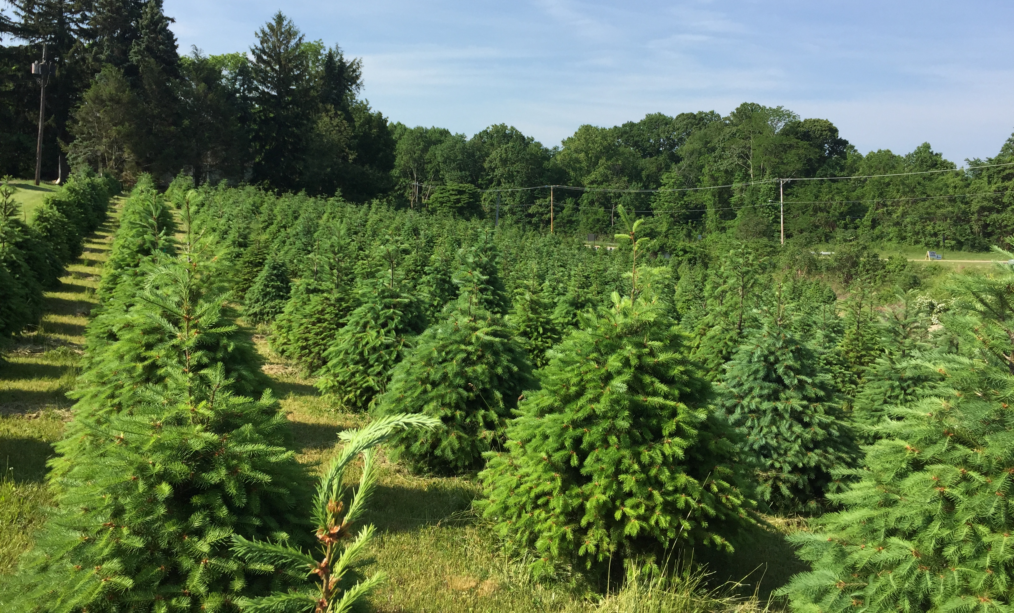
Real Christmas Trees Help the Environment
Many people think artificial Christmas trees are better than real trees because they don’t want to cut down a living tree. But Christmas tree farmers plant acres of trees especially for the holidays.
During the 8 years that the trees are growing, they are taking in carbon dioxide and releasing oxygen. An acre of Christmas trees can provide the daily oxygen for 18 people. In fact, the trees are cleaning the air and helping slow climate change.
Also, artificial trees are made of plastic. You may be able to use an artificial tree for many years, but eventually it will be thrown away and end up in a landfill, where it can sit for the next 1,000 years!
Real Christmas trees can be recycled. After the holidays, many towns gather used Christmas trees and grind them up into mulch. The mulch is spread over the ground and used to grow more trees or other plants.

Slide 15
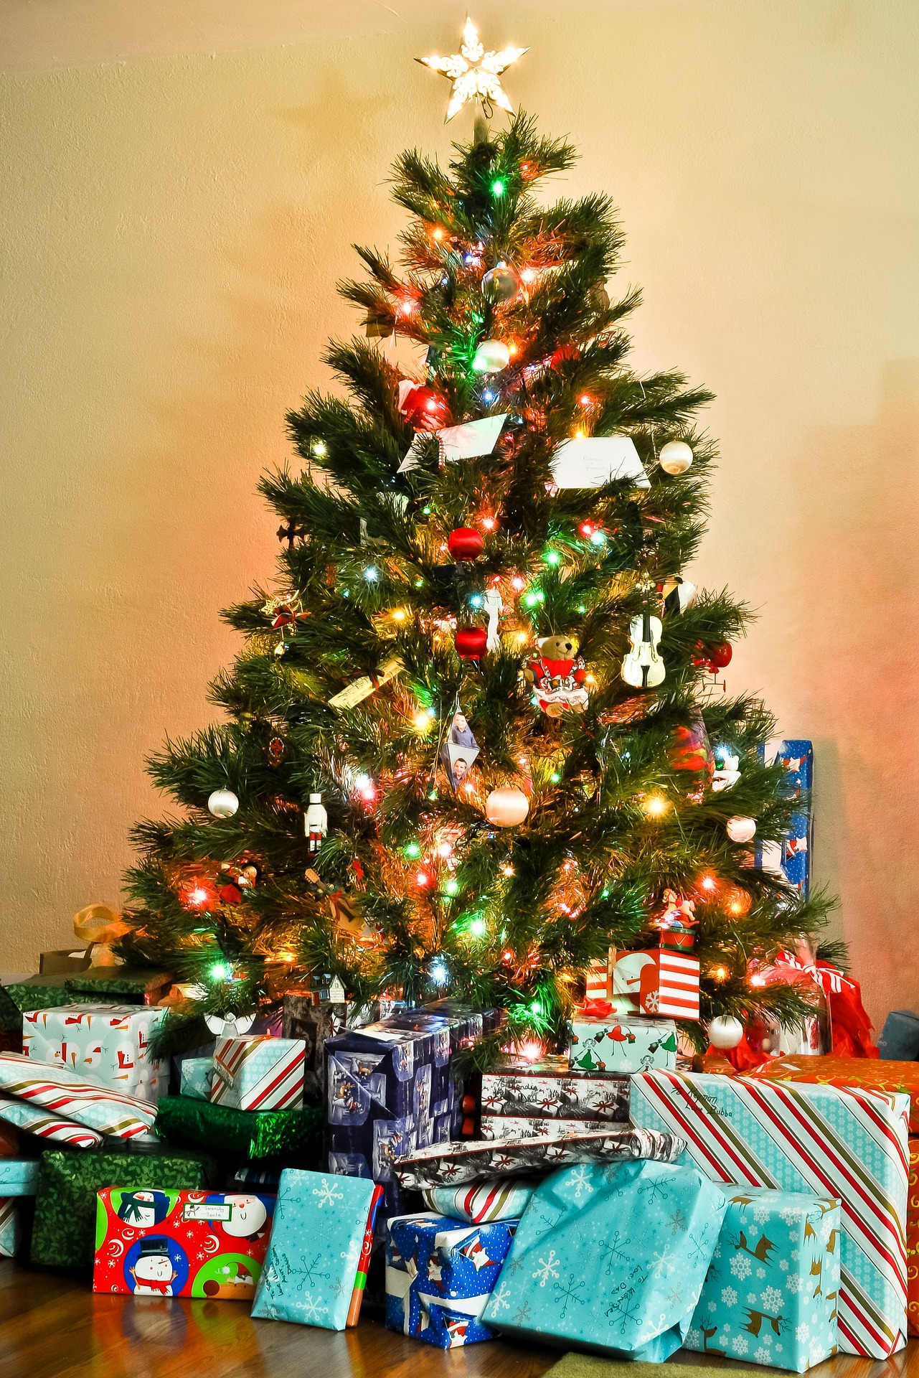
The next time you see Christmas trees for sale, ask the salespeople where the trees were grown.
You may be surprised. They might be from right here in New Jersey!

