Slide 1
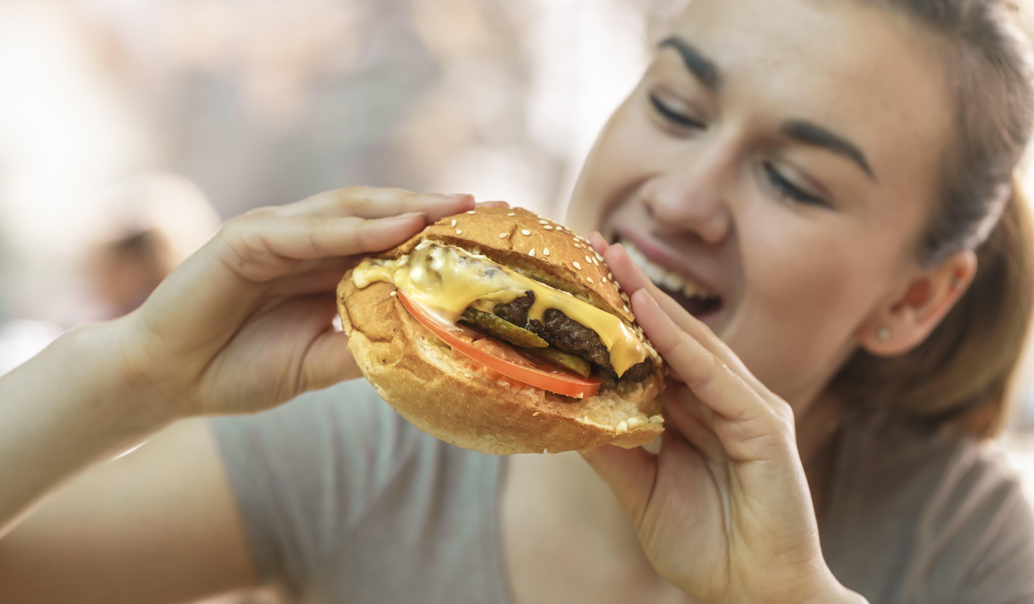
Have A Cheeseburger and See New Jersey
A presentation by

Slide 2
Making a delicious cheeseburger is really very easy. Simply buy all the ingredients at the supermarket, prepare them safely, pile on your favorite condiments, and enjoy!

Slide 3
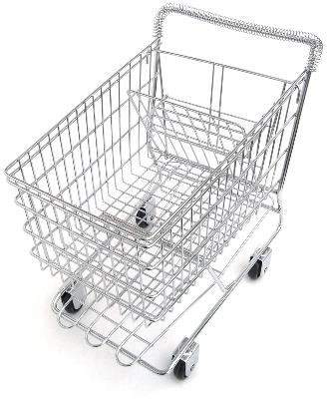
Unless, of course, the supermarket is closed!

Slide 4
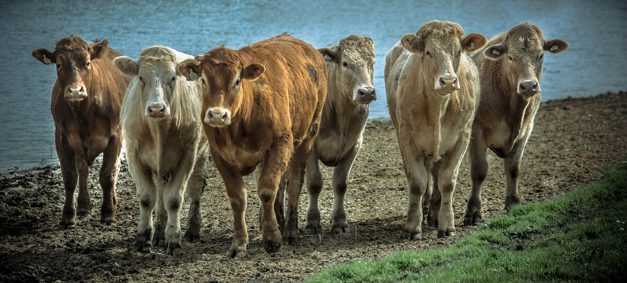
In that case, go home and pack a bag. Take your shopping list and some walking shoes. Start walking north to several counties that grow cattle in New Jersey.
Use your time while walking to familiarize yourself with all the breeds of beef cattle and determine which breeds provide the leanest beef. Brush up on your branding and roping skills.

Slide 5
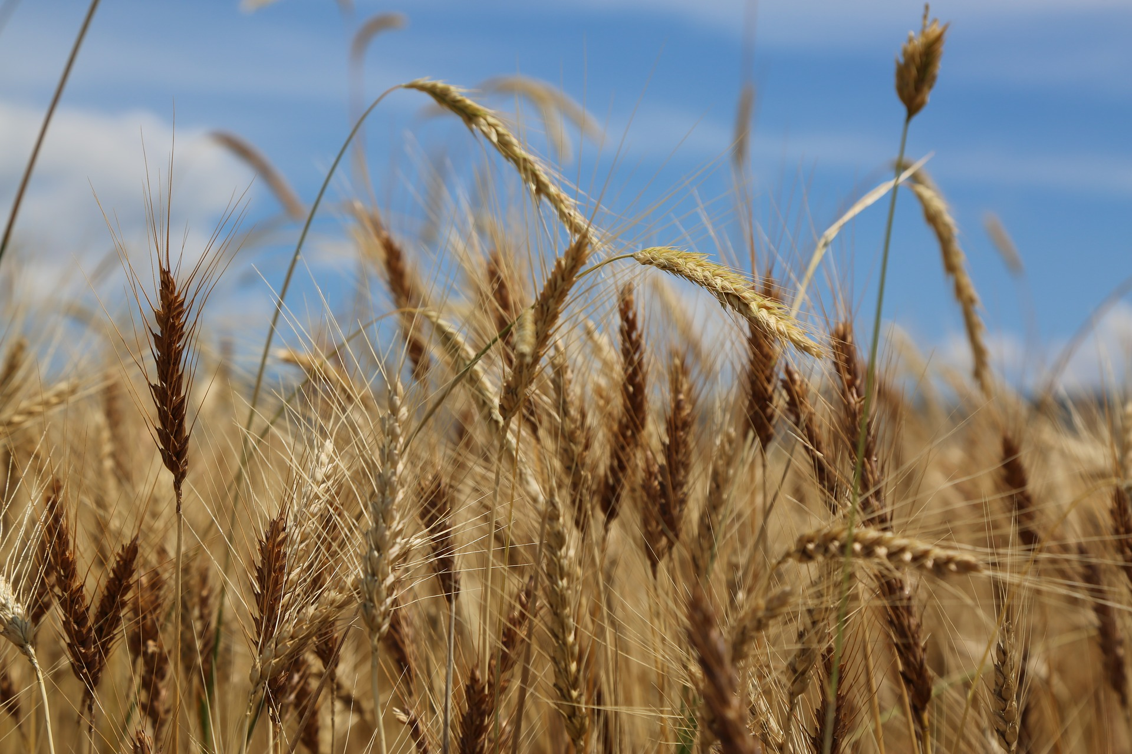
Now for the bread. This time you can head north or south to find a county where wheat is grown. If you time it right, you’ll arrive at harvest time. Most of the wheat in the United States is grown in Kansas, but New Jersey has some specialty wheat growers who sell their wheat locally.
Find a large field out in the countryside. Gather up several armloads of wheat. It must be ground into flour for the bun for your burger.
Do you like whole-wheat buns? With seeds or without?

Slide 6
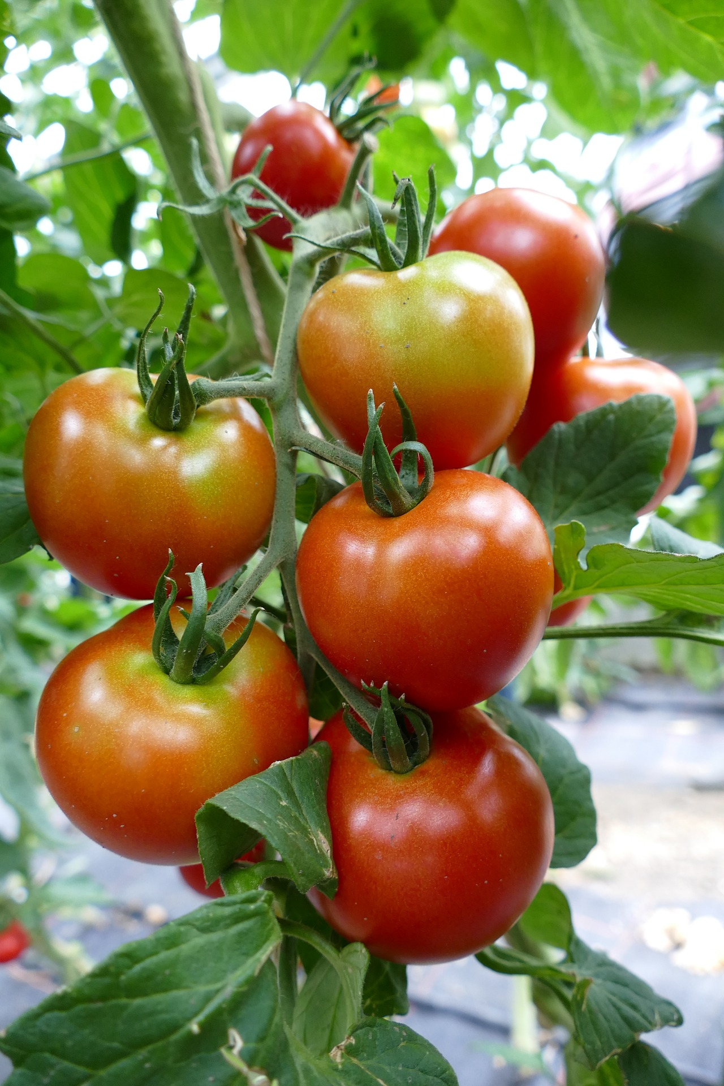
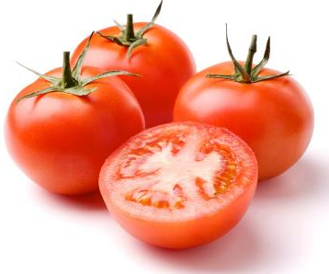
Next, take a bike ride to South Jersey. Here’s where you will find large fields of tomatoes growing in the good old USA.
Locate the counties that produce them on the map in the book From the Garden State to Your Plate.
Tomatoes add a nutritious zest to America’s favorite sandwich and provide the primary ingredient for everyone’s favorite condiment, ketchup. Or is it catsup?

Slide 7
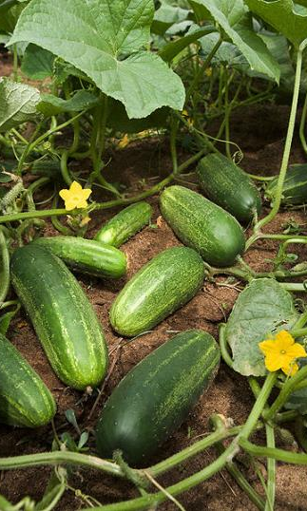
Time for pickles! A long, brisk walk will take you across the Garden State, as New Jersey has many farms that grow cucumbers.
Locate the counties that produce them on the map in the book From the Garden State to Your Plate.
Do you put cucumbers on your burger? You do if you like to add a pickle for tangy flavor.

Slide 8
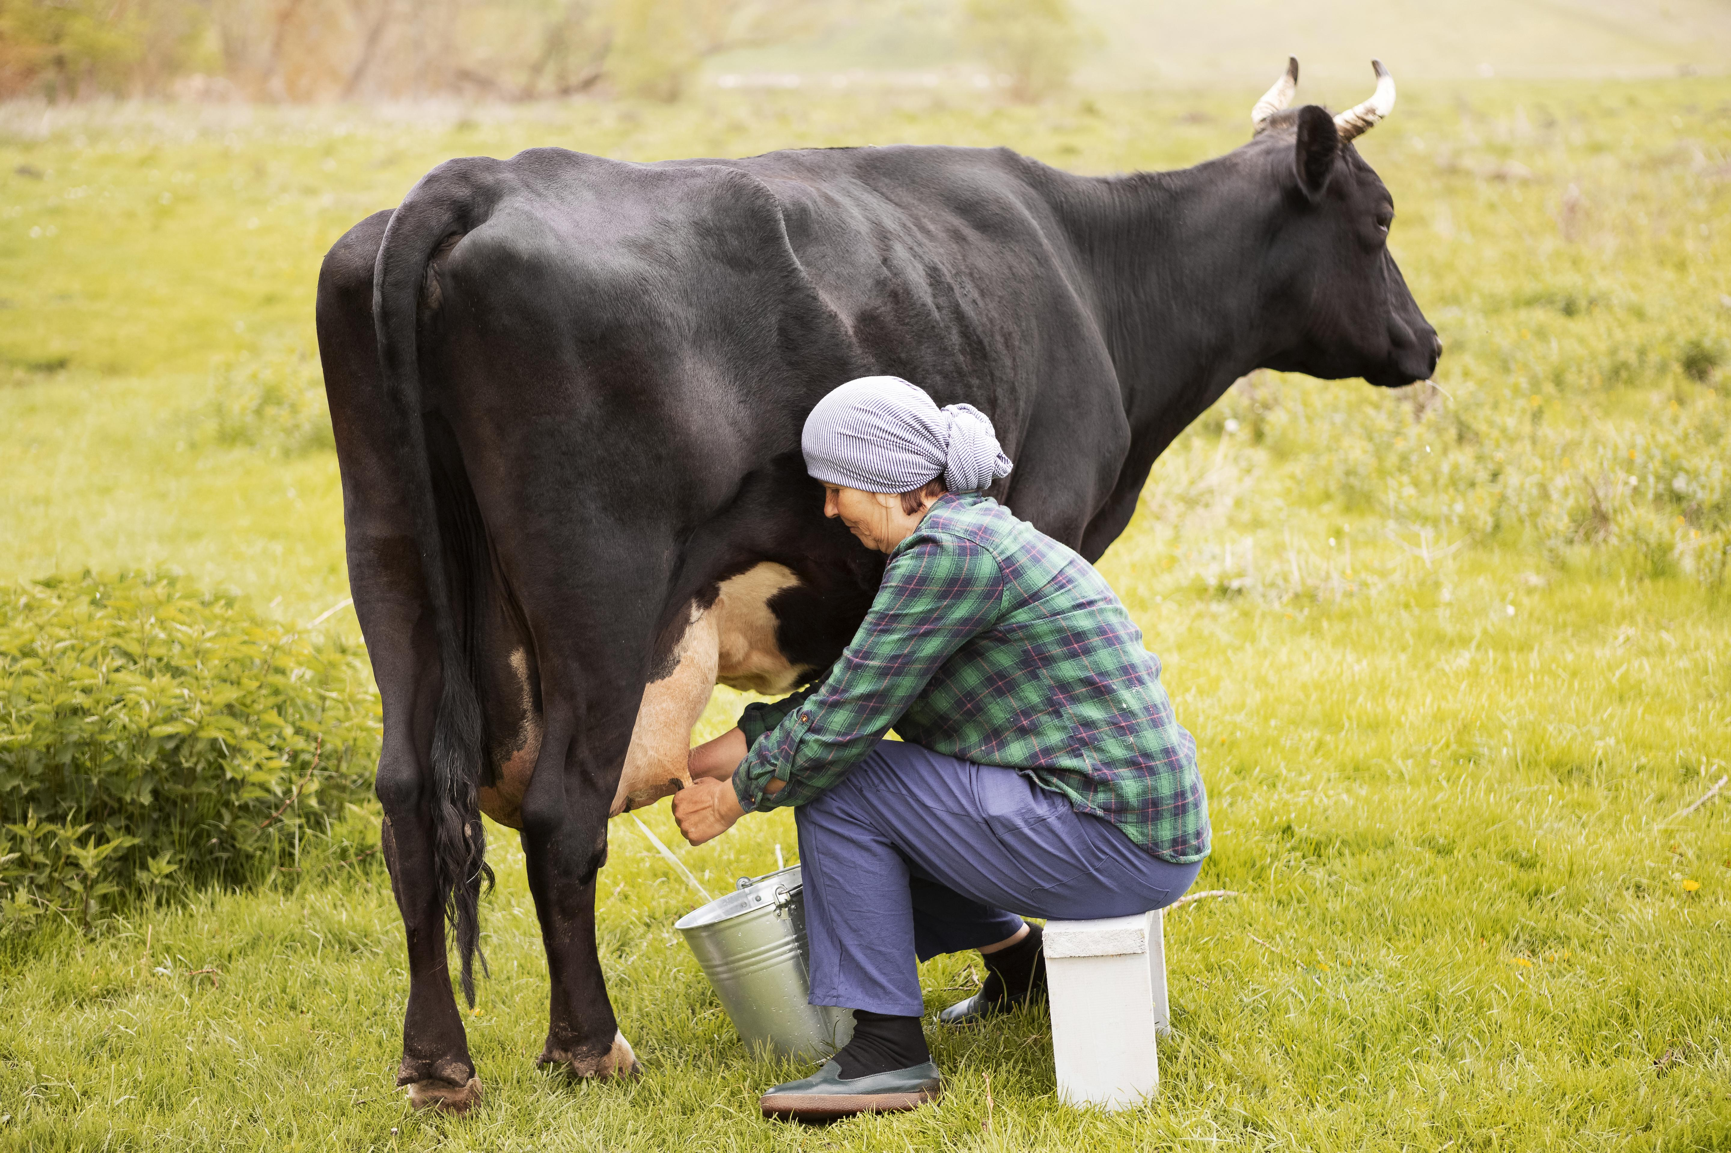
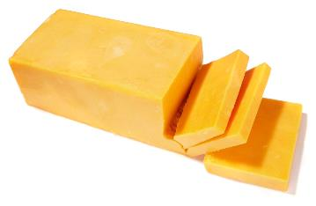
Hop a scooter and ride around our state to find a dairy farm. There are farms in many counties that raise dairy cows and make cheese! What’s a cheeseburger without the cheese?

Slide 9
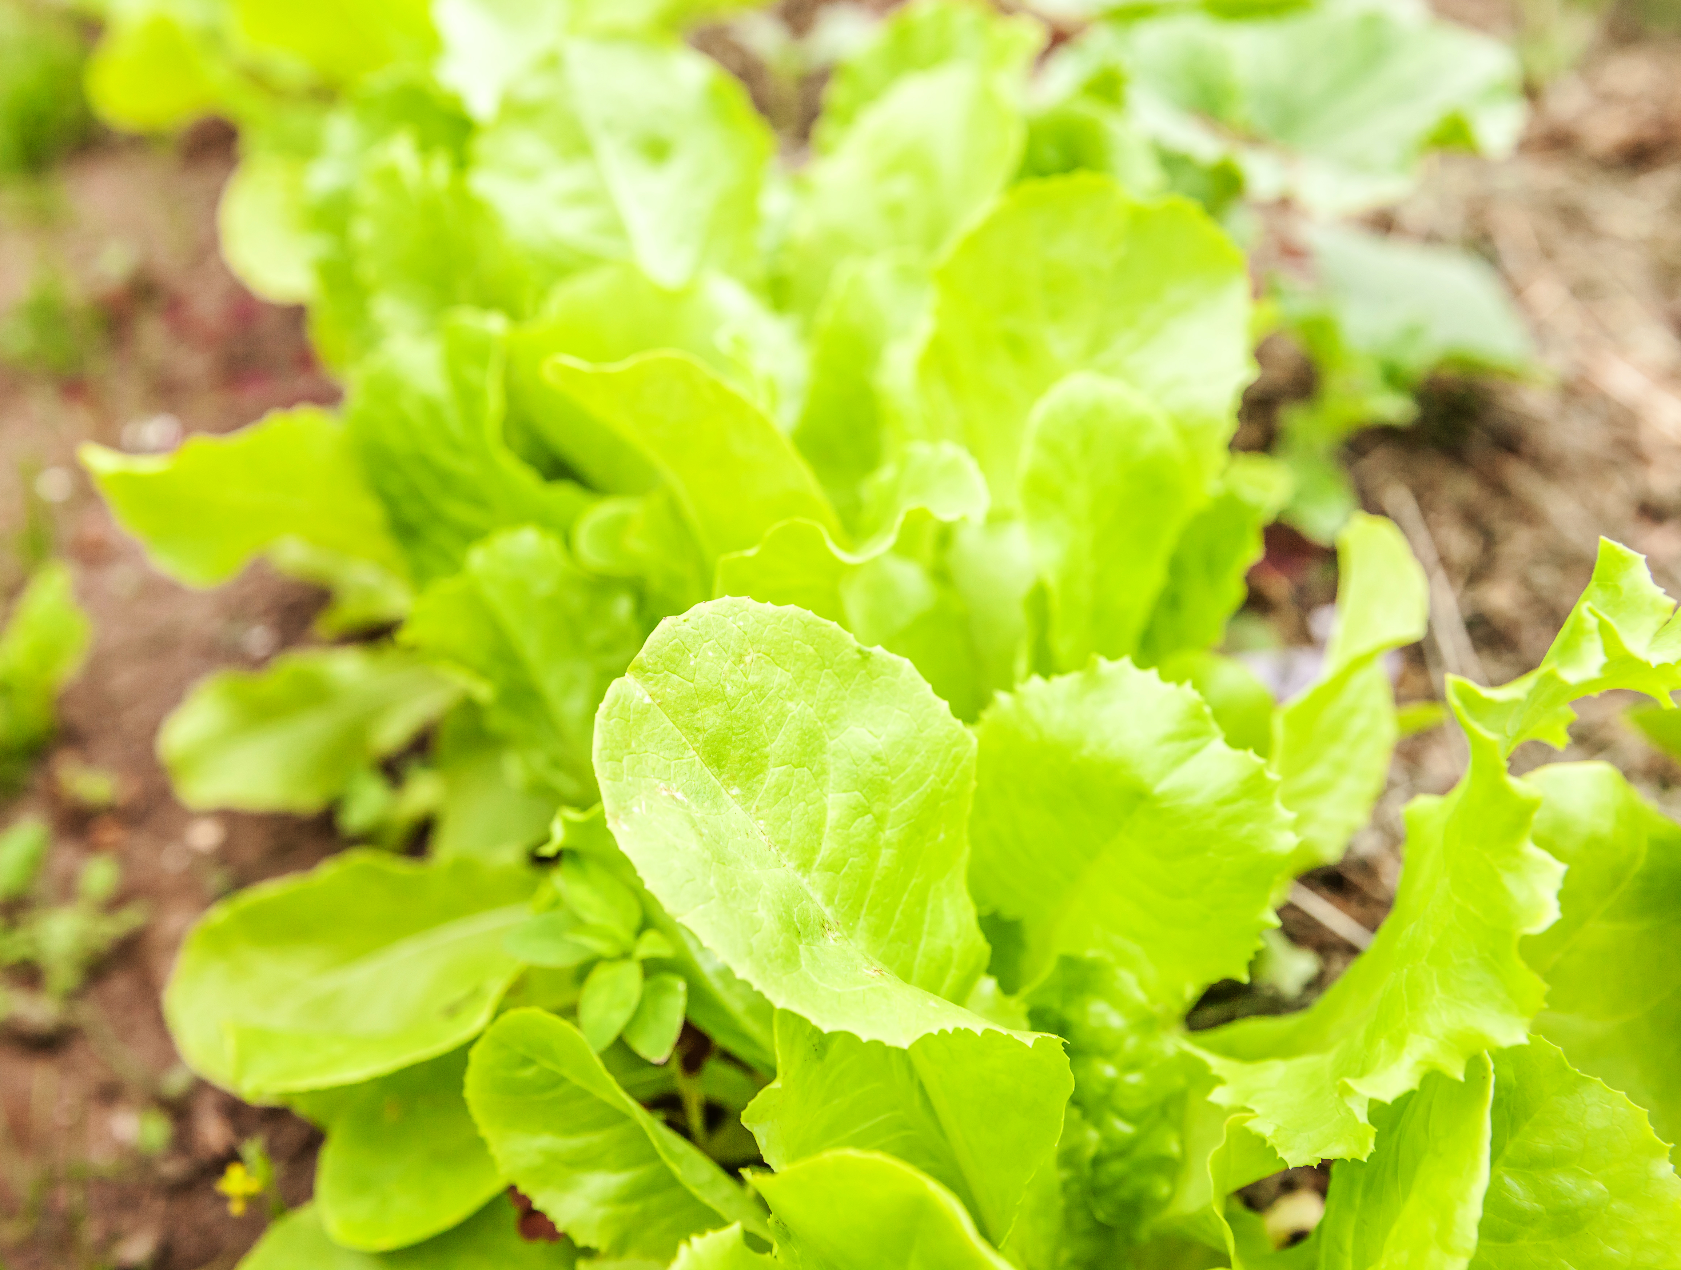
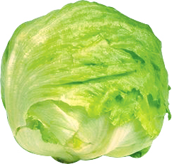
You can head back south to pick fresh lettuce, or you can head to a farmer’s market in almost any county in New Jersey to find the crisp, cool lettuce that will complete your cheeseburger masterpiece.

Slide 10
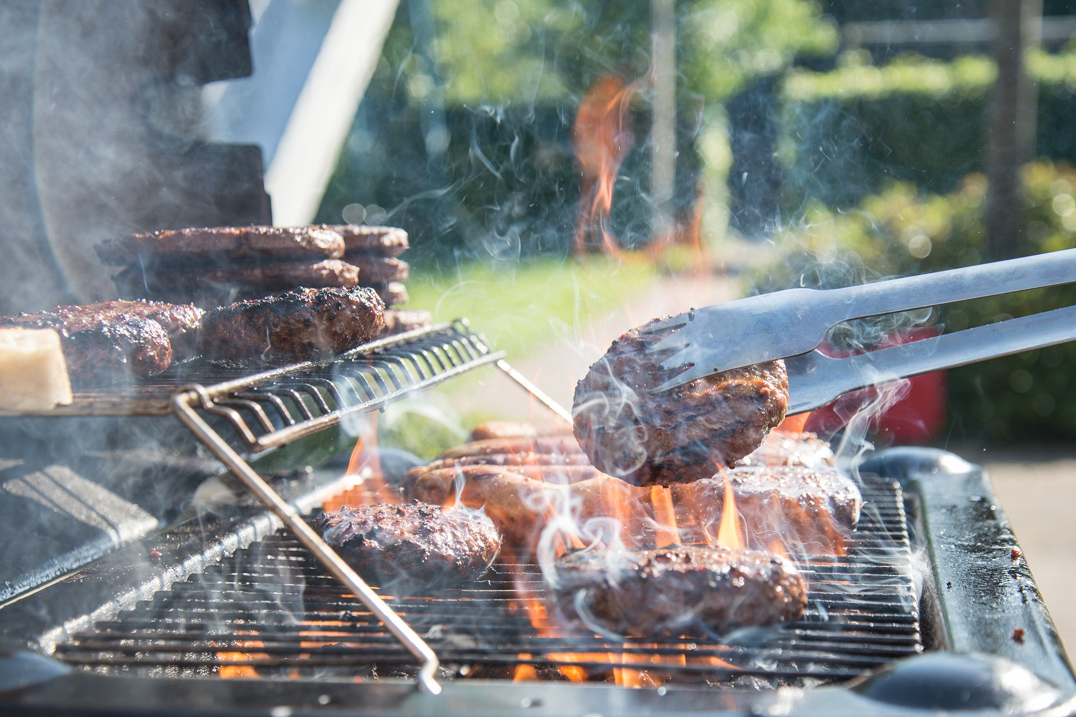
While at the farmer’s market, make some new friends to invite to a barbecue. Enjoy your beautiful cheeseburger creation!

