Slide 1
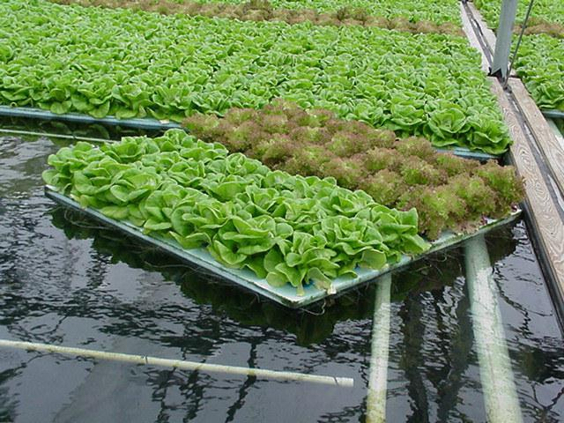
HYDROPONICS
Growing Plants
Indoors
Without Soil
A presentation by

Slide 2
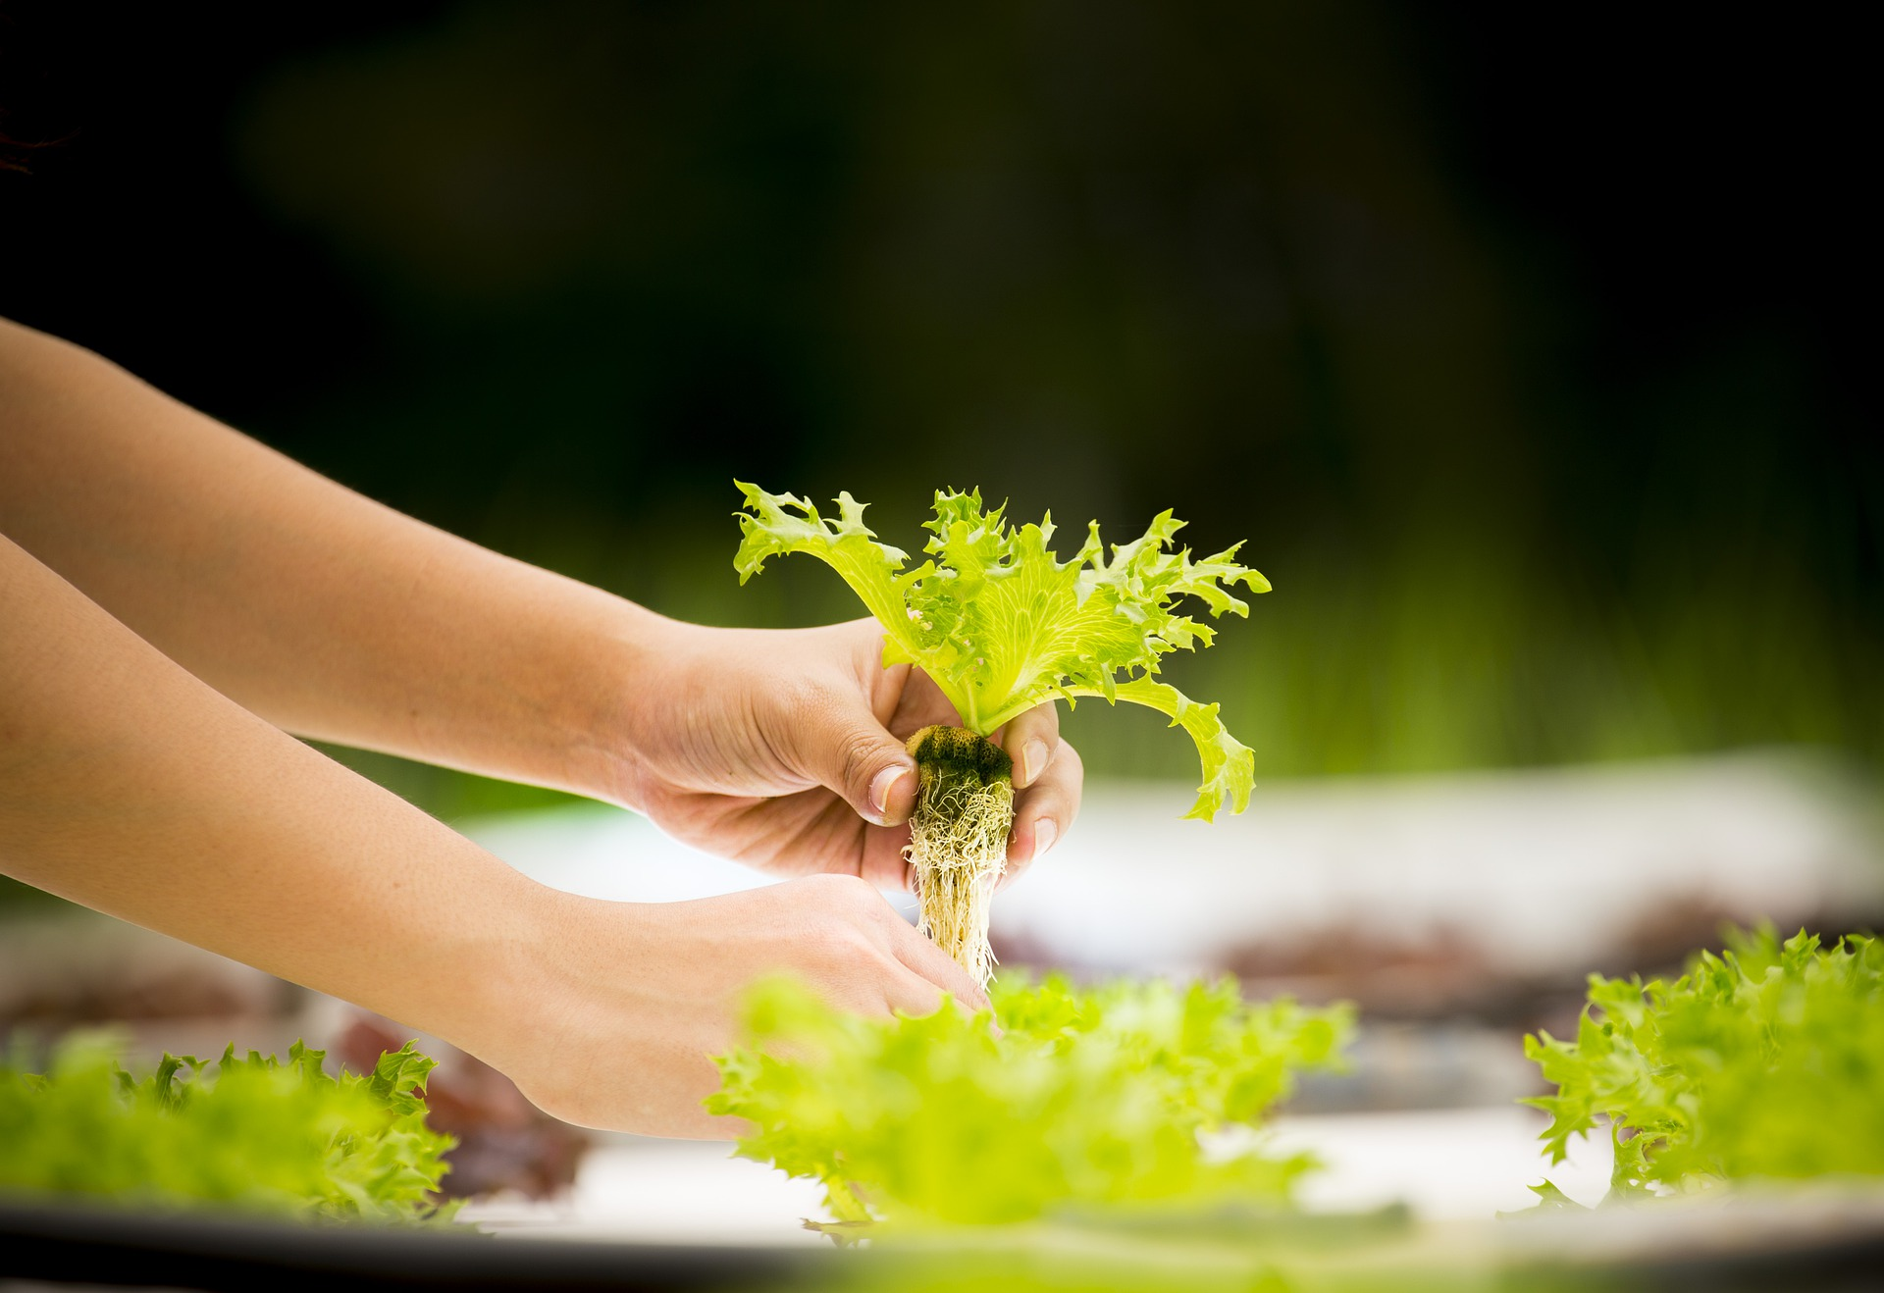
Hydroponics is a way to grow plants without soil. In hydroponics, the nutrients, or important materials plants need to grow, are put into water. The plant takes up the nutrients from the water through its roots.

Slide 3
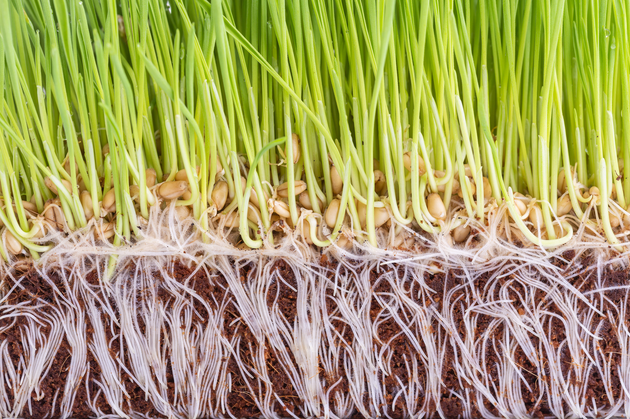
The Importance of Roots
Outside, in nature, a plant’s roots do two things:
1) The roots take up water and nutrients from the soil for the plant to survive and grow. Nutrients plants need are naturally present in the soil, but farmers also add them with fertilizers.
2) The roots help anchor or fix the plant to the ground so it isn’t blown away by wind.

Slide 4
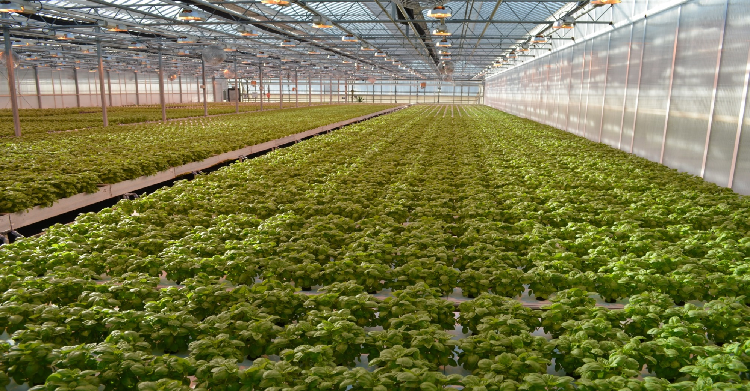
By using hydroponics to grow plants indoors, farmers do not need to worry about the wind. So the roots’ only job is to deliver nutrients to the plant. This can be done by putting both the nutrients and the plant’s roots into water.

Slide 5
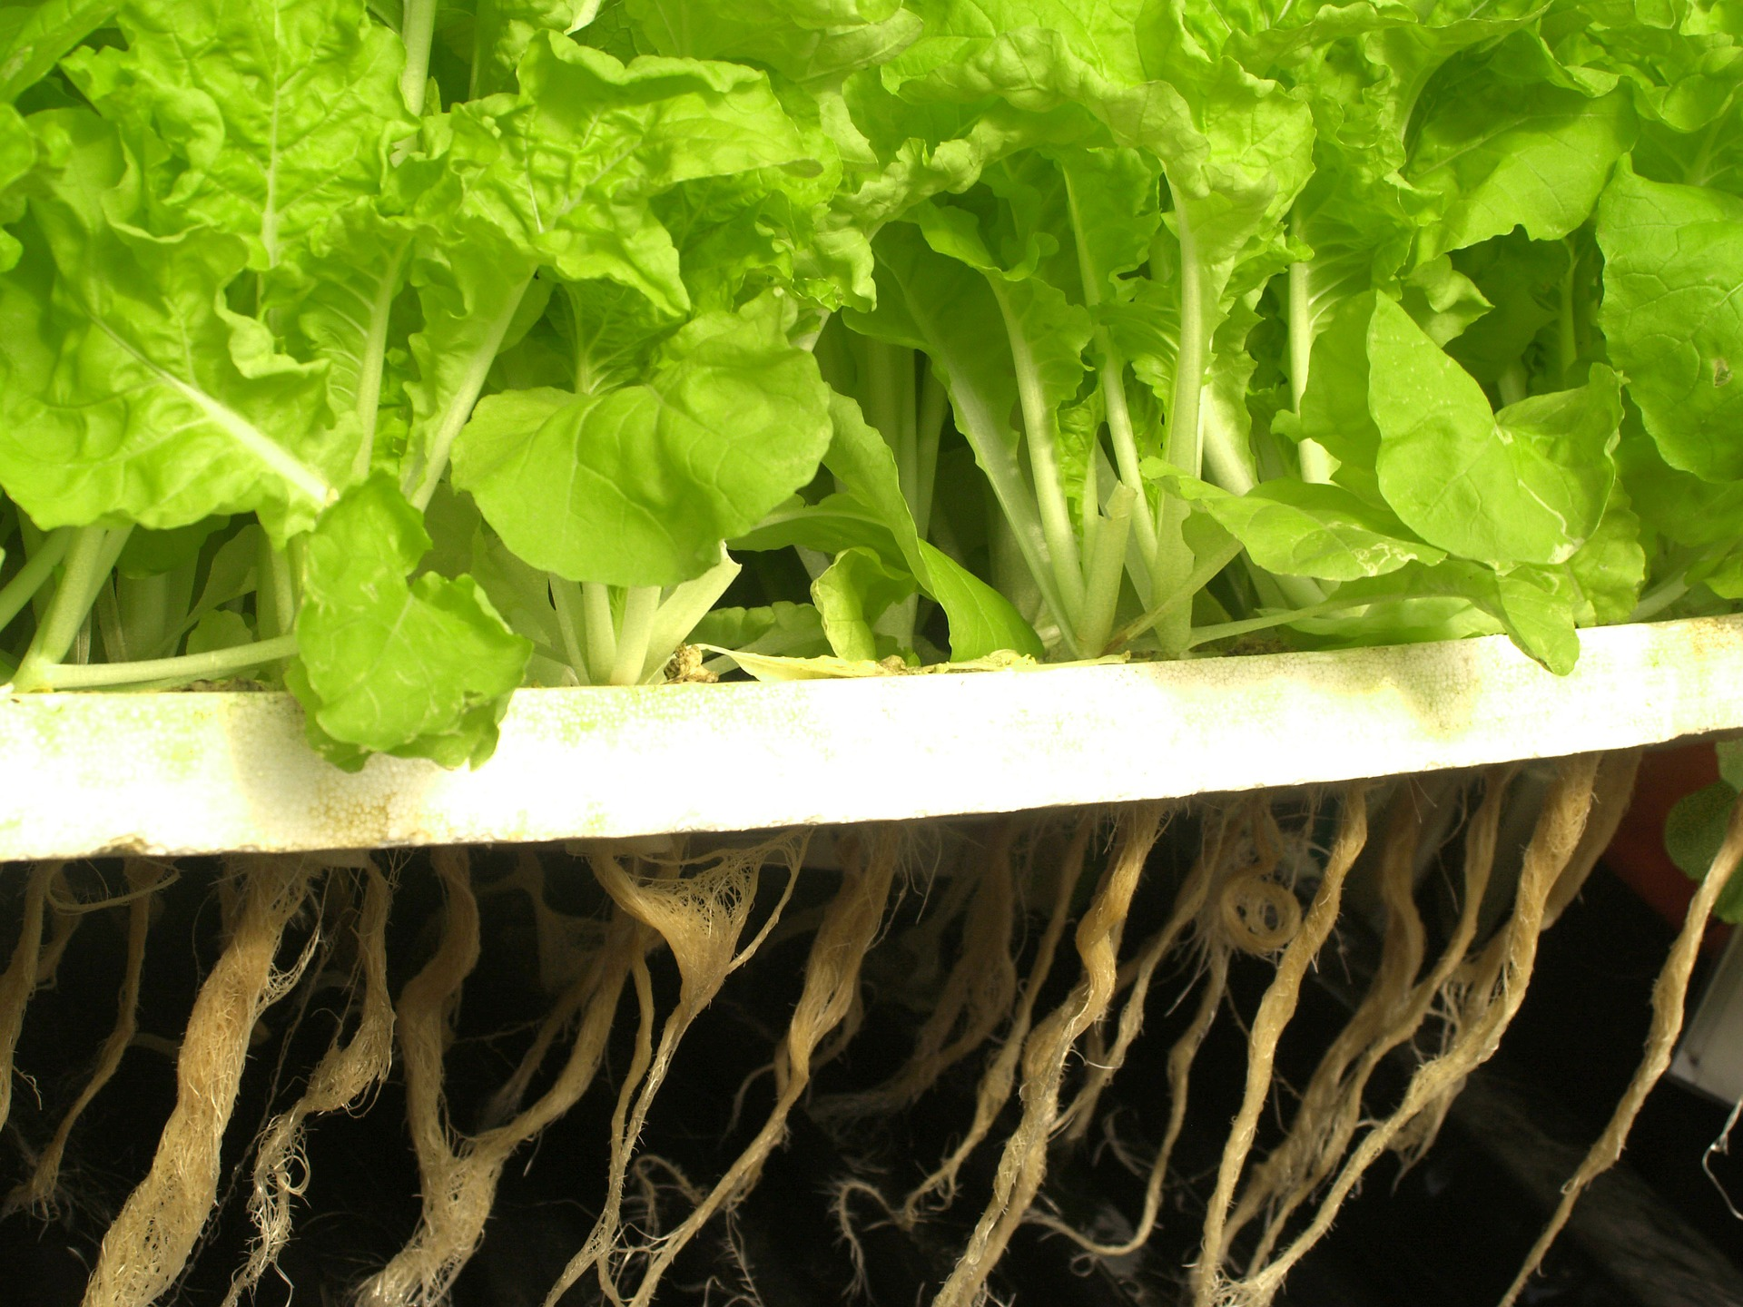
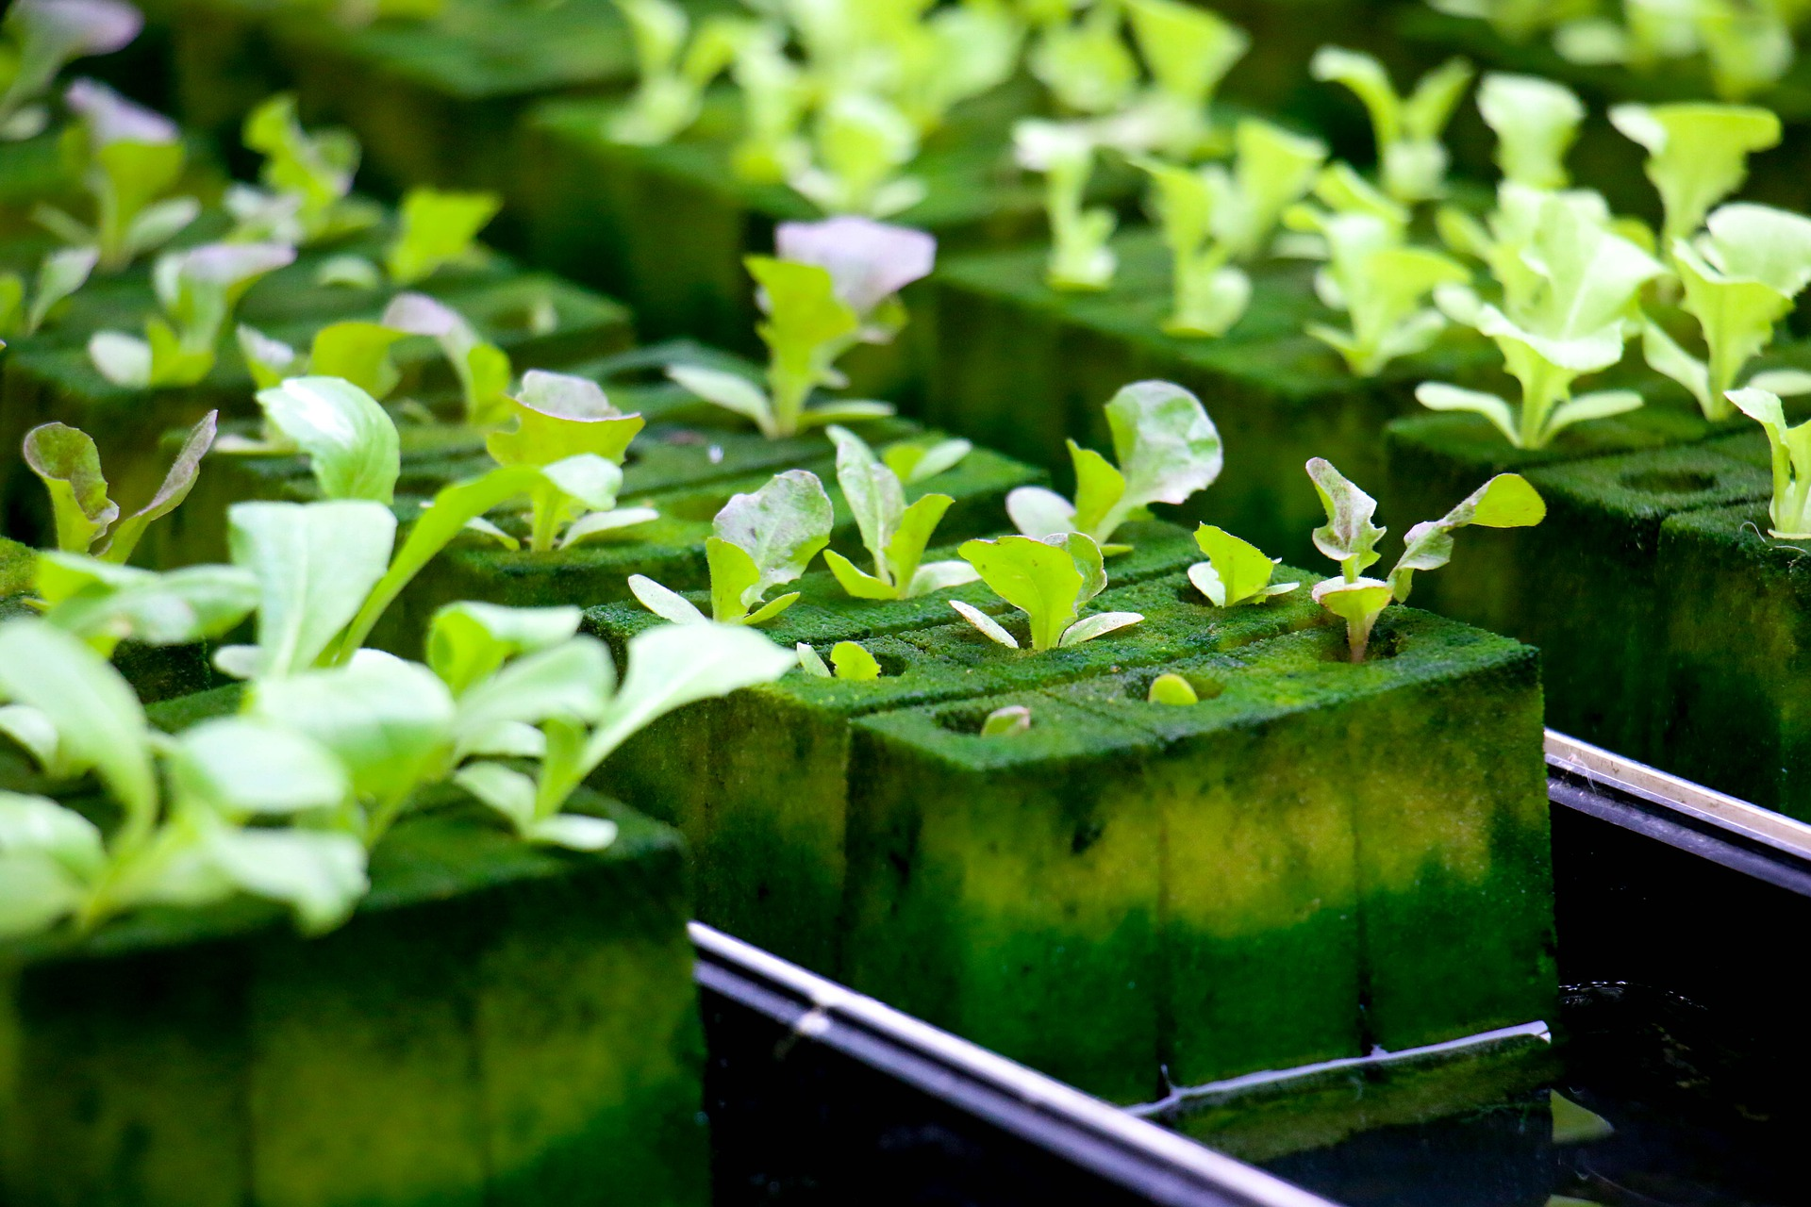
There are several different ways to build a hydroponics system. Sometimes the plants are hung in nets or other structures with their roots dangling into the water below. In some systems, the plant's roots grow in materials other than soil. This material supports them while they grow and allows the roots to soak up water.

Slide 6
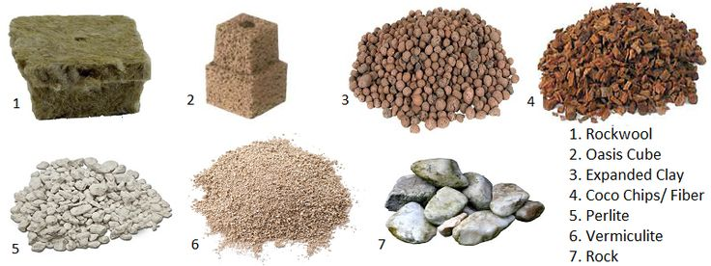
One of these support materials is vermiculite, which is a mineral that looks like a stone but is very light and can absorb water easily. The outer husks of coconuts are also used. Another material is called rock wool, a light substance that looks a little like moss and is made by blowing air through very hot rocks. Below are pictures of different materials used in hydroponics instead of soil.
Image courtesy www.nosoilsolutions.com

Slide 7
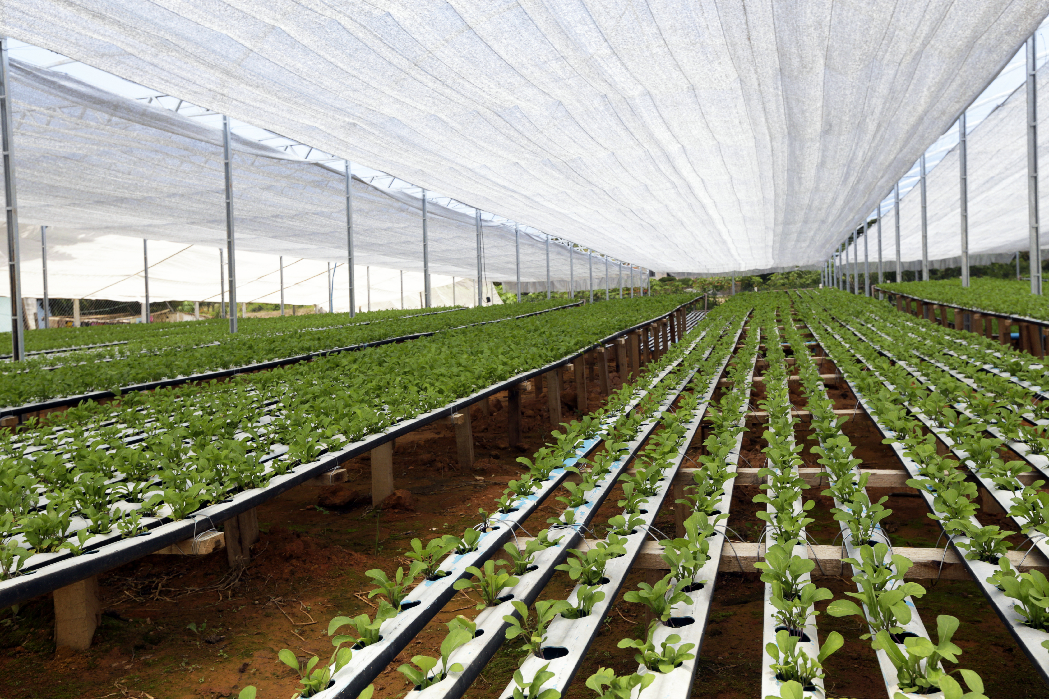
Why grow plants without soil?
There are many benefits to hydroponics farming.
Plants are off the ground and inside, so there are no weeds and fewer insect pests and diseases.
Hydroponic gardens actually use less water, even though the plant always sits in water. Less water is needed than for crops in the ground, and the plants are never over-watered or under-watered. Water in hydroponics systems is always recirculating.

Slide 8
Photo by Phil Sadler
Hydroponics is a perfect way to grow plants in places without good soil, such as deserts or very cold climates. These pictures show the outside and inside of a hydroponics greenhouse in Antarctica that provided fresh vegetables for many years for the scientists who work in the frozen climate of the South Pole.

Slide 9
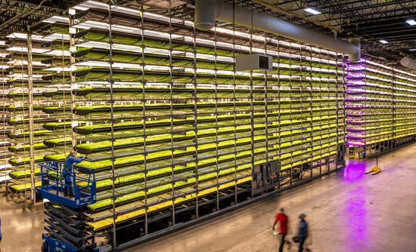
Hydroponics can also be used to create indoor farms in cities. A company called Aerofarms in Newark, New Jersey is turning empty city buildings into large indoor farms growing vegetables.

Slide 10
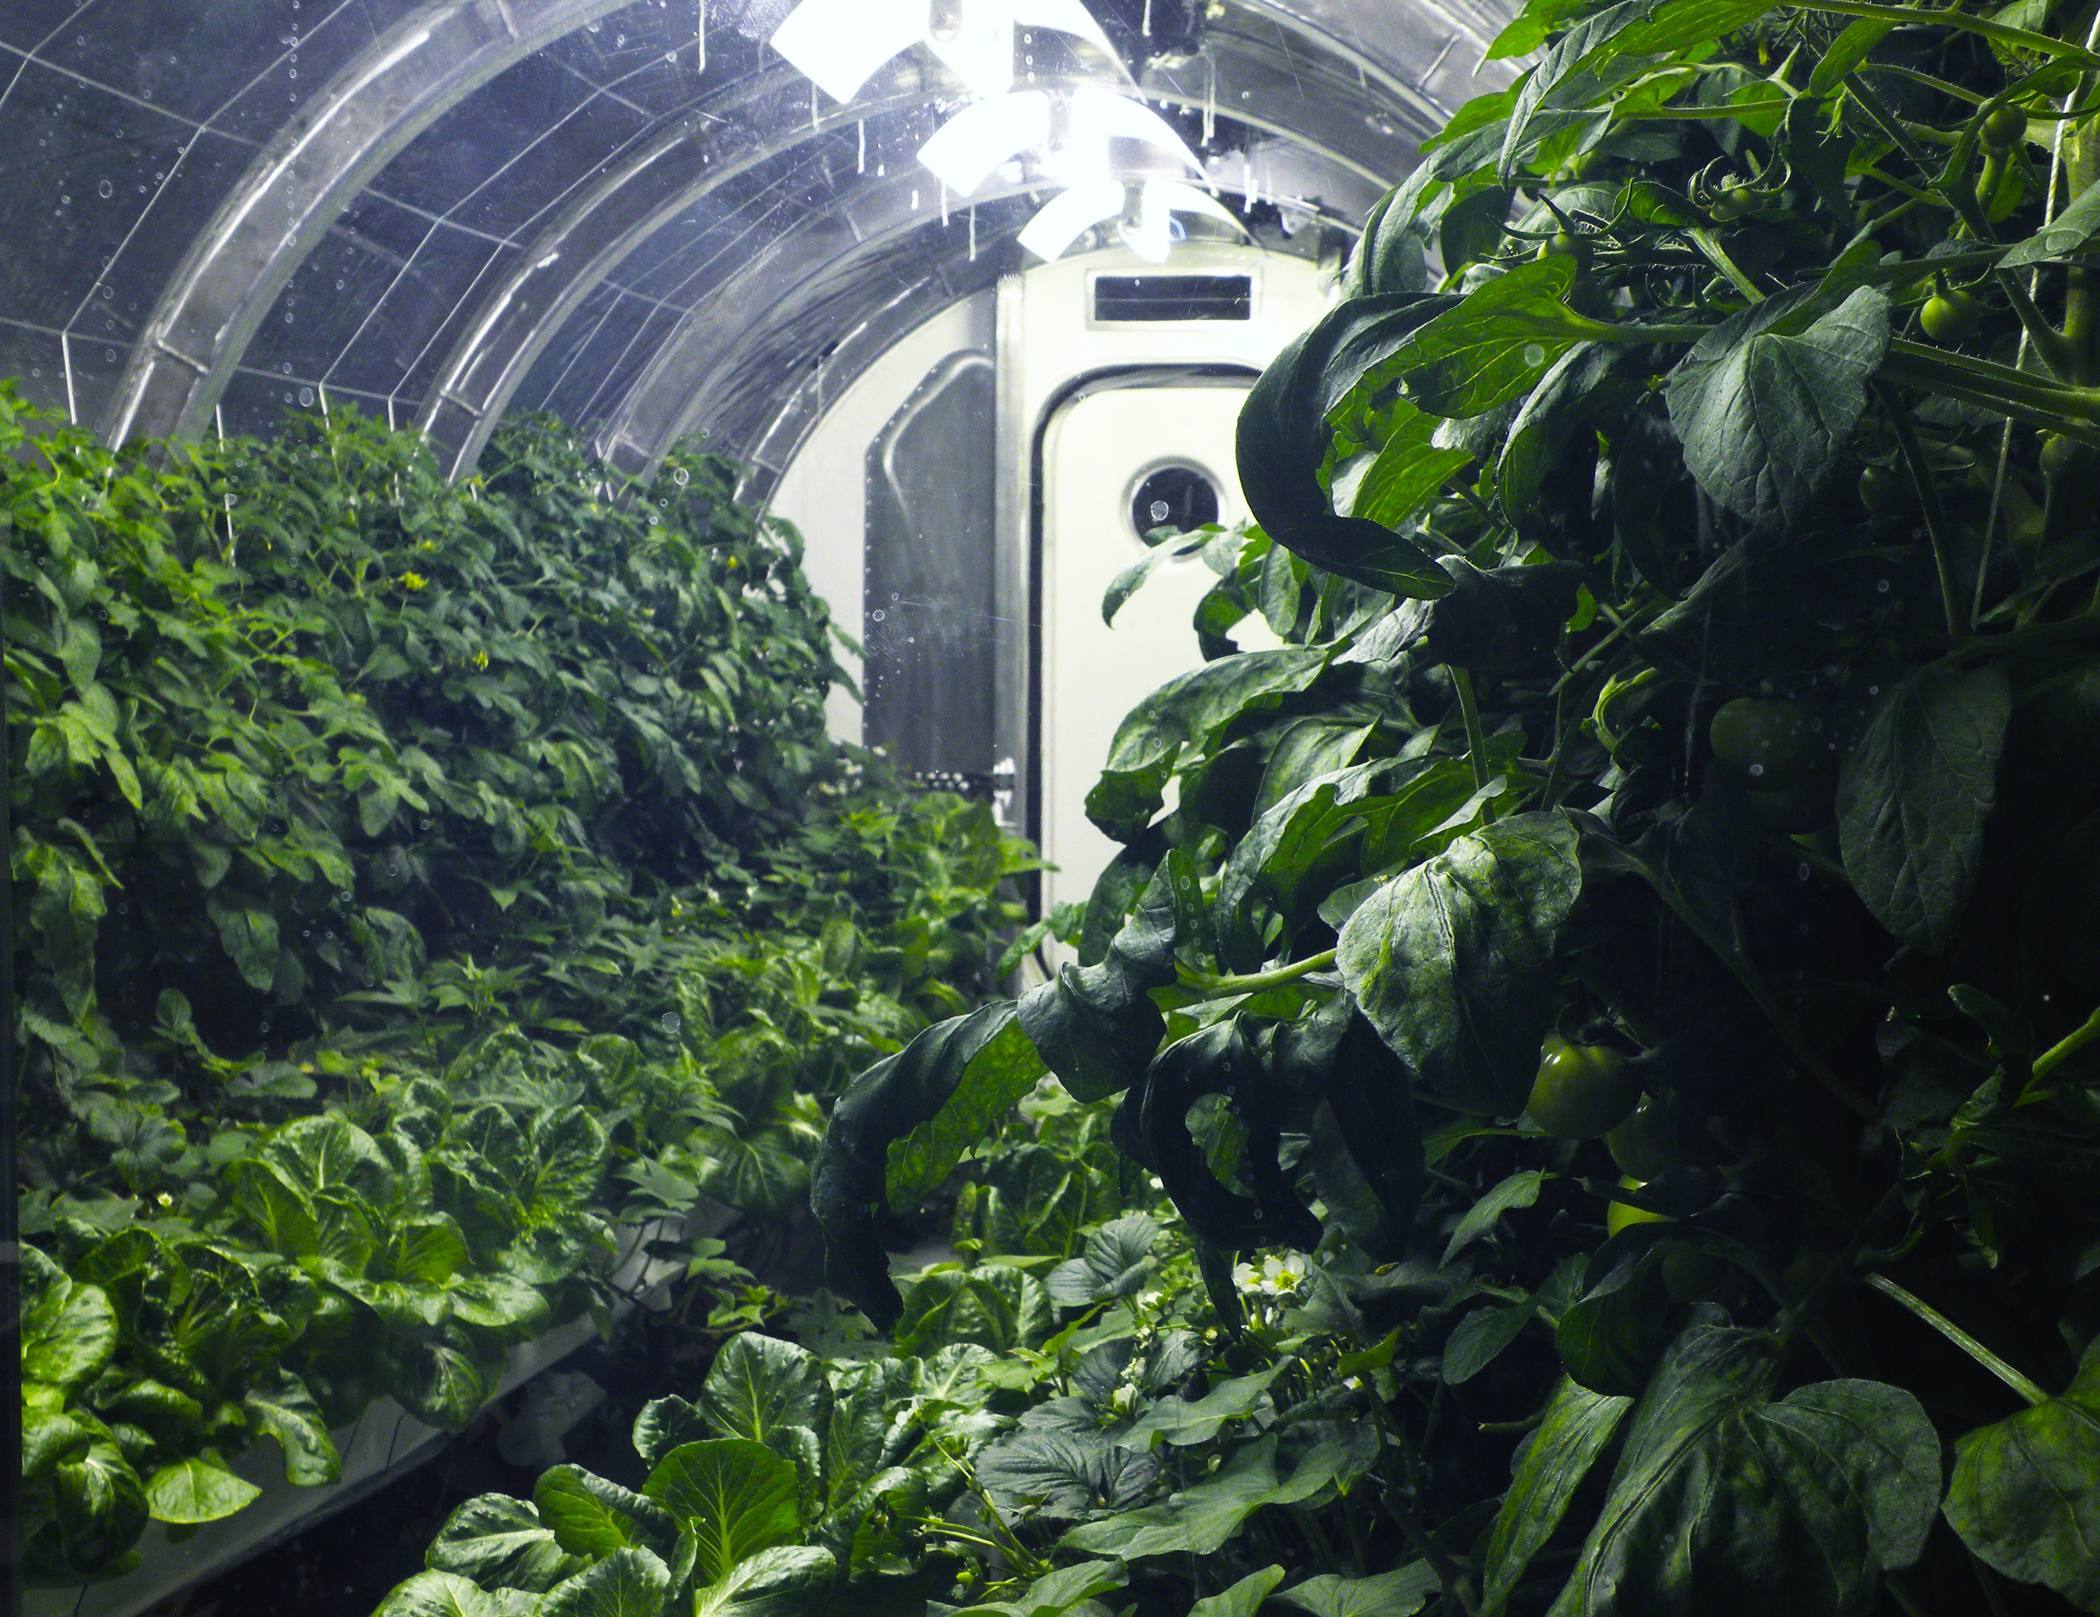
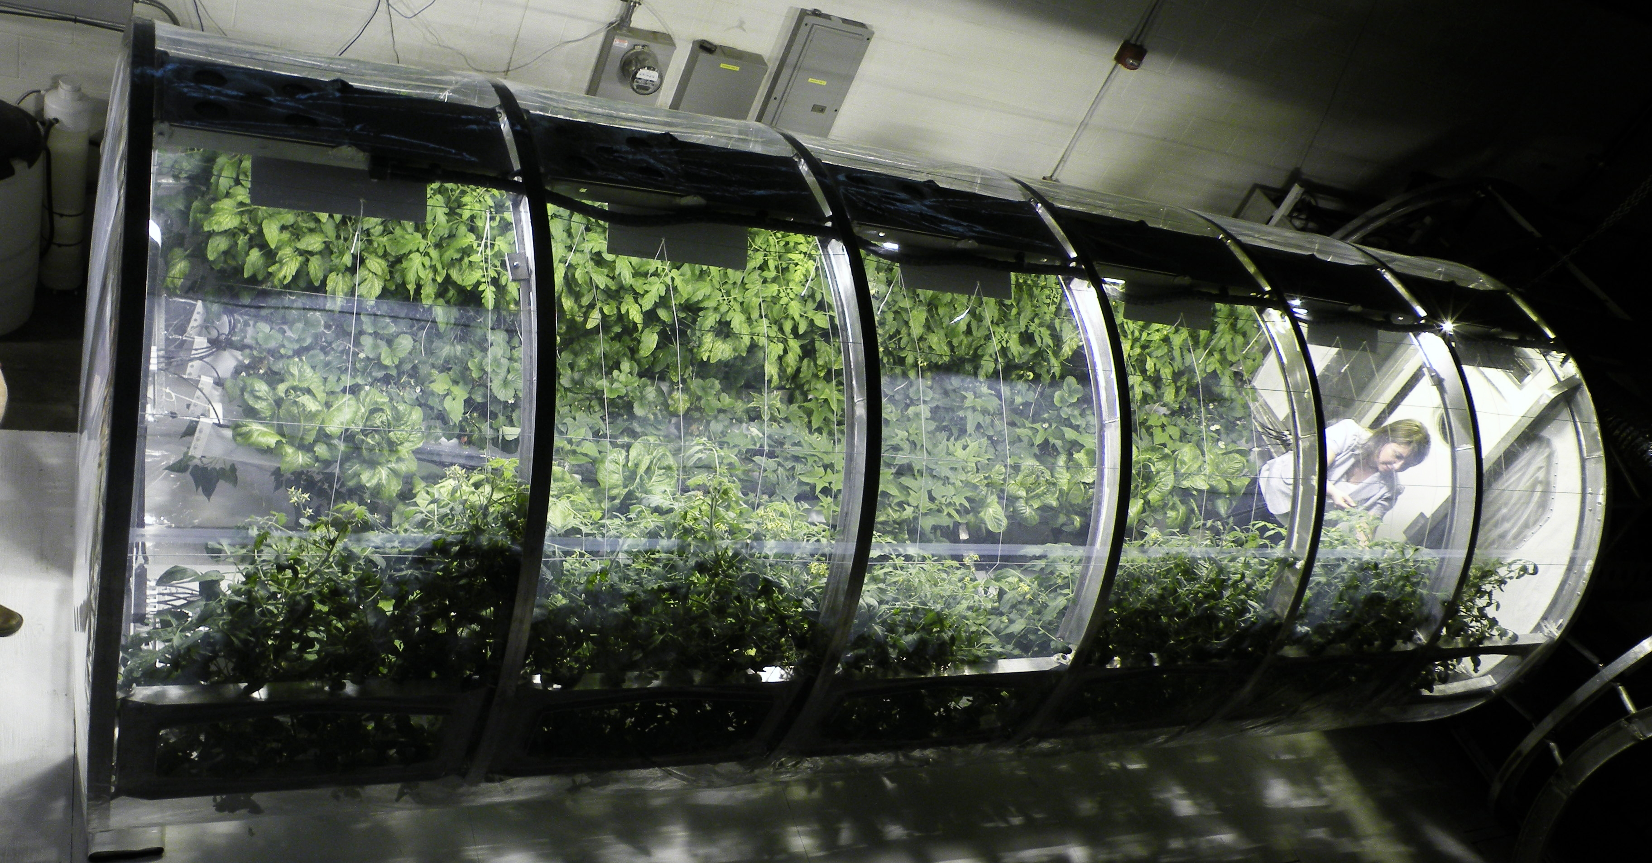
Photos courtesy NASA
Aeroponics is another type of hydroponics. In aeroponics, the roots of the plants do not sit in water. The plants hang in the air and a fine mist of water containing nutrients is sprayed on the roots. A larger variety of plants can be grown with aeroponics, as some plants do not like to have their roots always sitting in water.
NASA is experimenting with using aeroponics in space. A fine mist spray is easier to handle than liquid water in zero gravity. NASA has also built a model of an aeroponics system that space pioneers might be able to use on Mars or on the moon. All the water in the system is recycled. Astronauts use the oxygen that plants release to breathe, and plants use the carbon dioxide that astronauts breathe out to make their food in the process known as photosynthesis.

Slide 11
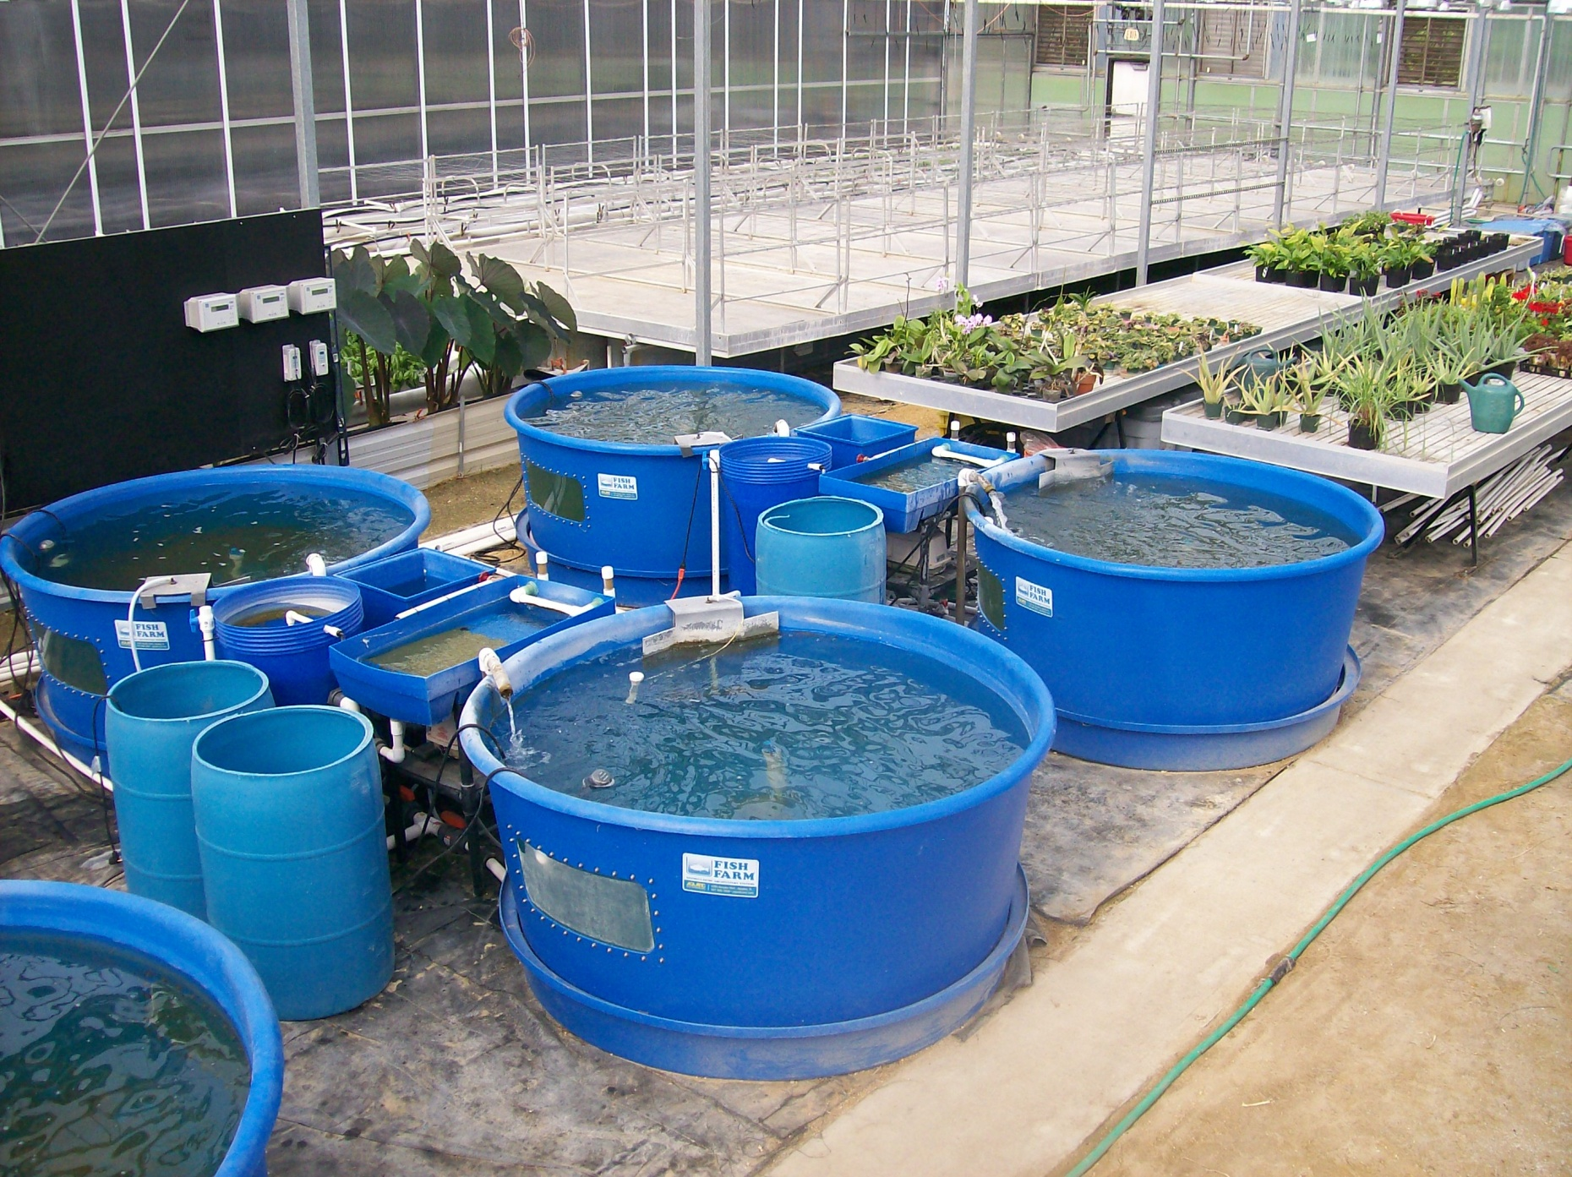
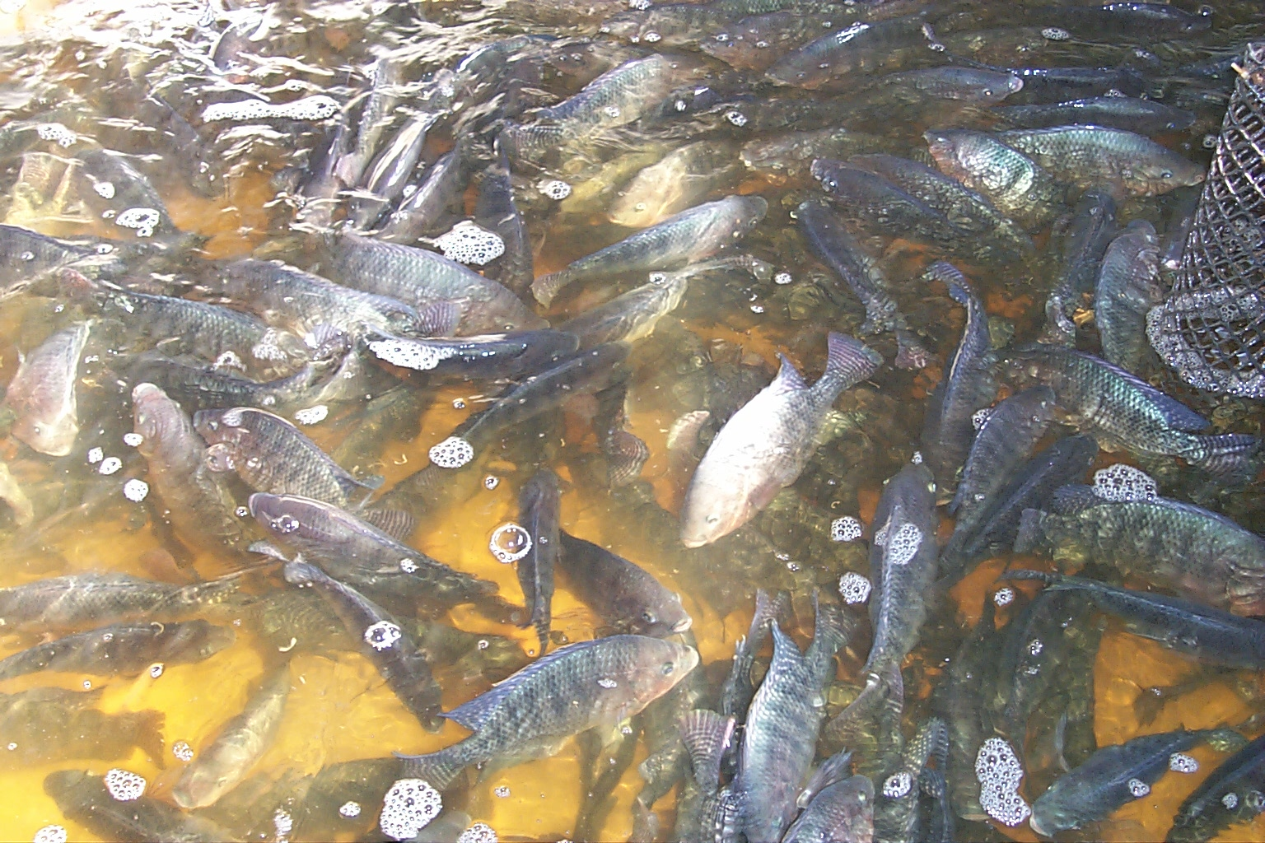
Aquaponics is another type of hydroponics. In this system, the roots of plants float in or near a fish tank. The fish give the plants all the nutrients they need in the form of fish poop. Bacteria in the water breaks down the fish poop into nutrients that the plant roots can absorb. The plants help the fish by removing the fish poop from the water and keeping the water clean.
Tilapia is a freshwater fish often raised with aquaponics.
Hydroponic fish tanks provide nutrient-rich water to nearby plants.

