Slide 1


White Bread or
Whole Wheat Bread
Which is Better For You?
A presentation by

Slide 2
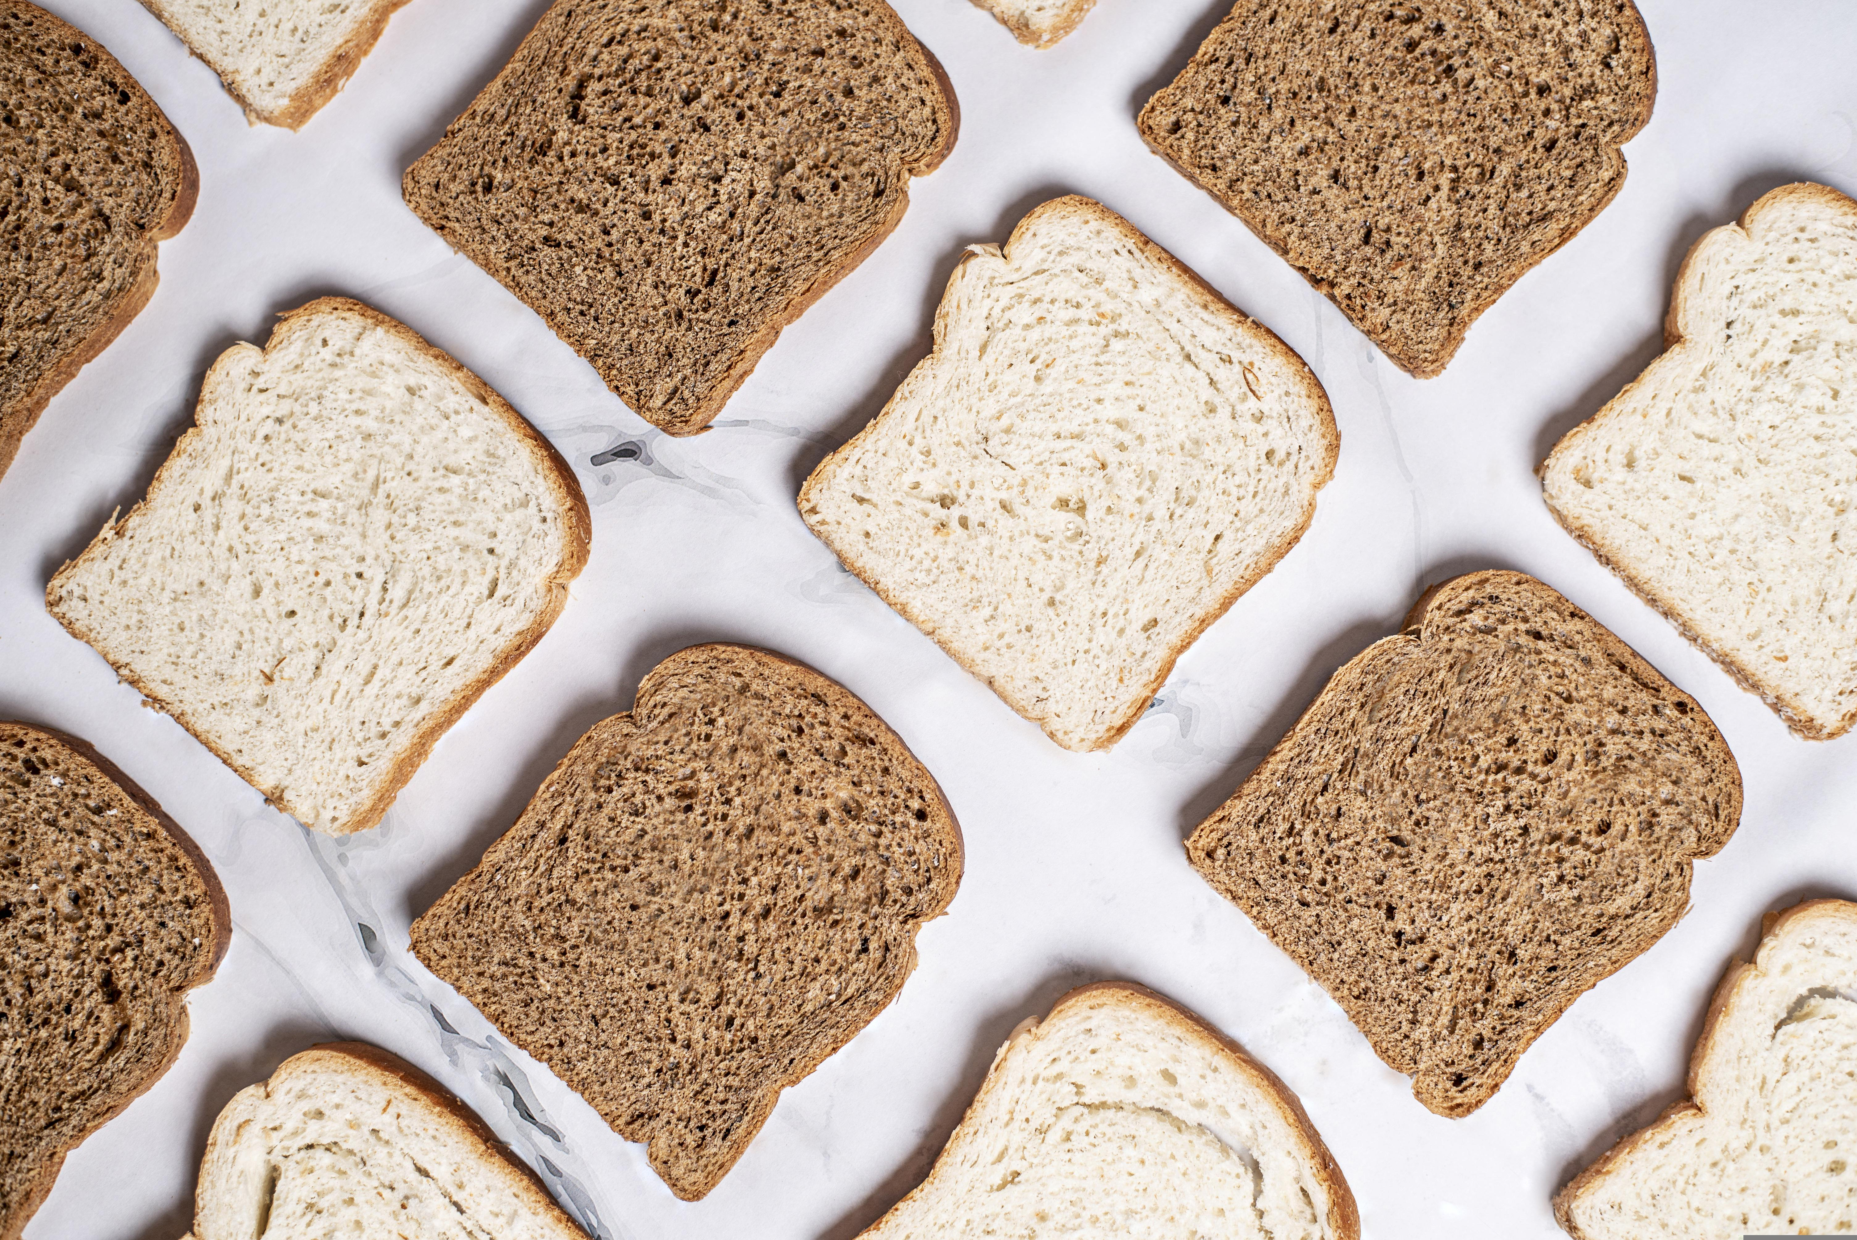
Which type of bread do you usually eat?
White bread or whole wheat bread?
These two types of bread are both made from
wheat seeds.
So what is the difference between them?

Slide 3
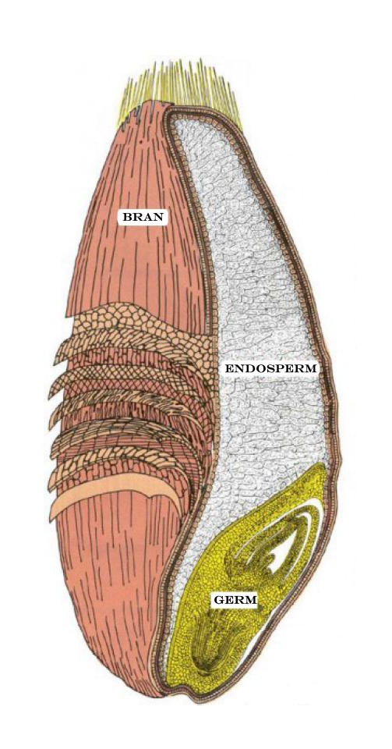
Wheat flour is made from the wheat seeds or kernels.
A wheat seed contains three parts:
the bran, the germ, and the endosperm.
The bran is the hard outer covering of the seed.
The germ is the baby plant – or embryo - inside the wheat seed.
The endosperm is the food supply for the embryo to use until it grows leaves and can make food on its own through photosynthesis.
The wheat seeds must be ground up or milled into the fine powdery flour we use for baking.

Slide 4
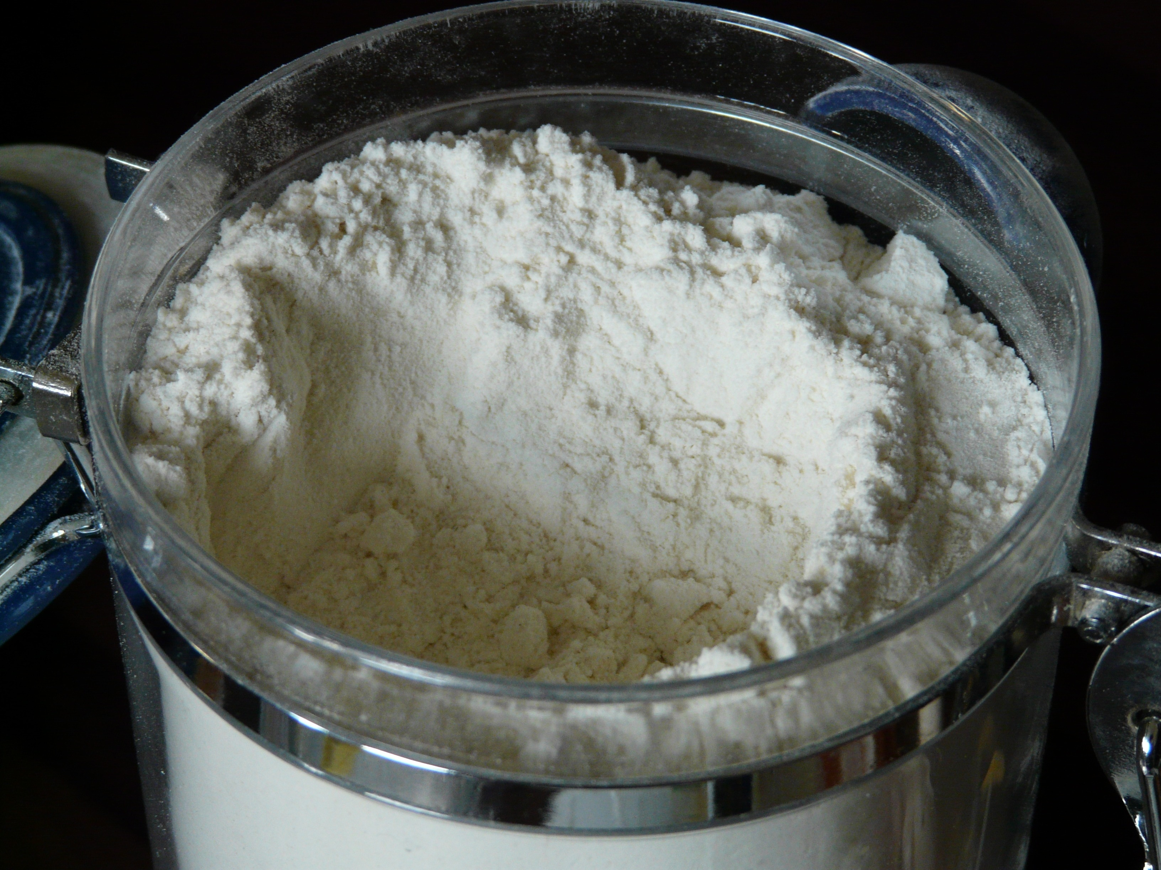
To make white flour, a flour mill removes the germ from the wheat seeds. This gives the flour a long shelf life. Shelf life is how long food can sit on a store or pantry shelf before it goes bad.
Mills also remove the bran from white flour. This makes the flour white and gives it its fluffy, light texture. Texture is how something feels when you touch it.
White bread is mostly just carbohydrates, a nutrient that is the body’s main source of energy. The body needs carbohydrates for fuel, but the carbohydrates in white flour are digested very quickly. That means it gives your body a quick burst of energy, but that energy also fades quickly, making you feel tired.

Slide 5

Unfortunately, the germ and the bran that are removed when making white flour contain most of the nutrients that keep you healthy and strong.
White flour contains mostly just carbohydrates, a nutrient that is the body’s main source of energy.
The body needs carbohydrates for fuel, but the carbohydrates in white flour are digested very quickly.
That means it gives your body a quick burst of energy, but that energy also fades quickly, making you feel tired.

Slide 6
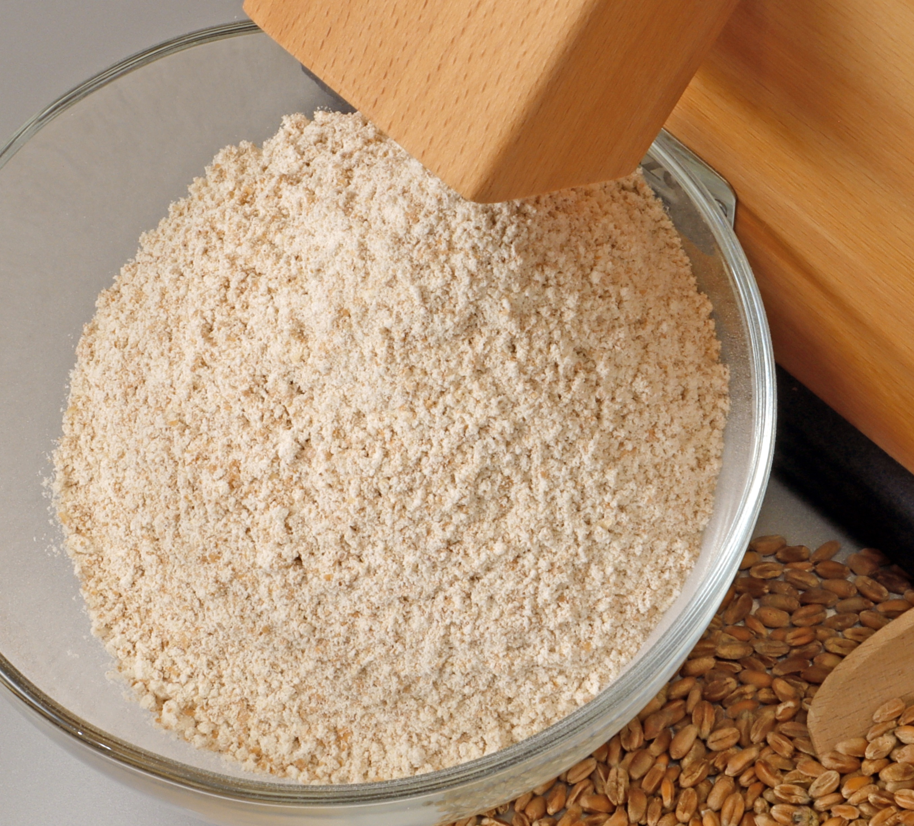
Whole wheat flour contains all three parts of the wheat seed – the germ, the bran, and the endosperm.
The germ and the bran provide many nutrients your body needs, making it a much healthier choice than white bread.
Whole wheat bread contains a lot of fiber, a type of carbohydrate that slows down your digestion, giving you energy for a longer time.
Fiber also acts like a broom. It pushes food and waste smoothly through your stomach so you do not get a blocked or upset stomach.
And fiber is a favorite food for the tiny, friendly bacteria living in your stomach that help to keep your whole body healthy.

Slide 7

Whole wheat bread also gives you:
Protein: It acts like the body's main building blocks. It builds strong bones and muscles and helps repair injuries.
Iron: It carries oxygen through the blood, builds energy for muscles, supports brain development, and fights infections.
Whole wheat flour also contains several other vitamins and minerals that keep you healthy.

Slide 8
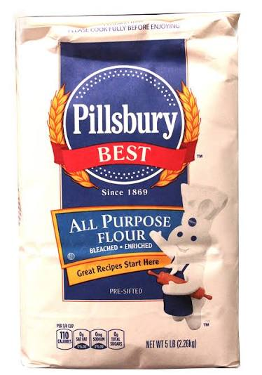
Sometimes milling companies will add nutrients back into white flour. This is called enriched flour. Fiber, however, is not added back in.
The nutrition chart on the back of the flour bag will tell you which nutrients were added.

Slide 9

Even though whole wheat flour is much healthier,
most of the flour sold in the United States - about 85% - is white flour.
What do you think about that?

