Slide 1
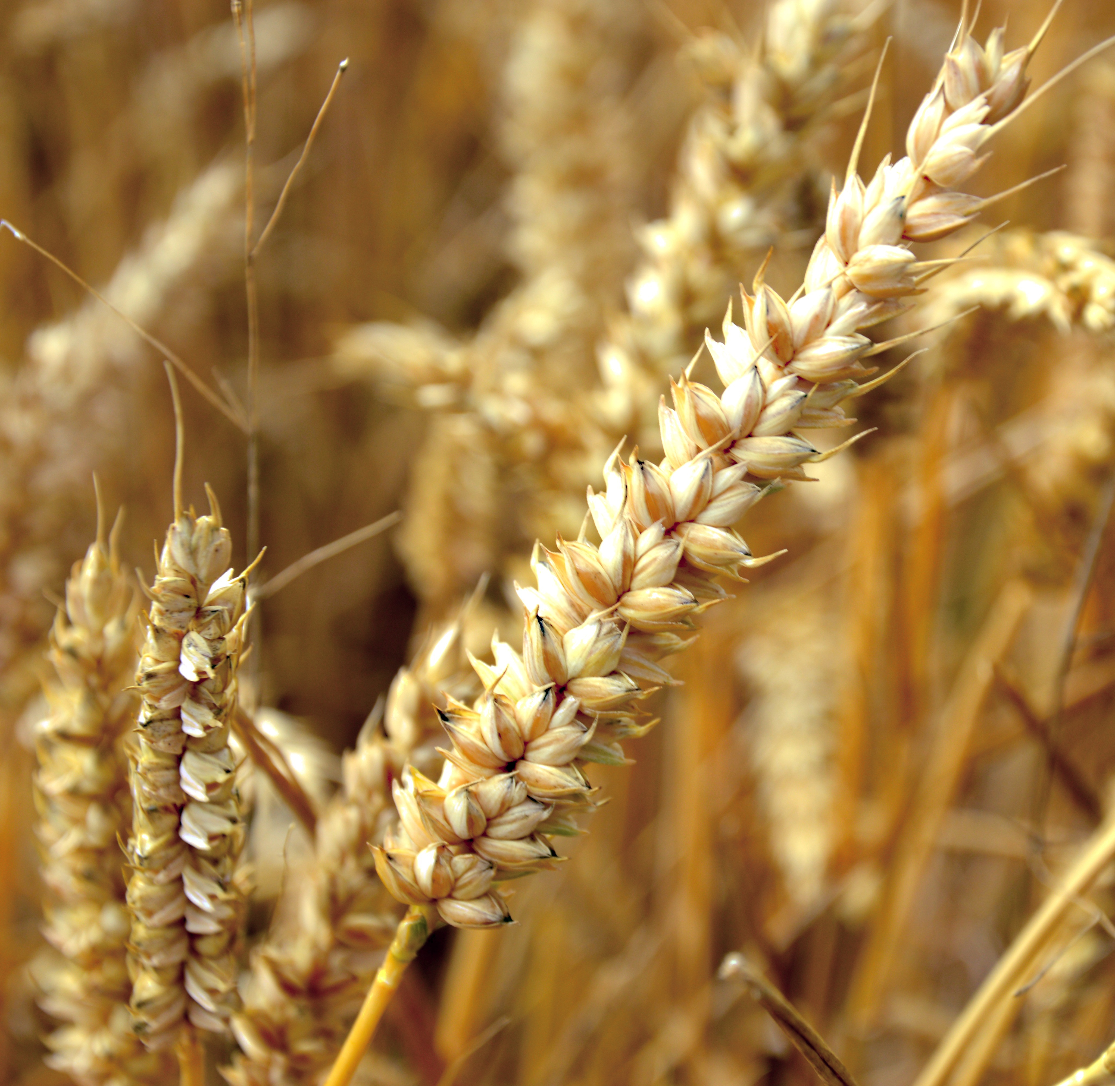
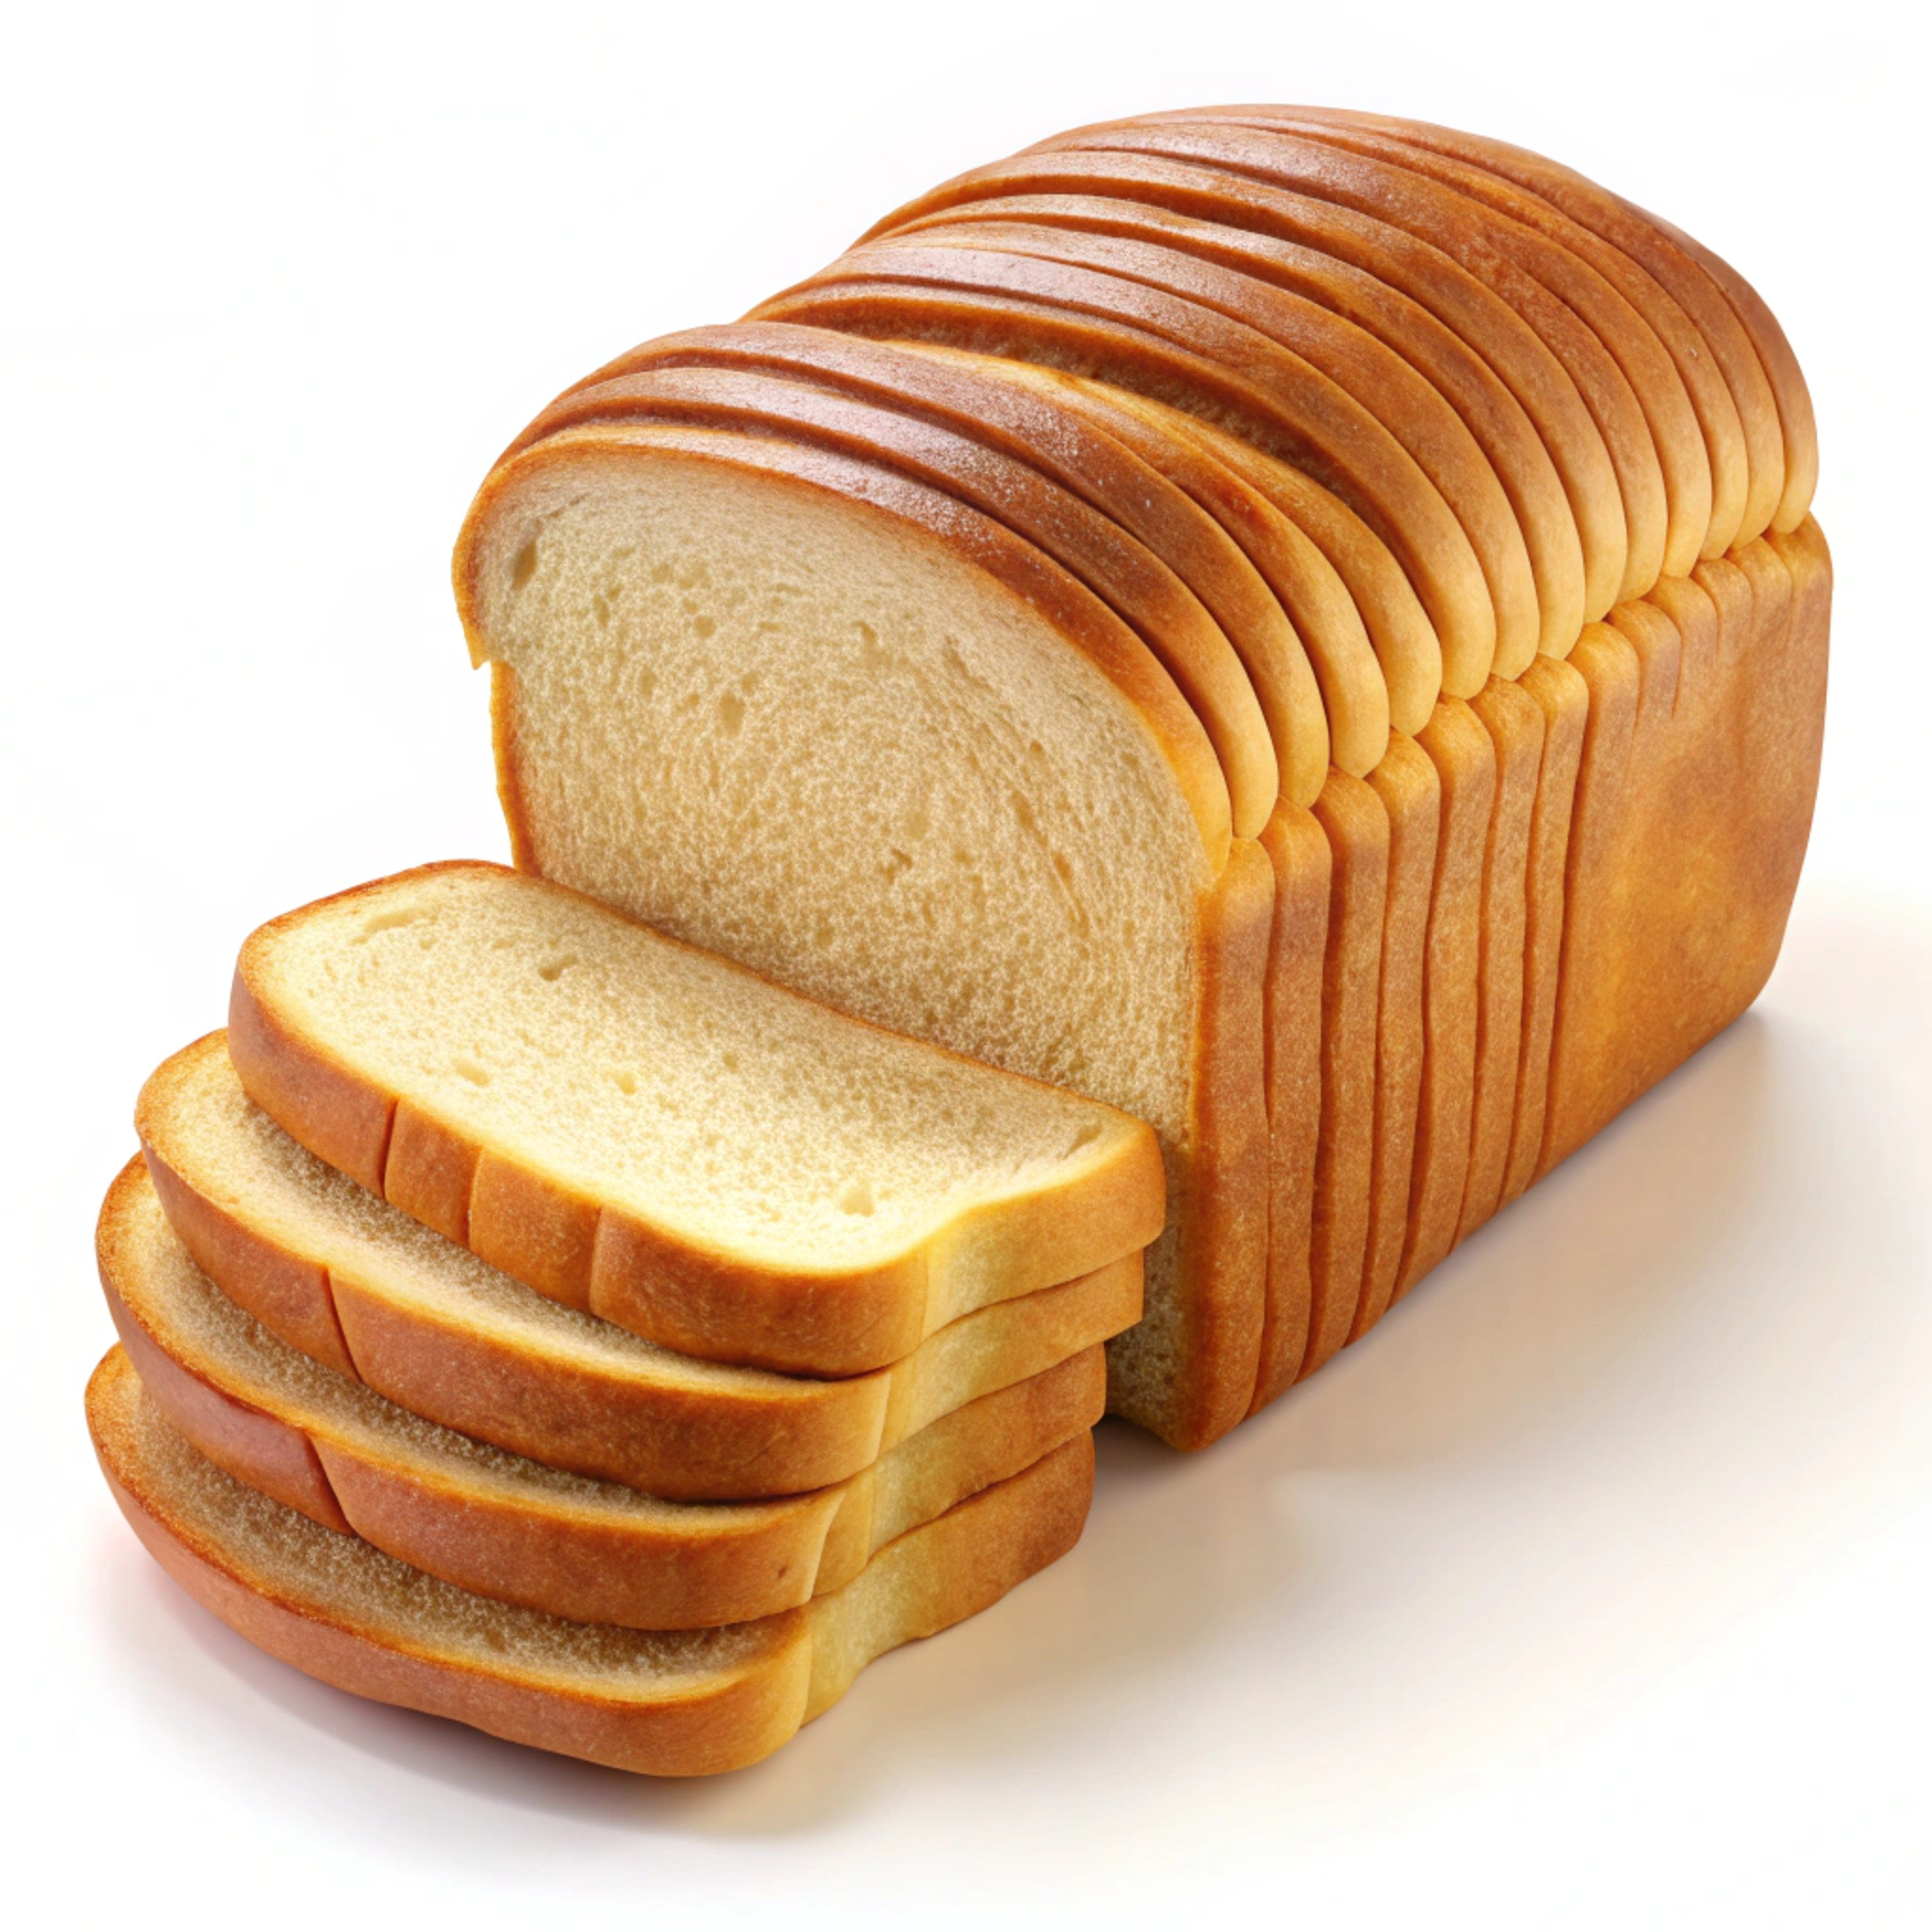

The Story of Wheat
A presentation by

Slide 2
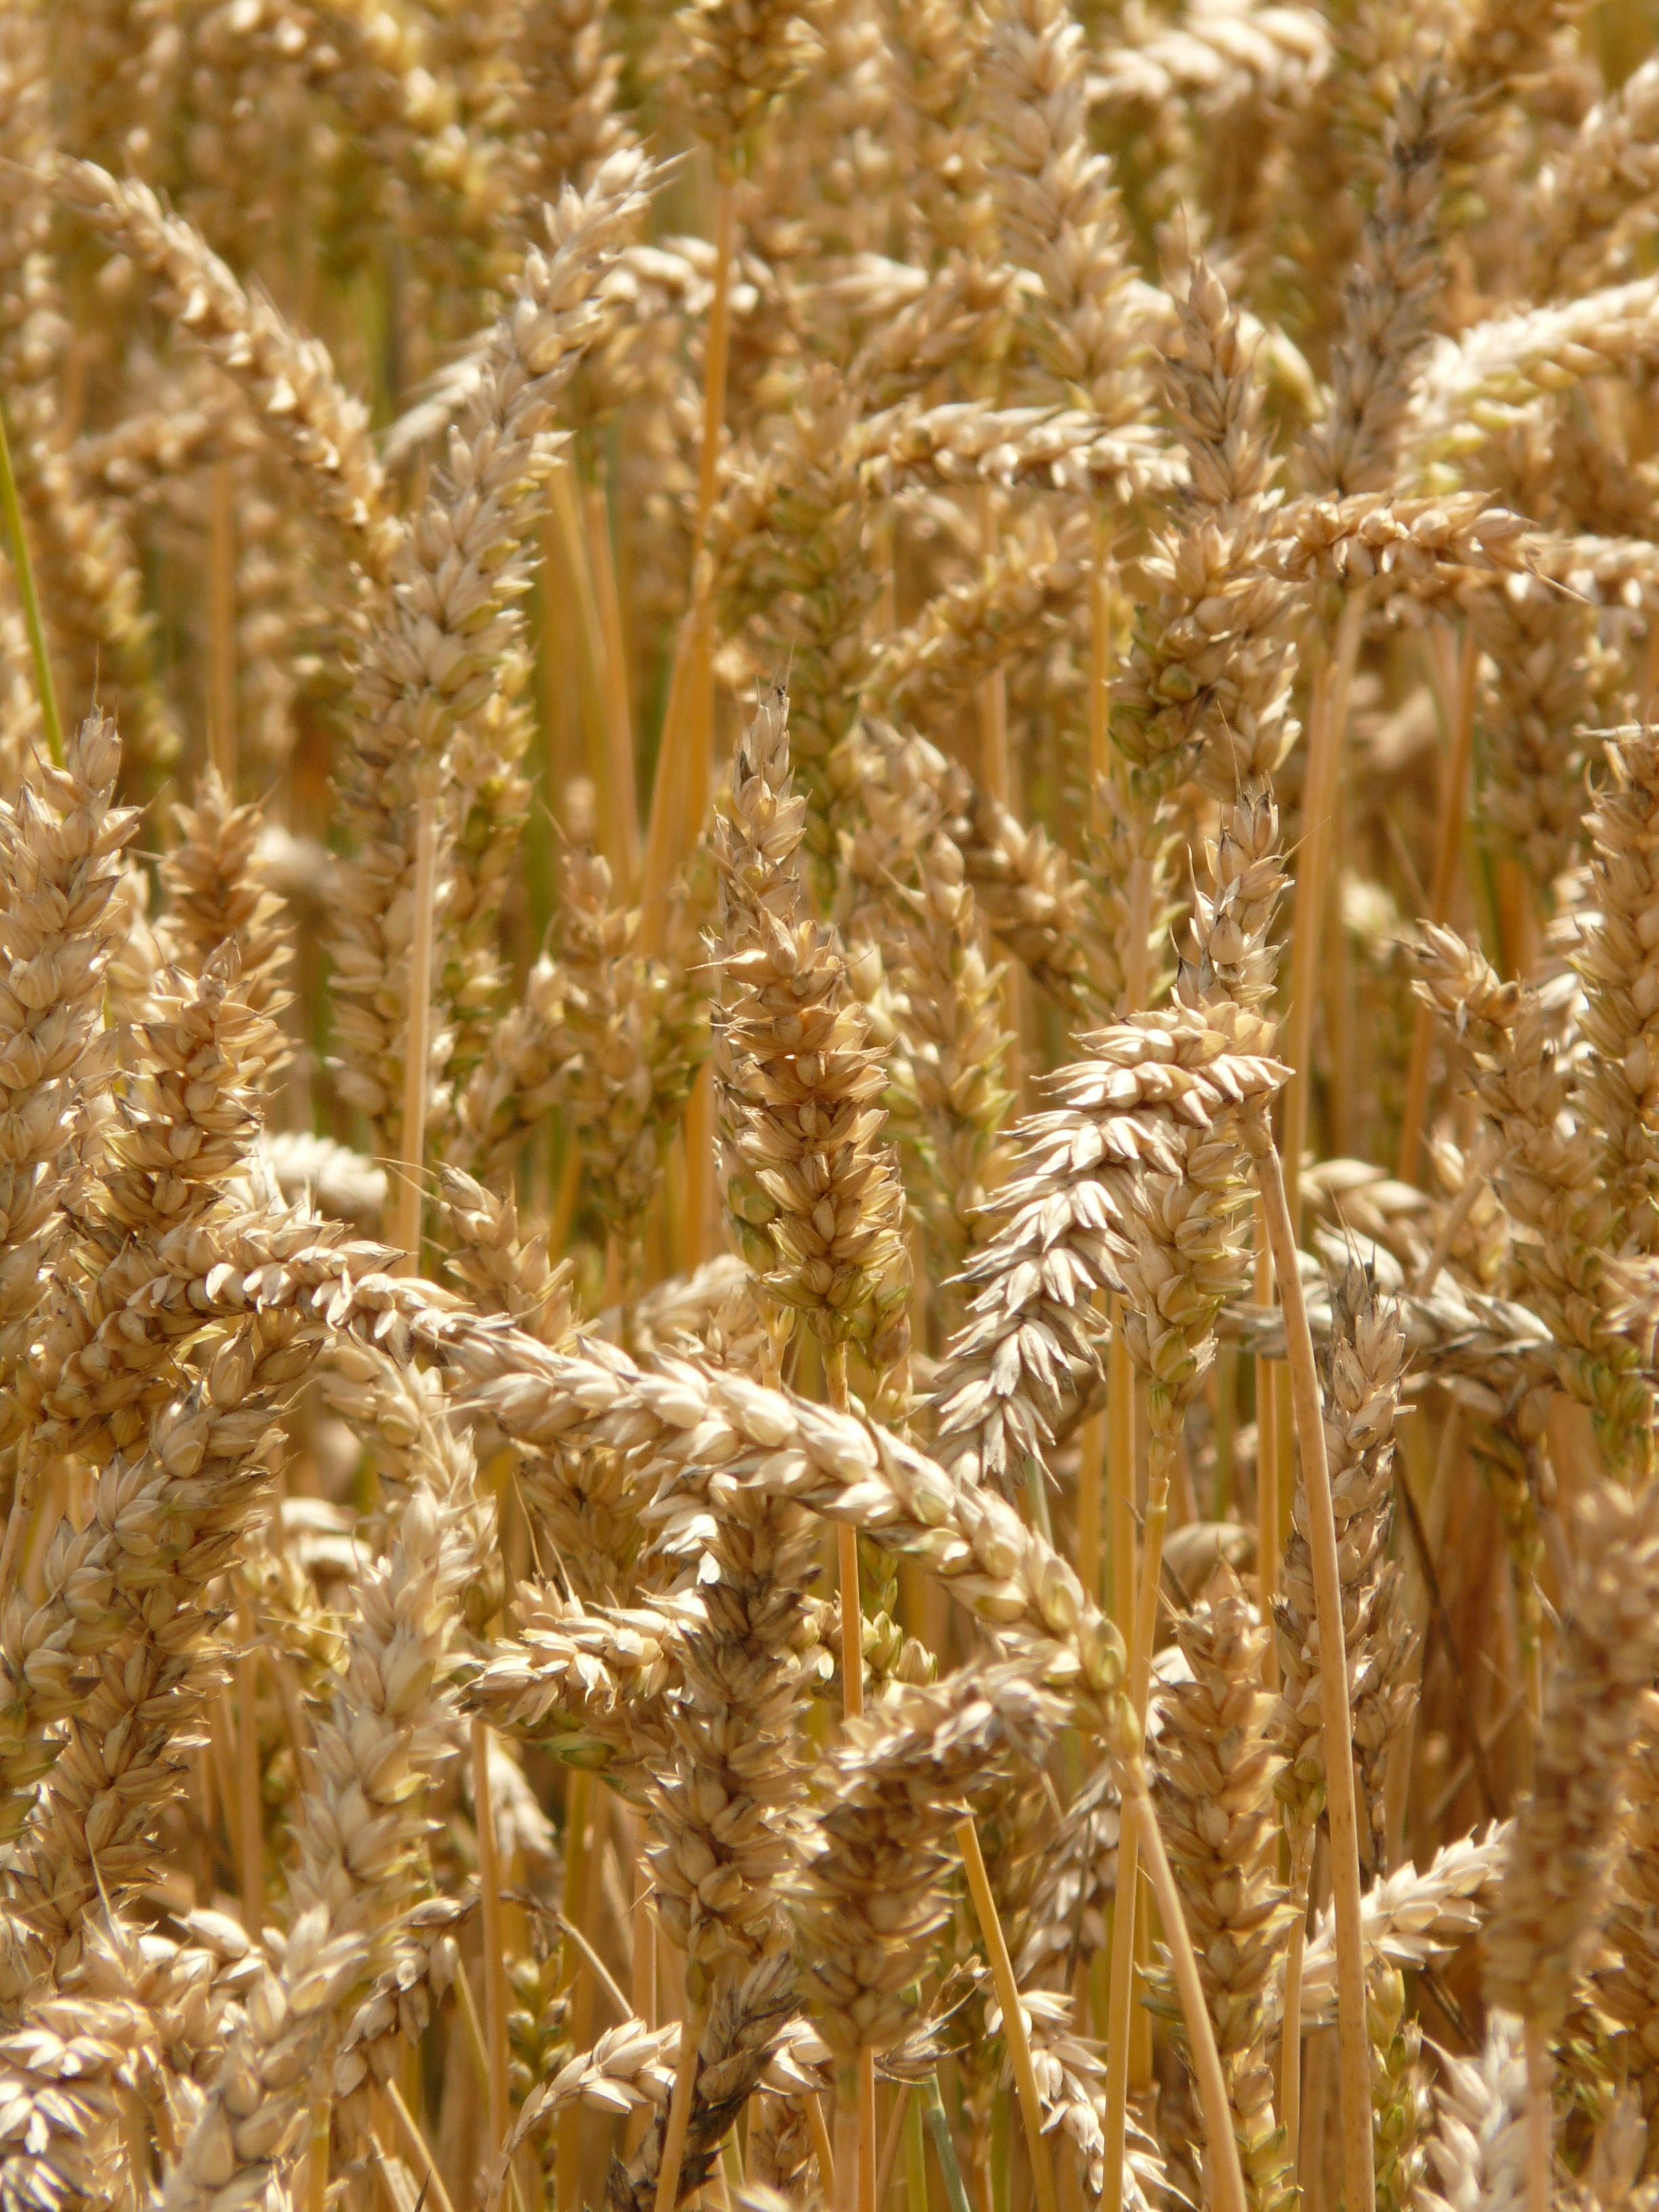
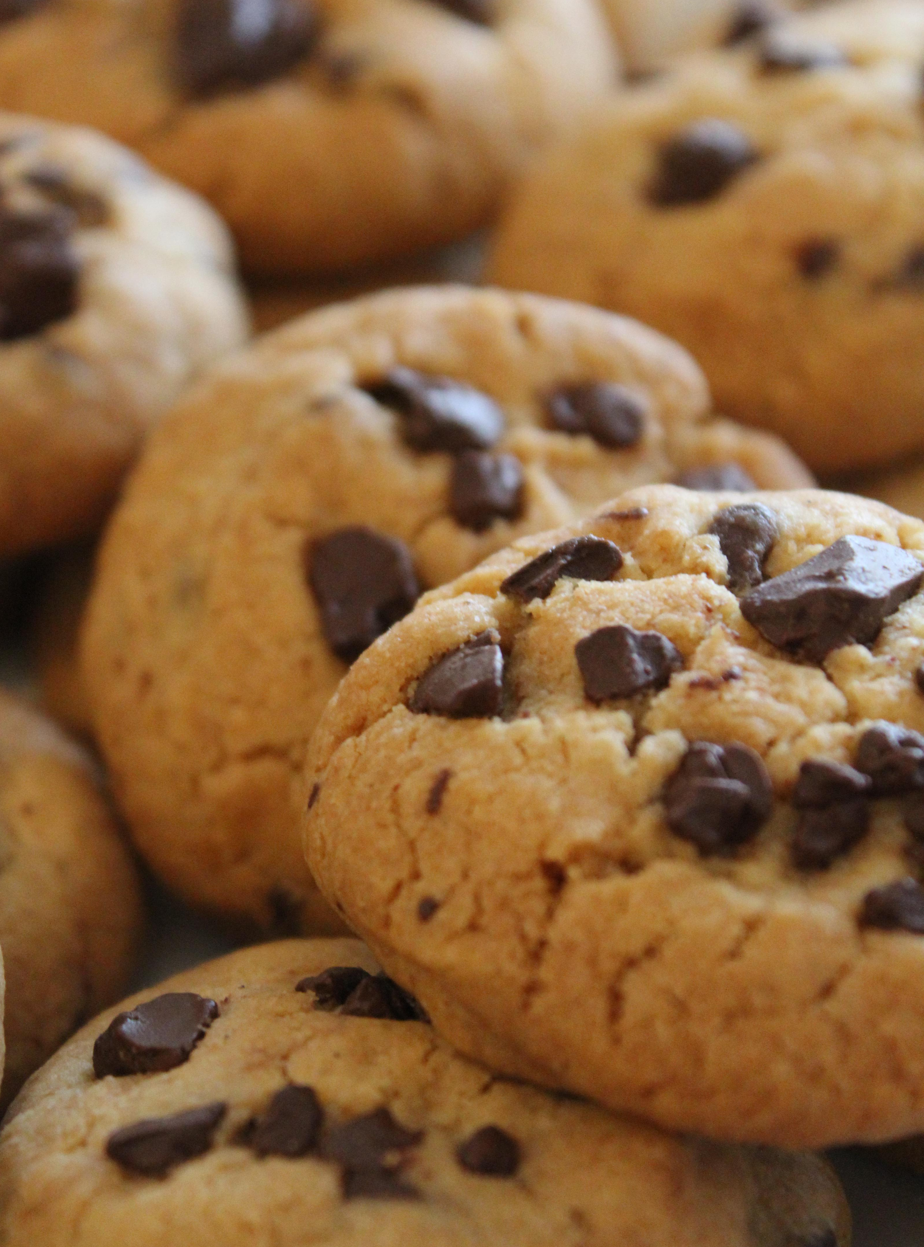
Think about all the things you eat that are made from flour:
Sliced bread, rolls, pizza dough, bagels, muffins, tortillas, pancakes, waffles, cookies, cake, donuts…
Can you think of more?
Did you know that all of those things come from a plant?
Wheat!
The white flour used in most breads and desserts is made from the
seeds of the wheat plant.

Slide 3
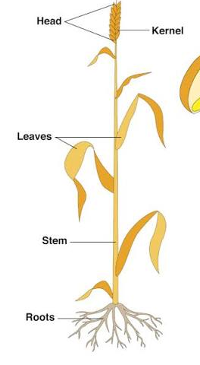
The wheat plant has four basic parts—roots, stem, leaves, and head.
The roots anchor the plant in the soil, absorbing water and nutrients and transporting them to the stem.
The stem supports the head and helps transport nutrients and water throughout the plant.
The leaves are responsible for making food for the plant in the process of photosynthesis.
The head of the wheat plant contains the wheat seeds, also known as kernels.
Image courtesy crop protection network

Slide 4
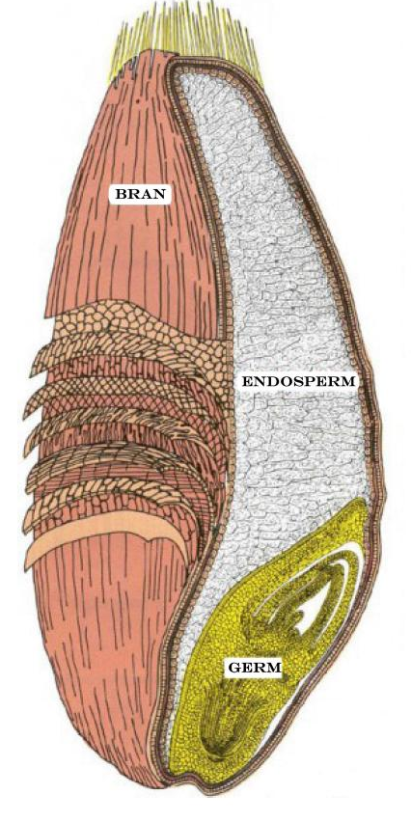
Wheat flour is made from the wheat seeds or kernels.
A wheat seed contains three parts:
the bran, the germ, and the endosperm.
The bran is the hard outer covering of the seed.
The germ is the baby plant – or embryo - inside the wheat seed.
The endosperm is the food supply for the embryo to use until it grows leaves and can make food on its own through photosynthesis.
The wheat seeds must be ground up or milled into the fine powdery flour we use for baking.

Slide 5
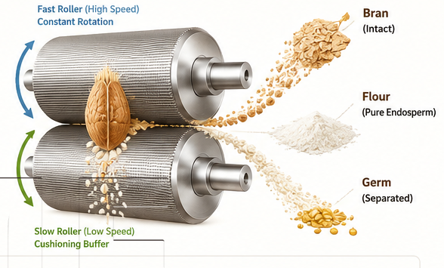
During the milling process, the germ and bran are separated from the flour.
The germ is removed because its fat content limits the flour's shelf-life. That is how long the flour will last in your pantry before it goes bad.
The bran is removed to give the flour its white color and fluffy texture. This is called refined flour.
What’s left is the starchy endosperm. It is ground by metal rollers and sifted several times to make white, all-purpose flour.
Image courtesy ACME Agricultural Machinery

Slide 6
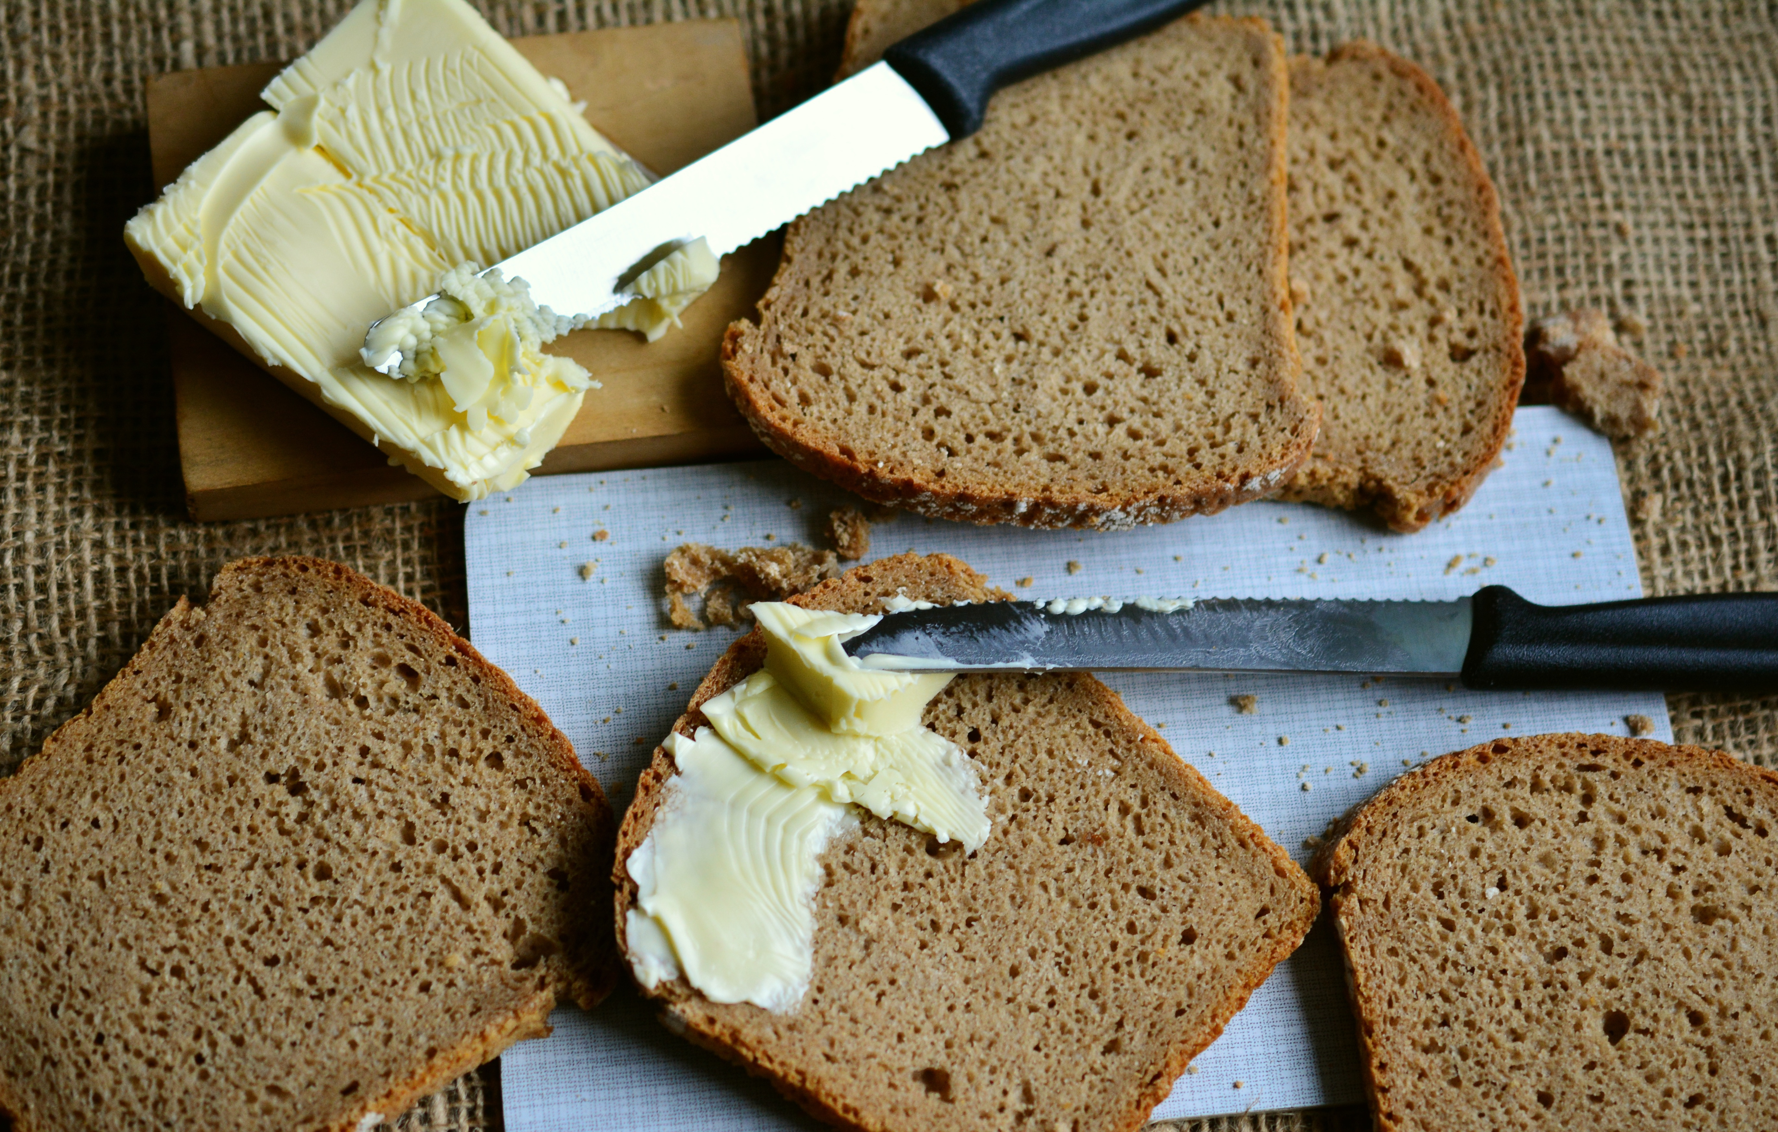
Whole wheat bread is made from all three parts of the wheat seed.
Whole wheat bread looks quite different from white bread.
Whole wheat bread looks quite different from white bread.

Slide 7
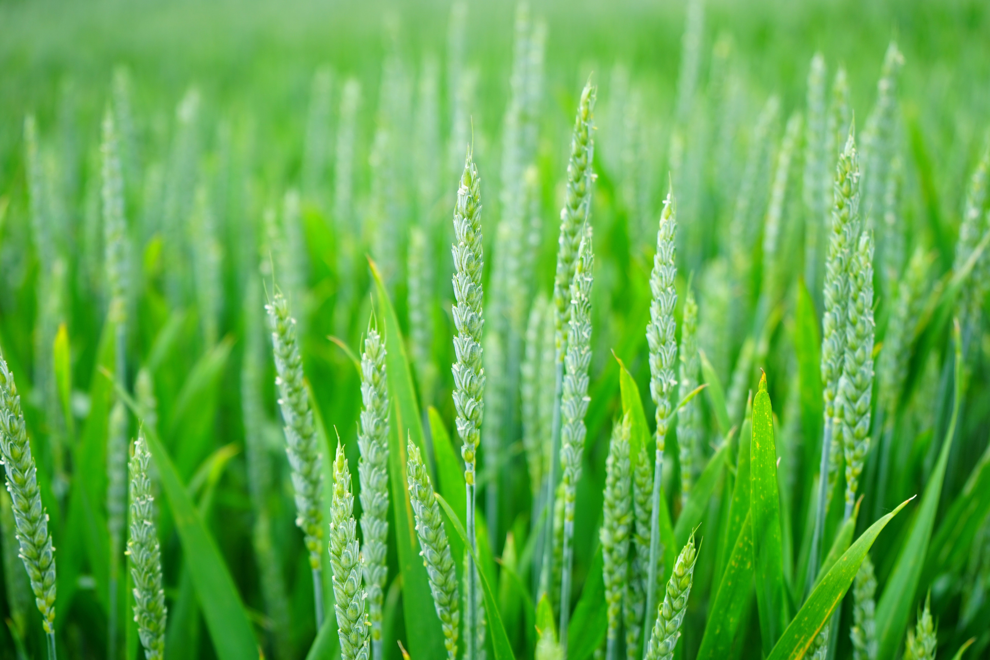
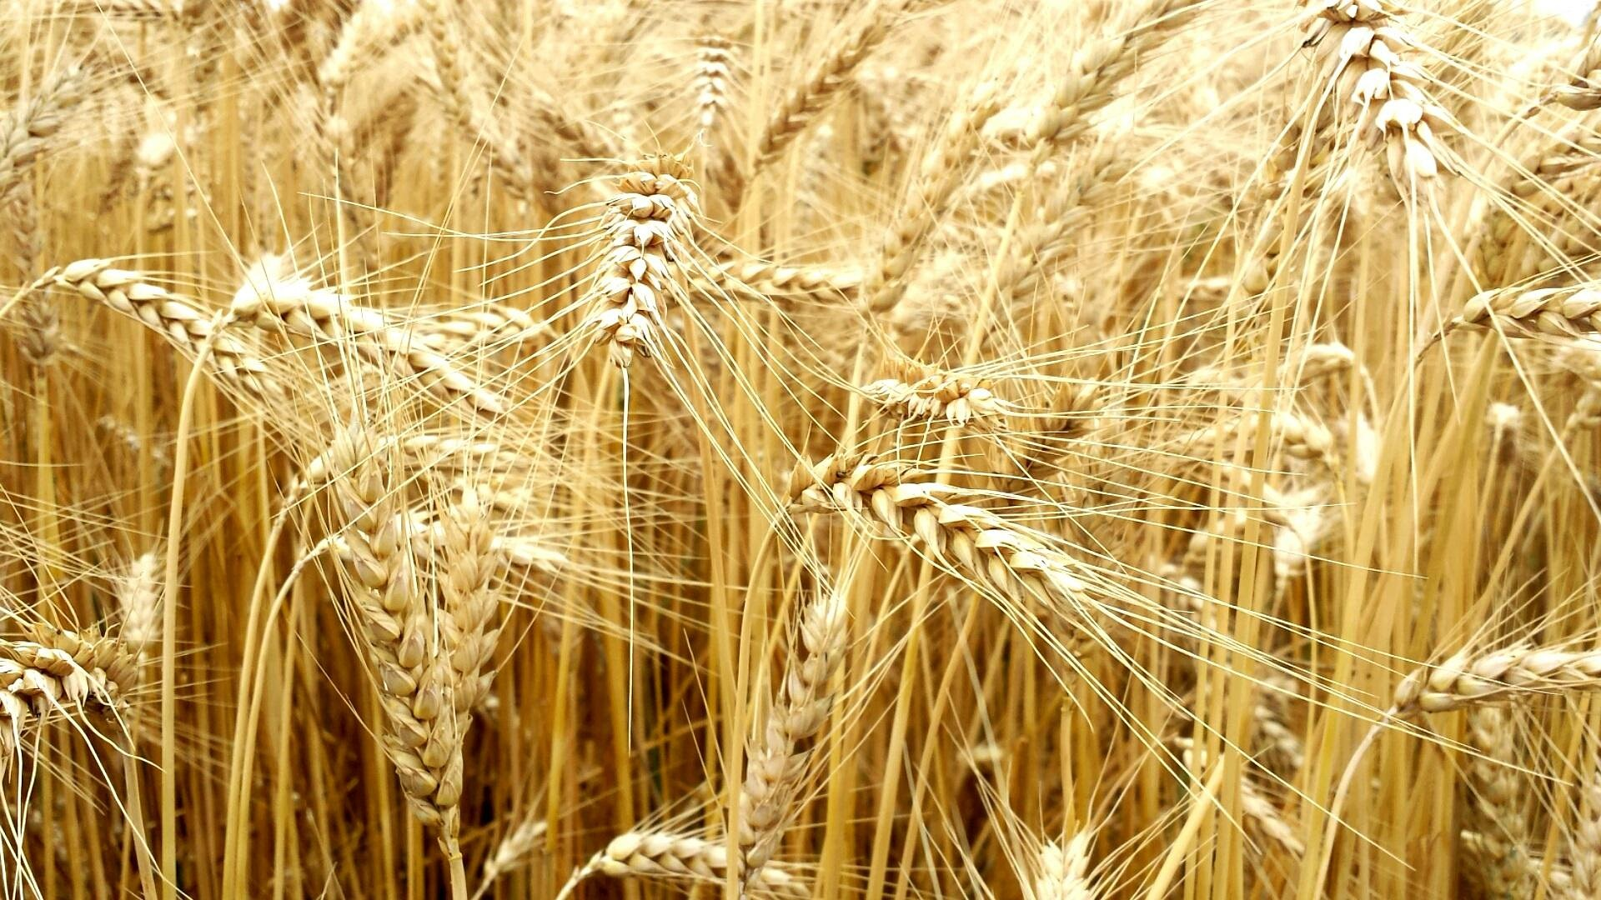
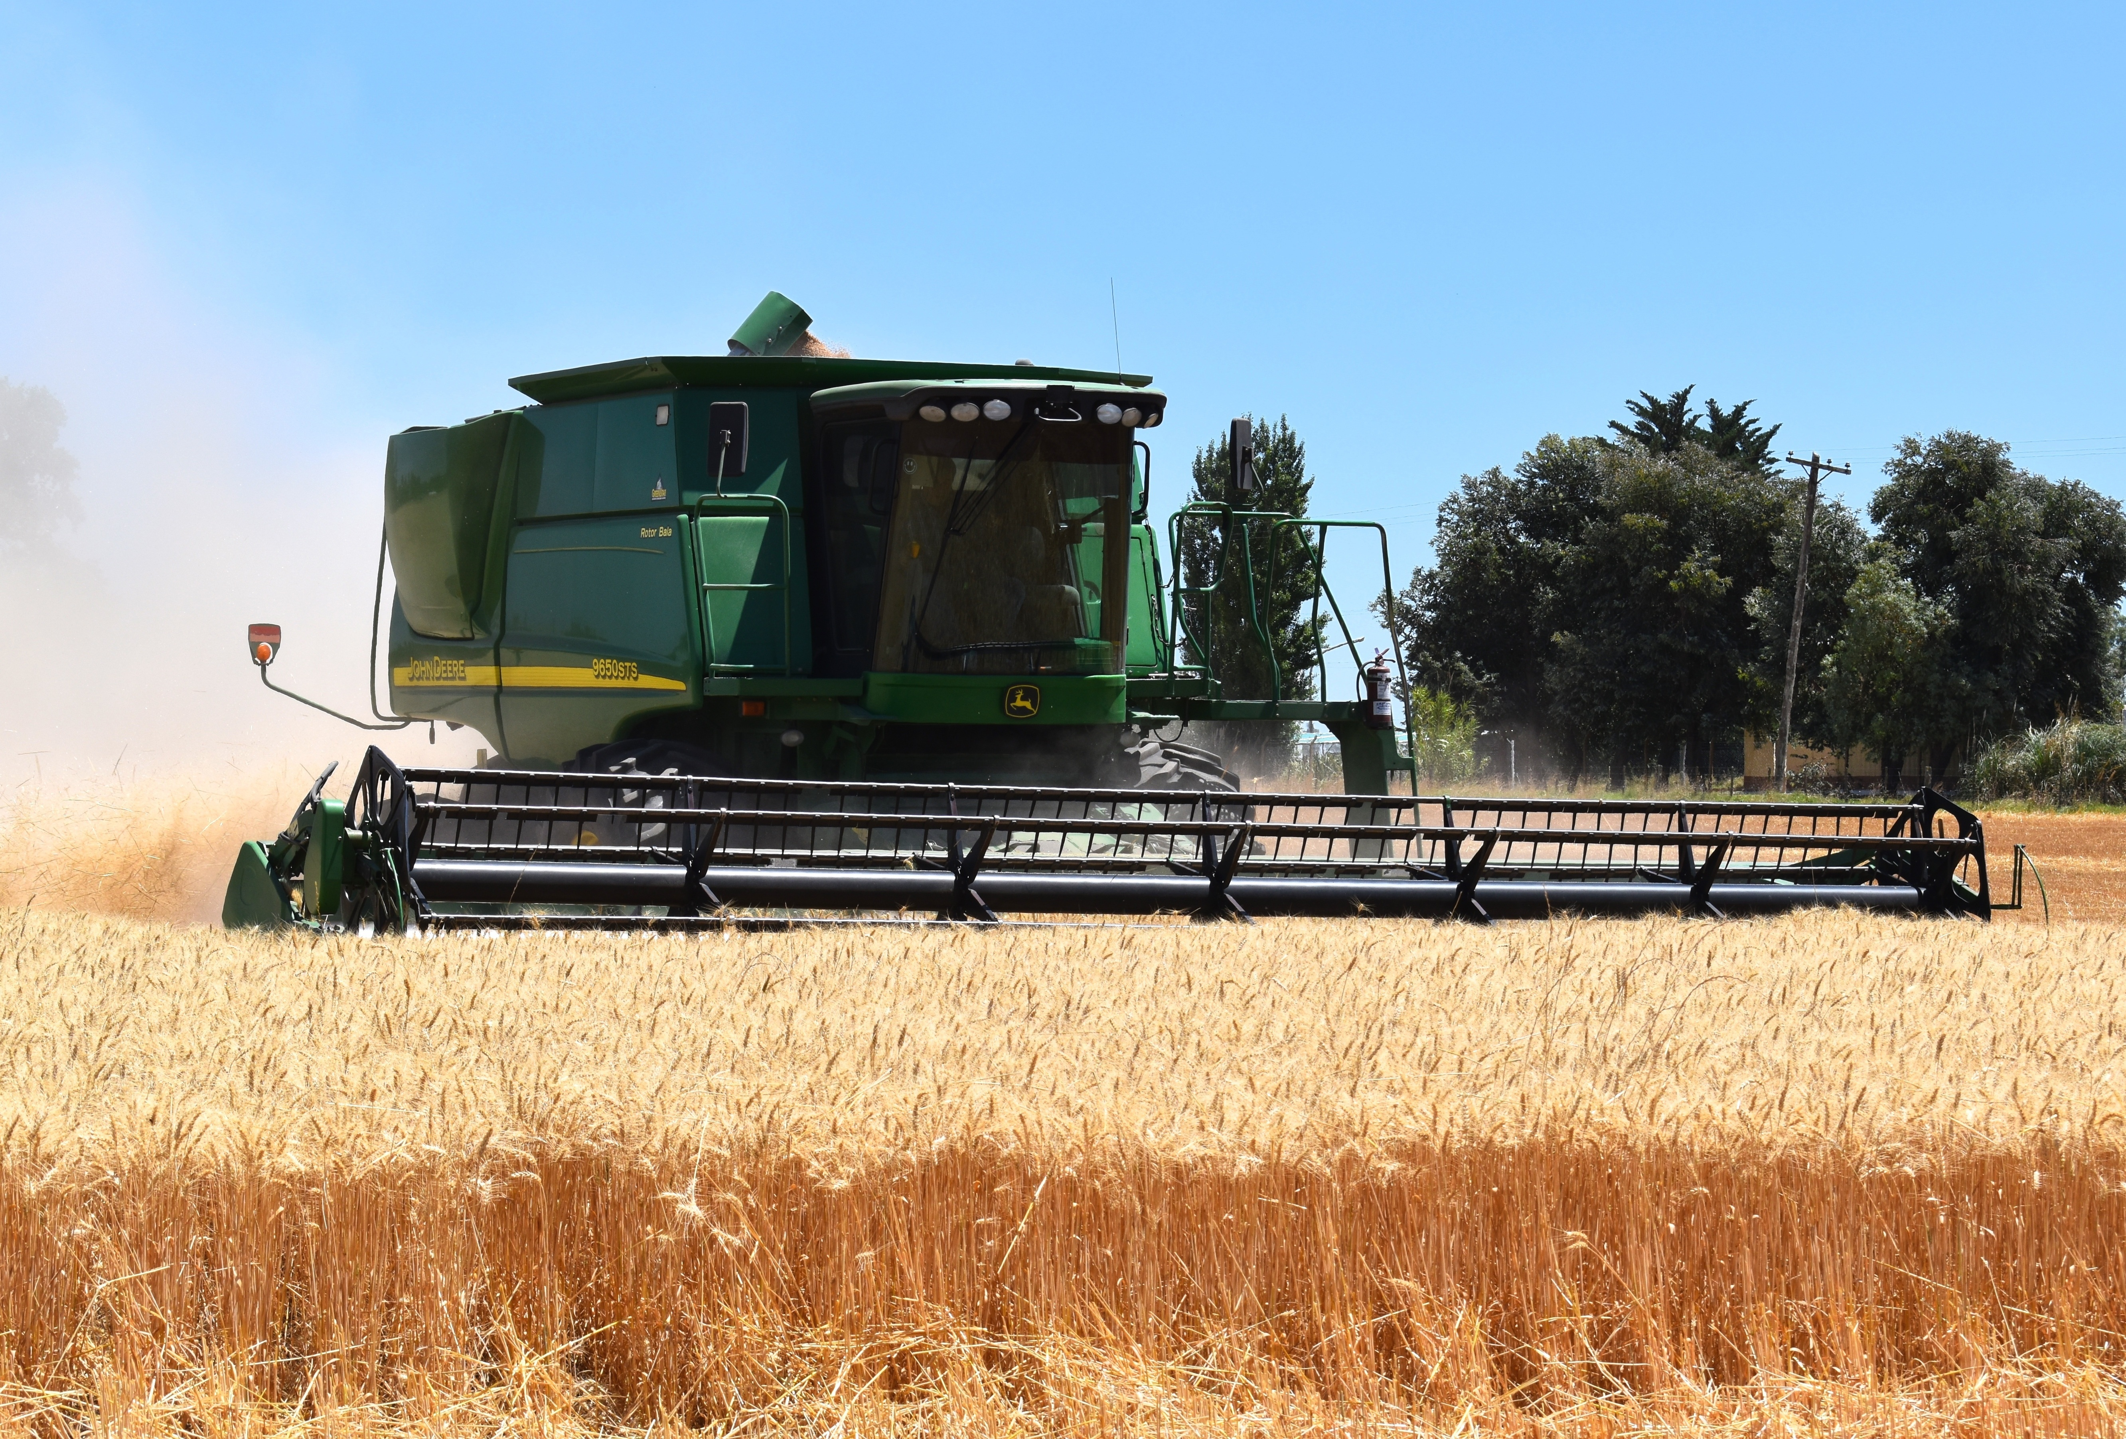
In New Jersey, farmers usually plant winter wheat, which is planted in early fall and harvested in June or July, when the green wheat plants have turned golden.
Farmers use a big machine called a combine to harvest the wheat. It is called a combine because it combines three big jobs: it cuts down the plants, shakes out the seeds, and cleans away the leftover leaves and stems. These leftovers are called chaff, which is often fed to farm animals.
Combine

Slide 8
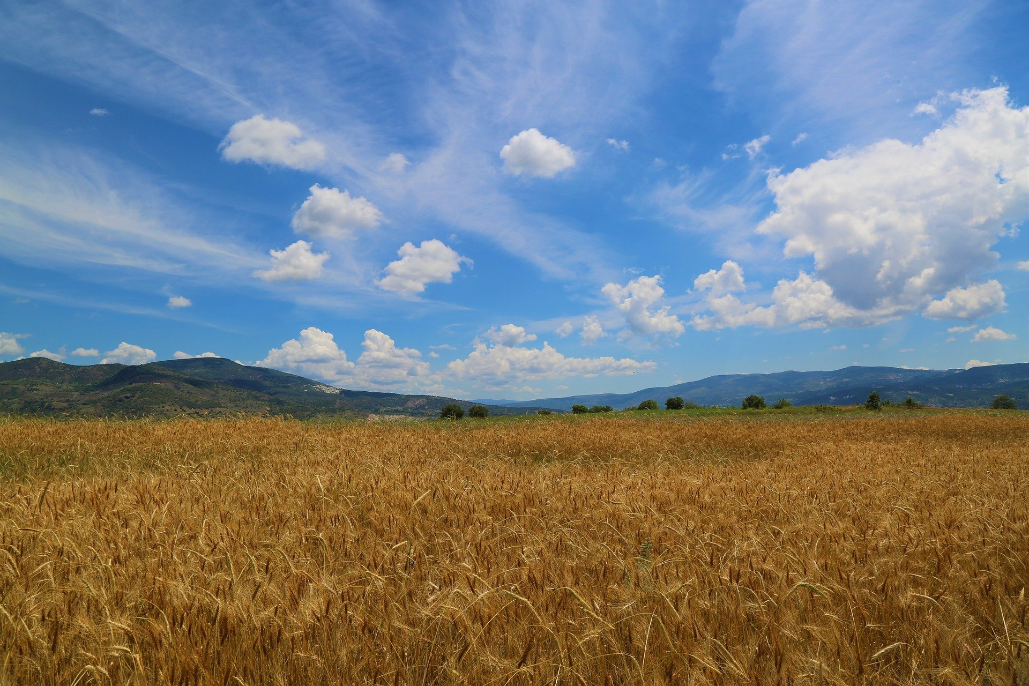
Wheat is a not a major field crop in New Jersey. It ranks fifth behind soybean, hay, corn, and vegetables.
About 2.62 million bushels of wheat are harvested in New Jersey each year.
A bushel is equal to about 9 gallons of a liquid -- picture 9 gallons of milk jugs filled with wheat seeds.
New Jersey is a small producer of wheat compared to other states. The most wheat is grown in Kansas, which produces 346.8 million bushels per year.

Slide 9
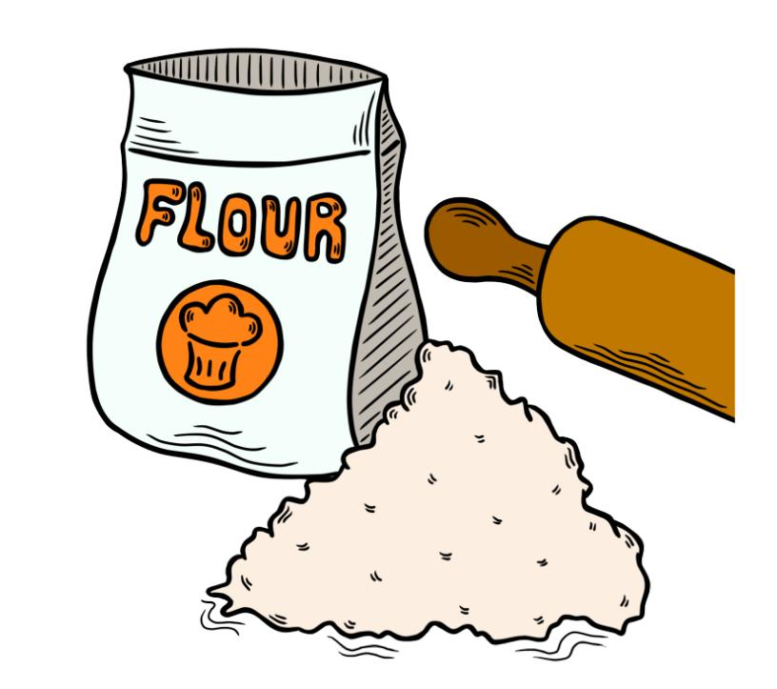
Finally, the flour is packed into bags to be transported to stores, bakeries, or food processing plants, where it will be used to make products such as bread, cookies, cereal, tortillas, and many more.

