Slide 1


SOY
THE
SUPER BEAN
Graphics courtesy of pngtree.com
A presentation by

Slide 2
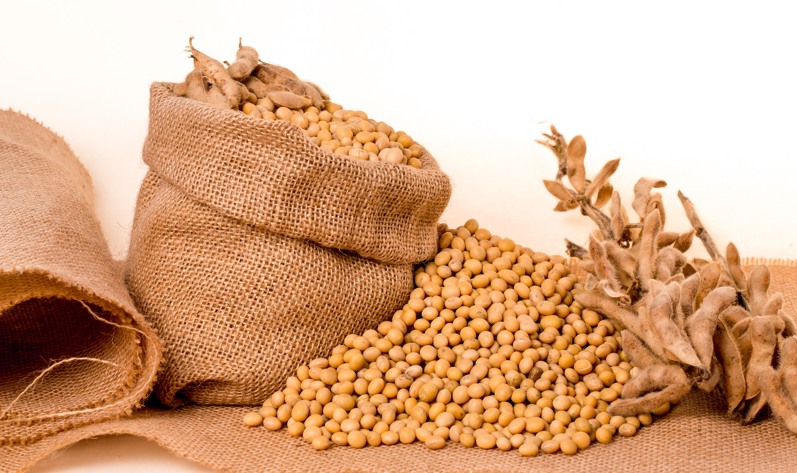
Soy What?
Meet the super soybean. Soybeans are grown all over the world, but more soybeans are grown in the United States than in any other country. In fact, soybeans are this country's second biggest crop. Last year, 90 million tons of soybeans were grown here.

Slide 3
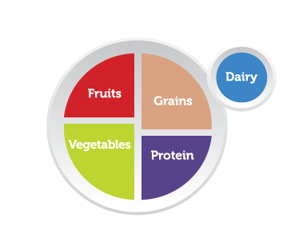
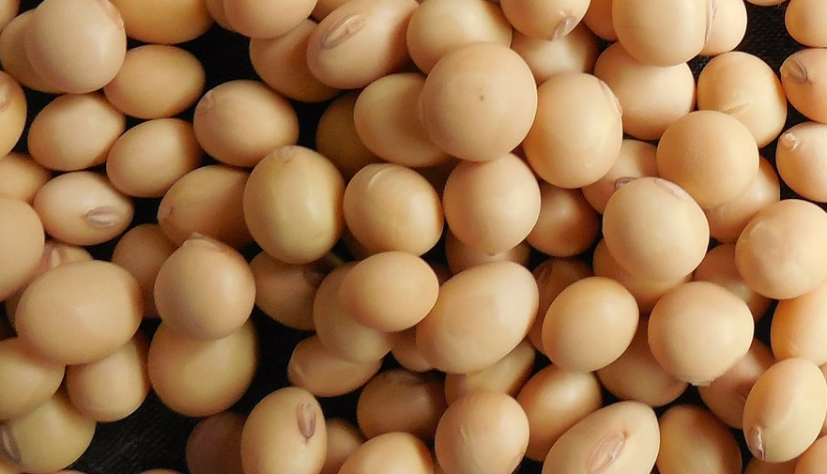
Have you ever eaten a soybean?
You may not know it, but most likely the answer is yes. Soy is in many of the foods you eat. Soybeans are also called edamame.
Soybeans are packed with protein, more than any other bean. Vegetarians - people who do not eat meat – often eat a lot of soy for protein. Soybeans are frequently made into a dish that looks like soft cheese called tofu.

Slide 4
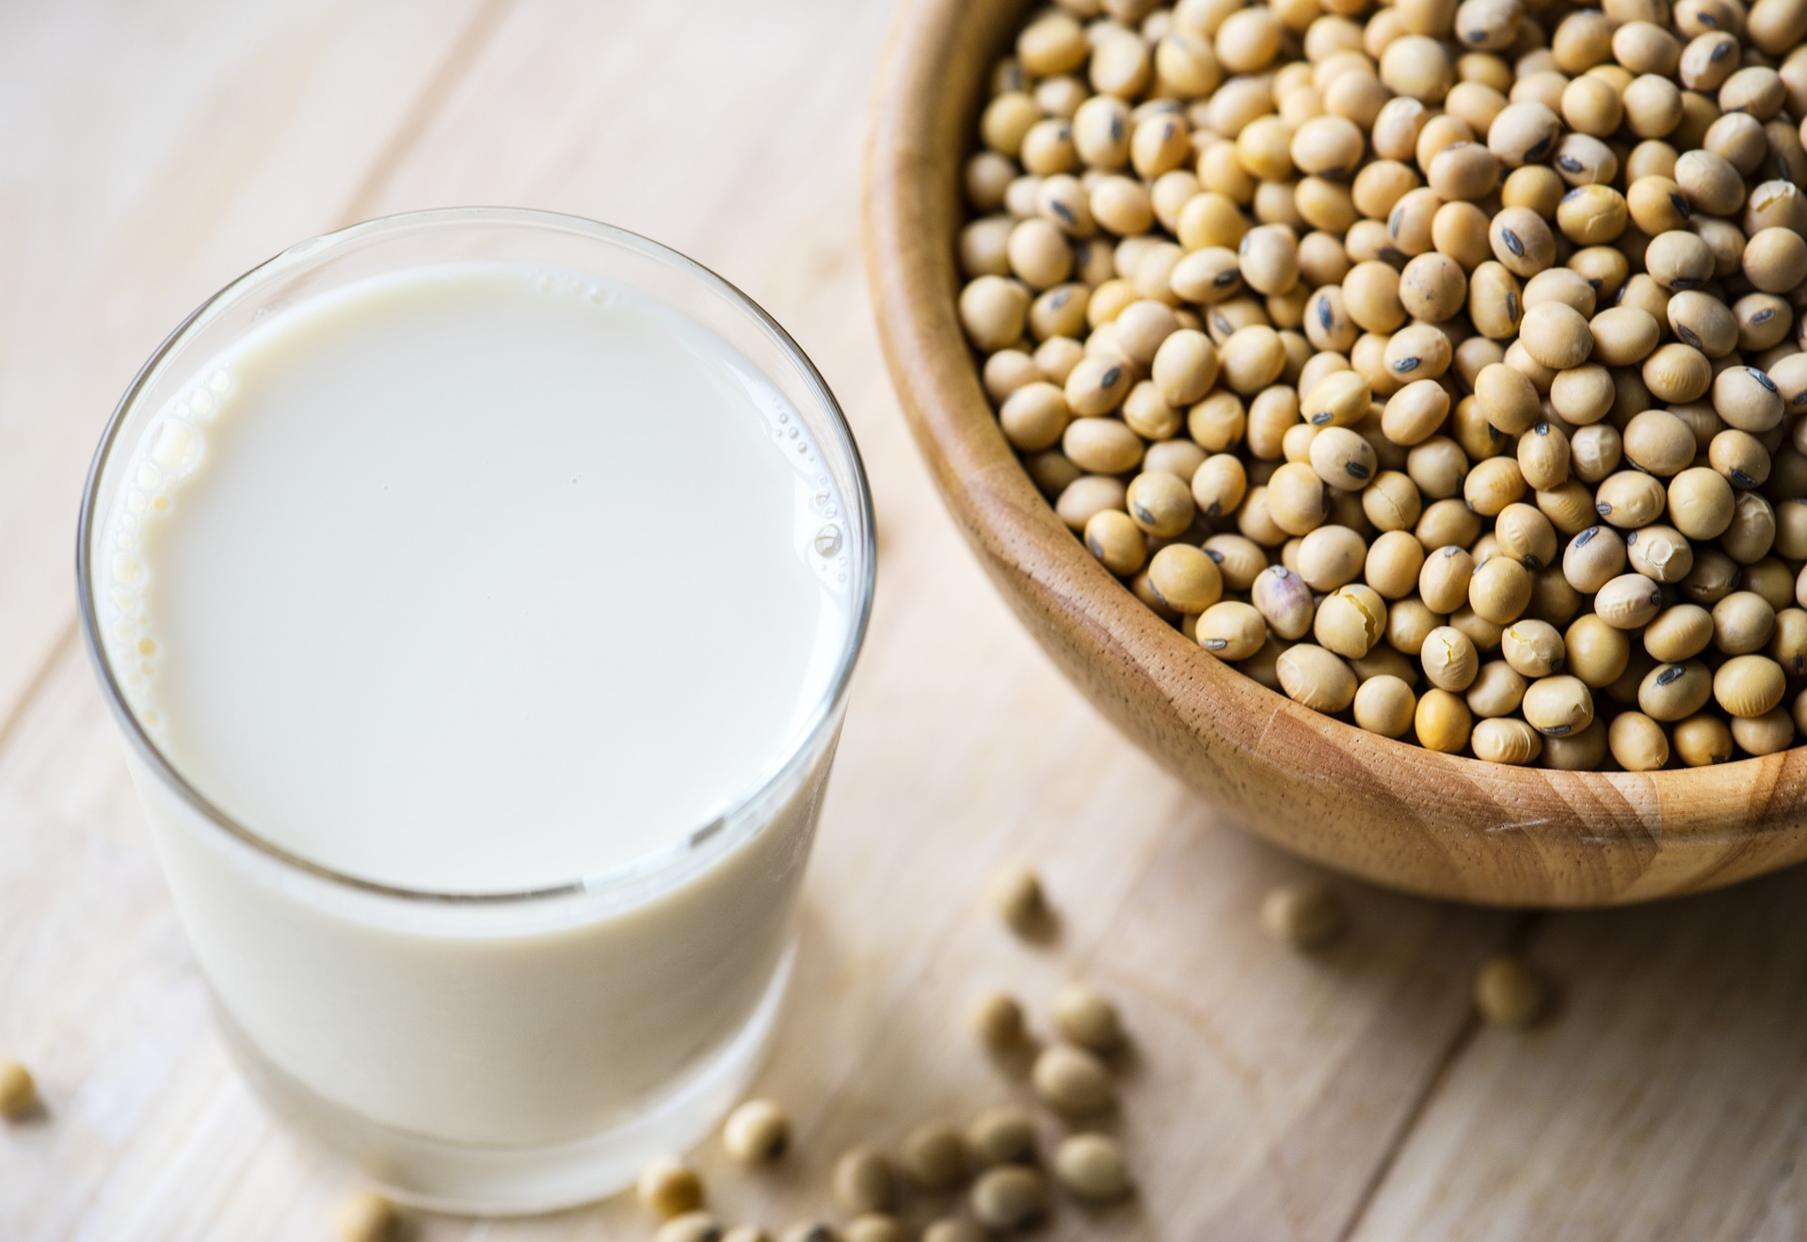
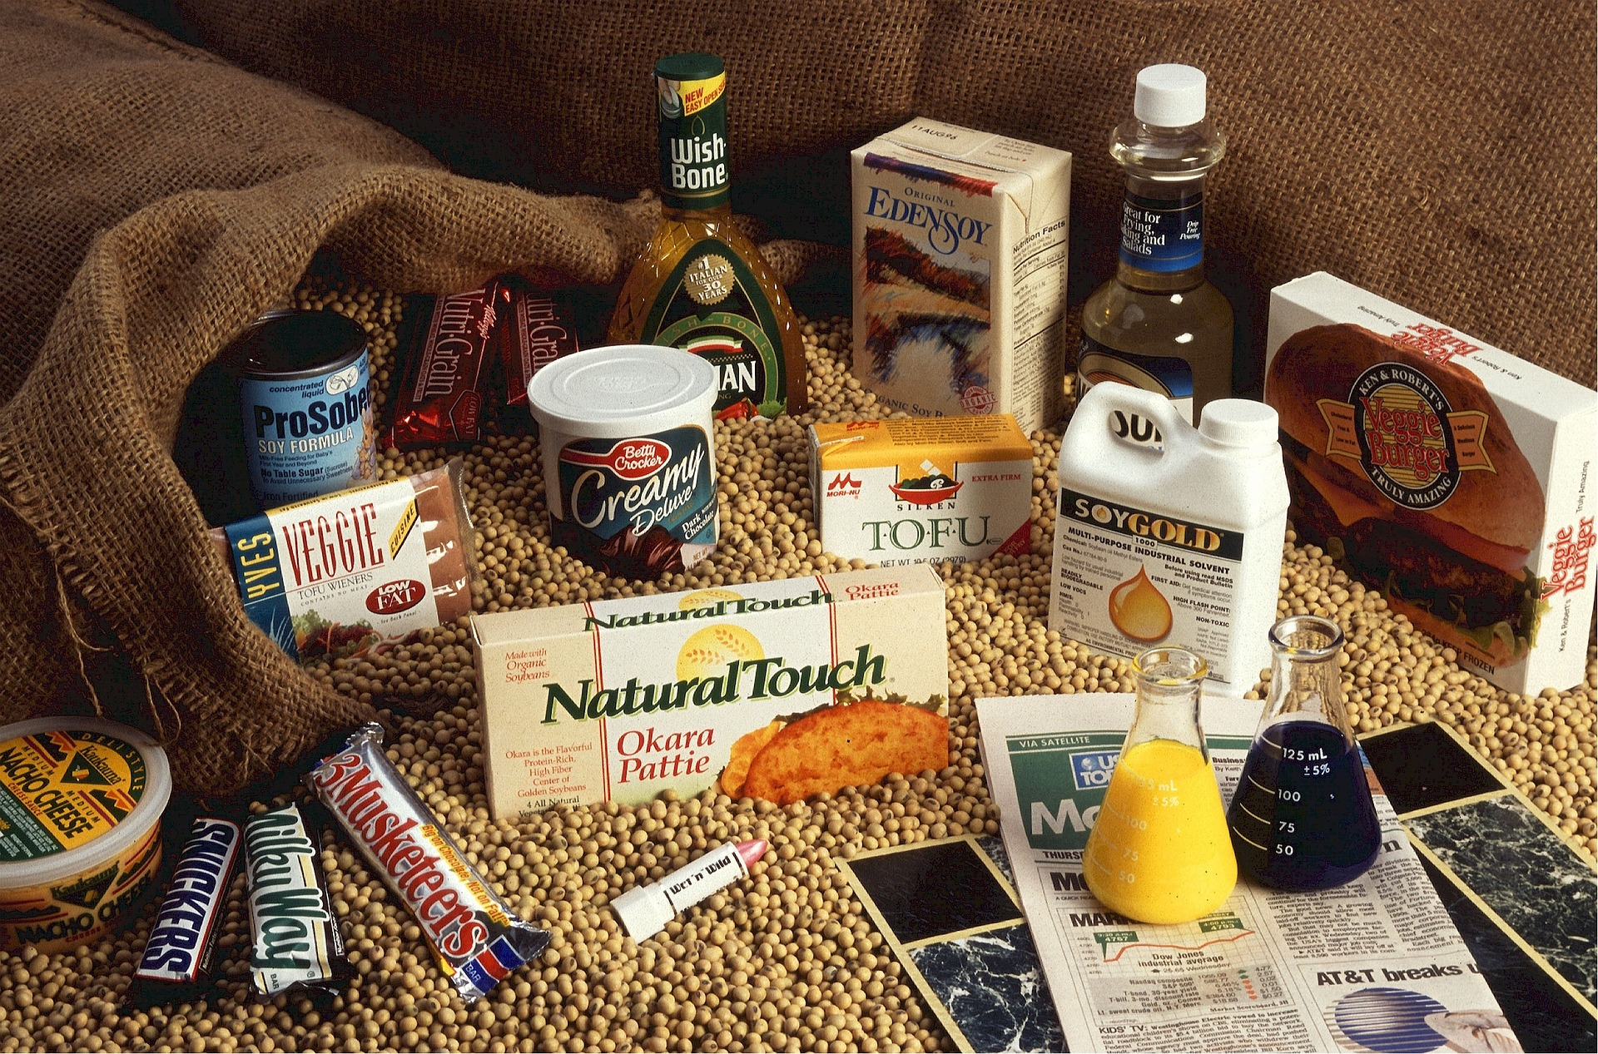
Today, Soy is Everywhere!
Soybeans are made into milk, flour, oil, and sauce. You can find soy in salad dressings, candy bars, frozen food, soup, crackers, hot dogs, and cereal. Check the labels on food in your kitchen pantry. Do any contain soy?

Slide 5

Soy – Much More Than Food
Soy is not just for eating. Believe it or not, soybeans are used to make hundreds of things we see every day.
I’m going to be milk!
I’m going to be a crayon!
Graphics courtesy of pngtree.com

Slide 6

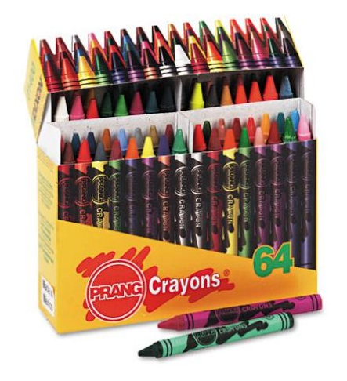
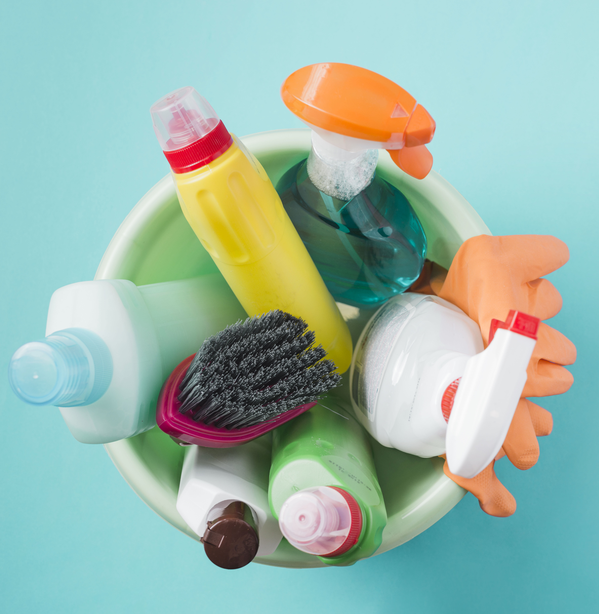
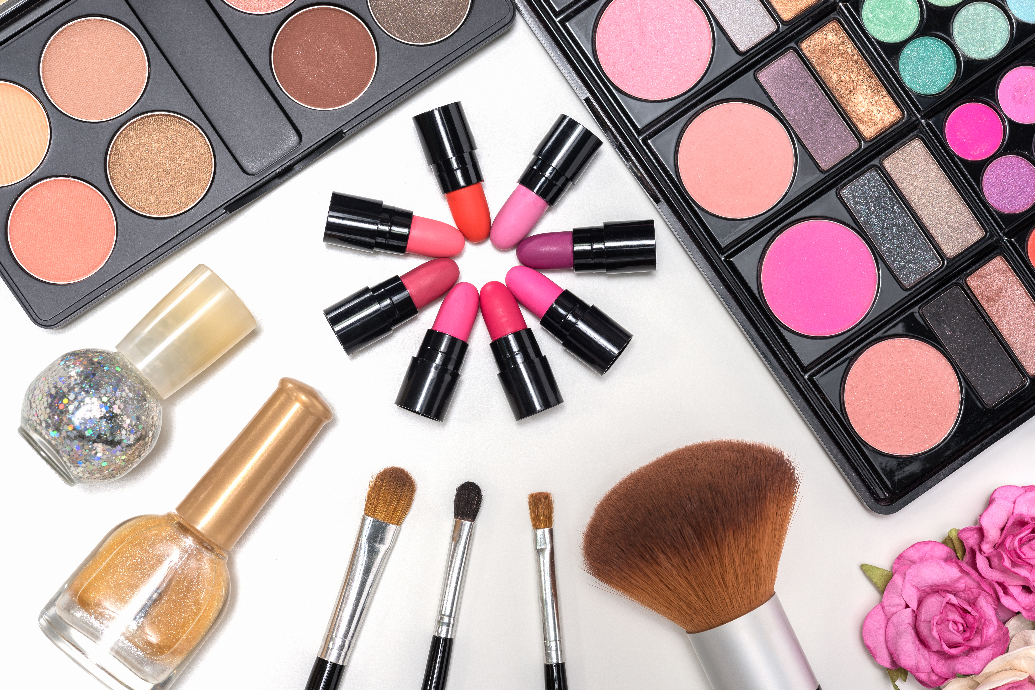
Soy is used to make shampoo, skin cream and makeup, as well as candles, crayons, and household cleaners.
Soy is also used to make padding for car seats and carpets and is even used to make clothes and shoes.

Slide 7
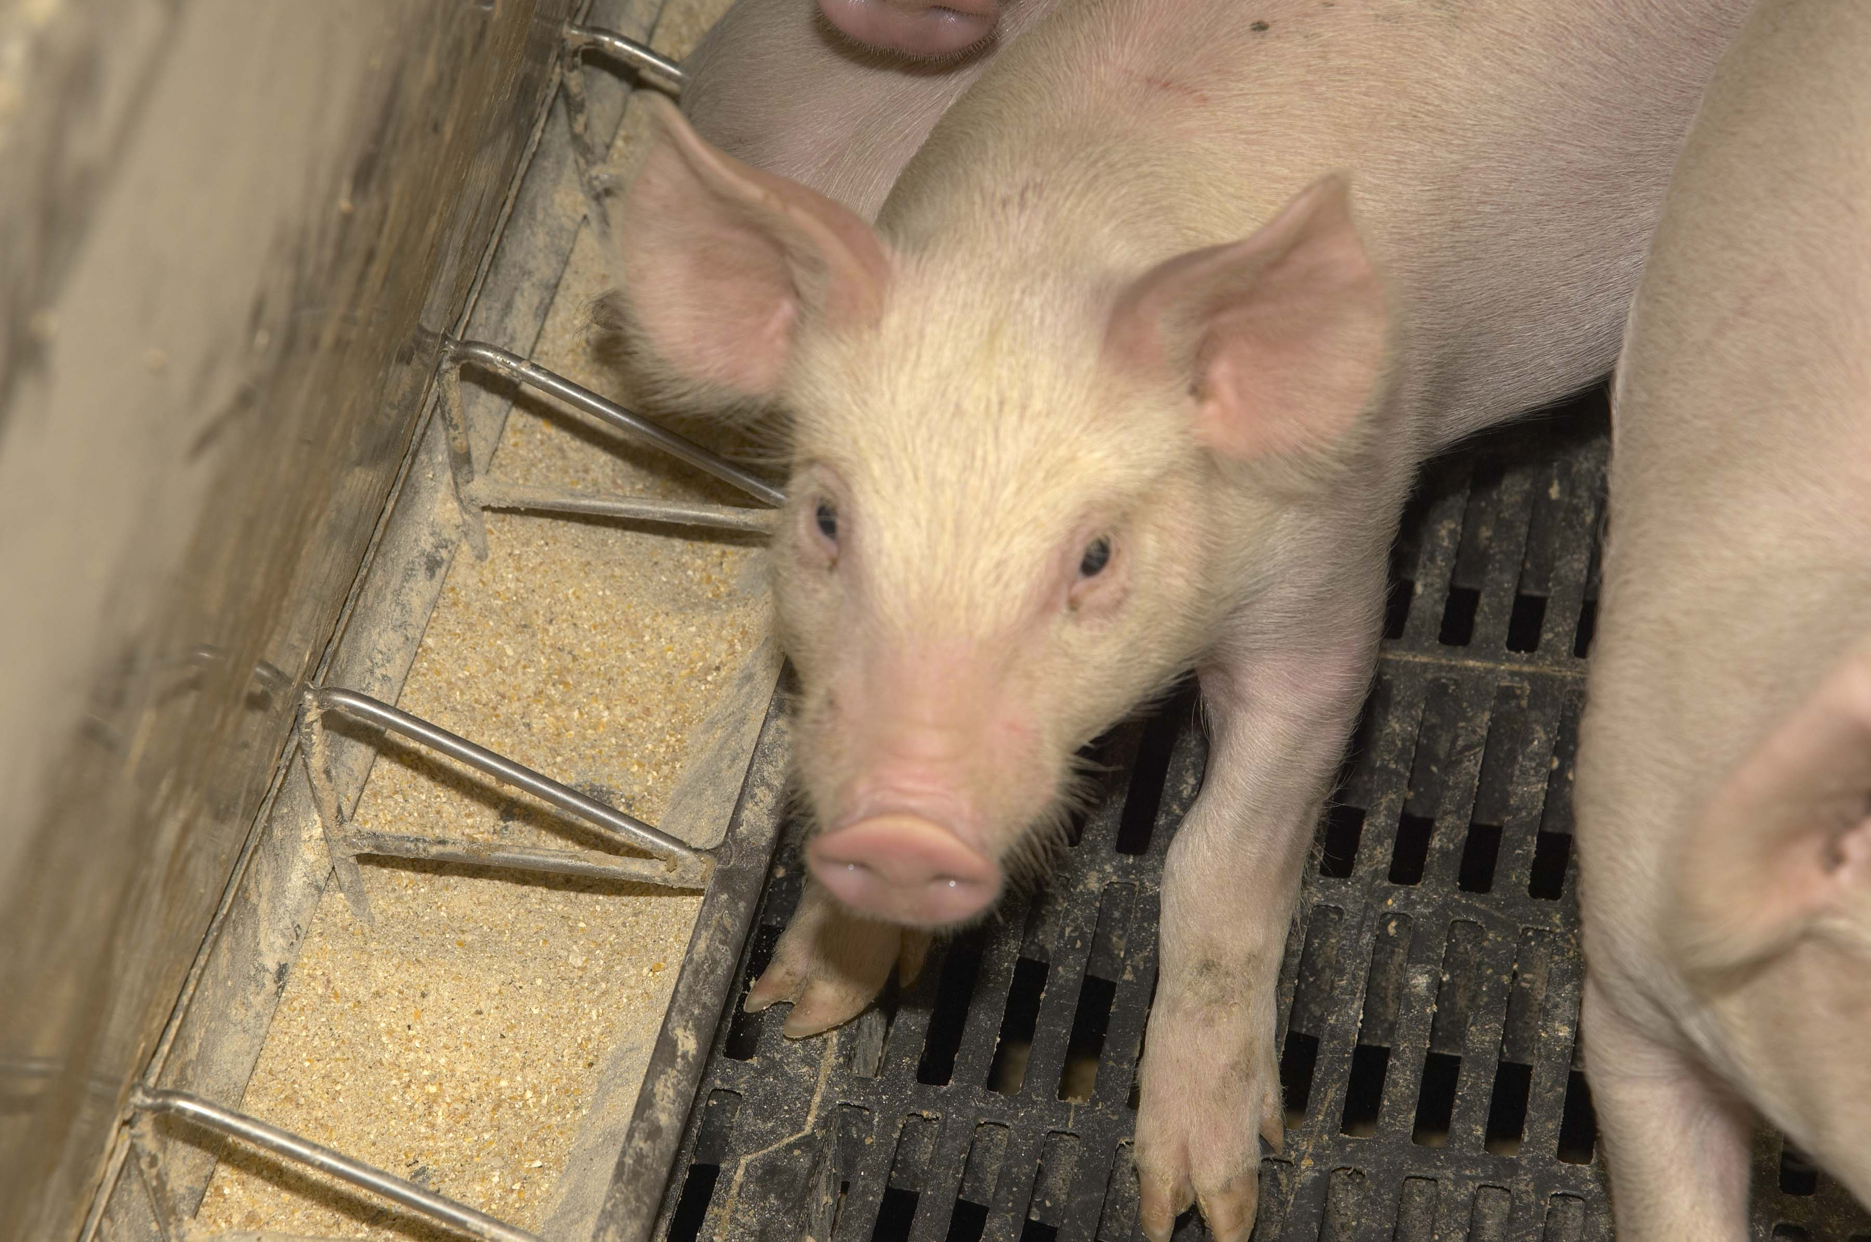
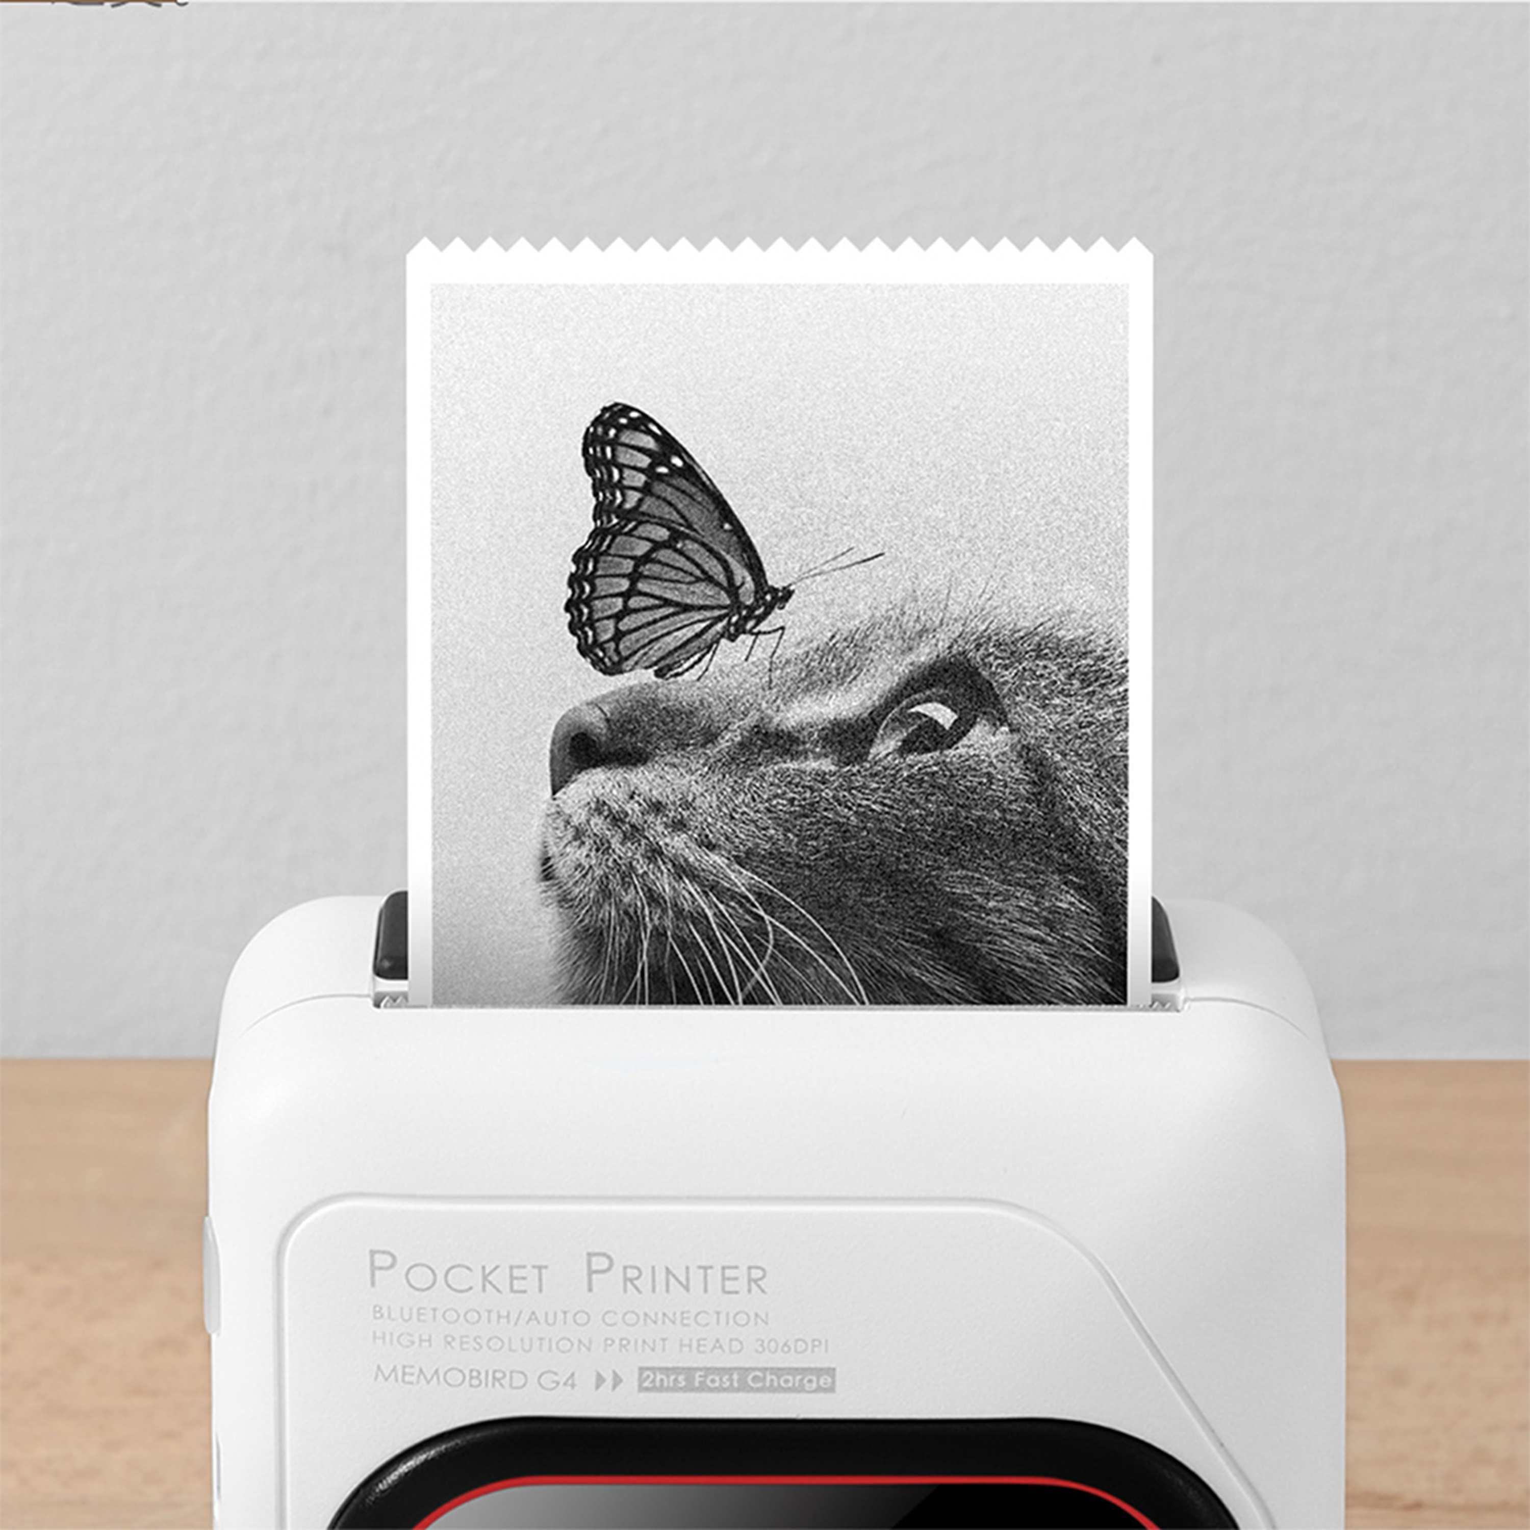
Soybean meal is fed to chickens, pigs, and cows.
Photo courtesy United Soybean Board
Soy ink is used to print books, and soy is used to make toner for printers.

Slide 8

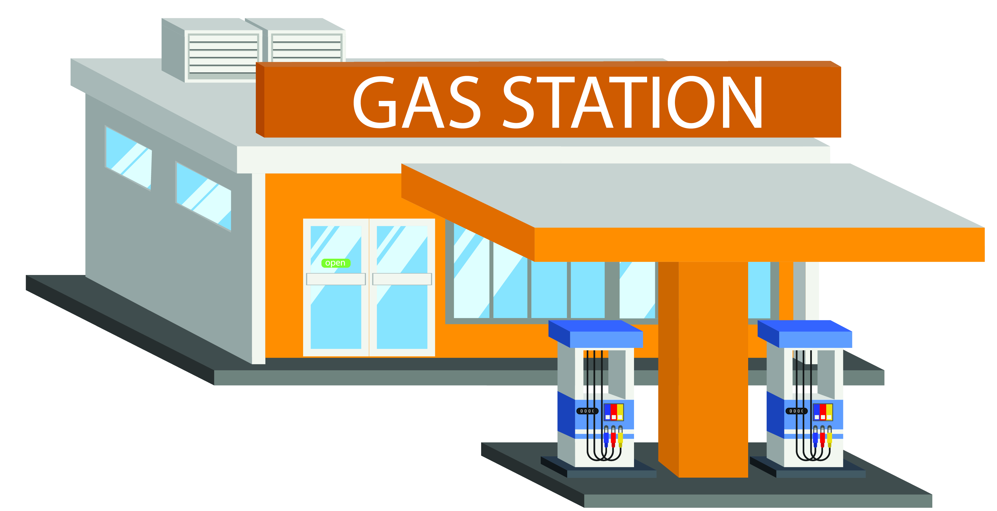
Soybeans are used to make biodiesel fuel that is used instead of gasoline to power cars, trucks, and farm machinery.
Biodiesel fuel is what we call renewable. Farmers can always plant more soybeans to make more fuel. Scientists believe, however, that it takes hundreds of thousands of years for oil that is pumped from deep underground to form. Oil is a nonrenewable resource.

Slide 9
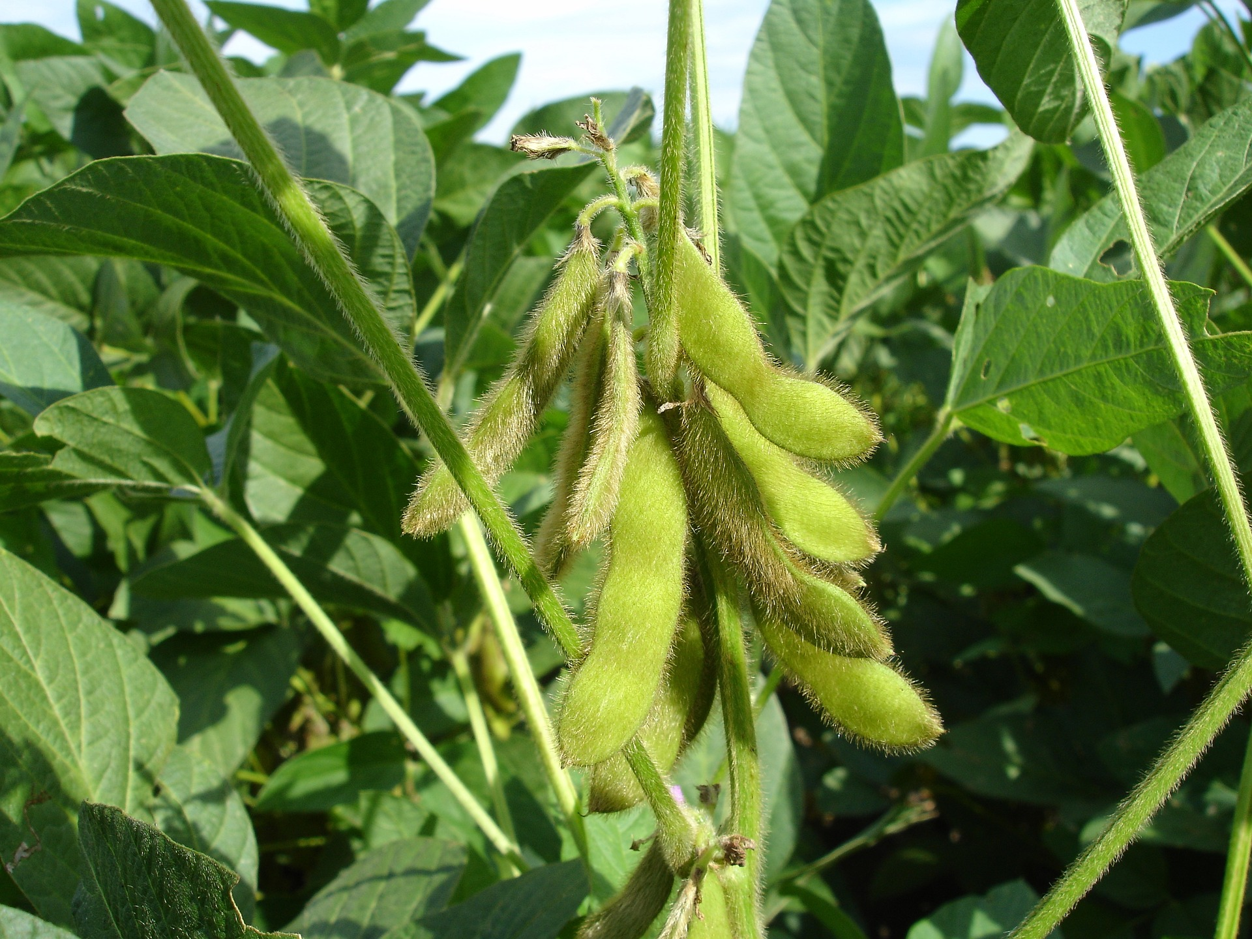
Let Me Tell You About Legumes
Soy beans and all other beans are a type of plant called a legume. The word is pronounced
lay-goom.
Lentils, peas, and peanuts are also legumes.
Legumes can do something special that no other plants can.

Slide 10
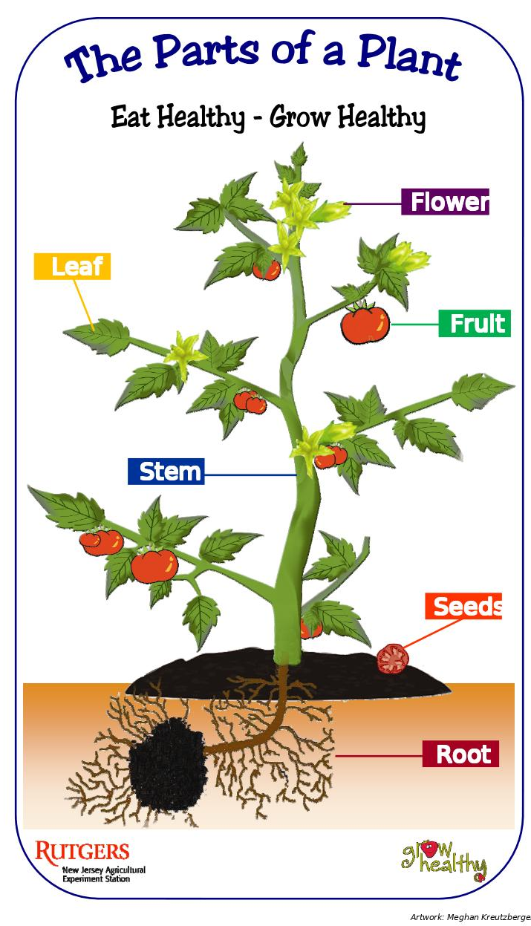
Nitrogen – A Nutrient the Plants Need
You know that plants use their roots to soak up water and nutrients to help them grow.
One of the most important nutrients for plants is called nitrogen. There is a lot of nitrogen in the air around us, but plants cannot get nitrogen from the air. Plants must get nitrogen from the soil.
Some plants such as tomatoes, corn, and lettuce, soak up a lot of nitrogen from the soil.
If tomatoes are planted in the same soil year after year, soon there will not be enough nitrogen left in the soil for more tomatoes to grow.

Slide 11
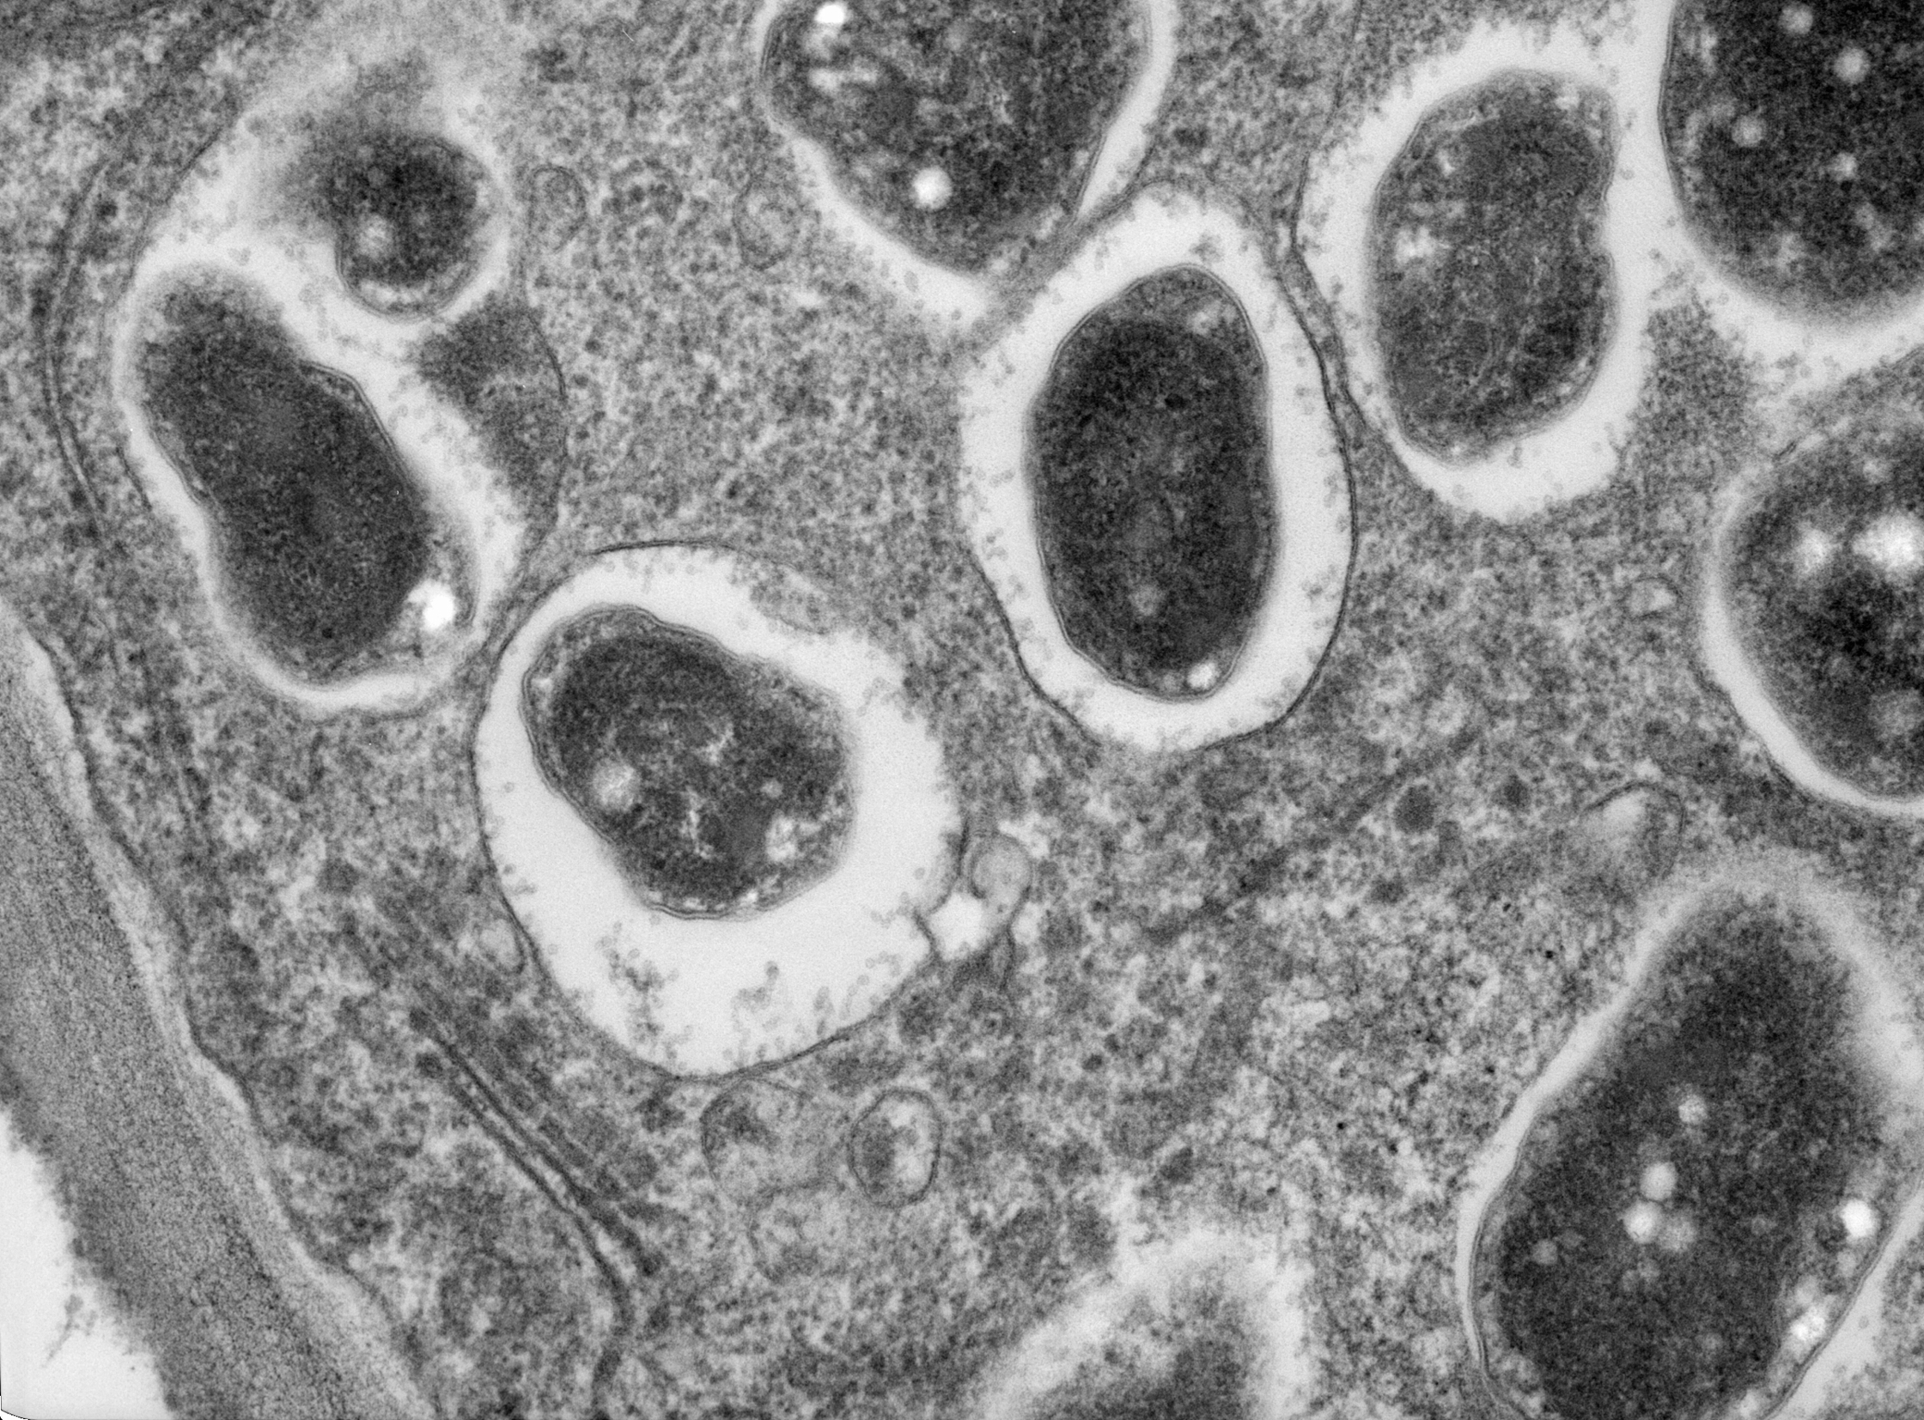
TA DA!
Legumes can fill the soil with NITROGEN!
Legumes such as soybeans are special. Only these plants can capture the nitrogen in the air and put it back in the soil. Legumes can't do this alone, though. They need help from tiny living things in the soil called bacteria.
Bacteria are so small you cannot see them with just your eyes. You need a strong microscope to see them. This picture shows what bacteria look like under a microscope. The bacteria that team up with soybeans are called rhizobia.

Slide 12
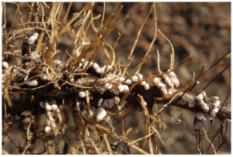
Look! Lumpy roots!
A soybean plant that needs nitrogen grows lumps on its roots. These lumps are called nodules. The bacteria that is in the soil move to live in the nodules. Together, the bacteria and the soybean plant pull nitrogen from the air and store it in the lumps.
Photo by Scotty Real, dudegrows.com
When the soybean plant is harvested, its lumpy roots stay behind and release all that stored nitrogen back into the soil.

Slide 13
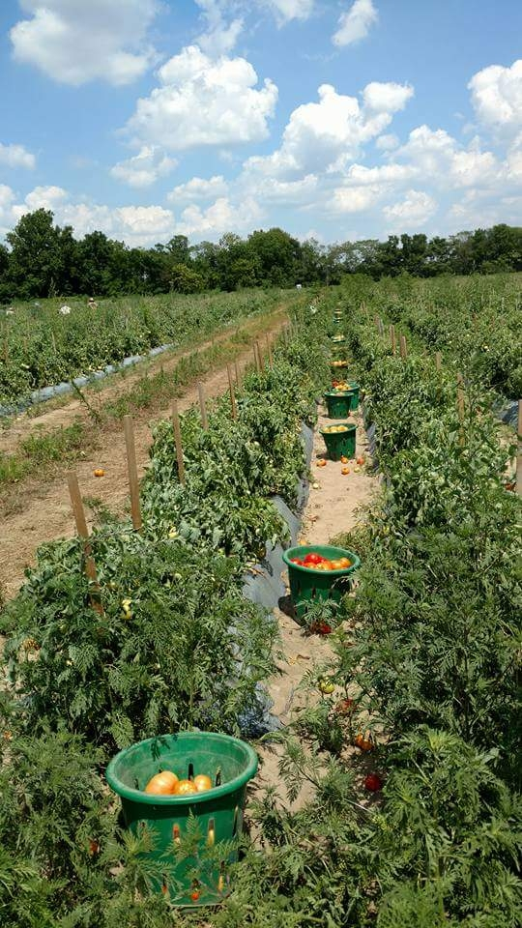
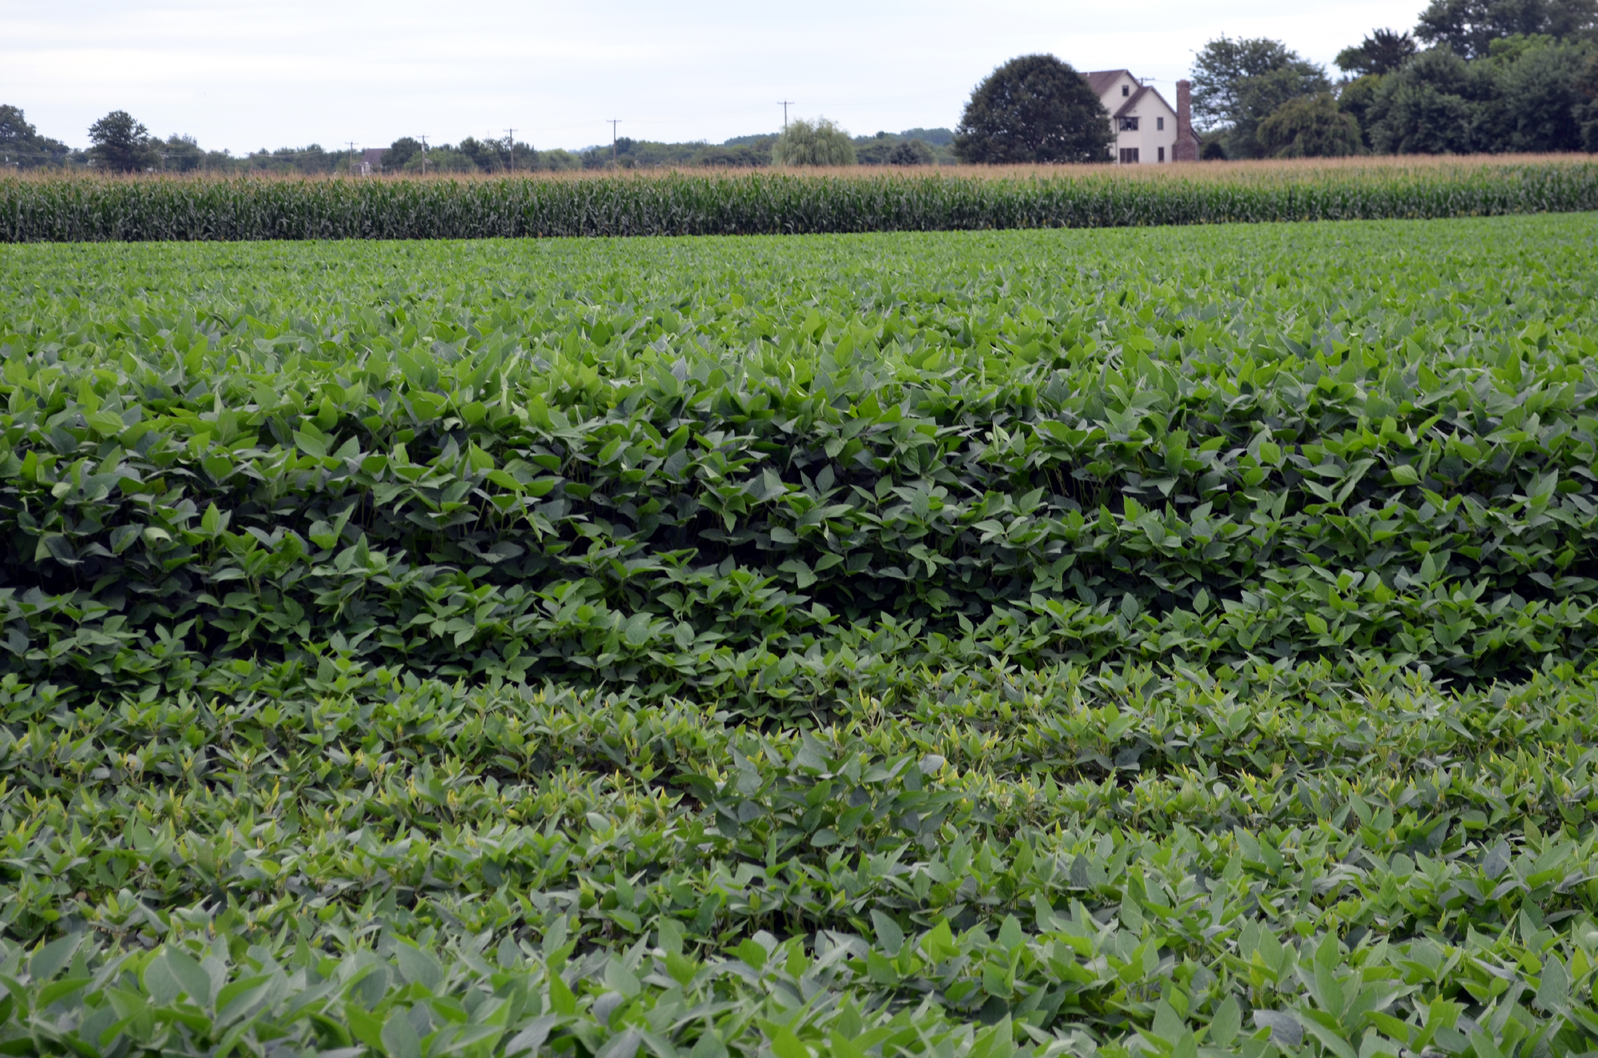
The Farmer's Switcheroo
Farmers have learned to switch their crops from year to year to keep their soil rich with nitrogen.
If one year they plant a crop such as tomatoes that take a lot of nitrogen from the soil, the next year they will plant legumes such as soybeans that put nitrogen back in the soil. This is called crop rotation.

Slide 14
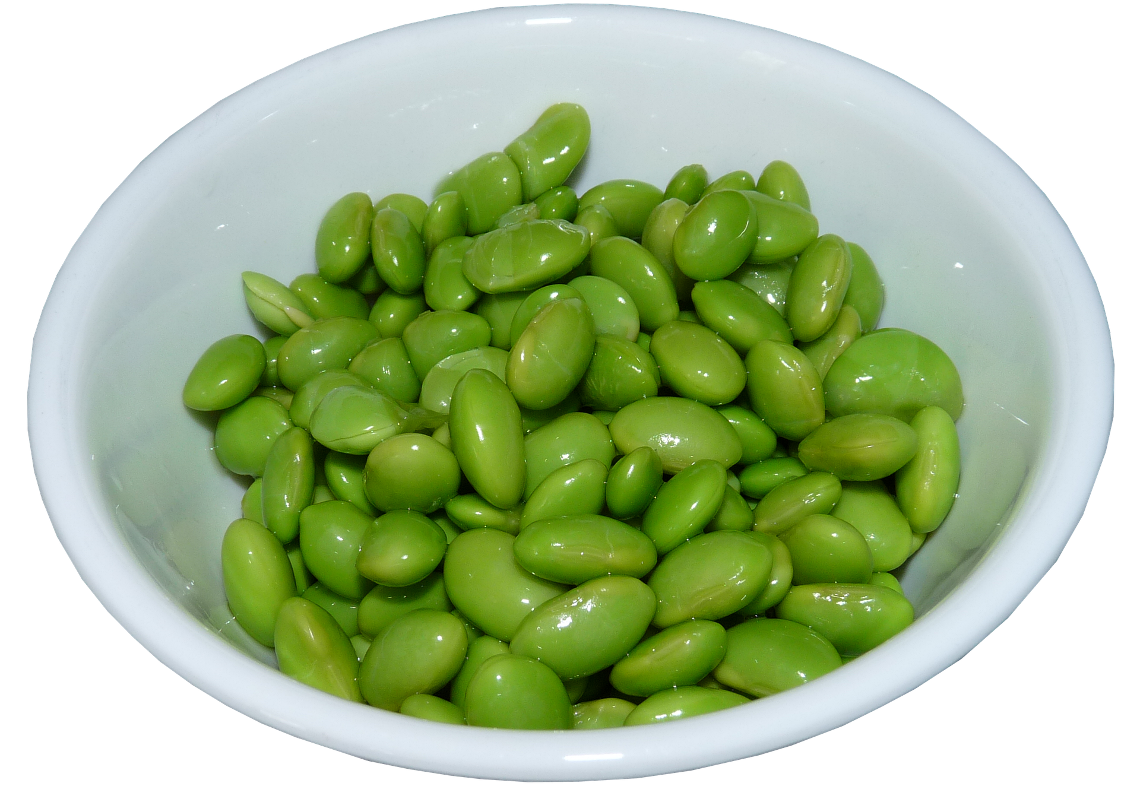
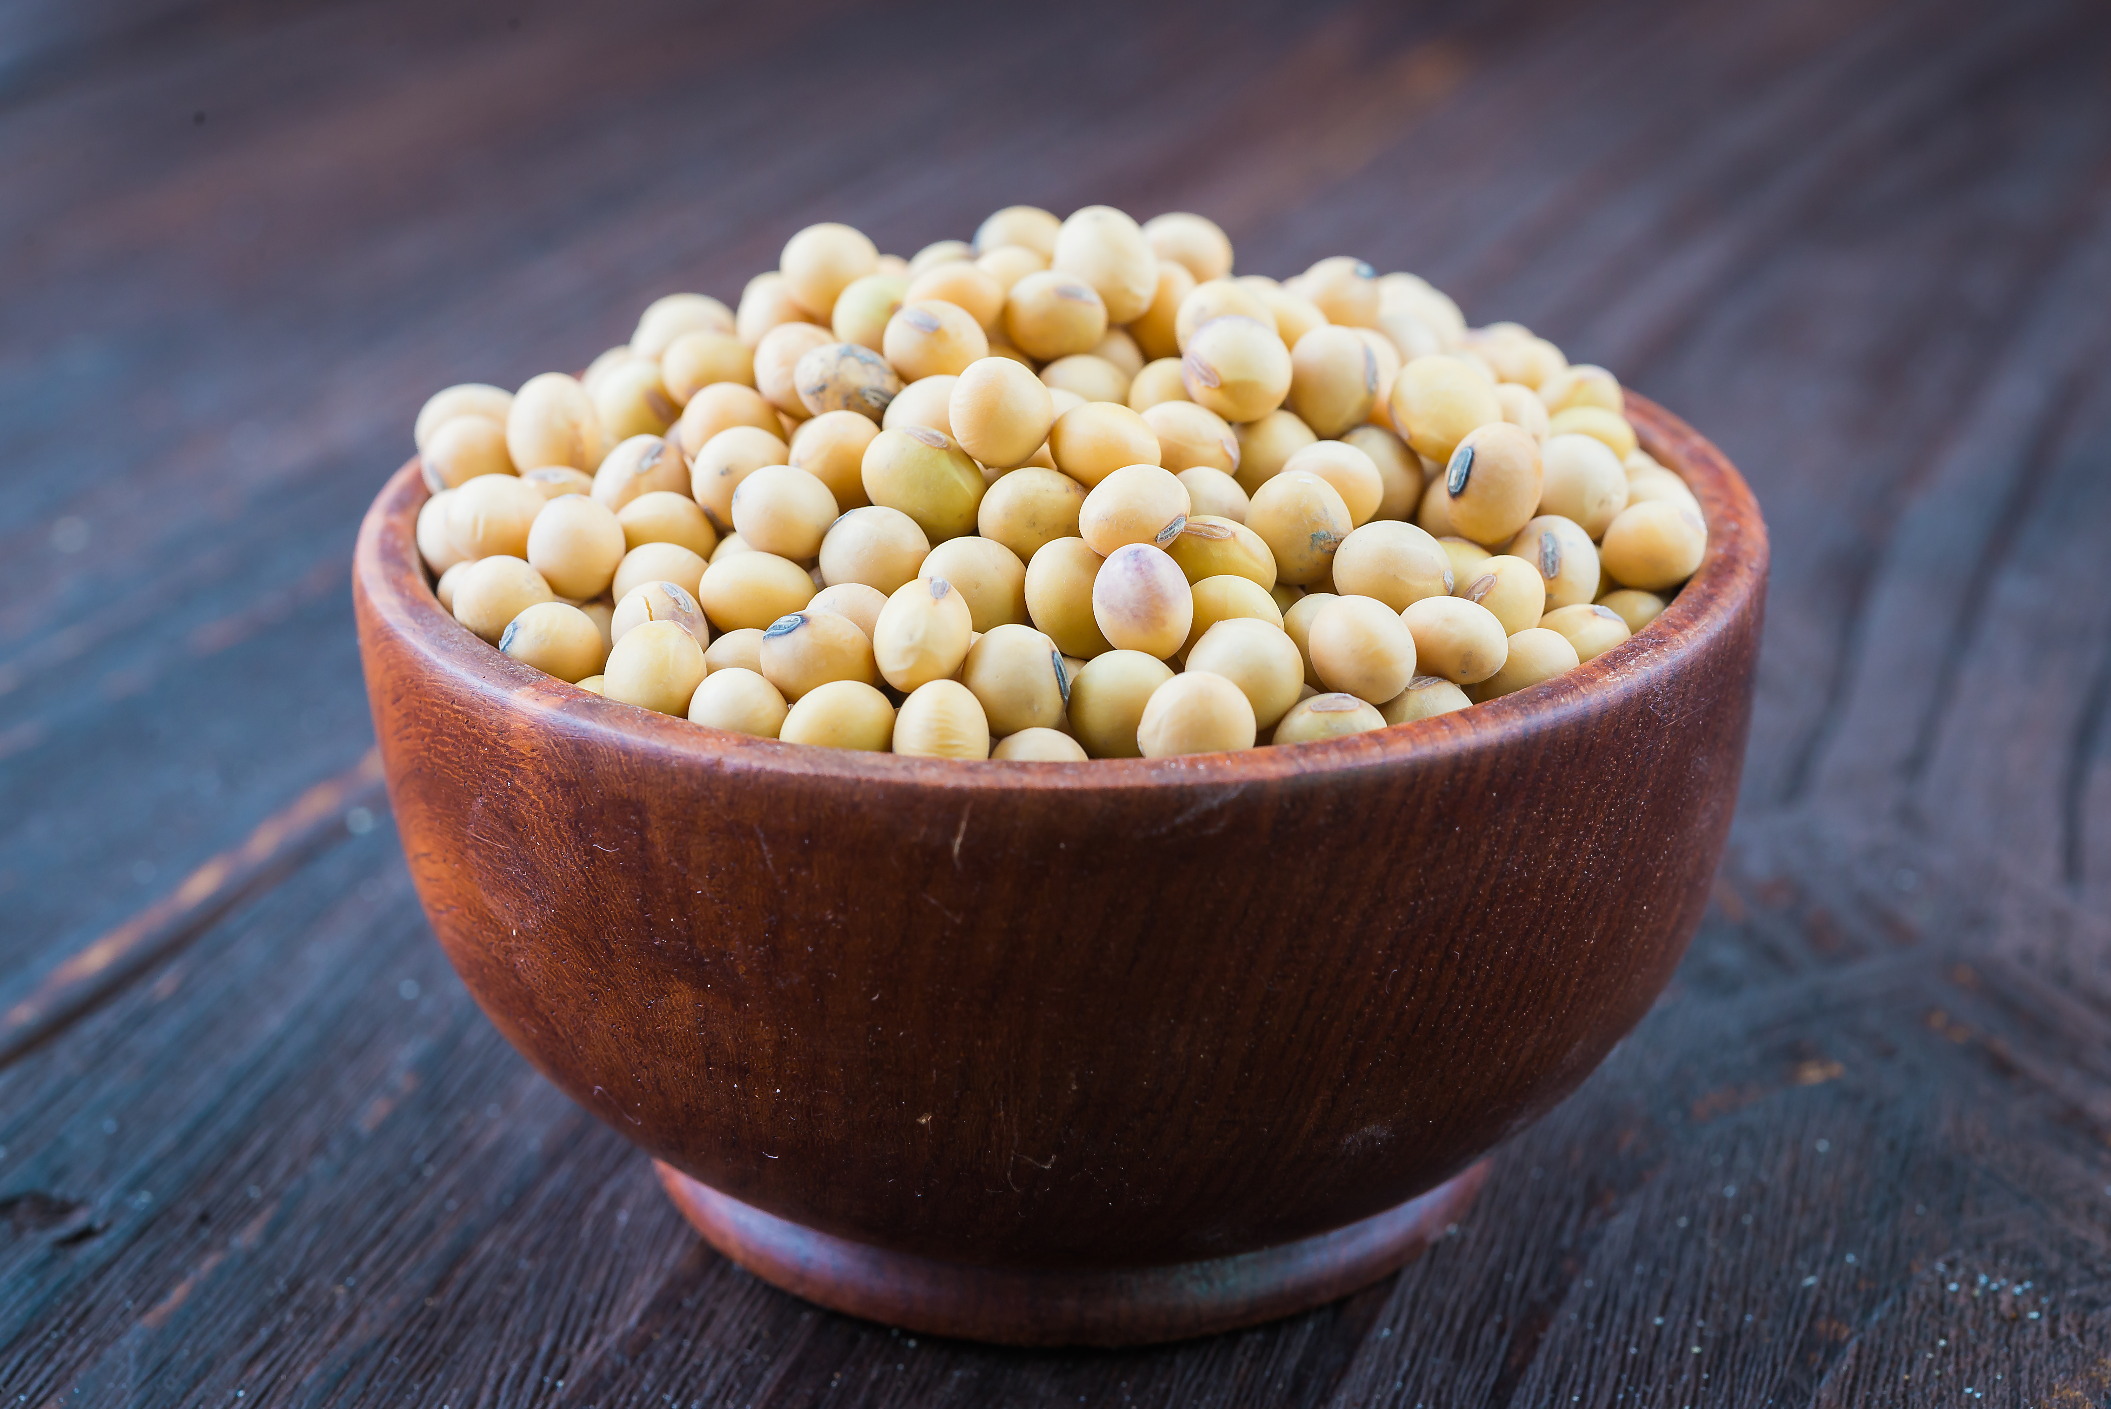
Pod Protection
Legumes are also different from other plants because their seeds grow inside a pod instead of a fruit. Most soybeans are harvested when their pods are brown. Soybeans that are picked when their pods are green are used in salads and other dishes and are called edamame.

Slide 15
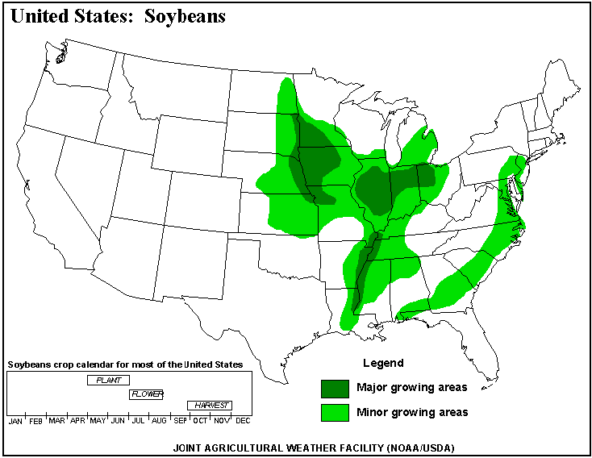
Soybeans are grown in New Jersey and many other states in this country. The green areas on this map show where soybeans are grown.

Slide 16
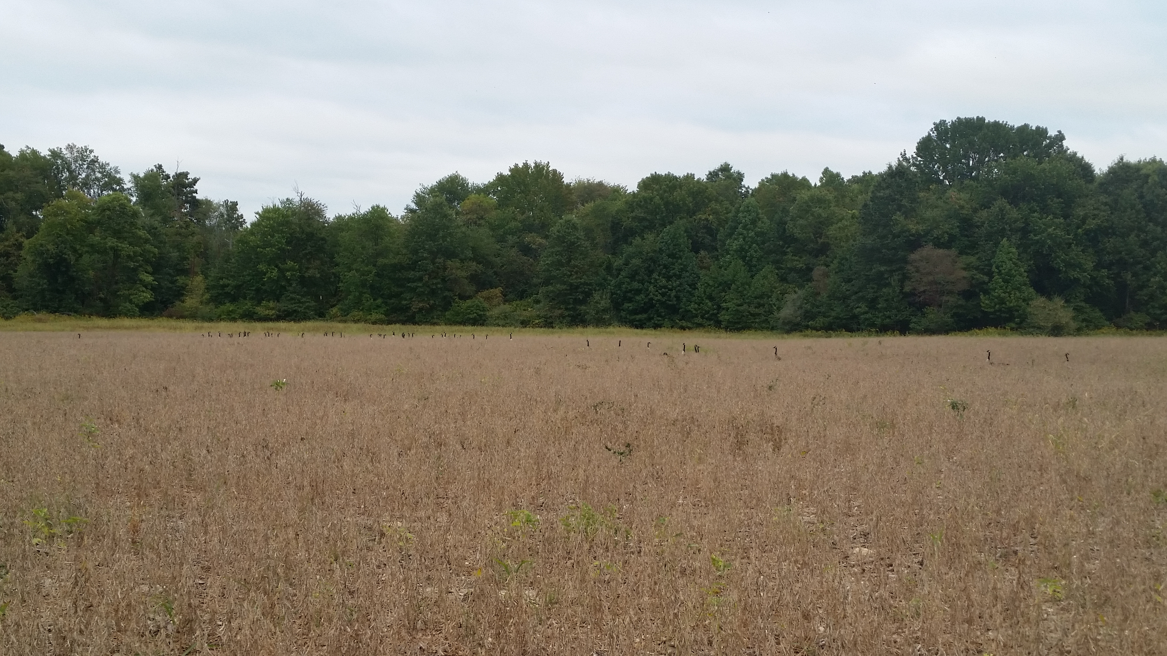
In New Jersey, soybeans are planted in May and are harvested in October.

Slide 17
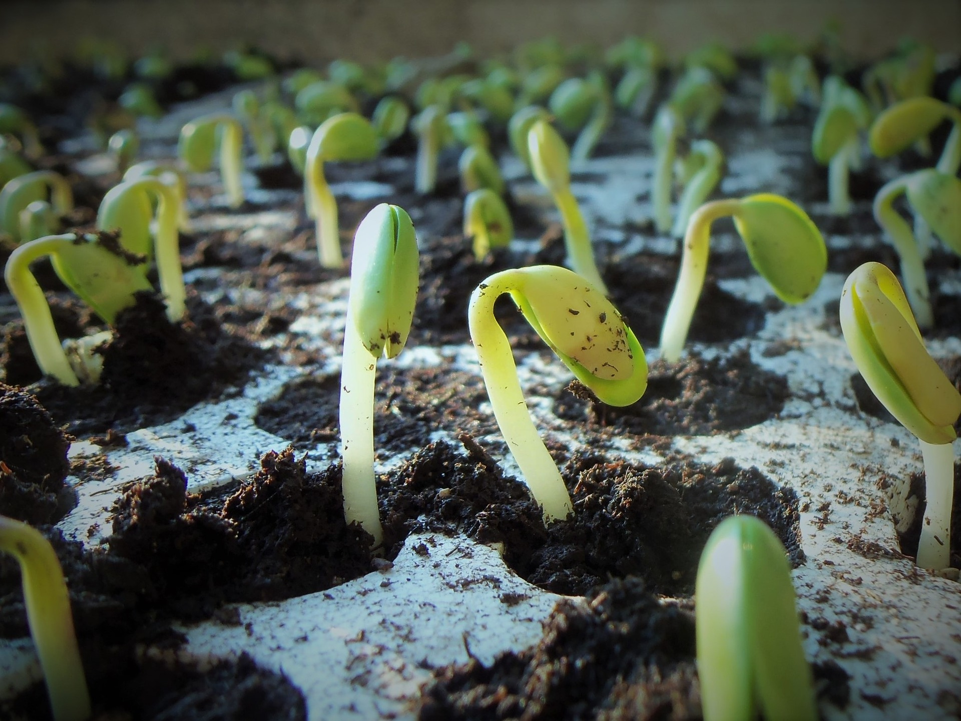
How To Plant Soybeans
Soybeans should be planted one inch deep. The soil should be kept moist but not too wet. Soybeans are big plants – they grow two or three feet tall – so they need a lot of space in the garden. Seeds can be planted about four inches apart, but the rows should be about two feet apart.

Slide 18
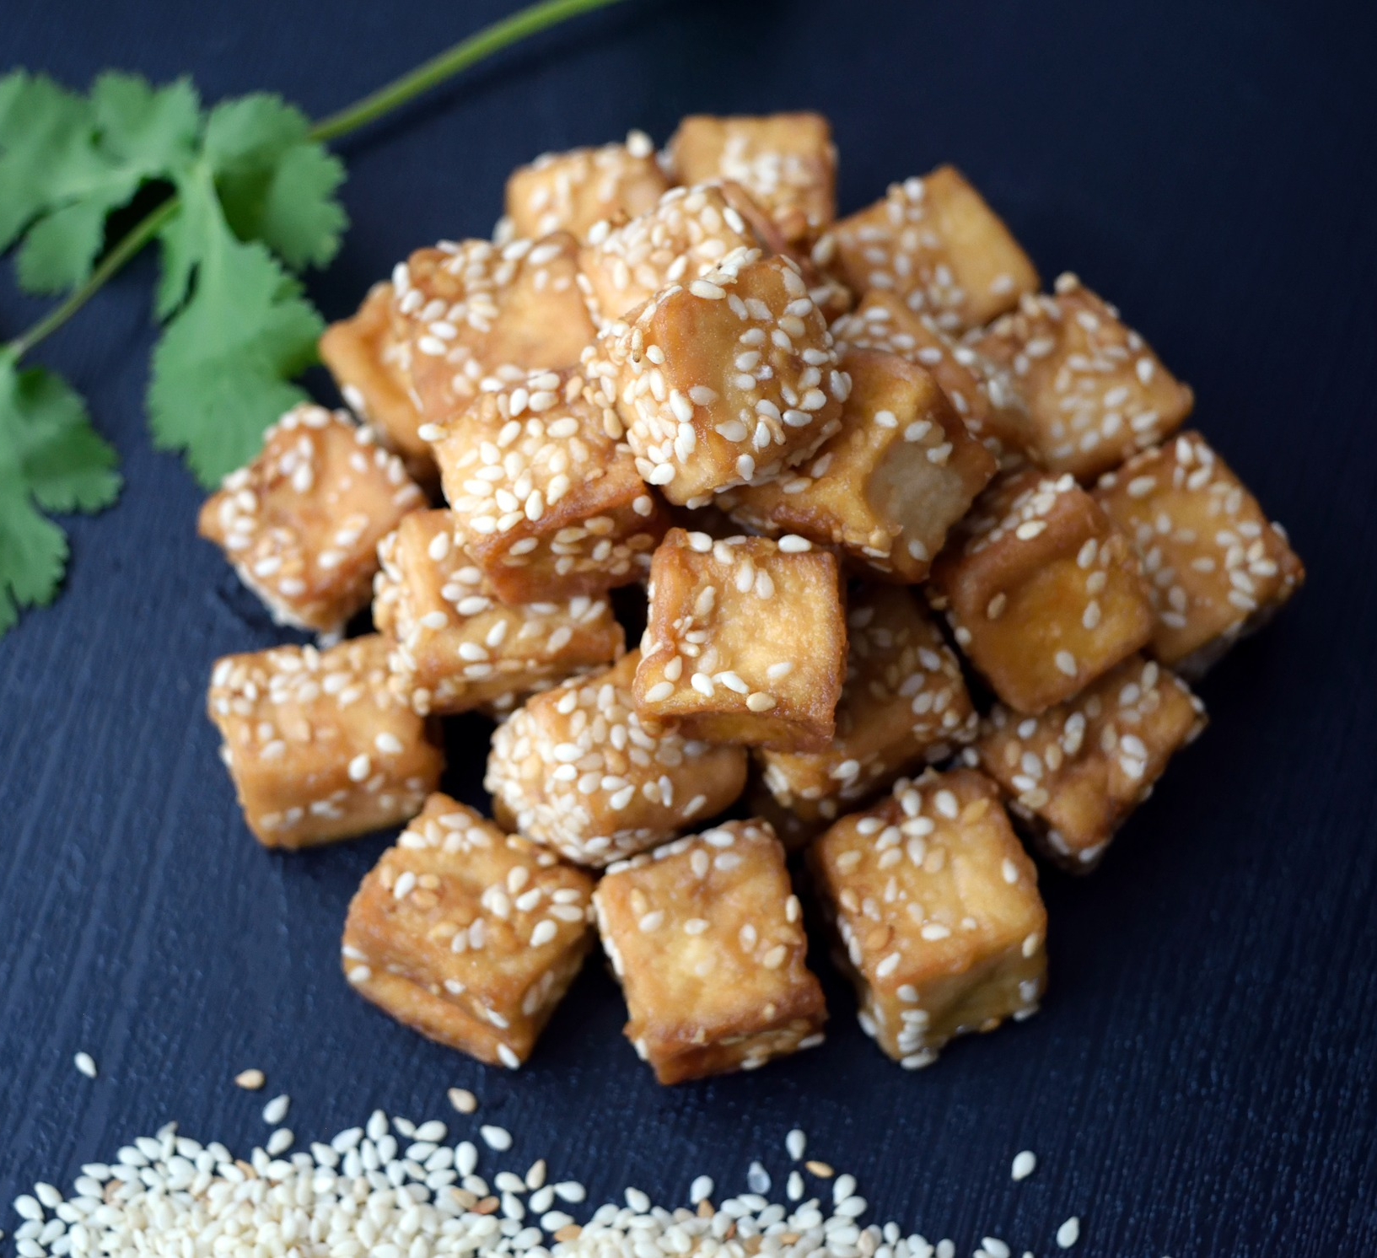
A Short History of Soybeans
Soybeans have been eaten in countries in Asia for thousands of years. That's why some of the names we use for soybeans – edamame and tofu – are Japanese.
Farmers in China grew soybeans as early as 5,000 years ago, and their use spread quickly to other Asian countries.
But the first soybeans were not brought to America until 1765 – only 250 years ago – when they were planted on a plantation in Georgia.

Slide 19
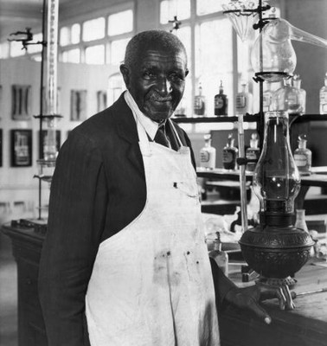
Soybean Discoveries
Still, soybeans did not catch on in America until the early 1900s, when the famous American chemist George Washington Carver discovered that soybeans are a valuable source of protein and oil. He also realized the ways soybeans could preserve good soil.
Cotton is a crop that uses a lot of nitrogen. Mr. Carver encouraged cotton farmers to rotate their crops every few years so that peanuts, soybeans, and other legumes would put nitrogen back into the soil.
Many farmers were surprised to find that rotating their crops like this produced a far better cotton crop than they had seen for many years.
Courtesy Tuskegee University, Tuskegee, AL

Slide 20
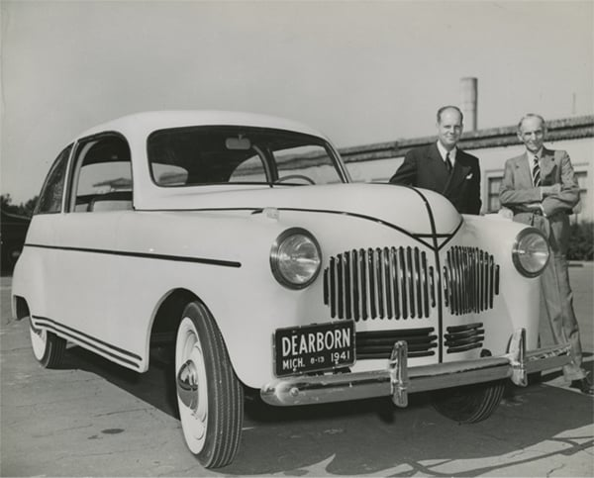
A Soybean Car? Really!
In 1908, Henry Ford made the first inexpensive automobile by producing his Model T car on an assembly line. He started the Ford Motor Co.
Mr. Ford was also very interested in agriculture and wanted to explore using crops such as peanuts and soybeans to produce plastics, paint, fuel, and other products. In 1942, his company built a car with a plastic body made from soybeans.
Photo from the Collections of The Henry Ford
But then all production of U.S. cars stopped when World War II began. When the war was over, the soybean car project was abandoned

Slide 21
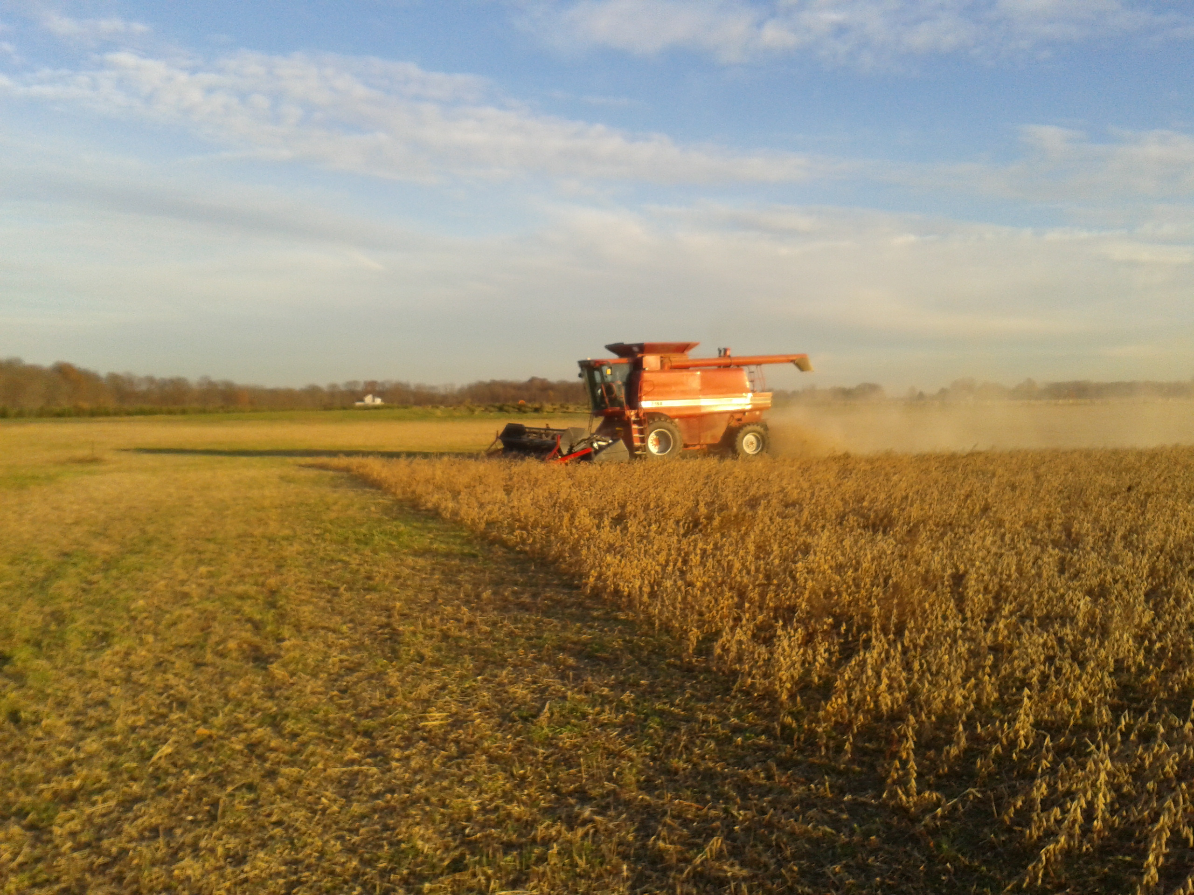
Now More Soybeans Here Than Anywhere
During World War II, the United States needed oils, plastics, and other products that could be made from soybeans, so U.S. farmers started growing them.
After the war, people in this country began to make more money, and they used their money to add more meat to their diets.
In the 1950s, farmers began to grow more soybeans to use to feed chickens, turkeys, cattle, and hogs.
Since then the use of soybeans has grown and the United States has become the largest grower of soybeans in the world.

Slide 22

Now you know all about soy. Have you eaten or used any soybeans today?
Graphics courtesy of pngtree.com

