Slide 1
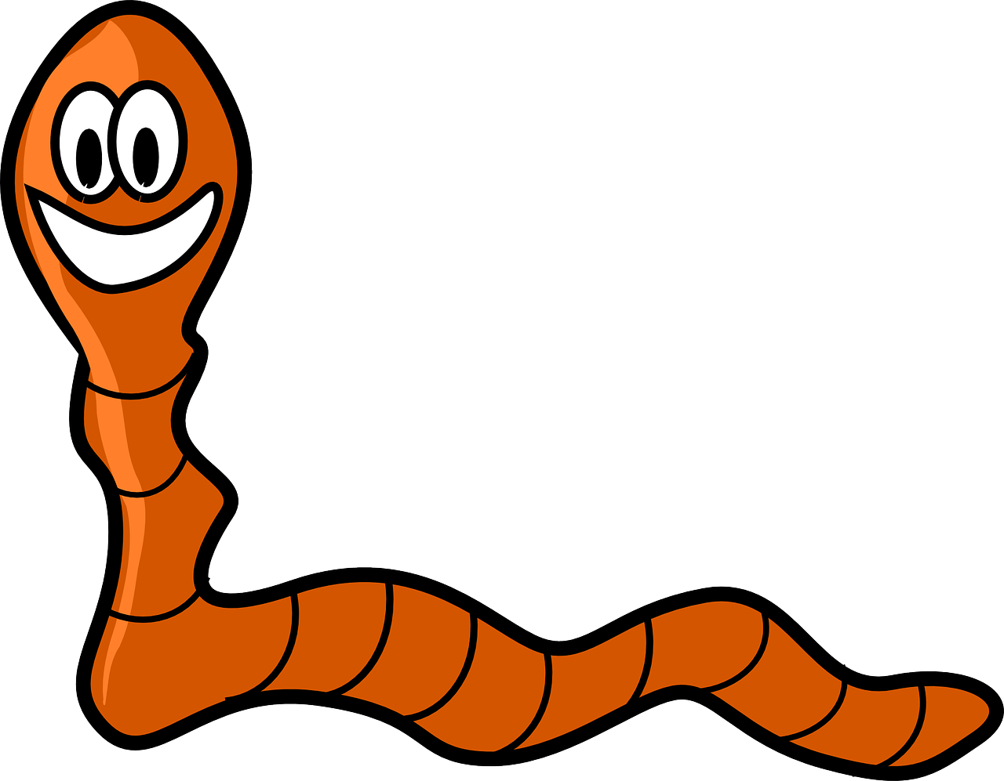
The Cleanup Crew
Worms
and Other Decomposers
A presentation by

Slide 2
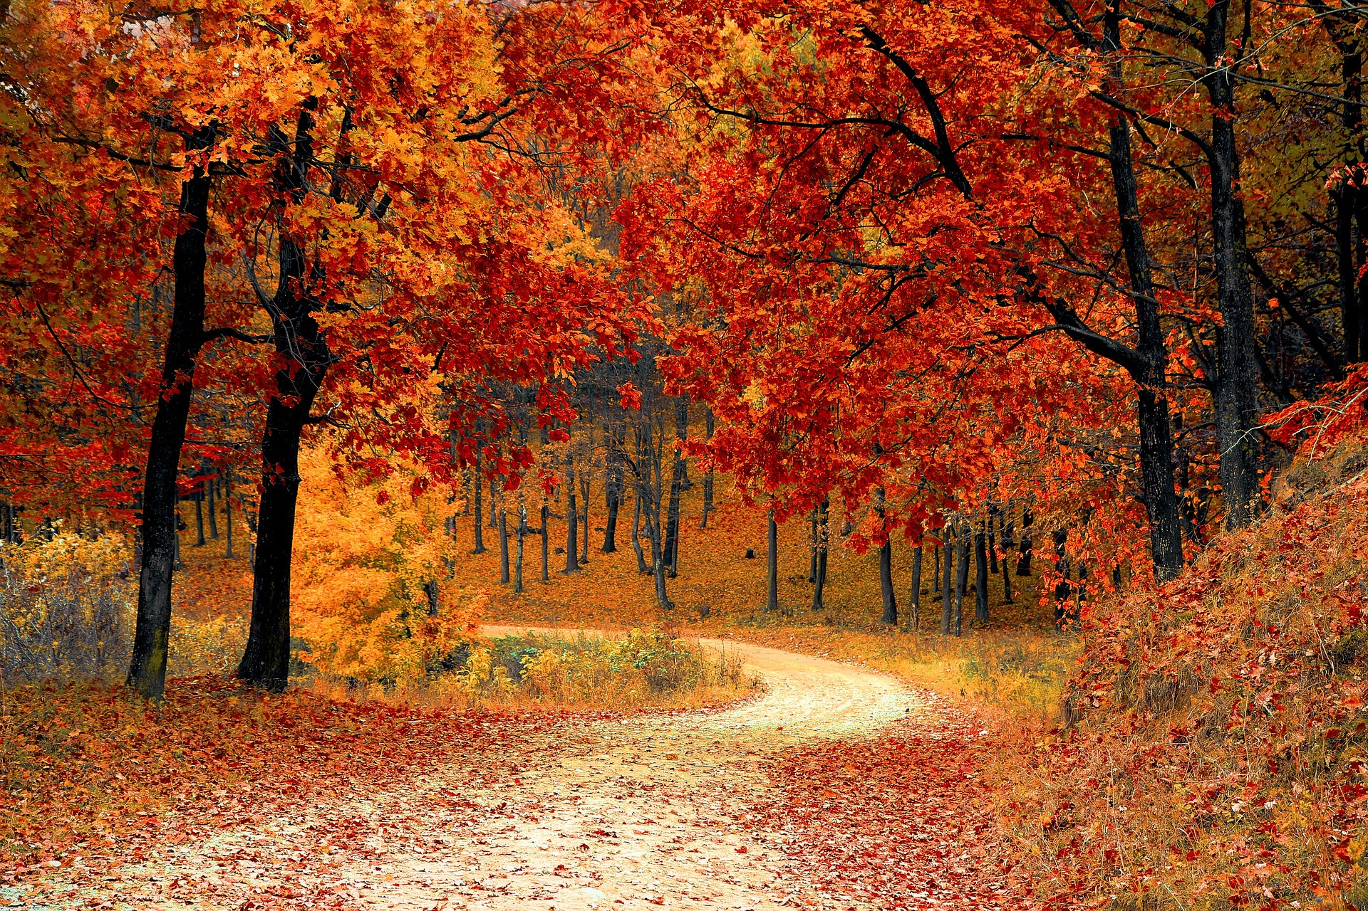
Decomposition
Where do all the leaves go that fall from the trees in autumn?
They become part of the soil in a natural process called decomposition.
Notes:
<number>

Slide 3
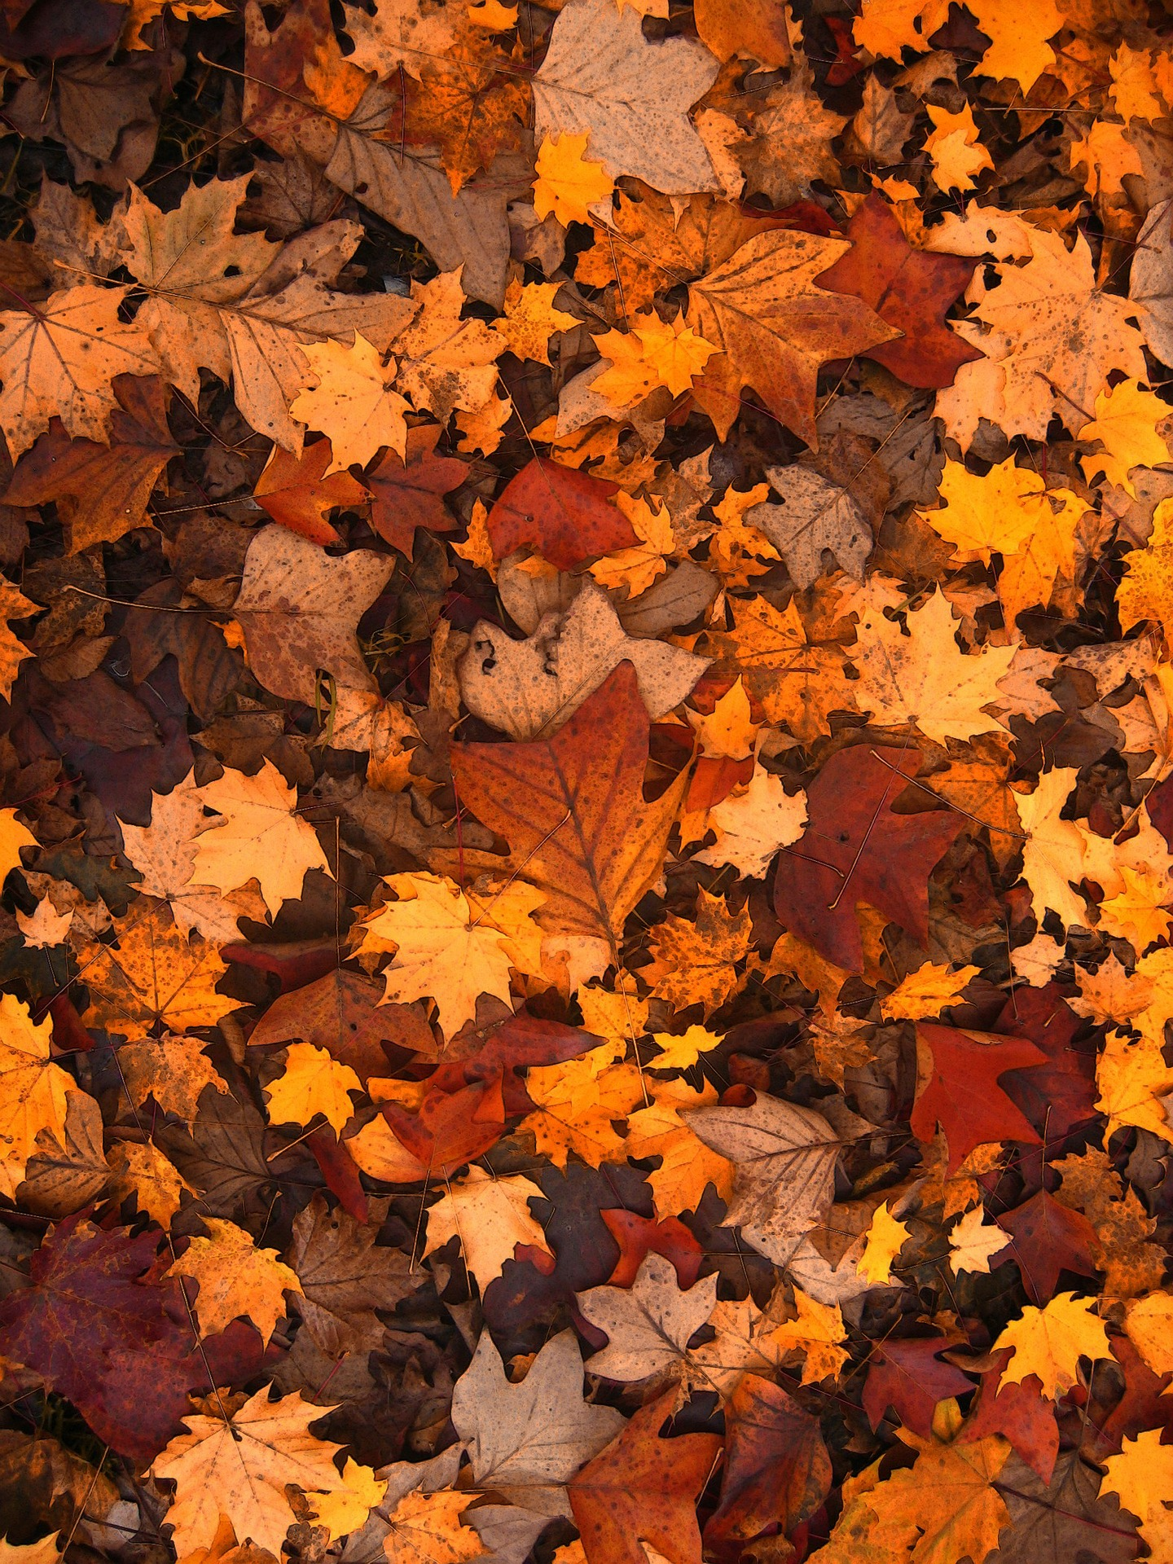
Decomposers
There are many small creatures that speed the process of decomposition by eating dead leaves and plant matter and releasing their nutrients into the soil.
Some of these creatures are worms, pillbugs, springtails, and millipedes.
Notes:
<number>

Slide 4
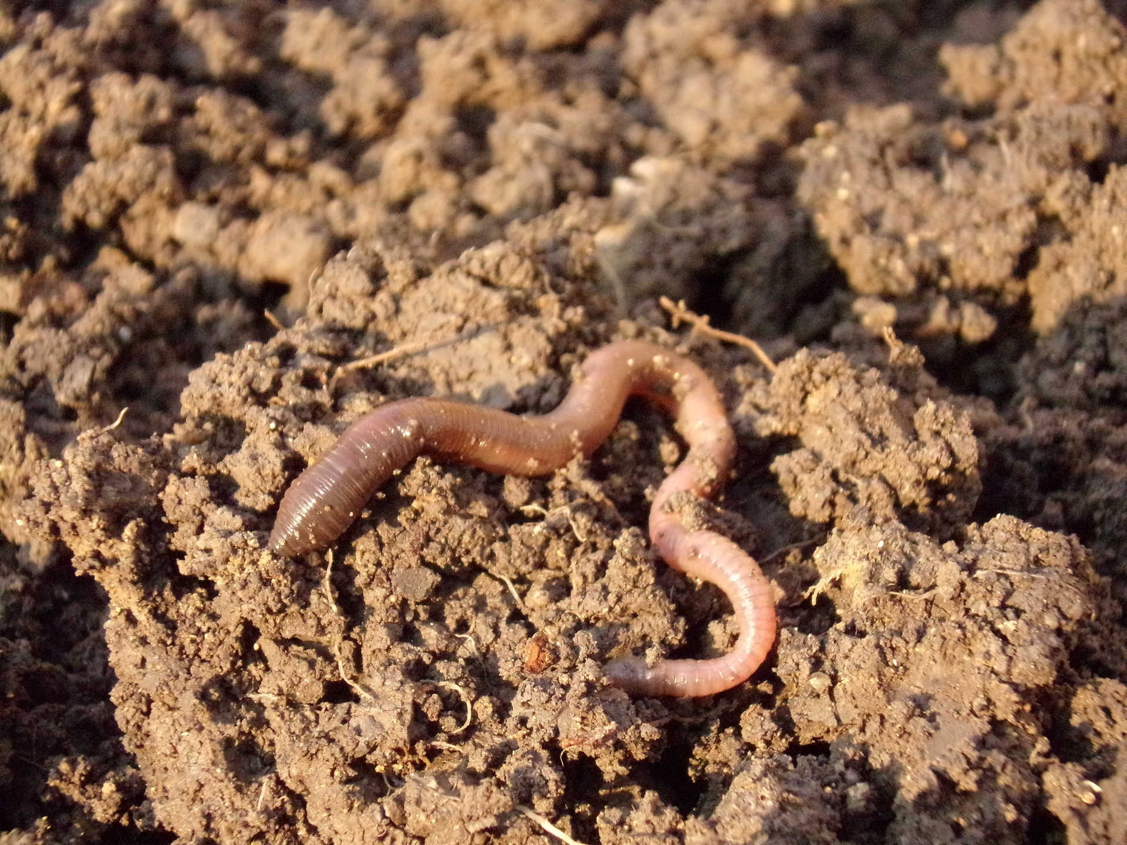
Worms
Worms tunnel through hard-packed soil by eating it. The soil is ground up by tiny stones and fine grains of sand in the worm's gizzard. The worm digests some leaves and other plant matter for its food. The rest of the ground-up soil is released from the back end of the worm.
An earthworm can eat as much as one-third of its weight in one day. Imagine if you ate that much!
Notes:
<number>

Slide 5
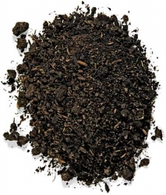
Worm Poop – Nature's Fertilizer
The pellets the worm releases are called castings. This is actually worm poop. Castings are filled with nutrients that make great plant food. Worms are great to have in your garden, because they feed the plants!
Photo courtesy Uncle Jim’s Worm Farm
Notes:
<number>

Slide 6
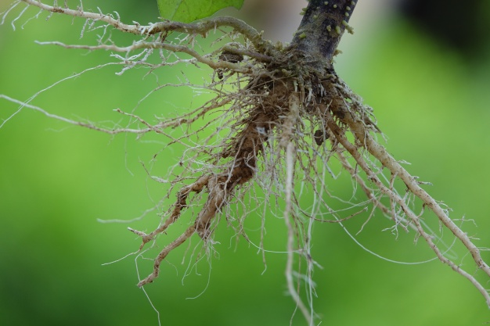
Worms Help Roots to Grow
As worms burrow through the ground, they also break up the soil, allowing air and water into the soil and making it easier for roots to grow.
Notes:
<number>

Slide 7
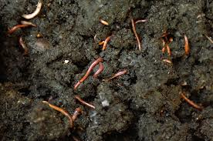
Worms Make Tunnels
Earthworms usually live near the surface but they can burrow under the soil as much as 6 ½ feet.
Notes:
<number>

Slide 8
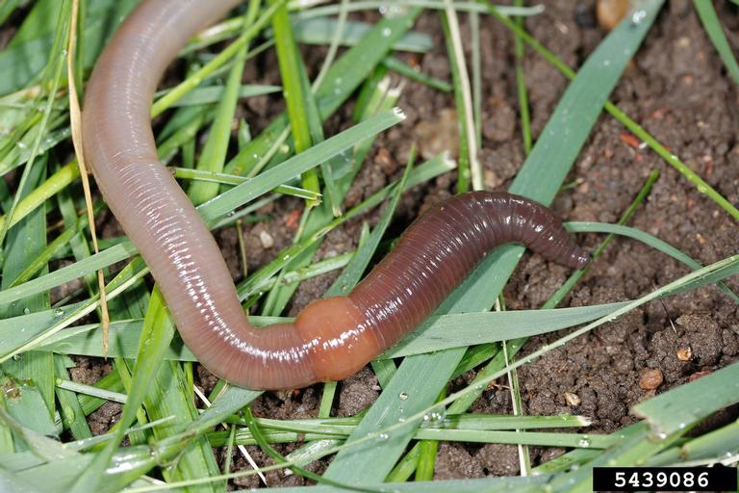
A Close Look at the Worm
Earthworms can grow to seven or eight inches long, but there are some that grow to as much as 14 inches long.
Their bodies are made up of ring-like segments called annuli. The different-colored segment or saddle part in the middle of the earthworm is called the clitellum. That's where the earthworm's eggs will form after mating. The earthworm's head is at the end closest to the clitellum.
Photo by Joseph Berger, Bugwood.org
Only adult worms have a clitellum; young worms do not. Each earthworm is both male and female, but it still takes two worms to produce baby worms.
Notes:
<number>

Slide 9
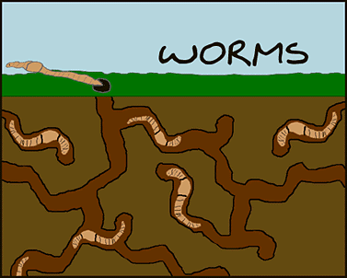
Rainy Days are Bad for Worms
An earthworm's skin is covered by small hairs called setae that help it move through the ground and allow it to cling to its tunnels when it is attacked by predators.
Courtesy dumielauxepices.net
Earthworms breathe though their skin and can only breathe easily when it is cool and damp. On very rainy days, however, a worm's air pockets underground fill with water and the worms have to go up to the surface. Otherwise, they would drown underground. During this time, if they get stranded on a driveway or a place where the ground is too hard, they will die. Above ground, worms are also vulnerable to predators such as birds, rats, toads, and people.
Notes:
<number>

Slide 10
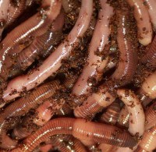
Nightcrawlers
Photo courtesy Uncle Jim’s Worm Farm
Earthworms are also called night crawlers because they are most active at night, and they tend to shy away from the sunlight, which can dry them out. Earthworms are invertebrates which means they have no skeleton. And because they have no skeleton, there are no fossils of earthworms.
Notes:
<number>

Slide 11
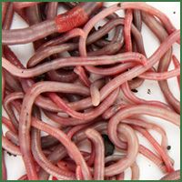
Red Wigglers
the common composting worm
Red wigglers are the variety of worm most commonly used in worm composting. They are not native to New Jersey and cannot survive outside in temperatures lower than 40 degrees.
They live in the upper layers of soil and among dead leaves on the ground, and are often found in compost or manure piles.
They are voracious eaters – they eat up to half their body weight every day. That’s why they have become a popular worm to use in making compost.

Slide 12
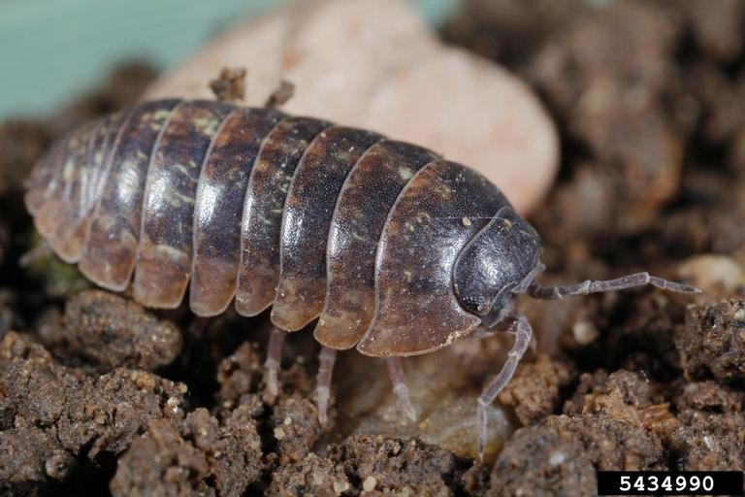
The Pillbug
Photos by Joseph Berger, Bugwood.org
Pillbugs eat dead leaves and other dead plant matter and help break down their nutrients into the soil. A pillbug is also called a doodlebug or a rolypoly because it will roll into a ball when it faces an enemy.
Notes:
<number>

Slide 13
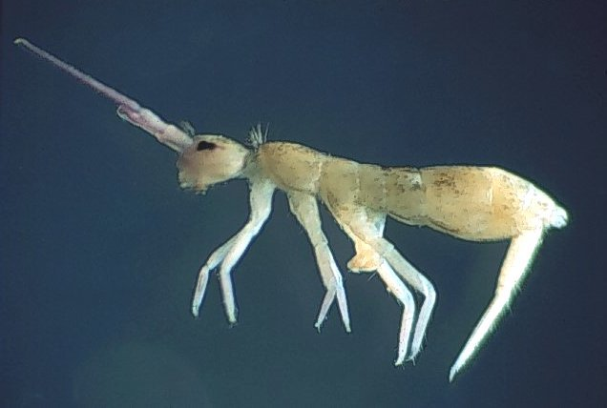
The Springtail
Springtails eat dead leaves and plant matter and help decompose them into the soil. The springtail gets its name because it can bend its tail back and jump when it is threatened.
Notes:
<number>

Slide 14
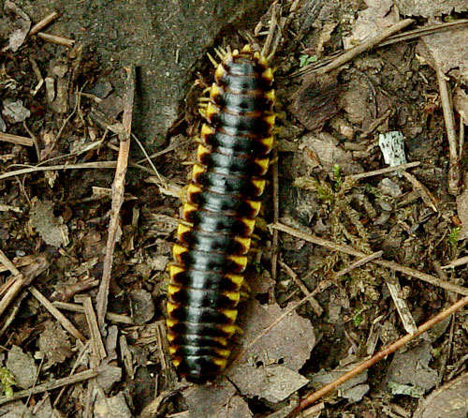
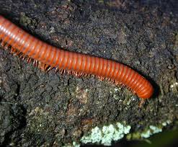
Millipedes
The millipede is another eater of dead plant matter.
Despite their name – 'milli' means thousand – they do not have one thousand legs. Millipedes have two legs per segment, or between 36 to 400 legs for the more common types.
Notes:
<number>

