Slide 1
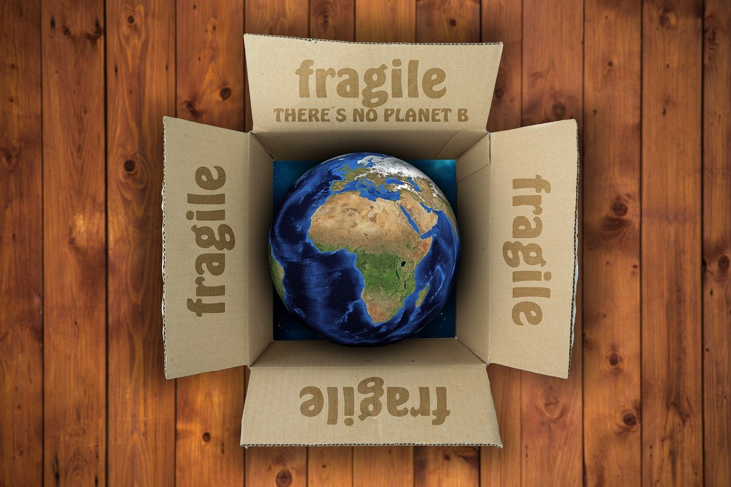
What Can You Do About Climate Change?
a presentation by

Slide 2
The Earth is Getting Hotter
The climate is changing. All over the world, in every season, it is getting hotter.
In fact, 2023 was the hottest year since records have been kept. This is called global warming.
Over thousands of years, it is normal for the climate to change, sometimes getting hotter and sometimes getting colder.
But over the last 100 years, the climate has been changing much faster than usual. And people are causing this change.

Slide 3
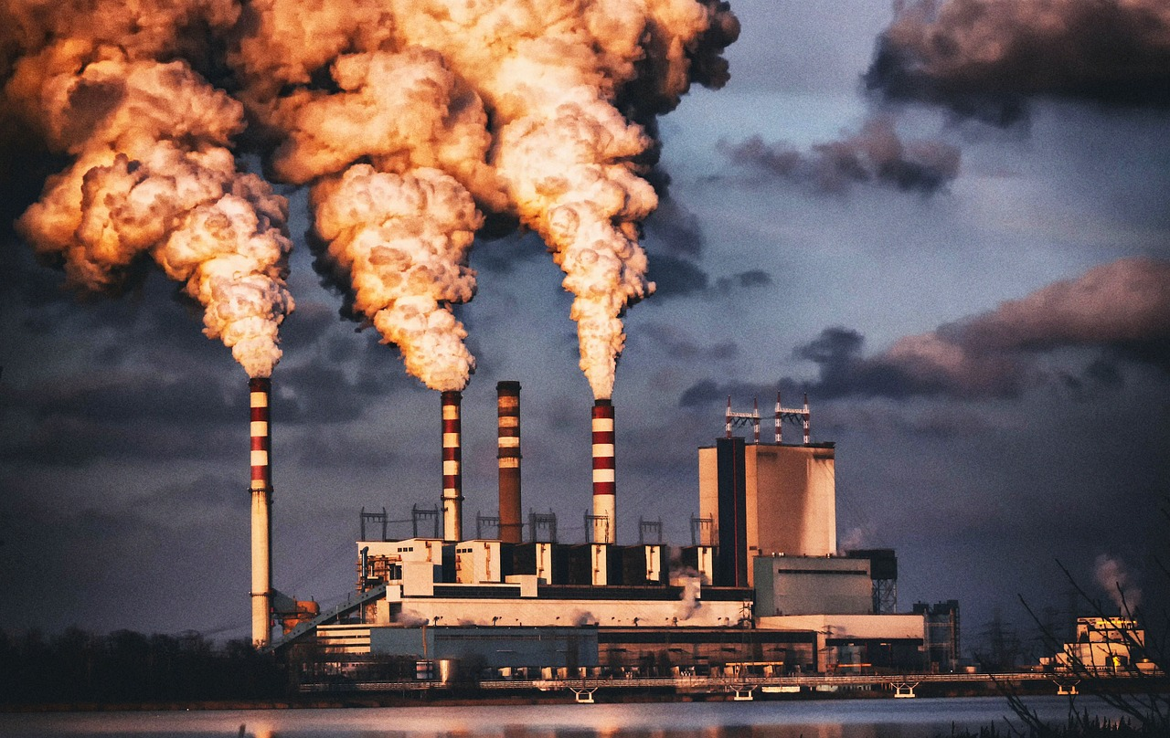
People Use A Lot of Energy
Many of the things we do today – such as plugging devices into electrical outlets, driving cars, cooling and heating our homes – require us to use energy sources such as natural gas, oil or coal.
These fuels release the carbon dioxide that is trapping heat in the Earth’s atmosphere and causing global warming.
You can do your part to help fight climate change by being careful how you use energy.

Slide 4
How Can You Use Less Energy?
If you see an open door that is letting the warm or cool air out of your home or school, you can close the door to save energy.
You can ask your parents to lower the temperature in your house a little, and you can wear a sweater to stay warm.
Open windows when possible to cool your house instead of turning on the air conditioner.

Slide 5
Kill the Vampires!
“Vampire” devices keep drawing energy even when you are not using them.
If they are plugged in, your phone charger, laptop, and gaming console all keep sucking electricity out of the outlet even when they aren’t being used.
You can save energy and slay the vampires by unplugging these devices when you are not using them.
Search around your house for the vampires that are sucking power. Your parents will thank you, because using less power means lower utility bills.

Slide 6
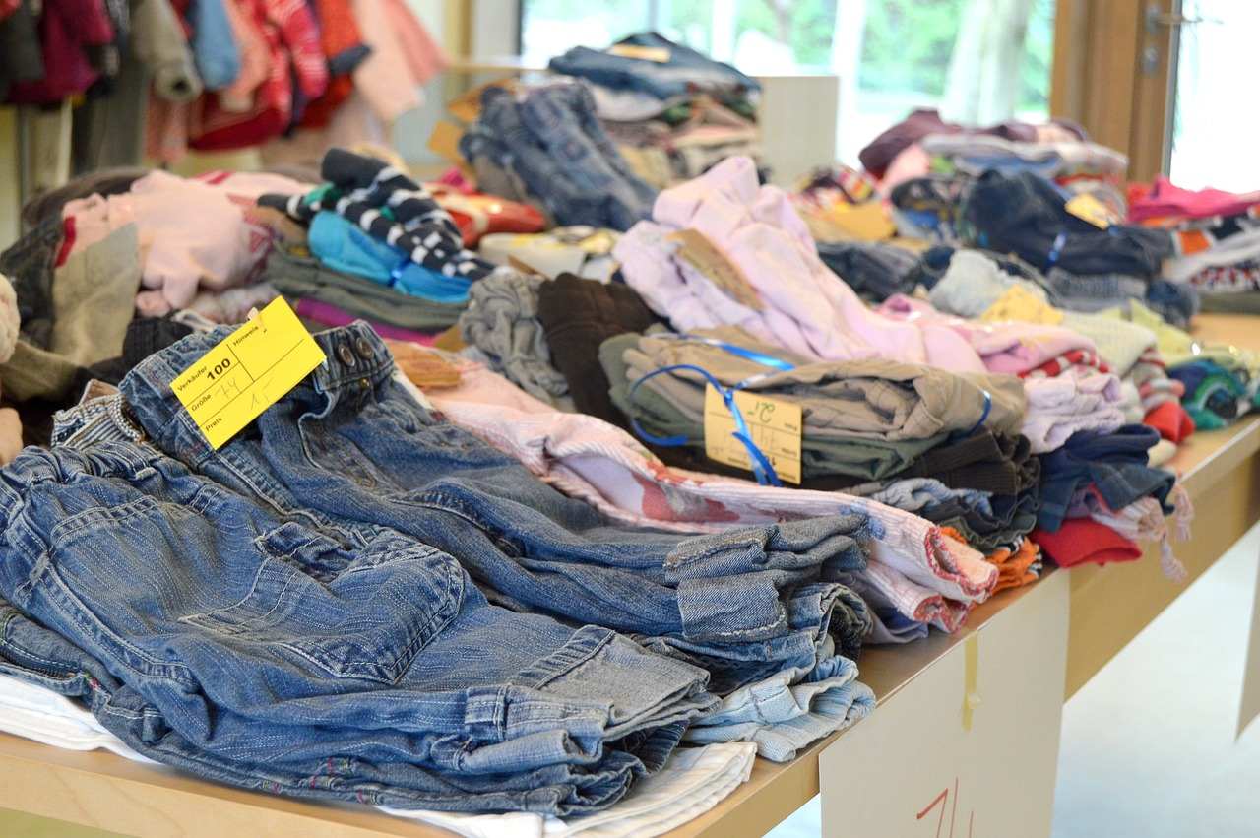
Reduce, Reuse, Recycle
Factories that make all of our new clothes, toys, and appliances release a lot of carbon dioxide into the air, helping to cause the greenhouse effect.
Whenever possible, recycle your old clothes and toys by giving them away or donating them to an organization that will sell them or pass them on.
Ask your parents if you can check out the local shops that sell used toys or clothing instead of buying everything brand new.

Slide 7
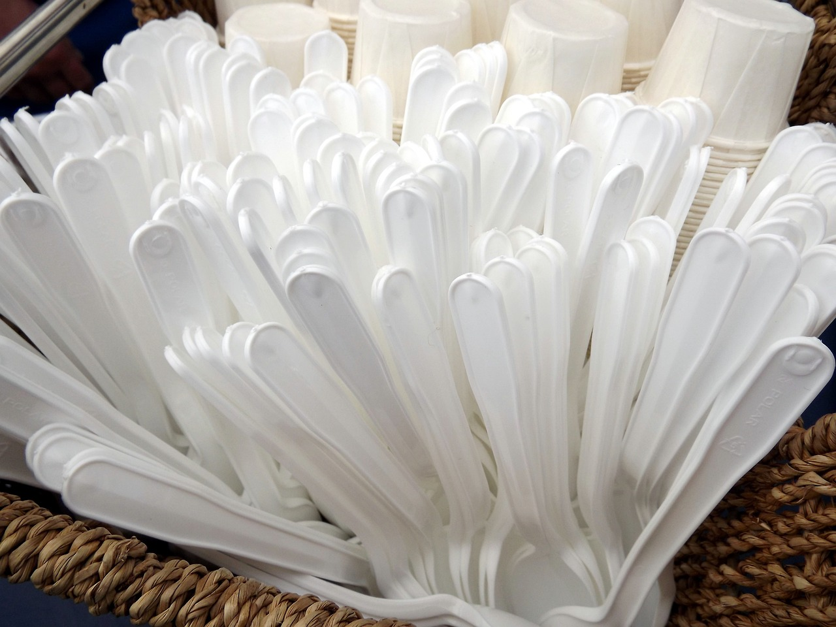
Put Less in the Trash
Try to avoid single-use plastics – plastic spoons, straws, plates, or bags that you use only once and throw away.
Recycle paper, glass, metal, and plastic whenever you can.

Slide 8
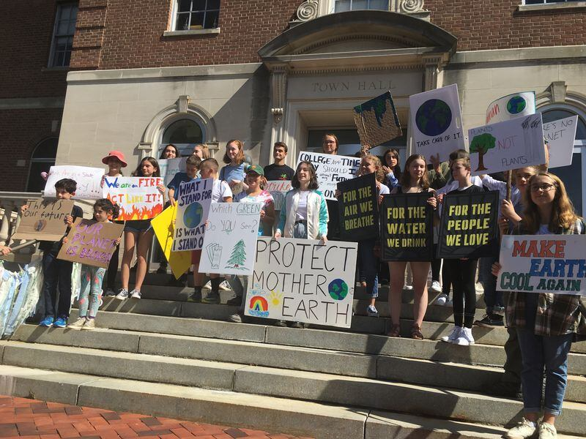
Spread the Word – People Can Stop Global Warning!
It is important that everyone understands the impact of climate change and what they can do to stop it.
Talk to your classmates and teacher about climate actions you can take. You might start a recycling program at your school, or a drive to collect used clothing or toys.
Or you could write to your elected officials, asking them to take actions to reduce the amount of greenhouse gases released into the atmosphere.
Photo courtesy nj.com

Slide 9
Climate change is everyone’s problem, but together, we can stop it!

