Slide 1
New Jersey Farming and Climate Change
a presentation by

Slide 2
The Earth is Getting Hotter
The climate is changing. All over the world, in every season, it is getting hotter.
In fact, 2023 was the hottest year since records have been kept. This is called global warming.
Over thousands of years, it is normal for the climate to change, sometimes getting hotter and sometimes getting colder.

Slide 3
People Are Causing Faster Climate Change
But over the last 100 years, the climate has been changing much faster than usual. And people are causing this change.
We burn fuel to power factories, cars, and planes, and to supply electricity to our homes and schools.
When we burn fuel, gases are released into the Earth’s atmosphere, where they are trapped, causing the Earth to become hotter.
This is called the greenhouse effect.

Slide 4
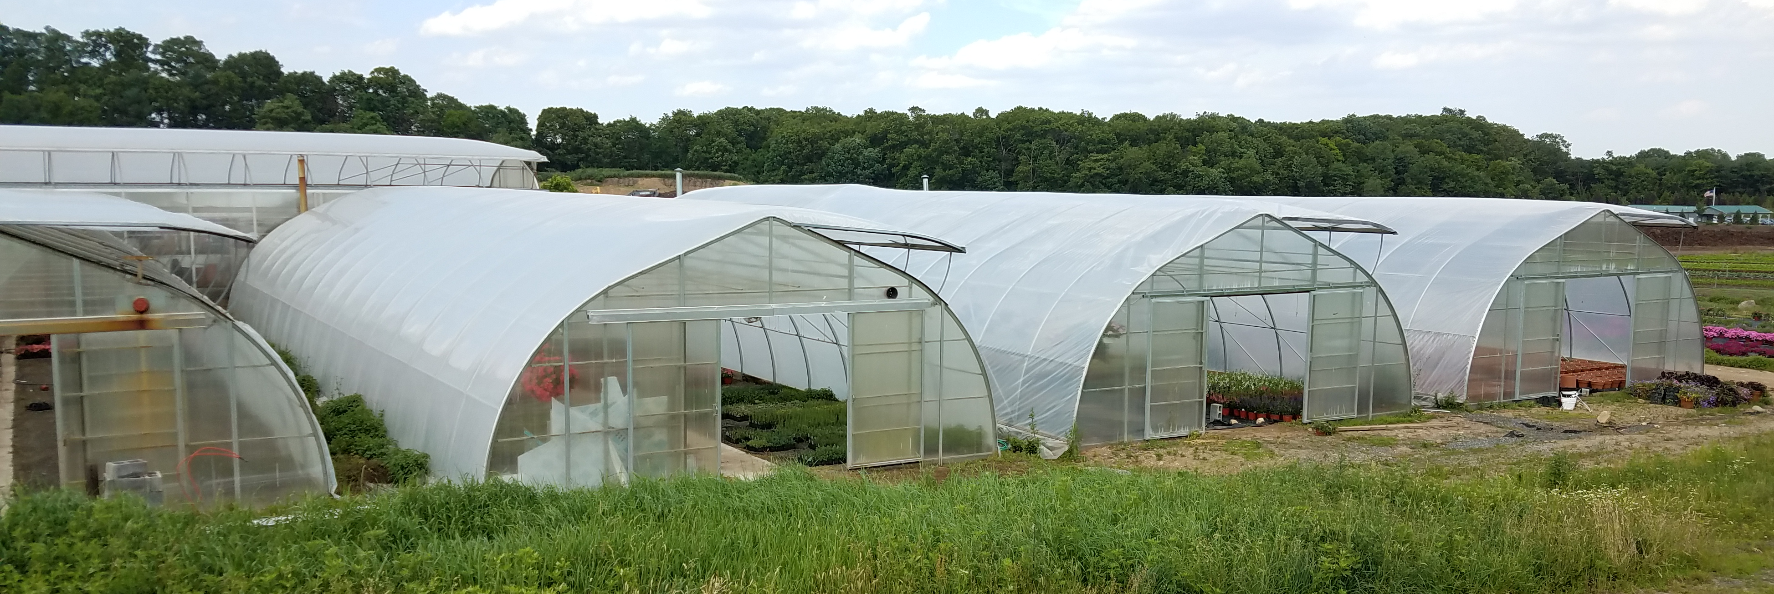
The Greenhouse Effect
The atmosphere surrounding Earth is a layer of gases that blocks heat from escaping and keeps the Earth warm for people, animals, and plants to live. This is called the greenhouse effect.
These gases keep Earth warm just like the glass in a greenhouse traps heat to keep plants warm.

Slide 5
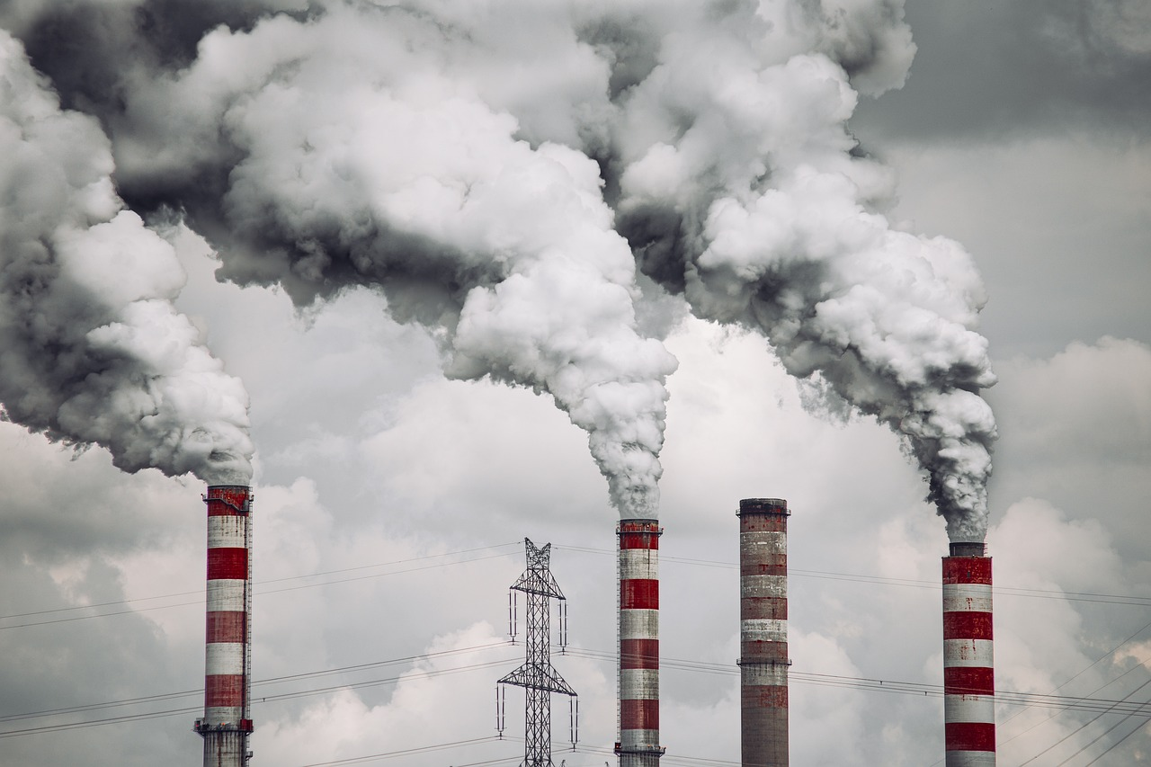
Gases from fuel are heating up the Earth
As people use more and more fuel to power all of the machines in our lives, this natural greenhouse effect has been changing.
The fuel we use – coal, oil, and natural gas, – is releasing more and more gases into the atmosphere.
This causes the atmosphere to trap more heat than usual, making the Earth warmer.

Slide 6
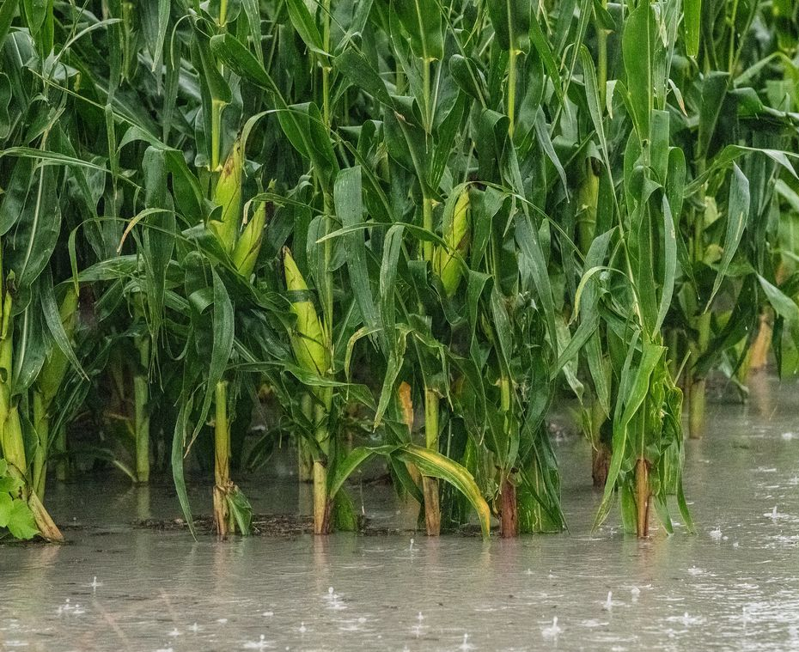
Hotter Air Causes
More Extreme Weather
Air temperatures near Earth's surface have gone up about 2°F in the past 100 years.
In fact, the past five years have been the warmest years in centuries.
Photo courtesy USDA
Two degrees may not sound like much, but this increase can cause big changes.
Storms such as hurricanes become stronger, bringing more rain in a shorter amount of time. This causes flooding.

Slide 7
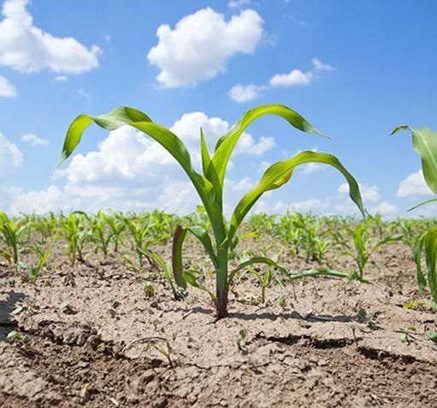
More Heat Also Means Dryer Weather
Droughts and heat waves are also expected to become more intense as the climate warms.
Sea levels rise as the ocean water warms and the ice in glaciers melt.
These changes in climate have a big impact on the farms where our food is grown.
Photo courtesy USDA

Slide 8
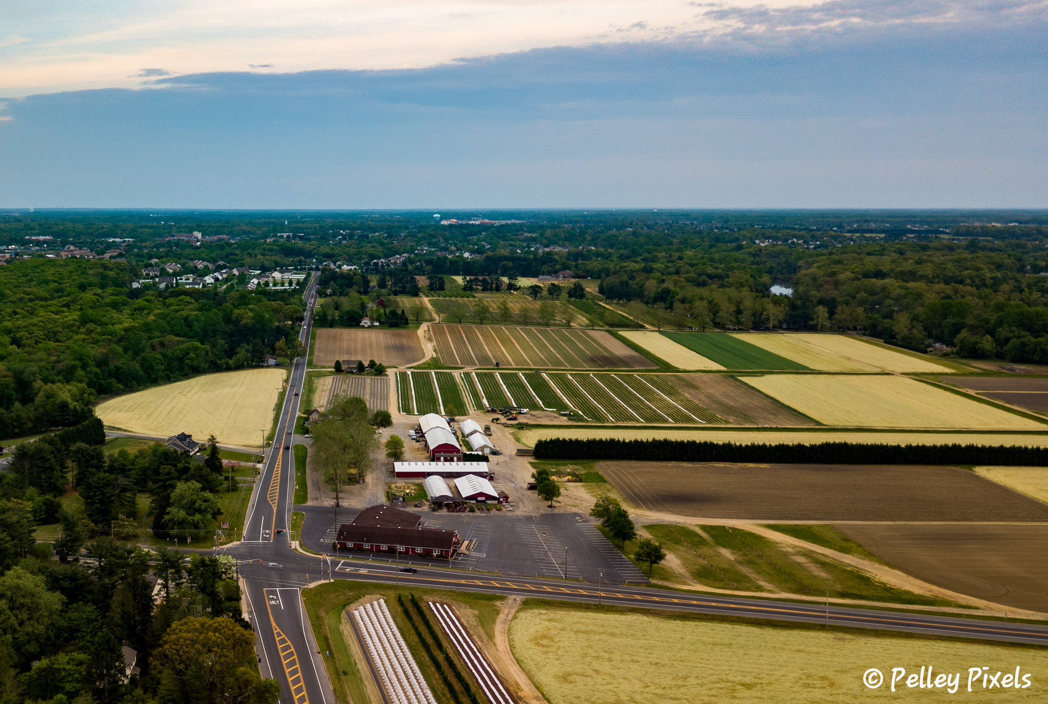
Farming is a Big Business in New Jersey
New Jersey is called the Garden State because of the 100 different kinds of fruits and vegetables that are grown here.
There are 9,000 farms in New Jersey. In fact, agriculture is New Jersey’s third largest industry. Agriculture is another word for farming.
Plants need the right amount of sun and water to grow, so changes in the climate can make big difference in whether farmers can grow crops successfully.

Slide 9
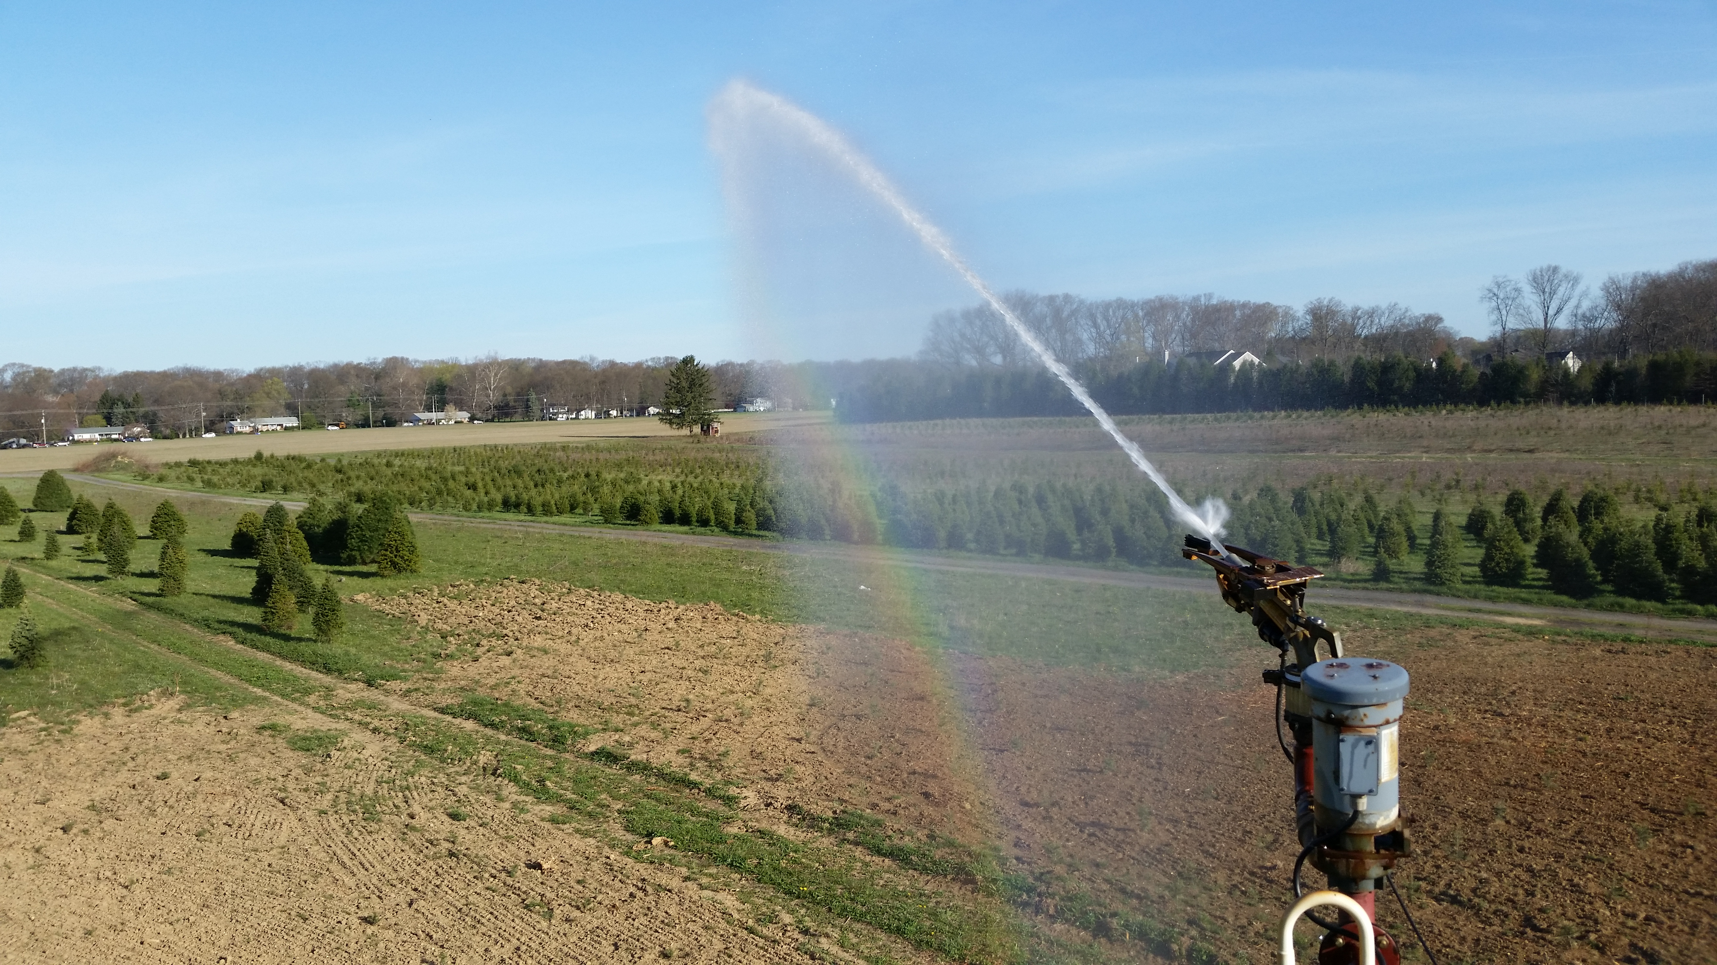
What Does Climate Change Mean for New Jersey Farmers?
Too little water
Temperatures in New Jersey are climbing even faster than the world as a whole, rising 4°F since the year 1900. And 2023 was the hottest year on record.
Warmer weather causes more heat waves, when the temperature reaches 90°F or warmer for 3 days or more in a row.
Higher temperatures also bring more periods of drought, which is when there is no rain for an unusually long time.
When summers become hot and dry in New Jersey, plants struggle to survive and farmers have to spend more money to water their crops by setting up long pipes in fields. This is called irrigation.

Slide 10
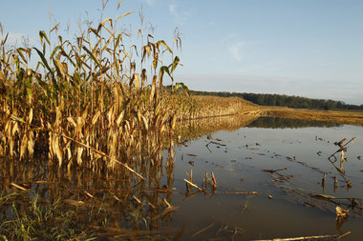
And too much water
When temperatures are higher, more water evaporates into the atmosphere. This causes storms to develop that are stronger than normal.
The wind that these storms bring can damage crops in the fields.
The storms also bring heavier rain in a shorter amount of time. This increased rainfall can flood fields. It can also cause the nutrient-rich topsoil, which plants need to grow, to erode – or run off – into streams and rivers.
Photo courtesy nj.com

Slide 11
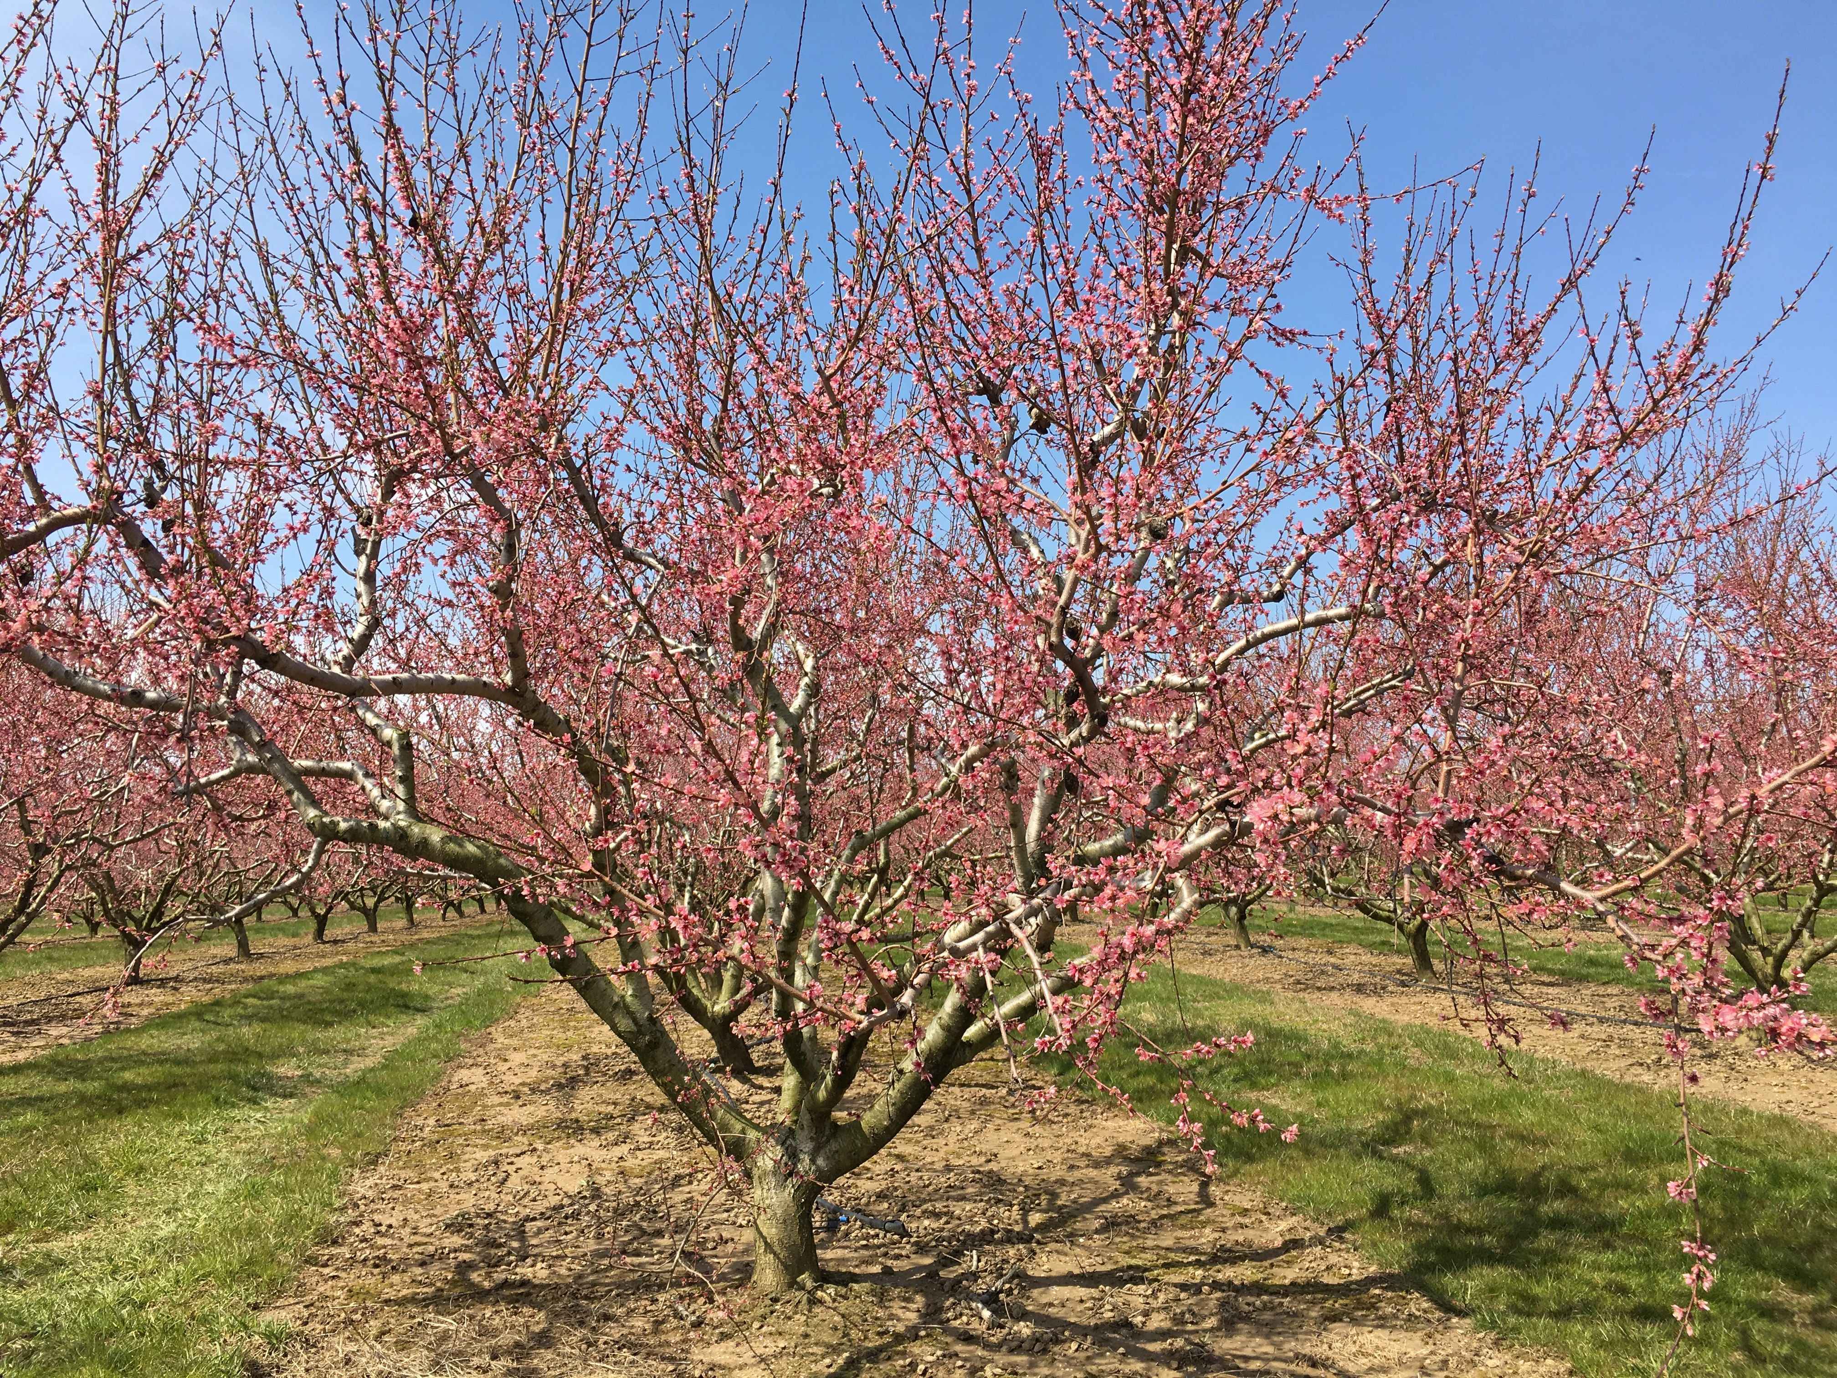
Warmer Weather Means Trouble for Fruit Crops
A warming climate also means that temperatures are warmer in the winter. That can be a problem for the fruits that grow in New Jersey.
Peaches, blueberries and cranberries are major crops in this state. All three of these fruits need what is called chilling time before the tree will blossom in the spring.
Without blossoms, a plant cannot produce fruit.
Peach trees in bloom.

Slide 12
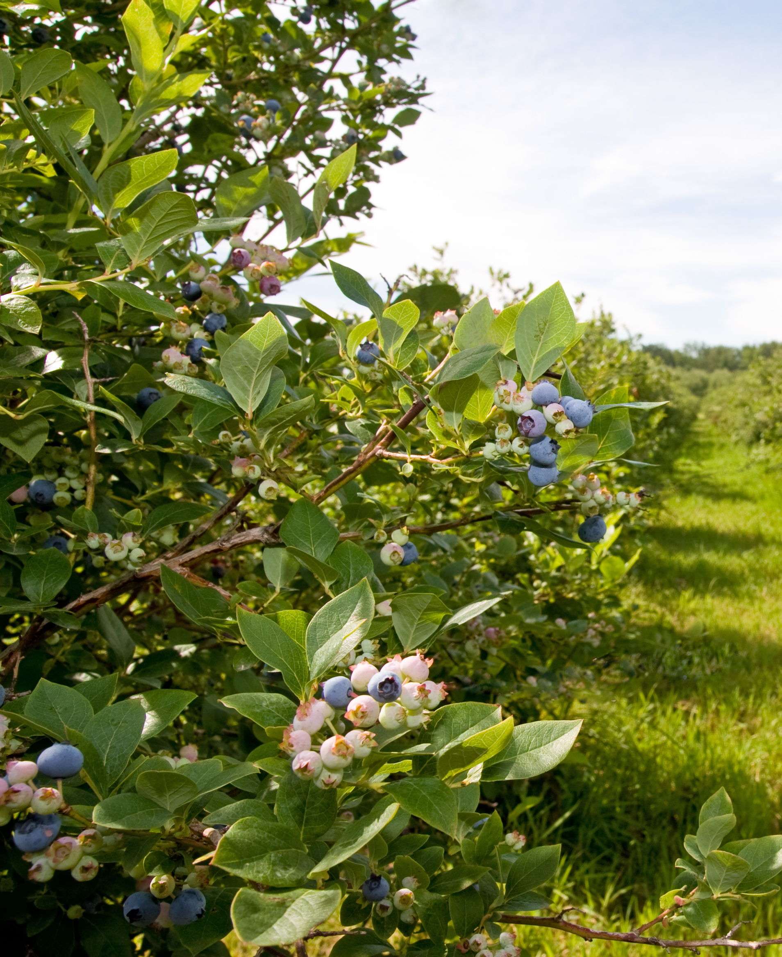
No cold, no fruit!
Chilling time is a period of time when the temperature is lower than 45°F and higher than the freezing temperature of 32°F. The scientific word for chilling time is vernalization.
Peach trees need 800 hours of chilling time. Blueberry bushes need 500 hours and cranberry vines need to chill for at least 1,500 hours.
If the fruit plants don’t have these vital low temperatures, they will not produce fruit the following year.

Slide 13
Crazy spring weather is tough on flowers
In the spring, fruit trees and bushes begin to flower. After the flowers are pollinated by bees, they begin growing into fruit with seeds inside.
When the climate is changing, spring weather can be dangerous for flowering fruit plants because there can be wild swings in temperatures.
You may be wearing a sweatshirt on a warm day in March, and the next week, you may need your heavy winter coat.
Blueberry blossoms
Cranberry blossoms

Slide 14
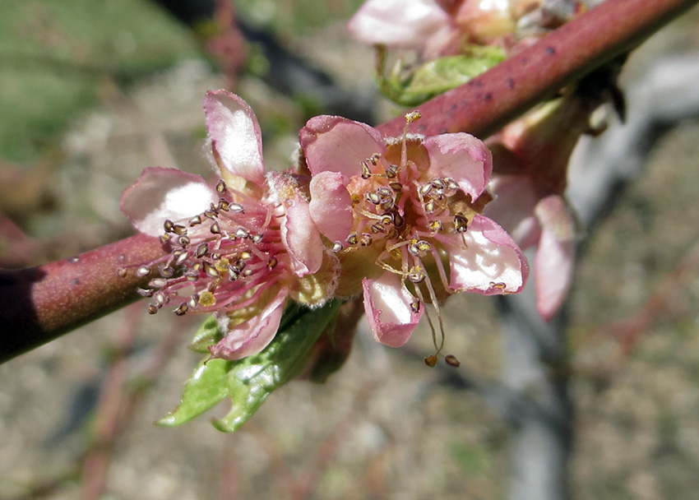
Brrr, Flowers Don’t Like the Cold!
An unusual period of warm weather in February or March will signal the fruit trees and shrubs to begin growing flower buds.
If that warm weather is followed by a period of freezing temperatures, those new buds will die, and the plants will not grow any fruit that year.
Fruit blossoms cannot survive in freezing temperatures. A sudden drop in temperature will kill blossoms on a cranberry vine or a blueberry bush.
Frost damaged peach blossom
photo courtesy Utah State University Extension

Slide 15
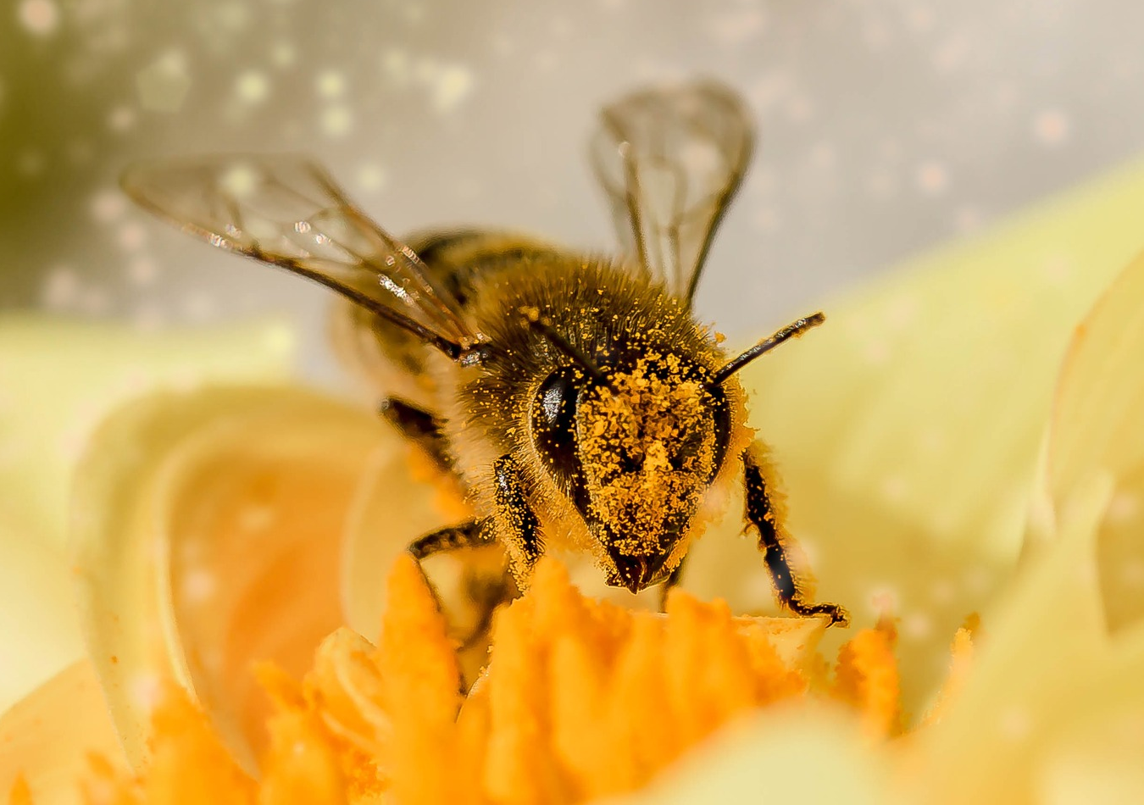
All Fruit Crops
Need Bees
In order for peach trees, blueberry bushes, or cranberry vines to grow fruit, their flowers must first be pollinated by bees.
Pollination happens when bees transfer pollen from one flower to another. Without pollination, plants will not produce seeds or fruit.

Slide 16
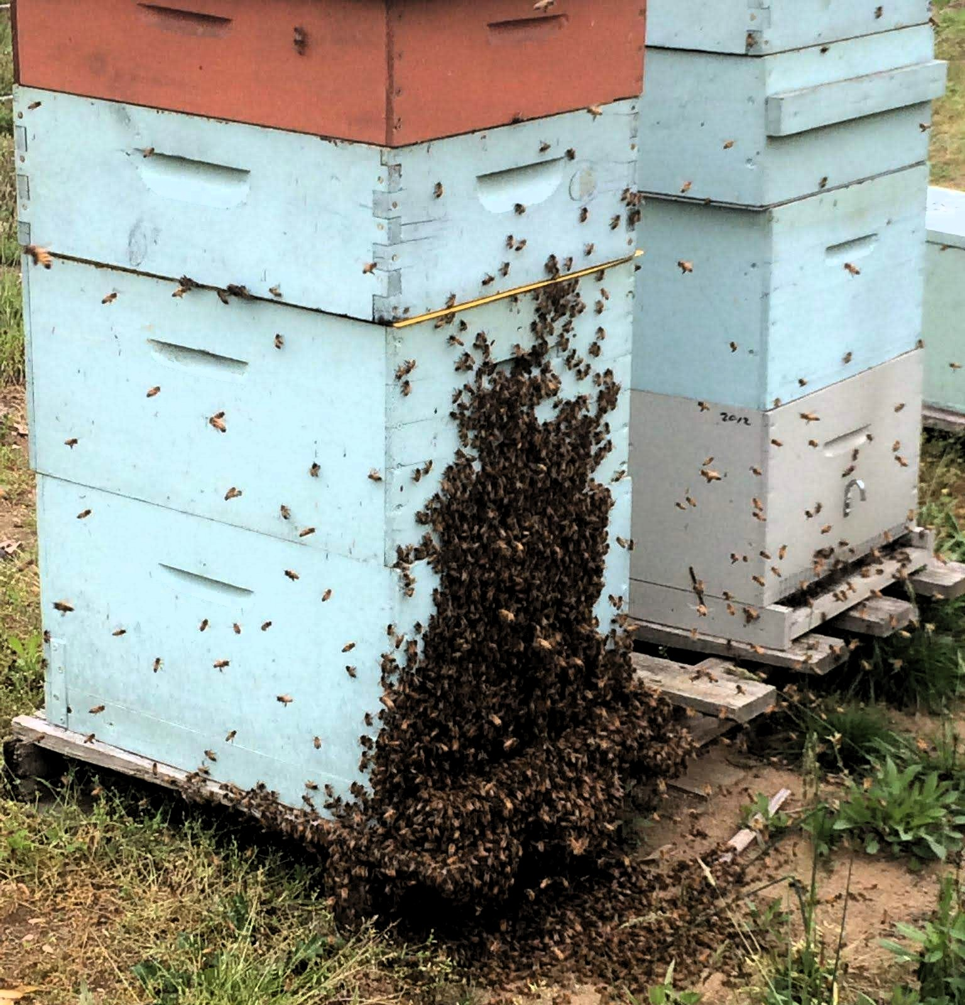
Beekeeping is a Big Business
Fruit crops need a lot of bees. It takes bees from 18,000 bee hives just to pollinate all of New Jersey’s blueberry fields.
To make sure all their fruit crop is pollinated, farmers hire beekeepers to bring large boxes of bee hives to their fields.
They sit these hives beside the fields. The bees collect nectar and pollen from flowers, pollinating the crop at the same time.
Beekeeping is a big business. Many beekeepers travel all over the country, taking their bees to fields where crops are flowering.
Beekeepers move boxes like these
filled with bee hives from field to field.

Slide 17
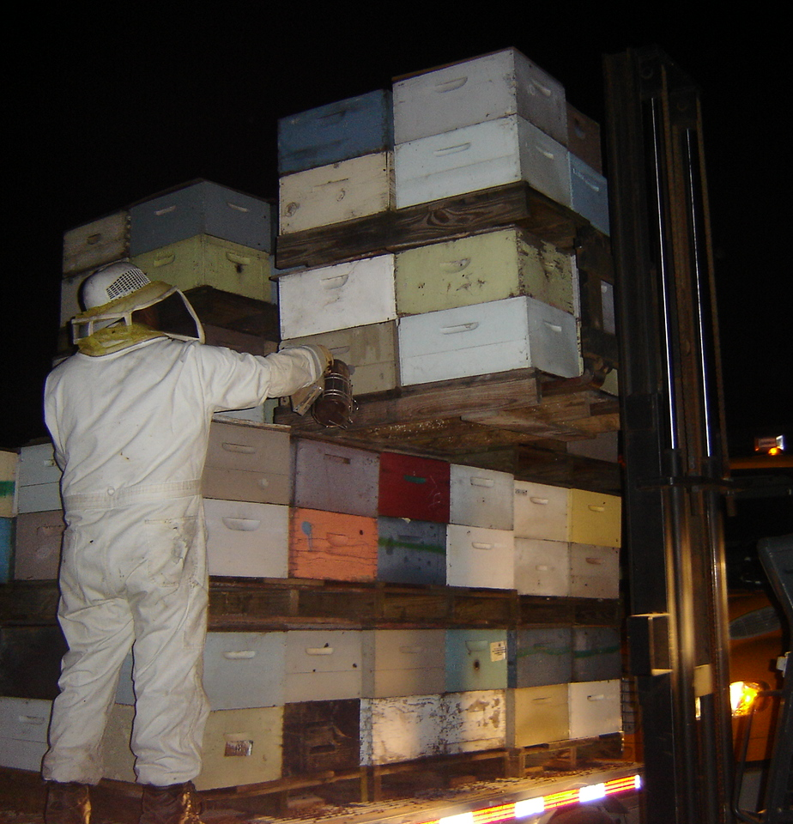
But Where Are the Bees?
Changes in weather due to climate change can cause problems with the beekeepers’ travel schedule.
Because of unusually warm spring weather in 2023, one type of New Jersey blueberry began to bloom too early.
Most commercial bee hives were in California at the time, pollinating the almond trees there.
There were not enough bees available to pollinate the early-blooming blueberry bushes, so fewer blueberries were harvested from that crop.
Beekeepers move their hives at night, when the bees are resting.

Slide 18
Watch out for warm weather bugs!
Warmer weather throughout the year means that harmful insects that feed on crops are active longer and may survive winter in greater numbers.
Rising temperatures also encourage insect pests, weeds, and plant diseases that are usually found only in the South to move north into New Jersey.

Slide 19
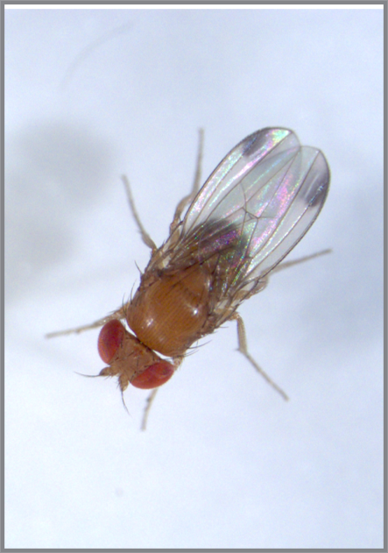
A Blueberry Enemy
Take for example, the spotted wing drosophila, an insect that lays its eggs on blueberries.
When its larva hatch, they feed on the berries and cause much damage to the crop.
The spotted wing drosophila is not native to New Jersey and normally would be dormant in the cold winter months.
But as winters become warmer, these flying pests emerge earlier in the spring.
Cesar Rodriguez-Saona
They can lay eggs a number of times throughout the growing season, causing more and more damage to blueberry crops.
To combat these pests, farmers have to spray their blueberry fields more often with insecticide, which costs farmers more money and is not good for the environment.

Slide 20
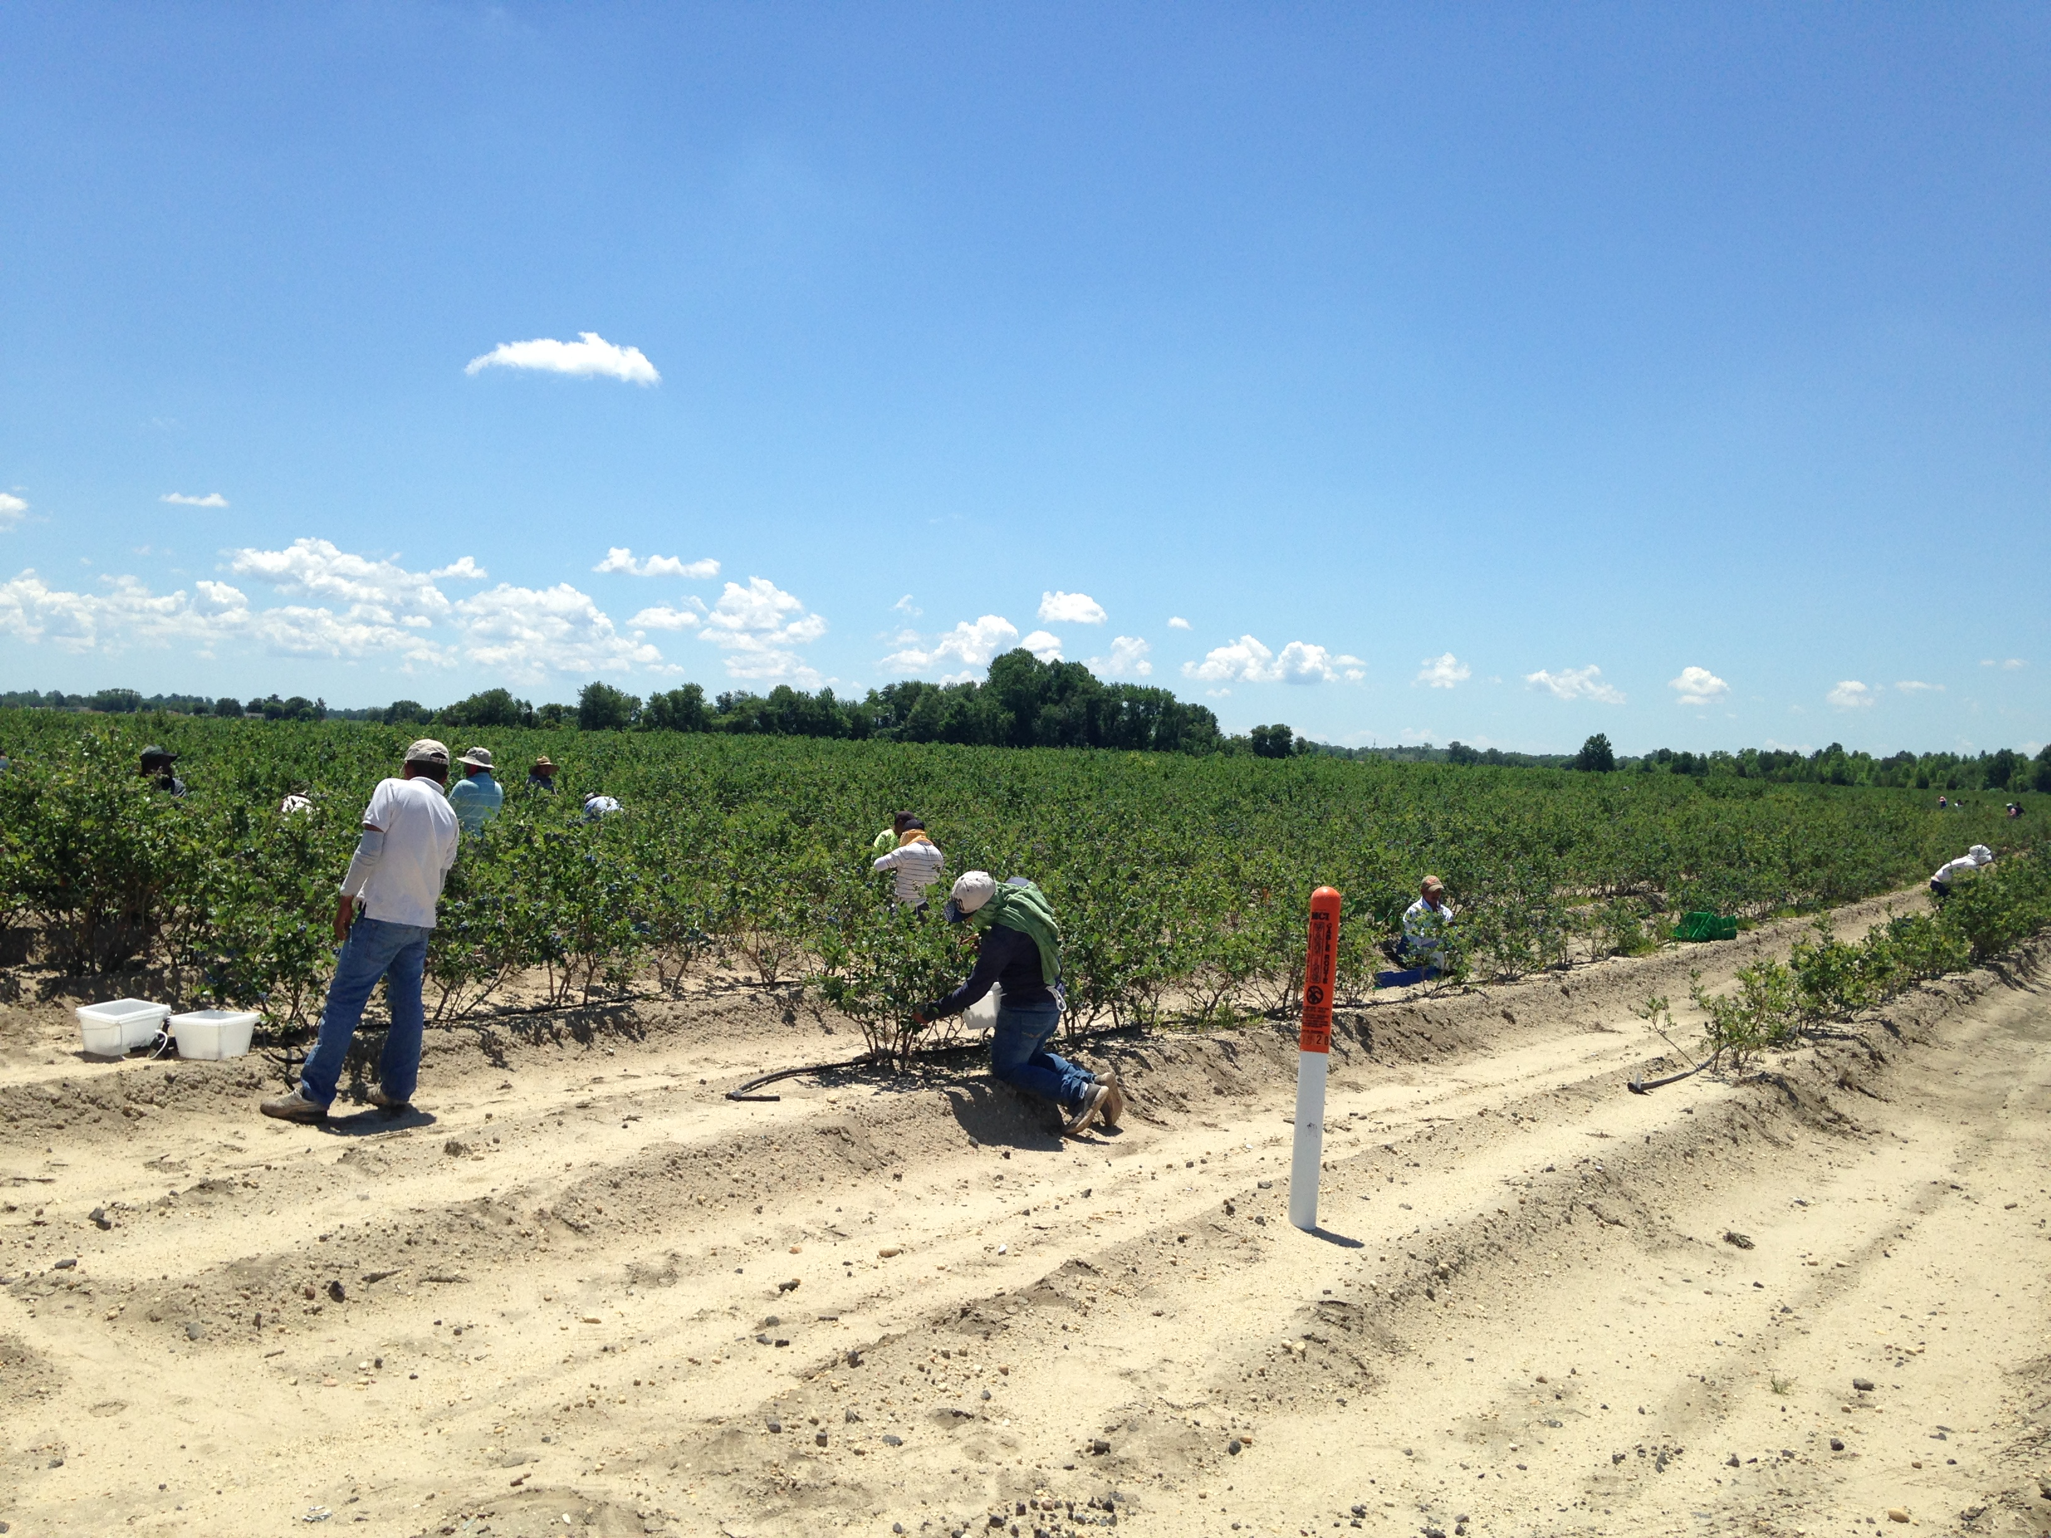
Be Careful People, It’s Hot Out There
Hotter weather makes it more difficult for farm workers to work outside, tending the crops and picking the harvest.
People can become sick from working outside in extreme heat if they are not careful.
Workers must drink a lot of water, cover their skin, and take many breaks if they must work in the high temperatures of a heat wave.

Slide 21
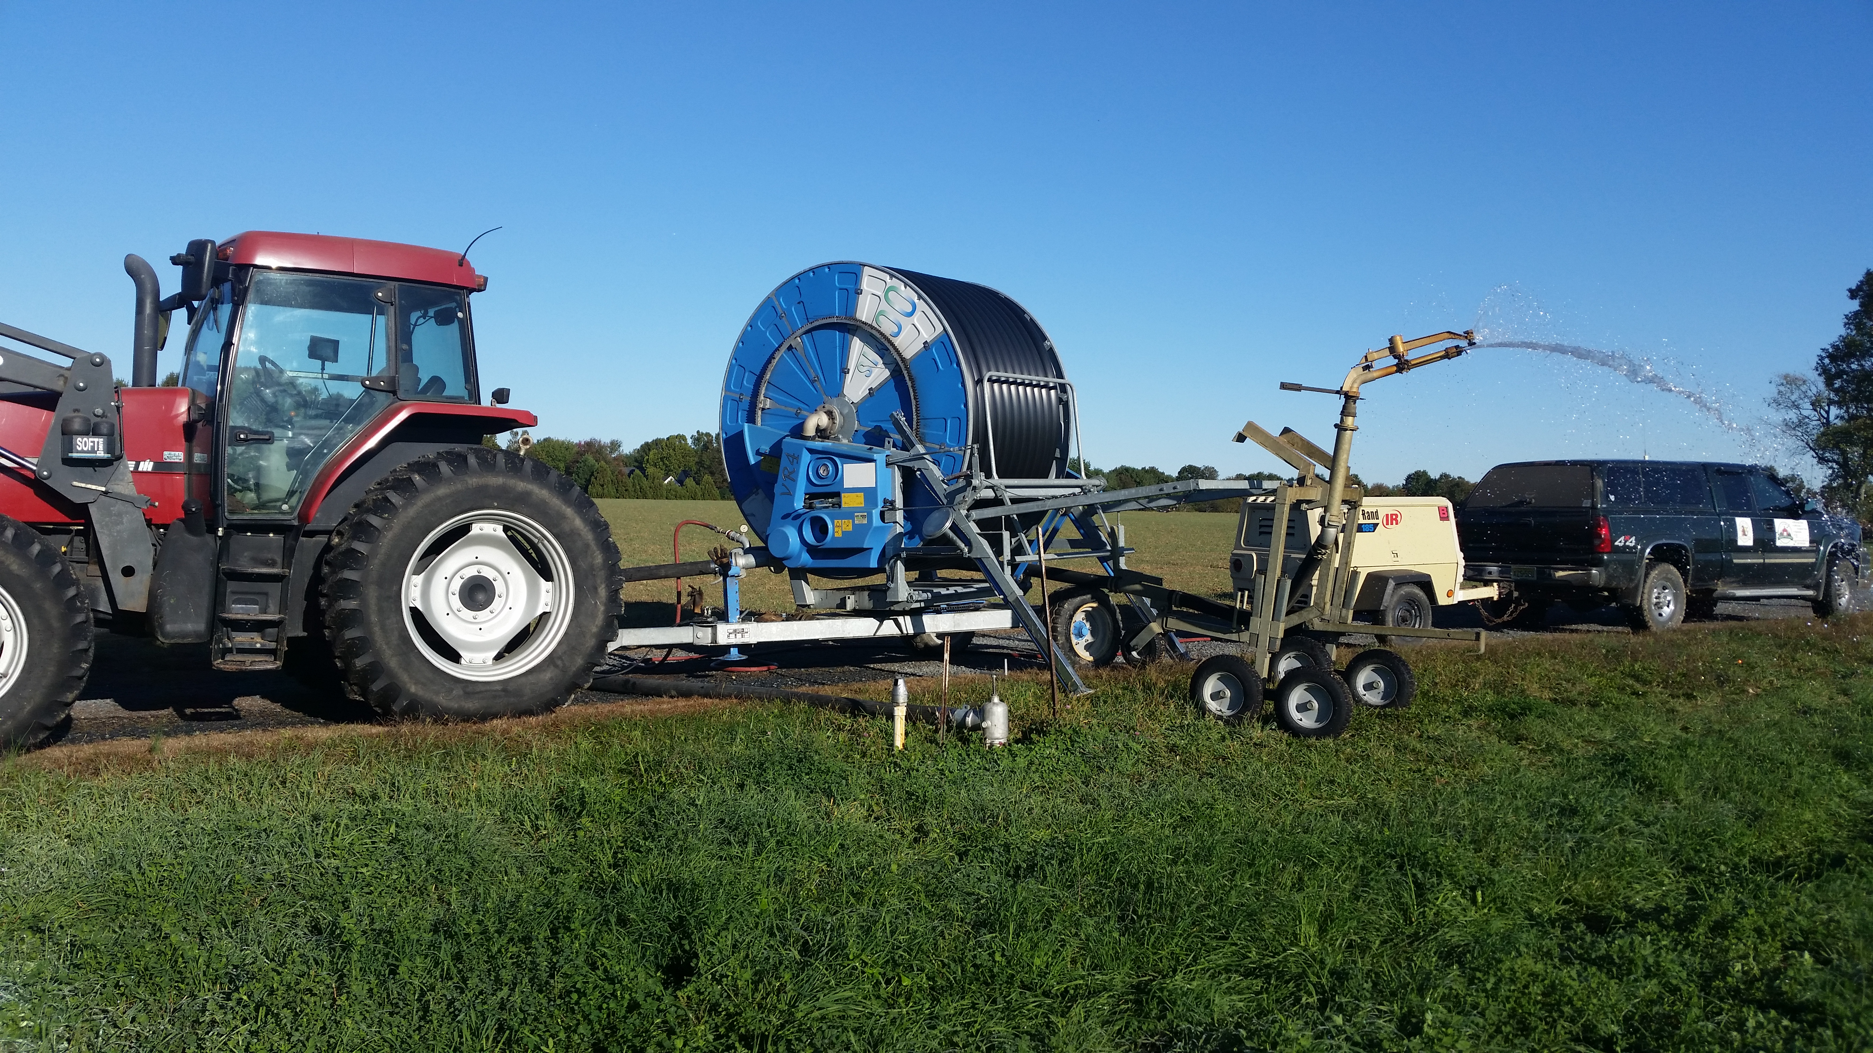
How Do
New Jersey Farmers
Adapt to
Climate Change?
Climate change is changing the weather in New Jersey and farmers have to adapt to these changes to keep their crops alive. Adapt means to change your actions to live and thrive in a new situation.
New Jersey summers are becoming hotter, with some long periods without any rain. Farmers have to irrigate by setting up long pipes to bring water to their fields.

Slide 22
Cover Those Plants
It’s Cold Outside!
Farmers have to work to keep the fragile flowers of fruit crops alive if temperatures drop to freezing.
They cover fruit crops on the ground with plastic to keep them warm.
And they set up wind machines or fans to keep flowers on trees and bushes warm. These machines mix cold air close to the ground with warmer air above. They blow the warm air on the blossoms to keep them from freezing.

Slide 23
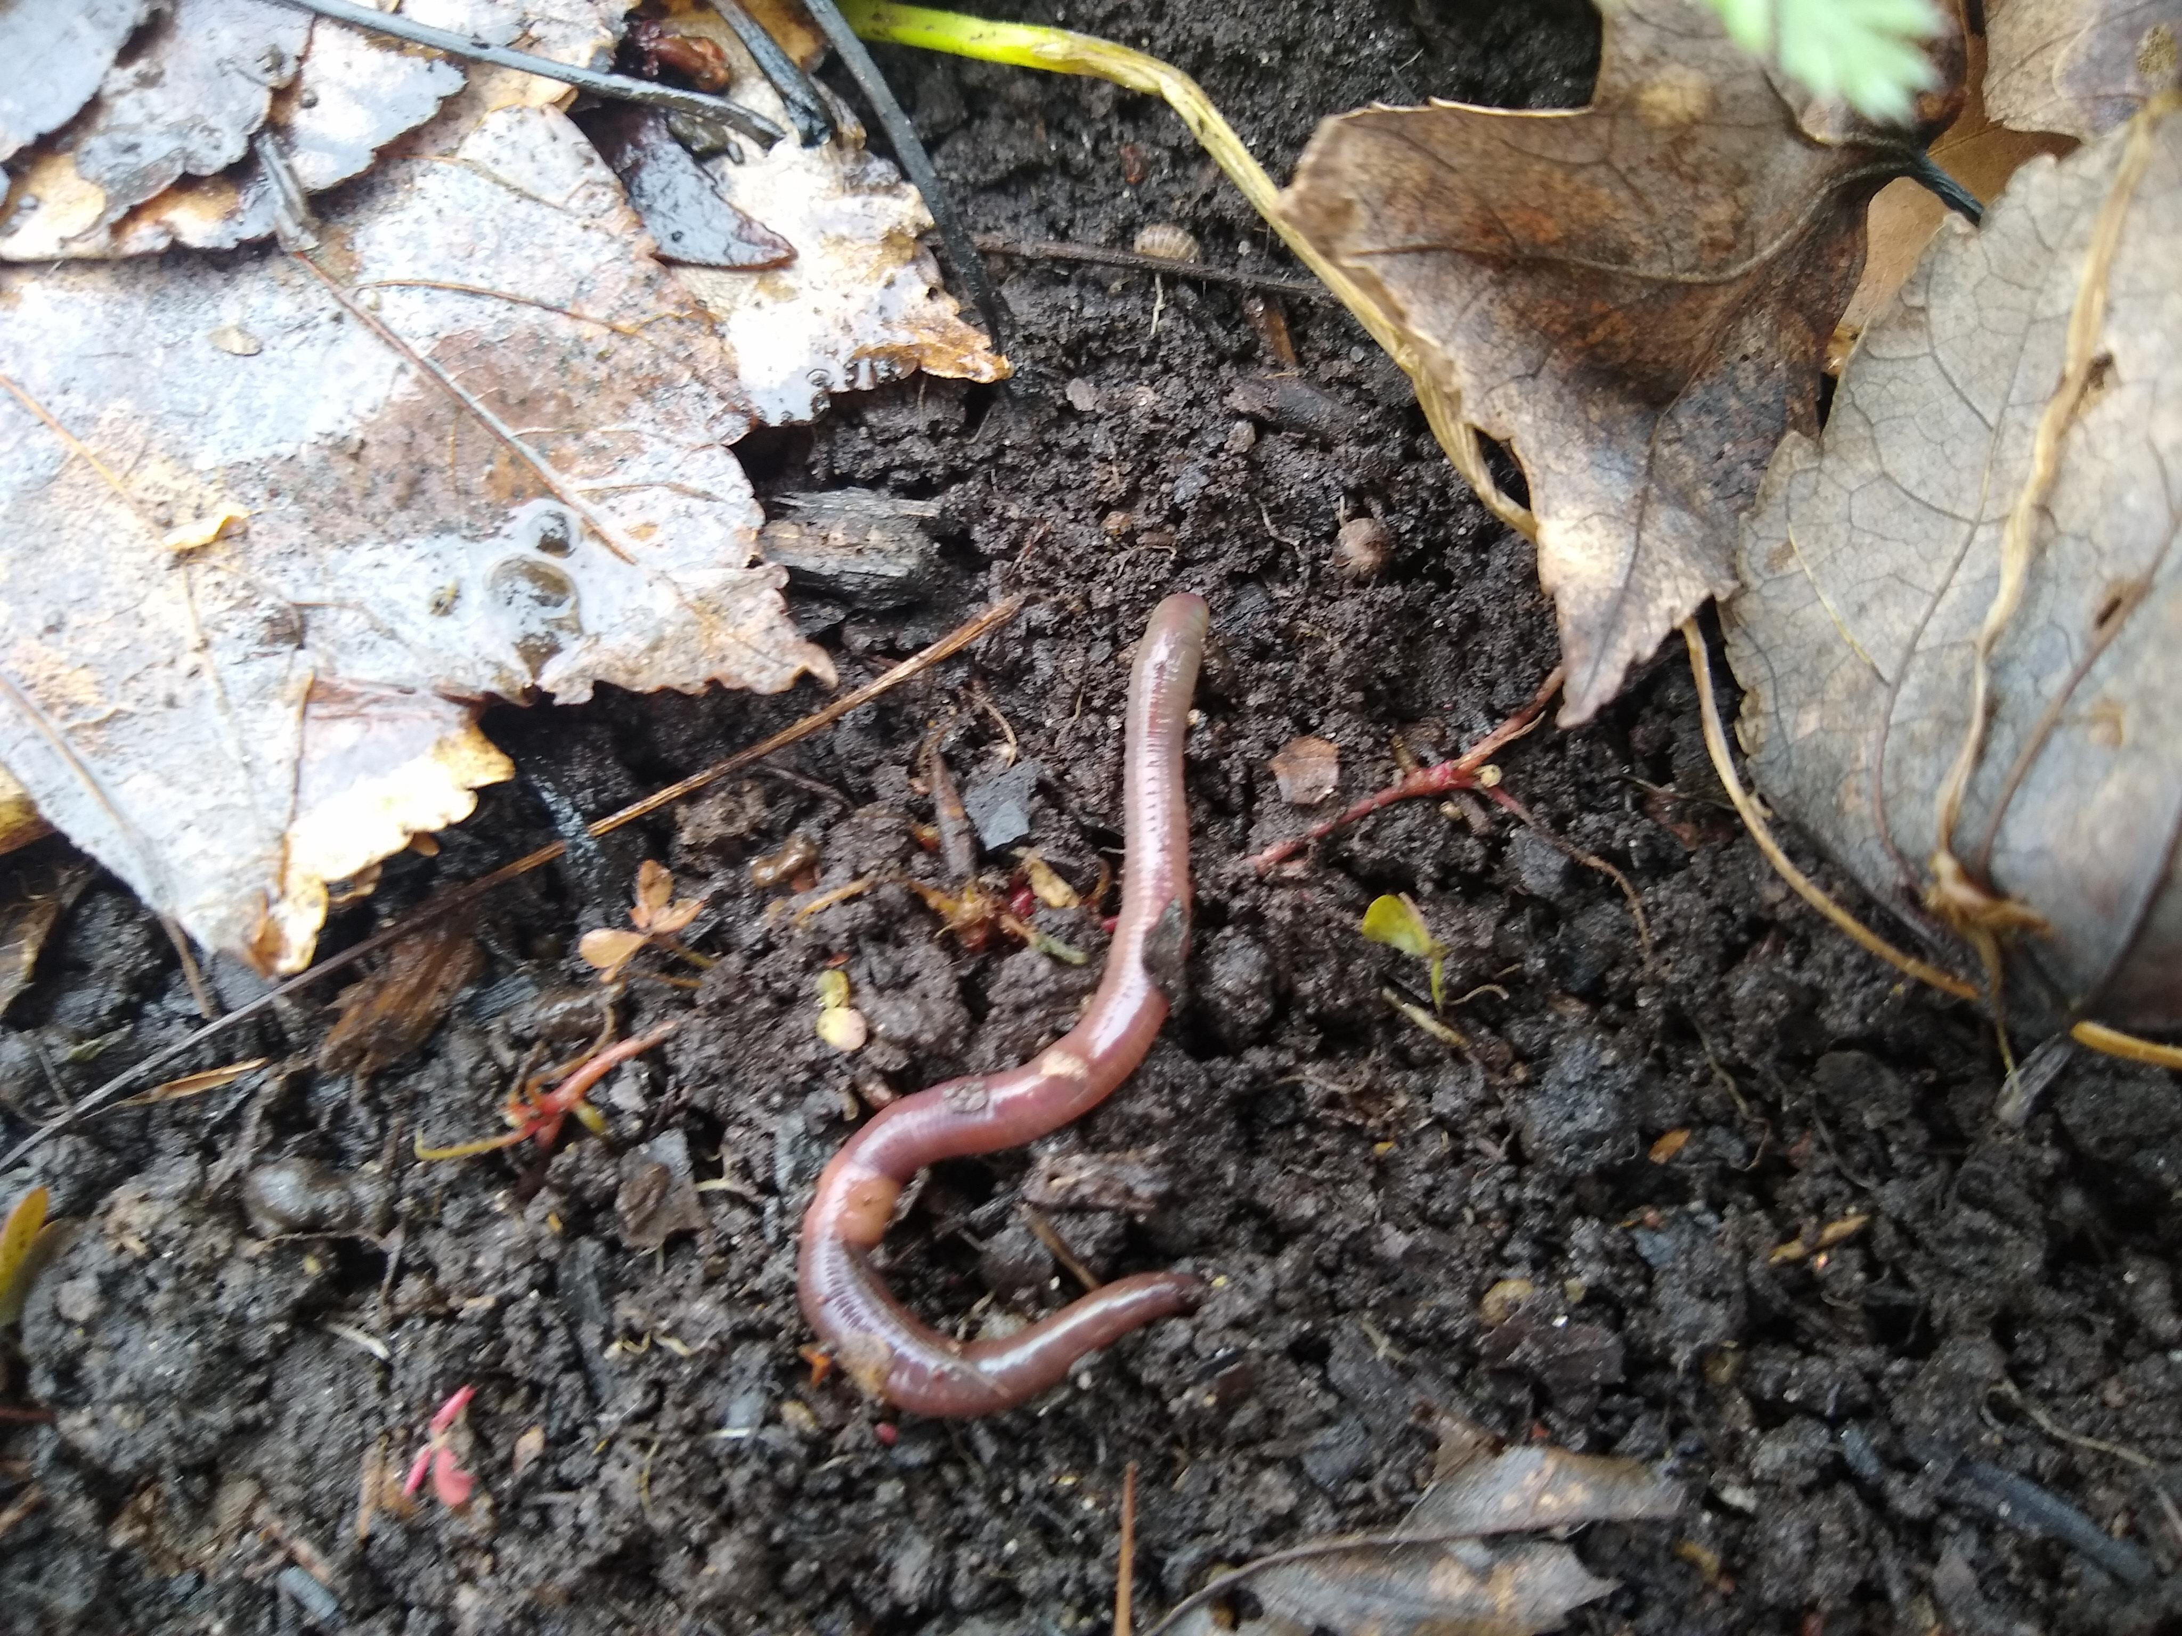
Healthy Soil is Important in a Changing Climate
As the climate changes, farmers work to improve the health of their soil.
Healthy soil is filled with living creatures called decomposers.
Some of these decomposers are bacteria and fungi that are so small that you can only see them with a microscope, Others, like worms, are easy to spot.
All of these decomposers feed on dead plants and animals in the soil. They then release important nutrients back into the soil.
Plants need these nutrients, such as nitrogen, phosphorus, and potassium, in order to live and grow.

Slide 24
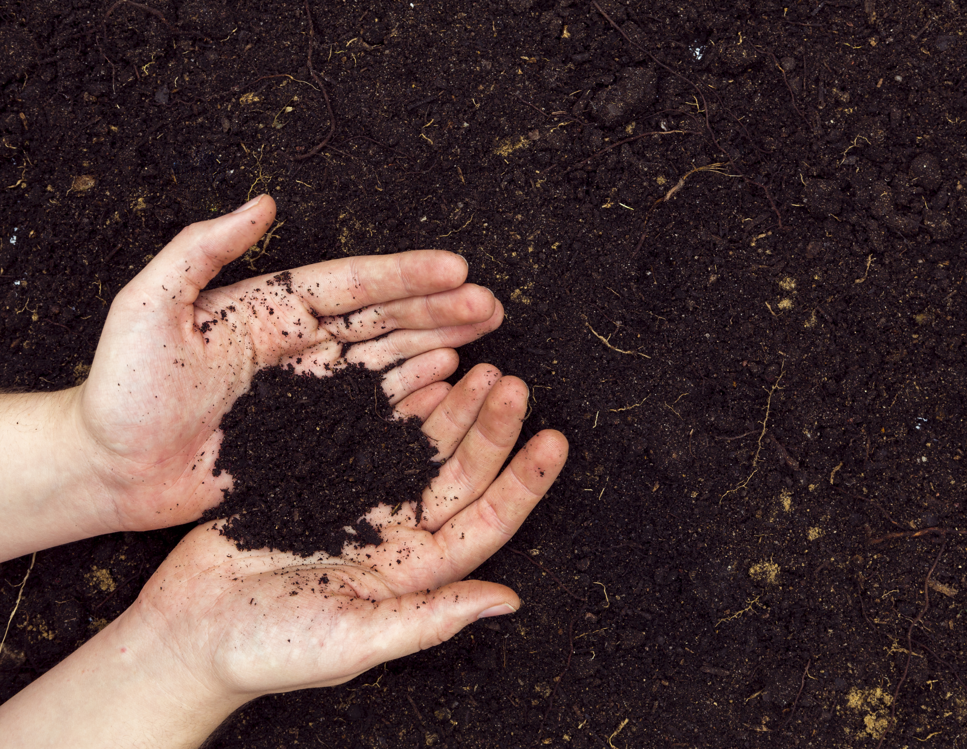
Farmers Work to Keep the Soil Alive and Well
Soil filled with decomposers that provide nutrients for plants is healthy soil. This type of soil is an ecosystem, a community of living things.
Healthy soil can hold onto more water during droughts and can soak up more water during heavy rains.
When farmers use a plow to turn over the soil in the field, it breaks up the soil’s ecosystem and makes the soil weaker.
To improve the health of their soil, many farmers do not plow their fields or just plow a little. This is called no-till or low-till farming.
Some farmers plant what’s called a cover crop in winter when the fields are normally bare, so that the healthy soil on top won’t run off - or erode - during winter storms.

Slide 25
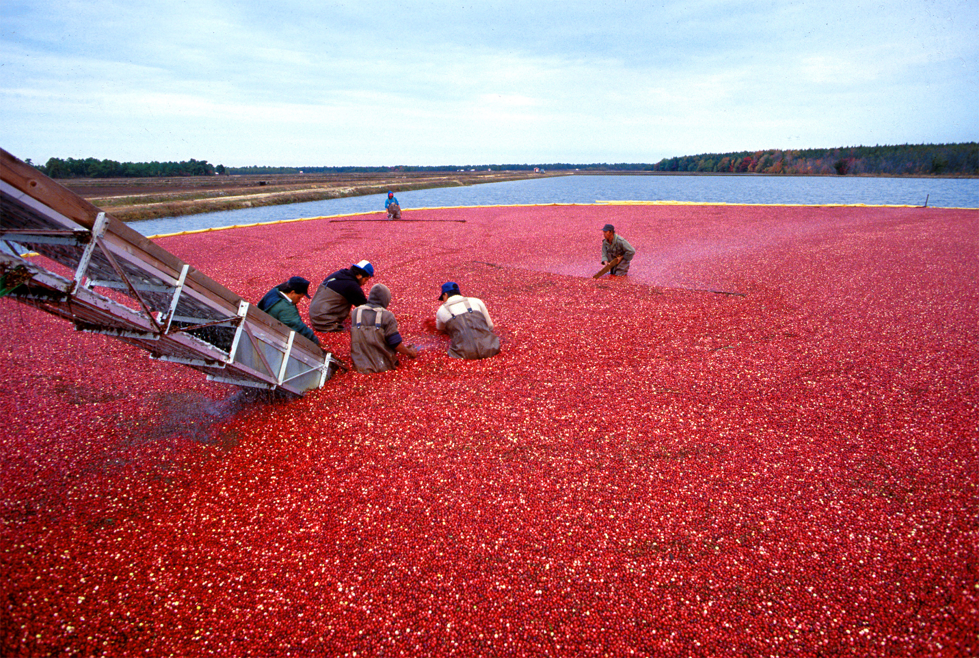
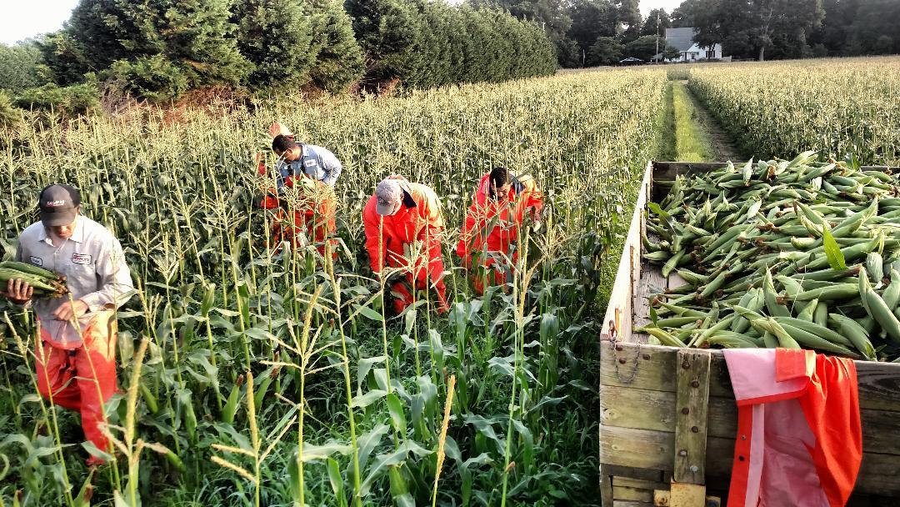
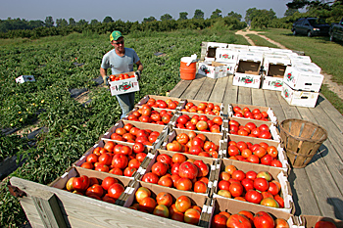
Climate change is definitely changing New Jersey’s weather. New Jersey farmers are working to make sure that they can continue to grow all the fruits and vegetables we all enjoy from the Garden State.

