Slide 1
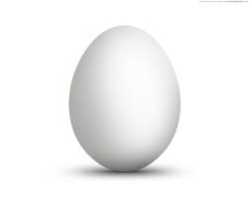
Parts of an Egg

Slide 2
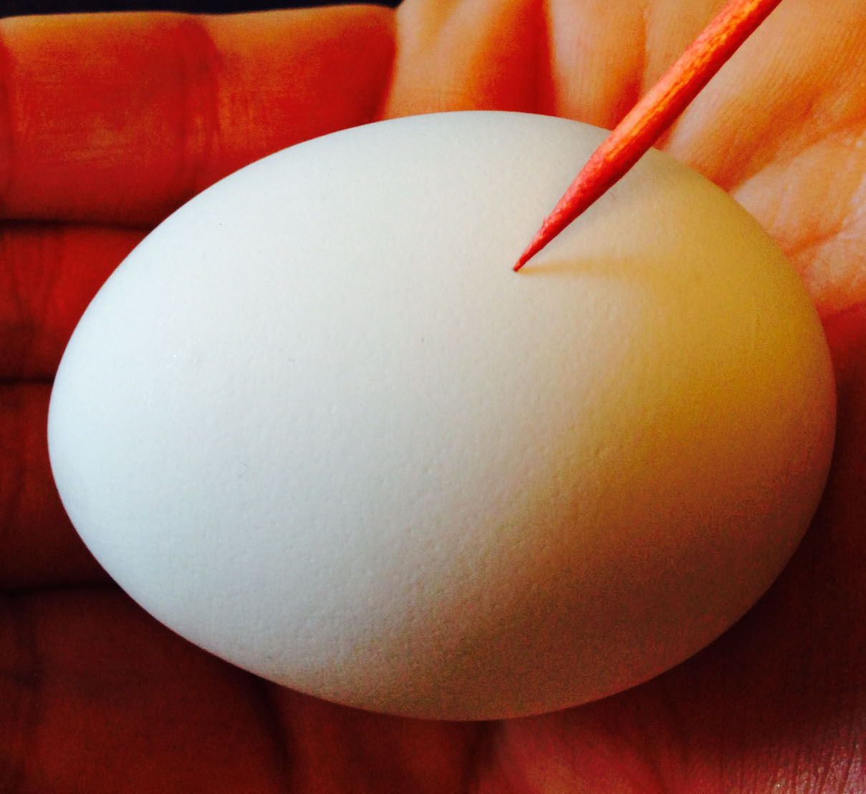
shell
The egg’s shell has more than 7,000 tiny pores that allow oxygen to pass into the egg and carbon dioxide to escape.

Slide 3
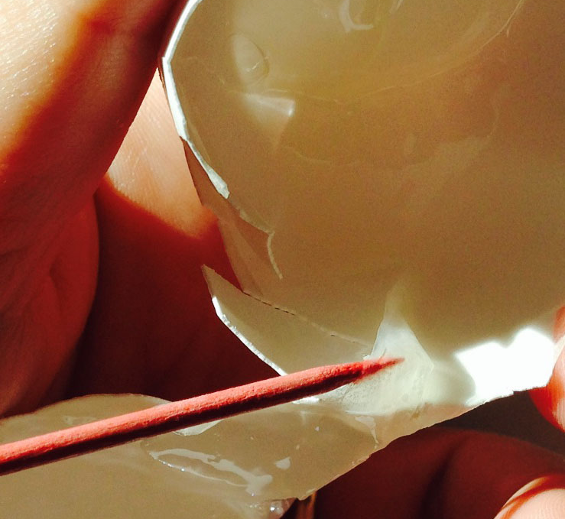
membrane
The inner and outer membranes, found between the eggshell and the egg white, keep bacteria from entering the egg and help to slow evaporation of moisture from the egg.

Slide 4
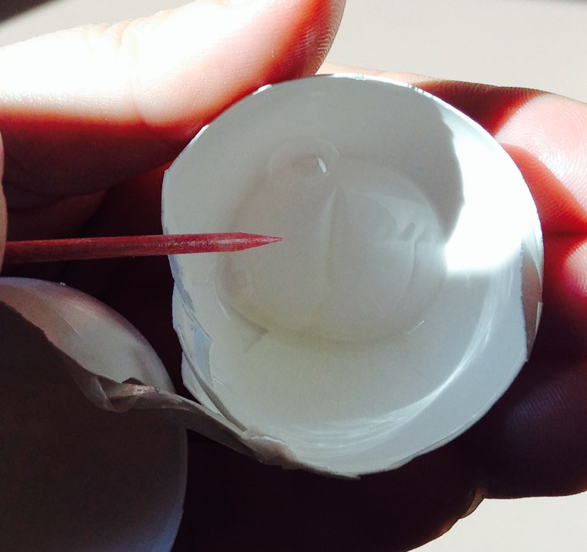
air cell
The air cell, located between the inner and outer membranes at the large end of the egg, holds oxygen for the chick to breathe.

Slide 5
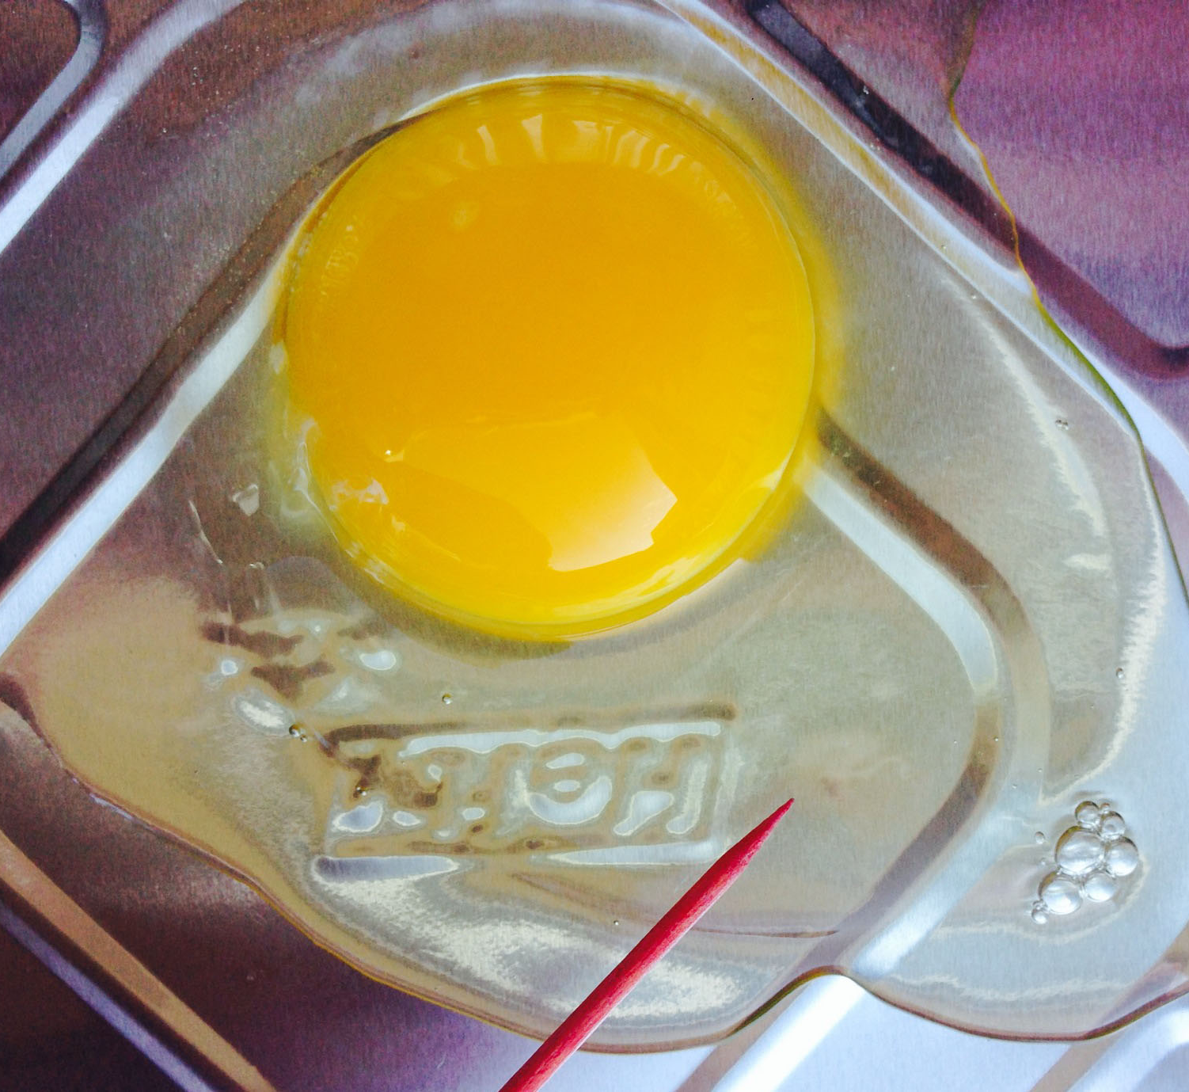
albumen
The albumen, or the egg white, cushions the egg yolk floating within it and is the main source of protein and water for the embryo.

Slide 6
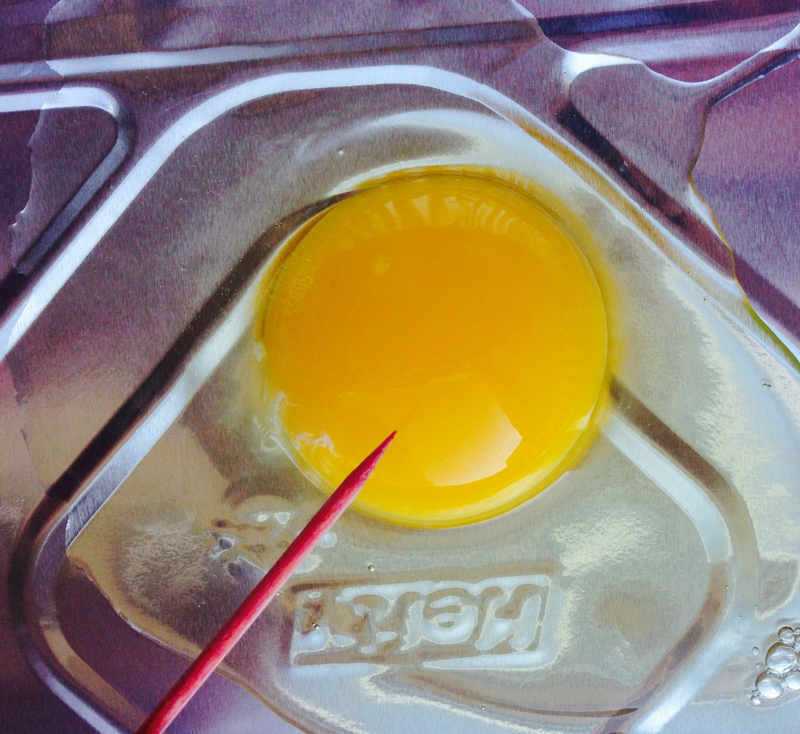
yolk
The yolk provides food for the embryo. It is made up of fats, carbohydrates, proteins, vitamins, and minerals.

Slide 7
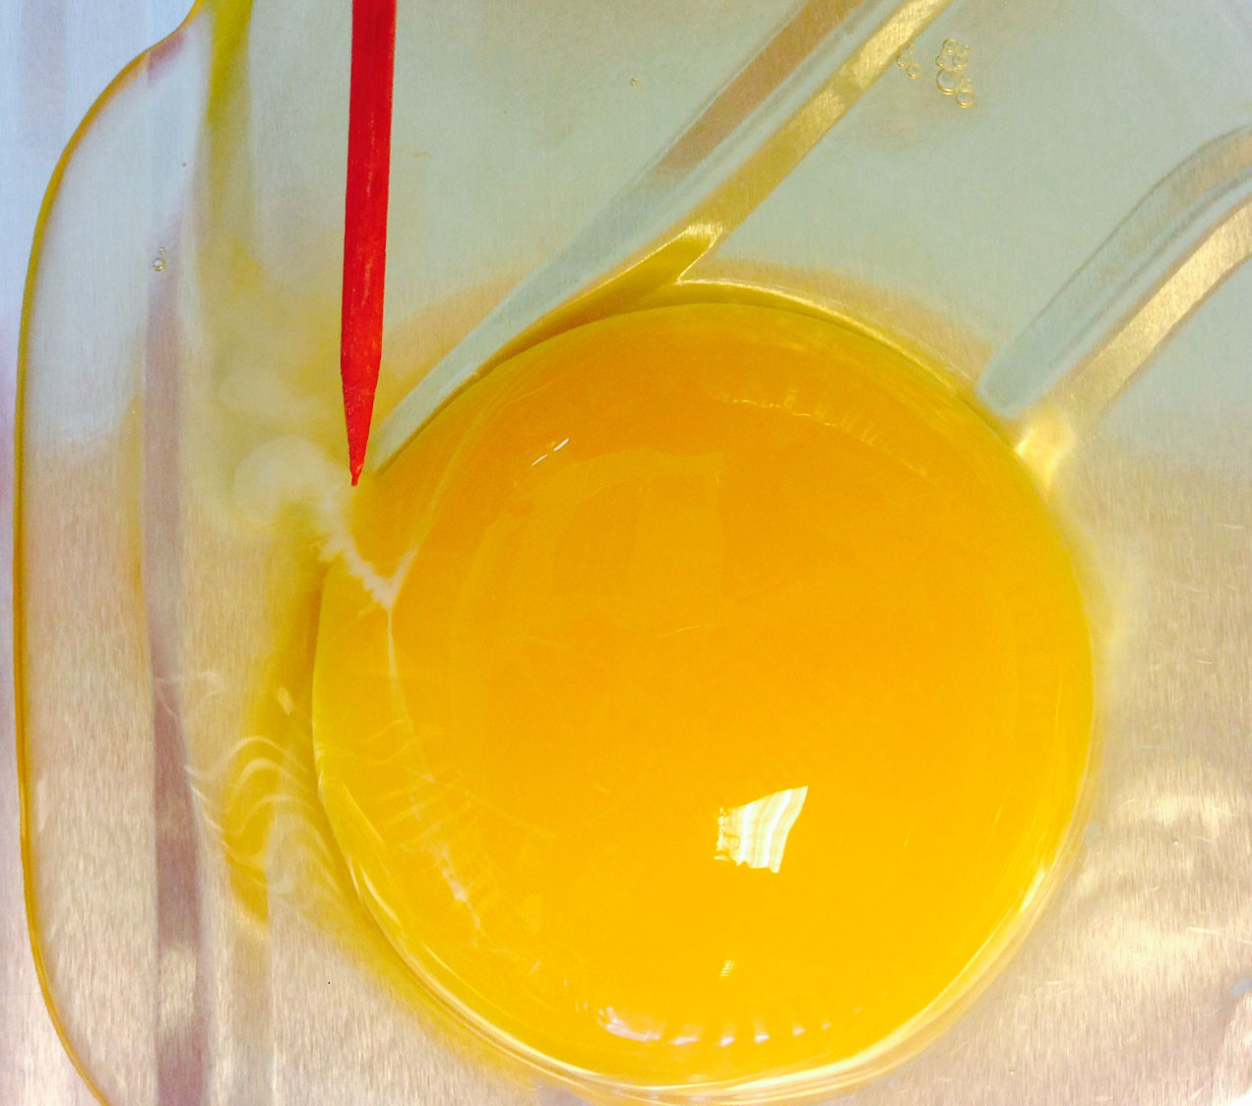
chalazae
The chalazae are cords on two sides of the yolk that keep the yolk floating in the center of the albumen.

Slide 8
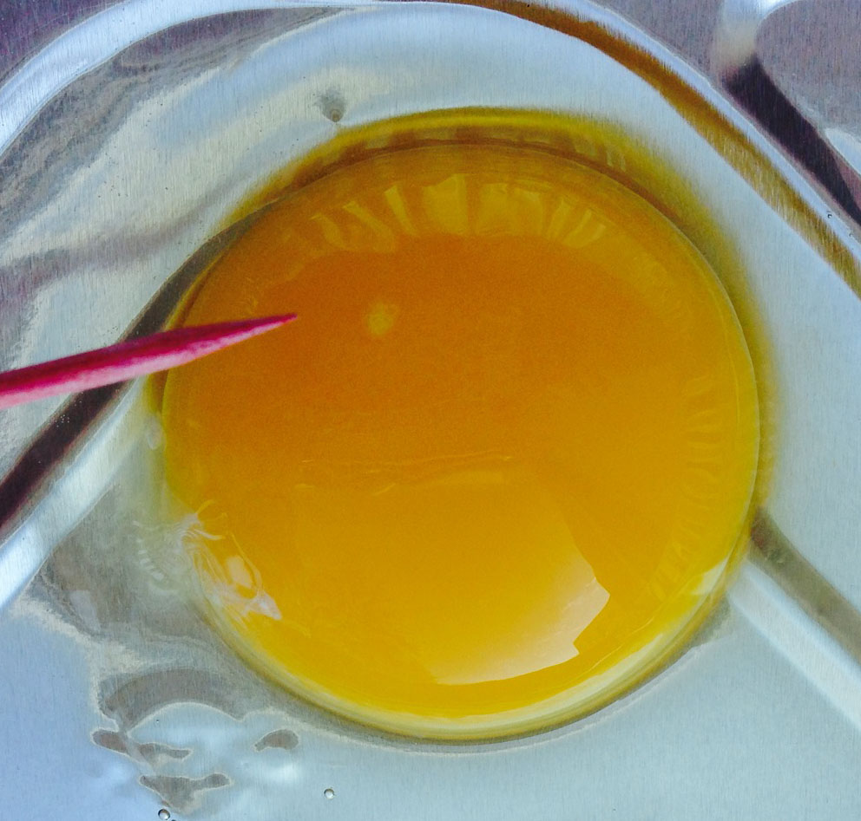
germinal disc
The germinal disc is the white spot on the yolk. This is where the female’s genetic material is found.

Slide 9
That’s all, yolks!

