Slide 1
Facts About Chickens

Slide 2
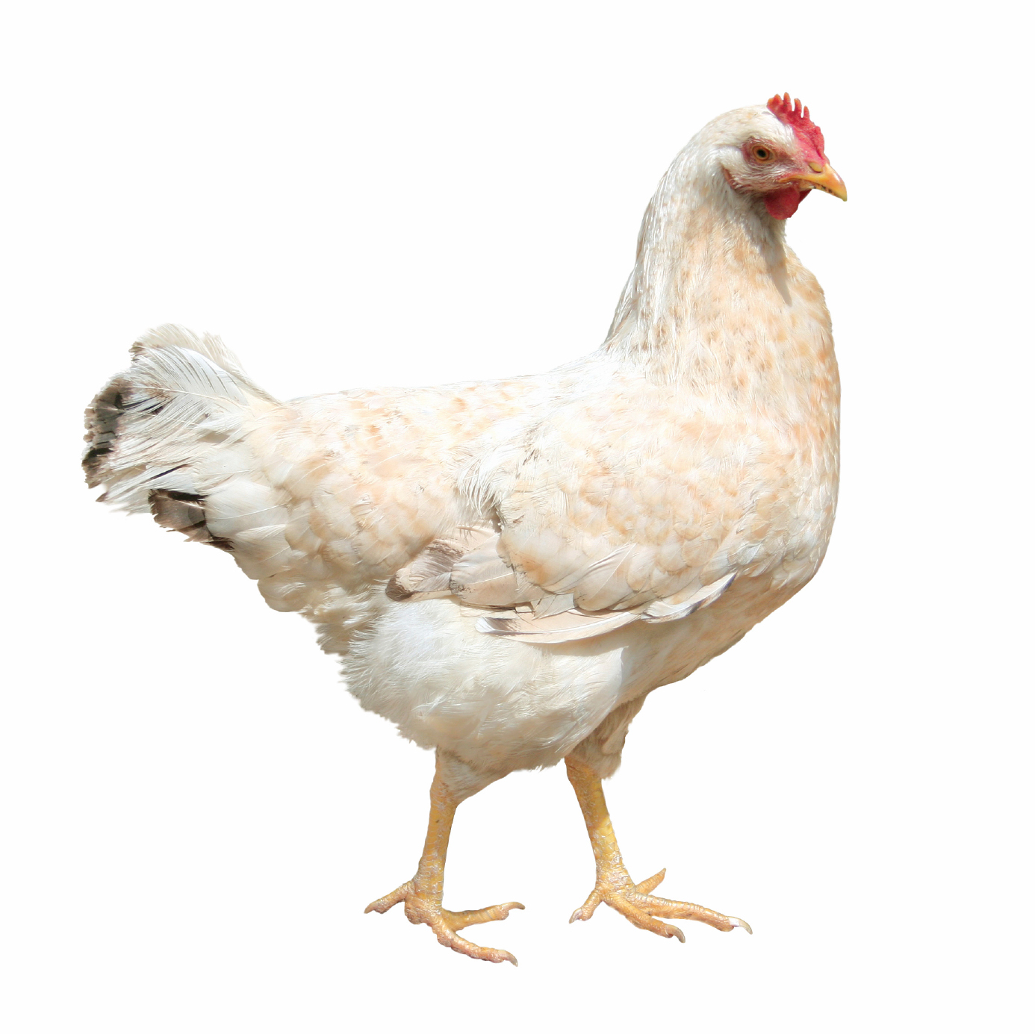
A female chicken is called a hen.

Slide 3
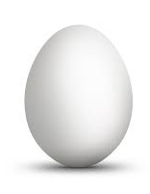
Hens can lay 1 egg per day.

Slide 4
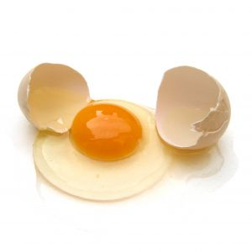
Eggs provide protein to our diet.

Slide 5
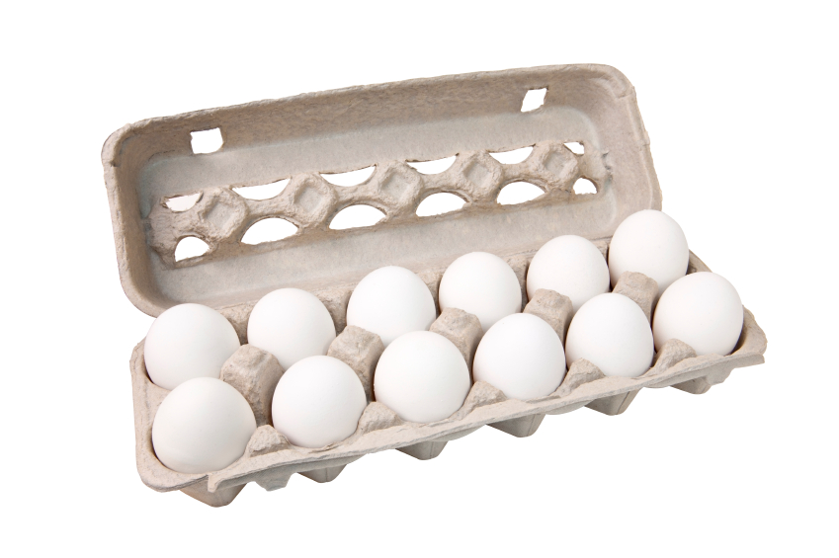
Eggs purchased at the store will never hatch
An embryo (baby chick) never even began developing because it wasn’t fertilized or incubated (Kept at right temperature)

Slide 6
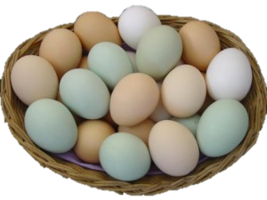
Eggs come in many colors
…but the color does not affect the nutritional value.

Slide 7
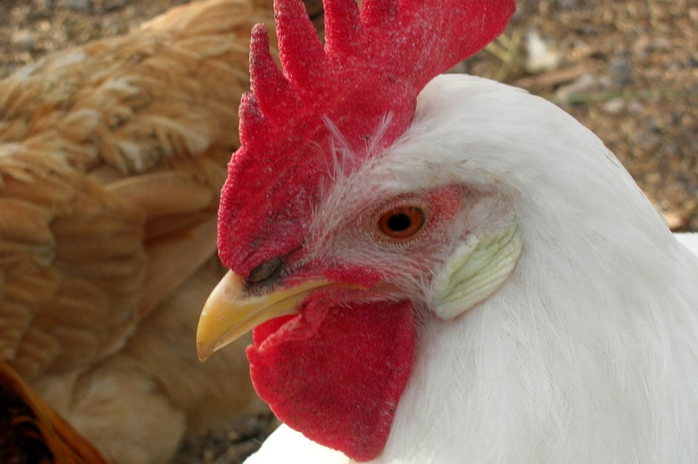
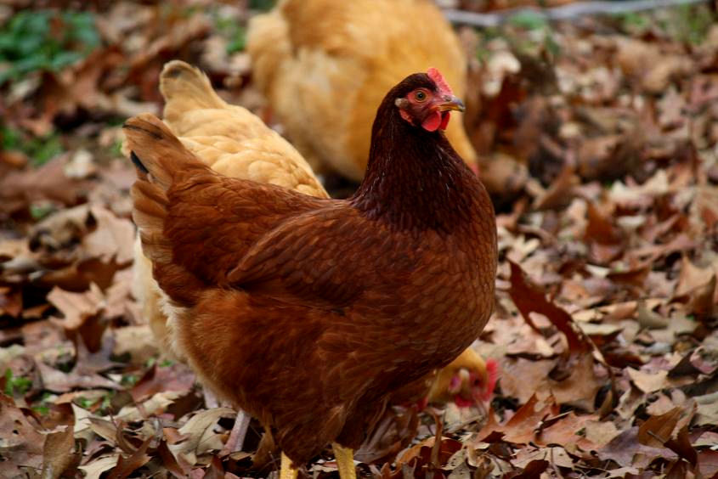
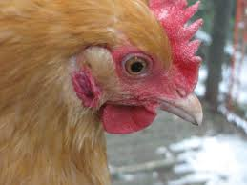
You can tell what color of egg a hen will lay by the color of her earlobe
Dark BROWN
White
LIGHT BROWN

Slide 8
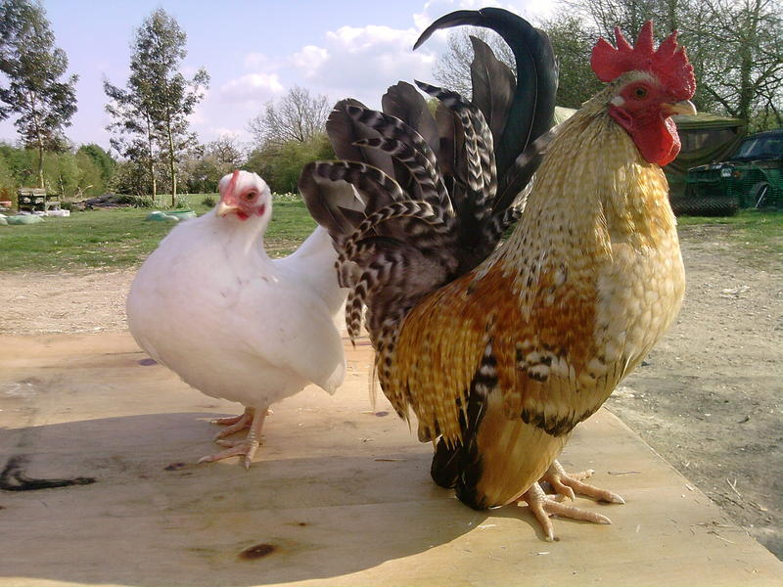
There are many kinds of chickens…
Big…
Small…

Slide 9
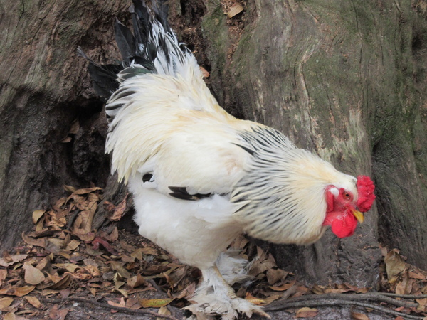
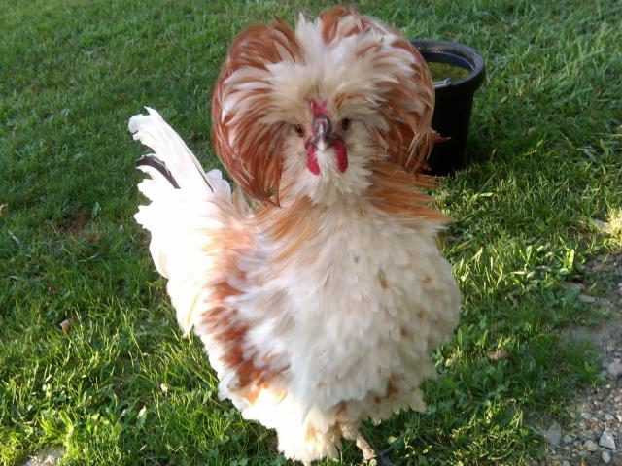
There are many kinds of chickens…
Extra feathers on their head
Or feet…

Slide 10
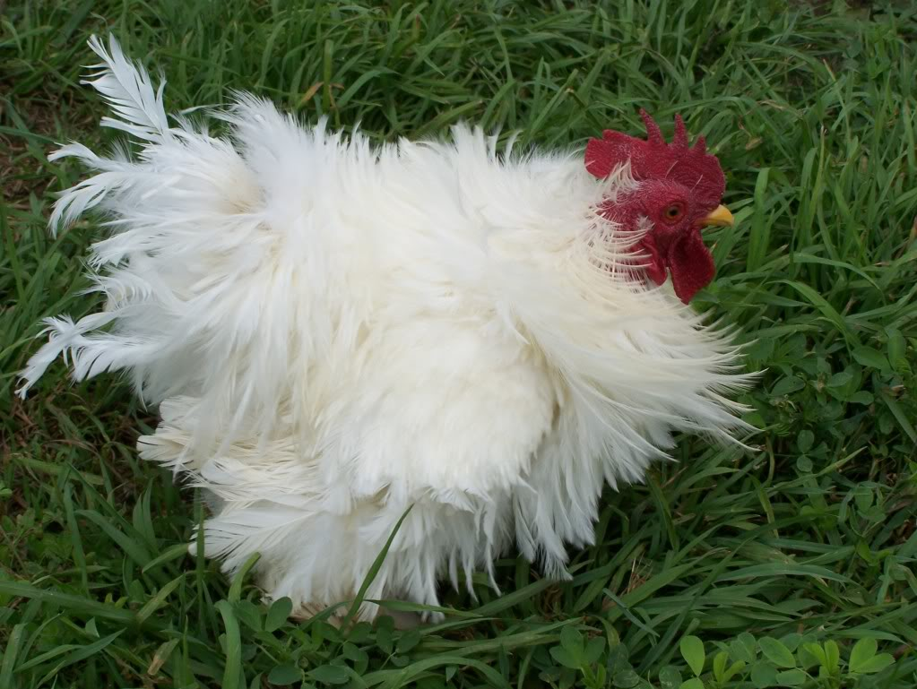
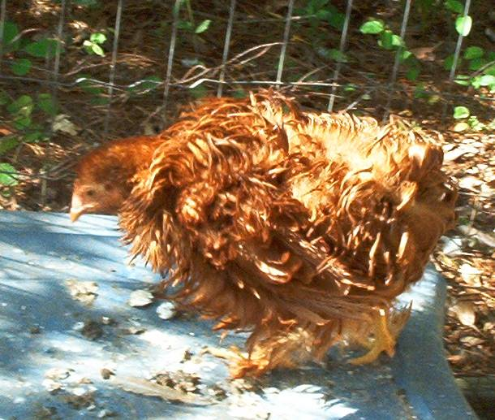
There are many kinds of chickens…
Fuzzy ones

Slide 11
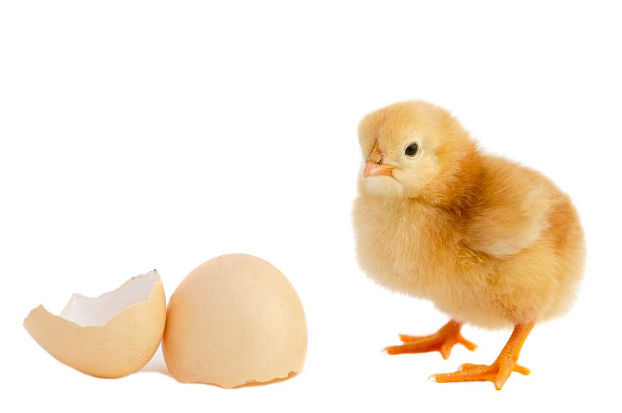
But they all developed inside an egg.

