Slide 1
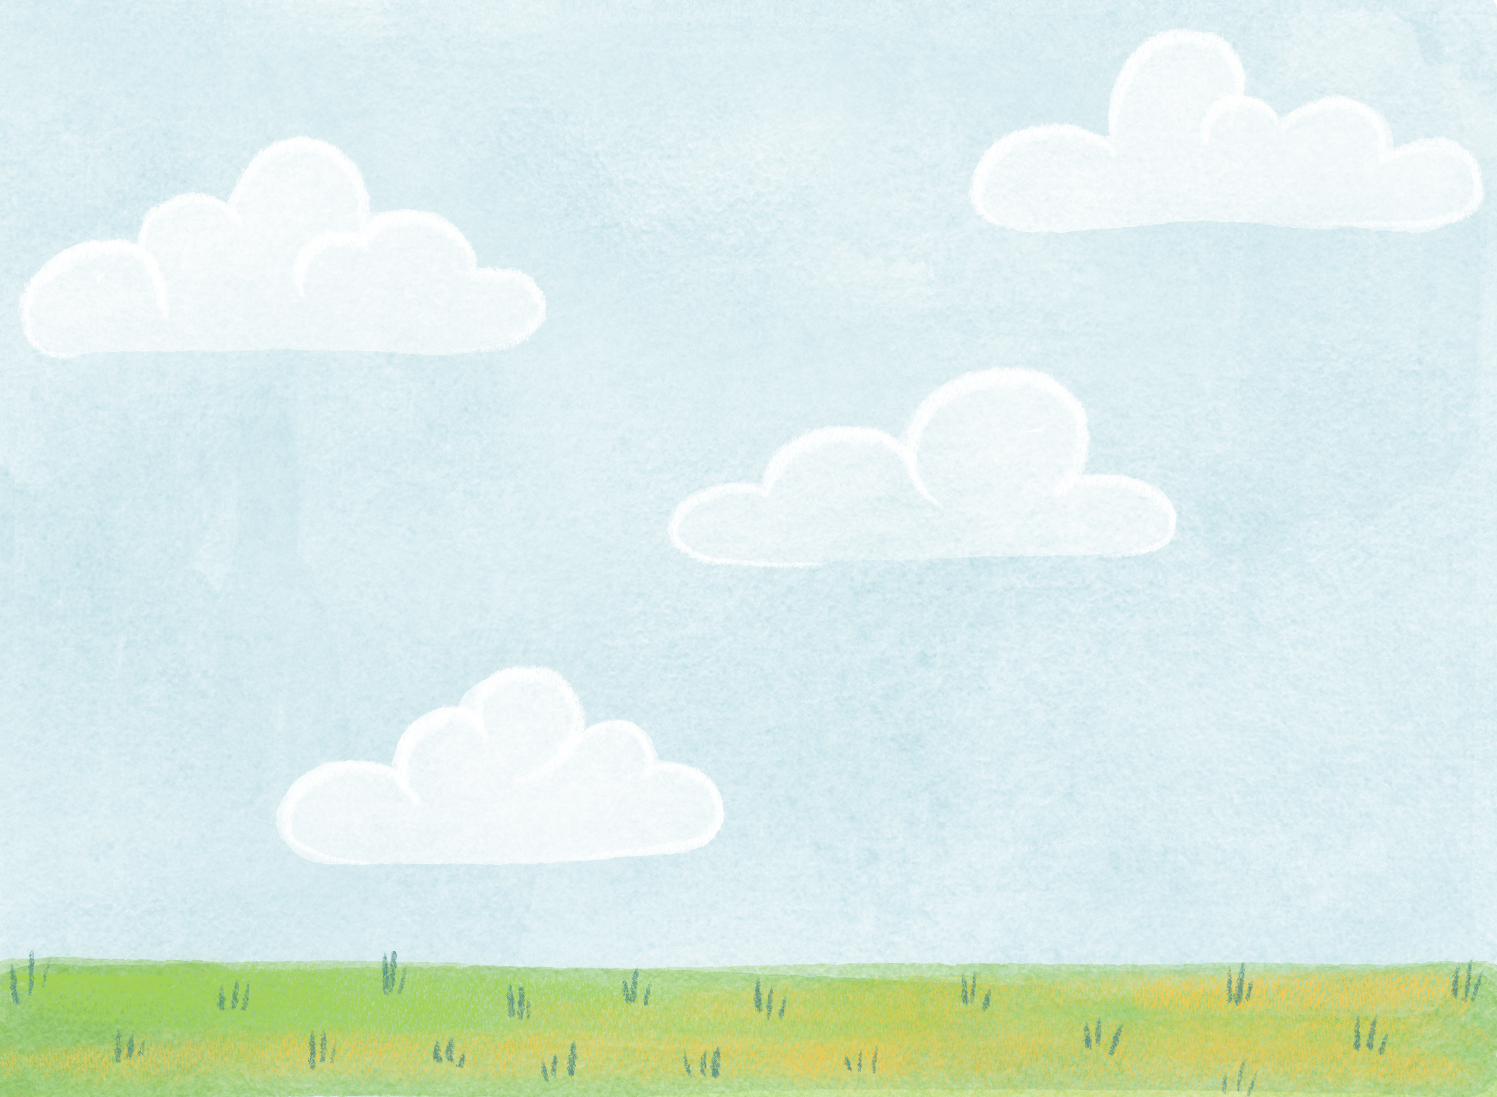
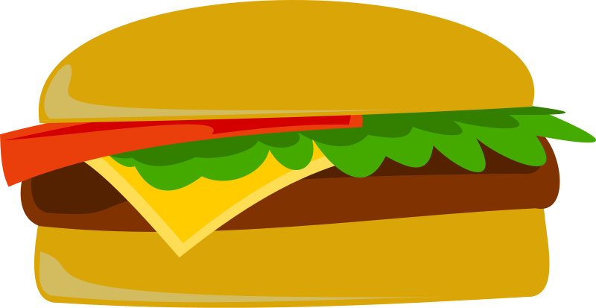
The Big Mac and the Bee

Slide 2
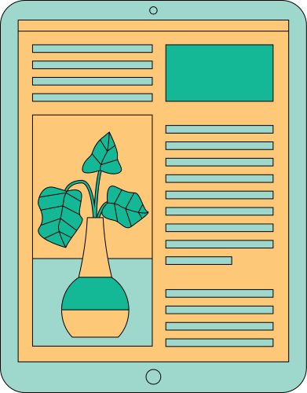
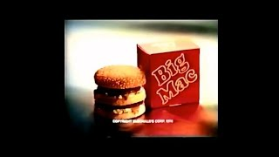
OUR COMPANY

Slide 3

Think about it:
Could you eat a Big Mac if there were no bees?

Slide 4

After you have thought about your answer, turn to a partner and discuss. Explain your ideas and reasoning.

Slide 5
Let’s break it down…
Two All-Beef Patties:
Do we need bees to make the burger patties?

Slide 6
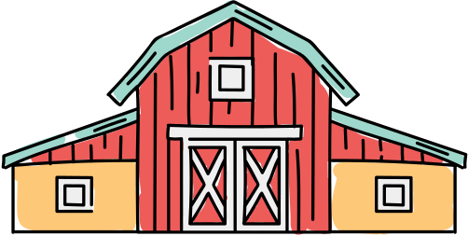
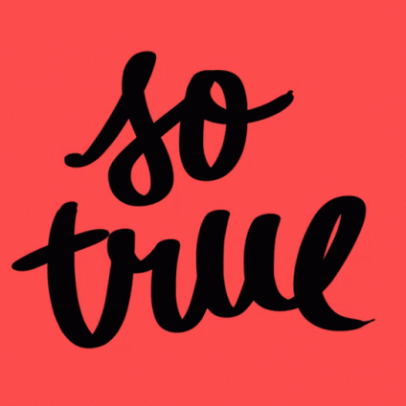
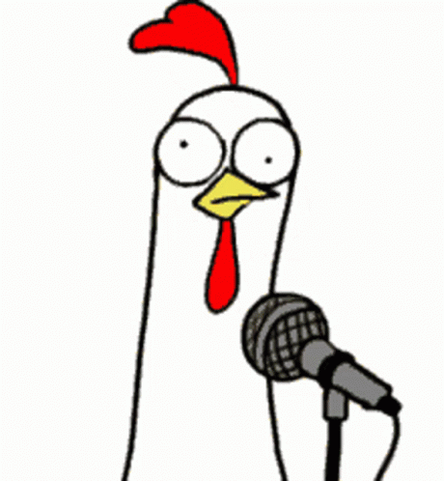
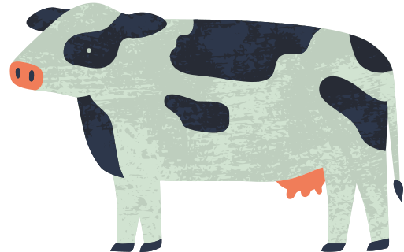
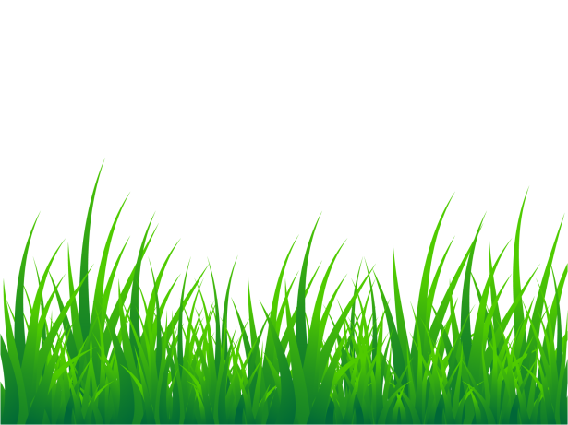
Think about it…
Where does the beef come from? Without bees, we would still be able to have the all beef patties.

Slide 7

Without bees, we would still be able to have the all-beef patties.
You are correct!
Two All-Beef Patties:
Beef comes from cows. Cows eat mostly grasses and grain. Those grasses and grain are pollinated by wind. That means we could still have beef patties without bees.

Slide 8

Two All-Beef Patties:
Beef comes from cows. Cows eat mostly grasses and grain. Those grasses and grain are pollinated by wind. That means we could still have beef patties without bees.
Without bees, we would still be able to have the all-beef patties.
This statement is true.

Slide 9

Let’s break it down…
Special Sauce:
Without bees, we could still have the special sauce.
Special Sauce Ingredients:
Sweet pickle relish
Onion
Paprika
Turmeric
Soybean or Canola oil
Corn syrup
Egg yolks
Preservatives

Slide 10
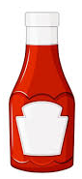
Without bees, we could still have the special sauce.
This statement is false.
Special Sauce:
OH NO!!
We could not have special sauce without bees!
Click the bottle of sauce to find out why.

Slide 11
Without bees, we could still have the special sauce.
This statement is false.
Special Sauce:
You are correct!
We could not have special sauce without bees!
Click the bottle of sauce to find out why.

Slide 12
We could not have special sauce without the bees!
Some ingredients wouldn’t exist without bees:
Pickle Relish is made with pickles which are made from cucumbers. Cucumber plants are pollinated by bees.
Onions are pollinated by bees.
Paprika is a spice that comes from a pepper plant that is pollinated by bees.
Turmeric comes from a root of a bee-pollinated herb in the ginger family.
Canola oil comes from a type of mustard plant. They need bees to reproduce.
Some of the ingredients don’t need bees. They are:
Soybean oil - the soybean plant can self-pollinate so we could have this type of oil. However, bees do improve how many plants reproduce each year by 15 - 50%!
The other ingredients that would exist without bees are corn syrup, egg yolks, and preservatives.

Slide 13
Let’s break it down…
Lettuce:
Without bees, we would still have lettuce.

Slide 14
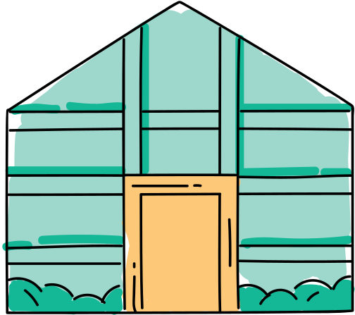
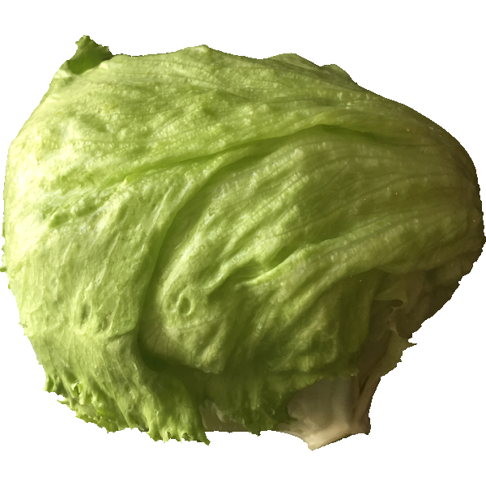
Without bees, we would still have lettuce.
This one is a little tricky.
Lettuce plants CAN self-pollinate, however, bees do a much better job of transporting the pollen between plants. So, technically, we could have lettuce but there wouldn’t be very much of it. Also, if it weren’t for bees, the “iceberg” variety of lettuce never would have existed!

Slide 15
Let’s break it down…
Cheese:
Without bees, we would still have cheese.

Slide 16
Without bees, we could still have the cheese.
This statement is false.
Cheese:
OH NO!!
We could not have cheese without bees!
Click the cow to find out why.

Slide 17
Without bees, we could still have the cheese.
This statement is false.
Cheese:
You are correct!
We could not have cheese without bees!
Click the cow to find out why.

Slide 18
Although it’s true that beef cattle eat mostly grass and grain, dairy cows are fed a different diet. They eat alfalfa which is pollinated by bees. Also, the cheese gets its yellow color from the bright seeds of annatto which comes from a tree found in South America. The texture and stretchiness of the cheese is because of something that is added to it when it’s made. It’s called an emulsifier. The emulsifier is made from soybeans. As we mentioned for the special sauce, the soybean could exist but the bees do help it out a lot.
Without bees, we could still have the cheese.
This statement is false.

Slide 19
Let’s break it down…
Pickles and Onions:
Without bees, we would still be able to have pickles and onions.

Slide 20
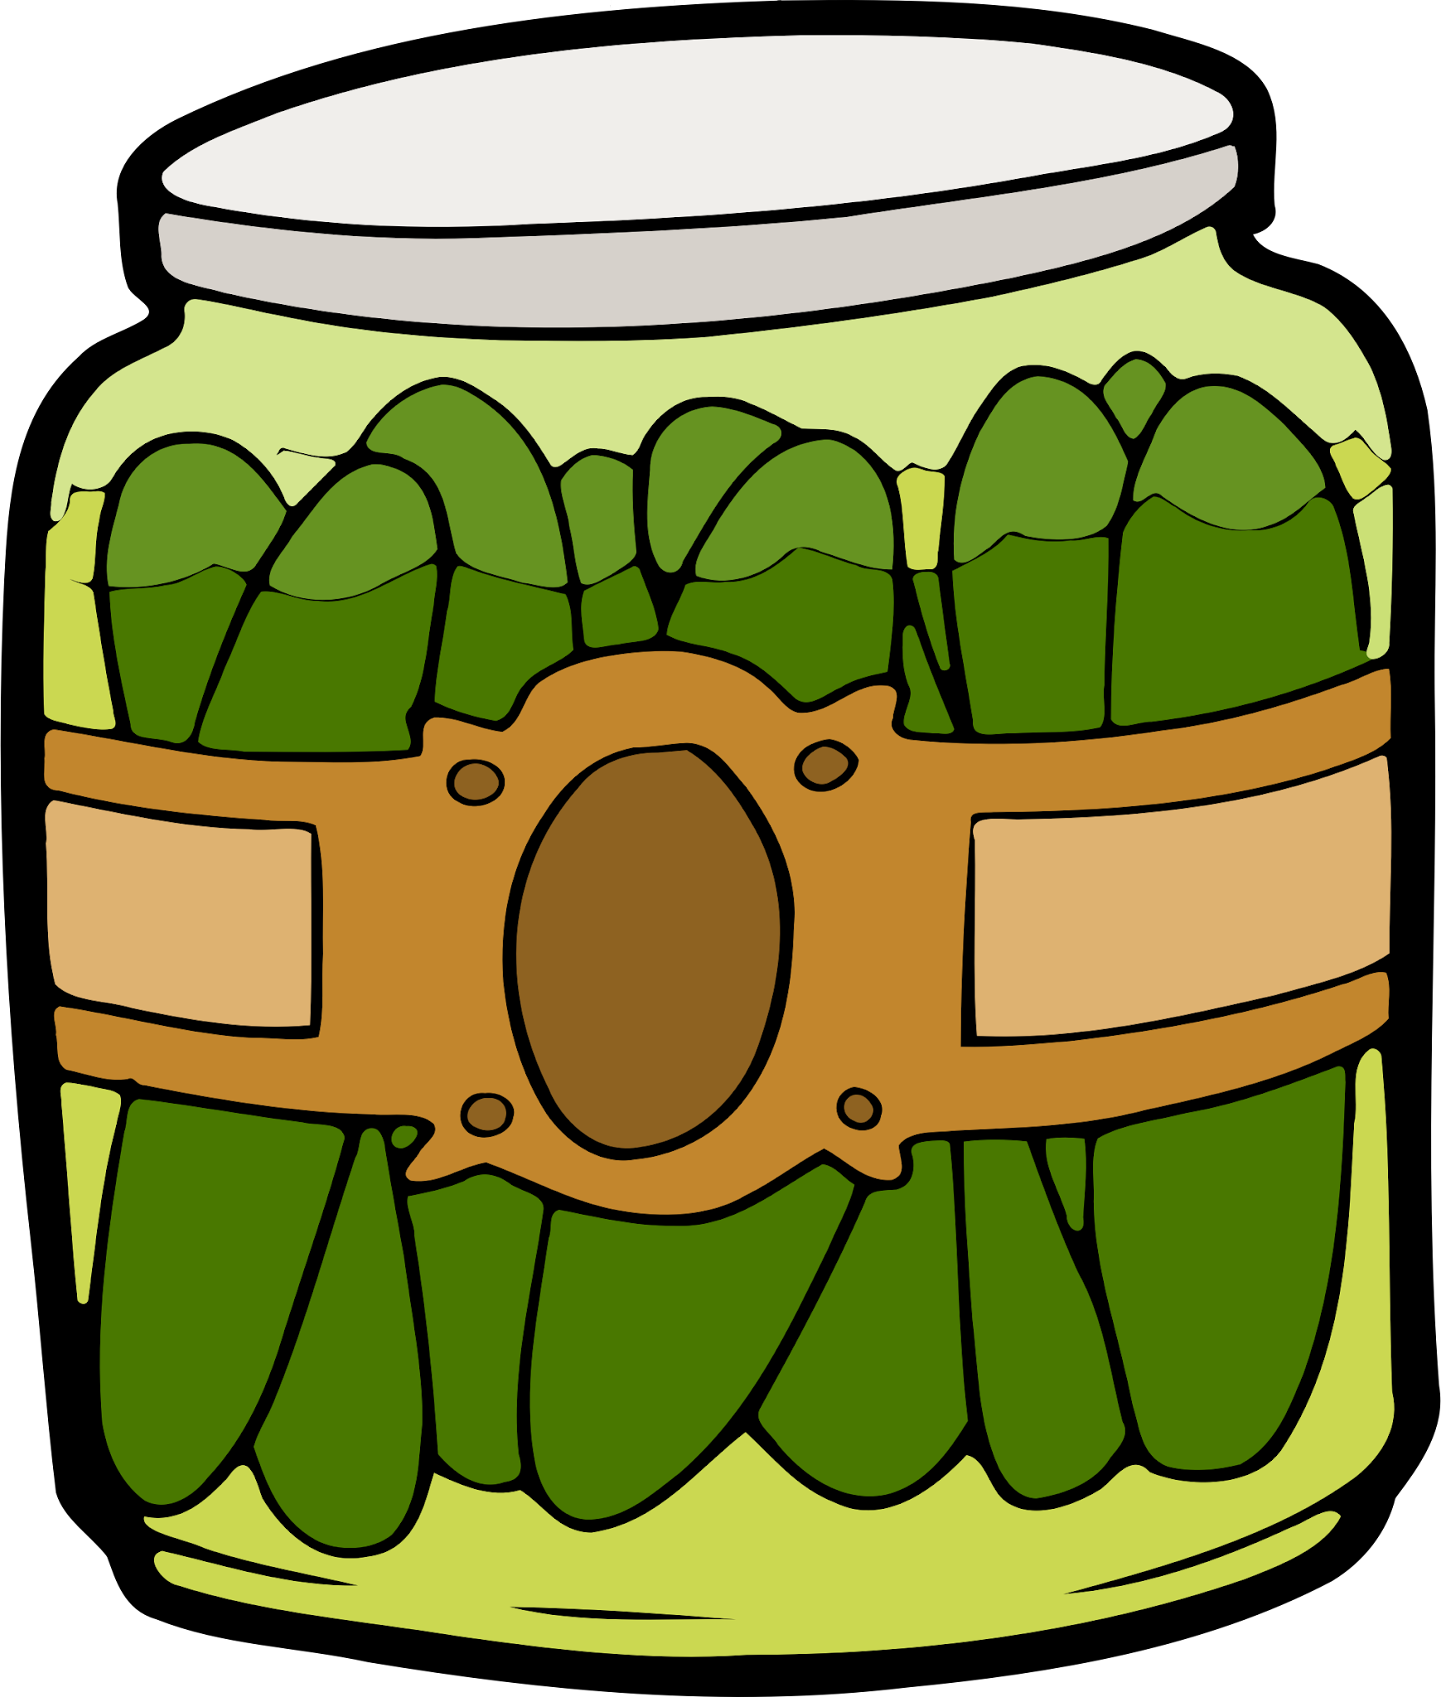
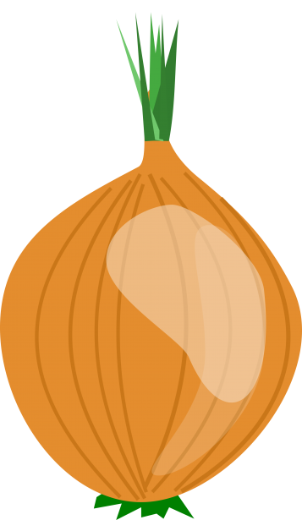
Without bees, we could still have the pickles and onions.
This statement is false.
Pickles and onions:
OH NO!!
We could not have pickles and onions without bees!
Click the pickles to find out why.

Slide 21
Without bees, we could still have pickles and onions.
This statement is false.
Pickles and onions:
You are correct!
We could not have pickles and onions without bees!
Click the pickles to find out why.

Slide 22
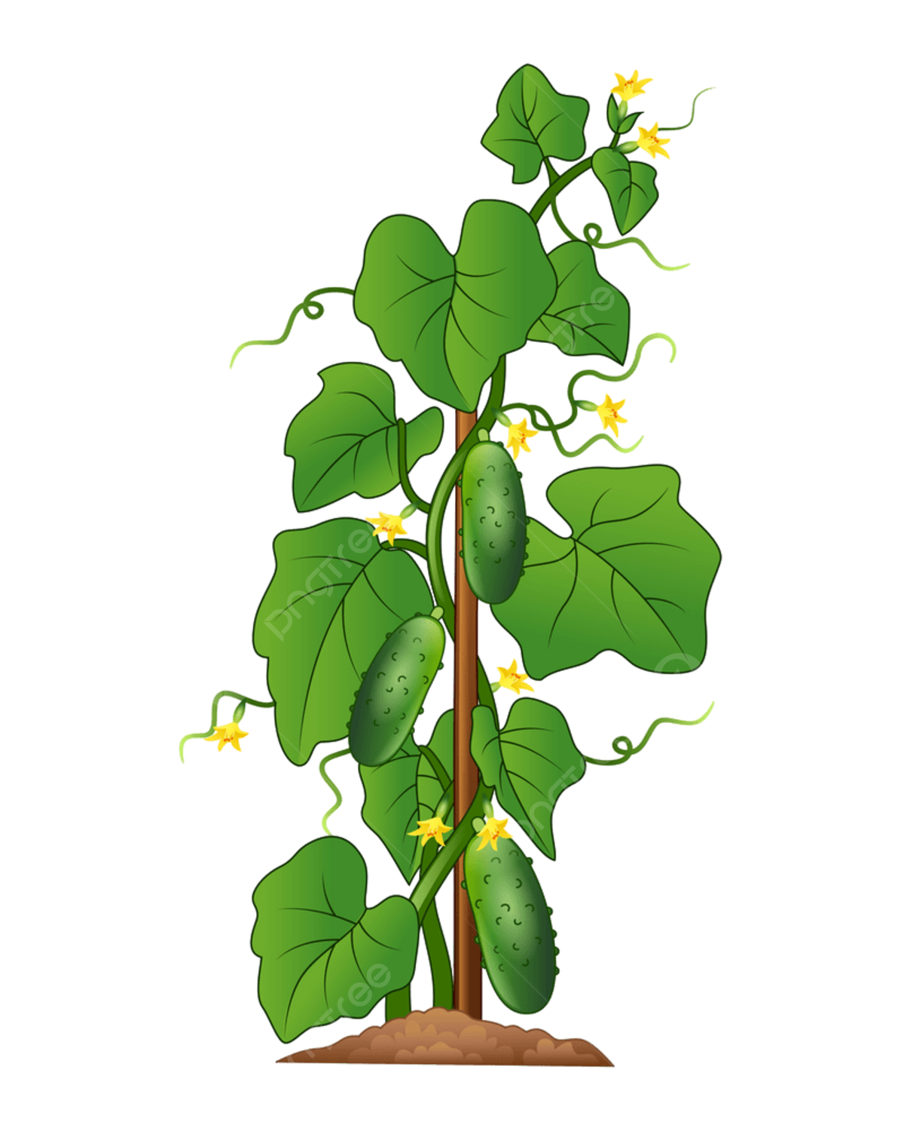
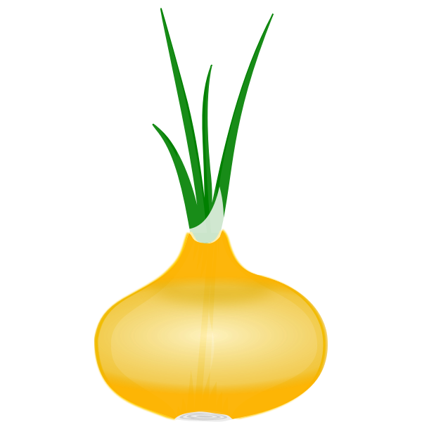
Without bees, we could still have pickles and onions.
This statement is false.
Pickles are made with cucumbers. Cucumber and onion plants are pollinated by bees. We wouldn’t have either of them without the bees.

Slide 23
Let’s break it down…
Sesame Seed Bun:
Without bees, would we be able to make a sesame seed bun?

Slide 24
Sesame Seed Bun:
This is another tricky one. The main ingredient in the bun is flour. Flour comes from wheat. Wheat does not depend on bees to pollinate the plants, so, we would be able to keep the bun. However, the sesame plant does depend on bees. Our bee-less burger would not be able to have sesame seeds.

Slide 25
Have you been keeping track?
What would be left of our burger if there were no bees?

Slide 26
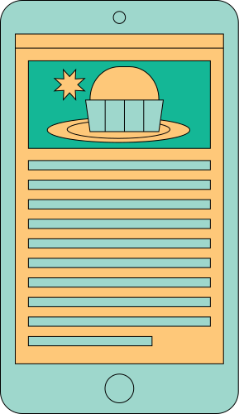
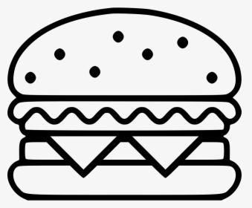
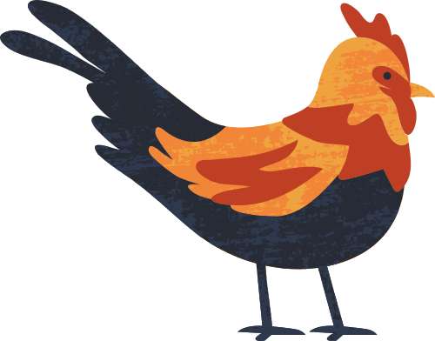
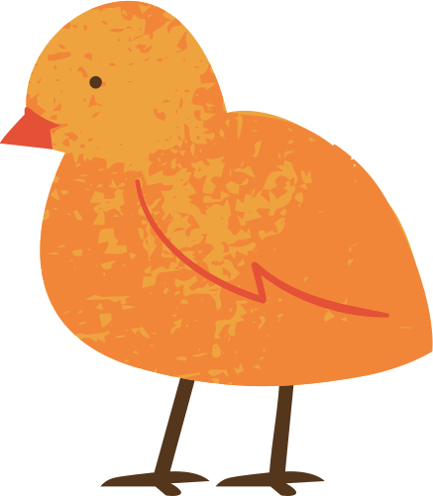
The answer is:
Not much!

Slide 27
WHAT’S LEFT?
WHAT’S LOST?
Two All-Beef Patties
The Bun (without sesame seeds)
Special Sauce
  Pickle Relish
  Onions
  Paprika
  Turmeric
  Canola
Lettuce
Cheese
Pickles
Onions
Sesame Seeds

Slide 28
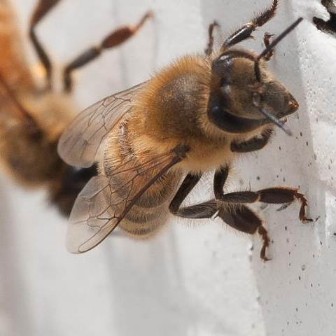
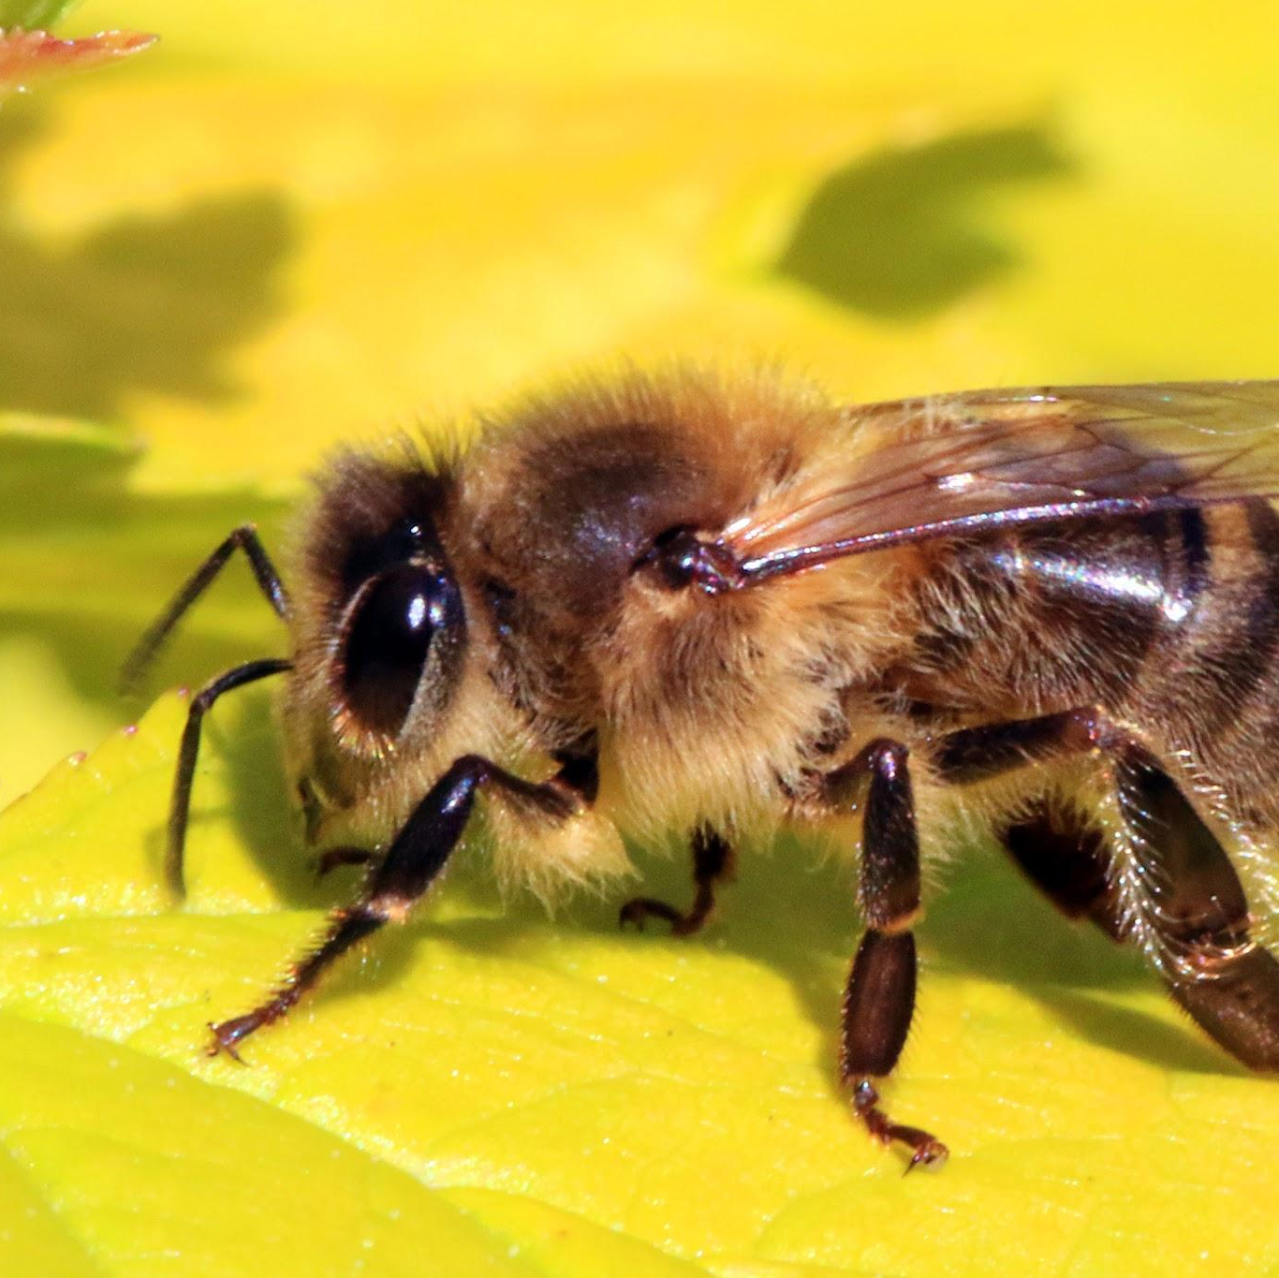
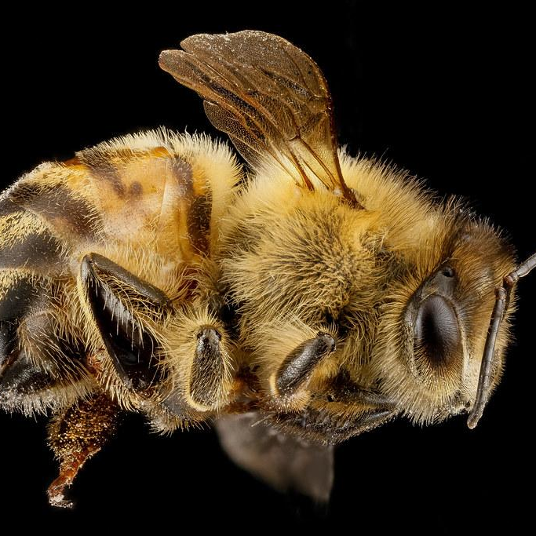
So, without bees, we would still have some foods but there wouldn’t be nearly as much variety and it wouldn’t be as nutritious.

