Slide 1
Staying Current with Educational Developments
Networking for State AITC Staff

Slide 2
Where Do You Stand?

Slide 3
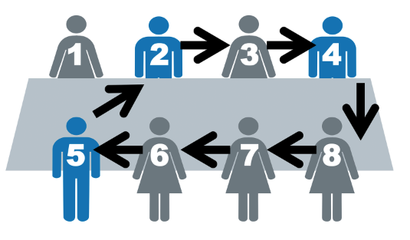
Speed Networking
Share:
The state you are from
Your AITC responsibilities
Your favorite part about your AITC position
The biggest challenge associated with your AITC position

Slide 4
Brainwriting
Why is it important to stay up-to-date with current education issues?
Independently write down ideas
Discuss ideas in small groups
Share the group’s best ideas with the whole group

Slide 5
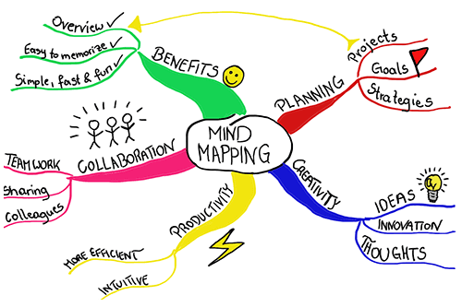
Mind Maps
What do you do to stay up-to-date with current education issues?
Write the topic in the middle of the paper
Draw branches from the topic, and label each branch with a related big idea
Draw sub-branches, and label each sub-branch with variations or details related to the big idea
Use your mind map to present ideas to the whole group

