Slide 1
Next Generation Science Standards Storylines, Phenomena & 3-Dimensional Learning
Max Longhurst & Debra Spielmaker
Utah State University
Notes:
Max: (2-3 min)
Position and background introduction
Teaching teachers – Professional Learning for classroom teachers in Science Education
Preservice methods courses
State and local level implementation
What are the Next Generation Science Standards
Historical influences on Framework – 1990’s (Science Standards, Benchmark documents), 2000’s (Taking Science to School, Ready Set Science) 2011 (Framework), NGSS
What influenced the work? Solid research foundation.

Slide 2
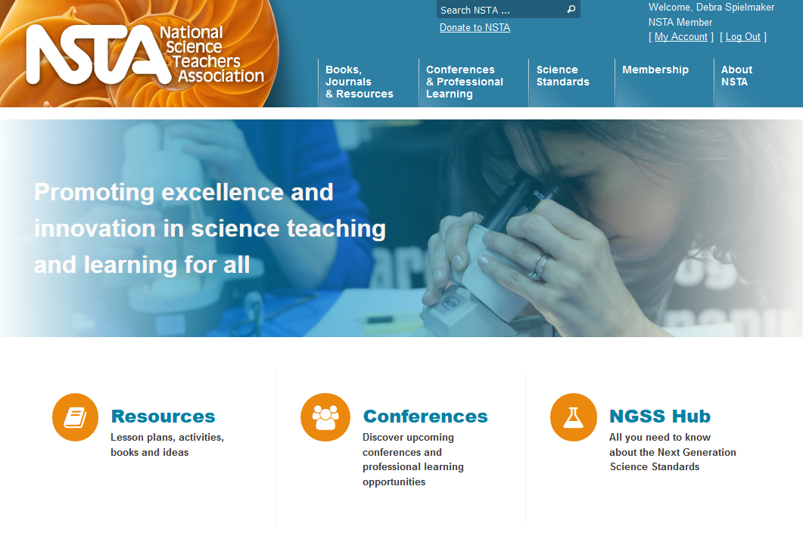
Where’s the conversation?
Notes:
Max: (5-8 min)
Where is the conversation?
19 states have adopted, 19 additional states have connected standards.
Less memorizing, grounding research in practice, apply knowledge in context,
What are the Next Generation Science Standards
Science and Engineering Practices
Disciplinary Core Ideas
Crosscutting Concept
A New Vision for Science Education (HANDOUT)
Discuss
Performance Expectation

Slide 3
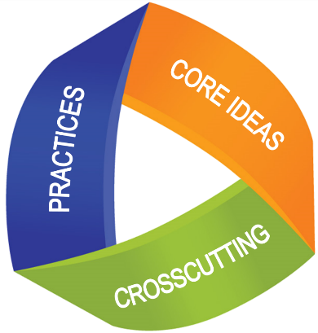
Vision for Science Proficiency
Three-Dimensional Learning
Science & Engineering Practices: Behaviors and skills
Crosscutting Concepts: Concepts with application across science disciplines
Disciplinary Core Ideas: Themes across science disciplines (STEM)
https://www.nextgenscience.org/three-dimensions
Notes:
Max: (3 min)
Dimension 1: Practices
The practices describe behaviors that scientists engage in as they investigate and build models and theories about the natural world and the key set of engineering practices that engineers use as they design and build models and systems. The NRC uses the term practices instead of a term like “skills” to emphasize that engaging in scientific investigation requires not only skill but also knowledge that is specific to each practice. Part of the NRC’s intent is to better explain and extend what is meant by “inquiry” in science and the range of cognitive, social, and physical practices that it requires.
Although engineering design is similar to scientific inquiry, there are significant differences. For example, scientific inquiry involves the formulation of a question that can be answered through investigation, while engineering design involves the formulation of a problem that can be solved through design. Strengthening the engineering aspects of the Next Generation Science Standards will clarify for students the relevance of science, technology, engineering and mathematics (the four STEM fields) to everyday life.
Dimension 2: Crosscutting Concepts
Crosscutting concepts have application across all domains of science. As such, they are a way of linking the different domains of science. They include: Patterns, similarity, and diversity; Cause and effect; Scale, proportion and quantity; Systems and system models; Energy and matter; Structure and function; Stability and change. The Framework emphasizes that these concepts need to be made explicit for students because they provide an organizational schema for interrelating knowledge from various science fields into a coherent and scientifically-based view of the world.
Dimension 3: Disciplinary Core Ideas
Disciplinary core ideas have the power to focus K–12 science curriculum, instruction and assessments on the most important aspects of science. To be considered core, the ideas should meet at least two of the following criteria and ideally all four:
Have broad importance across multiple sciences or engineering disciplines or be a key organizing concept of a single discipline;
Provide a key tool for understanding or investigating more complex ideas and solving problems;
Relate to the interests and life experiences of students or be connected to societal or personal concerns that require scientific or technological knowledge;
Be teachable and learnable over multiple grades at increasing levels of depth and sophistication.
Disciplinary ideas are grouped in four domains: the physical sciences; the life sciences; the earth and space sciences; and engineering, technology and applications of science.
Read more about the three dimensions in the NRC Framework online here.

Slide 4
Quick Poll
Poll Junkie: http://bit.ly/aitcngss
Notes:
Deb/Max: (5 min)

Slide 5
NGSS and State Standards
What the heck is NGSS?!
What term and concepts were new?
Notes:
Max: (10 min)
Show video pieces
https://youtu.be/HVFDxuFfrb4
8:34 min

Slide 6
What’s in for Science Education?
Science & Engineering Practices
Asking Questions and Defining Problems
Developing and Using Models
Planning and Carrying Out Investigations
Analyzing and Interpreting Data
Using Mathematics, Information & Computer Technology, and Computational Thinking
Constructing Explanations and Designing Solutions
Engaging in Argument from Evidence
Obtaining, Evaluating, and Communicating Information
Notes:
Max: (5 min)
Revisit PDF of “A New Vision for science education”
Introduce Practices
Prior standards documents listed what students should “know” or “understand.” (We have now moved to HOW and WHY) These ideas needed to be translated into performances that could be assessed to determine whether or not students met the standard. Different interpretations sometimes resulted in assessments that were not aligned with curriculum and instruction.

Slide 7
What’s in for Science Education?
Crosscutting Concepts
1- Patterns
2- Cause and Effect:
Mechanism and explanation
3- Scale, proportion, and quantity
4- Systems and system models
5- Energy and matter:
Flows, cycles, and conservation
6- Structure and function
7- Stability and change
Notes:
Max: (3 min)
Revisit PDF of A New Vision for science education
Introduce Crosscutting Concepts
Crosscutting concepts

Slide 8
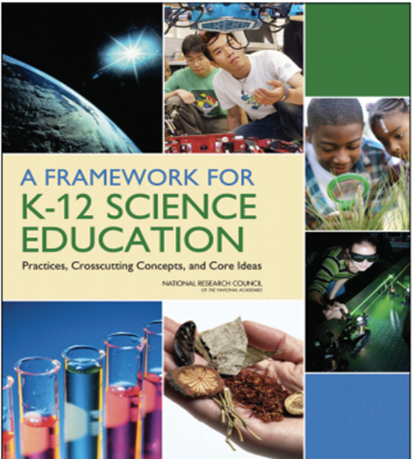
New Paradigm for Science Teaching and Learning
Implications for AITC Programming
Pre-service teacher presentations
In-Service Teacher Professional Development
Curriculum Resource Development
Casual conversation involving lingo and educators ☺
Notes:
Max: (2-3 min)
Read the first 4 chapters to get a foundation for the research behind the new paradigm.
Free download: https://www.nap.edu/catalog/13165/a-framework-for-k-12-science-education-practices-crosscutting-concepts

Slide 9
Science: A way of knowing
Notes:
Max: (3 min)
This is the next step after the framework and how the framework builds within each grade level.

Slide 10
NGSS and State Standards
Next Generation Science Standards by Topic: Let’s see how this works!
http://ngss.nsta.org/AccessStandardsByTopic.aspx
Notes:
Max: (3 min)
Exposure level to what is available on the web for the NGSS standards.

Slide 11
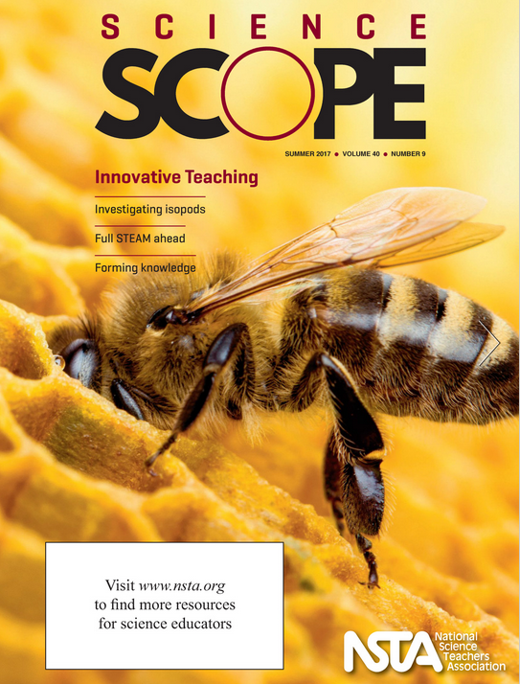
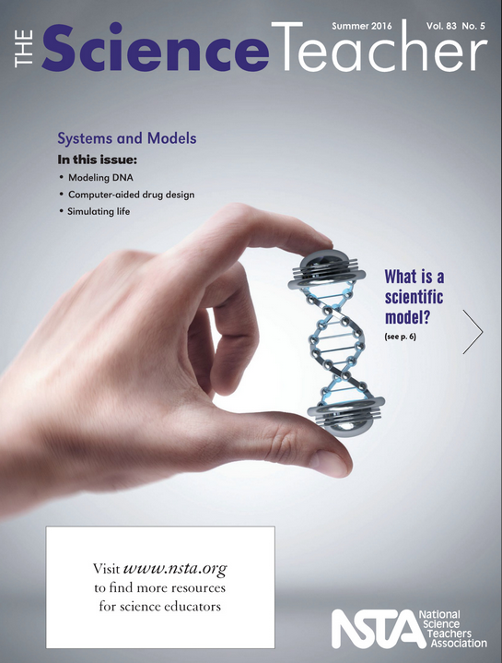
Online and in Print
Notes:
Max/Deb: (5 min)
Discussion of what a phenomena is and is not.
Example from Science Scope Dec. 2017 – Life vest chart
We will be sharing additional models for using a phenomenon in classrooms.
NOTE that these resources are models for Phenomenon, Storylines, and Episodes.

Slide 12
Phenomena
Consider the questions from students…and they usually start with “why do?” or “how come?”
This questioning about phenomena is the beginning of a way of knowing
Phenomena are observable events that lead to student generated questions
Notes:
Max: (3 min)
Discuss phenomena.
Question: What are the attributes of a phenomenon?

Slide 13
Creating Conceptual Storylines
Conceptual Storylines narrative approach to learning contextualizing concepts.
Storylines relate to a series of lessons, teachers determine which ones fit the best
Storylines begins with questions around phenomena (driving question, used in UbD and PBL)
Tools: http://www.nextgenstorylines.org/
Notes:
Max: (3 min)
Discuss storylines.
Question: What are the aspects of a storyline?
Show Skeleton from the website.

Slide 14
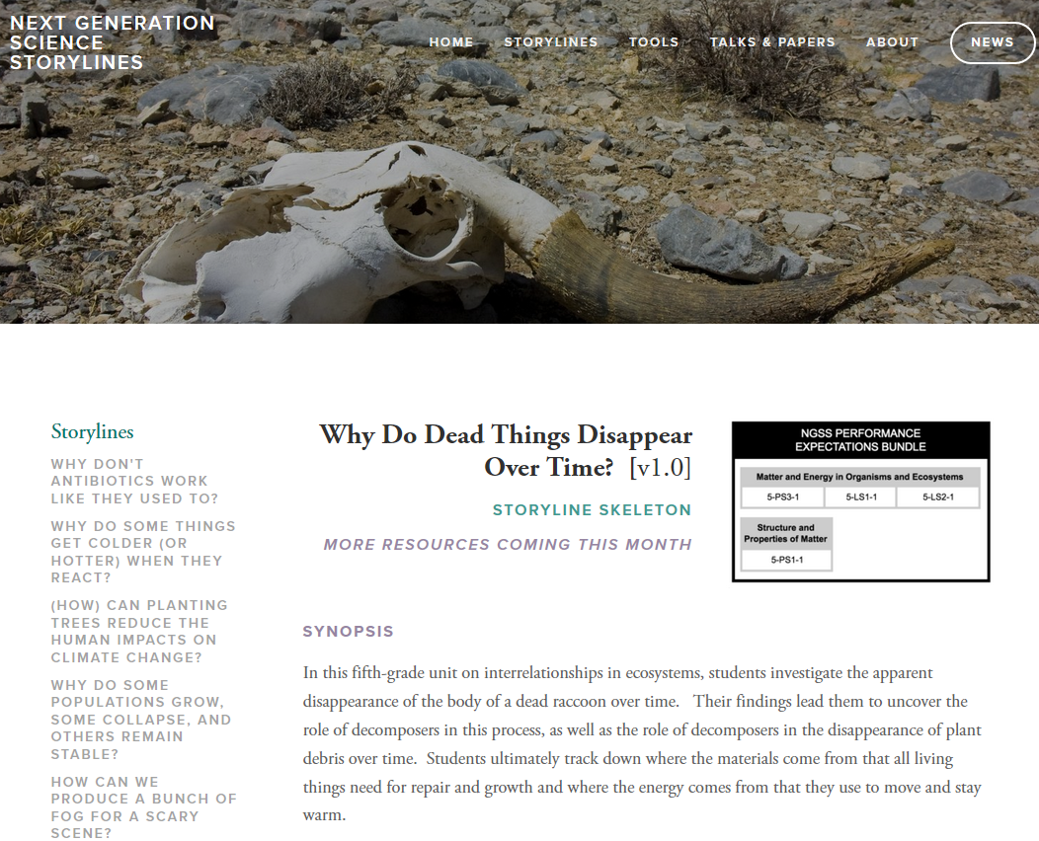
Steps in a Conceptual Storyline
Notes:
Max: (3-4 min)
Why Storylines…
What do episodes offer?

Slide 15
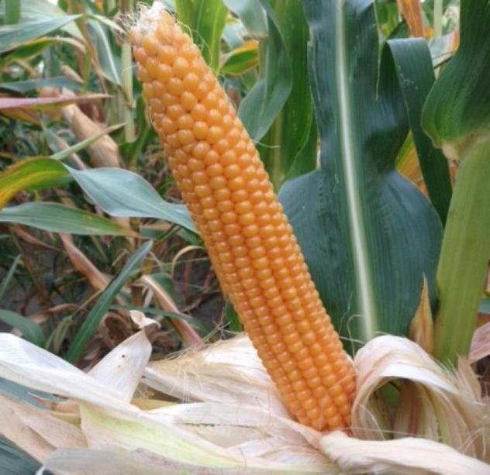
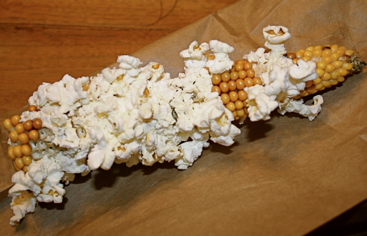
Phenomena… Why does corn pop?
Notes:
Lynn: (2 min)
Introduce a model storyline with episodes.

Slide 16
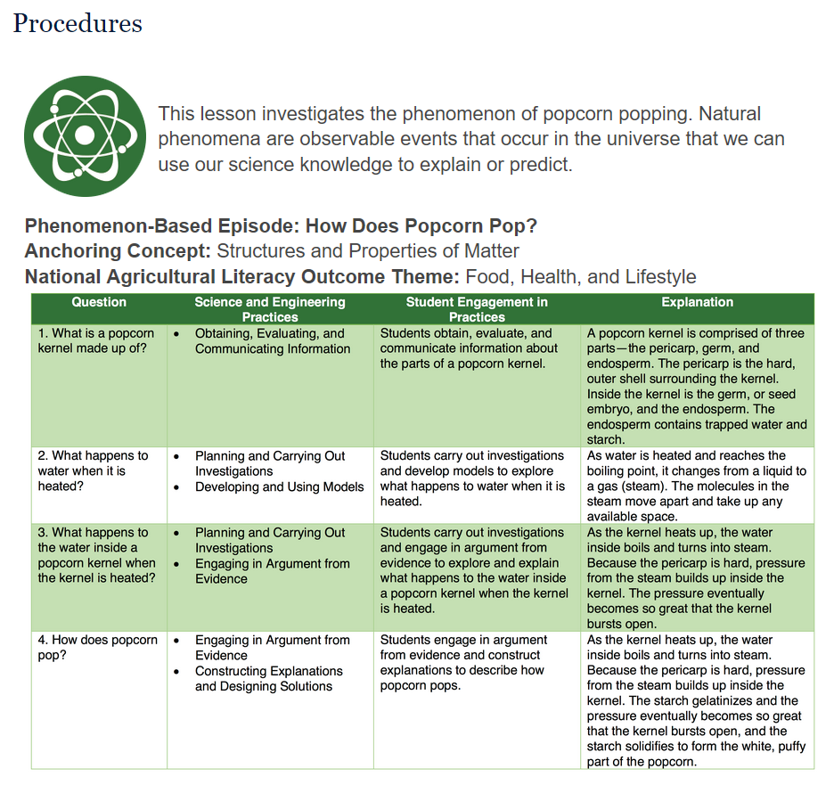
Get Popping!
Notes:
Lynn: (2-3 min)

Slide 17
Phenomena… Why does corn pop?
Notes:
Lynn: (5 min)
How Stuff Works: Popcorn (2:58 Min) - https://www.youtube.com/watch?v=q2lKV02JzPc
Google
https://books.google.com/books?id=sk69rBru61YC&printsec=frontcover#v=onepage&q&f=false

Slide 18
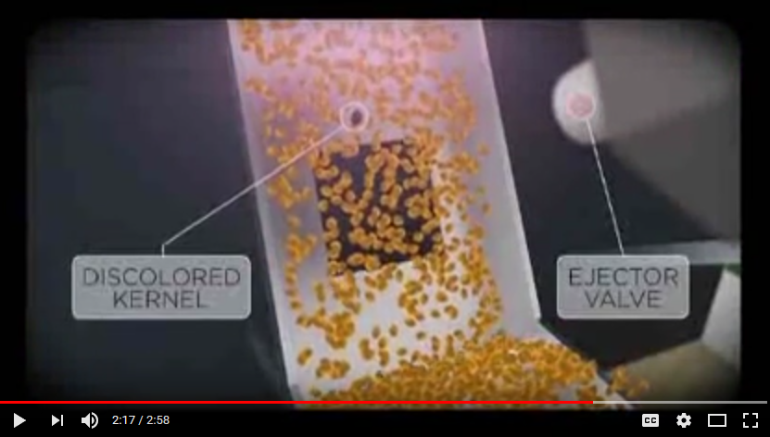
Exploding Corn and more in Gourmet Lab: The Scientific Principles Behind Your Favorite Foods, by Sarah Young
Notes:
Lynn: (3-4 min)
How Stuff Works: Popcorn (2:58 Min) - https://www.youtube.com/watch?v=q2lKV02JzPc
Google
https://books.google.com/books?id=sk69rBru61YC&printsec=frontcover#v=onepage&q&f=false

Slide 19
Science Storylines in Agriculture: Try it!
Post it Pile it: What are some ideas you have for a phenomena in agriculture where we can develop a storyline?
One note per person (individual idea)
In your group number off 1-6 (if there are 6 of you)
Number 1 then take you idea and share it paste in the middle of the table
Go in order (1-6) and place your idea in the middle of the table, if your idea is the same as someone else's, “pile” it on top
Look at your groups ideas and if there is one idea with more than any other select this…if not come to a consensus on the idea you like the best for a phenomena in agriculture (we’ll then collect all the notes).
Using the “Get Popping” lesson as a model to develop a phenomenon-based episode for a conceptual storyline (you can use multiple lessons).
Each group share!
Notes:
Deb: (10 min)
Post it Pile it…
Participants will follow sequence of PPT and have each person share ideas for phenomenon.

Slide 20
Science Storylines in Agriculture
YouTube list for storyline engagement in ag phenomena
http://bit.ly/agphenomena
Notes:
Deb: (10 min)
Deb will take this slide – Explain Playlist of phenomena
I created a YouTube list for storyline engagement in ag phenomena:
popcorn
ice cream
butter making
browning apple
plants growing toward the light
air holes and rising bread
free range chicken egg cost in the winter
pumpkin meltdown
food scraps to compost

Slide 21
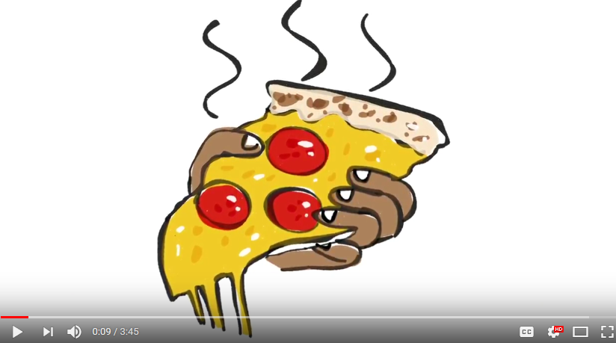
The phenomena of the flabby pizza
Watch 1:12 min of the 2017 1st Place Winner - Food Science In Action - The Mystery of The Flabby Pizza
Resist going on for now, just pause the video
Notes:
Deb: (If time allows)
Watch 1:12 of the 2017 1st Place Winner - Food Science In Action (FSIA) - The Mystery of The Flabby Pizza
Resist going on for now. What is going on? What :
https://www.youtube.com/watch?v=yZ5O0MCHHBY
1st place: ($1,000 prize) “Food Science Investigation - The Mystery of The Flabby Pizza” by Amadeus Driando Ahnan, from University of Massachusetts Amherst, Food Science Department

Slide 22
Connecting Lesson Phenomena to Anchor Phenomena in the NGSS Performance Expectations
How can these phenomena be explained? Lessons in the Storylines | NGSS: Topics
Decomposition: Where do all the leaves go? “The Rotten Truth” | 5th Grade: Matter and Energy in Organisms and Ecosystems – Compost & Decomposers
Erosion: How is soil moved by water? How far? Does soil type matter? “Splash Zone” | 4th Earth’s Systems – Erosion
Pollination: So many different types of flowers, how might these different flowers be pollinated? “Flower Power” | 2nd Grade: Interdependent Relationships in Ecosystems - Pollination
How do we know what spoils milk? “Blue’s the Clue: Souring Milk for Science” | Middle School Matter & Energy in Organisms
How does yeast get energy to raise dough? “Bread Dough Challenge” | High School Ecosystems: Interactions, Energy & Dynamics
Notes:
Max: (2-3 min)
Discuss the power of connecting to the NGSS DCI.
Disciplinary Core Idea.

Slide 23
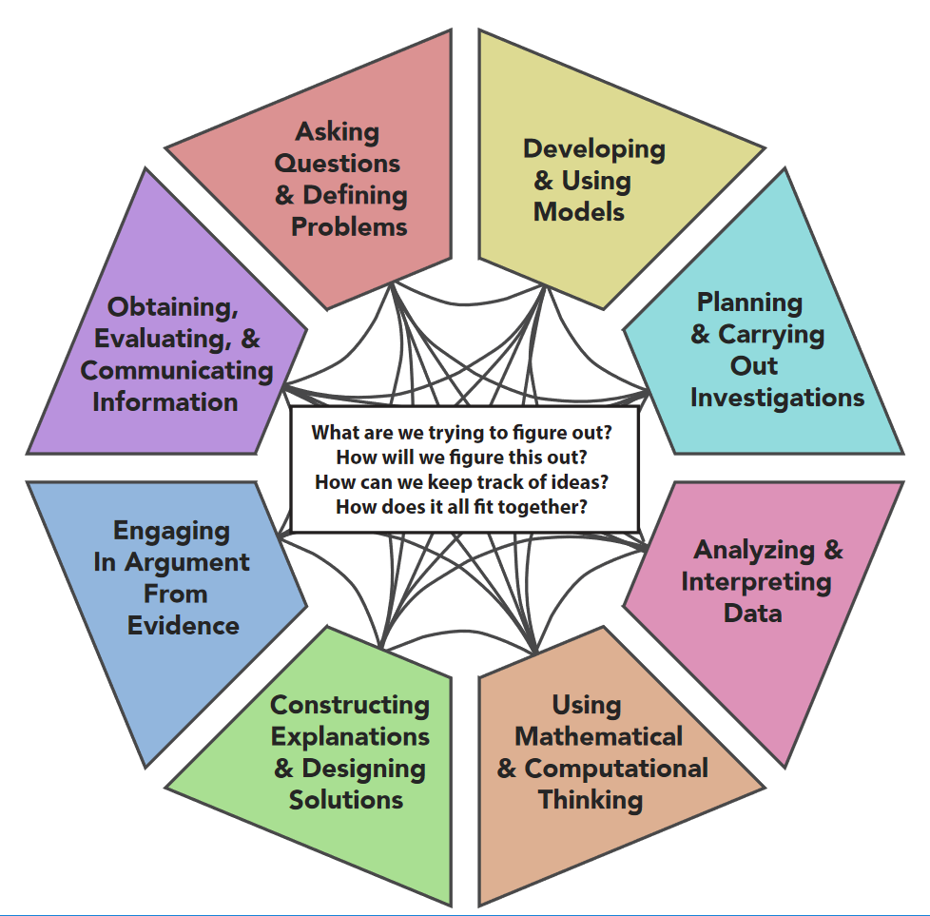
Science & Engineering Practices Web
Source: http://nextgenstorylines.org
Notes:
Max: (5 min)
Berland (2011) describes practices as the habits of mind and processes undertaken by communities of scientists as they work to develop explanations and arguments for explaining natural phenomena and/or leverage science for making informed decisions as citizens.

Slide 24
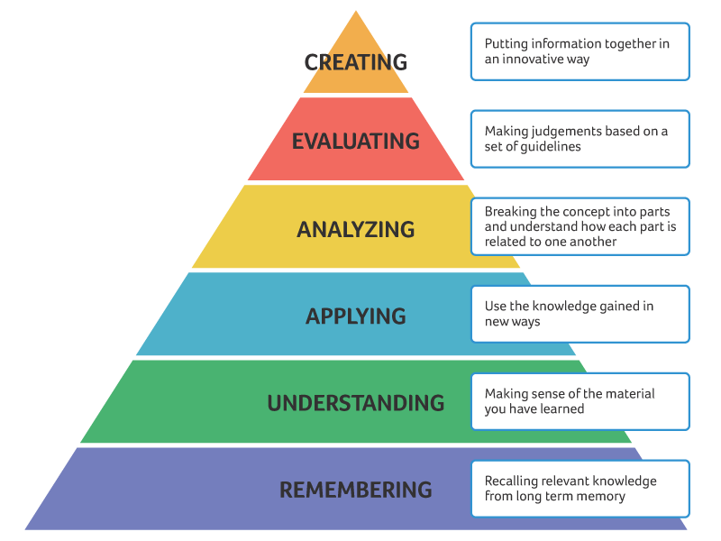
Rethink the way we design instruction with student centered approaches
Develop outcomes that require higher order thinking
Not just for science! Bloom’s Action Verbs
Notes:
Max: (2-3 min)
Who is asking the questions when we work with storylines, episodes, or specific phenomenon.

Slide 25
Questions?
Really want more…
EQuiP: https://www.nextgenscience.org/resources/ngss-equip-rubric-using-phenomena
KnowAtom Channel: https://www.youtube.com/channel/UCS0rbN0RfqaU1xaISrdVpTA
For more on phenomena and storylines, read the NSTA Science Scope articles from December - February.
Notes:
Max: (5 min)

Slide 26
Next Generation Science Standards Storylines, Phenomena, & 3-Dimensional Learning
Notes:
Conclusion…

