Slide 1
Engaging effectively In Conversations on Ag Sciences
Global Insights & Research April 2018

Slide 2
Overview of Market Research
OUR OBJECTIVES:
Understand consumers perceptions of core science platforms used in modern agriculture
Identify clear & compelling language for these core science platforms
Uncover key insights to drive improvement in engagement & communications

Slide 3
modern ag has given us the right approach
Using fewer natural resources
Digital tools and data
Looking forward, not back
Evolution, not revolution

Slide 4
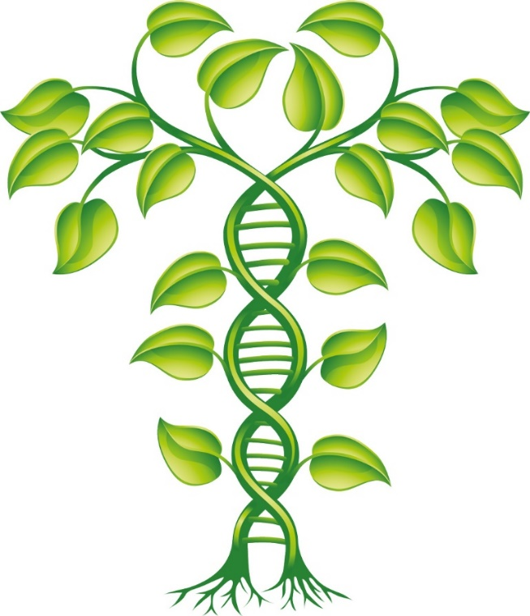
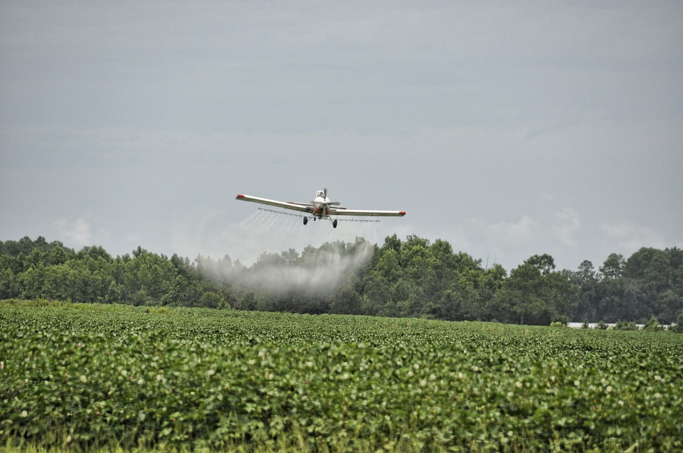
there's a GREAT opportunity to apply Learnings To Improve communications & Engagement
To a greater or lesser degree, technologies and solutions like plant breeding, gene editing, crop protection, and ag biologicals are unfamiliar to our audience
Importantly, there’s a great opportunity to move beyond pre-engrained narratives and mental images
Plant Science
Crop Protection

Slide 5
Five Things That Apply Across Technologies
1
2
3
4
5
The right analogies, metaphors feel personally relevant and human
The environment is a universal positive
Benefits to your audience greater than benefits to farmers
Bring in expert sources
whenever possible
Connect on shared values and be mindful of concerns
Notes:
LEE

Slide 6
how to tell the story varies by technology
Your audience is starting from a different place on each technology – and that impacts how you can communicate
UNDERSTANDING PERCEPTIONS OF NEW TECHNOLOGY
SEEMS MORE NATURAL
Agricultural biologicals
Plant breeding
LESS
FAMILIAR
MORE
FAMILIAR
MORE
FAMILIAR
Gene editing
Crop protection
SEEMS LESS NATURAL

Slide 7
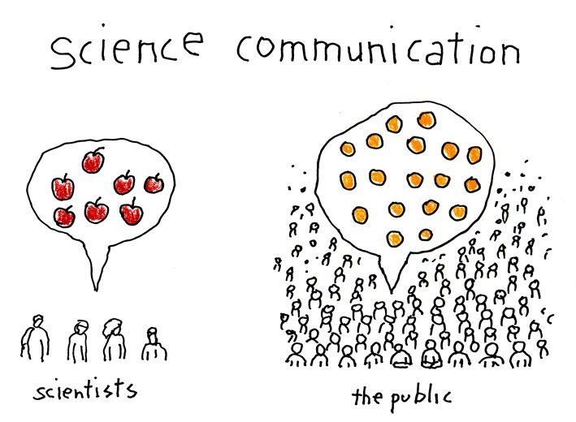
‘Communication about science
is just as important as the
science itself’
Notes:
We must tackle the huge challenge of learning to communicate effectively about science in a consistent, uniform and impactful way. We need to be able to help people understand what we’re working on, how the technologies are achieving all the benefits I’ve been talking about…and how those innovations benefit them personally. Improved communication is the gateway to meeting our other challenges.
How bad are our communications? You may have heard recent interviews with Alan Alda (and yes, that’s Alan Alda the actor from MASH, the host of Scientific American Frontiers on PBS, and an AAAS member) as he just published a book on the subject of science communication. It’s called, “If I Understood You, Would I Have This Look on My Face?” As Alan points out in his book, nothing could be more serious than this communication barrier across all sciences – not just agriculture. He writes: "People are dying because we can't communicate in ways that allow us to understand one another…it sounds like an exaggeration, but I don't think it is. When patients can't relate to their doctors and don't follow their orders, when engineers can't convince a town that the dam could break, when a parent can't win the trust of a child to warn her off a lethal drug. They can all be headed for a serious ending."
You could also add: When people suffer from diseases that could be easily prevented by vaccinations or when they spend $30B/year on supplements and miracle cures touted by Dr. Oz and the Food Babe. Or when governments let smallholder farmers suffer, along with those who rely on them, because they won’t them grow genetically modified crops.
In many ways, GM crops are the poster child for a science that is widely misunderstood – and how that lack of understanding can create major obstacles to adoption. We have tens of thousands of academic and industry scientists who have spent their careers working on research that they believe will make the world a better place. But there are detractors out there spreading the message that GMOs are poison, using things like Seralini’s debunked rat study as “evidence” – and if that’s the first or only message people have heard about GMOs, they’re likely to believe it.

Slide 8
Engagement & Education Opportunities around the sciences HAS GREAT POTENTIAL
Q12. Honestly speaking, how familiar are you with each of the following solutions used in the agriculture industry?

Slide 9
Sciences Can Benefit All Ag Systems, Consumer Awareness is key
Q13. Now, thinking about the same list, where do you think each of these practices are used? Please select the option that best completes the statement for each practice. This practice or product is used _________________

Slide 10
specific findings around ag sciences

Slide 11
Talking about Plant Breeding
DO… | DON’T…
Start conversations about plant advancements with plant breeding | Overuse the term “natural” when referring to plant breeding
Talk about plant breeding’s history – use triggering examples to unlock lost knowledge | Compare plant breeding with other types of breeding (animal, etc.)
Use examples of everyday fruits and veggies to connect plant breeding to daily life
Discuss how plant breeding provides consumers with greater choice beyond the food they eat

Slide 12
Talking about Gene Editing
DO… | DON’T…
Help by using an analogy to explain DNA to set the foundation for the science | Utilize alternative analogies that try to oversimplify the science
Connect the science to human medicine | Discuss medical applications outside of human illness and disease
Discuss how this science can also “preserve plant life” | Focus on more superficial uses of gene editing
Underscore that scientists, researchers and regulators are focused on the safe, responsible use of this technology

Slide 13
Talking about Crop Protection
DO… | DON’T…
Broadly talk about crop protection – and discuss how pesticides are one tool among many | Narrowly focus on one tool
Make clear that regulatory authorities rigorously assess pesticide safety | Inundate people with too many data and facts
Discuss how regulatory authorities continue to study pesticides after approval
Emphasize that farmers apply pesticides efficiently in a targeted way, and that digital tools are helping
Help people understand that all farmers look to use crop protection products to manage the threats they face on farm

Slide 14
How to Talk about Ag Biologicals
DO… | DON’T…
Start with how this science helps farmers to make better use of nature | Assume people understand this topic
Lead with microbials and connect them to everyday food and health to make them relatable | Overwhelm with technical descriptions of how cellular processes work
Highlight how ag biologicals positively impact both plant health and the environment (using less resources, protect plants, etc.)
Mention that conventional and organic farmers use biologicals as part of integrated management plans

Slide 15
trusted sources, mediums

Slide 16
Trusted voices as Sources
Q54. Thinking back to everything that you've heard about these practices (crop protection and pesticides, gene editing, plant breeding, agricultural biologicals) who would you most trust around the following topics? Select and rank your top three.

Slide 17
Trusted voices as Sources
Q54. Thinking back to everything that you've heard about these practices (crop protection and pesticides, gene editing, plant breeding, agricultural biologicals) who would you most trust around the following topics? Select and rank your top three.

Slide 18
Trusted voices as Sources
Q54. Thinking back to everything that you've heard about these practices (crop protection and pesticides, gene editing, plant breeding, agricultural biologicals) who would you most trust around the following topics? Select and rank your top three.

Slide 19
Understanding Social Channel Preference
Q53. Honestly speaking, which of the following social media outlets do you turn to most often to get news about food safety and how food is grown? Use a scale from 1 to 7, where 1 is the channel you get information from MOST often and 7 is the channel you get information from LEAST often.

Slide 20
Thank you.

