Slide 1
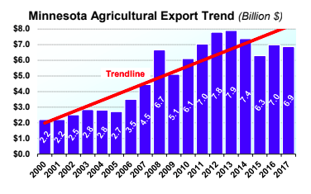
Minnesota Agriculture in the Global Economy:
Farm Producers, Products & Trade Partners
TRIVIA!
Notes:
Sources (including image credits): https://www.mda.state.mn.us/sites/default/files/2018-07/MNAgExportProfile2018.pdf
https://www.mda.state.mn.us/sites/default/files/inline-files/mnagprofile2019.pdf
(Give students five minutes to look over this profile & try to memorize it before the game?)

Slide 2
Academic Goals/Objectives:
Through this activity, students will be able to access prior knowledge and build new knowledge about Minnesota agriculture in the global economy, including being able to describe demographic characteristics about Minnesota’s farmers, farms, primary farm products, agricultural trade partners, and major agricultural imports and exports.
-MN Standards:
9.3.2.4.4 Describe patterns of production and consumption of agricultural commodities that are traded among nations
-AP Benchmarks:
Unit 5: Agriculture and Rural Land-Use Patterns and Processes; Topic 5.6, Agricultural Production Regions; Topic 5.7, Spatial Organization of Agriculture, PSO-5.C.4 (Explain how economic forces influence agricultural practices; complex commodity chains link production and consumption of agricultural products; Topic 5.9 The Global System of Agriculture; PSO-5.E.1-3 (food and other agricultural products are part of a global supply chain, some countries have become highly dependent on one or more export commodities, the main elements of global food distribution networks are affected by political relationships, infrastructure, and patterns of world trade

Slide 3
Connections to State/National/AP Standards & Benchmarks:
-MN Social Studies Standards:
9.3.2.4.4 Describe patterns of production and consumption of agricultural commodities that are traded among nations
-AP Human Geography Benchmarks (Course Description):
Unit 5: Agriculture and Rural Land-Use Patterns and Processes; Topic 5.6, Agricultural Production Regions; Topic 5.7, Spatial Organization of Agriculture, PSO-5.C.4 (Explain how economic forces influence agricultural practices; complex commodity chains link production and consumption of agricultural products); Topic 5.9 The Global System of Agriculture; PSO-5.E.1-3 (food and other agricultural products are part of a global supply chain, some countries have become highly dependent on one or more export commodities, the main elements of global food distribution networks are affected by political relationships, infrastructure, and patterns of world trade)
-Common Core:
Integration of Knowledge and Ideas:
CCSS.ELA-LITERACY.RH.9-10.7Integrate quantitative or technical analysis (e.g., charts, research data) with qualitative analysis in print or digital text.
Presentation of Knowledge and Ideas:
CCSS.ELA-LITERACY.SL.9-10.5Make strategic use of digital media (e.g., textual, graphical, audio, visual, and interactive elements) in presentations to enhance understanding of findings, reasoning, and evidence and to add interest.

Slide 4
Directions:
You will be assigned teammates (groups of 2 or 3)
Write your name at the top of your trivia sheet (EACH PERSON MUST COMPLETE HIS/HER/THEIR OWN SHEET & TURN IT IN at the end of the hour today)
Choose ONE team leader to be the official scribe; this person’s sheet will get scored by another team at the end of the game
Create a school-appropriate Team Name
Questions?
Notes:
Teachers:
-Consider using the Team Shake app to create groups/teams of 3 students
-More than 3 students and you start to see less engagement from each student
-Collect answer sheets from students at the end of each class period; this avoids students changing answers outside of class, forgetting their answer sheets for Day 2, and it allows for you to use answer sheets as an informal assessment
-Consider giving extra credit points to the winning teams, or another prize of your choosing

Slide 5
Directions (continued):
Discuss answers to questions quietly so other groups can’t “steal” your answers :)
You may not use any resources except your teammates’ combined knowledge (no books, no notes, no handouts, no internet, no phone, etc.)
Each member of the top three winning teams will get a prize :)
Have fun!
Questions?
Notes:
Teachers:
-Consider using the Team Shake app to create groups/teams of 3 students
-More than 3 students and you start to see less engagement from each student
-Collect answer sheets from students at the end of each class period; this avoids students changing answers outside of class, forgetting their answer sheets for Day 2, and it allows for you to use answer sheets as an informal assessment
-Consider giving extra credit points to the winning teams, or another prize of your choosing

Slide 6
Visual Round:
Minnesota’s Exports
-On the world map on your answer sheet, match the correct percentage of MN ag exports to the world region using the % bank, below; write the % of MN exports inside the correct world region on your map:
1 point for each correct match (percentage to region);
6 total possible points
45% .3% 38% 4% 9% 3%
Notes:
A: Give students %’s, have them guess which region the % goes with?
Sources: https://www.mda.state.mn.us/sites/default/files/inline-files/MNAgExportProfile2018_0.pdf
https://www.mda.state.mn.us/exporting-and-international-trade

Slide 7
Round 1:
Minnesota’s Farmers
Notes:
Source: www.nass.usda.gov/AgCensus

Slide 8
Round 1: Question #1
-In 2017, what percentage of farmers in MN were non-white/people of color?
3 points for team with closest guess
2 points for team with 2nd closest guess
1 point for team with 3rd closest guess
Notes:
Teachers: Feel free to use your own scoring system. We are trying to reward students for being close and keep engaged the game. To simplify you could just do an all-or-nothing scoring system or award points to any student/group within a certain range.
A: 1.4% farmers of color in MN in 2017; 1,593 farmers of color in MN in 2017 compared to 111,117 white farmers in MN in 2017 (112,710 total farmers in MN in 2017)
Sources: https://www.mprnews.org/story/2019/04/11/ag-census-2017-minnsota-snapshot
https://www.nass.usda.gov/Publications/AgCensus/2017/Full_Report/Census_by_State/Minnesota/
https://mn.gov/admin/assets/average-mn-farmer-is-55-popnotes-march2015_tcm36-219519.pdf
https://www.house.leg.state.mn.us/hrd/pubs/minnfarmer.pdf

Slide 9
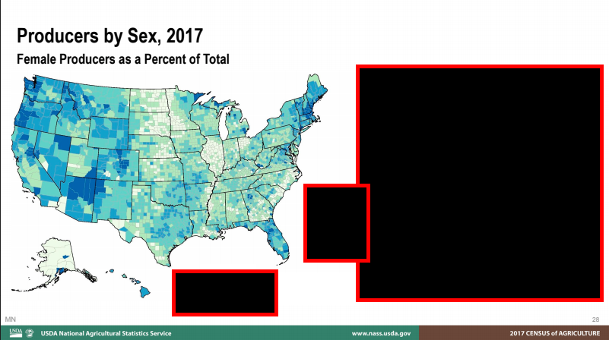
Round 1: Question #2
-In 2017, what percentage of Minnesota farmers were female?
3 points for team with closest guess
2 points for team with 2nd closest guess
1 point for team with 3rd closest guess
(The key has been hidden.)
Notes:
A: 31% (compared to 27% in the US)
Source: https://www.nass.usda.gov/Publications/AgCensus/2017/Full_Report/Census_by_State/Minnesota/

Slide 10
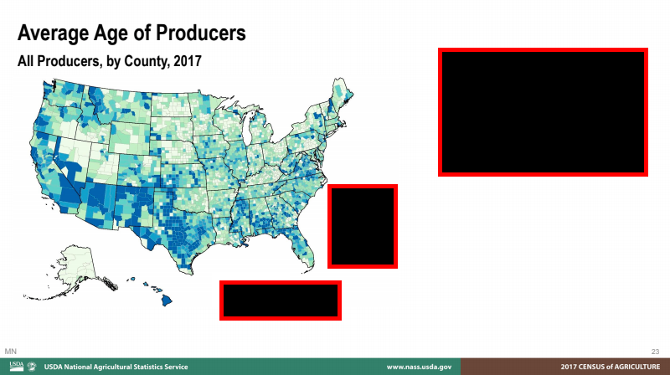
Round 1: Question #3
-What was the average age of farmers in MN in 2017?
3 points for team with closest guess
2 points for team with 2nd closest guess
1 point for team with 3rd closest guess
Notes:
A: 56.5 years old (compared to 57.5 years old US average)
Source: https://www.nass.usda.gov/Publications/AgCensus/2017/Full_Report/Census_by_State/Minnesota/

Slide 11
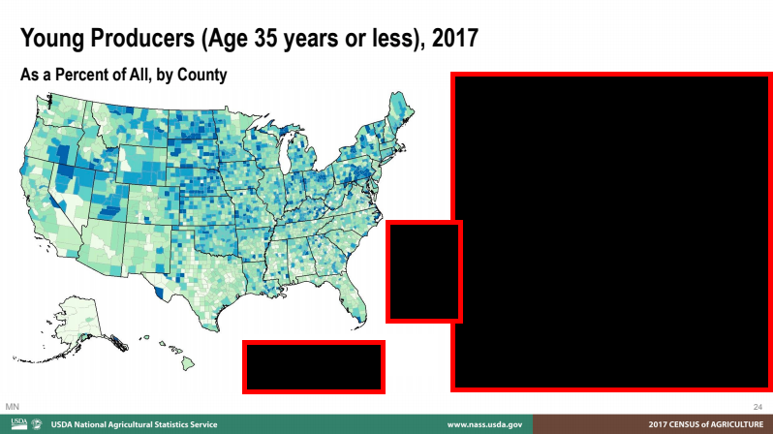
Round 1: Question #4
-In 2017, what percentage of Minnesota farmers were age 35 or less?
3 points for team with closest guess
2 points for team with 2nd closest guess
1 point for team with 3rd closest guess
Notes:
A: 10.3% (compared to 9.4% in the US)
Source: https://www.nass.usda.gov/Publications/AgCensus/2017/Full_Report/Census_by_State/Minnesota/

Slide 12
Round 1: Question #5
-In 2017, what percentage of Minnesota farmers were new to the profession (defined as having worked for 10 years or less on any farm)?
3 points for team with closest guess
2 points for team with 2nd closest guess
1 point for team with 3rd closest guess
Notes:
A: 21% ; compared to 27% in the whole USA
Source: https://www.nass.usda.gov/Publications/AgCensus/2017/Full_Report/Census_by_State/Minnesota/

Slide 13
Round 2:
Minnesota’s Farms
Notes:
Sources: https://www.mda.state.mn.us/sites/default/files/inline-files/mnagprofile2019.pdf

Slide 14
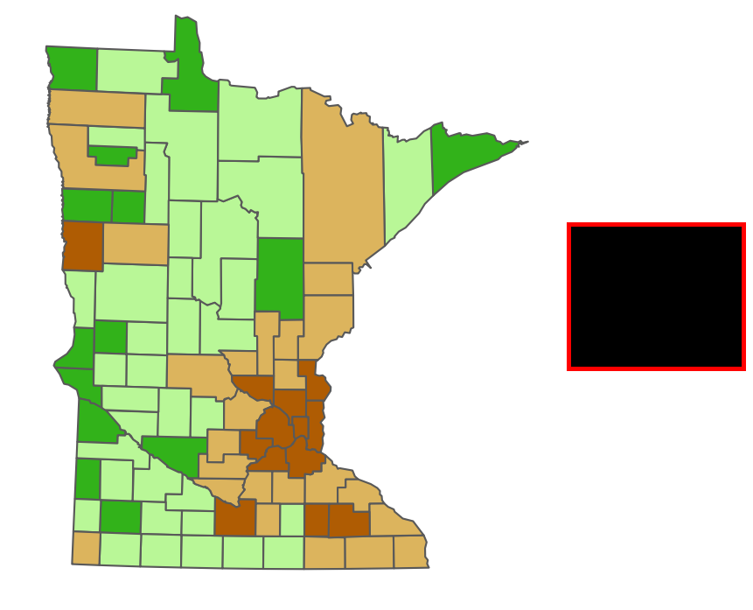
Round 2: Question #1
-What percentage of MN’s population was rural in 2019?
3 points for team with closest guess
2 points for team with 2nd closest guess
1 point for team with 3rd closest guess
Notes:
A: 23% (77% urban)
Source: https://www.mda.state.mn.us/sites/default/files/inline-files/mnagprofile2019.pdf
Image/map credit: https://center-for-rural-policy.shinyapps.io/Rural_Atlas/

Slide 15
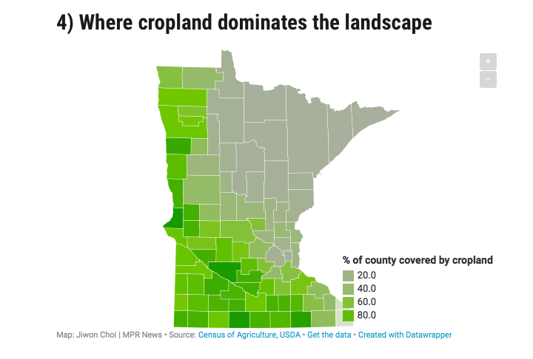
Round 2: Question #2
-MN is home to 26 million acres of farmland.
What percentage of MN’s total
land area was farmland in 2019?
3 points for team with closest guess
2 points for team with 2nd closest guess
1 point for team with 3rd closest guess
Notes:
A: 51% of total land area was farmland in 2019
Source: https://www.mda.state.mn.us/sites/default/files/inline-files/mnagprofile2019.pdf
Image/map credit: https://www.mprnews.org/story/2019/04/11/ag-census-2017-minnsota-snapshot

Slide 16
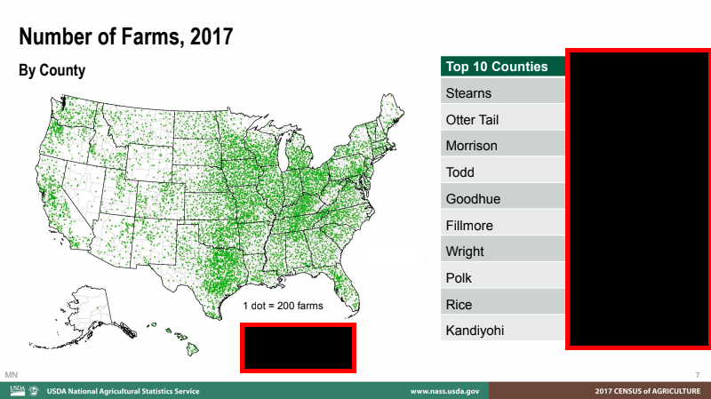
Round 2: Question #3
-By what percentage did the number of farms in MN change between 1997 and 2017? (Hint: Percentage change can be negative or positive.)
3 points for team with closest guess
2 points for team with 2nd closest guess
1 point for team with 3rd closest guess
Notes:
A: The number of farms in MN decreased from 78,755 in 1997 to 68,822 in 2017, representing a 12.6% decrease in the total number of farms in MN in two decades.
Source: 2017 Census of Agriculture Data Release for Minnesota (www.nass.usda.gov/AgCensus)

Slide 17
Round 2: Question #4
-What was the average farm size in MN in 2012 vs. 2017, in acres?
3 points for team with closest guess
2 points for team with 2nd closest guess
1 point for team with 3rd closest guess
(An acre is a little smaller than a football field)
Notes:
A: 349 acres in 2012; 371 acres in 2017; 6.3% increase
Source: https://www.nass.usda.gov/Publications/AgCensus/2017/Full_Report/Census_by_State/Minnesota/

Slide 18
Round 2: Question #5
-In 2019, where was MN ranked compared to other states (i.e. #1-50) in terms of total agricultural exports?
Hint: MN was ranked somewhere in the Top 10
1 point for team with closest guess
OR
1 point for each team with exact answer
1st?
4th?
9th?
Notes:
A: 5th
Source: https://www.mda.state.mn.us/sites/default/files/inline-files/mnagprofile2019.pdf

Slide 19
Round 3:
Minnesota’s Ag Production Regions
Notes:
Sources & Image/Map Credits: https://minnesota.agclassroom.org/educator/fft_mapcolor.cfm
https://www.mda.state.mn.us/sites/default/files/inline-files/MNAgExportProfile2018_0.pdf
https://www.mda.state.mn.us/exporting-and-international-trade

Slide 20
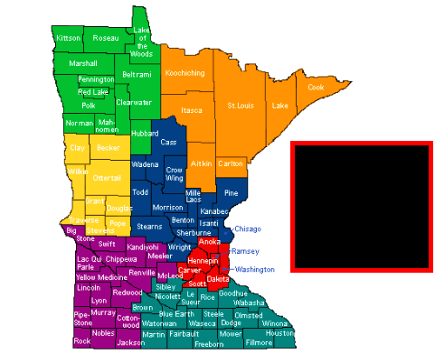
Round 3: Question #1
7 total possible points; 1 point for each correct match (products to region/color)
-This thematic choropleth map shows Minnesota’s
primary agricultural products by region in 2019.
Match the correct product/set of products to its
corresponding region (color) using this
word bank:
Metro Area - Crops/Dairy/Hogs - Forest Area Cash Grains - Sugar Beets/Wheat - Crops/Hogs Dairy/Cattle/Crops
Notes:
A: ORANGE=FOREST AREA; GREEN=SUGAR BEETS/WHEAT; YELLOW=CASH GRAINS; BLUE=DAIRY/CATTLE/CROPS; PURPLE=CROPS/HOGS; TEAL=CROPS/DAIRY/HOGS; RED=METRO AREA
Source: https://www.mda.state.mn.us/sites/default/files/inline-files/mnagprofile2019.pdf

Slide 21
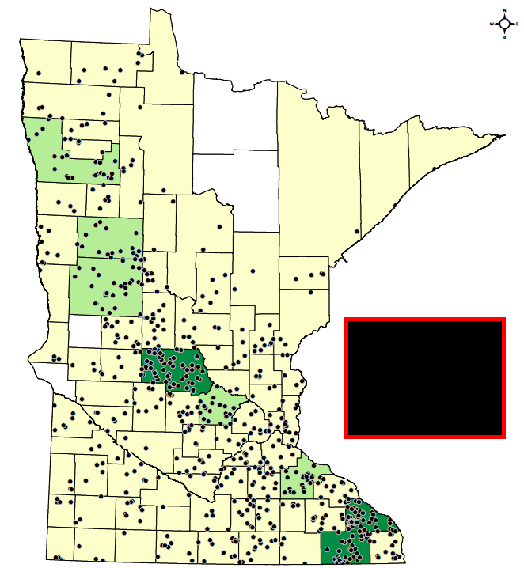
Round 3: Question #2
-What type of farm do you think the dots
in this dot map represent?
Organic Farms
Conventional Farms
Livestock Farms
Crop Farms
1 point
Notes:
A: Organic farms in MN (2014)
Source: https://minnesota.agclassroom.org/educator/fft/mapcolor20.pdf

Slide 22
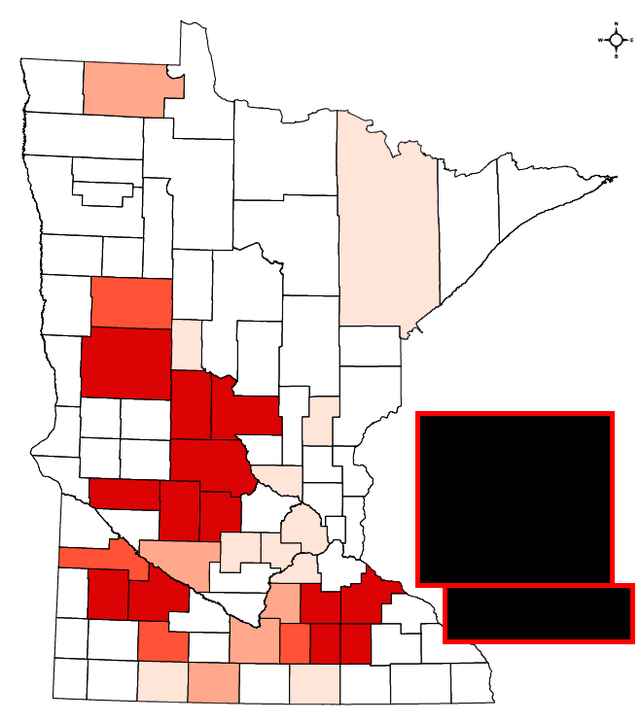
Round 3: Question #3
-Which type of livestock product (which
has important cultural significance to
most Americans) do you
think this thematic (choropleth) map is
displaying?
(The darker the red, the more of the animal.)
Hint: Jennie-O is a major MN company
that produces this product.
1 point
Notes:
A: Turkeys
For fun with answer (Jennie-O “Give Your Family the Bird” TV commercial: https://www.adforum.com/creative-work/ad/player/34587473/give-your-family-the-bird-30/jennie-o-oven-ready
Source: https://minnesota.agclassroom.org/educator/fft/mapcolor13.pdf

Slide 23
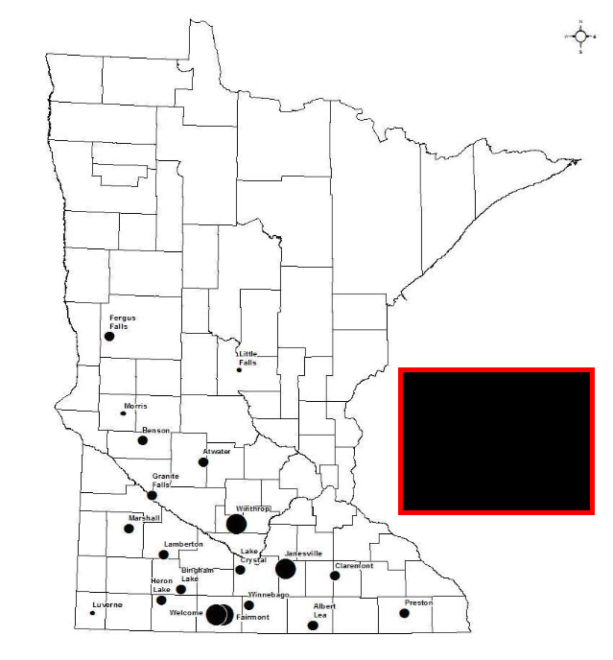
Round 3: Question #4
-In recent years, MN has been in the
Top 5 producers in the nation of this
biofuel, beaten out by states such as
Iowa, Nebraska, and Illinois.
1 point
Name the biofuel represented on
this graduated symbol map.
Notes:
A: Ethanol
Sources: https://minnesota.agclassroom.org/educator/fft/mapcolor27.pdf
https://www.eia.gov/todayinenergy/detail.php?id=31832

Slide 24
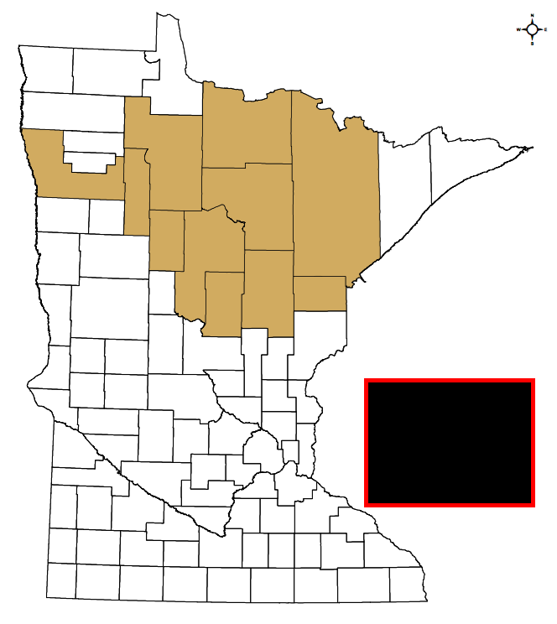
Round 3: Question #5
-What MN crop do you think this thematic
(choropleth) map is showing?
1 point
Hint: This crop has been important to the
Ojibwe people for centuries. It has a
higher protein content than most grains,
attracts waterfowl, and is worth $2 million
to MN’s economy each year.
Notes:
A: wild rice
Sources: https://minnesota.agclassroom.org/educator/fft/mapcolor16.pdf
https://www.dnr.state.mn.us/aquatic_plants/emergent_plants/wildrice.html

Slide 25
Sound Round:
MN’s Global Ag Trade Partners
Notes:
Suggestions to educators on Sound Round: If you have iTunes/Apple Music, Spotify, or another music streaming service, consider making a playlist for the Sound Round in advance; this allows you to play just excerpts of the songs, quickly, without having to take time to open a link on YouTube and wait to skip an Ad, etc., for each song; it also helps you avoid visuals that might give away the answers; it’s also fun to play the “Jeopardy” theme music while students collaborate on their answers to each question. You can also search each week’s pop charts at: https://www.billboard.com ; that will allow you to use current/updated pop songs from each country in your trivia game, which is engaging for students, but changes regularly; iTunes also compiles some “global” pop chart lists each day at: https://music.apple.com/us/playlist/top-100-global/pl.d25f5d1181894928af76c85c967f8f31 . You could also use the national anthems or highest grossing artists from each country to save yourself some time searching for current pop songs from each country.
Sources: https://www.mda.state.mn.us/sites/default/files/inline-files/MNAgExportProfile2018_0.pdf
https://www.mda.state.mn.us/exporting-and-international-trade
“Minnesota’s agricultural exports bring in $7.1 billion a year, and agricultural exports account for more than a third of the state’s total exports.
Our top export commodities include soybeans, corn, feed grains and processed feed, and pork. We’re also home to many leading processed food companies, whose products range from snack foods to frozen entries to bakery products.
Minnesota’s primary export markets are China, Mexico, Japan, Canada, South Korea, and Taiwan. However, emerging markets like Indonesia, Vietnam, the Philippines, and Colombia are beginning to gain importance for food and agricultural exporters.”

Slide 26
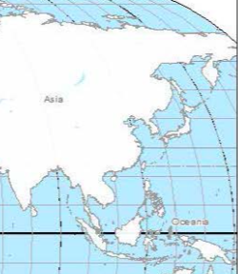
Sound Round: Question #1
-Which country accounts for 17% of MN’s agricultural exports, making it MN’s Number 1 agricultural trade partner?
Hint: 50% of all pigs on the planet live in this country; more than 90% of all farms in this country are smaller than 2.5 acres; many farmers in this country use terracing to increase yields; this country has to find innovative ways to feed its 1.4 billion population & is the world’s #1 producer of agricultural products such as cereals, cotton, fruits/vegetables, poultry/eggs & fish
1 point for country;
1 point for song title;
1 point for artist
-THIS SONG HAS BEEN AT THE TOP OF POP CHARTS IN THIS COUNTRY IN 2019-
-song from this country’s 2019 pop charts
Notes:
A: China
Sound Clue: “Bullet to the Heart” by Jackson Wang https://www.youtube.com/watch?v=NZbsCXrBcyA
Sources: https://www.mda.state.mn.us/exporting-and-international-trade
https://www.billboard.com/charts/billboard-china-social-chart
https://www.natgeokids.com/nz/discover/geography/countries/30-cool-facts-about-china/
https://www.nationalgeographic.com/magazine/2018/02/feeding-china-growing-appetite-food-industry-agriculture/#close
http://english.agri.gov.cn/aboutmoa/message/

Slide 27
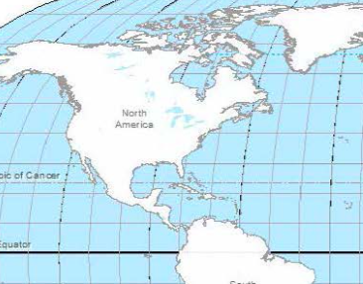
Sound Round: Question #2
-Which two nearby countries account, together, for almost 30% of MN’s agricultural exports?
1 point for each correct country (2 possible points)
Hint: One of these countries produces 76% of the world’s maple syrup; the other country exports more beer to the United States than any other country
-1st Sound Clue: EXCERPT FROM THE FIRST COUNTRY’S NATIONAL ANTHEM
-2nd Sound Clue: EXCERPT FROM A SONG ON THE SECOND COUNTRY’S 2019 POP CHARTS
Notes:
A: Canada (15%); Mexico (14%)
Sound Clue 1: “Oh, Canada” (instrumental): https://www.youtube.com/watch?v=hr6kzHTPY1Y
Sound Clue 2: “Kitipun” by Juan Luis Guerra
https://www.youtube.com/watch?v=hpkaifThmOs
https://www.billboard.com/charts/regional-mexican-albums
Sources: https://www.mda.state.mn.us/exporting-and-international-trade
http://www.agr.gc.ca/eng/industry-markets-and-trade/explore-canadian-food-products/canadian-maple-syrup/?id=1425998175145
https://www.nytimes.com/2019/06/01/business/what-goods-come-from-mexico.html

Slide 28
Sound Round: Question #3
-Which East Asian country is MN’s fourth largest agricultural trade partner, accounting for 9% of MN’s agricultural exports in 2019?
Hint: In 2014, this wealthy island country with an aging population built the world’s largest indoor farm, powered by 17,500 LED lights, which can churn out 10,000 heads of lettuce every day, using less than 1% of the water needed to grow the same crops outdoors (since no water is lost to evaporation or into the soil)
-THIS SONG WAS AT THE TOP OF POP CHARTS IN THIS COUNTRY IN 2019-
1 point for country; 1 point for song title; 1 point for artist (3 points possible)
Notes:
Additional hint/piece of information to share: this country is home to one of the largest mega-cities in the world (Tokyo) Students may have had or will be studying urbanization in Geography classes.
A: Japan
Sound Clue: “Pretender” by Official Hige Dandizumu https://www.youtube.com/watch?v=TQ8WlA2GXbk&feature=youtu.be&autoplay=1
https://www.billboard.com/charts/japan-hot-100
Sources: https://www.mda.state.mn.us/exporting-and-international-trade
https://www.google.com/amp/s/relay.nationalgeographic.com/proxy/distribution/public/amp/news/2014/7/140717-japan-largest-indoor-plant-factory-food

Slide 29
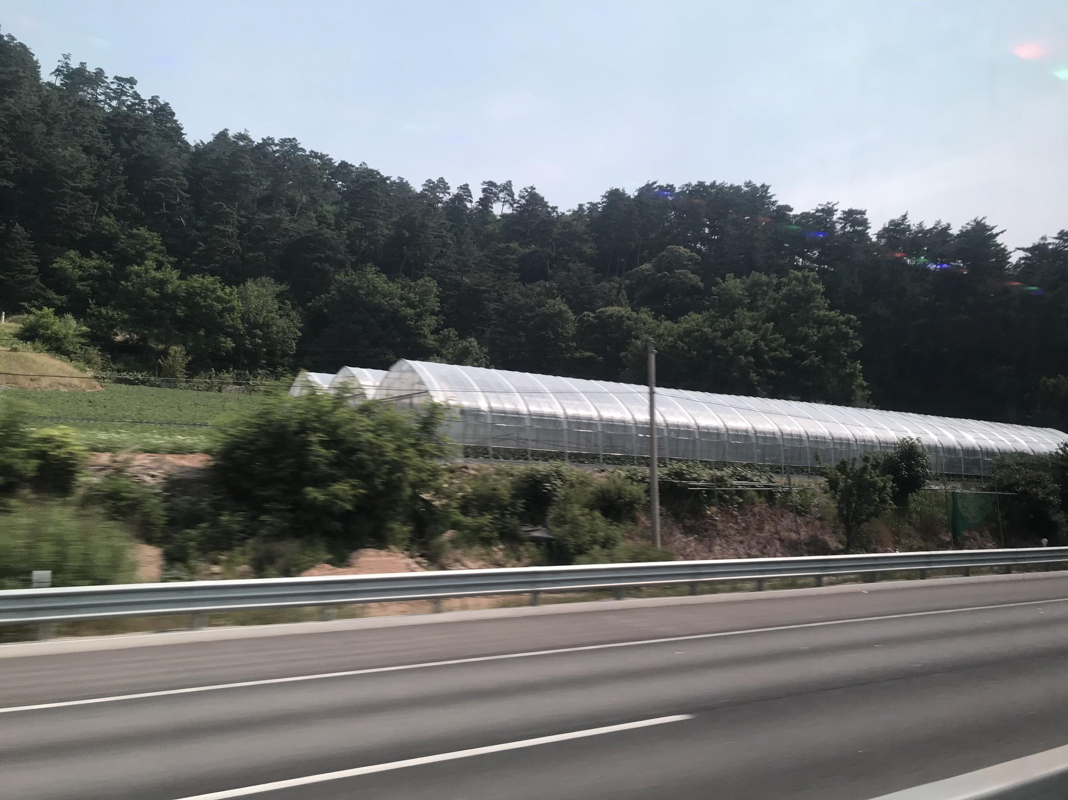
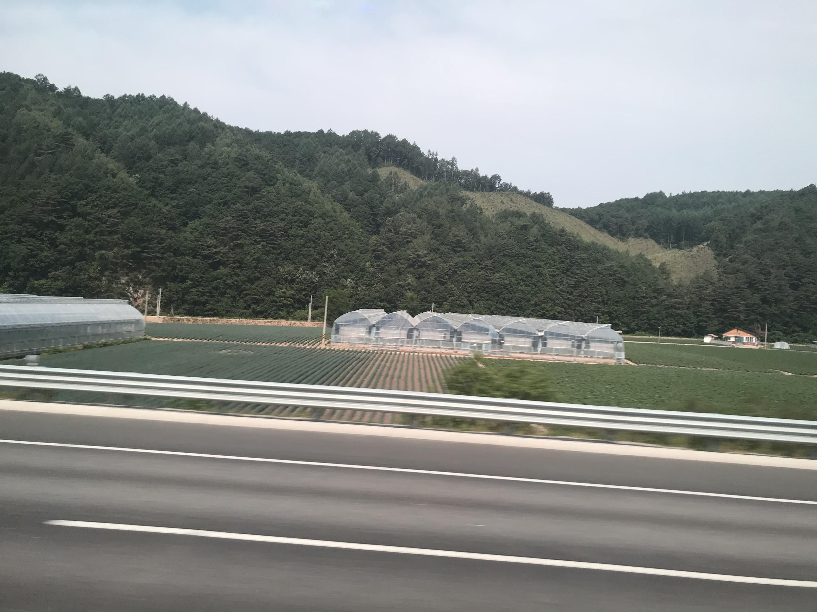
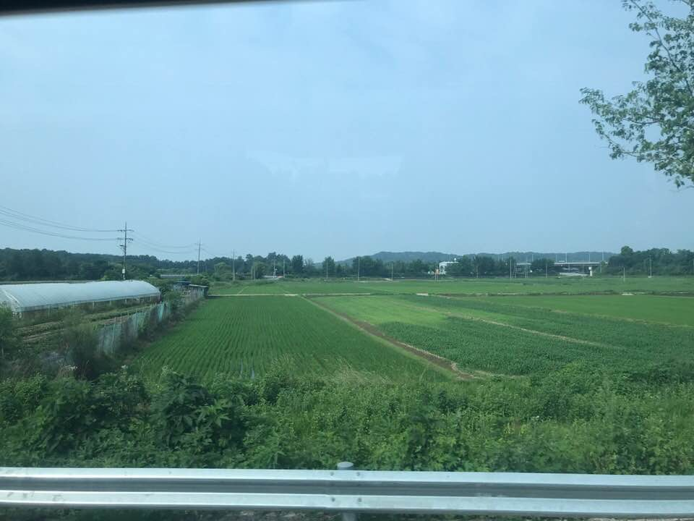
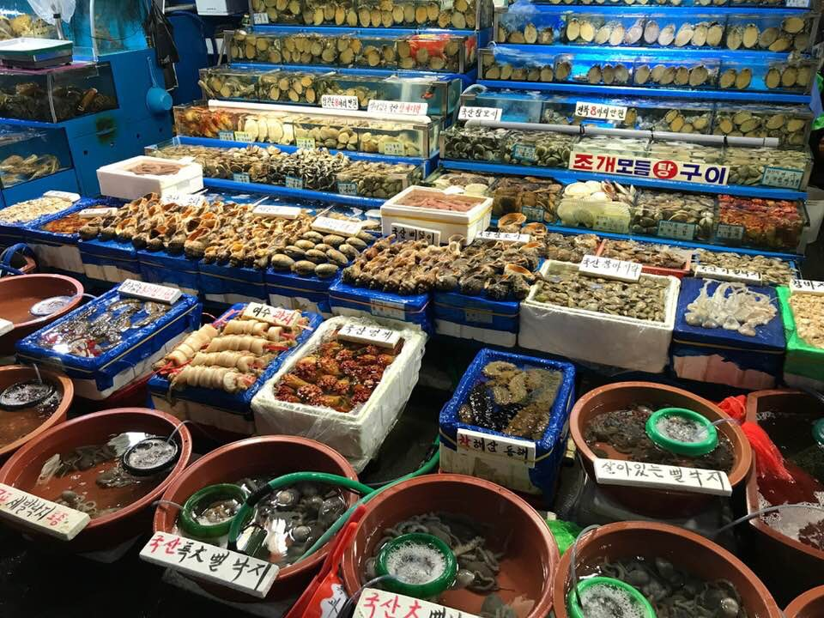
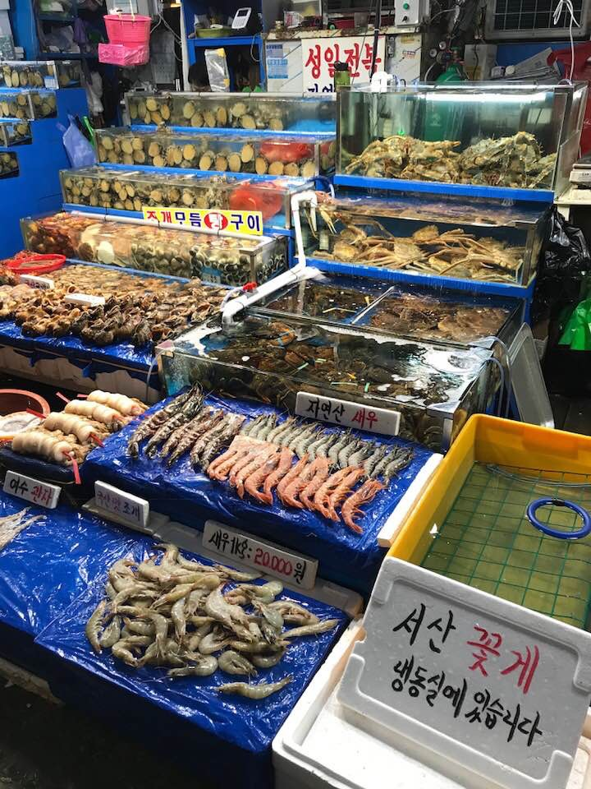
Sound Round: Question #4
Photos: Produce greenhouses
-Which East Asian country is MN’s fifth largest agricultural trade partner, purchasing 5% of MN’s agricultural exports in 2019?
Hint: In this country, even villagers who live inside the DMZ grow rice
to sell to tourists; because its physical geography is largely unsuitable
for agriculture, this country imports more than 60% of its food
-THIS SONG WAS AT THE TOP OF POP CHARTS IN THIS COUNTRY IN 2019-
1 point for country; 1 point for song title; 1 point for artist (3 points possible)
Photos: Seafood market
Notes:
A: South Korea
Sound Clue: https://www.billboard.com/charts/billboard-korea-k-pop-100
“Feel Special” by TWICE https://www.youtube.com/watch?v=3ymwOvzhwHs
Sources: https://www.mda.state.mn.us/exporting-and-international-trade
http://www.agr.gc.ca/eng/industry-markets-and-trade/international-agri-food-market-intelligence/reports/market-overview-south-korea/?id=1561662318603
Image/photo credits: Leah Hood, South Korea, June 2018; top 3 photos: produce greenhouses along the highway between Seoul and Pyongchang; bottom two photos: oldest seafood market in Seoul

Slide 30
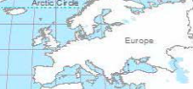
Sound Round: Question #5
-Which European country purchased 2% of MN’s agricultural exports in 2019?
Hint: This country may be famous for its orange soccer team, tulips, & windmills, but is also a global leader in sustainable agriculture, its farmers having reduced their water usage in farming by 90% in the past two decades; it is a global leader in production of tomatoes and other vegetables
-THIS ARTIST HAS BEEN AT THE TOP OF POP CHARTS IN THIS COUNTRY MANY TIMES IN RECENT YEARS-
1 point for country; 1 point for song title; 1 point for artist (3 points possible)
Notes:
A: The Netherlands
Song Clue: “Scared To Be Lonely “ by Martin Garrix featuring Dua Lipa https://www.youtube.com/watch?v=e2vBLd5Egnk
https://www.billboard.com/music/dutch
Sources: https://www.mda.state.mn.us/exporting-and-international-trade
https://www.nationalgeographic.com/magazine/2017/09/holland-agriculture-sustainable-farming/

Slide 31
Round 4:
MN’s Emerging Ag Trade Markets
“[E]merging markets are increasingly importing soybeans and soybean products, corn and corn products, feed, wheat, red meat, dairy, poultry, and processed food [from MN producers].” -Su Ye, Chief Economist, MN Dept. of Agriculture (via email 10/18/19)
Notes:
Sources: https://www.mda.state.mn.us/sites/default/files/inline-files/mnagprofile2019.pdf
https://www.mda.state.mn.us/exporting-and-international-trade
https://blog.nationalgeographic.org/2016/09/03/booming-seaweed-farming-exposes-producers-and-environment-to-risks-experts-warn/
“Minnesota’s primary export markets are China, Mexico, Japan, Canada, South Korea, and Taiwan. However, emerging markets like Indonesia, Vietnam, the Philippines, and Colombia are beginning to gain importance for food and agricultural exporters.”
emerging markets like Vietnam, the Philippines, Colombia, and Thailand are beginning to gain importance for food and agricultural exporters.”
The emerging markets are increasingly importing soybeans and soybean products, corn and corn products, feed, wheat, red meat, dairy, poultry, and processed food.
Minnesota ag imports include wine/beer, fresh fruits/vegetables, snack food, seafood, nursery products, coffee, tea, spices.
From Mexico, Canada, China, Italy, and France (top 5) (Su Ye, Chief Economist, MN Dept. of Ag, email correspondence, 10/17/19)

Slide 32
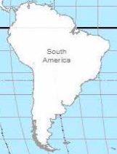
Round 4: Question #1
-Which South American country is one of MN’s top emerging markets for agricultural products?
Hint: This country’s capital is Bogotá; its coffee growers are largely
small family farmers, but the country’s long standing internal conflict
with the FARC has put a strain on the regional coffee industry
1 point
Notes:
A: Colombia
Sources: https://www.nationalgeographic.com/travel/destinations/south-america/colombia/partner-content-growing-coffee-and-community-caqueta-colombia/

Slide 33
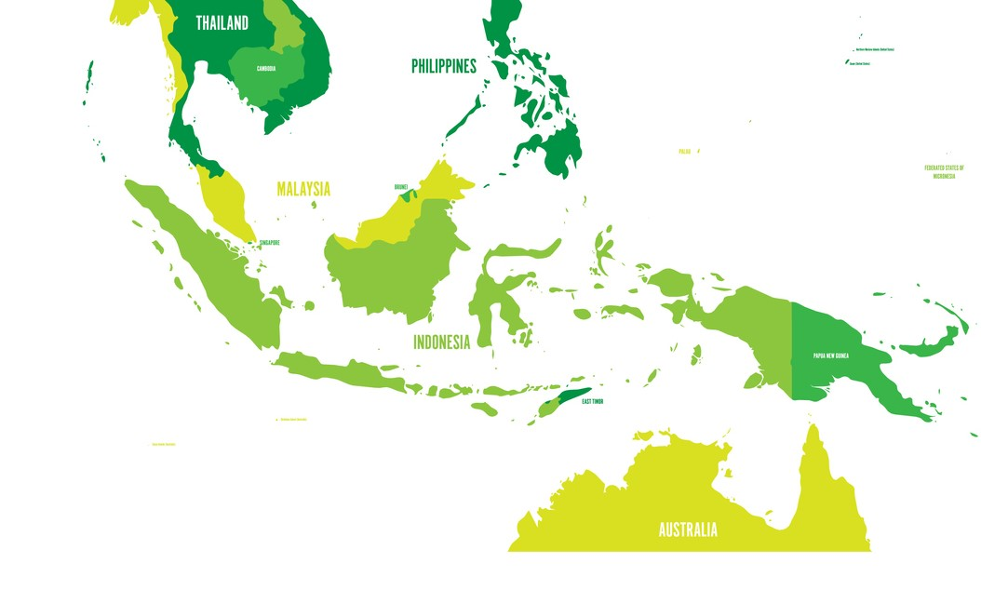
Round 4: Question #2
-Which island country in Southeast
Asia is one of MN’s top emerging
markets for agricultural
products?
Hint: This country is lime green on the map. It is the fourth most populous in the world, and is the world’s largest Muslim country; more than 40% of people are employed in agriculture, and it is the largest economy in Southeast Asia; it has experienced significant deforestation due to the palm oil industry; in recent years, global warming has caused more farmers to migrate within this country than natural disasters such as earthquakes and volcanoes
1 point
?
Notes:
A: Indonesia
Sources: https://www.google.com/amp/s/relay.nationalgeographic.com/proxy/distribution/public/amp/news/2014/6/140623-migration-climate-indonesia-temperature-science
http://www.agr.gc.ca/eng/industry-markets-and-trade/international-agri-food-market-intelligence/reports/market-overview-indonesia/?id=1475075685743

Slide 34
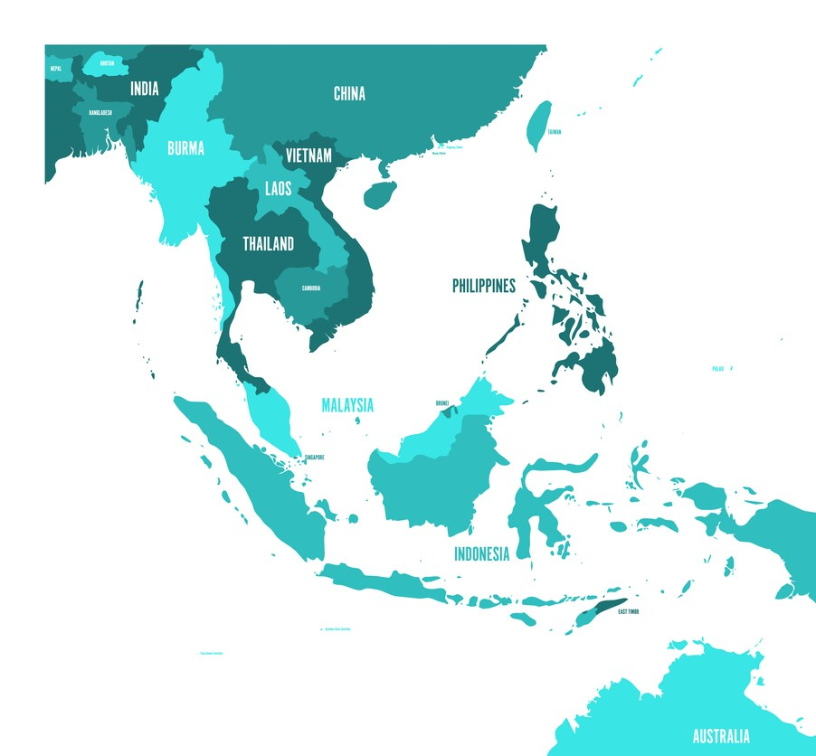
Round 4: Question #3
-Which Southeast Asian country is one of MN’s top emerging markets for agricultural products?
Hint: Around 90% of this country’s population is Buddhist;
its capital is called “The Venice of the East” due to its 83 canals
and floating markets; farmers in this country grow mulberry
trees that feed silkworms; agriculture and tourism are this
country’s largest economic sectors
1 point
Notes:
A: Thailand
Sources: https://kids.nationalgeographic.com/explore/countries/thailand/

Slide 35
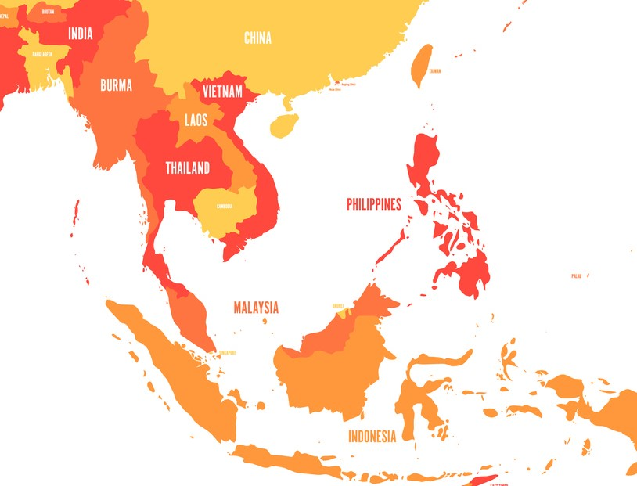
Round 4: Question #4
-Which Southeast Asian country is one of MN’s top emerging markets for agricultural products?
Hint: This communist country is one of the fastest growing economies in the region; its most important crop is rice; this country exports significant quantities of seafood
and coffee, and some farmers tend to tea plantations
1 point
Notes:
A: Vietnam
Sources: https://kids.nationalgeographic.com/explore/countries/vietnam/
http://www.agr.gc.ca/eng/industry-markets-and-trade/international-agri-food-market-intelligence/reports/market-overview-vietnam/?id=1556291175591
https://www.bbc.com/news/world-asia-pacific-16567315

Slide 36
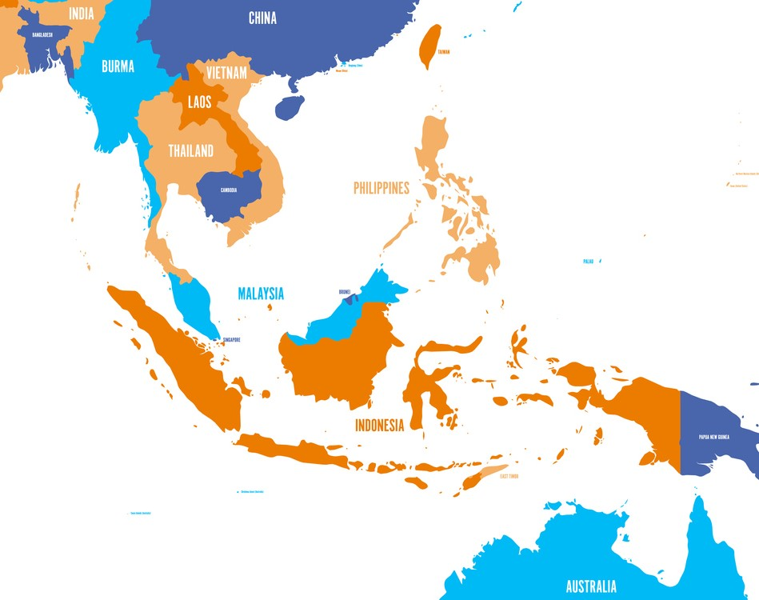
Round 4: Question #5
-Which Southeast Asian country is one of MN’s top emerging markets for agricultural products?
Hint: For thousands of years, a major crop for this island country (an archipelago made up of more than 7,100 islands) has been rice, grown in flooded rice paddies on
terraces; however, due to urbanization, 25-30% of the terraces
are now abandoned, as more and more young people move to
cities; other important crops include sugarcane, mangos,
bananas, pineapples, and coconuts
1 point
Notes:
A: The Philippines
Emerging markets are increasingly importing soybeans and soybean products, corn and corn products, feed, wheat, red meat, dairy, poultry, and processed food. (Su Ye, 10/17/19)
Sources: https://www.google.com/amp/s/relay.nationalgeographic.com/proxy/distribution/public/amp/travel/world-heritage/philippine-rice-terraces
https://kids.nationalgeographic.com/explore/countries/philippines/
https://kids.nationalgeographic.com/explore/countries/philippines/

Slide 37
Round 5:
MN’s Agricultural Exports & Imports
Notes:
Sources: https://www.mda.state.mn.us/sites/default/files/inline-files/mnagprofile2019.pdf
Minnesota ag imports include wine/beer, fresh fruits/vegetables, snack food, seafood, nursery products, coffee, tea, spices.
From Mexico, Canada, China, Italy, and France (top 5) (Su Ye, Chief Economist, MN Dept. of Ag, email correspondence, 10/17/19)

Slide 38
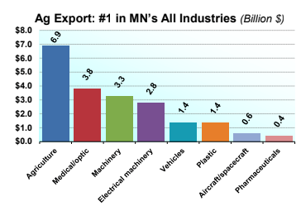
Round 5: Question #1
-MN’s agricultural exports accounted for what fraction/percentage of the state’s total merchandise exports in 2017?
3 points for team with closest guess
2 points for team with 2nd closest guess
1 point for team with 3rd closest guess
Notes:
A: ⅓ (33%)
Source: https://www.mda.state.mn.us/sites/default/files/inline-files/mnagprofile2019.pdf

Slide 39
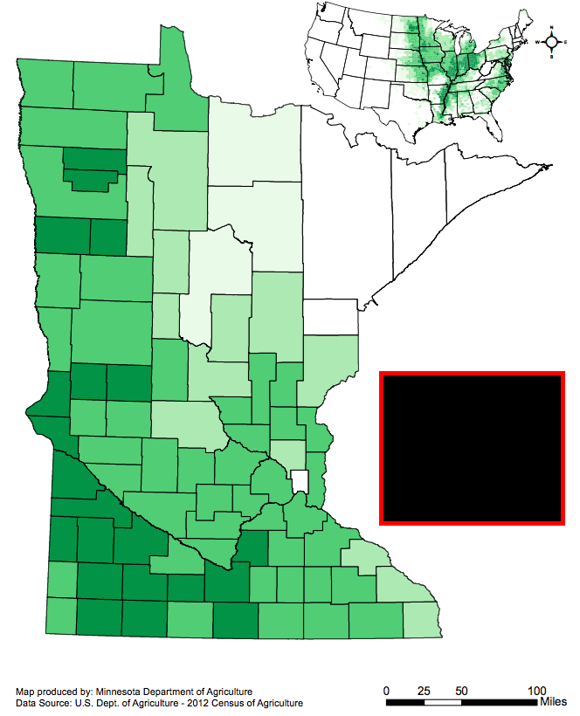
Round 5: Question #2
-Which agricultural product is MN’s most
exported commodity, making up 27% of
the state’s ag exports in 2019?
Hint: It’s a crop.
1 point
Notes:
A: Soybeans
Sources: https://www.mda.state.mn.us/sites/default/files/inline-files/mnagprofile2019.pdf
Image/map credit: https://minnesota.agclassroom.org/educator/fft_mapcolor.cfm

Slide 40
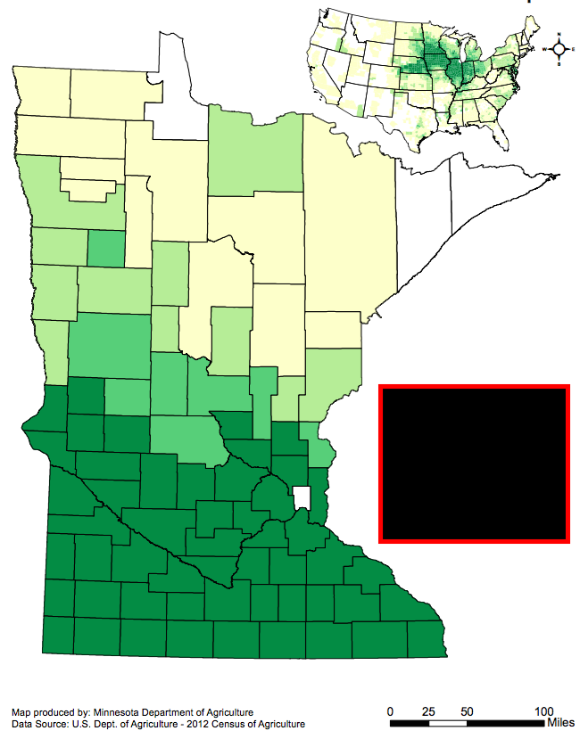
Round 5: Question #3
-At 13% of the state’s exports in 2019,
which farm product is MN’s second largest
agricultural export?
Hint: It’s a crop.
1 point
Notes:
A: Corn
Sources: https://www.mda.state.mn.us/sites/default/files/inline-files/mnagprofile2019.pdf
Image/map credit: https://minnesota.agclassroom.org/educator/fft_mapcolor.cfm

Slide 41
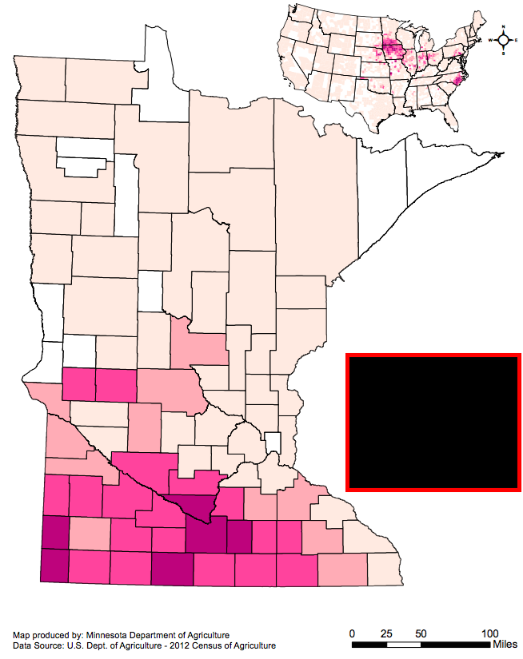
Round 5: Question #4
-Which agricultural commodity accounted for
12% of MN’s agricultural exports in 2019?
Hint: It’s livestock.
1 point
Notes:
A: Pork
Sources: https://www.mda.state.mn.us/sites/default/files/inline-files/mnagprofile2019.pdf
Image/map credit: https://minnesota.agclassroom.org/educator/fft_mapcolor.cfm

Slide 42
Round 5: Question #5 ...THE GRAND FINALE!!
-What do you think are the Top 10 agricultural products that MN imports from other countries? (List them.)
-What do you think are the Top 5 countries from which MN imports agricultural products? (List them.)
1 point for each correct product in Top 10 Imports
1 point for each correct country in Top 5 Countries Imported From
(15 possible points!!)
Notes:
A: MN Imports: wine, beer, fresh fruits, vegetables, snack food, seafood, nursery products (nursery/horticultural products include floricultural crops and greenhouse plants, i.e., cut flowers/greens, flowering & shade trees & shrubs, foliage/fruit/nut plants, bedding plants, etc.), coffee, tea, spices
A: MN Imports from: Mexico, Canada, China, Italy, and France
Sources: https://www.mda.state.mn.us/sites/default/files/inline-files/mnagprofile2019.pdf
Minnesota ag imports include wine/beer, fresh fruits/vegetables, snack food, seafood, nursery products (nursery/horticultural products include floricultural crops and greenhouse plants, i.e., cut flowers/greens, flowering & shade trees & shrubs, foliage/fruit/nut plants, bedding plants, etc.), coffee, tea, spices.
From Mexico, Canada, China, Italy, and France (top 5) (Su Ye, Chief Economist, MN Dept. of Ag, email correspondence, 10/17/19)

Slide 43
The end!
-Check your team’s master score sheet
-Trade papers with another team (you may not score your own team’s sheet)
-Check another team’s answer sheet
-Add up their score for each Round
-Add up their total score for all Rounds
-Return scored answer sheets to original owners
-Determine 1st, 2nd, & 3rd place winning teams

