Slide 1
Apple Genetics

Slide 2
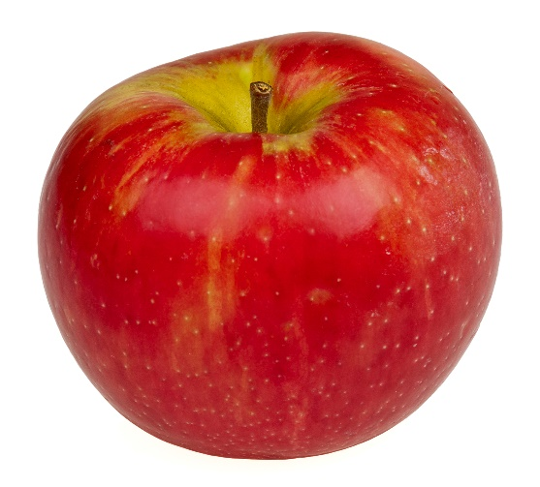
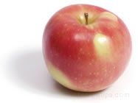
What similarities and differences did you find between the two apples?
Honeycrisp
Zestar!
Notes:
Facilitate large group discussion. Ask students what similarities and differences they found between the Honeycrisp and Zestar! apple. Ask students which apple they preferred.

Slide 3
Genetics Vocabulary Review
Gene: a section of DNA that codes for a certain trait
Allele: a variant of a gene
Dominant Allele: an allele whose trait always shows up in the organism when the allele is present (written as uppercase letter)
Recessive Allele: an allele that is masked when a dominant allele is present (written as lower case letter)
Genotype: an organism's genetic makeup or allele combinations
Phenotype: an organism's physical appearance or visible trait
Punnett Square: a diagram that is used to predict an outcome of a particular cross or breeding experiment
Homozygous : having 2 identical alleles for a trait
Heterozygous: having 2 different alleles for a trait
Notes:
Review basic genetics vocabulary with students. Use your judgement to see if you need to review these terms with your students.

Slide 4
Apple Genotypes
Here are examples of genotypes that the Honeycrisp and Zestar! apples may possess
Sweetness is recessive (Honeycrisp’s genotype is ss, Zestar’s genotype is Ss)
Juiciness is dominant (Honeycrisp’s genotype is Jj, Zestar’s genotype is Jj)
Crunchiness is dominant (Honeycrisp’s genotype is Cc, Zestar’s genotype is cc)
Red skin coloring is dominant (Honeycrisp’s genotype is RR, Zestar’s genotype is Rr)
Smooth skin texture is dominant (Honeycrisp’s genotype is Bb, Zestar’s genotype is Bb)
Notes:
When making observations in Part 1, you described traits for each apple such as color, juiciness, or sweetness. The genes in the apple determine these traits. Below are examples of genotypes that the Honeycrisp and Zestar! apples may possess. You will use this information to complete Punnett Squares on the following page.

Slide 5
Punnett Square Activity
Complete Punnett Squares for each trait to illustrate genetic cross
Honeycrisp Apple Genotype (Female)
s
s
Probabilities
______% SS (not sweet)
______% Ss (not sweet)
______% ss (very sweet)
S
Ss
Ss
0
Zestar! Apple
Genotype (Male)
50
50
s
ss
ss
Notes:
Students will complete Punnett Squares for each of the traits on the worksheet. Students will also determine probabilities of possible genotypes.

Slide 6
SweeTango Apple
Fusion between Honeycrisp and Zestar! apple
Developed at the University of Minnesota
“Juicy and sweet with hints of fall spices”
SweeTango was introduced in 2009 as a “managed variety”. Commercial growers in Minnesota must be licensed to grow SweeTango apples. Growers outside of Minnesota must be licensed members of the growers cooperative, Next Big Thing (NBT).

Slide 7
Crossbreeding Apples
SweeTango apple is the result of crossbreeding
Goal is to make better quality apples
Breeders must look at both genotypes and phenotypes of apples
Must decide on what traits they hope to see in new apple
Often use a backcrossing approach – successive generations of apples with the trait of interest are crossed with different high quality parent apples at each generation
Process typically takes 15 years
Some consider crossbreeding a genetic modification
Notes:
Here are some facts about crossbreeding apples. The goal of crossbreeding is to produce better quality apples and select particular traits they hope to see in their offspring.

Slide 8
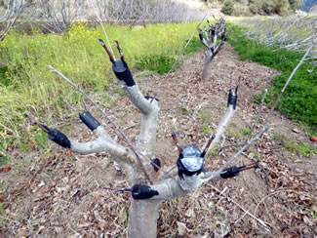
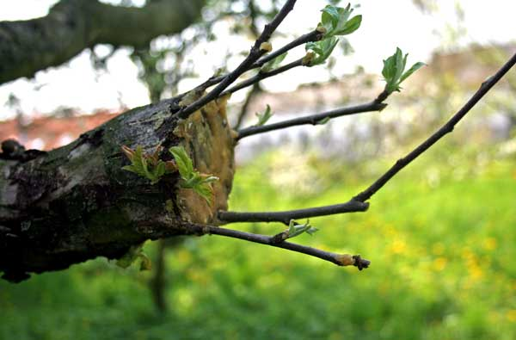
Grafting
Most apples are not grown from seed
Most apple trees originate from method called grafting
A section of a stem with leaf buds is inserted into another tree
Allows the tree to skip the juvenile phase which may last 5-9 years.
Notes:
Students may believe that apple trees grow from seeds. However, a practice known as grafting is used. This is where a section of a stem with leaf buds is inserted into the stock of a tree. This allows the tree to skip the juvenile phase which may have lasted 5-9 years. http://www.writerguy.com/deb/compost/2011Winter/WinterNws10-2011.html
http://www.homengardeningtips.com/grafted-fruit-trees

