Slide 1
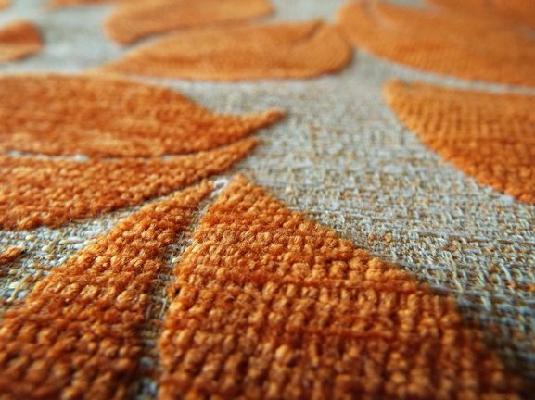
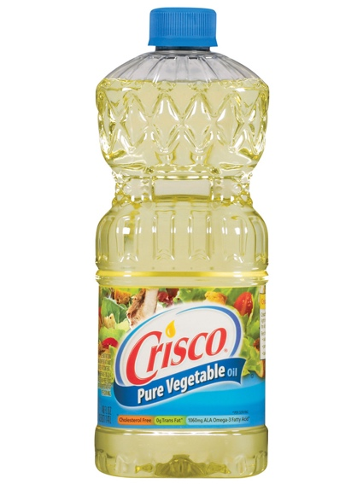
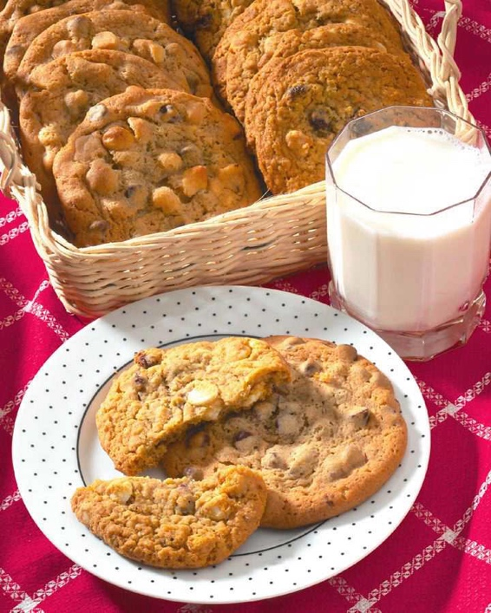
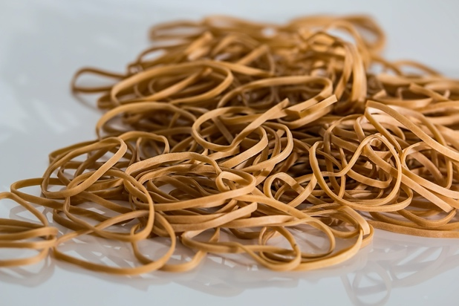
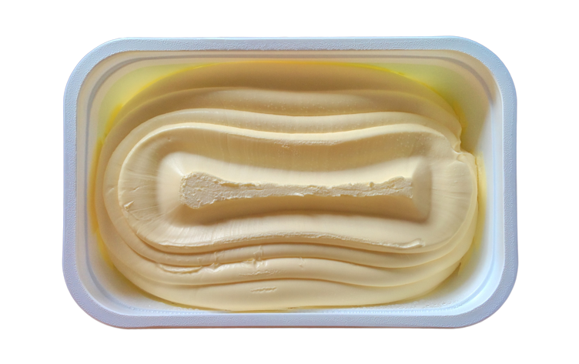
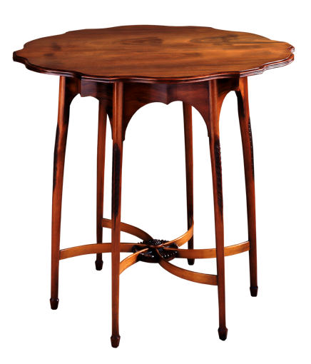
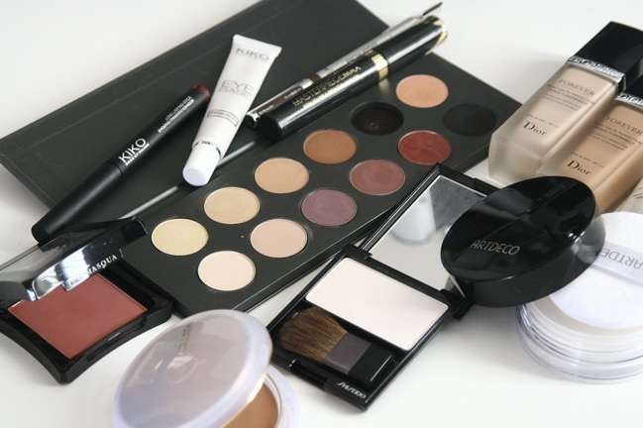
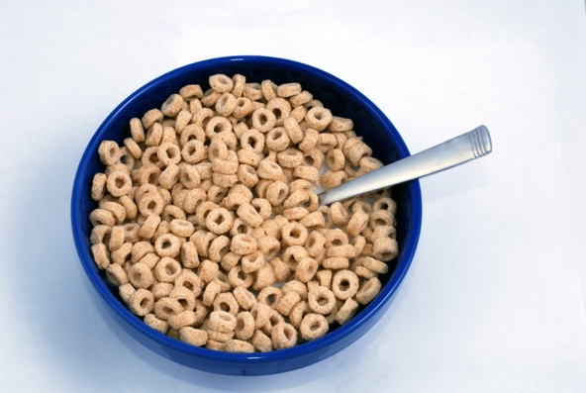
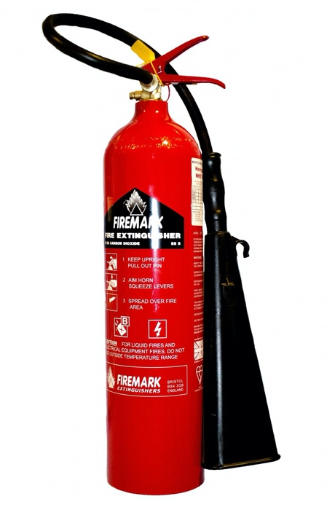
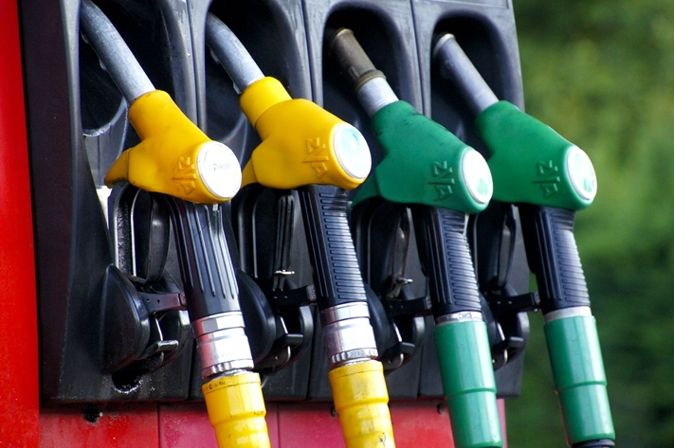
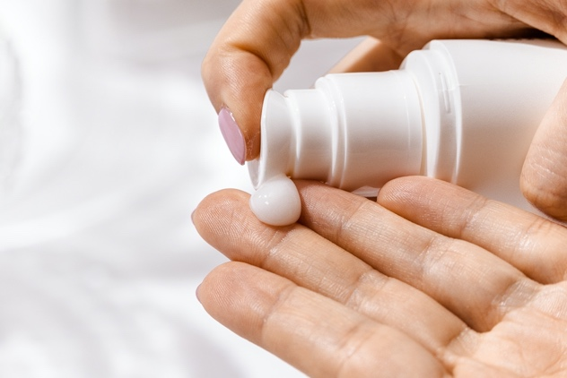
Carpet
Paint
Cooking Oil
Baked Goods
Rubber
Crayons
?
Margarine
Furniture
Cosmetics
Cereal
Biodiesel
Fire Extinguisher Foam
Candles
Sunscreen
Notes:
What common ingredient do all these products contain?

Slide 2
What is it?
It was first brought to the United States from China in 1765.
The United States now leads the world in its production.
75,000,000 acres of U.S. farmland are used to grow it.

Slide 3
What is it?
This is where it is grown in the United States

Slide 4
What is it?
It is 18% oil and 38% protein.
Most baked breads, cookies, crackers, and cakes contain its oil.
It contains all eight amino acids, which are essential for human health.

Slide 5
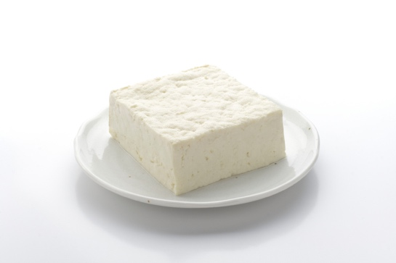
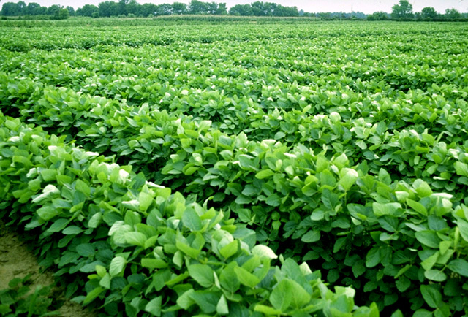
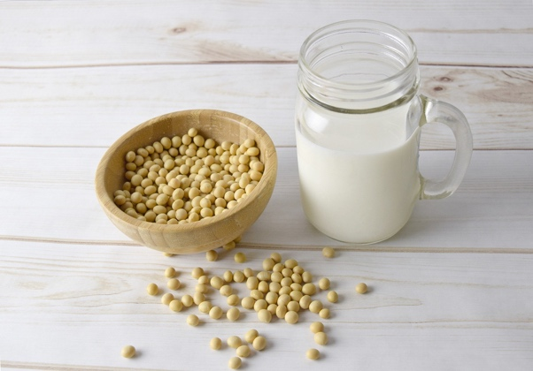
What is it?
One acre (about the size of a football field) of its product can produce 40,000 servings of tofu, 2,500 gallons of soymilk, or 82,368 crayons.

