Slide 1
How Portion Sizes Have Changed

Slide 2
Bagel
20 Years ago:
Today:
140 Calories
3" in diameter
350 Calories
6" in diameter

Slide 3
Muffin
20 Years ago:
Today:
210 Calories
1.5 ounces
500 Calories
4 ounces

Slide 4
Cheeseburger
20 Years ago:
Today:
333 Calories
590 Calories

Slide 5
Spaghetti & Meatballs
20 Years ago:
Today:
500 Calories
1025 Calories

Slide 6
French Fries
20 Years ago:
Today:
210 Calories
2.4 ounces
610 Calories
6.9 ounces

Slide 7
Soda
20 Years ago:
Today:
85 Calories
6.5 ounces
250 Calories
20 ounces

Slide 8
Theater Popcorn
20 Years ago:
Today:
270 Calories
5 cups
630 Calories
1 tub

Slide 9
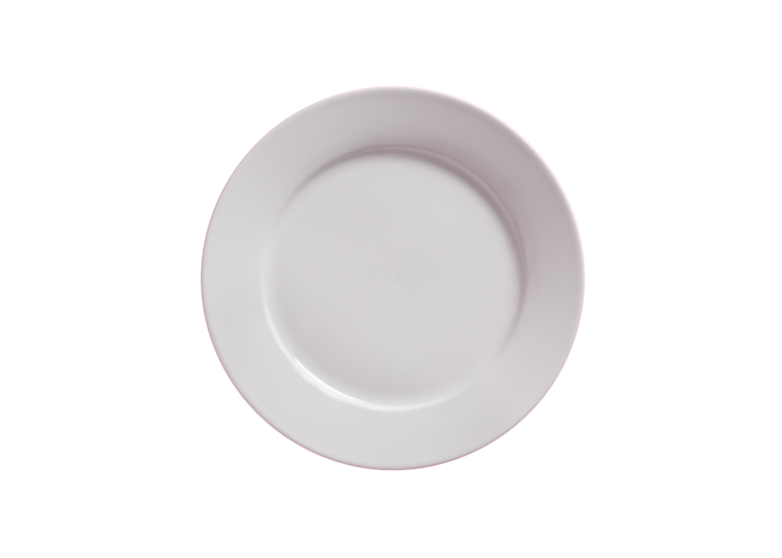
History of Dinner Plates:
12"
11"
10"
8 ½"
2009
Holds about
1900 calories
2000s
Holds about
1600 calories
1960s
Holds about
800 calories
1980s
Holds about
1000 calories

