Slide 1
Human or Farm Animal?
Sorting Necessities of life

Slide 2



Humans
Farm Animals
I eat grass.

Slide 3
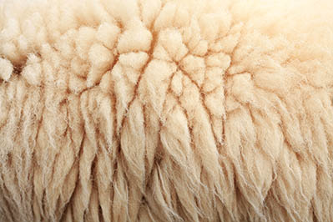
Humans
Farm Animals
I am covered in wool or other hair to keep warm.

Slide 4

Humans
Farm Animals
I drink water from a glass.

Slide 5
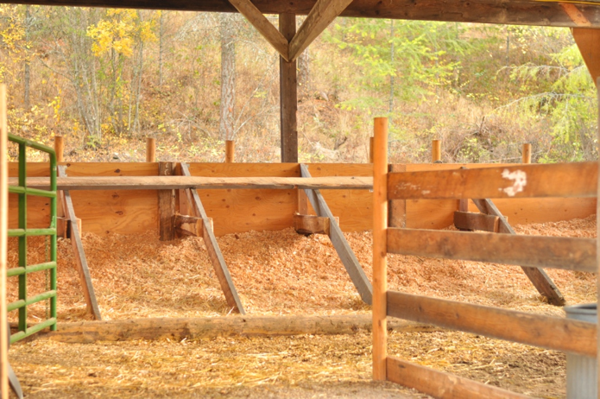
Humans
Farm Animals
Straw or shavings are used as my bedding so I can be comfortable and warm.

Slide 6
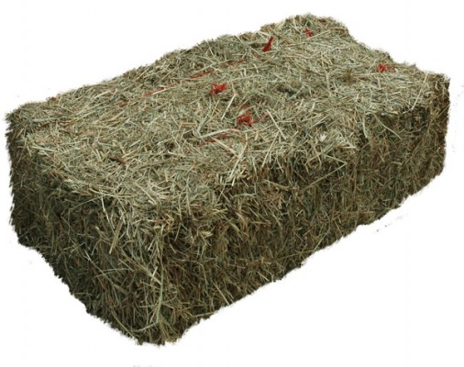
Humans
Farm Animals
I eat hay.

Slide 7
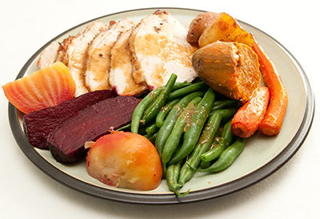
Humans
Farm Animals
I eat fruits, vegetables, and meats.

Slide 8
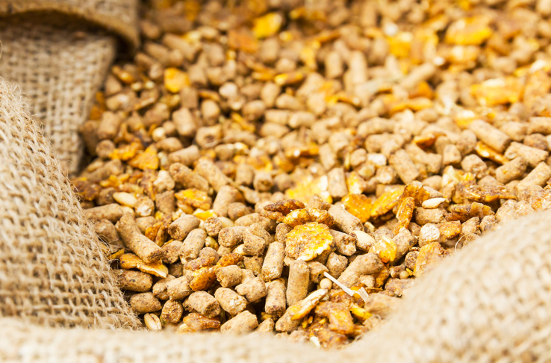
Humans
Farm Animals
Grains like corn, soybean, and barley give me lots of protein and energy.

Slide 9
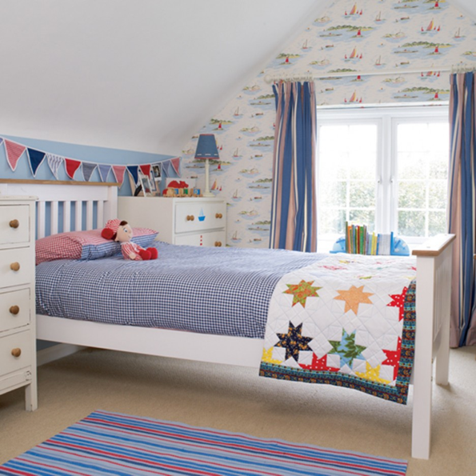
Humans
Farm Animals
I live in a house with heat and use a blanket to keep warm at night.

Slide 10
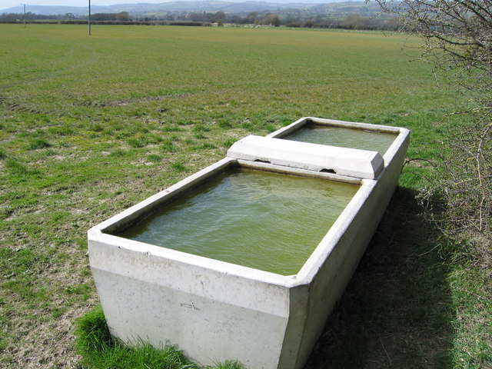
Humans
Farm Animals
I drink water from a trough.

Slide 11
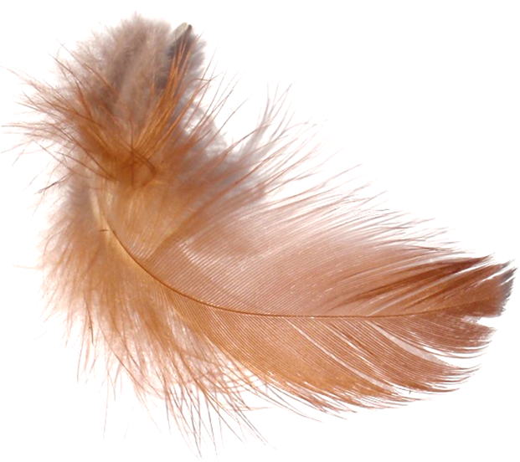
Humans
Farm Animals
Thick feathers keep me warm in the cold.

