Slide 1
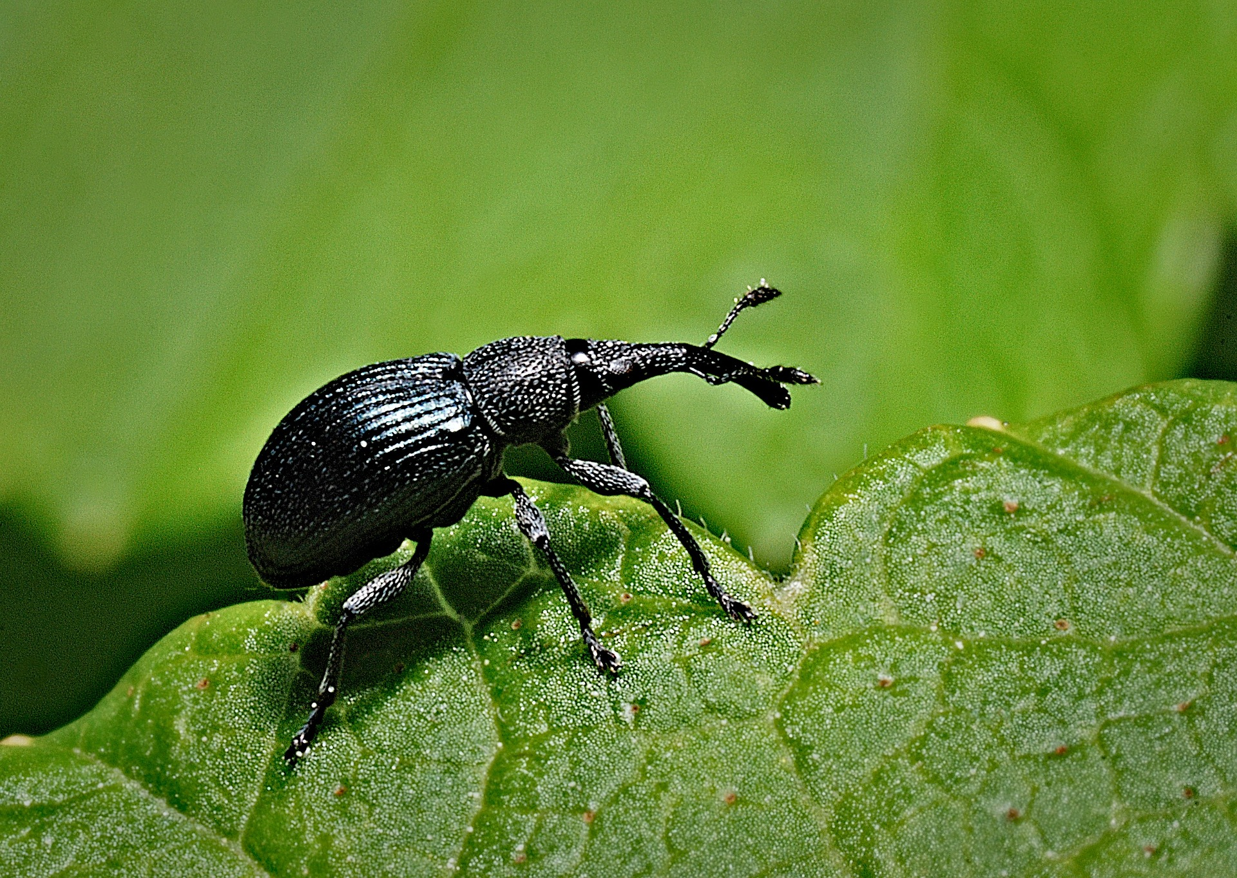
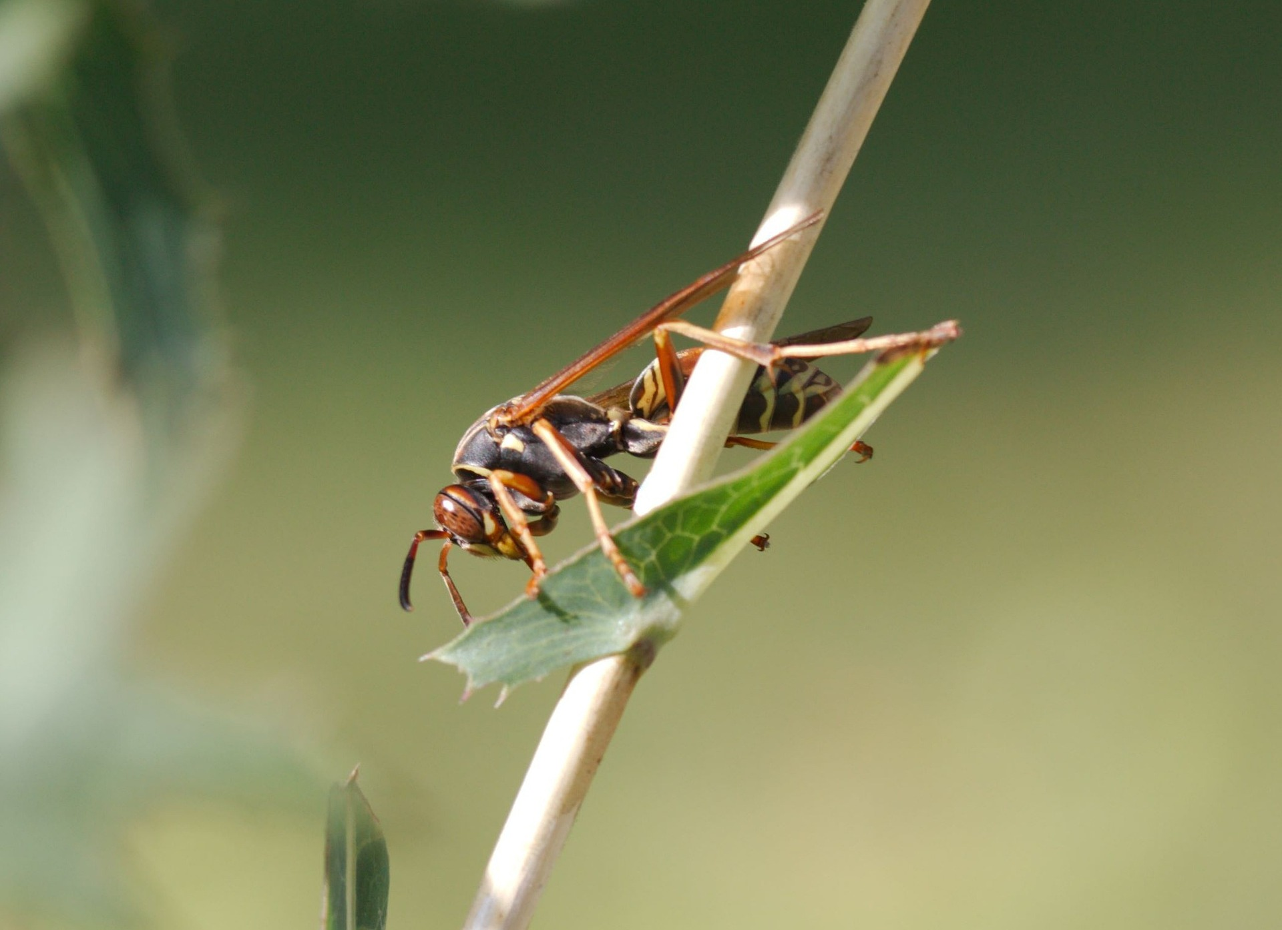
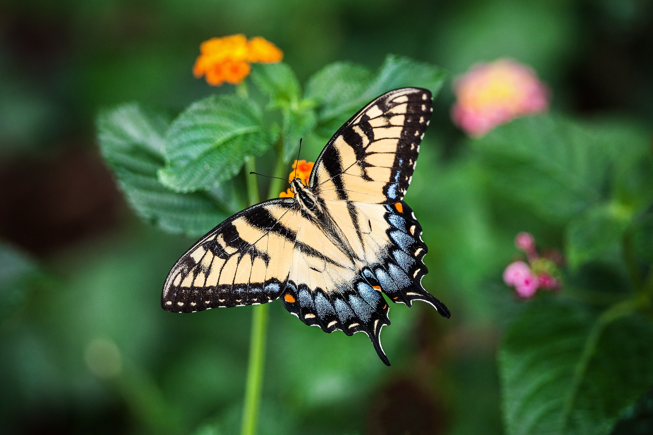
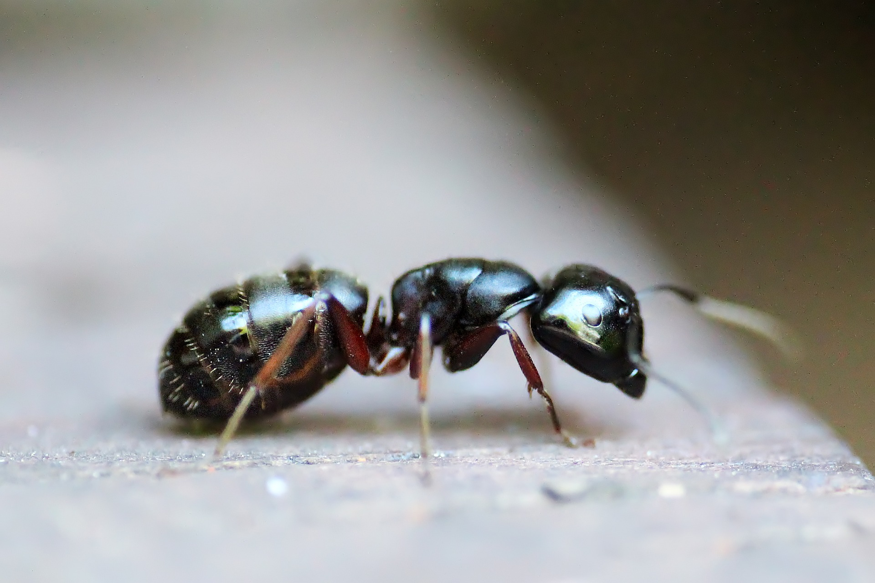
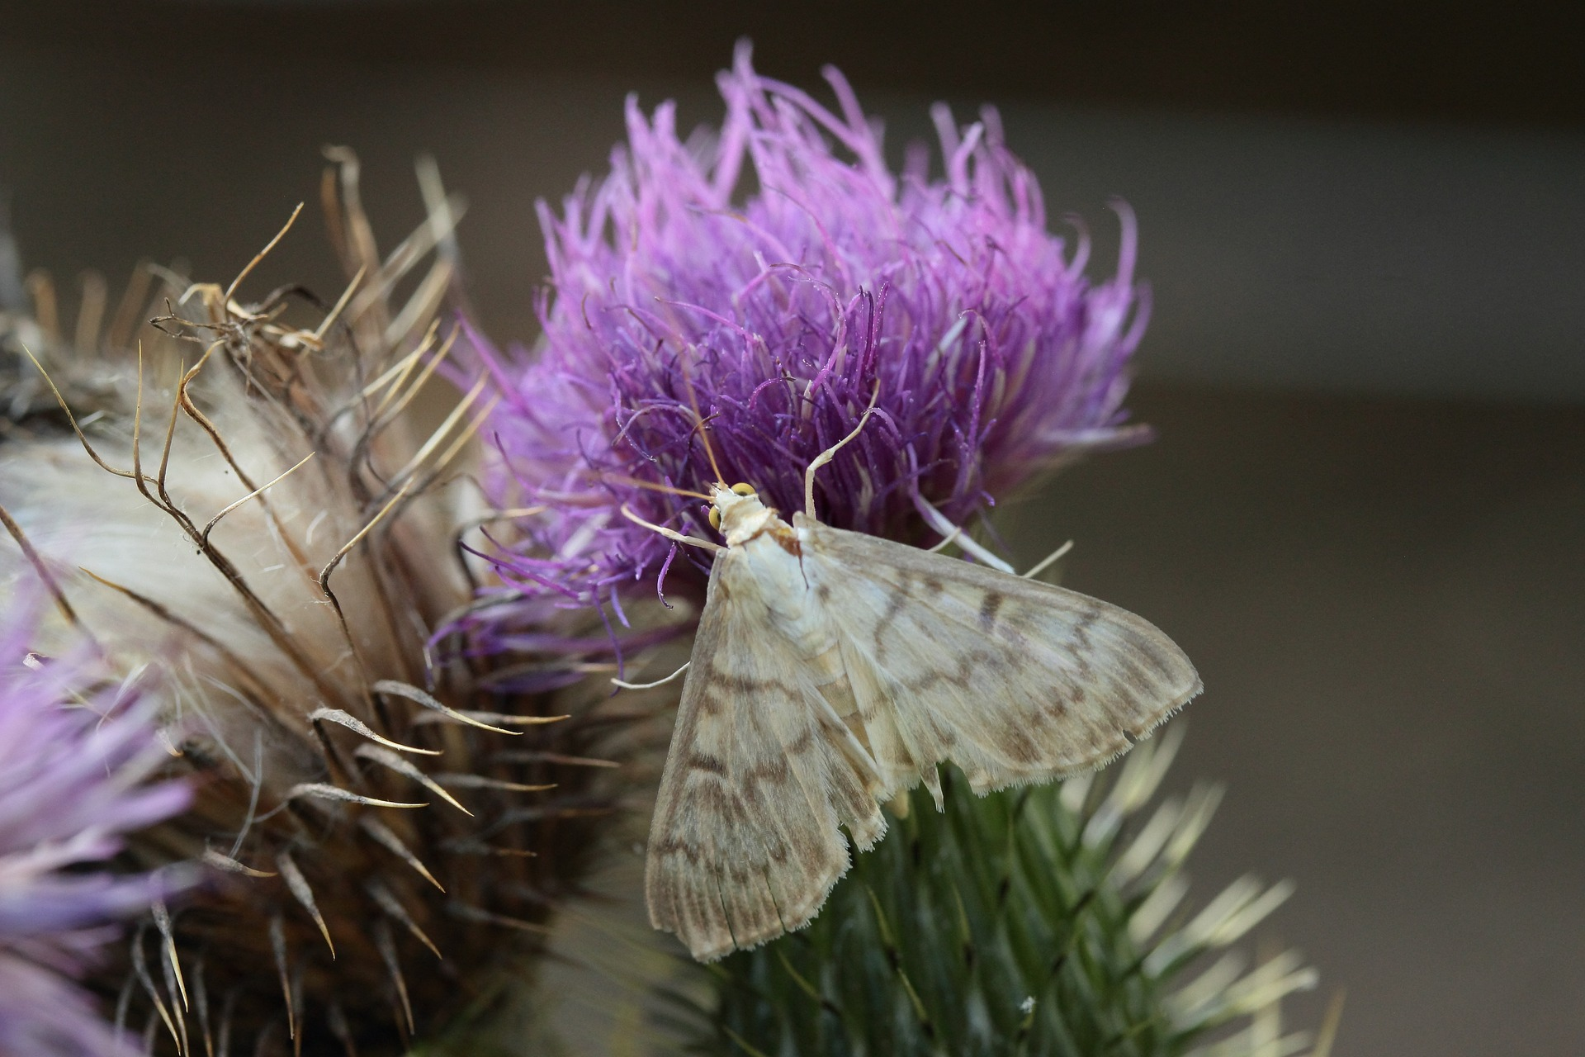
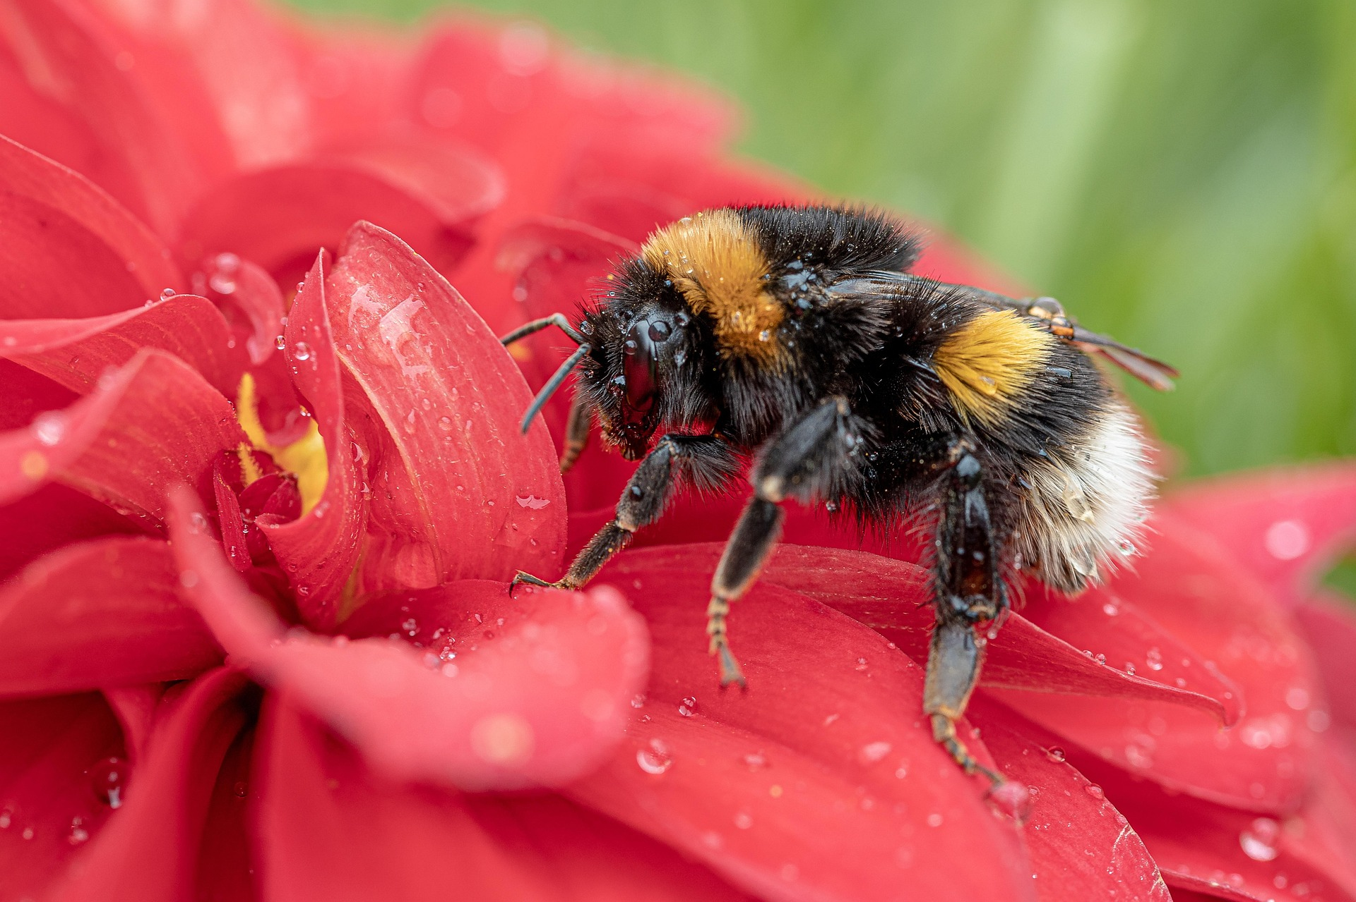
Song
of the Pollinators

Slide 2



Poem spoken
Poem with added sound effects
Some bugs pinch
And some bugs creep
Some bugs buzz themselves to sleep
Buzz, buzz, buzz, buzz
This is the song of the bugs.

Slide 3
Song alone
Song with accompaniment

Slide 4
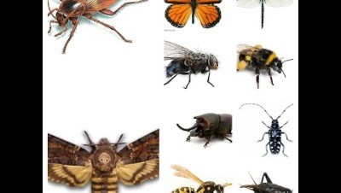
Suggested start to shorten: .45

Slide 5
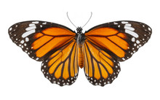
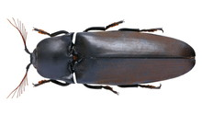
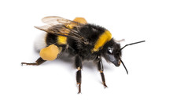












 |  |  | BUZZ!

Slide 6

 |  |  | BUZZ!

