Slide 1
The Function of Eggs

Slide 2
Directions:
Analyze the picture of the food product and the associated recipe.
Use what you have learned about eggs to determine the function of the egg in the recipe.

Slide 3
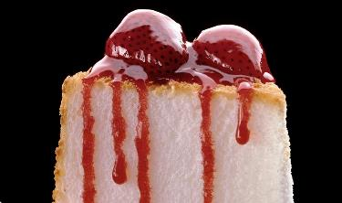
Angel Food Cake
Makes 10 Servings
Ingredients
12 egg whites, room temperature
1-1/2 tsp. cream of tartar
¾ cup granulated sugar
1-1/2 tsp. vanilla extract
½ tsp. almond extract, optional
1-1/4 cup powdered sugar
1 cup sifted cake flour
¼ tsp. salt
Directions:
Heat oven to 375°F. Beat egg whites and cream of tartar in mixer bowl with whisk attachment on high speed until foamy. Beating constantly, ADD granulated sugar, 1 tbsp. at a time, beating after each addition until sugar is dissolved before adding the next. (Rub a bit of mixture between thumb and forefinger; it should feel completely smooth.) Continue beating until whites are glossy and stand in soft peaks. Beat in vanilla and almond extract, if desired.
Sift powdered sugar, flour and salt together twice. Sift about ½ cup of the flour mixture over egg whites. Fold gently just until flour disappears. Do not stir. Repeat sifting and folding in flour mixture ½ cup at a time.
Pour batter into ungreased 10x4-inch tube pan. Gently cut through batter with metal spatula to release any air pockets. Bake in center of oven until top springs back when lightly tapped with finger, 30 to 40 minutes. Invert cake in pan, with tube resting on a bottle. Cool completely, about 1-1/2 hours.
Source: www.incredibleegg.org
Notes:
Leavening: Egg whites are whipped which helps trap air allowing the cake to rise and be light and fluffy.

Slide 4
Deep Fried Chicken
Makes 4 Servings
Ingredients
1 cup all-purpose flour
Salt to taste
1 tbsp. white or black pepper
½ tsp. cayenne pepper to taste
2 tsp. paprika
1 tsp. garlic powder
2 eggs beaten
1 lb. chicken tenders cleaned
Vegetable oil for deep frying
Directions:
Combine flour with salt, pepper, paprika and garlic powder.
Add eggs to a separate bowl and beat.
Dredge chicken in flour, egg wash, and flour again.
Add chicken to hot oil and fry until golden brown on both sides.
Source: https://www.tasteofhome.com/recipes/crispy-fried-chicken/
Notes:
Coating: Since the egg white and yolk are thicker than water and other liquids, eggs help the flour and seasonings stick to the chicken.
Source: https://www.tasteofhome.com/recipes/crispy-fried-chicken/

Slide 5
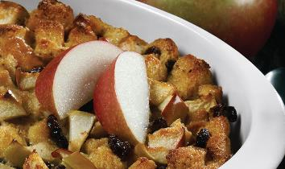
Apple-Raisin Bread Pudding
Makes 8 Servings
Ingredients
2 cups chopped peeled apples (about 2 medium)
2 tbsps. butter
3 cups day-old bread cubes (1-inch) (about 3 slices)
1/2 cup raisins
4 EGGS
2 cups milk
1/3 cup packed brown sugar
1 tsp. vanilla
3/4 tsp. pumpkin pie spice
Directions:
Cook apples in butter, covered, in medium saucepan over medium heat, stirring occasionally, until slightly softened, 5 to 7 minutes.
Combine bread and raisin in greased shallow 1-1/2-quart baking dish. Add apples; toss to mix.
Beat eggs, milk, sugar, vanilla and spice in medium bowl until blended. Pour over bread mixture. Refrigerate, covered, several hours or overnight.
Heat oven to 350°F. Remove bread pudding from refrigerator; uncover and let stand while oven heats. Bake, uncovered, in center of oven until knife inserted near center comes out clean, 45 to 55 minutes. Serve warm or cold.
Source. www.incredibleegg.org
Notes:
Binding: As the eggs coagulate it helps the bread pieces to stay together.

Slide 6
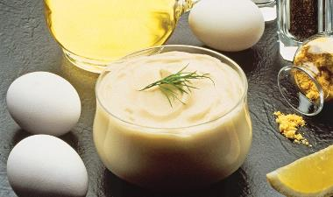
Easy Mayonnaise
Makes 1 ¼ cup
Ingredients
2 egg yolks
2 tbsp. fresh lemon juice or vinegar
2 tbsp. water
1 tsp. sugar
1 tsp. dry mustard
½ tsp. salt
Dash pepper
1 cup olive oil or vegetable oil
Directions:
1. WHISK egg yolks, lemon juice, water, sugar, mustard, salt and pepper in small saucepan until blended.
2. COOK over very low heat, stirring constantly, until mixture bubbles in 1 or 2 places. REMOVE from heat immediately; let cool 4 minutes.
3. POUR mixture into blender; cover. With motor running on high speed, ADD oil slowly, in a thin stream; blend until mayonnaise is thick
and smooth. Turn blender off occasionally to scrape down sides with rubber spatula. REFRIGERATE, covered.
Source: www.incredibleegg.org
Notes:
Emulsion: The main ingredients are water and oil and the lecithin in the yolk helps to keep them from separating.

Slide 7
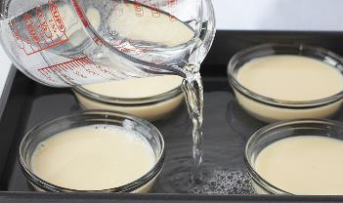
Basic Baked Egg Custard
Makes 6 Servings
Ingredients
3 cups milk
4 eggs
½ cup sugar
1-1/2 tsp. vanilla extract
¼ tsp. salt
Ground nutmeg or cinnamon, optional
Directions:
Heat oven to 350° F. Heat milk in small saucepan until very hot. Milk should be steaming but not bubbling. Meanwhile Beat eggs, sugar, vanilla and salt in medium bowl until blended but not foamy; slowly stir in hot milk.
Place six lightly greased 6-ounce custard cups in baking pan large enough to hold cups without touching each other or siders of pan. Pour egg mixture into cups, dividing evenly. Sprinkle with nutmeg, if desired.
Place pan on rack in the center of oven; pour very hot water into the pan (hot-water bath) to within ½ inch of top of cups. Bake until knife inserted near center comes out clean, 25 to 30 minutes; centers will still be soft. Remove cups from water bath at once. Cool on wire rack 5 to 10 minutes. Serve warm or refrigerate until cold.
Source: www.incredibleegg.org
Notes:
Thickener: The eggs are heated to allow the protein to coagulate thickening the mixture.

Slide 8
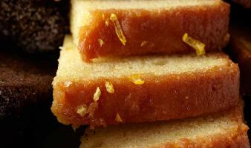
Lemon Pound Cake
Makes 8 Servings or 1 loaf
Ingredients
1-3/4 cups all-purpose flour
1 tsp. freshly grated lemon peel
¾ tsp. baking soda
½ tsp. salt
½ cup (1 stick) butter, room temperature
1 cup sugar
4 eggs
½ cup sour cream
1 tsp. fresh lemon juice
Directions
1. HEAT oven to 325°F. COAT bottom and sides of 9x5x3-inch loaf pan with cooking spray. DUST bottom and sides of pan with flour; tap out excess.
2. MIX flour, lemon peel, baking soda and salt in medium bowl.
3. BEAT butter and sugar in mixer bowl on medium speed until light and fluffy. BEAT in eggs, sour cream and lemon juice. Reduce speed to low. ADD flour mixture, ½ cup at a time, just until blended.
4. POUR batter into prepared pan. BAKE in 325°F oven until cake begins to pull away from sides of pan and wooden pick inserted in center comes out clean, 60 to 70 minutes. COOL on wire rack 10 minutes. LOOSEN cake from sides of pan with thin knife. Remove from pan and cool completely.
Source: www.incredibleegg.org
Notes:
Leavening: Unlike the angel food cake the whole egg is added. The yolk prevents it from rising as much as the angel food cake.

Slide 9
Coconut Shrimp
Makes 4 Servings
Ingredients
2 large eggs
½ cup panko breadcrumbs
1 cup flaked unsweetened coconut
½ cup all-purpose flour
½ teaspoon garlic powder
½ teaspoon paprika optional
Salt and freshly ground black pepper
1 pound large shrimp about 25, peeled (tails left on), deveined
Directions:
Pre-heat oven to 425°F. Grease a cookie sheet with oil and set aside.
Beat eggs in a small bowl and set aside. Combine breadcrumbs and coconut in another bowl and set aside. Lastly, combine flour and
spices in a 3rd bowl.
Dip shrimp in small batches in the flour mixture then the egg mixture (letting the excess drip off the shrimp and then coat in the
coconut/breadcrumb mixture, pressing to adhere.
Place the shrimp on the baking sheet in a single layer. Lightly spray with nonstick spray or drizzle with oil. Bake until the shrimp
are golden on the outside and opaque in the center, about 10 minutes.
Source: https://therecipecritic.com/baked-coconut-shrimp/#wprm-recipe-container-64974
Notes:
Coating: Since the egg white and yolk are thicker than water and other liquids, eggs help the breadcrumbs and seasonings stick to shrimp.
Source: https://therecipecritic.com/baked-coconut-shrimp/#wprm-recipe-container-64974

Slide 10
Pie Crust
Makes 1 pie crust
Ingredients
1 ½ cup vegetable shortening
3 cups All-purpose flour
1 whole egg
5 tbsps. cold water
1 tbsp. white vinegar
1 tsp. salt
Directions:
In a large bowl, with a pastry cutter, gradually work the vegetable shortening into the flour for about 3 or 4 minutes until it resembles a coarse meal.
In a small bowl, beat an egg with a fork and then pour it into the flour/shortening mixture. Add cold water, white vinegar and salt.
Stir together gently until all the ingredients are incorporated.
Separate dough into thirds, roll dough until ½” thick, place in pan, and pinch edges.
Bake with chosen filling.
Source: Adapted from https://thepioneerwoman.com/cooking/p-p-p-pie_crust_and_its_p-p-p-perfect/
Notes:
Binding: The egg protein coagulates and helps bond the structure together which allows the crust to stick together and not fall apart.
Source: https://thepioneerwoman.com/cooking/p-p-p-pie_crust_and_its_p-p-p-perfect/

Slide 11
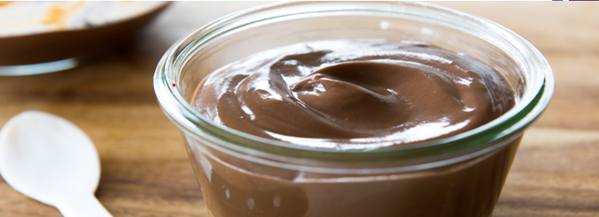
Chocolate Pudding
Makes 8 Servings
Ingredients
6 egg yolks
2 cups half & half or light cream
½ cup sugar
6 squares ( 1 oz. each) unsweetened chocolate, coarsely chopped
1 ½ tsp. vanilla extract
Directions:
1. In medium saucepan, whisk together egg yolks, half and half, and sugar until blended. Cook stirring constantly over low heat until mixture thickens, bubbles at edges and reaches 160 F. Remove from heat.
2. Stir in chocolate until completely melted and add vanilla.
3. Portion into 8 ramekins. Cover with plastic wrap. Chill for 8 hours or overnight.
Source: www.incredibleegg.org
Notes:
Thickener: The eggs are heated to allow the protein to form a gel which thickens the mixture.

Slide 12
Baked Italian Meatballs
Makes 4 Servings
Ingredients
1 pound Ground Beef (90% to 95% lean)
1/4 cup seasoned dry breadcrumbs
1 egg
2 tablespoons water
1 teaspoon minced garlic
1/2 teaspoon salt
1/8 teaspoon pepper
Directions:
1. Heat oven to 400°F. Combine Ground Beef, breadcrumbs, egg, water, garlic, salt and pepper in large bowl, mixing lightly but thoroughly. Shape into twelve 2-inch meatballs. Place on rack in broiler pan that has been sprayed with cooking spray. Bake in 400°F oven 24 to 27 minutes.
Cook's Tip: Cooking times are for fresh or thoroughly thawed Ground Beef. Ground Beef should be cooked to an internal temperature of 160°F. Color is not a reliable indicator of Ground Beef doneness.
2. Serve with pasta sauce over hot cooked pasta or as sandwiches in crusty Italian rolls, if desired.
Courtesy of BeefItWhatsForDinner.com
Notes:
Binding: The egg proteins coagulate and help the meatball ingredients stick together in the ball shape.

Slide 13
Zucchini Fries
Makes 4 Servings
Ingredients
1/2 cup breadcrumbs
1/4 cup grated parmesan cheese
2 eggs beaten
3 zucchinis cut into 1” strips
Directions:
Preheat oven to 425 degrees F (220 degrees C). Line a baking sheet with aluminum foil and spray with cooking spray.
Stir bread crumbs and parmesan cheese together in a shallow bowl. Whisk eggs in a separate shallow bowl.
Working in batches, dip zucchini strips into egg mixture, shake to remove any excess, and roll strips in bread crumb mixture to coat. Transfer coated zucchini strips to the prepared baking sheet.
Bake zucchini fries in the preheated oven, turning once, until golden and crisp, 20 to 24 minutes.
Source: https://www.allrecipes.com/recipe/236302/baked-zucchini-fries/
Notes:
Coating: Since the egg white and yolk are thicker than water and other liquids, the eggs help the breadcrumbs and seasonings stick to the zucchini.
Source: https://www.spendwithpennies.com/crispy-parmesan-zucchini-fries-chipotle-mayo/#wprm-recipe-container-137129

Slide 14
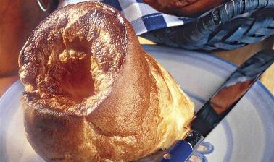
Popovers
Makes 12 Servings
Ingredients
3 eggs
1 cup milk
2 tbsp. butter, melted
1 cup all-purpose flour
½ tsp. salt
Directions:
1. heat oven to 425° F. Beat eggs in mixer bowl on medium speed until foamy. Beat in milk and butter. Reduce speed to low, add flour and salt; beat until smooth, about 3 minutes.
2. Fill 12 greased muffin pan or 6-ounce custard cups half full. Bake until puffed well browned and firm, 35 to 40 minutes. For crisper popovers, pierce the side of each popover with tip of knife and bake additional 3 to 6 minutes longer loosen edges with knife. Serve immediately.
Source: www.incredibleegg.org
Notes:
Leavening: Whole eggs and yolks trap and hold air that expands during heating that creates the airy form due to a large cavity in the center. Baking helps the proteins coagulate and set the structure.

