Slide 1
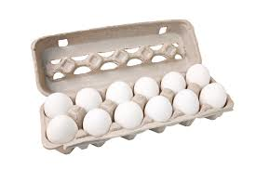
From Hen to Home

Slide 2
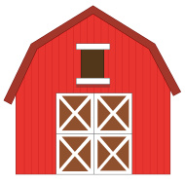
Farm

Slide 3
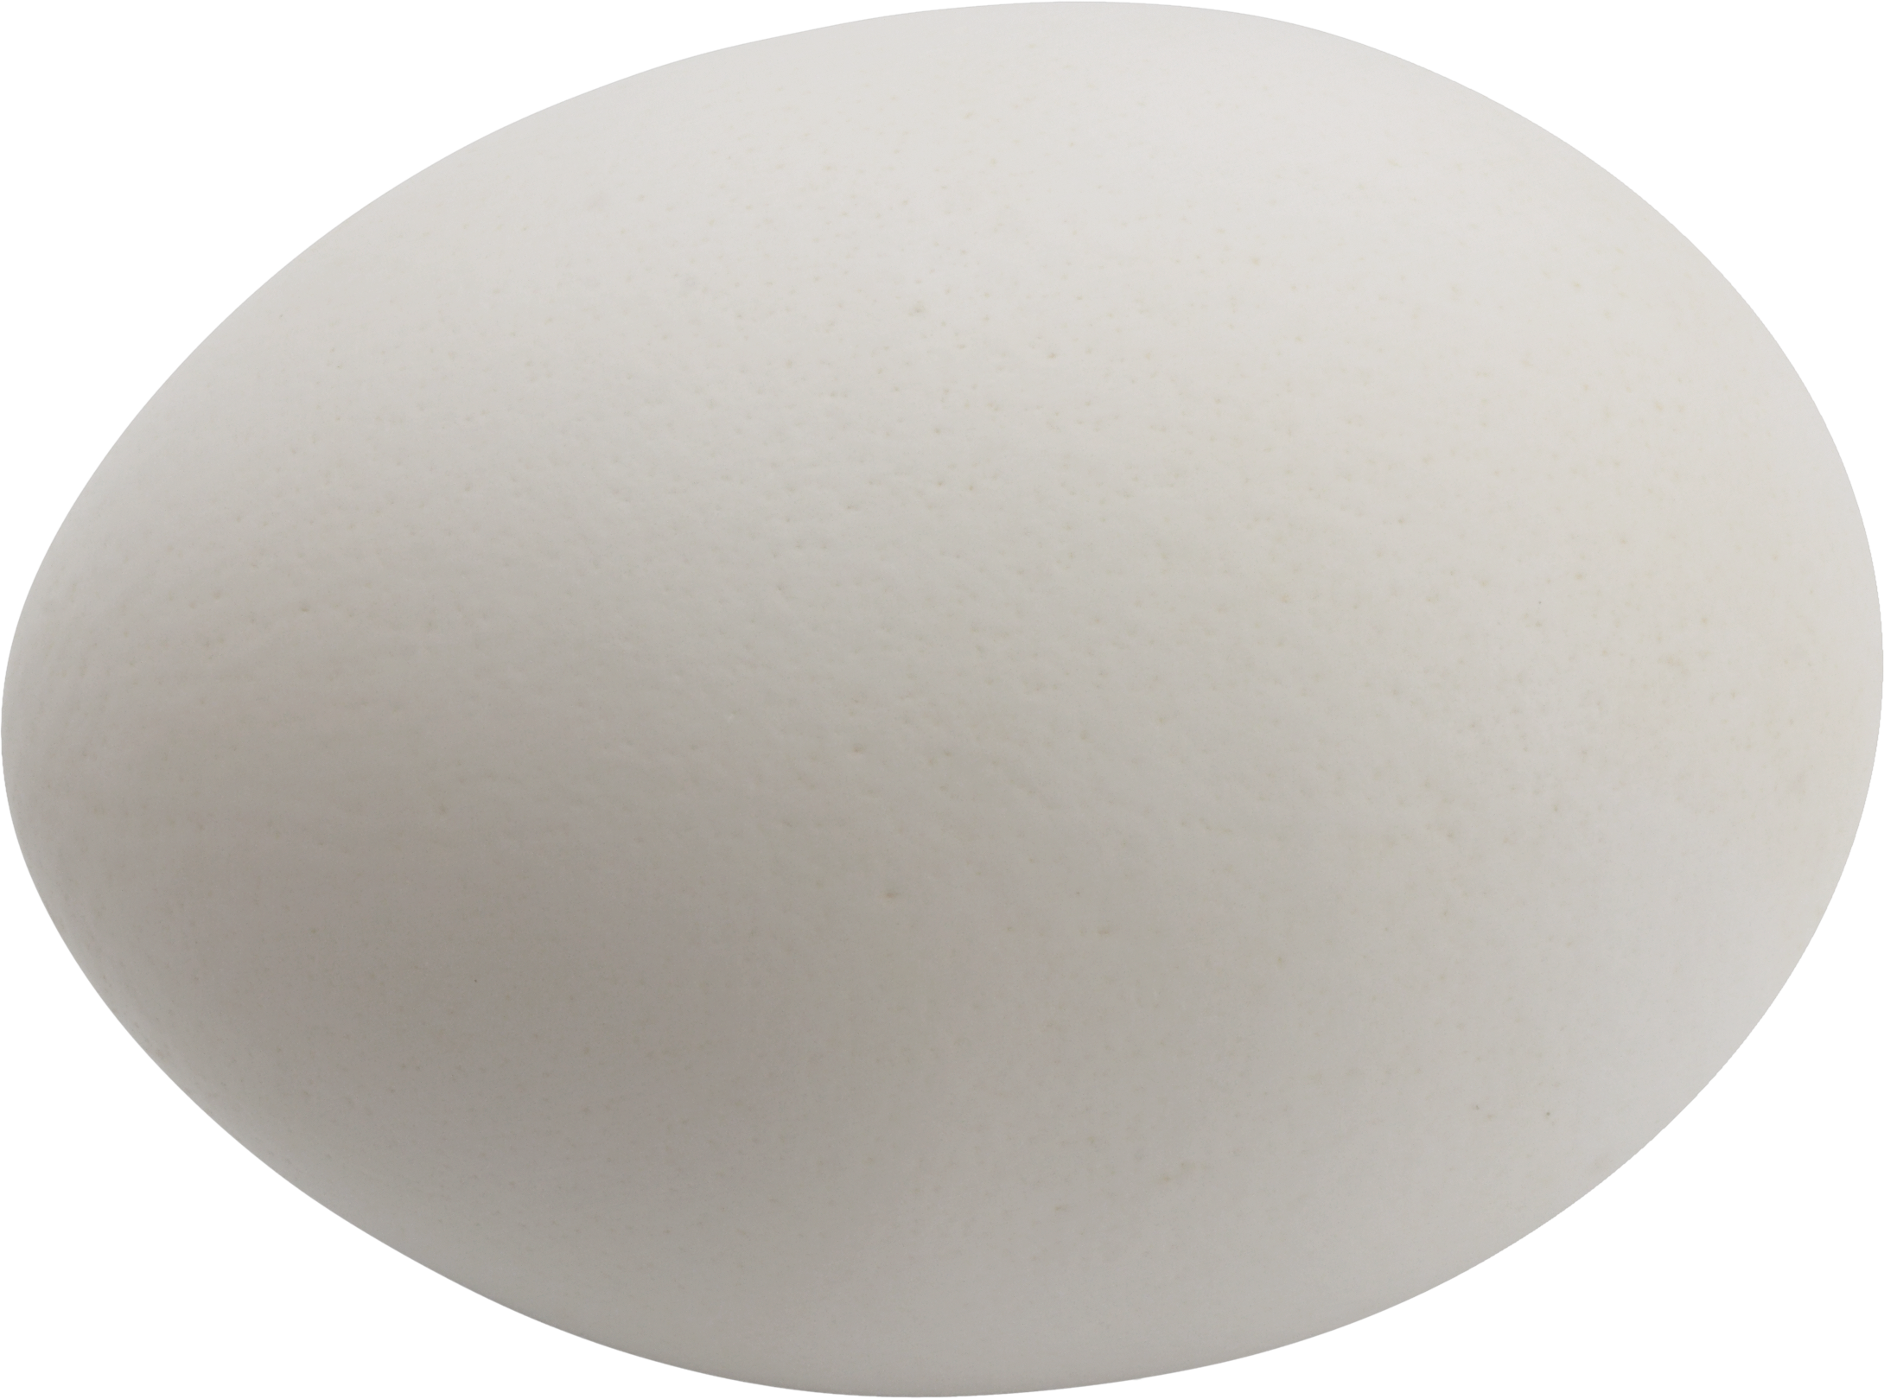
Farm
1
How many eggs does a chicken lay each day?

Slide 4
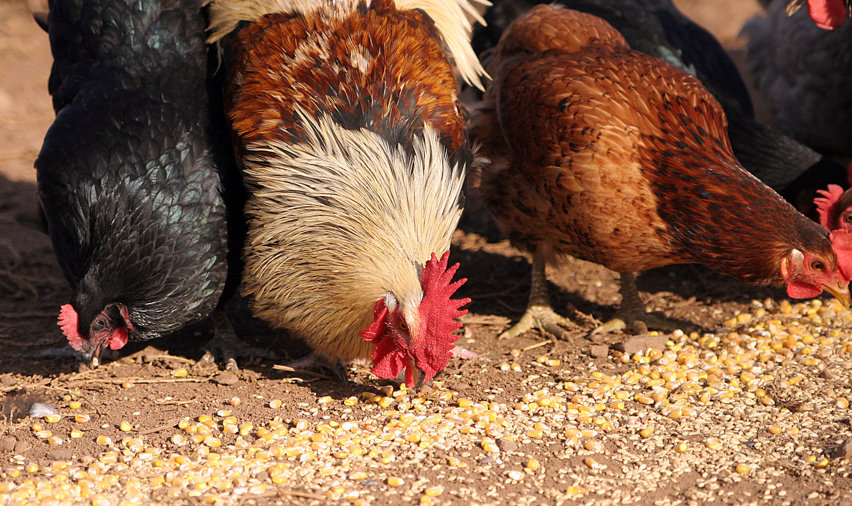
Farm
Corn, wheat, and other grains
What do chickens eat?

Slide 5
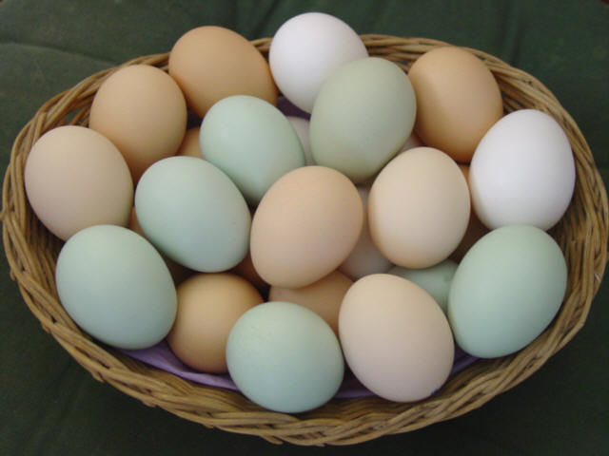
Farm
White, brown, or light green
What color are eggs?

Slide 6
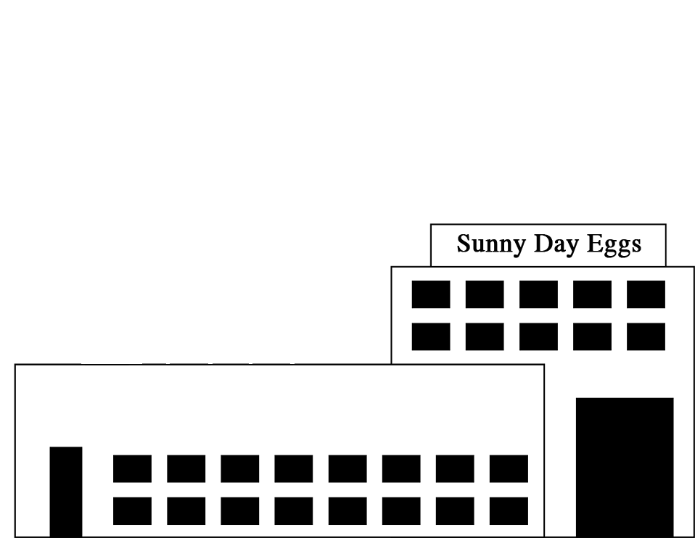
Processing Plant

Slide 7
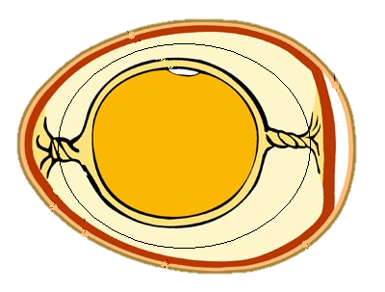
Processing Plant
Yolk
Air
Cell
Shell
White

Slide 8
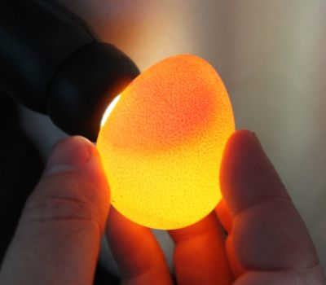
Processing Plant
Yolk
White

Slide 9
Transportation

Slide 10
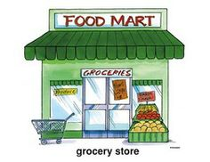
Grocery Store

Slide 11
Home

Slide 12
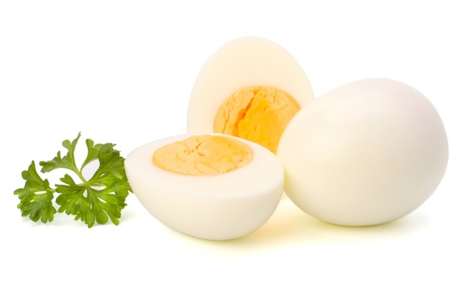
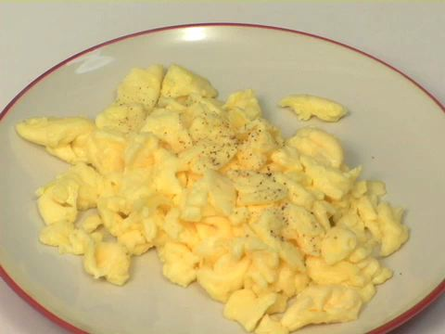
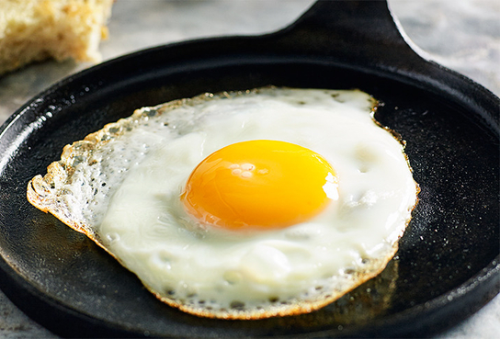
Home
Boiled
Scrambled
Fried
How can eggs be cooked?

Slide 13
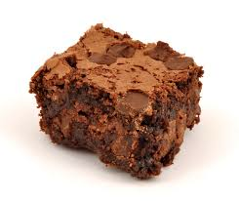
Home
Brownies
Cake
Cookies
What other foods use eggs as an ingredient?

Slide 14
Home
Yes!
Eggs contain protein, vitamins, and minerals that help build strong bodies.
Are eggs a good food choice?

