Slide 1
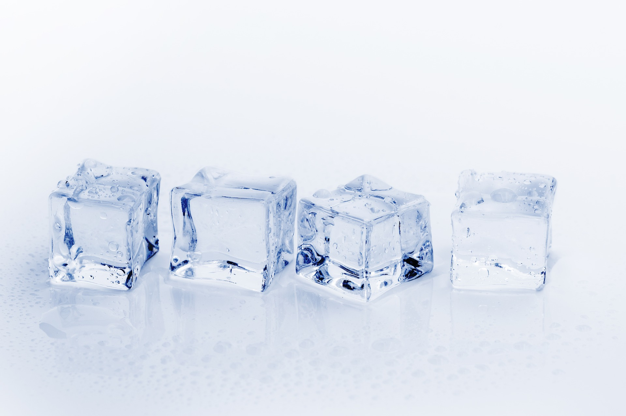
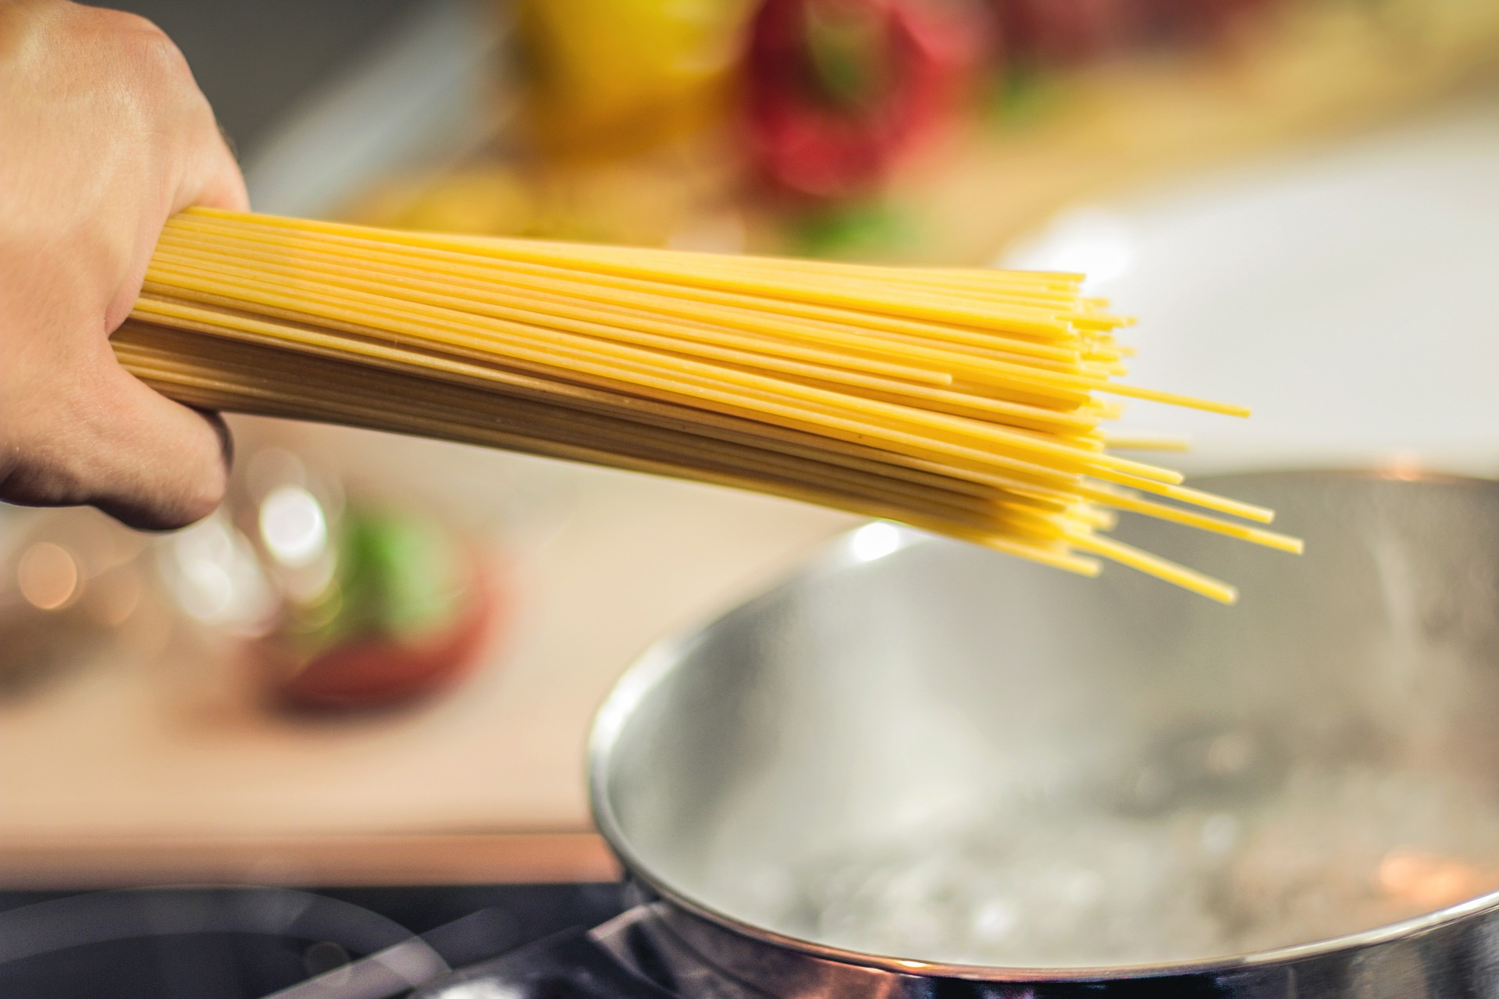
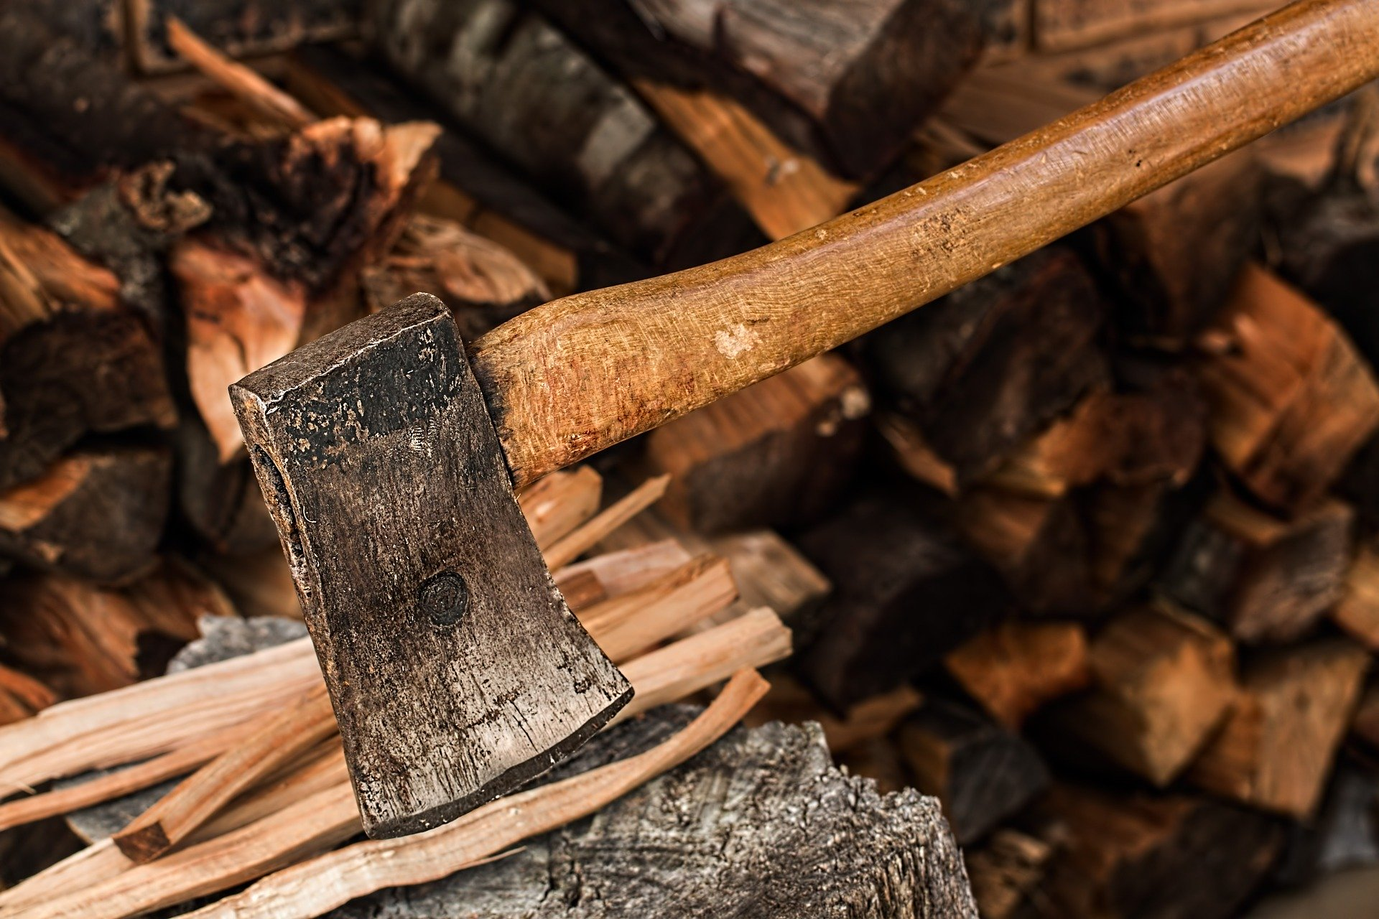
Physical Change
A change that does NOT change the identity of the substance.
Melting ice
Boiling pasta
Tearing paper
Chopping wood

Slide 2
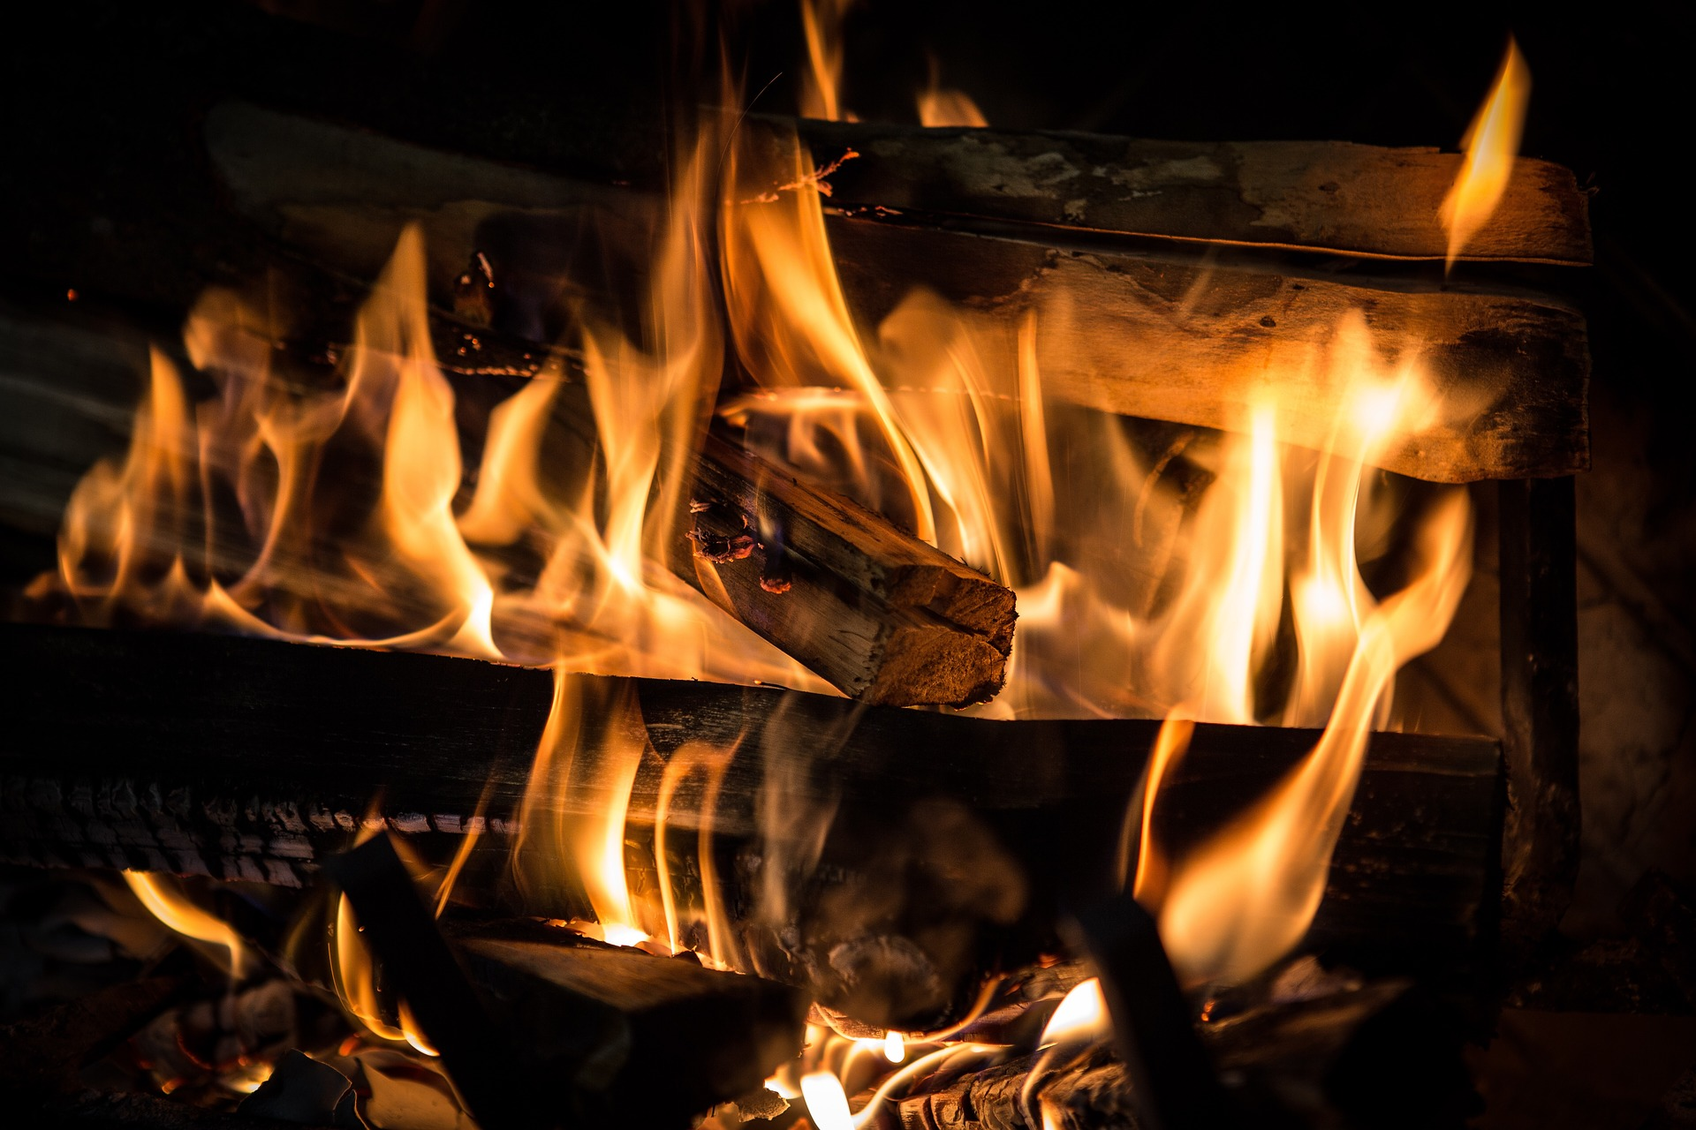
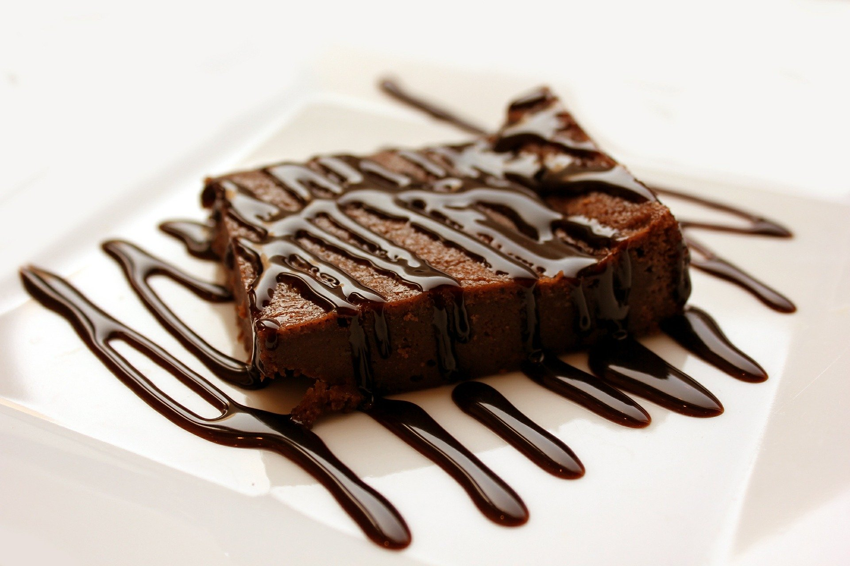
Chemical Change
A change that causes the identity of the substance to change.
Burning wood
Digesting food
Baking a cake
Cooking an egg

Slide 3
Indicators of a Chemical Change
Indicators (signs) of a chemical change include:
Light is produced
Heat is absorbed or produced
Gas is produced
Change in color

Slide 4
Is it a physical or chemical change?
Type of Change | Physical | Chemical
Melting Ice
Burning Wood
Souring Milk
Shredding paper
Rusting metal
Chopping Wood
Soybean Plastic

Slide 5
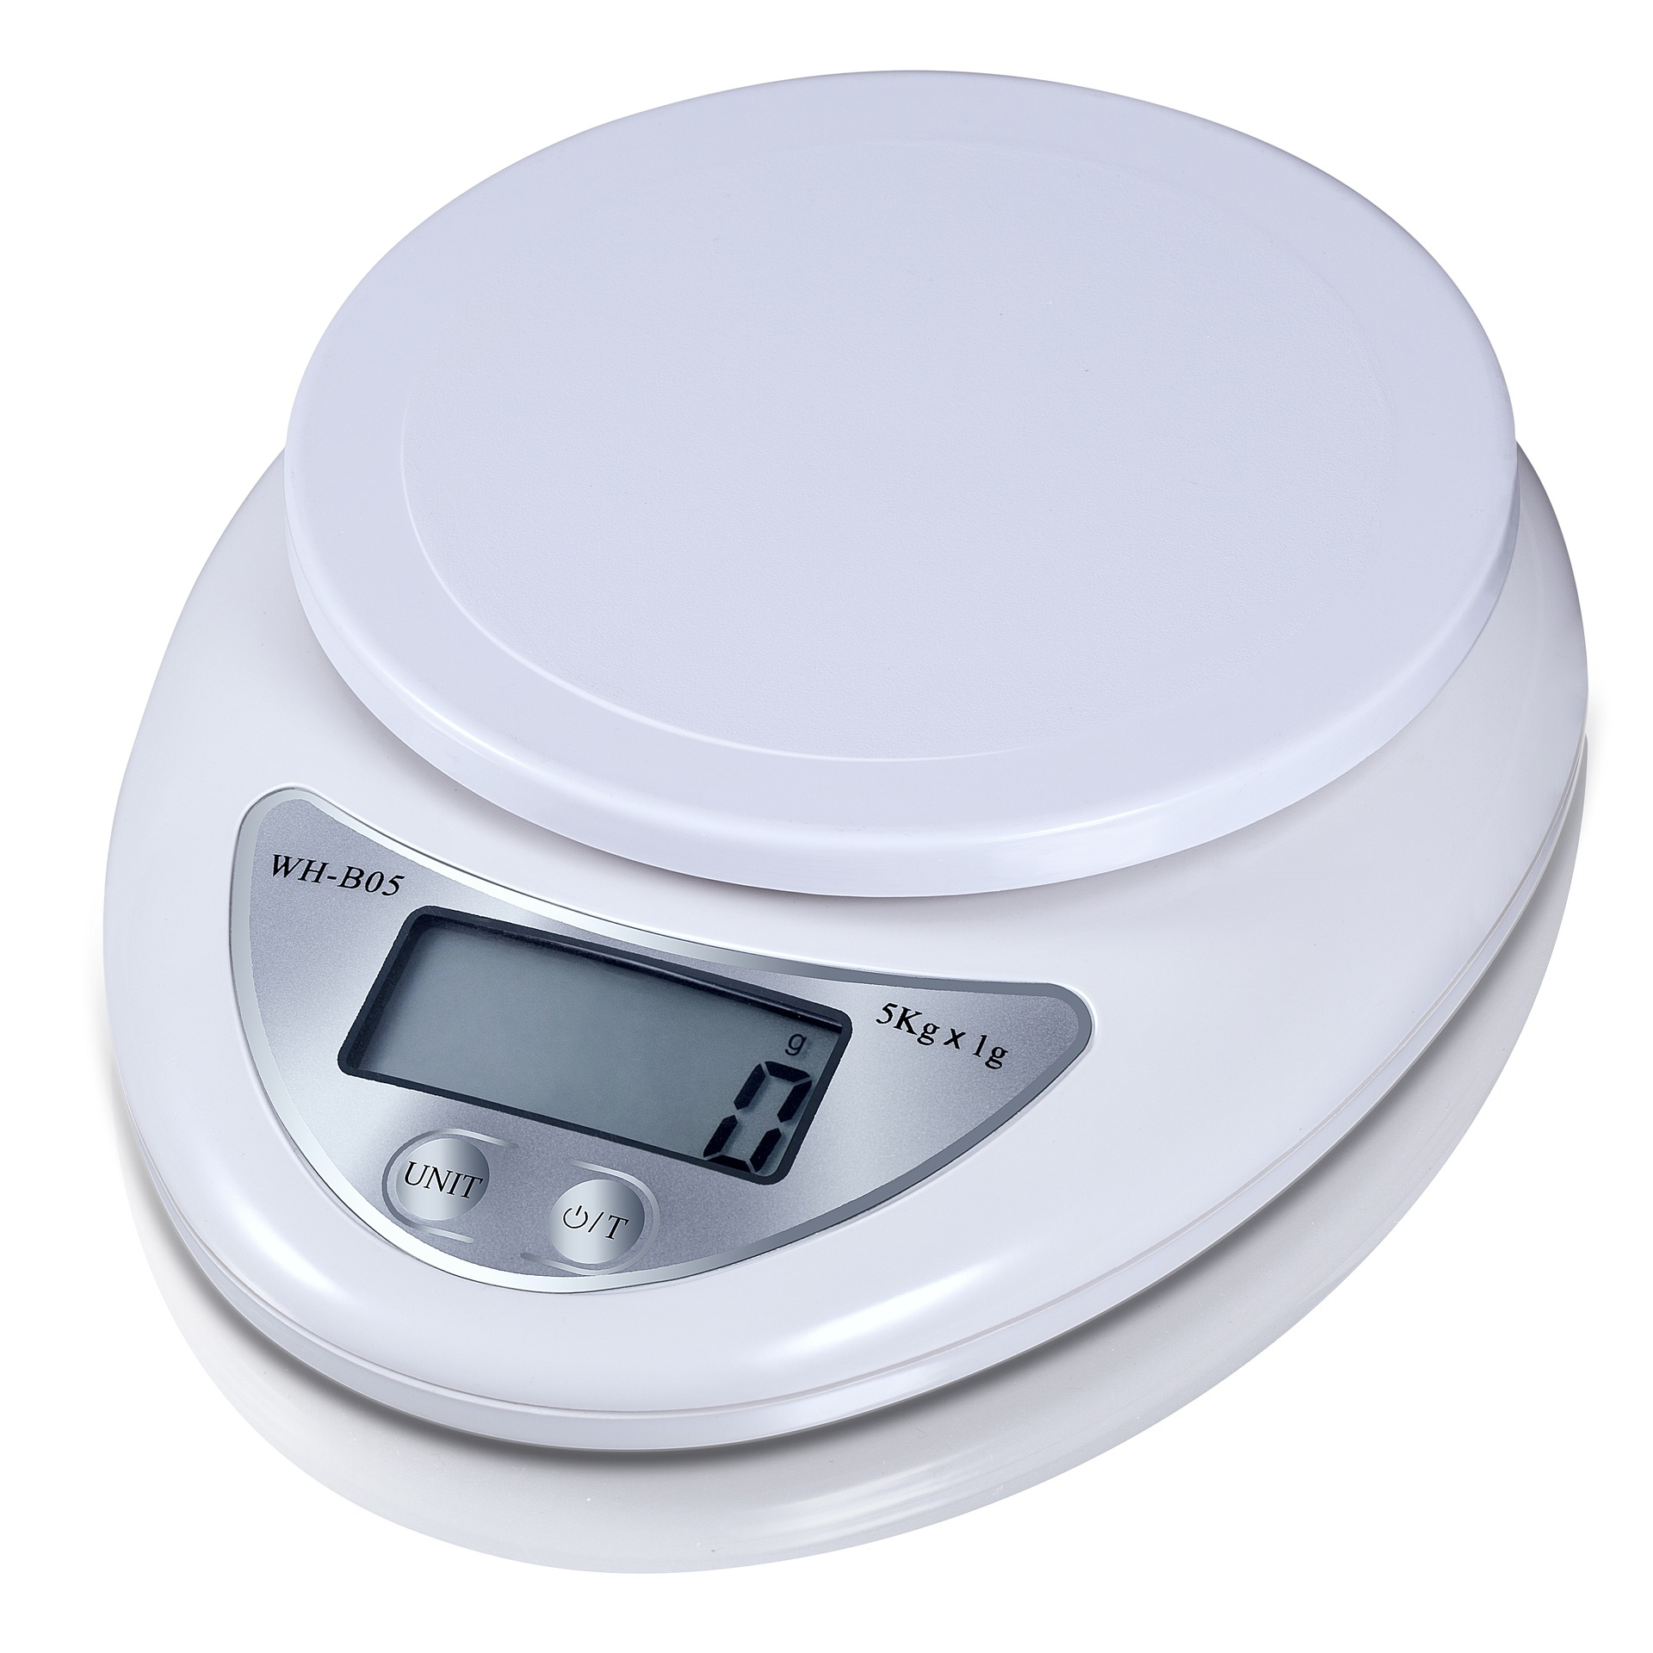
What about the weight of matter?
Whether a change results in a new substance or not, the total amount of matter is always conserved.
Melting an ice cube
Dissolving salt in water
Combining baking soda and vinegar in a closed bag
Producing soybean plastic

