Slide 1
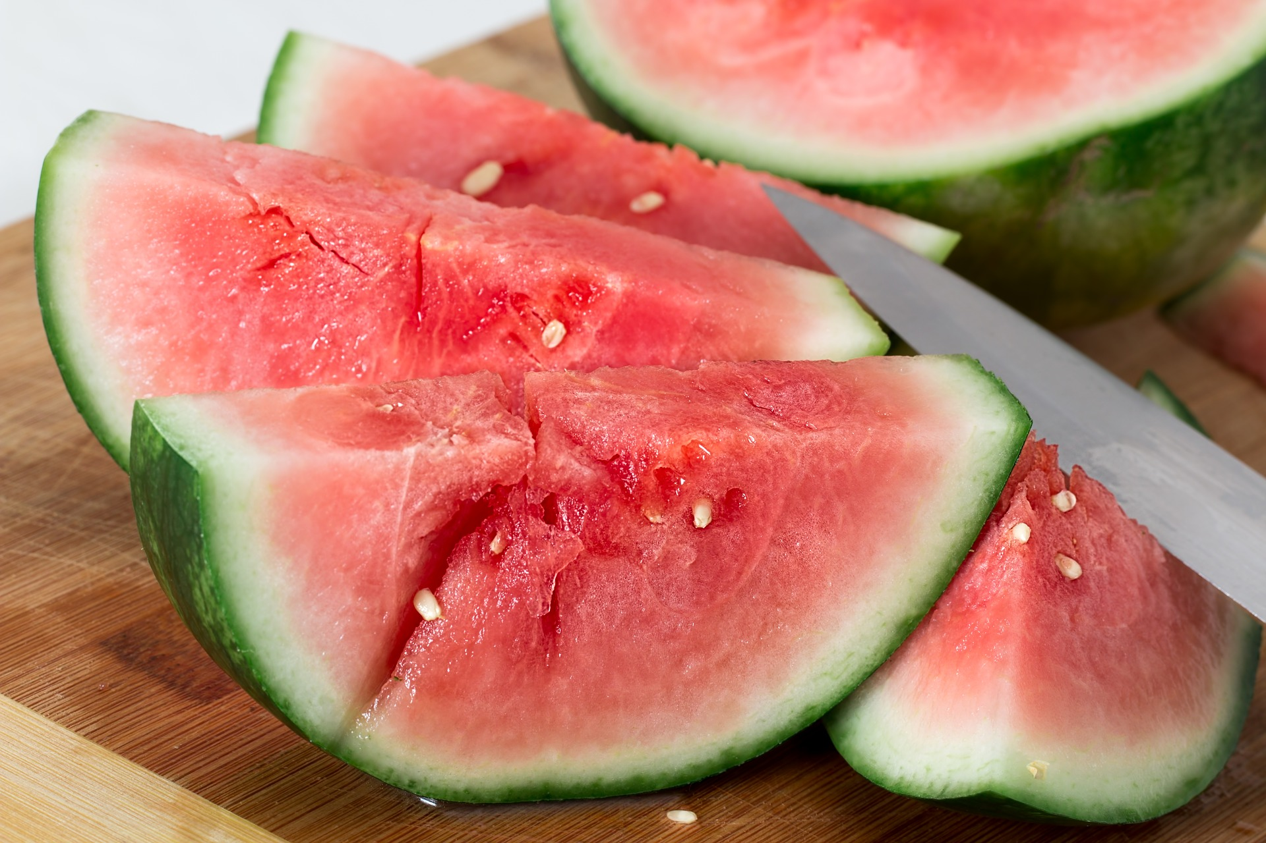
Then and Now

Slide 2
Then…

Slide 3
Now…

Slide 4
Then…

Slide 5
Now…

Slide 6
Then…

Slide 7
Now…

Slide 8
Then…

Slide 9
Now…

Slide 10
What has caused these traits to change?

Slide 11
Have humans influenced animal traits?

Slide 12
Then…
In 1944, the average cow produced 548 gallons of milk per year.

Slide 13
Now…
The average cow produces 2,429 gallons of milk per year.

