Slide 1
Beeswax
A Byproduct of Honey Production

Slide 2
Beeswax is a substance secreted from the glands located on the underside of a worker honey bee’s abdomen.

Slide 3
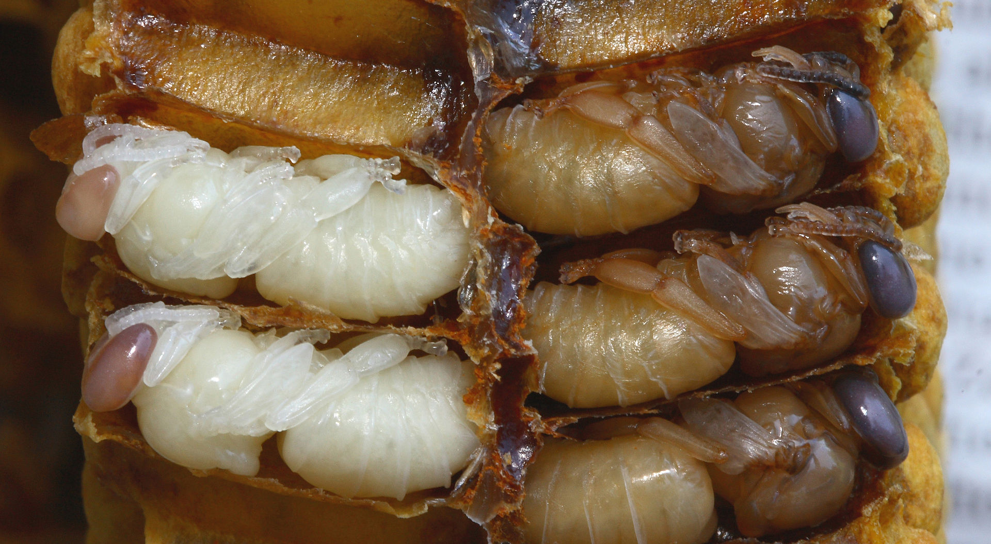
The wax is used by the bees to form cells within the hive for honey storage and to protect eggs, larvae, and pupae through the process of metamorphosis.

Slide 4
To form the beeswax into honeycomb, the bees chew and mold the wax into hexagon-shaped cells.

Slide 5
Honey bees use the nectar they gather from flowers to make honey, which is stored in the hive’s cells. The bees cap off each cell with wax to prevent moisture loss.

Slide 6
When beekeepers harvest honey, they collect the frames from the hive and use a hot knife to remove the wax cappings.

Slide 7
The wax is taken to a capping tank and the frames are placed in an extractor to spin out the honey.

Slide 8
Heat is applied to the wax cappings, causing the honey and wax to liquify and separate. The residual honey is then filtered out and the clean wax is cooled and molded.

