Slide 1
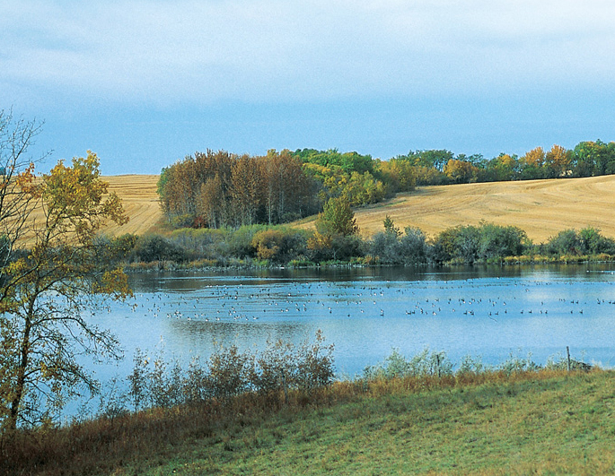
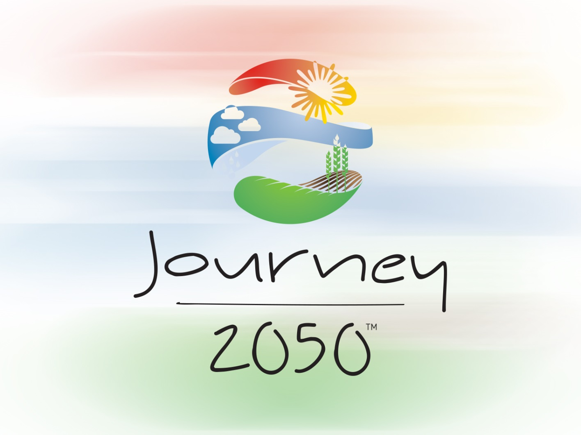
Water
Lesson 3
V5.0
Notes:
Time
45 minutes
Activity Expectations
Students will be able to:
Discuss the limited amount of fresh water on earth and identify how best management practices can reduce water consumption;
Discuss the need for water conservation and protection related to population growth and agriculture; and
Compare and contrast methods of irrigation for water conservation.
Materials
Water PowerPoint
Interest Approach Supplies
Option 1: Rain jacket, hat, 5-gallon (18L) bucket of water, tablespoon
Option 2: One-gallon container, clear bowl, ½-cup measuring cup, eyedropper
Map of local watershed (optional)
Water video (https://youtu.be/bI7hYAomzGk)
Sustainability Farm Game Level 3 Water
Computer or tablet device for each student
Key Terms
Conserve, Protect, Conservation Tillage, Riparian Area, Wetland, Watershed, Native Species, Irrigation, Crop Residue

Slide 2
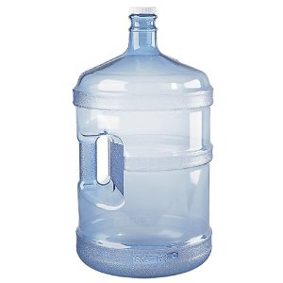
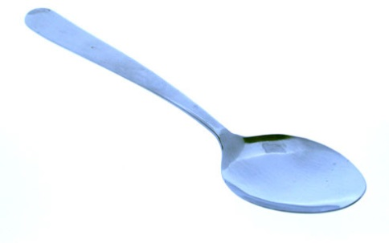
World of water
© Environment Canada, 2004
Notes:
https://www.youtube.com/watch?v=1fB2N7chZlU
Ask the class: why do you think water is important? What do we use water for? Try to get them thinking outside of JUST in their house. We use water for food production (agriculture, plants in our house and in our backyard), other plants and animals need water, drinking, washing, recreation….etc. We use water for pretty much everything!
The earth is over 70% water. Approximately 2.5% of that water is freshwater. The other 97% is saltwater in the oceans. Of all the water on earth, more than ¾ is surface water, but less than 0.3% of that water is available to us to use.
Where is the rest? It is tied up in ice caps and glaciers.
Props - Rain jacket, hat, bucket of water, tablespoon
[Ask for one volunteer. Dress the student in rain gear, including a rain hat. Have a full bucket of water]
If this 18L (5-gallon) bucket were to represent all the water on earth, I’m going to dump how much is fresh water in a useable form on your head. Pick up the bucket of water and pretend to dump…stop…set it down and grab a tablespoon. Drop three tablespoons on the student’s head

Slide 3

World of water
Watch the Journey 2050
Water Video
As you watch, discover:
How is water used in agriculture?
What methods do farmers use to irrigate their crops?
What best practices can be implemented to use water more efficiently in agriculture?
Notes:
Play the Water video (https://youtu.be/bI7hYAomzGk)
Prepare students for the video by asking them to discover three things: 1) How is water used in agriculture? 2) What methods do farmers use to irrigate their crops? 3) What best practices can be implemented to use water more efficiently in agriculture?

Slide 4

How is water used in agriculture?

Slide 5
How is Water Used in Agriculture?
What do farmers need to grow a crop?
Open Space
Sunshine
Acceptable
Climate
Nutrient-Rich
Healthy Soil
What else??
Seeds
WATER!
Notes:
Ask students, “What do farmers need to grow a crop?” Use the click animations on the PowerPoint slide to display open space, fertile soil, sunshine, correct climate and seeds. Once these items have been discussed, explain that there is one more item. Without it, the crop will fail completely. Ask students what this could be. (water)

Slide 6
What is irrigation?

Slide 7
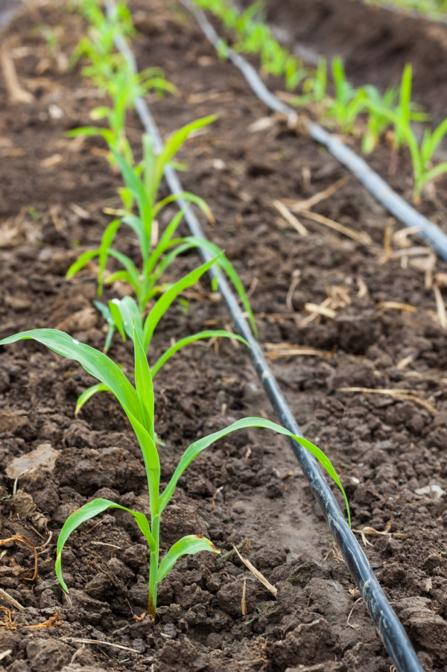
Drip irrigation
Water is sent through plastic pipes that are laid along the crop rows
A tiny hole allows water to drip at the base of the plants
Most effective for fruits and vegetables
Notes:
Using the picture, describe drip irrigation. Water is sent through plastic pipes that are laid along the crop rows. Tiny holes allow water to drip at the base of the plants. This method is most effective for fruit and vegetable crops.

Slide 8
Center-pivot Irrigation
Large sprinkling system
Line of sprinklers “pivot” around a center point in a field
Notes:
Using the picture, describe center-pivot irrigation. This is a large sprinkling system on wheels. A line of sprinklers pivot around a center point in a field. This method of irrigation is what creates green crop circles that can be seen from a plane.

Slide 9
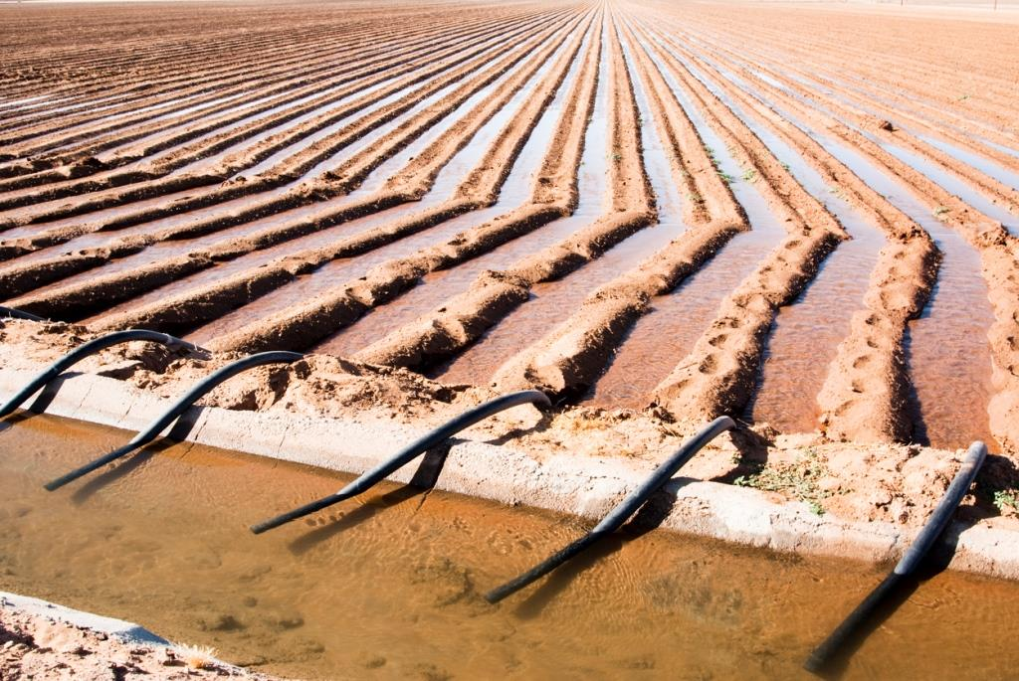
Flood (furrow) Irrigation
Furrows are dug between plant rows
Water is delivered to each row by a series of ditches or siphon hoses
Crop is irrigated as water flows to the end of each row
Notes:
Using the picture, describe flood or furrow irrigation. To utilize this method of irrigation, farmers dig furrows between their crop rows. Water is delivered to the top of each row using ditches or siphon hoses. The crop is irrigated as the water flows from the top to the bottom of each row.

Slide 10
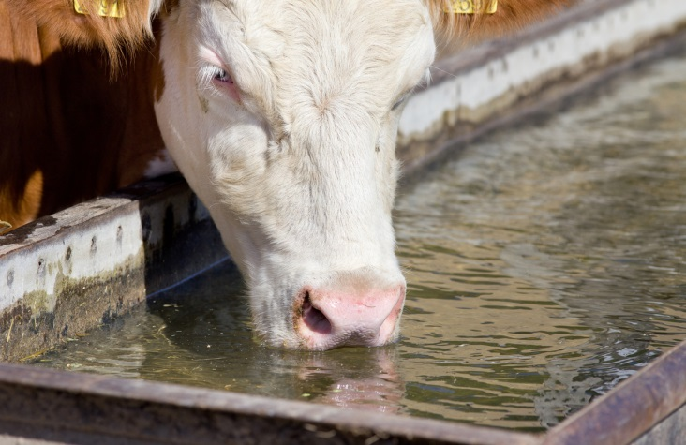
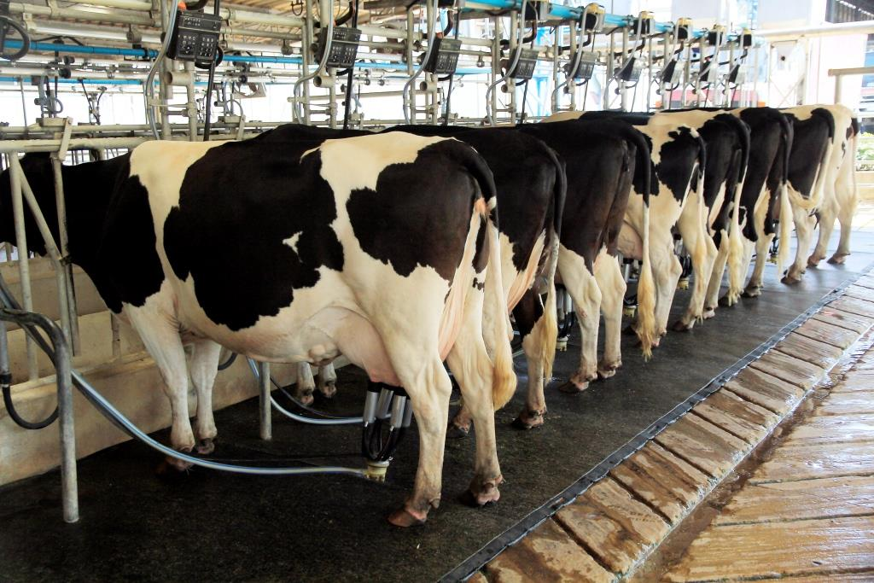
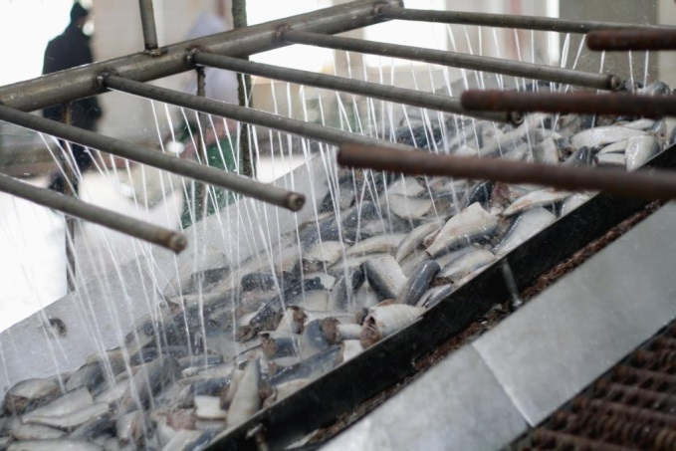
How is Water Used in Agriculture?
Besides irrigation, in what other ways does agriculture use water?
Watering
Livestock
Cleaning & Sterilization
Food
Processing
Notes:
Ask students, “Besides irrigation, what other ways do farmers use water?” Allow students to offer their answers. Guide the discussion, clarifying that irrigation accounts for the majority of water use in agriculture, but water is also needed to raise livestock and to clean and sterilize facilities such as milk barns or food processing plants in order to prevent food-borne illness.

Slide 11
What Best Practices can be implemented to use water most efficiently in agriculture?

Slide 12
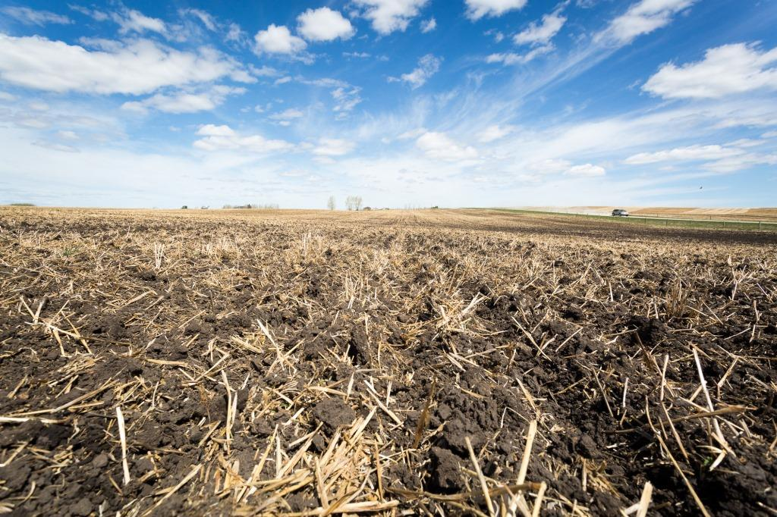
Conservation tillage
Notes:
Refer back to the video clip students viewed at the beginning of the lesson. It described a practice called conservation tillage. Explain that farmers will leave crop residue (materials such as stalks, stems and seeds) in their fields without plowing it under in the fall. In the spring they use an air seeder (device that precisely plants the seeds at equal distances and proper depth in the soil and then covers them) to plant the next crop, eliminating the need to plow the soil. Conservation tillage improves water-use efficiency in crops.

Slide 13
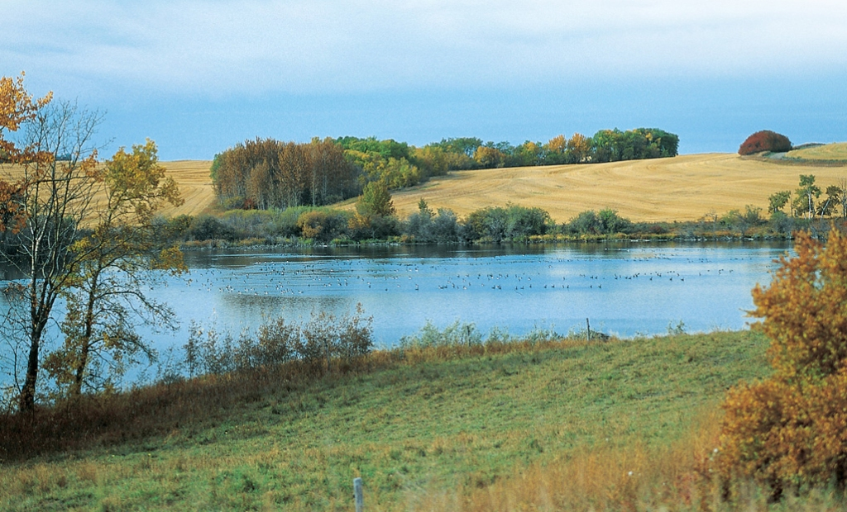
Riparian areas
Notes:
Explain that a riparian area is a space between land and a waterway, ideally filled with native grasses, shrubs and trees. Landowners can improve water quality by preserving wetland and riparian areas, which have many benefits. These areas help filter nutrients that are collected as water runs over the land; help control water levels during floods; and provide habitat for animals. If possible, use a local riparian area as an example to help students understand.

Slide 14
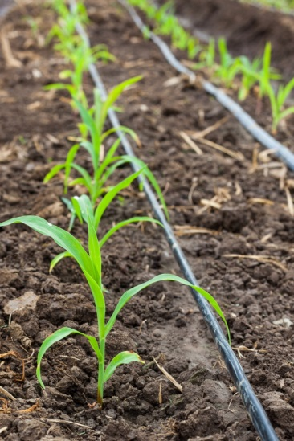
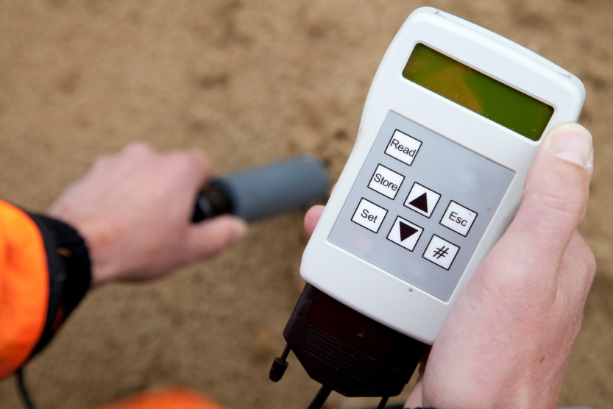
goal
Implement an irrigation system that makes sense for the crop and land
Decrease water evaporation
by delivering water directly to the plant roots
Use technology to measure precise soil moisture
Notes:
Explain to students that some methods of irrigation are more efficient than others. Best practices in irrigation vary by farm and crop but will generally enable farmers to decrease water evaporation, deliver water more directly to plant roots (eliminating water loss to other locations or from runoff), and measure precise soil moisture for exact watering.

Slide 15
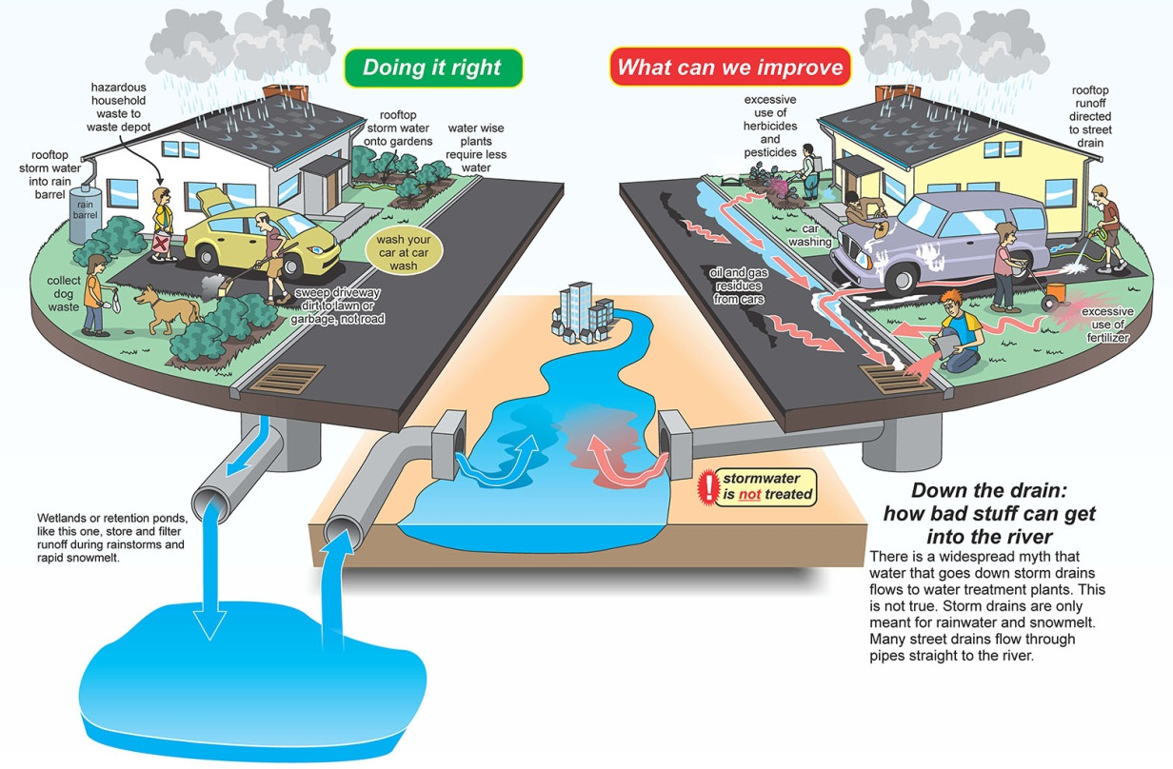
What Best Practices help conserve water?
How can we protect and conserve water at home and in our schools and communities?
Notes:
Option – complete slide 21 and 22 for further exploration of watersheds and how the student’s can make improvements in their own footprint.

Slide 16
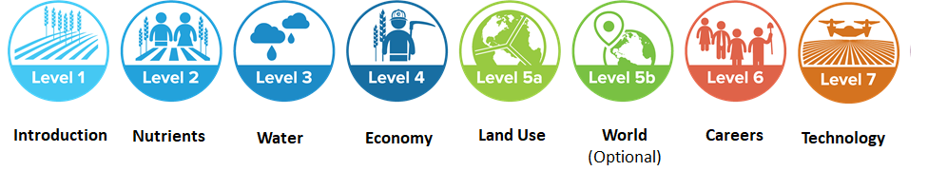
Sustainability Farming Game
Level 3 water
Play the game!
Notes:
In this level of the game you will primarily be managing water use. There will be a water meter on the left side of the screen that you will need to pay close attention to.
The game is simulated for the year 2030.
Stop when you finish farming in Canada
Total game time is 15 minutes (5 minutes in each country)

Slide 17
Follow-Up Discussion

Slide 18
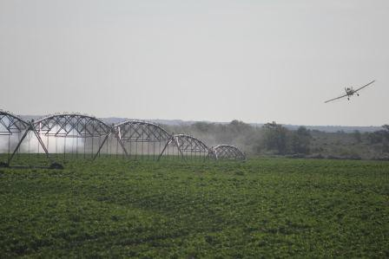
Follow-Up Discussion
  What were your limiting factors?
  Did you find it difficult to have enough water for your crops? Why is freshwater conservation and preservation important? How did the weather impact your crops?
  What ripple effects did you notice from your investments?

Slide 19



Wrap-Up
Water is a natural resource critical to agriculture.
Although the majority of the Earth is made up of water, only a small fraction is actually usable.
Farmers improve their water efficiency by using water conservation practices and technologies such as irrigation (with moisture sensors), conservation tillage and riparian areas.
Some regions of the world face greater threats to their water supply than others.

Slide 20

Questions?
Programs@naitco.ORG

Slide 21
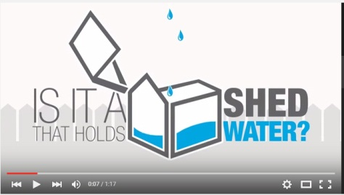
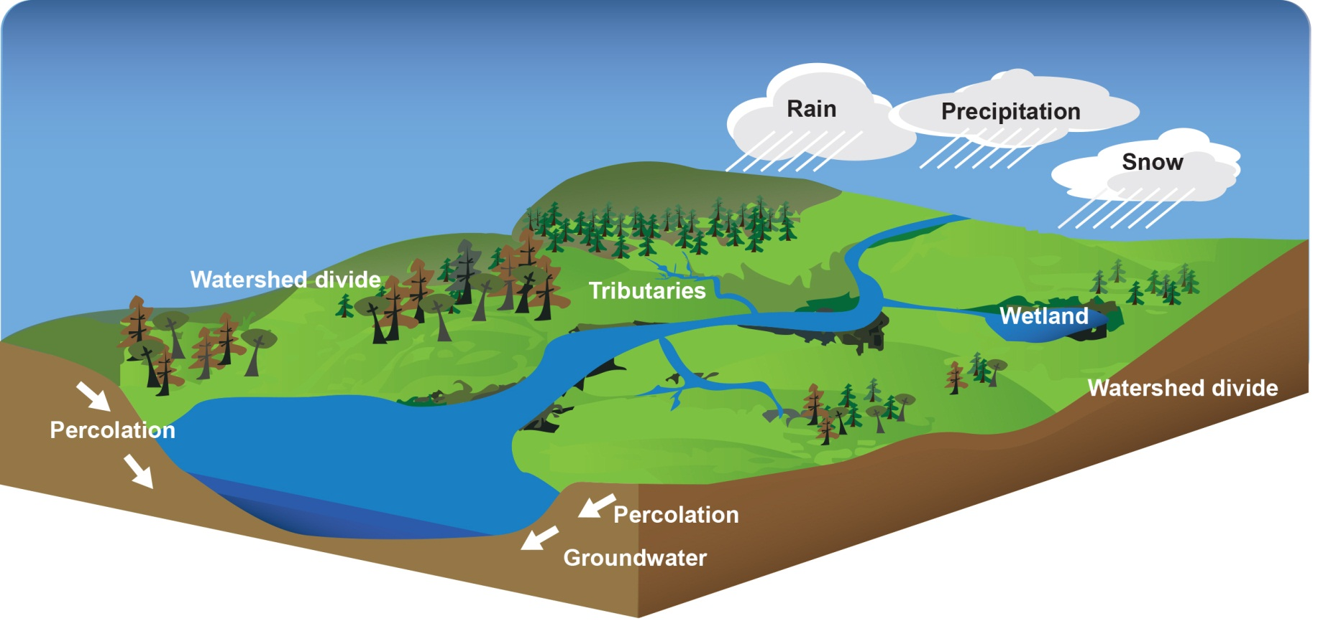
Enriching activities
All of the land that drains to the same location or body of water
Water bodies such as rivers, lakes and wetlands & Land including parks, fields and schoolyards
No borders
Play
Notes:
What Is a Watershed? (https://youtu.be/K_o-jK6vWIo, 1:17 min)
What do you see taking place in this diagram? (answers: rain, water is draining to one point a lake, etc.)
What do you think of when you hear the word watershed? (get students answers, and then reveal the answer for them to write down)
A watershed is all of the land that drains to the same location or body of water.
People tend to think only of water bodies such as rivers, lakes and wetlands as being part of their watershed. However any upland, whether it be a park, field, schoolyard, or even a parking lot, is also included.
Watersheds know no political borders, whether national or international and are key to a healthy environment
Display a map of your local watershed. Every action you take impacts our community and our neighbors downstream. Every day we must protect and conserve water.

Slide 22

Enriching activities
At School
ONE CONCERN =
ONE SOLUTION
What can YOU do
to improve your
local water footprint?
At Home - Outside
In your Community
At Home - Inside
Notes:
Why Should You Care About Our Watersheds? (https://youtu.be/4EqVISw2uwA, 2:04 min)
Brainstorm in small groups one answer for each
Home – Outside [manage lawn and landscape sprinklers]
Home – Inside [5-minute showers, don’t dump medicine in toilets as treatment plants might not be able to filter them, turn off water while brushing teeth]
School [rain gardens, sensor bathroom taps, water fountains vs water bottles, low flow toilets]
Community [Provide garbage bins and hang posters on impact of dog feces running into river, native tree planting day to stabilize river bank and collect runoff]
Optional – Local Industry such as Oil & Gas, Forestry, Manufacturing [re-use water in processing, clean water used before returning it to the rivers]
Optional – Farm [wetlands, drip irrigation, cell phones that turn irrigation on and off depending on weather]

Slide 23
Enriching activities
  Which countries have the least available freshwater? Which countries have the most available freshwater?
  Discuss factors that impact water availability.
  Estimate how much water a person uses each day in countries such as the USA, Germany and Uganda.
  Students will understand the importance of taking action through service-learning using the WE Service Learning in Action: Water lesson plan

Slide 24
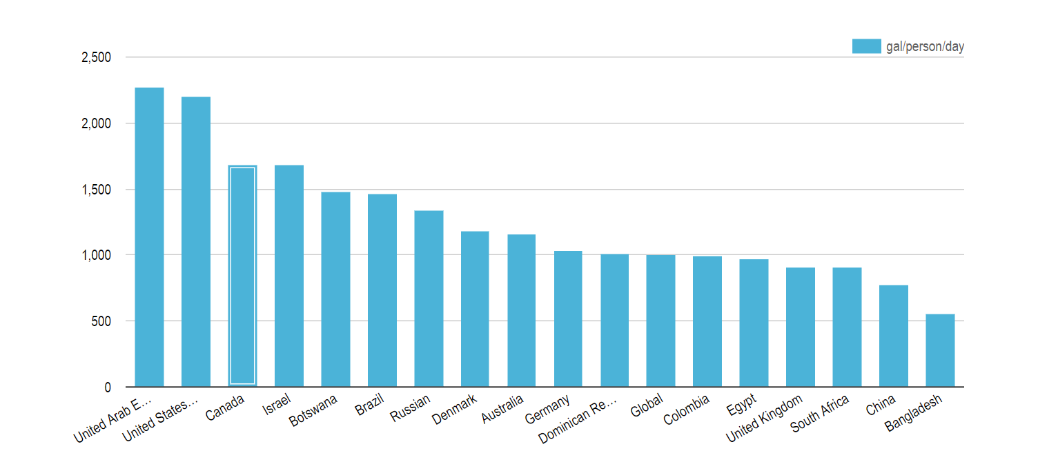
Enriching activities
Notes:
Image attributed to:
https://www.watercalculator.org/footprints/water-footprints-by-country/

Slide 25










Brought to you in collaboration
www.Journey2050.com
Notes:
Brought to you by community partners around the world.

