Slide 1
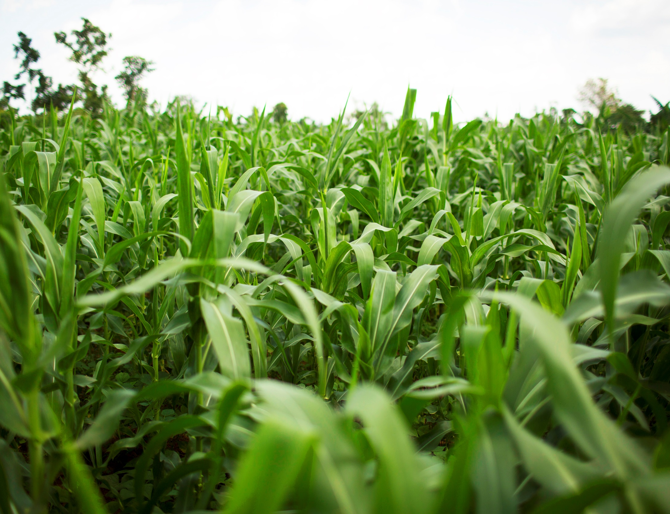

Plant Health
Lesson 2
V6.0
Notes:
Time
45 minutes
Activity Expectations
Students will be able to:
Identify nitrogen, potassium and phosphorus as primary soil nutrients necessary in the production of abundant and healthy foods;
Describe various methods of replenishing soil nutrients that have been depleted by plant growth;
Discover how overall plant health impacts a plant’s ability to resist disease and pests;
Describe the 4R Nutrient Stewardship System; and
Describe what best management practices are in agriculture.
Materials
1 clear drinking glass with 8 equidistant marks (glass or plastic, use a grease pencil or dry-erase marker to add the marks)
Water
Drinking straw
Plant Health video (https://youtu.be/chdtdWEV-0s)
Plant Health PowerPoint
Sustainability Farming Game Level 2 Nutrients
Computer or tablet device for each student
Optional: Glossary of Key Terms
Optional: Student Handout 2-4: Agriculture Terminology—Word Search, Crossword Puzzle, Matching Activity
Optional: Student Handout 5: Case Study—Pests and Disease
Key Terms
Nutrients, Fertilizer, Organic Material, Best Management Practices, 4R Nutrient Stewardship System

Slide 2
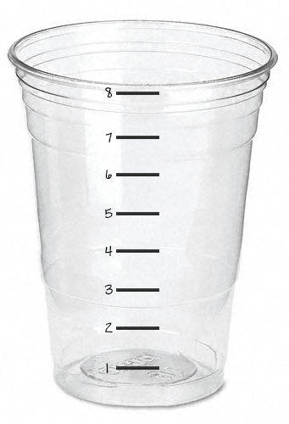
How are nutrients depleted
from the soil?
Notes:
Ask students to keep the question “How are nutrients depleted from the soil?” in mind as you give them a demonstration.
Follow instructions found in the Interest Approach section of the lesson plan.

Slide 3
Could farmers add too many nutrients to their fields?
Yes
Could farmers also not add enough nutrients?
Yes
If growing plants deplete soil nutrients, why should farmers continue to grow crops?
To produce our food so we can eat!
Notes:
Following demonstration, ask students these questions.

Slide 4
What is
SUSTAINABILITY?
Notes:
Remind students of the meaning of the word sustainability. Inform them that they will be learning how farmers can sustainably manage plant health to produce enough food for the world while also preserving the environment for future generations.

Slide 5

Watch the Journey 2050:
Plant Health Video
As you watch, discover:
What three primary nutrients are necessary for healthy plant growth, and how can they be replenished?
How does a plant resist disease and pests?
What are best management practices?
What are the 4Rs?
Notes:
Plant Health Video link: https://youtu.be/chdtdWEV-0s

Slide 6
soil
Why does soil matter?
Crops that we eat grow in the soil like potatoes, lettuce and beans
as well as the crops we use to feed livestock that provide us with foods like meat, milk and eggs.
Notes:
Ask students, “Why does soil matter to agriculture and to us?” (Crops that we eat grow in the soil, as well as the crops we use to feed livestock that provide us with foods like meat, milk and eggs.)
Explain to students that just like we need nutrients, which we obtain from the food we eat, plants also require nutrients, which they get from the soil.
The soil beneath our feet is one of our most precious resources; in reality, it makes life possible! It is much more than just dirt! Soil is composed of sand, silt, clay, plant nutrients, organic material, bacteria, crawling critters, oxygen, water and much more.

Slide 7
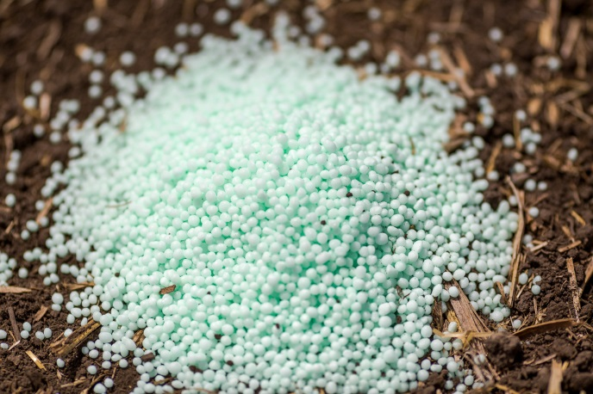
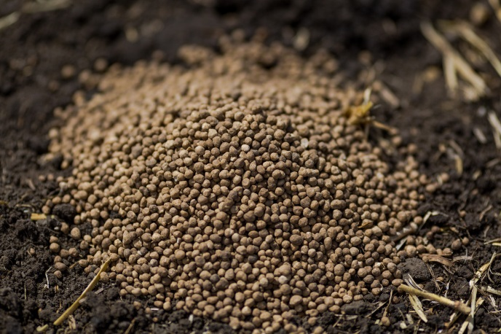
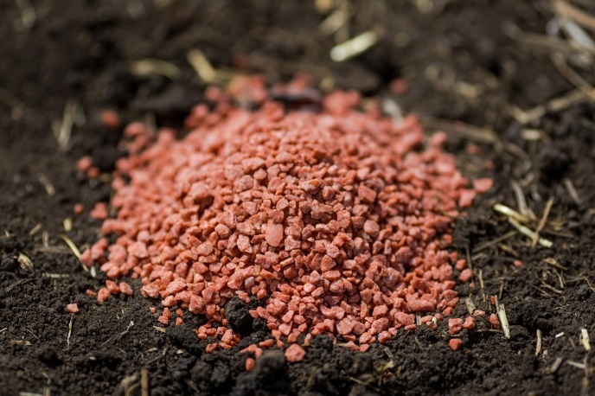
Nutrients
What three primary nutrients
do plants need to grow?
Nitrogen (N), Phosphorus (P) and Potassium (K)
N
P
K
Remember the bank analogy for stored nutrients.
How are nutrients replenished?
Notes:
Plants require 17 nutrients to grow.
Ask students, “What three primary nutrients do plants need to grow?” (nitrogen (N), phosphorus (P), and potassium (K))
Remember the bank analogy for stored nutrients.
In the video they use an analogy of a bank and storing nutrients. As an additional example you can use a refrigerator analogy. Explain that we have to restock the refrigerator when we run out of food. Similarly, after we harvest a crop, we need to “restock” the soil with the nutrients that were used as the crop grew. This will allow the next crop to reach its full potential.

Slide 8
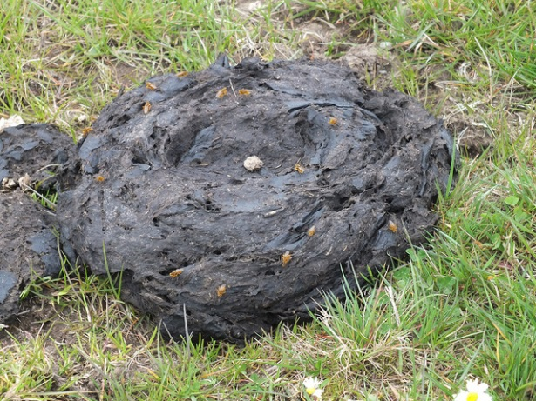
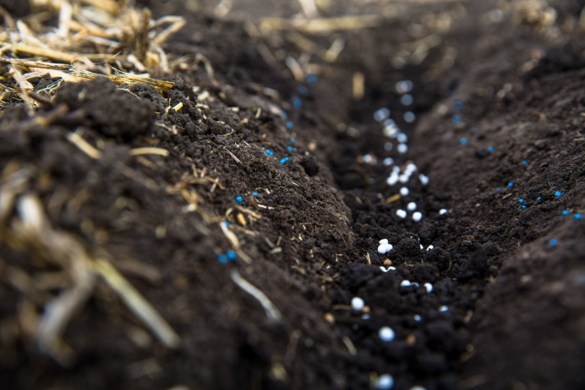
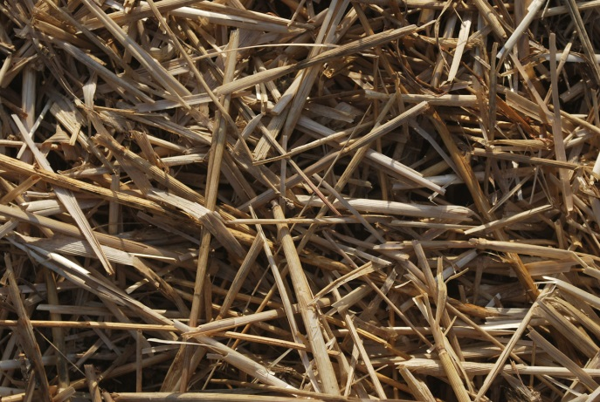
Nutrients
Where do plant nutrients come from?
Nature!
Manure
Fertilizer
Organic Sources/
Compost
Notes:
First and foremost, plants need nutrients to grow.
Recap with students, “Where do soil nutrients come from?” (Nature! Fertilizer, manure, organic sources/compost)
Be sure your students recognize that soil nutrients come from both organic and inorganic sources. Organic fertilizers come from sources that were once living. Examples include animal manure, green crops and composts. Inorganic fertilizers come from natural mineral deposits in the earth that are mined and processed into a source that plants can absorb.

Slide 9
How does overall plant health affect a plant’s ability to resist disease and pests?

Slide 10


Overall Plant Health
Which person is more likely to get sick if exposed to the same contagious illness?
Eats a balanced diet, exercises and is in overall good health
Eats a poor diet, does not exercise and is generally less healthy
Notes:
Ask students to picture two individuals. One eats a balanced diet, exercises and has overall good health. The other does not consume a healthy diet and is much less healthy. If both of these individuals were exposed to the same contagious illness, which one is more likely to get sick? (The less-healthy individual.)
Image attribution: http://cliparts.co/clipart/2726141

Slide 11
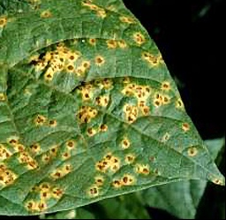
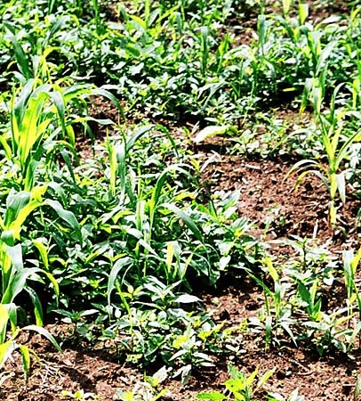
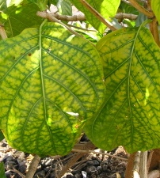
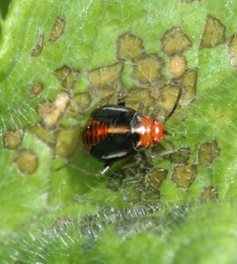
Overall Plant Health
Diseases
Weed Infestations
Insects
Nutrient Deficiencies
What can make a plant sick or destroy a plant?
Notes:
Explain that plants can also exhibit varying levels of overall health. Optimal plant health begins with proper nutrients. For plants, most nutrients are absorbed through the soil. Many nutrients are essential in photosynthesis, the process plants use to make their food. Kind of like cooking a balanced, healthy meal requires ingredients from all the food groups, plants need a balanced variety of nutrients in the soil in order to be healthy. Ask, “What can make a plant sick or destroy a plant?” Allow students to offer answers, then provide the following:
Insects
Diseases
Nutrient deficiencies
Weed infestation
Image attributions:
https://extension.umn.edu/insects
http://erec.ifas.ufl.edu/plant_pathology_guidelines/module_03.shtml
http://www.ctahr.hawaii.edu/noni/images/pestsDiseases/rootknot-noni-2-webize.JPG
http://eorganic.info/sites/eorganic.info/files/u118/weedy-sweet-corn.jpg

Slide 12

Overall Plant Health
Other benefits to maintaining optimal plant health:
Plants will be better able to resist pests and disease, thereby requiring less human intervention.
Plants will grow vigorously and be able to outcompete (grow faster than) weeds.
Plants will grow to their genetic potential and produce more food.
Notes:
As a class discuss the benefits of maintaining optimal plant health.

Slide 13
Best Management Practices
Choices come in varying degrees…
Poor
Good
Best!
“Best Management Practice” (BMP)
refers to the best way to do something.
Can you think of BMPs that protect the soil?
Notes:
Point out to students that we make lots of choices in life; some choices are poor, others are good, and still others are better or best. The same is true in managing plant health.
In agriculture the term “best management practice” refers to the best way to do something.
Ask students if they can think of ways to protect the soil.
Farmers use a variety of soil conservation practices to prevent erosion (contour plowing, terracing, windbreaks, cover crops, crop rotation, no-till farming, etc.) and other technologies to maximize yields sustainably. These are examples of best management practices.
Best Practices video: https://youtu.be/bLQ5QWN0NIg

Slide 14
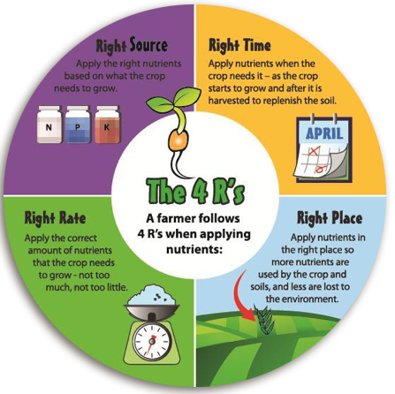
4r nutrient stewardship
Notes:
The 4Rs represent the best known method of applying nutrients to crops. Regardless of the type of nutrient used, these practices must be followed for ideal crop yields, environmental protection and economic returns.

Slide 15
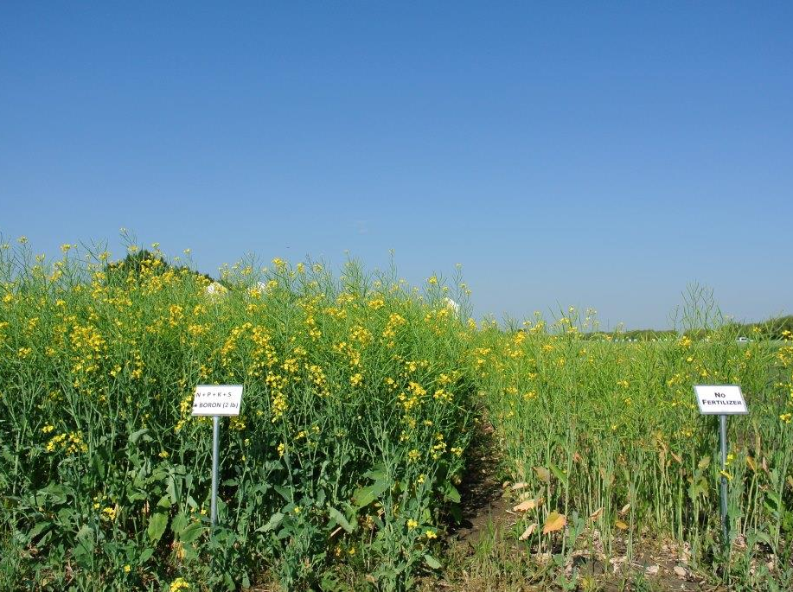
Canola crop
Manufactured fertilizers are responsible for 50% of the world’s food supply.
Fertilizer
Applied Based on
4R Nutrient Stewardship
No Nutrients
Added to the Soil
Notes:
Have students compare the canola test plot on the left to the test plot on the right. Ask, “Which crop is healthier?” Inform students that the plot on the right relied only on the existing soil nutrients for plant growth, which was not sufficient. The plot on the left was fertilized using the 4R Nutrient Stewardship model. As a result, the canola crop had the proper nutrients to grow to its best potential. Note the following:
When fertilizers are used properly, they provide the exact nutrients needed by soils and plants, reducing the risk of losses to the environment.
Fertilizer applied based on science and the 4R Nutrient Stewardship guidelines is essential as we strive to feed the world
Manufactured fertilizers are responsible for 50% of the world’s food supply. Without it, we couldn’t feed everyone.

Slide 16
Sustainability Farming Game
Level 2

Slide 17
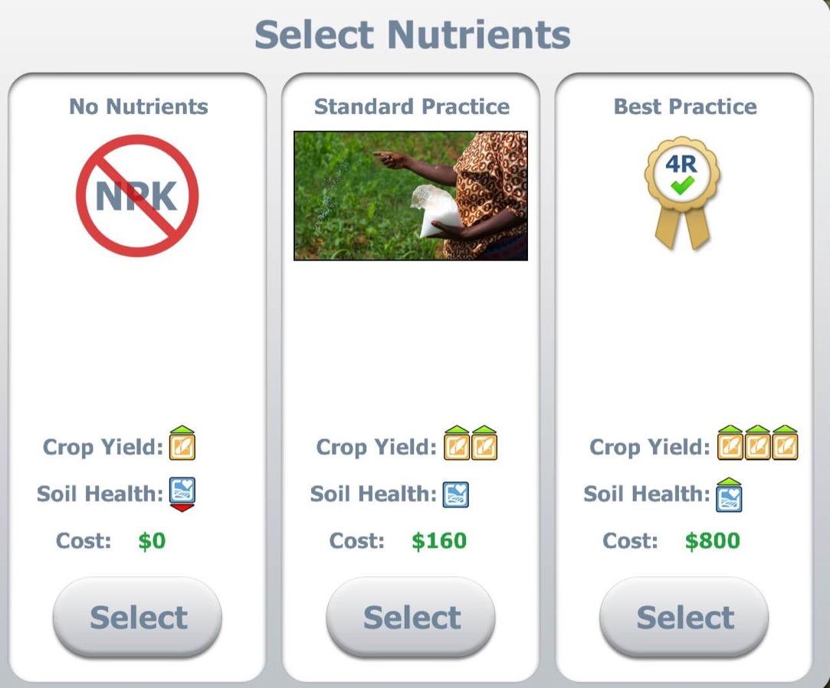
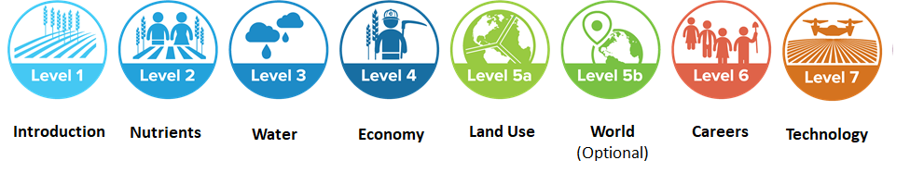
Sustainability Farming Game
Level 2 nutrients
Play the game!
World
(Optional)
Notes:
Open Level 2 of the Sustainability Farm Game on each student’s computer or device. Explain that this level of the game allows them to farm in all three countries (Kenya, India and Canada). Prepare students for the game by informing them of the following:
Level 2 allows you to see the impacts of adding nutrients to the soil. You will be comparing three nutrient management practices.
As you farm, you will be asked if you want to make investments that will cost money but will be used to improve the roads, research new seed varieties, etc. Explain that these are examples of real-life investment opportunities that exist in each country.
OPTIONAL: Divide your class into three groups and assign each group a specific nutrient practice. Group 1 will choose “No Nutrients” each time they plant a new crop. Group 2 will choose “Standard Practice” each time they plant a crop. Group 3 will choose “Best Practice” each time they plant a crop. (These nutrient management methods represent a poor, good and best practice.) Instruct students to stop after they finish the first round in Kenya. Their screens should show their sustainability scores and the results of their sustainability barrels.
Once the students have finished round one, compare the results of the three groups and their nutrient management practices. What were their sustainability scores? What were their limiting factors? After the class discussion, allow the students to complete the next two rounds using the nutrient management practice that they deem best. Once they finish farming in Canada they will be done with Level 2. Have them stop here.

Slide 18
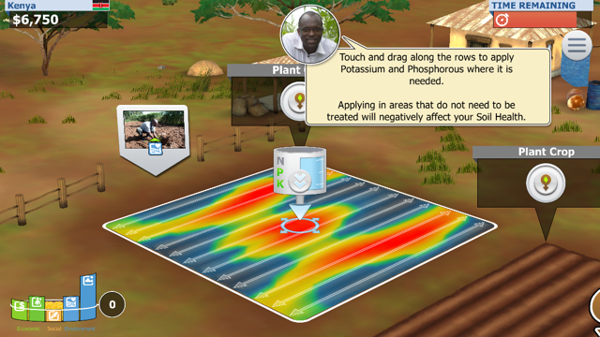
Slide over red/yellow areas
Notes:
Apply nutrients where it is colorful! This is where the nutrients are needed on the field. If students apply nutrients in areas that are grey eventually their soil health and money will drop.

Slide 19
Follow-Up Discussion

Slide 20

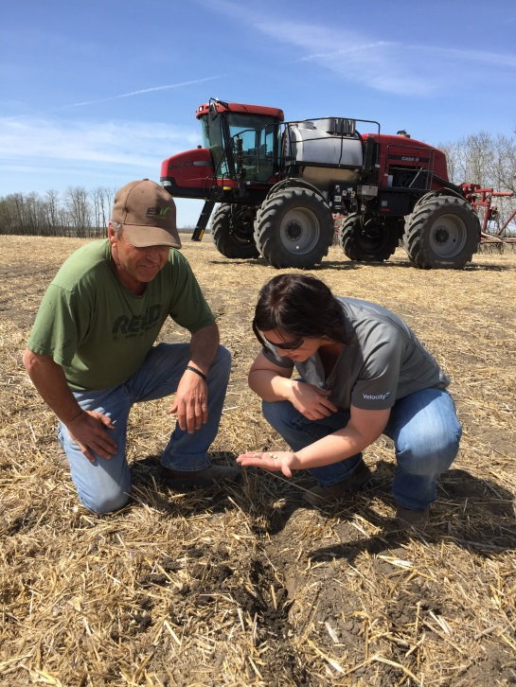


game Discussion
Which nutrient practice was best?
If nutrients are over or under applied what impacts did you notice on crop yields, environment or economics?
How can farmers be sure they are applying nutrients in a sustainable way?
Notes:
Once students have completed the game, use the following questions to help students synthesize what they have learned:
Which nutrient practice was best?
If nutrients are over or under applied what impacts did you notice on crop yields, environment or economics? (When excess nutrients are applied, the crop can’t use them all, and the nutrients can be lost to the environment, potentially damaging water quality and habitat. Using excess nutrients isn’t economical for the farmer. When insufficient nutrients are applied, the crop cannot reach its full potential, earning less for the farmer and producing less food to feed the world.)
How can farmers be sure they are applying nutrients in a sustainable way? (Refer back to the demonstration at the beginning of the lesson to tie the concepts together for understanding. Farmers who use best management practices monitor the health of their soil and apply soil nutrients as they are needed by following the 4Rs.)

Slide 21

Wrap-Up
Agriculture provides our food supply. Growing our food requires the use of nutrients, which must be returned to the soil through proper application in order to continue growing healthy crops.
Crops grown in soil without proper nutrients are less healthy, less resistant to insects and diseases, and produce a less abundant harvest than crops grown in nutrient-rich soil.
When plant health is managed using best practices farmers can be more successful in harvesting an abundant crop of healthy foods.

Slide 22

Questions?
Programs@naitco.org

Slide 23
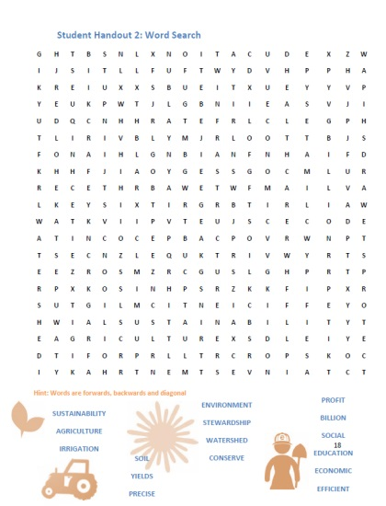

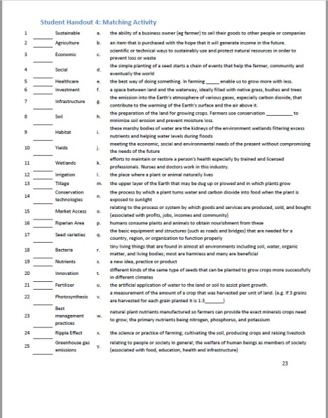
Enriching activities
Student Handouts:
  Word Search
  Crossword Puzzle
  Matching Activity
Nutrients for Life Resource:
Feeding the World and Protecting the Environment.
Notes:
Optional:
1. Choose one or more of the optional handouts on agriculture terminology, Student Handout 2-4: Agriculture Terminology—Word Search, Cross Word Puzzle, Matching Activity. Pass out one copy to each student. Inform students that they will be using this activity sheet to learn vocabulary and key words related to plant health and sustainability. Have students work through the handout(s). Completing at least one activity out of the three will teach and reinforce the key terms. Reference the Glossary of Key Terms for definitions.
2. Use the free, downloadable PDF Feeding the World and Protecting the Environment from the Nutrients for Life Foundation to provide an overview of sustainability and the 4R Nutrient Stewardship System.

Slide 24
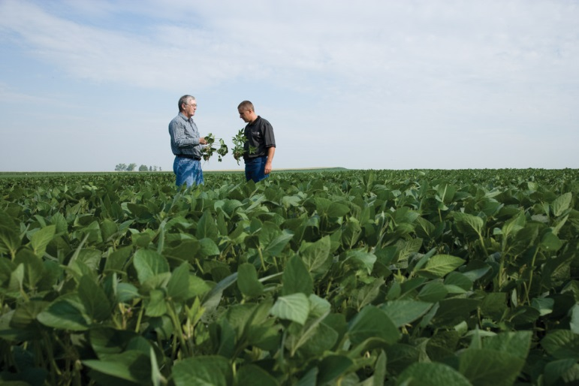
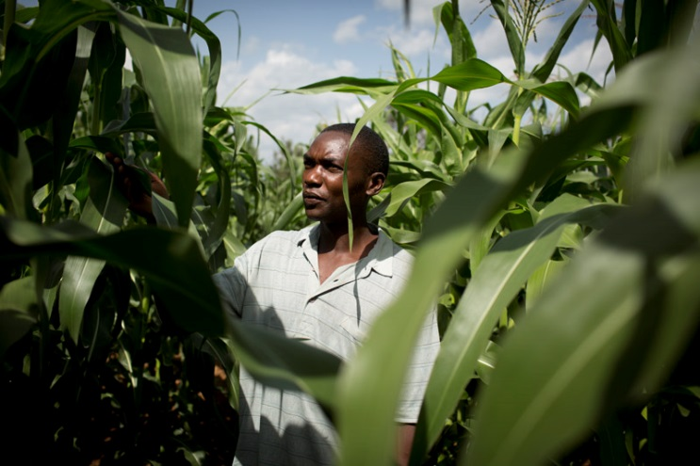
Enriching activities
Case Study:
Pests and Diseases
Split the class into two groups and assign each a case to review.
Students will understand the importance of taking action through service-learning using the WE Service Learning in Action: Plant Health lesson plan

Slide 25
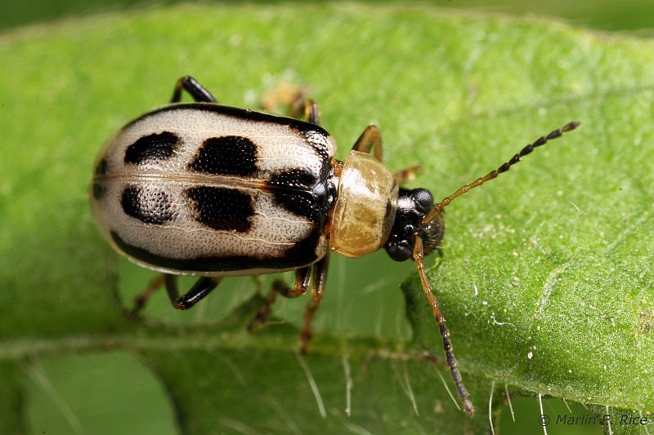
Case study 1
Farmers: Bob & Sue Jenson
Location: Minnesota, USA
Crop: Soybeans
Problem: Bean Leaf Beetle
Agronomist Report: An agronomist inspected this crop and noticed that all stages of plant growth were impacted. There is a decrease in crop yield and poor seed quality. The beetles are feeding on pods and breaking the pods, as well as scarring the leaves allowing for fungus to enter. Last, the agronomist report said this beetle was carrying a virus to the plant called bean pod mottle virus, which is mainly a concern if the Jenson’s are selling their soybeans for food because it affects the seed coat quality.
1. Research the Bean Leaf Beetle
2. Identify at least one solution to address this pest
Notes:
Optional Slide
Refer to Student Handout 5: Case Study—Pests and Disease
Image attributions:
https://www.pioneer.com/home/site/us/agronomy/crop-management/soybean-insect-disease/bean-leaf-beetle/

Slide 26
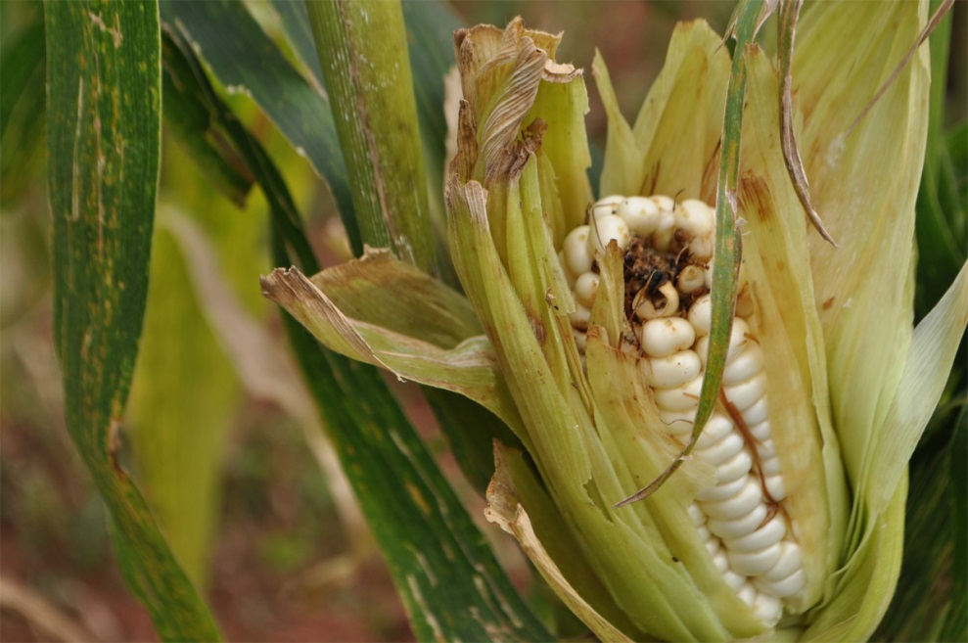
Case study 2
Farmers: Shad & Lita Meena
Location: Kenya, Africa
Crop: Maize
Problem: Maize Lethal Necrosis Disease (MLND)
Agronomist Report: An agronomist inspected this crop and noticed a 30 percent loss in yields! The agronomist could see the leaves were dry, there were malformed ears, sometimes even no ears on the plants, and some of the ears were rotting. The agronomist let the Meena family know the disease was likely from a long drought, poor soil fertility and poor agricultural
practices.
1. Research the Maize Lethal Necrosis Disease.
2. Identify at least one solution to address this disease
Notes:
Optional Slide
Refer to Student Handout 5: Case Study—Pests and Disease
Image attributions:
http://agricnation.com/disease-still-ravaging-maize-east-africa/

Slide 27
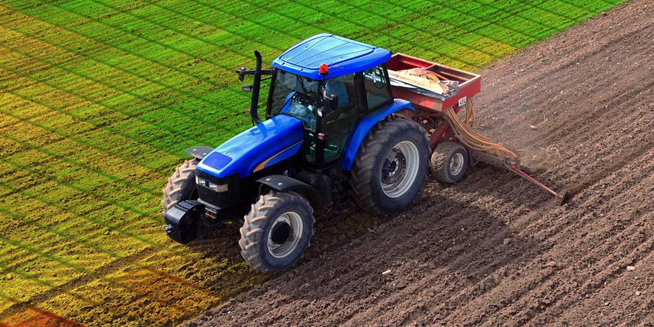
SCIENCE OF FARMING: Recap
Farm practices and technology are constantly evolving.
  Conservation practices (4R Nutrient Stewardship System, contour plowing, terracing, windbreaks, cover crops, crop rotation, no-till farming, etc.)
  Cultural controls (varied planting seasons, etc.)
  New farm equipment
  New technology (Global Positioning System, weather monitoring system, soil PH and temperature analysis, new seed varieties, etc.)
  Biological controls (ladybugs, etc.)
  Chemical controls (pesticides and herbicides)
Notes:
Optional Slide

Slide 28
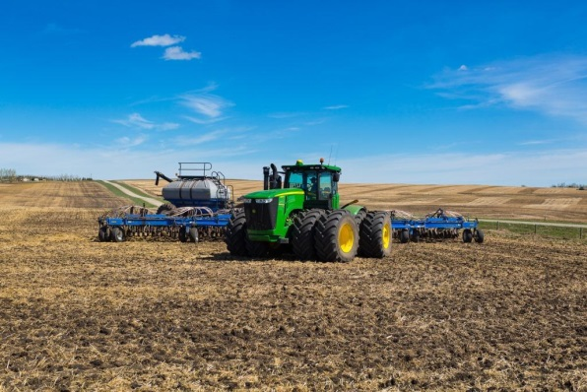
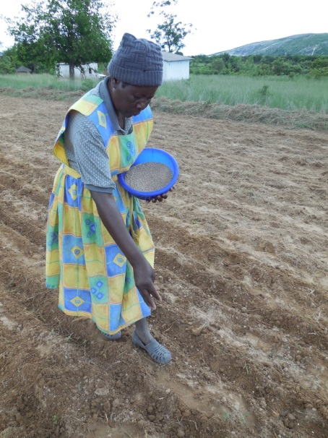
SCIENCE OF FARMING: Recap
Goal: Grow a healthy crop and raise healthy livestock while balancing a budget and environmental footprint
Reality: Farmers must use the resources they have to make informed decisions
  Does a Kenyan farmer have the same equipment as a North American farmer?
  How does an organic farmer vs a conventional farmer respond to a problem with nutrients, pests or diseases?
There is no one-size-fits-all solution.
Every farmer grows the healthiest plants and animals they can.
A farmer’s livelihood depends on sustainable practices.
Notes:
Optional Slide

Slide 29










Brought to you in collaboration
www.Journey2050.com
Notes:
Brought to you by community partners around the world.

