Slide 1
Aeroponic Farming

Slide 2
Aeroponic Farming: Activity 1 What do Plants Need?

Slide 3
What do plants need to survive and grow?
In the next 2 minutes, make a list of everything you think plants need to grow.

Slide 4
What Did You Write?
Water?
Sunlight?
Heat?
Soil?
Air?
Some of these are right, but let’s explore deeper!

Slide 5
Air, Water, & Heat
Air
Plants need carbon dioxide from the air in order to perform photosynthesis
Water
Plants need water in order to prevent dehydration
Heat
Plants need warm enough temperatures to keep their cells from freezing
Some plants can tolerate cooler or warmer temperatures than others
What about sunlight and soil? Do plants really need these to grow?

Slide 6
What about Sunlight and Soil?
Plants DO NOT need sunlight or soil to survive and grow!
Plants DO need nutrients and certain colors of light to survive and grow, but these don’t necessarily need to be provided by the sun or soil.
Growing plants indoors without sunlight is made possible by specialized “grow lights,” which emit light of specific colors that are calibrated for plant use.

Slide 7
Growing Plants Without Sunlight and Soil?
Hydroponics:
Plant roots are suspended in nutrient-rich water.
Aquaponics:
Plant roots are suspended in water with fish and bacteria living in it to provide nutrients for the plants.
Aeroponics:
Plant roots are suspended in air and misted periodically with nutrient-rich water.
These three methods use much less water than traditional field farming.
Aeroponic farming can use up to 95% less water than field farming!

Slide 8
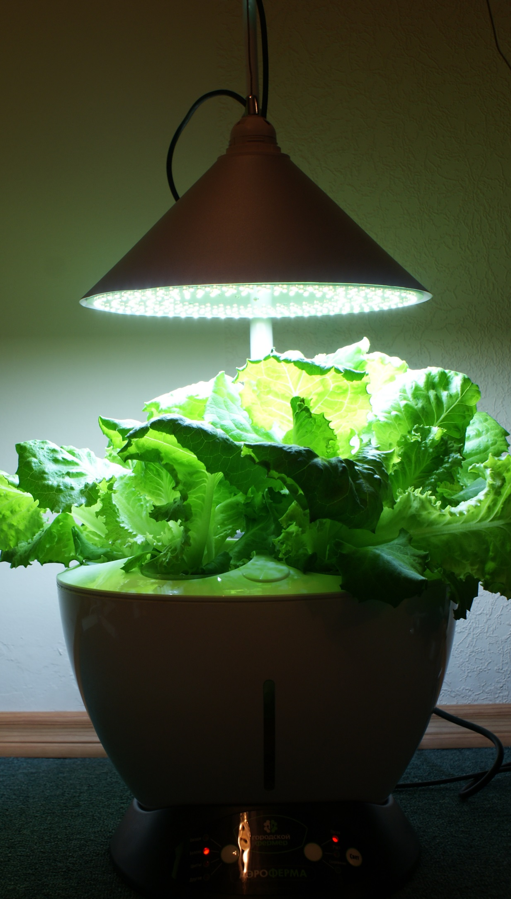
So What do Plants Really Need?
Air
Carbon dioxide is taken in by special openings in the plant’s exterior called “stomata”
Water
Taken up by roots and delivered to all parts of the plant
Heat
Not too hot, and not too cold, just like Goldilocks
Nutrients
Nitrogen, phosphorus, potassium, magnesium, sulfur, and other trace chemicals
Can be provided by soil or other means
Light
Mostly red and blue wavelengths
Can be provided by the sun or artificial lighting

Slide 9
Aeroponic Farming: Activity 2 Vertical Garden Design Challenge

Slide 10
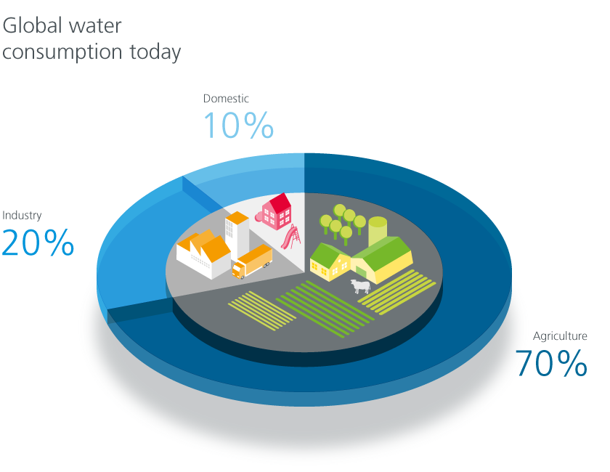
The problem
70% of fresh water globally is used for agriculture
By 2050, increased population may require as much as 15% more water to feed everyone
In the U.S., more than 80% of Fresh Water is used for agriculture, approaching 90% in some western states
Agricultural activity is the leading source of several fresh water pollutants, leading to species loss and decrease in drinking water quality
Notes:
Graph Source: https://www.gea.com/es/technology-talks/zero-water.jsp

Slide 11
A possible solution
Aeroponic farms “mist” the roots of plants with nutrient-rich water
Reduce water use by up to 95%
Provide better root oxygenation
Have a faster growing cycle
Use vertical AND horizontal space more efficiently

Slide 12
Your role
You are an agricultural engineer who has been hired to develop a small-scale vertical garden for families living in urban areas. Your team has been tasked with designing an inexpensive, self-contained vertical garden unit that can produce food for a family.

Slide 13
Your assignment
Work with a team of 3-4 students
1
Design and construct a vertical garden unit which meets the design criteria and constraints listed in your student handout
2
Keep a design notebook to thoroughly document your work
3

