Slide 1
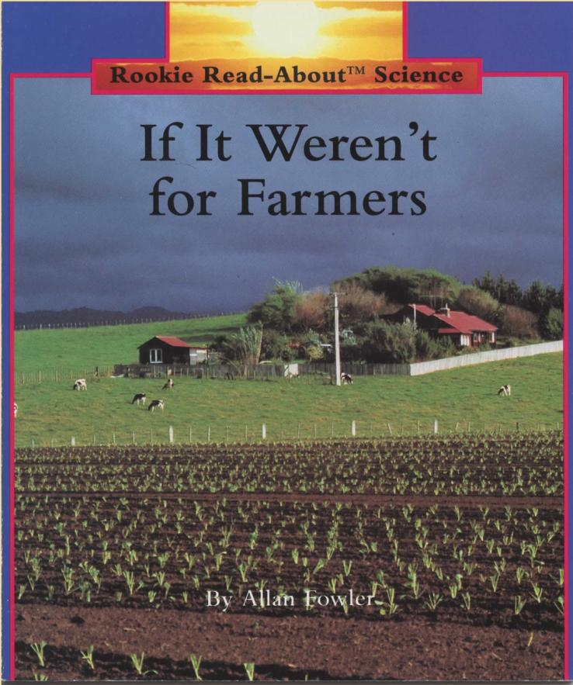
If It Weren’t for Farmers
Rookie Read-About™ Science
By Allan Fowler
Power Point presentation created by permission of Maria Felizardo and Scholastic Publishers

Slide 2
If it weren’t for farmers—
what would there be to eat?

Slide 3
All the fruits and vegetables,

Slide 4
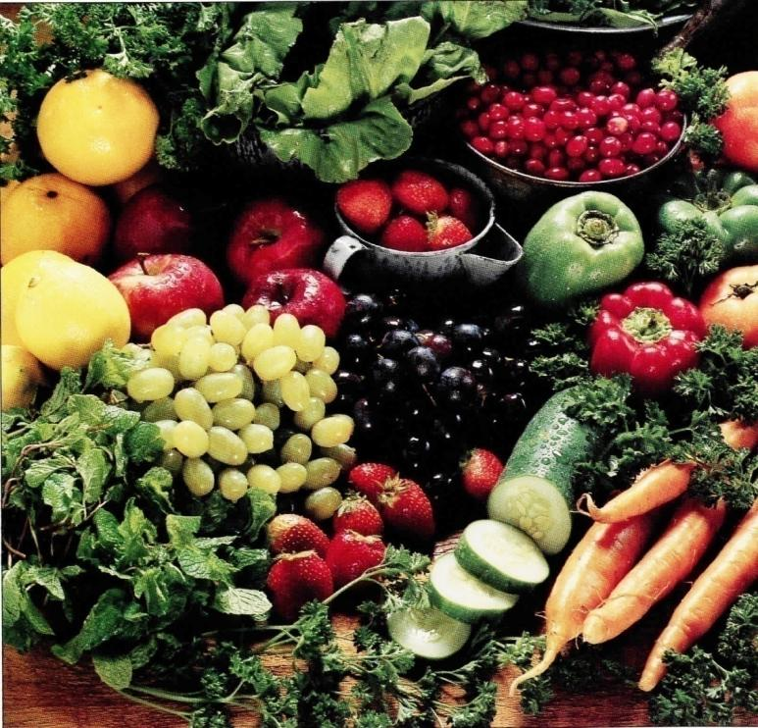
All the fruits and vegetables,
all the milk and cheese,

Slide 5
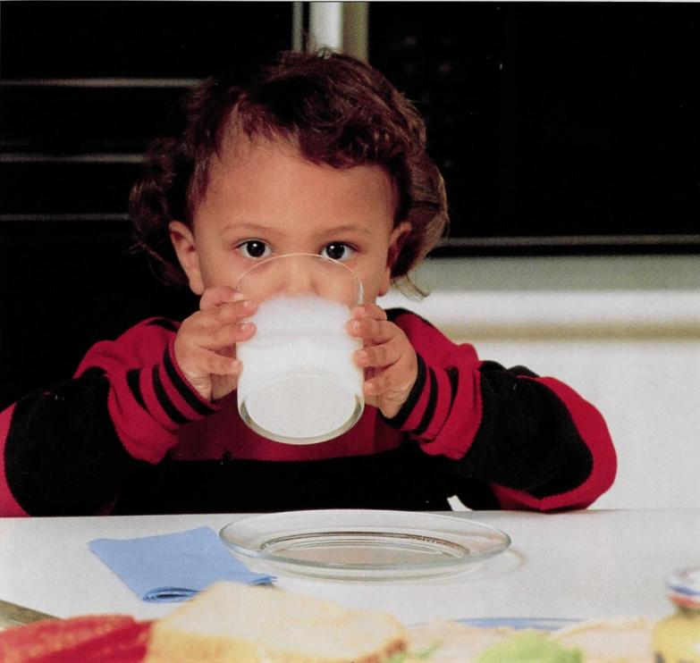
All the fruits and vegetables,
all the milk and cheese,
meat and eggs you enjoy,

Slide 6
all the wheat that’s made into flour,

Slide 7
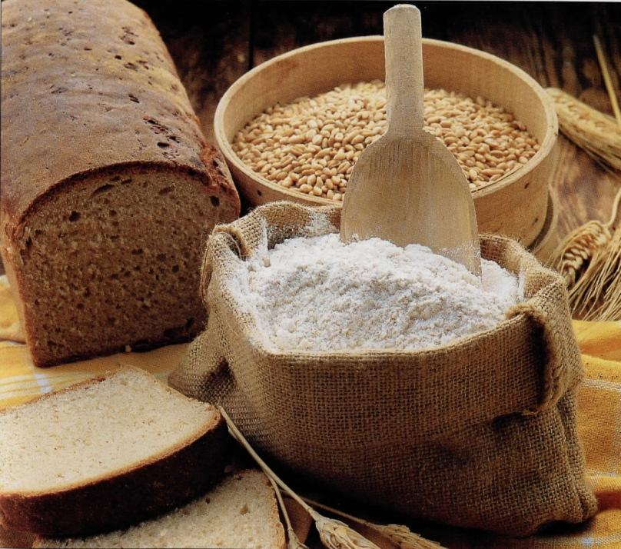
all the wheat that’s made into flour,
that’s baked into bread and cookies and cakes,

Slide 8
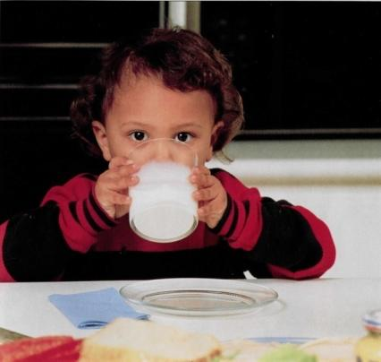
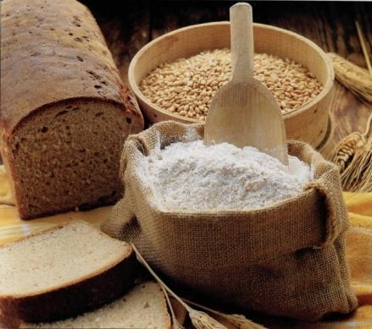
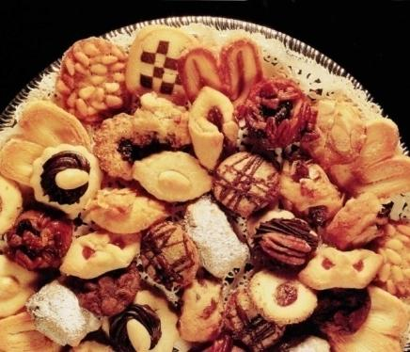
…all of it comes from farmers.

Slide 9
A farm is a place where people go to work…to grow plants or raise animals for food.

Slide 10
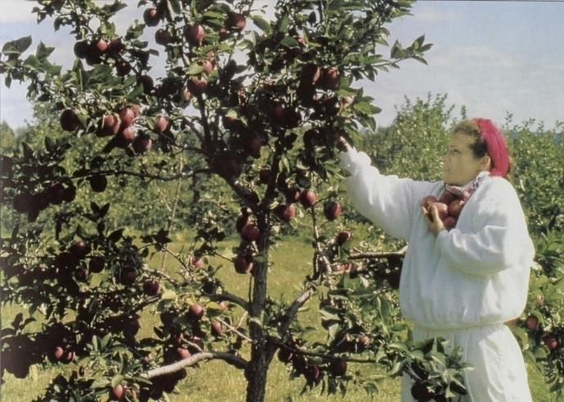
Some farm crops—such as oranges, grapefruits, and peaches—grow best where it’s warm most of the time.
Others—such as apples and berries, potatoes, and tomatoes—can be grown in cooler climates.

Slide 11
And there are places where the soil and climate are just right for growing corn and grains.
Fields of wheat or corn stretch as far as the eye can see.

Slide 12
Farmers often add fertilizer to their soil. Fertilizer is plant food. It helps farmers grow bigger, healthier plants.

Slide 13
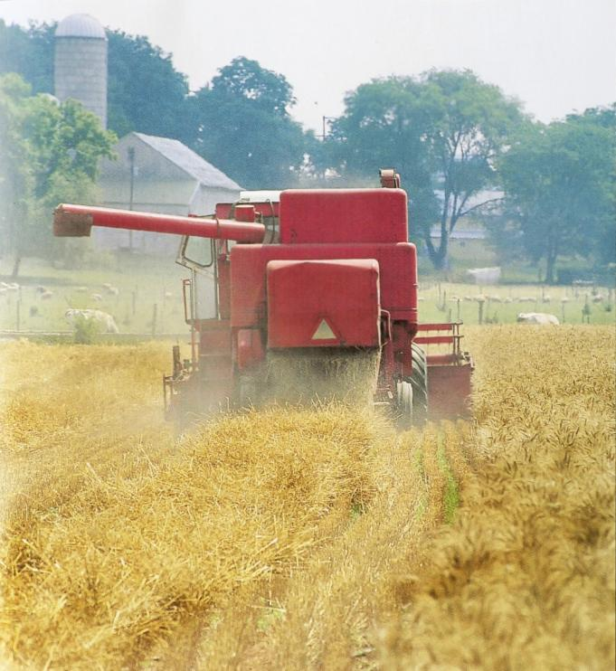
Farmers protect their crops from harmful weeds, insects, and plant diseases.

Slide 14
The most important thing all crops need is water.

Slide 15
Nothing can grow without water.
Sometimes there isn’t enough rain.

Slide 16
Then the farmer irrigates his crops. He brings water to them from natural sources such as rivers or springs.

Slide 17
The water reaches the crops through an irrigation ditch, or
through a pipeline connected to sprinklers.

Slide 18
Today, machines help the farmers do their work.
Tractors pull the plows that break up the soil… and the planters that plant the seeds…

Slide 19
and the harvesters that gather in the crops.

Slide 20
Some crops are so delicate that they would be crushed by machines.
Raspberries, blueberries, and strawberries are like that, so they are picked by hand.

Slide 21
Besides crop farms, there are dairy farms where milk and cheese are produced…

Slide 22
poultry farms, where chickens are raised for meat and eggs…

Slide 23
And cattle farms or ranches, where cattle are raised for beef.

Slide 24
If it weren’t for farmers—what would there be to eat?

Slide 25
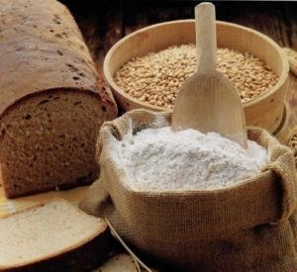
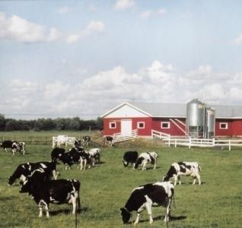
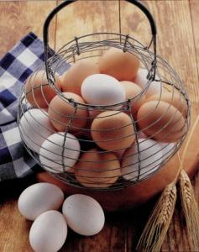
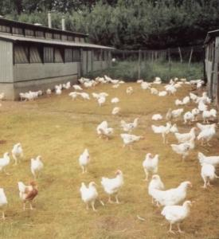
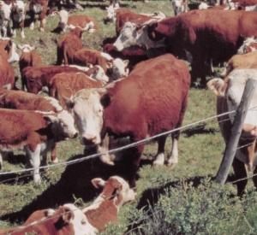
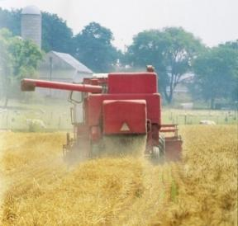
Words You Know
Crop Farms
Dairy Farms
Wheat
Fruits and Vegetables
Cows
Poultry Farms
Milk
Cattle Ranch
Organic Farm
Eggs
Chickens

Slide 26
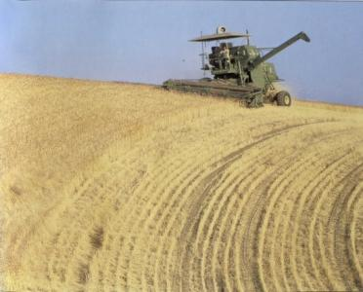
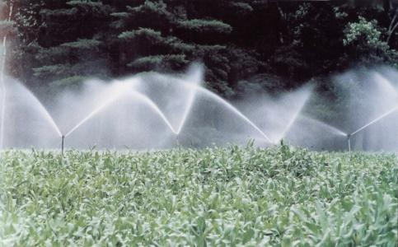
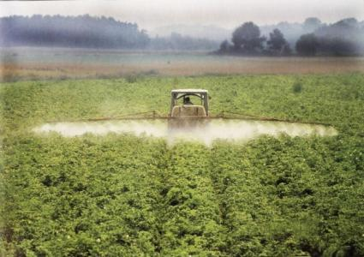
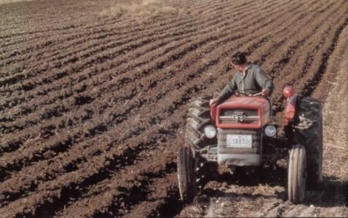
Words You Know
Tractor
Sprinklers
Harvester
Chemicals
Tractor

