Slide 1
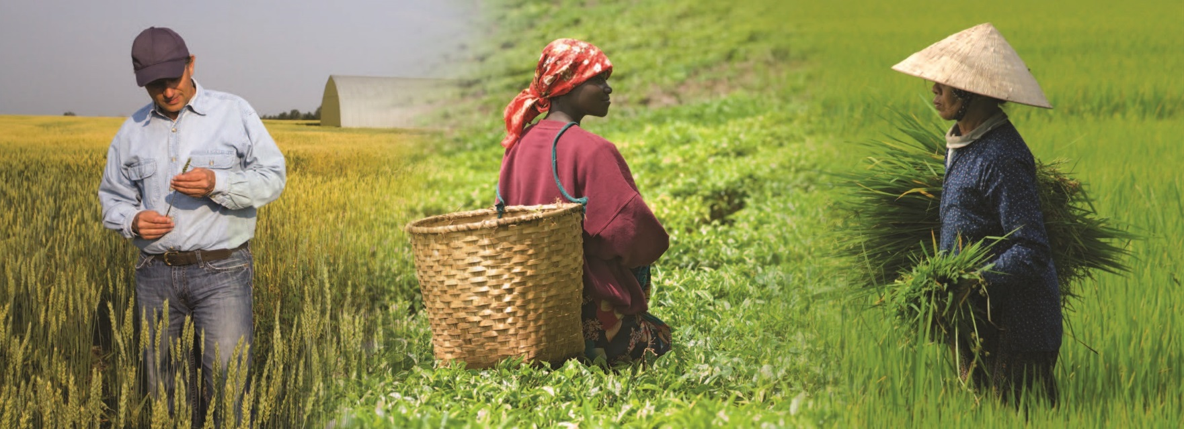
Notes:
Lesson 2: Properties of Soils
Nourishing the Planet in the 21st Century
Download your free copy of the curriculum: https://www.nutrientsforlife.org/for-teachers
Topics Covered and Major Concept
Soils vary with regard to the amount of organic and inorganic matter they contain. Some soils hold and transmit water better than others do. Plants generally take up whatever is dissolved in soil water.
Alignment with Next Generation Science Standards
Science Practices in Lesson 2
Developing and Using Models
Planning and Carrying Out Investigations
Analyzing and Interpreting Data
Using Mathematics and Computational Thinking
Constructing Explanations and Designing Solutions
Engaging in Argument from Evidence
Obtaining, Evaluating, and Communicating Information
Selected Disciplinary Cored Ideas in Lesson 2
LS1.A: Structure and Function: Systems of specialized cells within organisms help them perform the essential functions of life.
LS1.C: Organization for Matter and Energy Flow in Organisms: The process of photosynthesis converts light energy to stored chemical energy by converting carbon dioxide plus water into sugars plus released oxygen.
LS1.C: Organization for Matter and Energy Flow in Organisms: The sugar molecules thus formed contain carbon, hydrogen, and oxygen; their hydrocarbon backbones are used to make amino acids and other carbon-based molecules that can be assembled into larger molecules (such as proteins or DNA) used, for example, to form new cells.
LS1.C: Organization for Matter and Energy Flow in Organisms: As matter and energy flow through different organizational levels of living systems, chemical elements are recombined in different ways to form different products.
LS2.B: Cycles of Mater and Energy Transfer in Ecosystems: Photosynthesis and cellular respiration are important components of the carbon cycle, in which carbon is exchanged among the biosphere, atmosphere, oceans, and geosphere through chemical, physical, geological, and biological processes.
LS2.B: Cycles of Mater and Energy Transfer in Ecosystems: The chemical elements that make up the molecules of organisms pass through food webs and into and out of the atmosphere and soil, and recombine in different ways.
LS2.C: Ecosystem Dynamics, Functioning, and Resilience: Moreover, anthropogenic changes (induced by human activity) in the environment— including habitat destruction, pollution,
introduction of invasive species, overpopulation, and climate change—can disrupt an ecosystem and threaten the survival of some species.
Crosscutting Concepts in Lesson 2
Cause & Effect
Scale, Proportion, and Quantity
Systems and System Models
Stability and Change of Systems
Common Core Standards in Lesson 2
English Language Arts/Literacy
Anchor Standards
CCSS.ELA-LITERACy.CCRA.R.1
CCSS.ELA-LITERACy.CCRA.R.7
CCSS.ELA-LITERACy.CCRA.R.10
CCSS.ELA-LITERACy.CCRA.W.1
CCSS.ELA-LITERACy.CCRA.W.4
CSS.ELA-LITERACy.CCRA.W.9
CCSS.ELA-LITERACy.CCRA.SL.1
CCSS.ELA-LITERACy.CCRA.SL.2
CCSS.ELA-LITERACy.CCRA.SL.4
CCSS.ELA-LITERACy.CCRA.L.6
Math Standards
Standards for Mathematical Practice
CCSS.mATH.PRACTICE.mP1
CCSS.mATH.PRACTICE.mP2
CCSS.mATH.PRACTICE.mP3
CCSS.mATH.PRACTICE.mP4
CCSS.mATH.PRACTICE.mP6
The Nutrients for Life Foundation provides a search tool on their website, http://nutrientsforlife.org, allowing teachers to select their state and find soil science lessons that correlate with their state’s science standards. The search tool can align this curriculum with science standards for all 50 states, National Sciences Education Standards, Common Core State Standards, and Next Generation Science Standards.
Explore: Students consider what makes one soil better able to support plant growth as compared with another.
In the Explore phase of this module, Lesson 2: Properties of Soil, students investigate the compositions of soils. Students perform experiments designed to provide a common set of experiences within which they can begin to construct their understanding. Students:
Interact with materials and ideas through classroom and small-group discussions;
Acquire a common set of experience so they can compare results and ideas with their classmates;
Observe, describe, record, compare, and share their ideas and experiences; and
Express their developing understanding of testable questions and scientific inquiry.

Slide 2
Properties of Soils
Lesson 2
Explore
Notes:
Overview
Students examine different types of soil that have been mixed with water and allowed to settle. Next, they work with a soil model to investigate its components (sand, silt, and clay) and learn how the properties of these components affect the passage or retention of water through the soil and the amount of air in the soil.
Major Concepts
The primary components of soil include sand, silt, and clay.
The particle sizes of sand, silt, and clay affect how water moves through soil.
Soils vary in their compositions.
Soils contain both organic and inorganic matter.
Soils contain differing amounts of air space.
Soils are a bank of nutrients.
Teacher Background: Consult the following sections in the Teacher Background: 4.0 Soil Formation, 5.0 Soil Horizons, and 6.0 Soil Triangle.
See pages 66-87 in Nourishing the Planet in the 21st Century high school curriculum for preparation instructions.

Slide 3
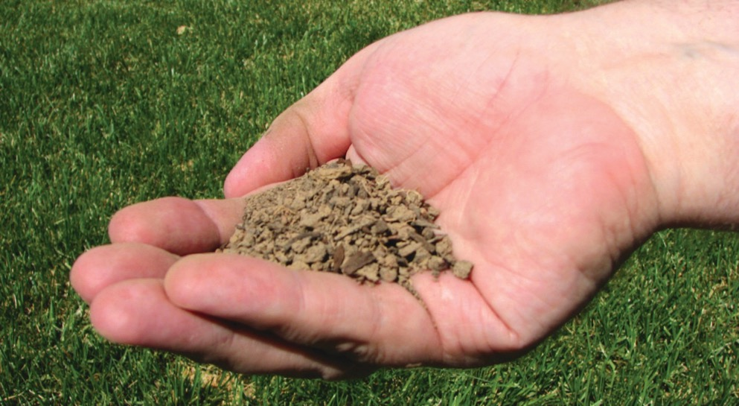
What we’re learning!
By the end of this lesson, you’ll be able to:
• list aspects of soil composition,
• explain the relationship between particle size and water movement through soil,
• appreciate that soils are living and dynamic,
• recognize that soils vary in composition,
• describe where nutrients in soil come from, and
• recognize that plants generally take up water and nutrients from the soil.
Notes:
OBJECTIVES
After completing this lesson, students will be able to list aspects of soil composition, explain the relationship between particle size and water movement through soil, appreciate that soils are living and dynamic, recognize that soils vary in composition, describe where nutrients in soil come from, and recognize that plants generally take up water and nutrients from the soil.

Slide 4
Virtual Classroom – Lesson Introduction
Notes:
For more virtual classroom videos, visit the Nutrients4Life YouTube channel.

Slide 5
What is soil?
Soil
Nonliving inorganic material
Clay
Silt
Sand
Living and nonliving organic material
Dead plant material
Bacteria
Insects
Worms
Notes:
Activity 1: Soil Separation (Page 71)
Be careful when moving the three bottles with the soils settled in water (Step 4). Excessive movement will cause the soil layers to mix. Try to keep the bottles undisturbed so that later classes can view them.
Remind students that in the previous lesson they investigated essential plant elements that are found in soil.
Ask, “What is soil?”
Write students’ responses on the board or chart paper. At this time, accept all answers. Student responses may include ideas about soil containing rocks, sand, clay, insects, worms, bacteria, bits of wood, and water. If necessary, point out that these materials contain many of the essential elements.
Ask students, “How would you categorize the components of soil?” Student responses will vary. Guide the discussion to bring out the fact that soil consists of nonliving inorganic material such as clay, silt, and sand as well as living and nonliving organic material such as dead plant material, bacteria, insects, and worms.

Slide 6
How does soil help plants grow?
Soil provides support for plants’ root systems.
Soil provides essential nutrients.
Soil holds water and makes it accessible to plants.
Soil contains air spaces, which is necessary for plant growth.
Notes:
Ask students, “How does soil help plants to grow?”
Student responses will vary. Guide the discussion to bring out the following:
Soil provides support for plants’ root systems.
Soil provides essential nutrients.
Soil holds water and makes it accessible to plants.
Soil contains air spaces, which is necessary for plant growth.

Slide 7
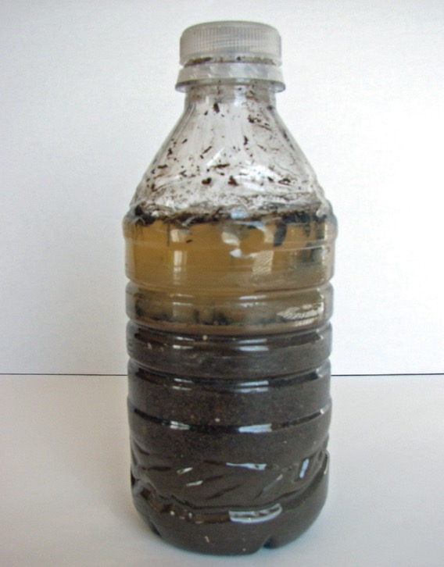
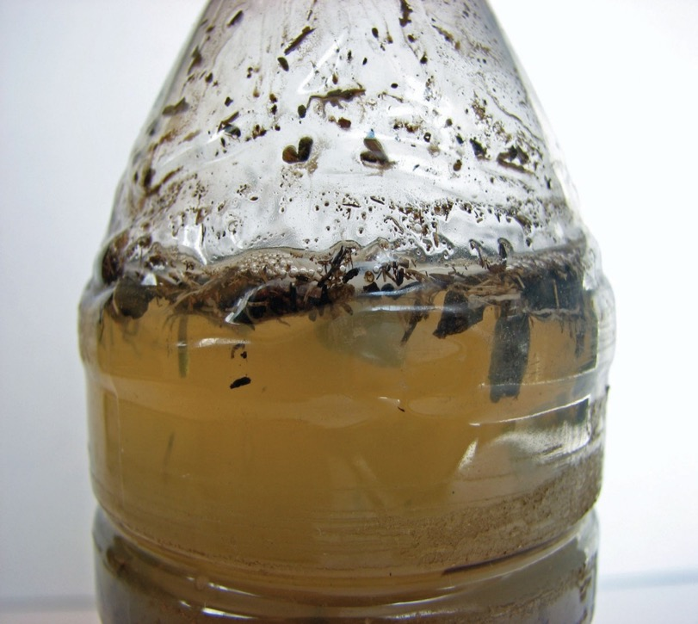
Figure A: Soil separation after sitting for one day.
Figure B: Organic material floats on the surface of the water.
A
B
Notes:
Show the class bottles of potting soil and local soil that were previously mixed with water and allowed to settle.
Explain how they were prepared.
Ask students to gather around the bottles and make observations about the different soils. Students will observe that the different soils separate differently. At this point, students will not know what is found in each layer. They should record their observations and refer back to them later in the lesson. The potting soil will show a thick layer of dark material on the bottom, a thick layer of cloudy water, and a thinner layer of organic material on the top. Local soils may differ, but a typical soil will show layering similar to potting soil though there may be less organic material floating on the surface.
Remind students that soil contains both organic and inorganic material. Ask, “Can you identify the organic material in each container?”
Responses will vary. If necessary, explain that the organic material is less dense than the inorganic material and floats on the surface of the water.
If students are unfamiliar with the term “organic,” explain that organic material includes decayed matter from plants, animals, and insects.

Slide 8
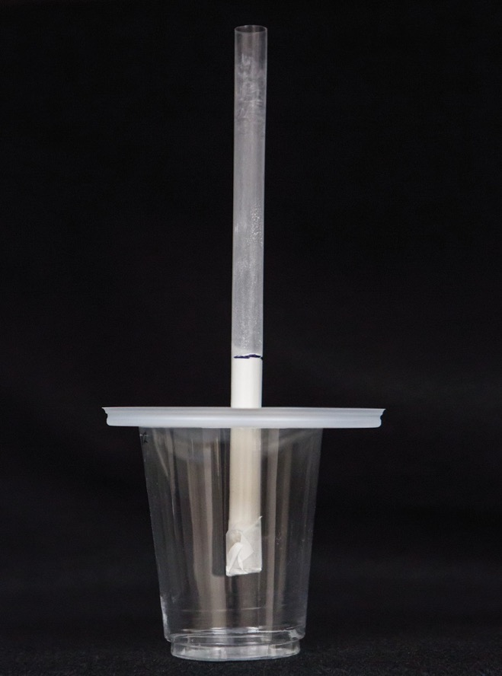
Explore
The major components of soil, in addition to the organic matter, are sand, silt, and clay. Let’s investigate these components and their affect on the properties of soil.
Notes:
Activity 2: Soil Columns (page 72)
Students investigate three components of soil to learn how the composition of soil affects the properties of the soil.
Explain to students that the major components of soil (in addition to the organic matter) are sand, silt, and clay.
Inform students that they are going to be investigating these soil components and thinking about how they affect the properties of the soil.
Tell students that this diagram illustrates how they will set up their soil columns.
Inform students that they will be using baby powder as a substitute for silt.

Slide 9
Setup
1. Using the marking pen, draw a line on each straw 2 cm from the bottom. Draw a second line 7 cm above the first line.
2. Cover one end of each straw with a piece of coffee filter and tape the coffee filter to the straws. Do not cover the bottom of the straws with tape.
3. Using the plastic spoon and the funnel, add sand to each straw up to the level of the lower line. The level of sand should be the same in each of your team’s straws.
4. Add baby powder to one straw until it reaches the upper line mark you drew on the straw. Be careful not to disturb the bottom layer of sand. To the other straw, add additional sand until it reaches the mark.
5. Insert the straws through the plastic lids. (Insert the top end so you will not tear the coffee filter.) Rest the lids on top of the cups, making sure the straws do not touch the bottom of the cup.
Notes:
Hold up a straw that is set up according to the same instructions but contains clay rather than sand or baby powder.
Demonstrate adding water and beginning to time the process.
The water will take quite a while to move through the clay. However, record the start time and allow students to watch for a few seconds before they move on.
Make sure they understand that water will move more quickly through the other substances so they need to make sure that they pay attention when they start their experiments.
Watch the clay column periodically to monitor the movement of water.
Watch more closely when the water nears the bottom of the column so that you can record a finish time.

Slide 10
Procedure
1. Decide what role each team member will play during the experiment. One student should be in charge of measuring and adding water. Another student will be responsible for timing the experiment and the third student will record data.
2. Measure 10 ml of water in the graduated cylinder. Use the pipet to add the water to the top of the sand in the straw. (Using the pipet will cause the least disturbance to the sand.) Begin timing.
3. Record the time when the first drop of water falls into the cup. Continue timing.
4. Stop the timer when the last drop of water falls into the cup. Measure the water in the cup.
Notes:
Allow time for teams to work through their experiments.
As teams work, circulate around the room to answer questions or to help resolve any difficulties that may arise.
TEACHER NOTE
Students may feel that it is difficult to determine when all the water has moved through the column. For baby powder and clay, for example, water may collect at the bottom of the straw but not drip for up to several minutes. The important thing is for students to be consistent. For example, if drops have been falling at approximately 4-minute intervals and then nothing drips for about 10 minutes, students could use the time of the last drop as a cut-off point.
As an alternative, to gauge how long it takes the water to move through the column, you could have students note the time at which they cannot see any water remaining at the top of the column. If you take this approach, ask all members of the class to use this same strategy in their measurements. Although this measurement may provide interesting data, if students find it difficult, they can skip this data and focus on the other categories of data collection.

Slide 11
Procedure (continued)
5. Record your team’s data on a chart (see next slide). Calculate the amount of water retained in the straw at the end of the experiment (10 mL – amount entered in column 5). Also, measure the decrease in height of the substance at the end of the experiment.
6. Repeat steps 2-5 using the straw containing baby powder.
7. Add your measurements to the class data chart.

Slide 12
Data chart
Substance | Time for First Drop to Fall | Time for All Water to Pass through Straw | Total Amount of Water through Straw (mL) | Amount of water Retained in Straw (mL) | Decrease in Height of Substance at End of Experiment (CM)
Sand
Baby Powder/Silt

Slide 13
Class Data Chart
Substance | Time for First Drop to Fall | Time for All Water to Pass through Straw | Total Amount of Water through Straw (mL) | Amount of water Retained in Straw (mL) | Decrease in Height of Substance at End of Experiment (CM)
Sand
Baby Powder/Silt
Notes:
After teams complete their investigations, make sure that each team adds their data to the class chart.
Calculate the averages of the class data for time and water volume. Add data for the clay component as well. If you wish, you could have students work individually or in teams to calculate the averages.
The data in Table 2.1 on page 73 in the curriculum was collected during testing of this activity. You can use the data for the clay component for your class to analyze. The other data may provide interesting comparisons for your class data. It is important to note, however, that your data may be different because of differences between the straws, type of sand, and so forth.

Slide 14
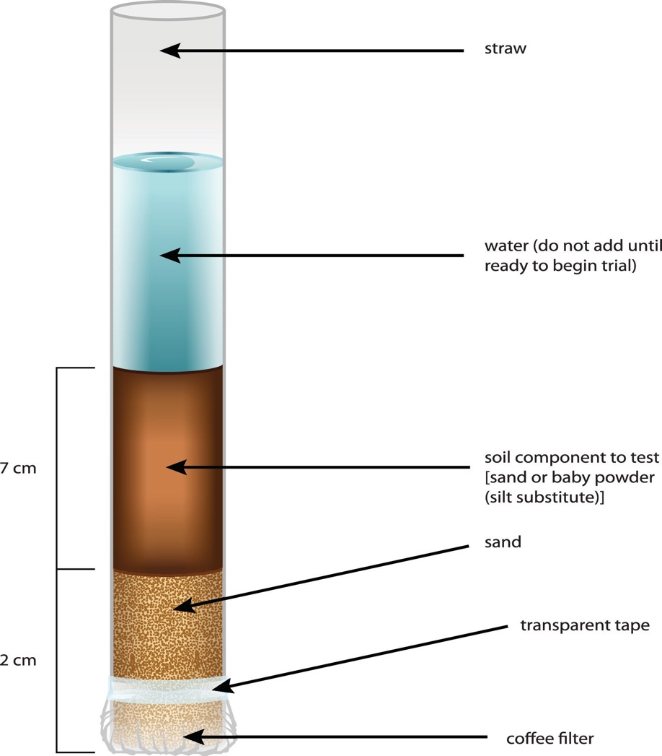
Notes:
Page 83, Master 2.2
Column Set Up

Slide 15
Data Analysis
How does the size of sand grains compare with the size of silt ( baby powder) particles? What is your evidence?
Which substance allowed water to move through more quickly?
Based on your data from your experiment using sand and silt (baby powder), write 1–2 sentences about particle size and the movement of water through the column.
The data from the column containing clay shows that it took longer for the water to move through the column. If the statement you wrote for question 3 is correct, how does the size of a particle of clay compare with a particle of sand or baby powder?
Which substance retained the most water in the straw? Which substance retained the least?
Write a sentence that summarizes the relationship between water retention and particle size.
At the beginning of the experiment, your column of sand, silt (baby powder), or clay (in the demonstration) was 7 cm in height. What differences did you see in the height at the end of the experiment?
What accounts for the differences in height at the end of the experiment?
Notes:
These questions should help students recognize a relationship between particle size of soil components and the way that water interacts with soil. In the next step, they will find out more about why particle size is important.
Answers:
1. How does the size of sand grains compare with the size of baby powder particles? What is your evidence? A: Sand grains are larger than particles of silt (baby powder.) The evidence of this is both the ability to see particles of sand whereas you cannot see individual particles of silt (baby powder.)
2. Which substance allowed water to move through more quickly?
A: Water moved through the column of sand more quickly than through the column of silt (baby powder).
3. Based on your data from your experiment using sand and silt (baby powder), write 1–2 sentences about particle size and the movement of water through the column.
A: Water moves through a column of larger particle sizes more quickly than through a column of smaller particle sizes. Water moves more slowly through a column containing smaller particle sizes than it does through a column containing larger particle sizes.
4. The data from the column containing clay show that it took longer for the water to move through the column. If the statement you wrote for question 3 is correct, how does the size of a particle of clay compare with a particle of sand or baby powder?
A: If smaller particle sizes cause slower movement through the column, clay particles should be smaller than baby powder particles and much smaller than sand particles because it took longer for the water to move through the column.
5. Which substance retained the most water in the straw? Which substance retained the least?
A: The clay column retained the greatest amount of water. The sand column retained the least.
6. Write a sentence that summarizes the relationship between water retention and particle size.
A: A column containing small particles retains more water than a column containing larger particles.
7. At the beginning of the experiment, your column of sand, silt (baby powder), or clay (in the demonstration) was 7 cm in height. What differences did you see in the height at the end of the experiment?
A: Answers will vary somewhat in the specific information, but the responses should indicate that the sand and clay columns did not change a great deal in height but the silt (baby power) decreased in height. Silt (baby powder) generally will show the greatest decrease in height.
8. What accounts for the differences in height at the end of the experiment?
A: The amount of air contained in the column between particles accounts for the difference. The silt (baby powder) generally compacts the most after water passes through. The clay, depending on how fine the initial powder put into the straws was, will vary. If the clay had some small chunks, it will likely compact more after water passes through the column than if it was already ground into a very fine powder that would pack tightly while dry. Smaller particles will compact more tightly reducing the amount of air in the column.

Slide 16
How does the surface area of a large particle, like sand grain, compare with the surface area of a small particle like clay?
SURFACE AREA = LENGTH X WIDTH X NUMBER OF SIDES
Sides = 10 cm
Sides = 5 cm
Notes:
Continue the discussion by asking students why they think particle size would change the way that water moves through soil or the amount of water retained in the soil. Student responses may vary. This is an opportunity to gauge student’s current thinking. To illustrate the relationship between surface area and particle size, work through an example with students about surface area of a cube.
Calculating surface area of a cube is simpler than calculating surface area of a sphere, but the basic principle is the same. Draw a cube on the board and indicate that each side is 10 cm long. The surface area of the cube is calculated using the formula. Now imagine that the same cube was cut into 8 smaller cubes (same total volume). Each cube would have sides 5 cm in length. The surface area of each small cube would be 5 x 5 x 6 = 150 cm². However, when you calculate the total surface area for all 8 smaller cubes, you have a surface area equal to 150 x 8 = 1200 cm². This means that the surface area to volume ratio increases as the size of the cube (or other particle) decreases.
Similar to cubes, a collection of smaller spheres would have a greater total surface area than a single large sphere. However, calculating the surface area of a cube is easier than calculating the surface area of a sphere.
(Surface area of sphere = 4πr²)
Students may have considered other examples of surface area related to other areas of science. For example, students may have thought about why single-celled organisms are small and why large organisms are multicellular. In large part, this is due to issues related to surface area. Large organisms must be multicellular (made up of many small cells) because very large cells would not have adequate surface area for processes such as gas exchange, and so forth.

Slide 17
Particle Size, Surface Area, and Water Movement
Notes:
Help students continue to build their understanding by summarizing what they know so far. From their experiments, they learned that particle size was important for issues related to water movement and retention in soil components. They also now know that there is a relationship between particle size and surface area. Display a copy of Master 2.4, Particle Size, Surface Area, and Water Movement. As a class, work together to indicate the relationships between these factors.
Answers to graphic can be found on page 76 of Nourishing the Planet in the 21st Century high school curriculum. If students are having difficulty with this summary, draw their attention back to the straw activity and the cube surface area problems. To assess each student’s understanding, you could ask them to complete the information on Master 2.4 individually before having a class discussion. This could also give them a different way to synthesize what they have learned and be better prepared for a class discussion.
Now that students understand the relationship between particle size, surface area, and water movement in the soil components, explain that a key factor in the movement of water through soil is friction. The force of gravity pulls the water downward, but the friction, which is related to surface area, causes resistance. Therefore, water moves more slowly through soils with smaller particle sizes (silt or clay).

Slide 18
Review: How does soil help plants grow?
Soil provides support for plants’ root systems.
Soil provides essential nutrients.
Soil holds water and makes it accessible to plants.
Soil contains air spaces, which is necessary for plant growth.
Notes:
Activity 3: Soil is Complex (page 76)
Ask students, “How does soil help plants to grow?”
Student responses will vary. Guide the discussion to bring out the following:
Soil provides support for plants’ root systems.
Soil provides essential nutrients.
Soil holds water and makes it accessible to plants.
Soil contains air spaces, which is necessary for plant growth.

Slide 19
Based on what you learned about soil components (sand, silt, and clay) would any of these be ideal for helping plants grow?
Notes:
This is an opportunity to assess what students remember from the previous activity. Students’ responses should indicate that some soil components (e.g. sand) do not hold as much water, which could be detrimental to plants. On the other hand, clay does not let water move through very quickly which could also be a problem if there is too much water in the soil for healthy plants. In addition, clay (once it is wet) does not contain much air space, which also could be problematic for plants; sand contains a great deal of air space, which in extreme cases could mean that there is not enough support for a plant’s roots.

Slide 20
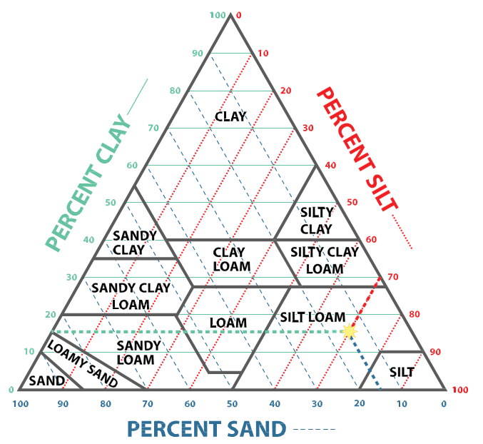
Notes:
Explain that soils are not as simple as the individual components they used in their investigation. Soils are made up of a mixture of sand, silt, clay, as well as organic matter. Display a copy of Master 2.5, the soil triangle. Explain that it is used to classify the different types of soil. Point out that the soil triangle diagram is divided into 12 soil classifications based on the amount of sand, silt, and clay in the soil.
You may want to point out the term “loam” to students. Loam is another word for a soil that includes an ideal mix of sand, silt, and/or clay for many crop plants. On the soil triangle, there are 12 categories of loam that are differentiated by the amount of each component the soil includes.
Help the students learn to use the soil triangle by giving them a hypothetical soil to classify. Ask, “How would you classify a soil that contains 20 percent clay, 70 percent silt, and 10 percent sand?” Demonstrate on the projected copy of Master 2.5 how students would determine that this soil sample would fall into the silt loam classification.
Start by finding 20 percent clay on the left side and drawing a line horizontally across the triangle.
Then find 70 percent silt on the right side of the triangle and draw a line for that percentage.
Finally, draw a line for 10 percent sand from the bottom of the triangle. The intersection of these 3 lines will determine the soil classification.
Ask, “In which category on the soil triangle do you think crop plants would grow best and why?” Allow volunteers to share their answers but make sure they support their answers with information about soil properties that they learned previously.
Answers will vary with respect to the specific type of loam that would be best, but they should include ideas that reflect what they have learned about water movement through soil, water retention, and air space. For example, an appropriate response might be, “Soil with some sand would allow water to move through the soil and it would have more air space than clay or silt, but having some clay or silt would help the soil retain some water and provide more structure for the roots.” Students may realize that plants living in different environments or types of soil have different root structures.
Conclude the activity by asking students how the soil triangle could be helpful to someone who is growing plants (either on a small scale such as an individual gardener or on a larger scale such as a farmer).
If students have difficulty getting started, you might ask them to think about the situation of someone who wants to grow a plant in their garden but the plant does not do well because the soil is very hard and compacted. What does this mean about the soil and how might it be changed? Another situation relates to irrigation. In one location, a crop may need a certain amount of water to thrive. In a different location, irrigating with the same amount of water may be either insufficient or excessive because the properties of the soil are different.
If you wish, this could be assigned for homework to allow students to do more research about situations in which knowledge of soil properties and the soil triangle may be beneficial.

Slide 21
Soil Particle Size
SOIL COMPONENT | PARTICLE DIAMETER
Rock | Greater than 75.0 mm
Gravel | 2.0 to 75.0 mm
Sand | 0.05 mm to 2.0 mm
Silt | 0.002 to 0.05 mm
Clay | Less than 0.002 mm
Notes:
Extension Activity: Particle Size (page 78)
In this lesson, students used sand, (silt) baby powder, and clay for their columns and began to think about particle size. However, it can be very difficult for students to grasp the variation in size among these different particles.
Use a ruler to emphasize that things over 75 mm are classified as rock and things over 2 mm in diameter are classified as gravel. Point out that it is more difficult to appreciate the size of the smaller particles since you cannot see individual particles.
Ask students to come up with a way to represent the difference in sizes among clay, silt, and sand (smaller particle sizes of sand).
Encourage students to use their creativity to think about how to visualize these relationships. For example, if a basketball represented a sand grain, what is something they could use to represent the size of a silt or clay particle? Ask students to include the calculations they used to identify objects that would be appropriately scaled.
If students pursue either of these options, make sure they have a testable question and that the experiment will be tied to the concepts developed in this lesson. You can require students to have their experimental designs approved by you before they can begin.

Slide 22
Design Your Own Experiment!
Use what you have learned in this lesson to design your own experiment!
Use the straw columns to learn more about soil texture and its relationship to water movement through soil or to plant growth.
Example: Use this setup to investigate local soil or potting soil.
Example: Design experiments that mix sand, silt (baby powder), and clay to see how water movement changes.
Remember to be clear about the data you want to collect!
Also make sure to design the experiment carefully with appropriate controls!
Notes:
Extension Activity: Digging Deeper Into Soil (page 78)
If students pursue either of these options, make sure they have a testable question and that the experiment will be tied to the concepts developed in this lesson. You can require students to have their experimental designs approved by you before they can begin.

Slide 23
Investigate How Plant Growth is Affected by Soil!
Grow plants in sand, silt (if available), clay.
Compare with growth in local soil or potting soil.
Remember: the data must be meaningful!
Pay attention to the number of replicates, conditions plants are kept, use of appropriate controls, and more!
Notes:
If students pursue either of these options, make sure they have a testable question and that the experiment will be tied to the concepts developed in this lesson. You can require students to have their experimental designs approved by you before they can begin.

