Slide 1
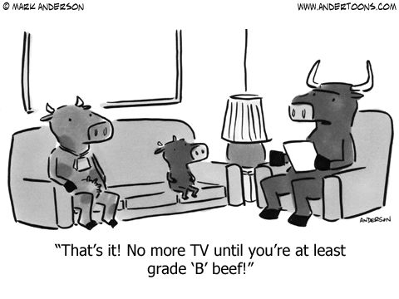

Slide 2
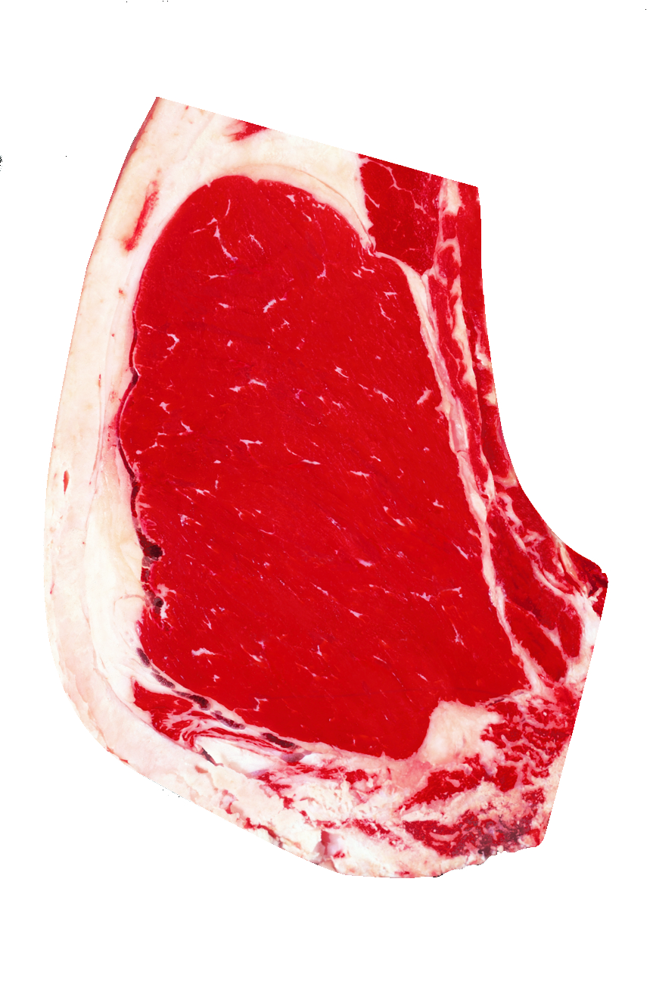
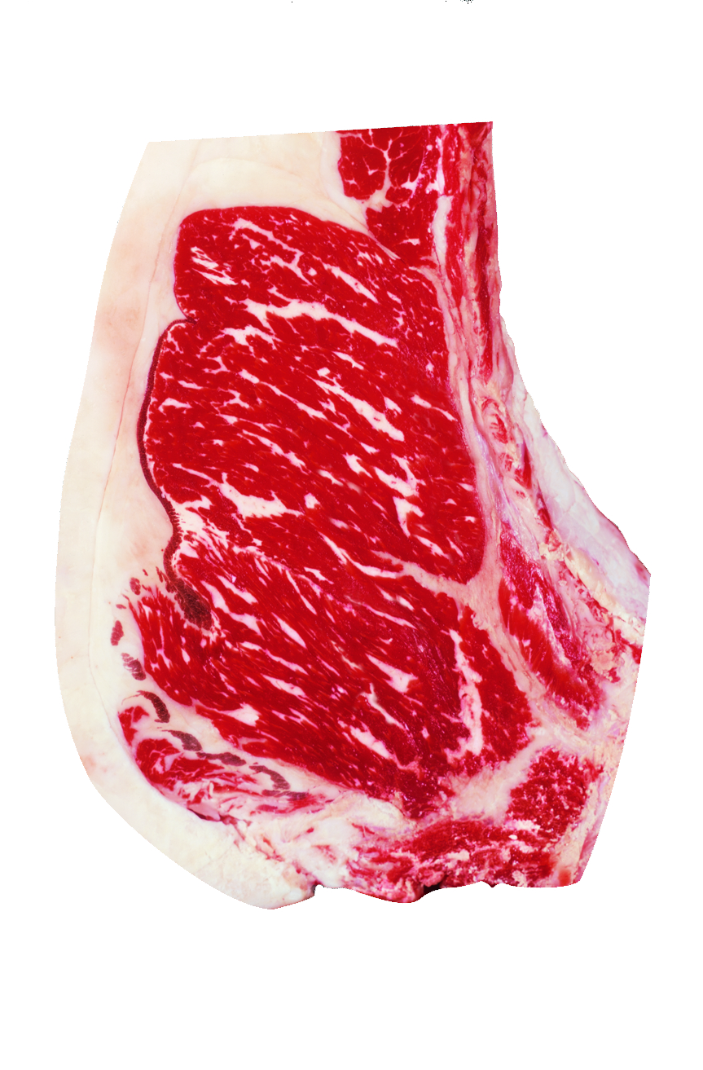
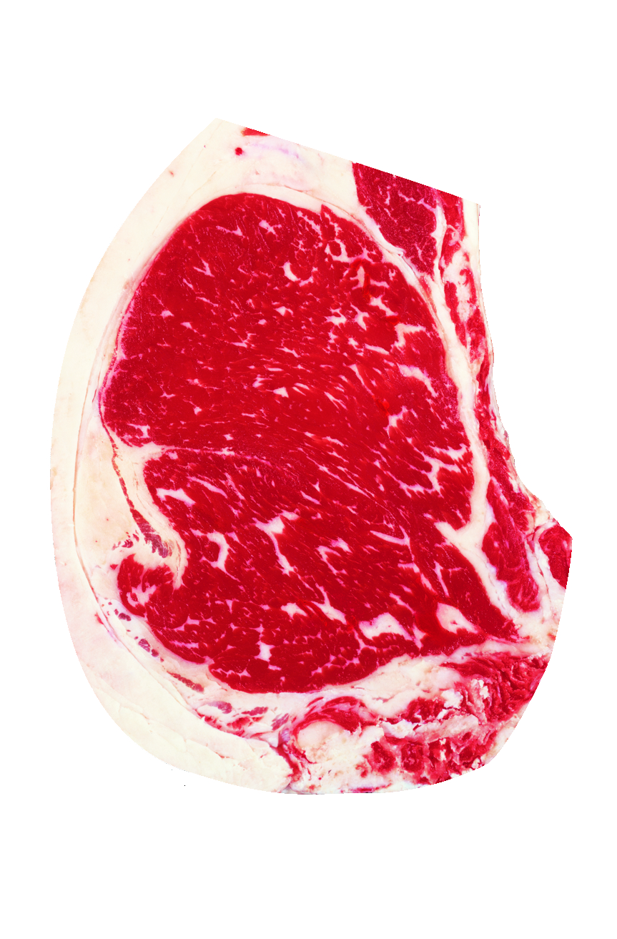
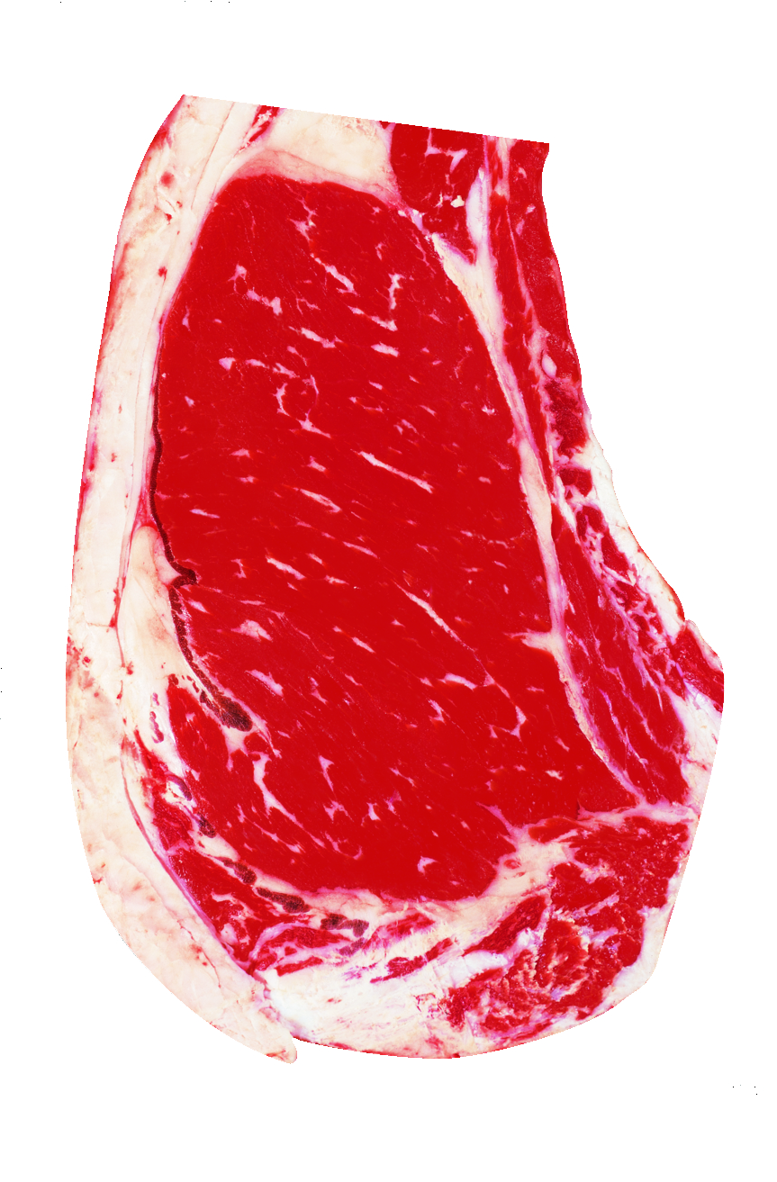
Grading Beef
Notes:
Can students see a difference in the degree of marbling?

Slide 3
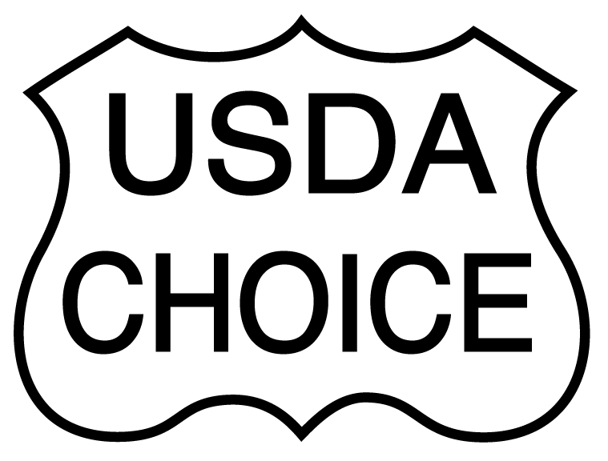
1
Modest marbling
32 months
What will it grade?
Notes:
Modest Marbling
32 months

Slide 4
2
Small marbling
28 months
What will it grade?
Notes:
Small Marbling
28 months

Slide 5
3
Moderately abundant marbling
18 months
What will it grade?
Notes:
Moderately Abundant
24 months

Slide 6
4
Slightly abundant marbling
23 months
What will it grade?
Notes:
Slightly Abundant
28 months

Slide 7
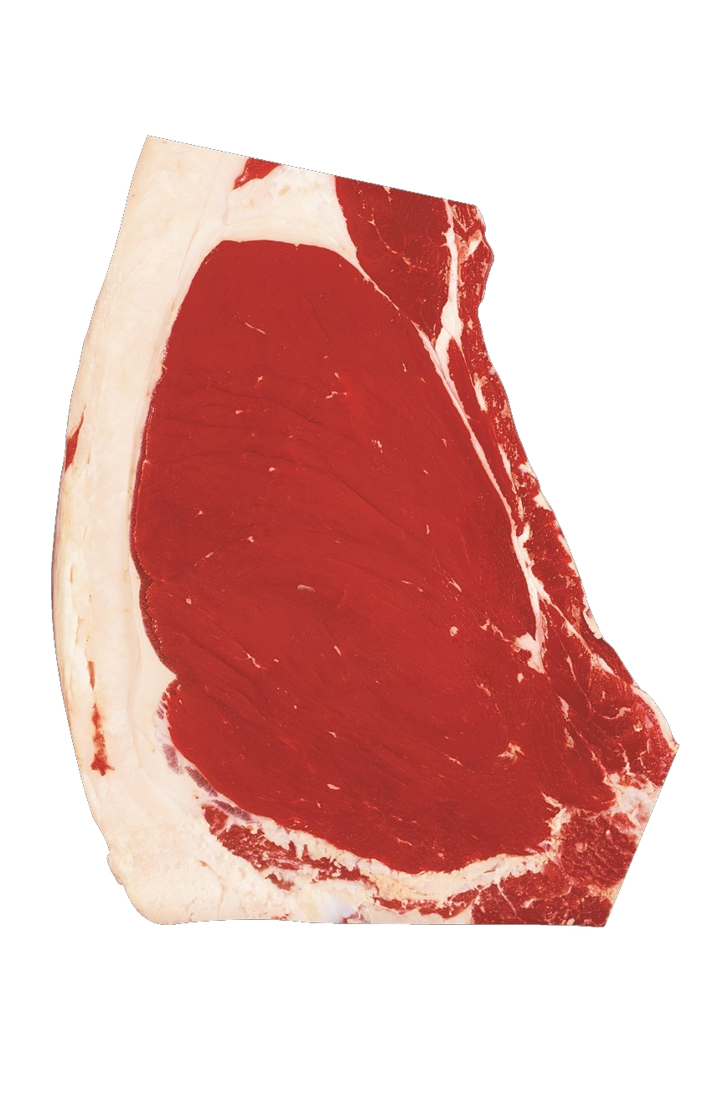
5
Slight marbling
16 months
What will it grade?
Notes:
Slight
16 months

Slide 8
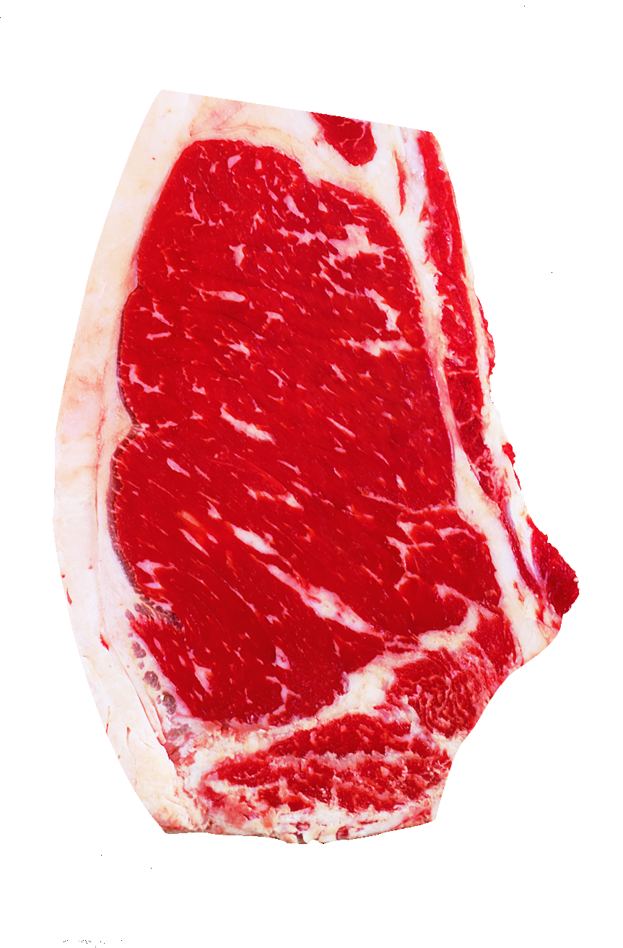
6
Moderate marbling
33 months
What will it grade?
Notes:
Moderate
33 months

Slide 9
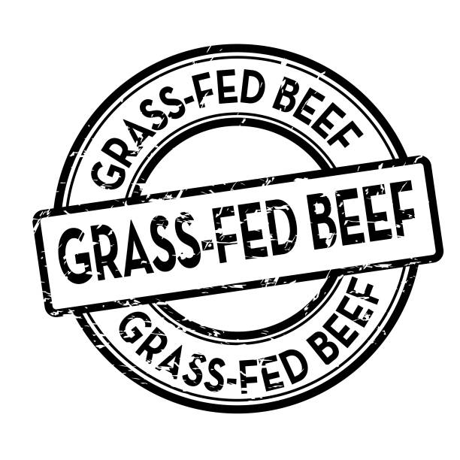
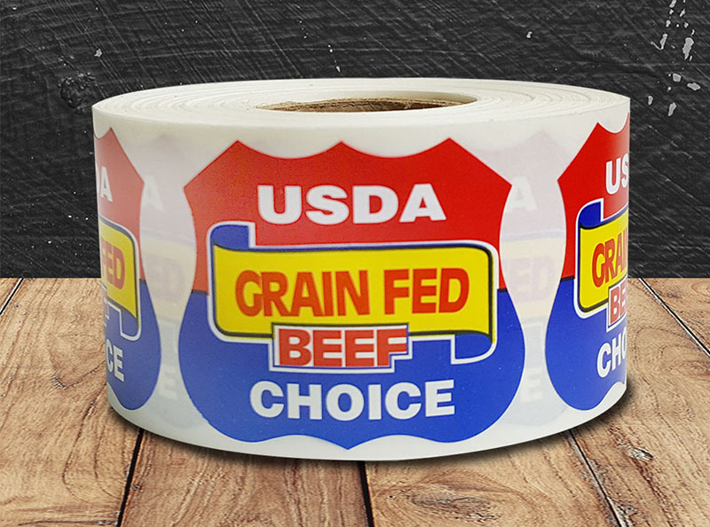
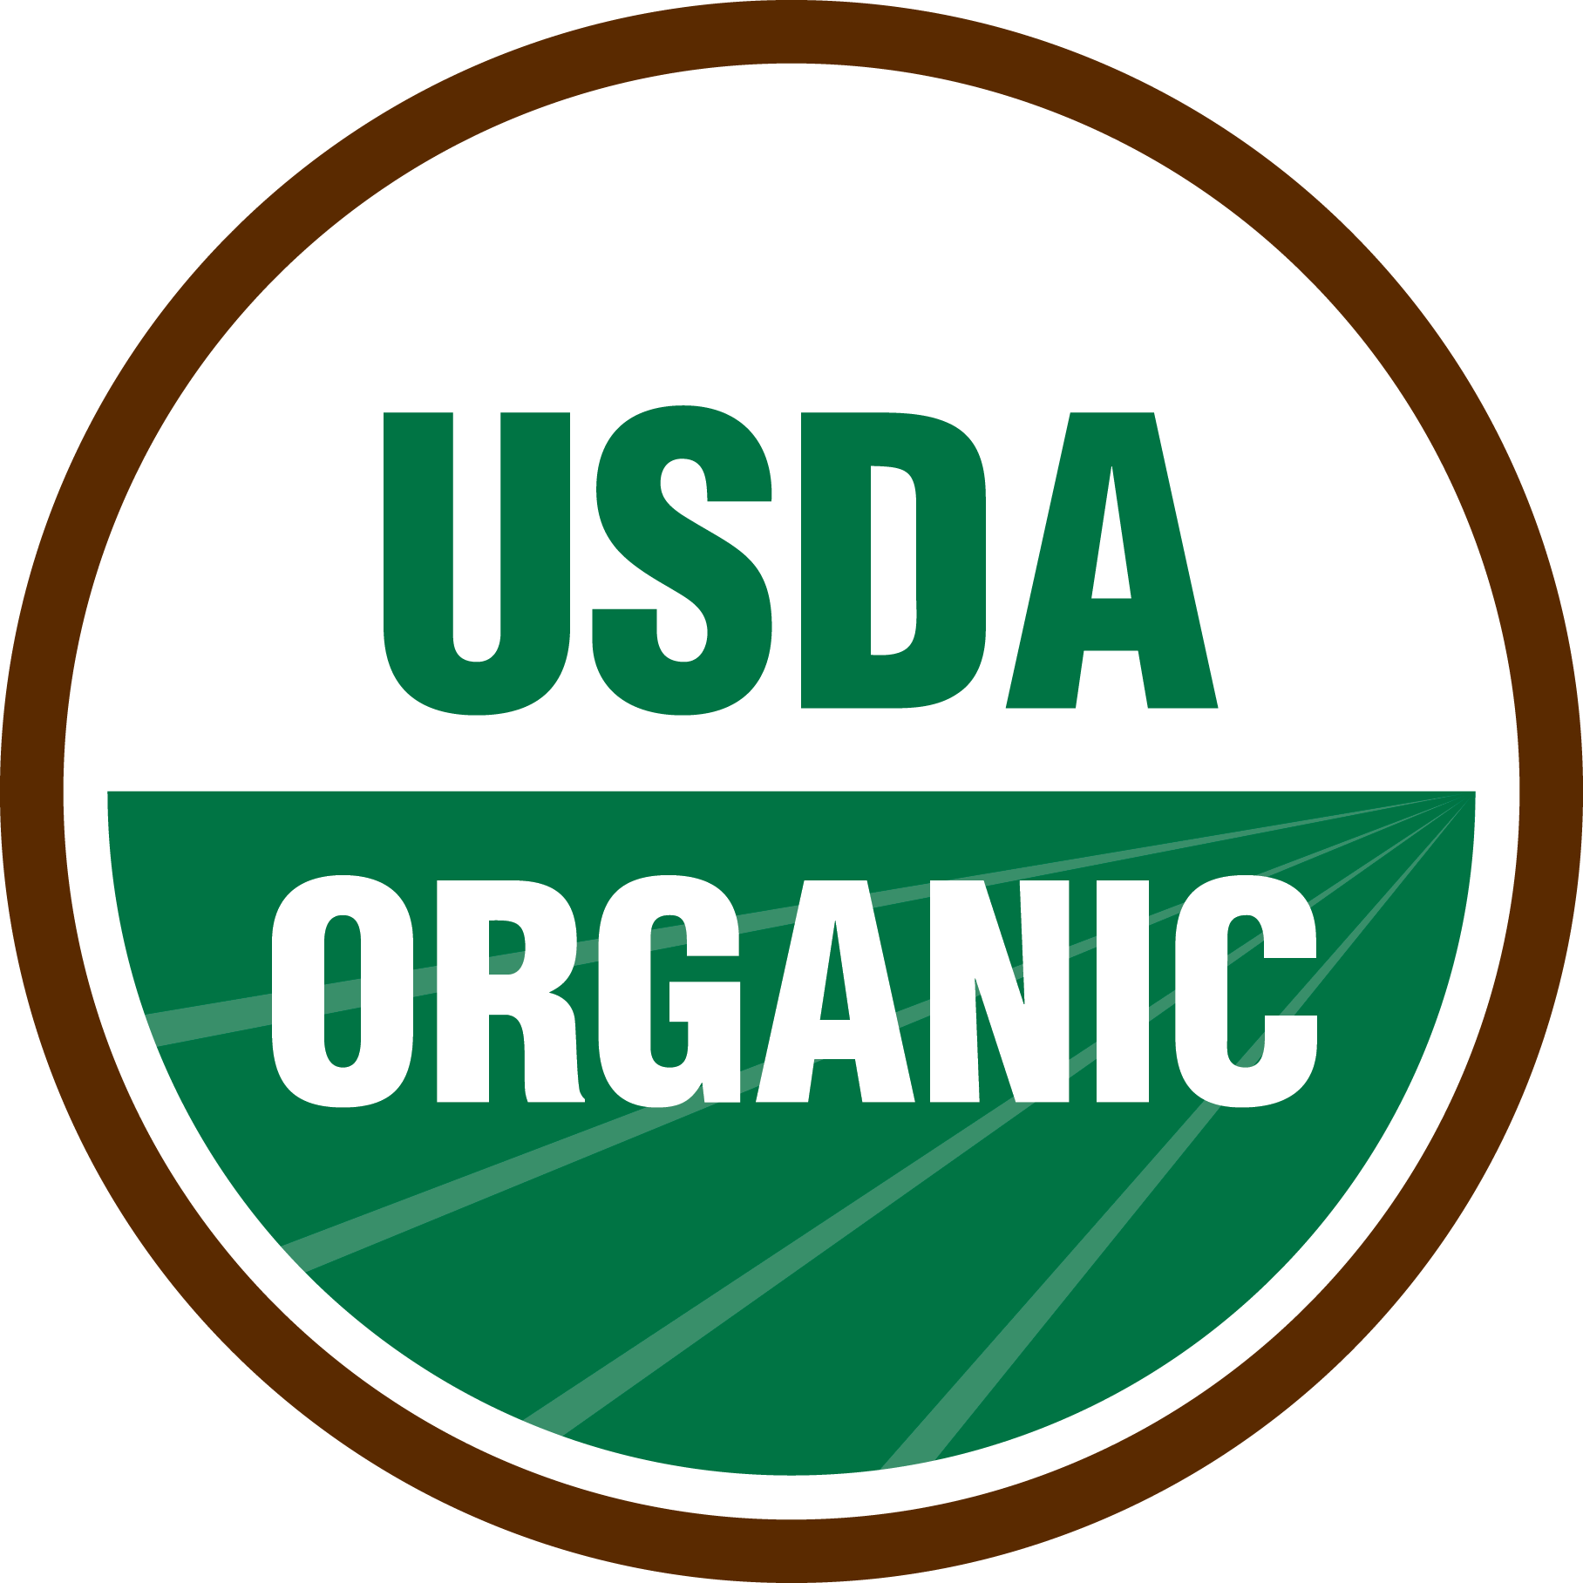
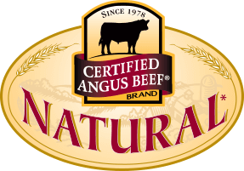
What do these mean?

Slide 10
Grain-Finished
This comes from cattle that…
Spend the majority of their lives eating grass or forage
Spend 4-6 months at a feedlot eating grains
May or may not be given FDA-approved antibiotics to treat disease
May or may not be given growth-promoting hormones
This label is not commonly placed on beef products since most beef is raised this way.

Slide 11
Certified Organic
This comes from cattle that…
Never receive any antibiotics or growth-promoting hormones
May be grass-fed or grain-fed, as long as the feed is 100% organically grown and certified
May spend time at a feedlot

Slide 12
Grass-Finished or Grass-Fed
This comes from cattle that…
Spend their whole lives eating grass
May or may not be given FDA-approved antibiotics to treat disease
May or may not be given growth-promoting hormones

Slide 13
Natural or Naturally Raised
This comes from cattle that…
Never receive any antibiotics
Never receive growth-promoting hormones
May be grass-fed or grain-fed
May spend time at a feedlot

Slide 14
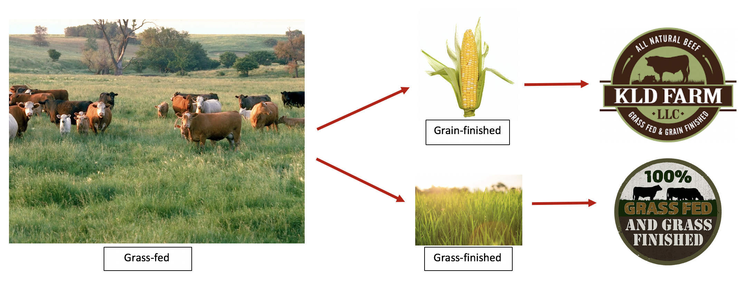
Cattle Lifecycles

Slide 15
Label Regulations: Who’s in Charge?

Slide 16
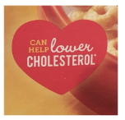
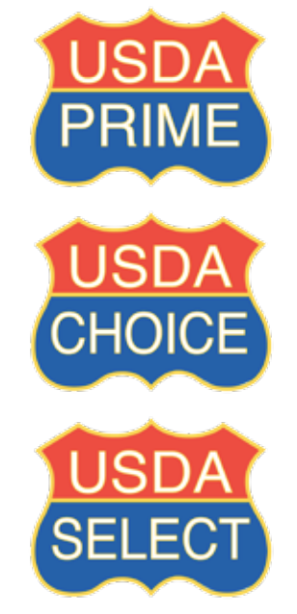
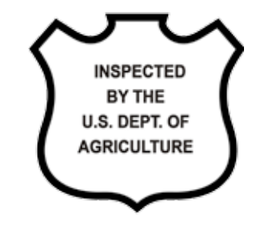
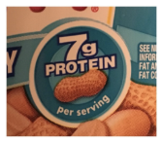
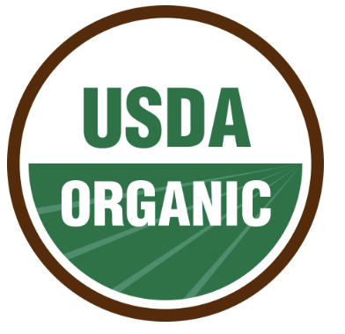
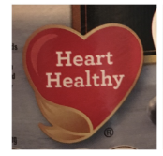
FDA
USDA
Prepared foods
Nutrition labels
Nutrient content labels
Health claim labels
Farm production styles
Meat products
Beef quality grades
Certified organic labels
Inspection labels

