Slide 1
Looking Under the Label

Slide 2
Activity 1: Impact of Labels on Marketing and Consumer Perceptions

Slide 3
What might a consumer imply from this label?
Is it more or less nutritious?
Is it worth more money?... Or less?
Was it more or less environmentally friendly to produce?
Is it safer for my long or short term health?
What else makes
it more or less appealing?
Ethics…
If its a food with an animal origin, were the animal welfare practices sufficient?
Would I pay more money for it? Why or why not?

Slide 4
Activity 2: Food Labels 101

Slide 5
Food Labels
Health
Claims
Nutrient
Content Claims
Describes relationship between food and reduced risk of a disease
States the level of a specific nutrient found in the food
Nutrition
Facts
Farm
Production Style
Required by law on most packaged foods providing details of nutrient content
Describes the type of farming practices used, or not used in producing the food

Slide 6
Activity 3: Production Style Food Labeling

Slide 7
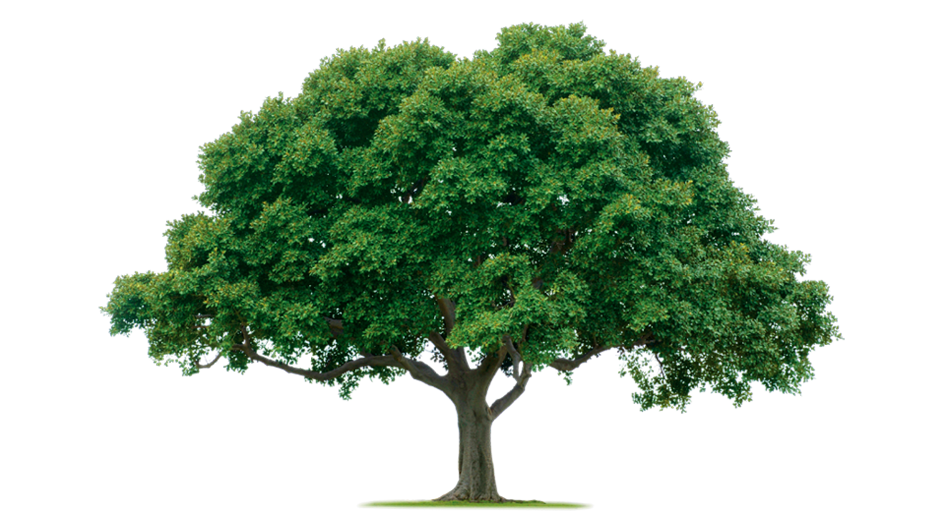
What tools could you use?

Slide 8
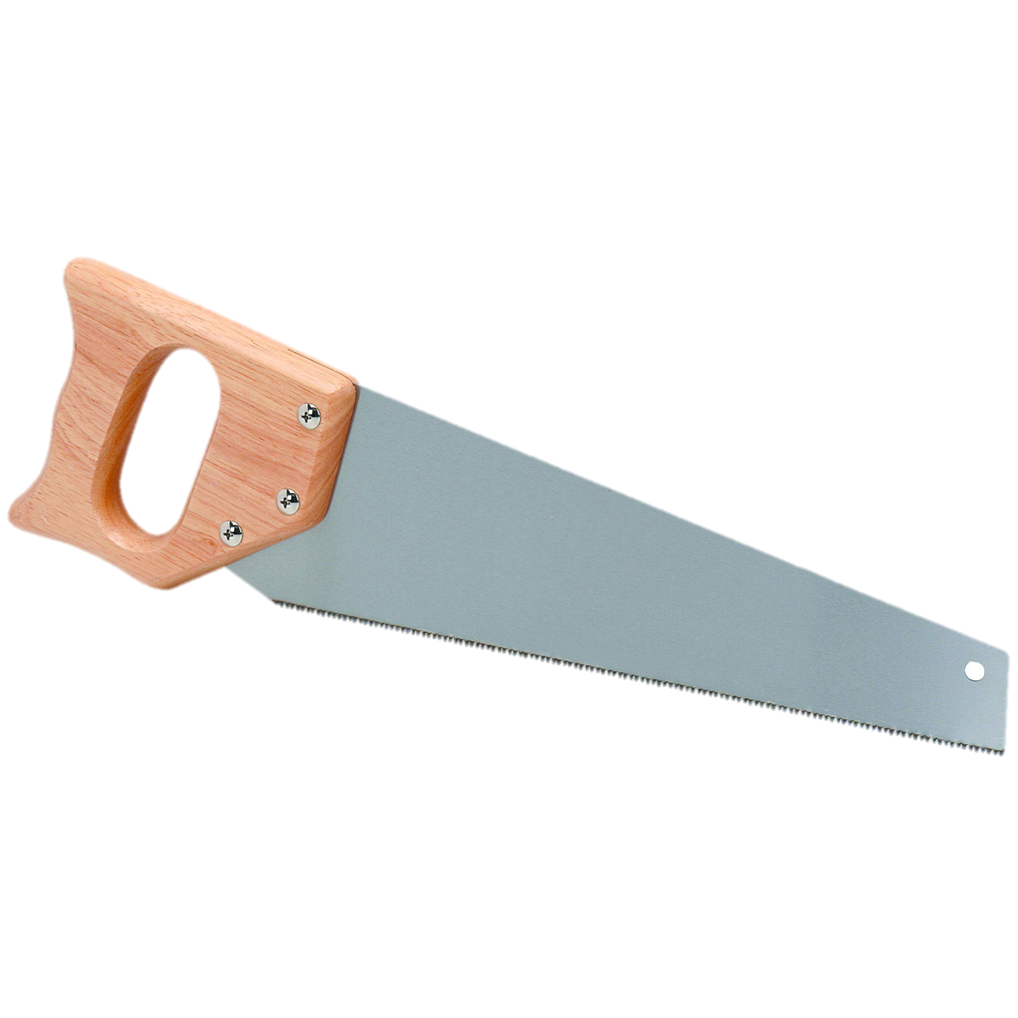
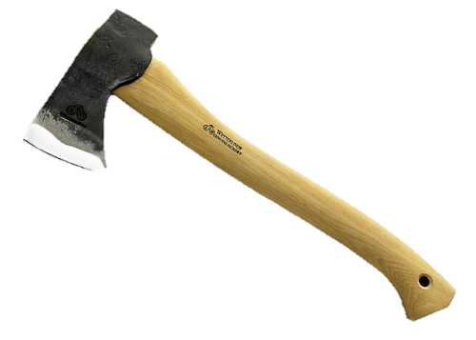

Slide 9
Organic Farming
Conventional Farming

Slide 10
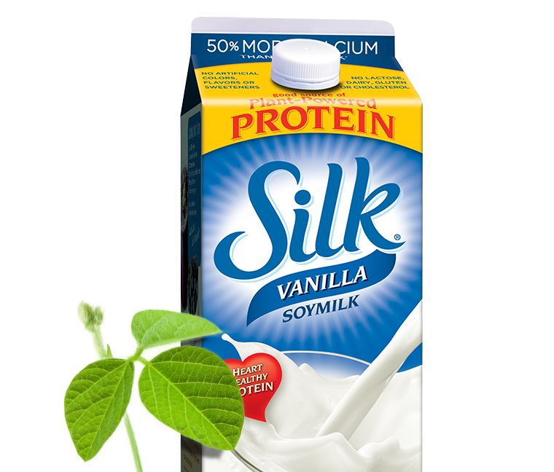
Tool: Pest and weed control
What “tool” is different?
Conventional Soybean Farm:
Farmer grows a variety of seed that is resistant to pests and herbicides through genetic modification.
Organic Soybean Farm:
Farmer did NOT use the genetically modified seed to control weeds and pests.
Soy products

Slide 11
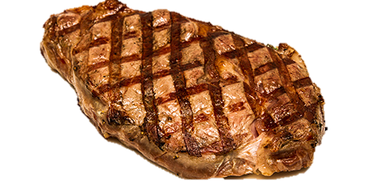
Tool: Type of Feed for Animals
What “tool” is different?
Conventional Beef Ranch:
Farmers feed their cattle a mixture of forages (grass or hay) and eventually grains before they are harvested.
Grass-fed Beef Ranch:
Farmers only feed cattle forages (grass or hay) and do not feed grain.
Beef

Slide 12
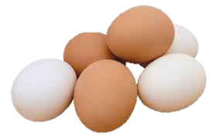
Tool: Type of Housing for Animals
What “tool” is different?
Conventional
Egg Farm:
Farmers house hens in small group cages inside large, highly automated buildings to control temperature, humidity, etc.
Free Range Egg Farm
Farmers house hens without cages in large groups that have indoor and outdoor access.
Eggs

Slide 13
Psychology: the scientific study of the human mind and its functions, especially those affecting behavior in a given context.
Can psychology impact consumer decisions about food?

Slide 14
We SEEK and AVOID specific things when we’re shopping for food….
To be healthier
To save
$$$
WHY?
To save
the planet
For happy animals

Slide 15
Confirmation Bias
A tendency to search for or interpret information in a way that confirms one’s preconceptions, leading to errors.

Slide 16
Our grocery store choices ripple through the agriculture industry.
Consumers perceive a specific food label as being superior.
Laws of supply and demand make that food more valuable.
Farming practices change

Slide 17
Our grocery store choices ripple through the agriculture industry.
This may lead to POSITIVE change!
…BUT what if it backfires?
Farming practices change

