Slide 1
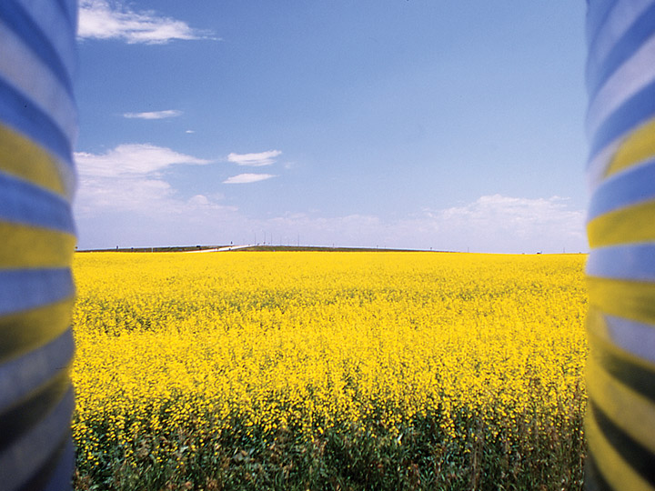
Summary
V7.0
Notes:
Time
15 minutes
Activity Expectations
Students will:
Answer the question, “How will we sustainably feed nearly 10 billion people by the year 2050?”
Materials
Summary PowerPoint
Key Terms
Refer to the Glossary of Key Terms handout for any words the students need to revisit.

Slide 2
Record your ideas as a group
“How will we sustainably feed nearly 10 billion people in the year 2050?”
Notes:
In groups of three or four, write down as many Best Management Practices and NEW IDEAS as you can think of to answer the question: “How will we sustainably feed nearly 10 billion people in the year 2050?” Think of realistic solutions happening right now and also think outside the box!
[If you want to discuss other interesting agricultural innovations and practices that improve sustainability, here are three in each country]
Canada
4R Nutrient Stewardship – is a global program that ensures farmers apply the right source of nutrients, at the right rate, time and place specific to their farm to improve their economic, social and environmental performance.
Global Positioning Systems (GPS) – machinery is guided by satellites to precisely place nutrients, seed and crop protection products at variable rates to match the soil’s productivity.
Wetland Restoration – brings back the kidneys of the environment, wetlands that filter excess nutrients and help reduce water levels during floods.
Africa
Cell Phone Towers - increase communication and result in improved market access, education and local jobs.
Improved Grain Storage – reduces spoilage and allows grain to be sold at a premium.
School Meal Program – nourishes children resulting in improved learning outcomes and school attendance.
India
Remote Control Drip Irrigation – reduces evaporation and improves water utilization by the crop; using a cell phone to turn the water on and off conserves water and energy.
New Seed Varieties – increase yield, crop quality and resistance to drought, insects and disease.
Marketing Cooperative – helps producers collectively sell crops, rather than individually, to increase market access and prices.

Slide 3
Share your ideas
Notes:
Pick one person in each group to share at least two ideas. Email the top ideas from your class to Journey2050@nutrien.com - all of the ideas are reviewed and the top ones are shared with the public. By sharing our ideas and making action plans, we can help sustainable agriculture reach the goal of feeding the world.

Slide 4
Wrap-up
Notes:
Pick one person in each group to share at least two ideas.
Email the top ideas from your class to Journey2050@nutrien.com - all of the ideas are reviewed and the top ones are shared with the public. By sharing our ideas and making action plans, we can help sustainable agriculture reach the goal of feeding the world.

Slide 5
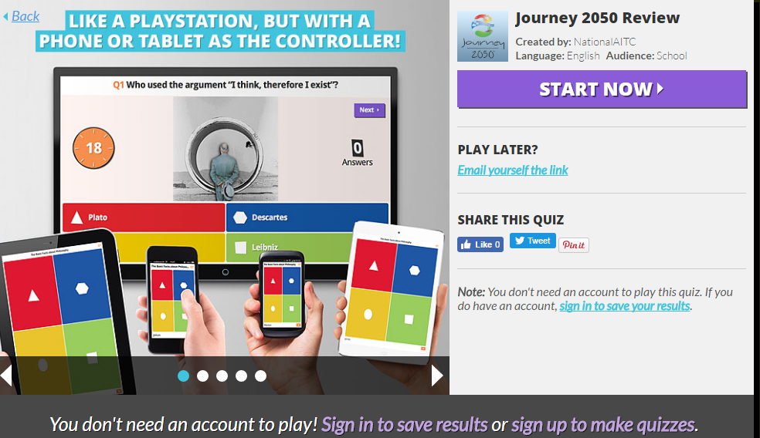
Test your knowledge
Review the concepts from Levels 1-6
Journey 2050 Kahoot!
Notes:
Review as a class what has been learned throughout the Journey 2050 program – Levels 1-6. Use the Journey 2050 Kahoot! as a formative assessment.
https://play.kahoot.it/#/k/69ea672b-8be0-4144-8504-8232d9dce211

Slide 6
Get involved
Tweet this…“How do we sustainably feed nearly 10 billion people by the year 2050?” #journey2050 #feedingtheworldresponsibly
Notes:
Get involved! Emphasize to students they can make a difference in sustainability – not only in agriculture but across all sectors!
Students could consider: volunteering to help a charity in need, making changes at home to be more sustainable, fundraising for charities contributing to sustainability and educating others about the challenges we face in feeding the world.
All teachers who complete the survey on the Journey 2050 website (one per year) will be entered in a drawing to win a $100 gift certificate! The certificate can be used as a donation to pre-selected charities contributing to sustainability. Two drawings of 25 names will take place on Dec. 1st and June 1st, and winning teachers will be notified. For those who use the online game, students must enter your Teacher Code on at least TWO of the games in order for you to be entered in the drawing. Your reports will be posted under Student Reports. We require at least 10 student reports per game on your profile. Learn more about the donation credit on www.Journey2050.com
Tweet this: How do we sustainably feed nearly 10 billion people by the year 2050?” #journey2050 #feedingtheworldresponsibly

Slide 7
Journey expansion
SCHOOL EDITION: JOURNEY 2050
HOME EDITION: FARMERS 2050
Notes:
The Journey 2050 game is available in the iOS, Android and Windows Stores; however, it wasn’t intended for public use. It has timers to make sure everyone starts and stops roughly at the same time, and it has less commodities simply because there isn’t enough time in the program to incorporate everything in agriculture.
Students who want to play at home are encouraged to download: Farmers 2050

Slide 8
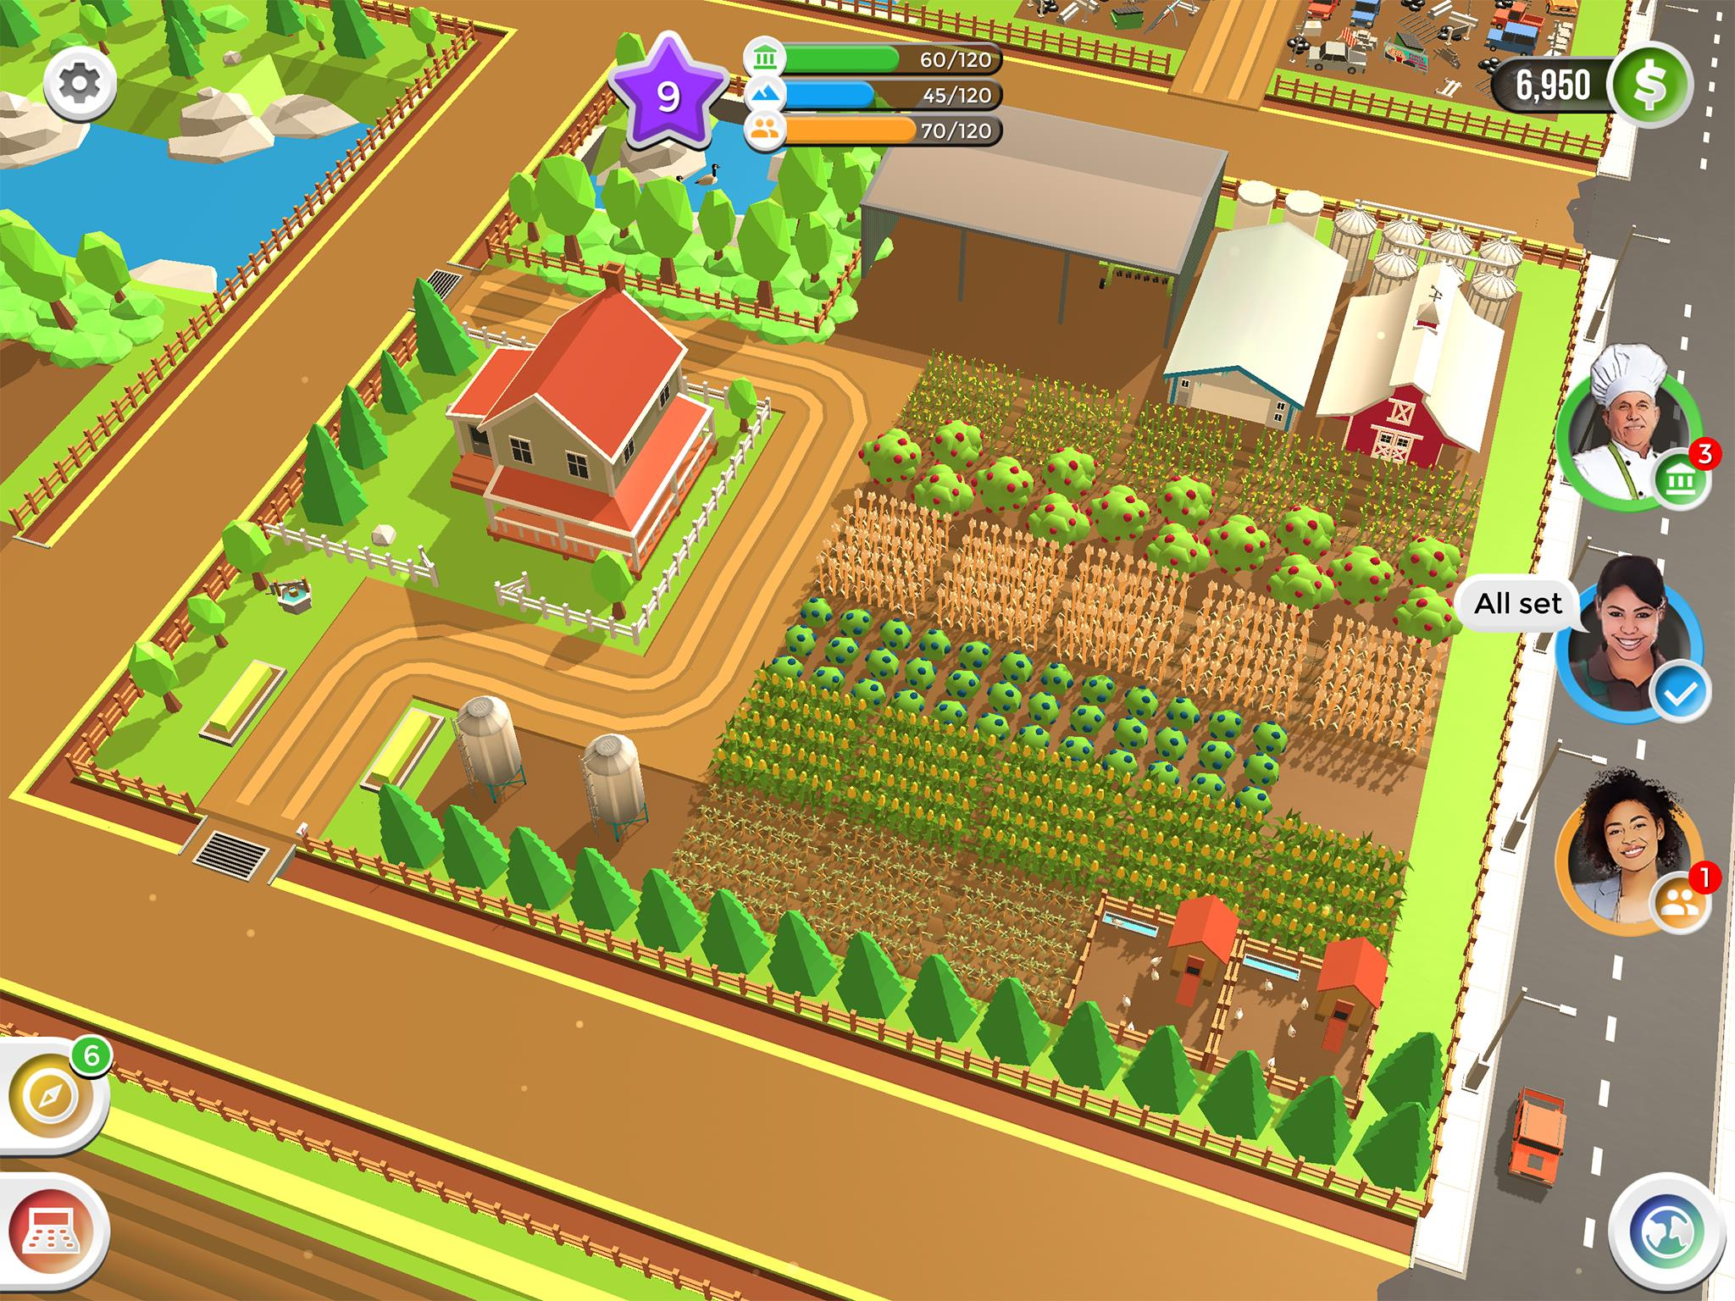
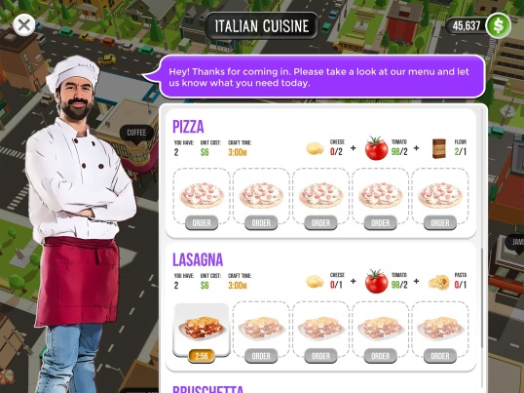
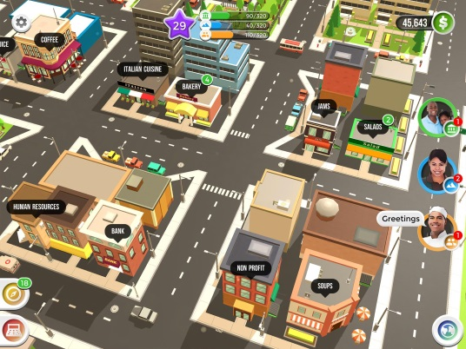
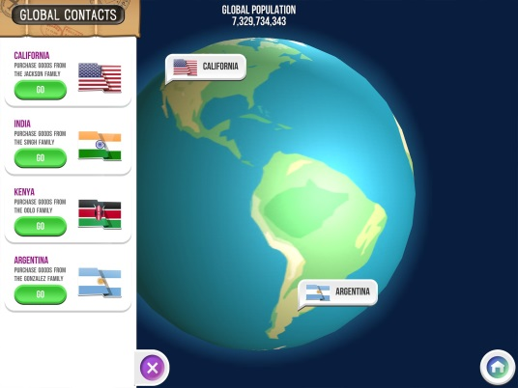
ONE FARM. NO TIMERS.
MORE CROPS, ANIMALS & CRAFTING.
CRAFT
SELL
TRADE
GROW CROPS
RAISE ANIMALS
FREE. NO ADS or IN-APP PURCHASES
Notes:
FARMERS 2050 is an animated farming game. Droughts occur, mortgage payments come due, and farm chores never stop. Students will discover what it really takes to feed the world.
Players will have one farm, instead of three, to grow crops, raise animals, and craft goods to sell in your local community all the while managing the three pillars of sustainability: environment, economic and social. Sound familiar!
Along the way, real farmers from across the world will show students what they are doing on their farms.
Farmers is FREE to play and there are no advertisements or in-app purchases.
It is available on iOS and Android devices.
Learn more at www.Farmers2050.com
30 Second Preview: https://youtu.be/dWxNwQKhbJg

Slide 9
Brought to you in collaboration
www.Journey2050.com
Notes:
Brought to you by community partners around the world.

Slide 10
Questions?
Journey2050@NUTRIEN.com
Notes:
Thank you for participating in the Journey 2050 program.

Slide 11
Enriching activities
Watch this video: Growing Today for Tomorrow. Discuss how farmers have been able to continually produce more food with fewer resources.
Record your ideas on how to feed the world responsibly and email them to Journey2050@nutrien.com.
Discuss agricultural innovations and practices that improve sustainability with your family.

