Slide 1
Egg Labels & Marketing

Slide 3
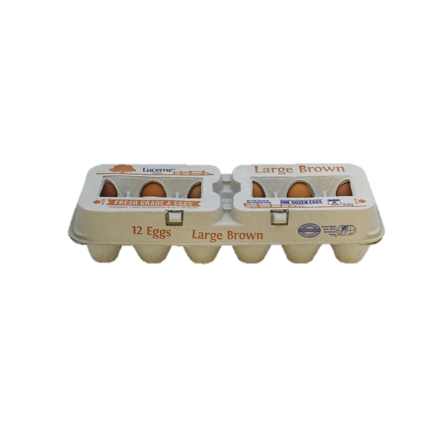
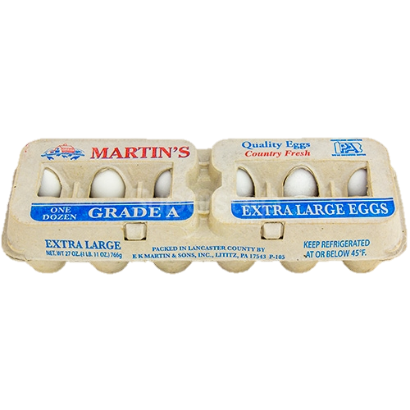
Which carton of eggs has more nutrient value?
Neither, they are equal
A
B
C

Slide 4
Which carton of eggs would likely cost more?
A
B

Slide 5
Which carton of eggs would YOU choose?
$2.05
$1.69
A
B
Why?

Slide 6
Which carton of eggs would likely cost more?
A
B

Slide 7
Which carton of eggs would YOU choose?
$1.69
$3.99
A
B
Why?

Slide 8
Which carton of eggs would likely cost more?
A
B

Slide 9
Which carton of eggs would YOU choose?
$3.99
$2.05
A
B
Why?

Slide 10
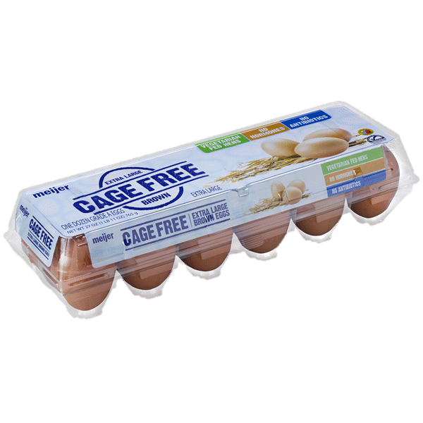
Which carton of eggs would likely cost more?
A
B

Slide 11
Which carton of eggs would YOU choose?
$1.69
$3.49
A
B
Why?

Slide 12
Economics of Egg Production
Brown-shelled eggs typically cost more than white-shelled eggs because the breeds of chicken that lay brown eggs are typically bigger and eat more feed, but do not lay more eggs.
White eggs produced in conventional style housing are typically the cheapest because that is the most cost effective way to produce eggs.
Eggs produced in cage-free or free range housing systems cost more because these housing systems have higher production costs to the farmer.

Slide 14
Price for 1 dozen eggs
Graph a Demand Curve
1 dozen white-shelled eggs
$3.00
$2.75
$2.50
$2.25
$2.00
$1.75
$1.50
$1.25
5
10
15
20
25
30
35
40
Number of consumers (students) willing to pay

Slide 15
Supply Curve
1 dozen white-shelled eggs
$3.00
$2.75
$2.50
Price for 1 dozen eggs
$2.25
$2.00
$1.75
$1.50
$1.25
12
24
36
48
60
72
84
100
Number (%) of producers willing to sell

Slide 16
Graph a Demand Curve
1 dozen brown-shelled, free-range eggs
$4.25
$4.00
$3.75
Price for 1 dozen eggs
$3.50
$3.25
$3.00
$2.75
$2.50
5
10
15
20
25
30
35
40
Number of consumers (students) willing to pay

Slide 17
Supply Curve
1 dozen brown-shelled, free-range eggs
$4.25
$4.00
$3.75
Price for 1 dozen eggs
$3.50
$3.25
$3.00
$2.75
$2.50
12
24
36
48
60
72
84
100
Number (%) of producers willing to sell

