Slide 1
Seed Parts

Slide 2
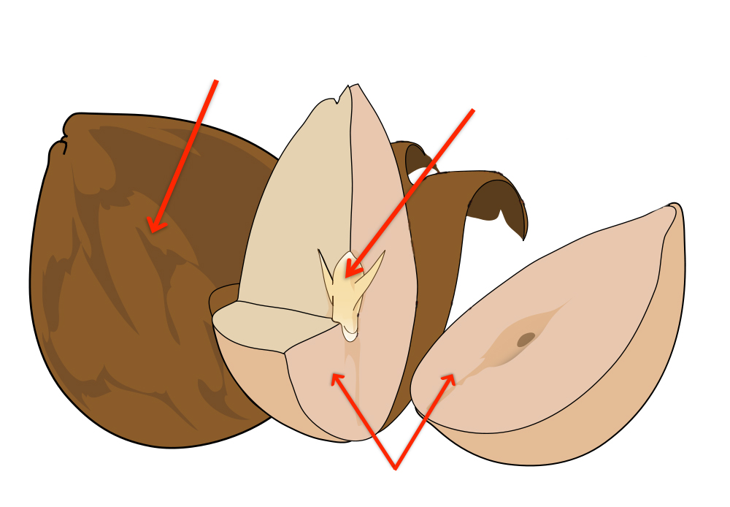
Seed Parts
Seed Coat
Embryo
Food Supply

Slide 3
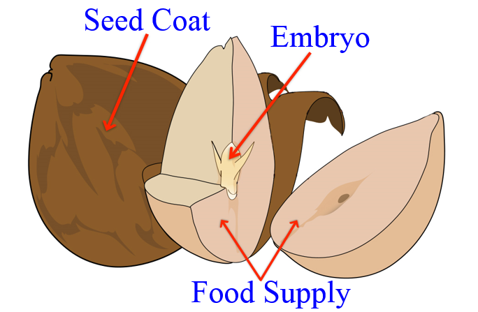
Seed Parts
Seed Coat: protective outer covering of a seed
Embryo: what will become the new plant
Food Supply: provides energy and nutrients for the embryo to grow

Slide 4
Monocot or Dicot?

Slide 5
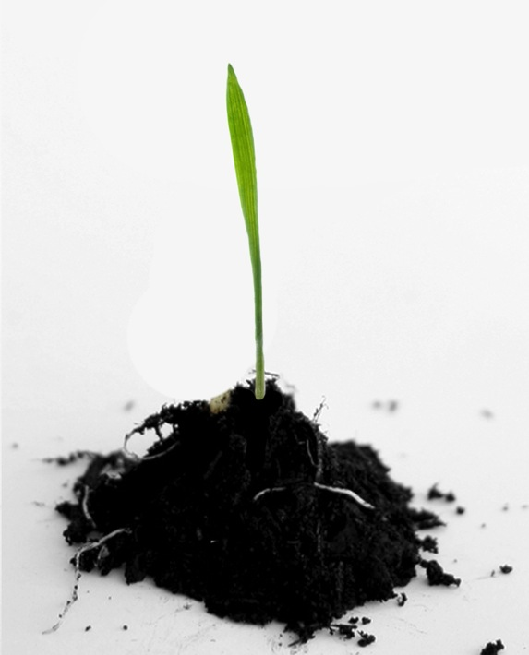
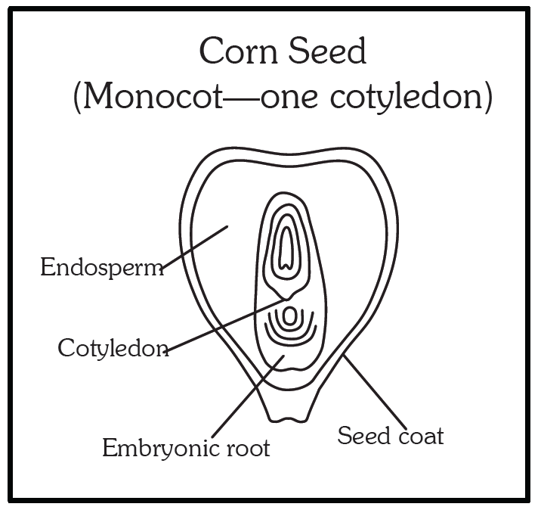
Monocot
1 primary leaf
(looks similar to grass)

Slide 6
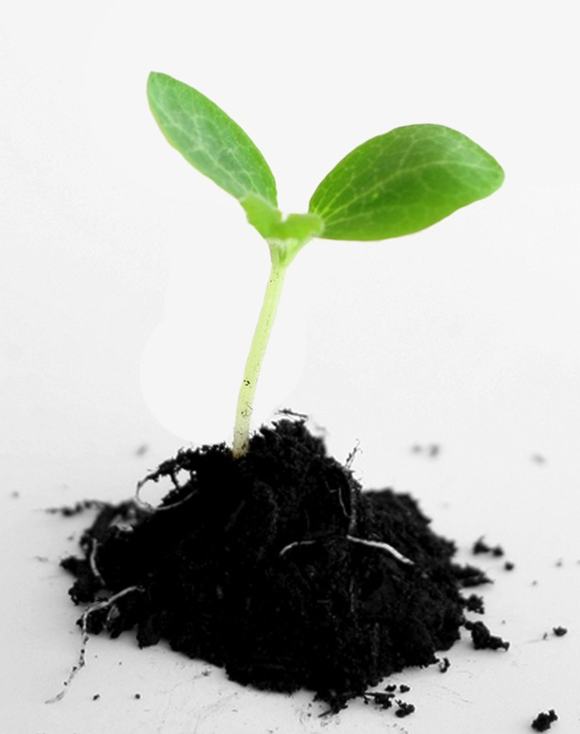
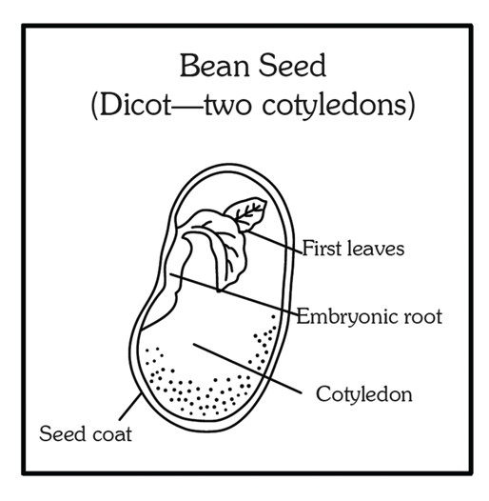
Dicot
2 leaves

Slide 7
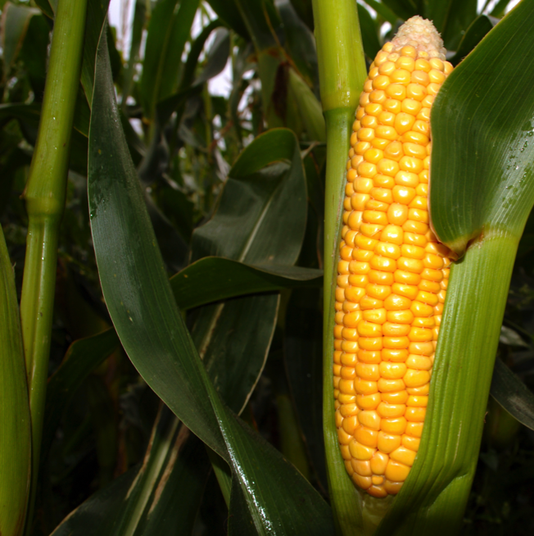
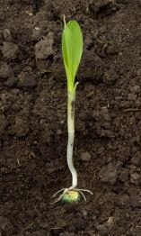
Monocot or Dicot?
Corn

Slide 8
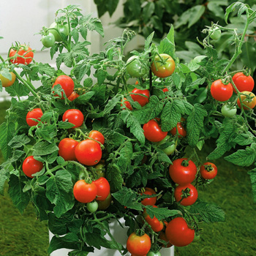
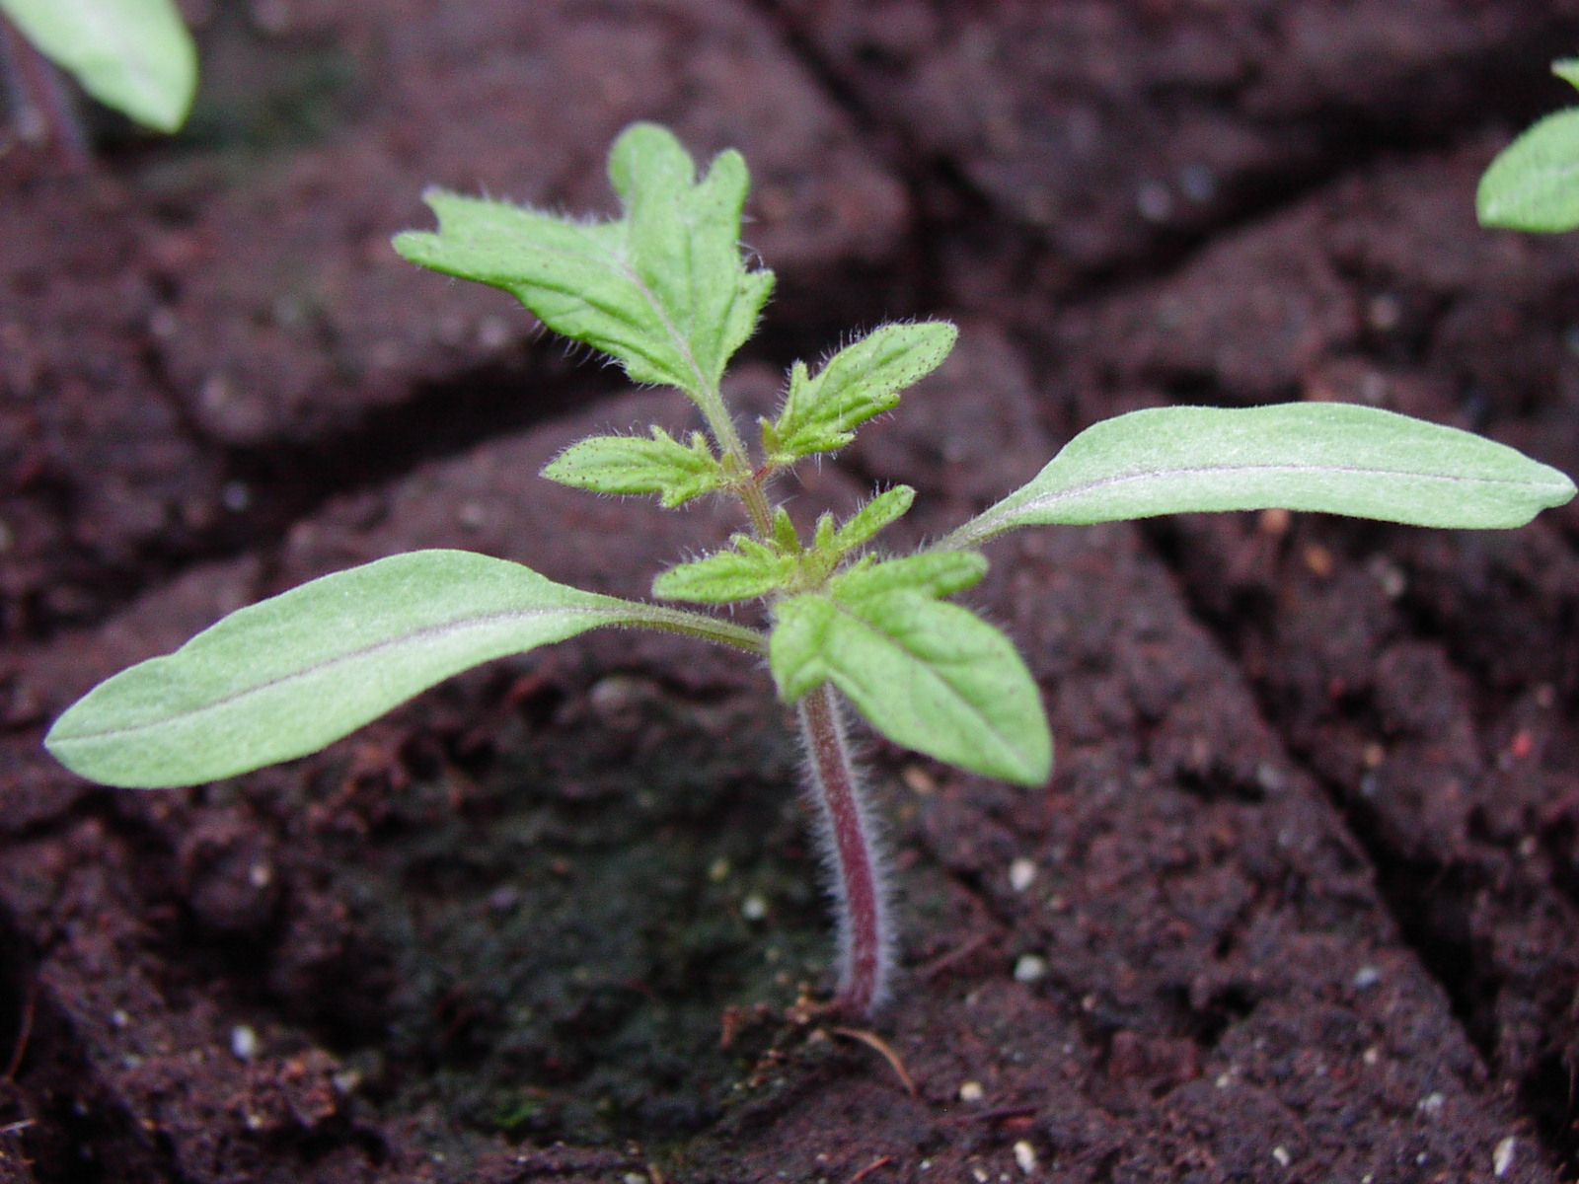
Monocot or Dicot?
Tomato

Slide 9
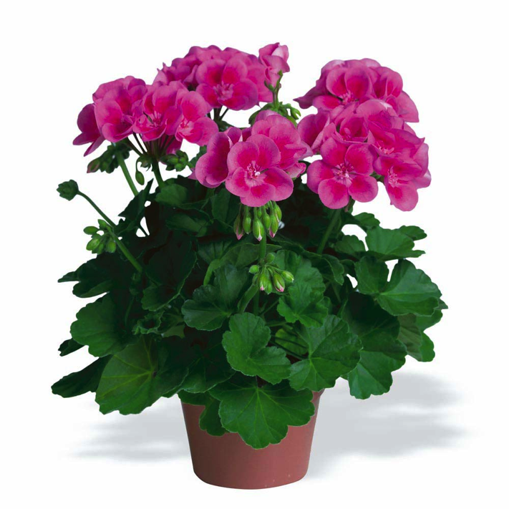
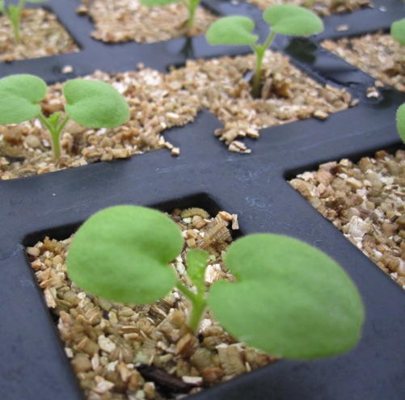
Monocot or Dicot?
Geranium

Slide 10
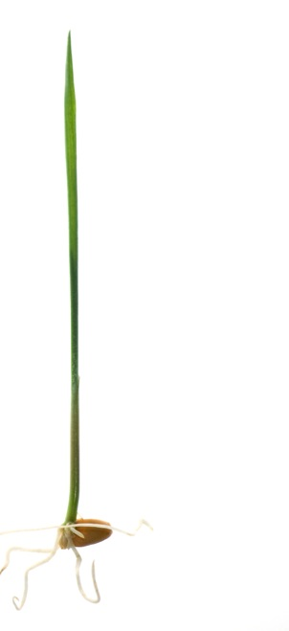
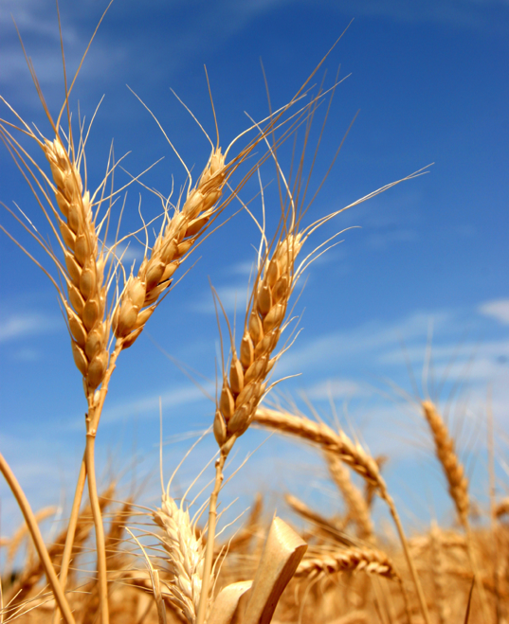
Monocot or Dicot?
Wheat

Slide 11
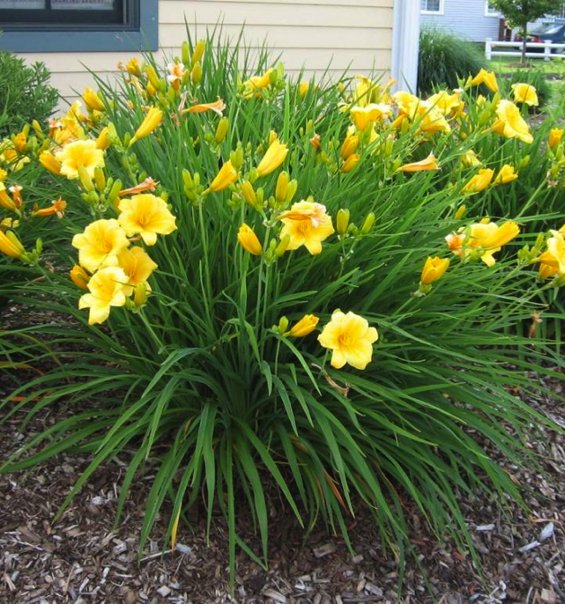
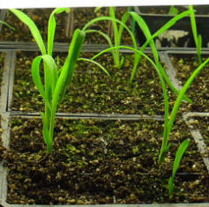
Monocot or Dicot?
Daylily

Slide 12
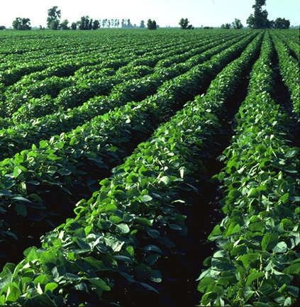
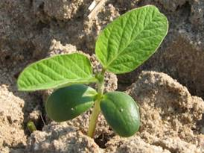
Monocot or Dicot?
Soybeans

Slide 13
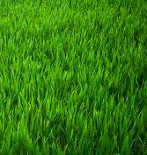
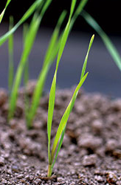
Monocot or Dicot?
Grass

Slide 14
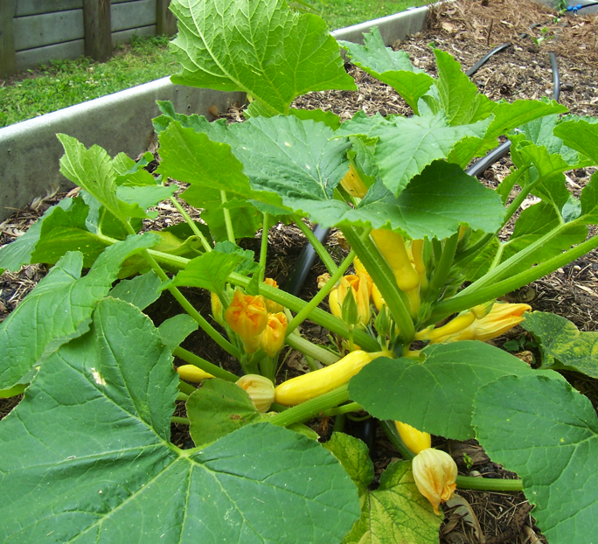
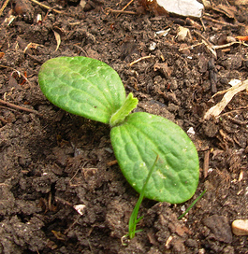
Monocot or Dicot?
Squash

