Slide 1
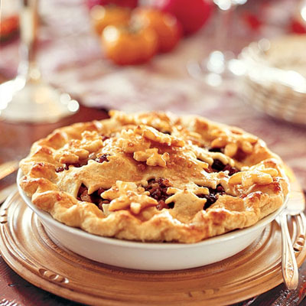
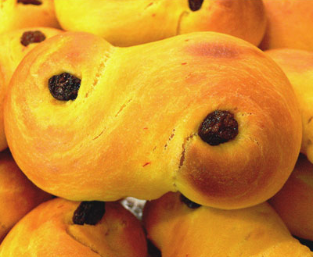
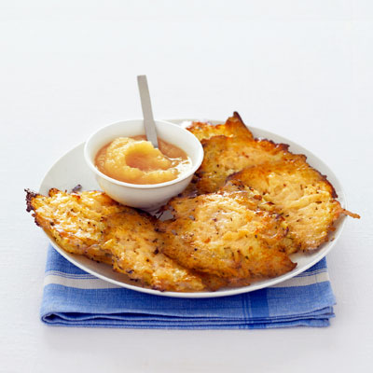
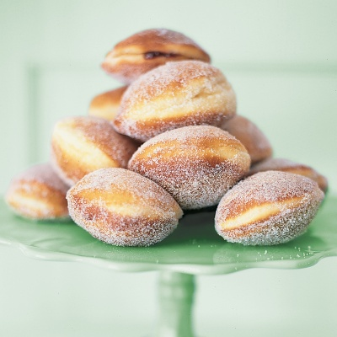
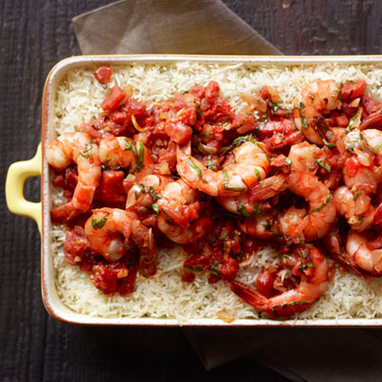
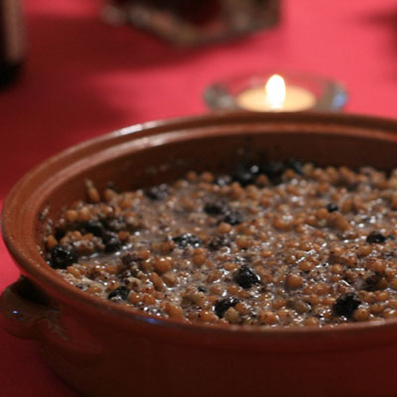
Holiday Foods around the World

Slide 2
Israel – Christmas
What is Christmas?
Annual Christian festival celebrating Christ’s birth, held on December 25th
What do they eat?
Latkes
Fried potato cakes
Sufganiyot
Fried, jelly-filled donuts
Notes:
Insert a picture illustrating a season in your country.

Slide 3
Ukraine – Christmas
What do they eat?
Kutya
A dish sweetened with honey
Includes ingredients like wheat, poppy seeds, and nuts
Cannot be eaten until the first star appears in the sky
Notes:
Add key points in the history of your country to the timeline.

Slide 4
United Kingdom – Christmas Feast
Minced Pies
Pies filled with mincemeat and dried fruits
Original minced pies actually contained beef
Notes:
Insert a map of your country.

Slide 5
Sweden – St. Lucia’s Day
What is St. Lucia’s Day?
December 13th is the first day of the Christmas season.
The oldest daughter of each family dresses in a white gown with a red sash and crown full of candles
She takes a tray of saffron buns to her parents in bed
What do they eat?
Saffron buns
Spiced sweet buns flavored with cinnamon
Notes:
Insert a picture of one of the geographic features of your country.

Slide 6
Sicily – Feast of the Seven Fishes
What is the Feast of the Seven Fishes?
On the eves of special holidays, Roman Catholics don’t eat meat or dairy products
After fasting, they eat seven seafood dishes
What do they eat?
Some dishes include salted cod, shrimp, and calamari
Notes:
Insert a picture of an animal and or plant found in your country.

Slide 7
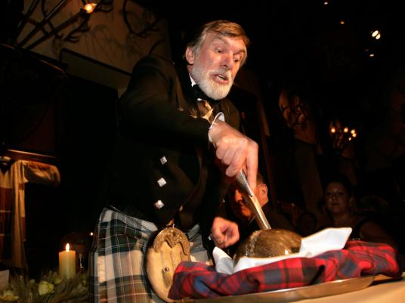
Scotland – Burns Night
What is Burns Night?
The Scottish poet Robert Burns is celebrated on January 25th
What do they eat?
Haggis
Pudding cooked in sheep’s stomach
Notes:
Insert a picture illustrating a custom or tradition here.

Slide 8
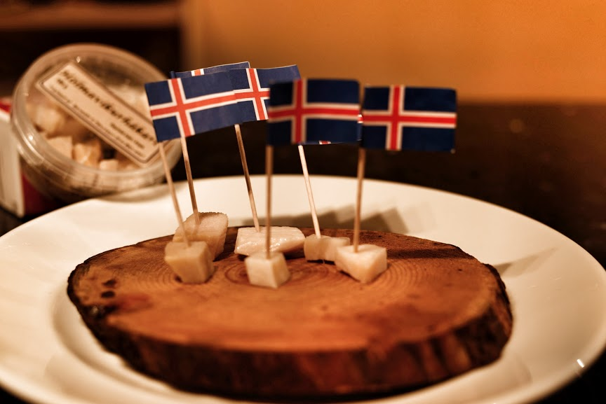
Iceland – Mid-Winter Festival
What is Mid-Winter Festival?
A festival held each January and February
Celebrated by feasting on traditional Viking food
What do they eat?
Smoked Lamb
Wind-dried fish
Harkal
Shark meat
Harkal
Notes:
Insert a picture of the head leader of your country.

Slide 9
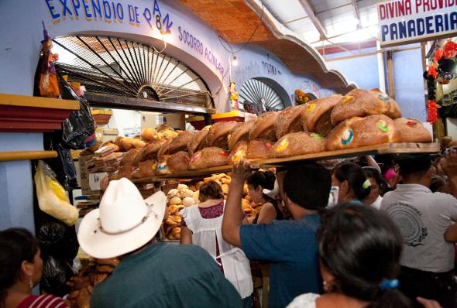
Mexico – Day of the Dead
What is Day of the Dead?
A celebration honoring loved ones who have passed away
What do they eat?
Bread for the Dead
Loaves of bread baked in the shape of people and animals
Notes:
Insert a picture that illustrates some part of your country’s economy.

Slide 10
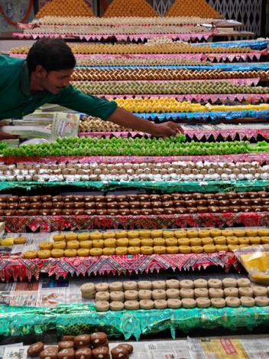
India – Diwali
What is Diwali?
Festival of Lights
Celebration of good over evil
Besan Burfi
Fudge-like biscuits
Notes:
Insert a picture of one of the points of interest for your country.

