Slide 1
Evolving Role of women in agriculture
Key messages from Women in Agriculture: Closing the Gender Gap for Development 2010-11
Food and Agriculture Organization of the United Nations

Slide 2
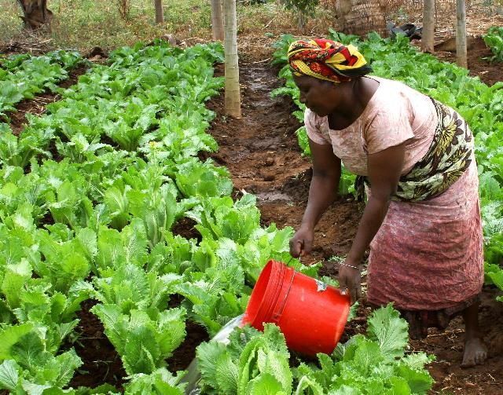
Women’s roles in agriculture…
differ significantly by region.
are changing rapidly in some areas.
On average, women comprise…
43% of the agricultural labor force in developing countries…
from 20% in Latin America
to 50% in Eastern Asia and sub-Saharan Africa.
two-thirds of the world’s 600 million poor livestock keepers.
“Maza Wanawake Kwanza Growers Association (7269688256”) by USAID Africa Bureau is in the public domain.

Slide 3
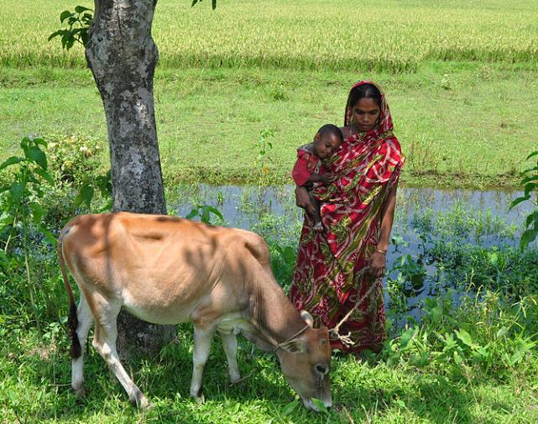
Women in agriculture and rural areas have this in common…
less access than men to productive resources and opportunities.
The gender gap is found in:
Land
Livestock
Labor
Education
Extension and financial services
Technology
“A village woman of Bangladesh” by Balaram Mahalder is licensed under Creative Commons Attribution-Share Alike 3.0 Unported

Slide 4
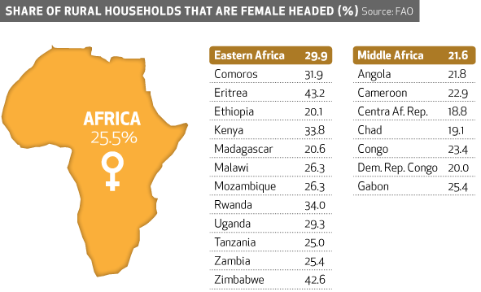
Female Heads of Households
A significant share of households in all regions are headed by women, yet their access to productive resources and services are limited.
[©FAO] [2015] [The Female Face of Farming] [http://www.fao.org/gender/infographic/en/] [Downloaded November 2015]

Slide 5
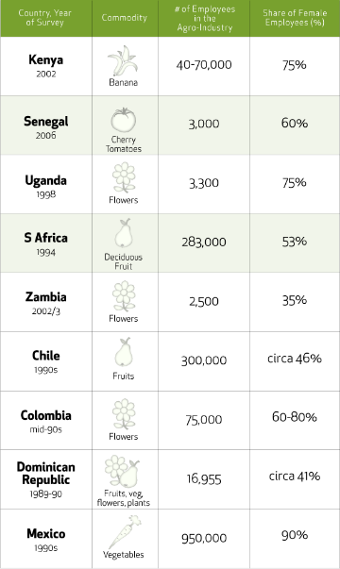
Employment in High-value Agro-Industries
Women wage workers dominate employment in areas of export-oriented high-value agriculture in the developing world.
[©FAO] [2015] [The Female Face of Farming] [http://www.fao.org/gender/infographic/en/] [Downloaded November 2015]

Slide 6
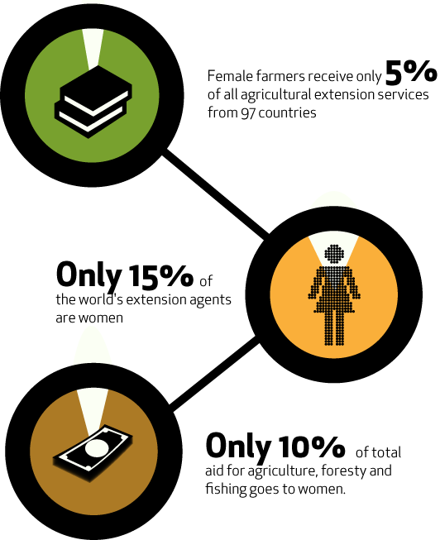
Extension Services
Because of cultural attitudes, discrimination, and a lack of recognition for their role in food production, extension and training benefits for women are limited or non-existent.
[©FAO] [2015] [The Female Face of Farming] [http://www.fao.org/gender/infographic/en/] [Downloaded November 2015]

Slide 7
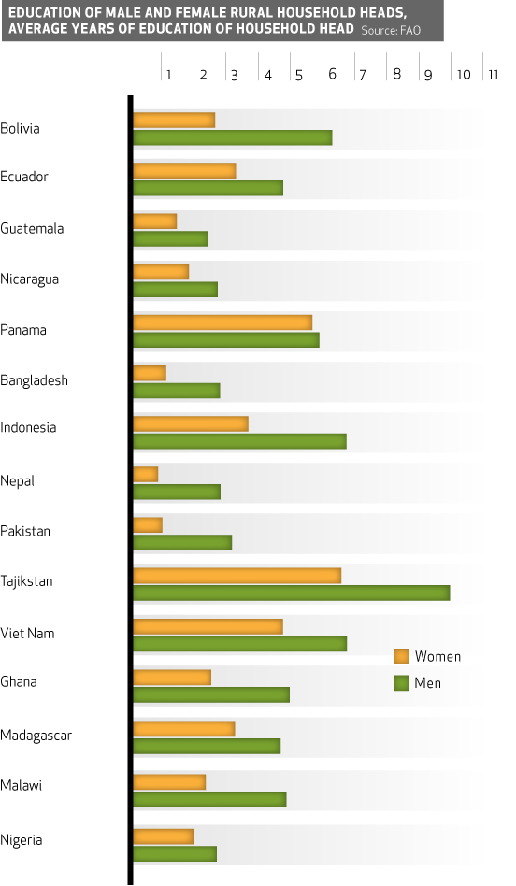
Education
Girls who stay in school are more likely as adults to be able to feed themselves and their families.
[©FAO] [2015] [The Female Face of Farming] [http://www.fao.org/gender/infographic/en/] [Downloaded November 2015]

Slide 8
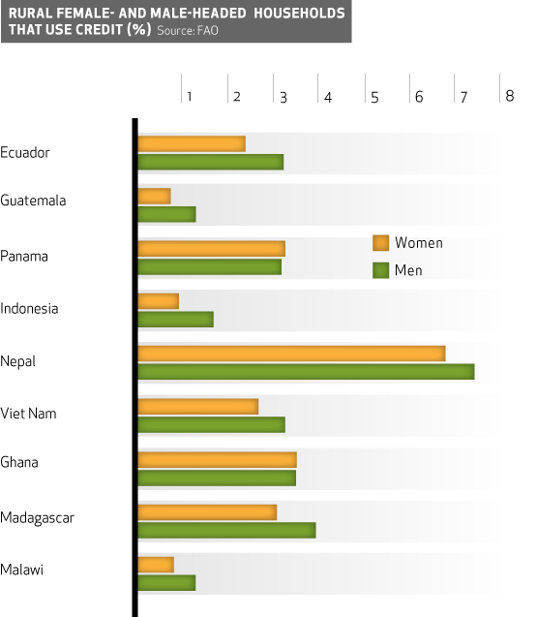
Access to Credit
Without access to credit, women often cannot buy essential inputs, such as seeds, tools and fertilizers, or invest in irrigation and land improvements.
[©FAO] [2015] [The Female Face of Farming] [http://www.fao.org/gender/infographic/en/] [Downloaded November 2015]

Slide 9
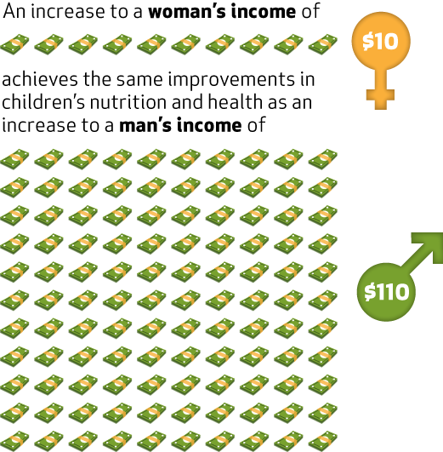
Income
Increasing women’s share of household income has broad benefits to improved rural livelihoods.
[©FAO] [2015] [The Female Face of Farming] [http://www.fao.org/gender/infographic/en/] [Downloaded November 2015]

Slide 10
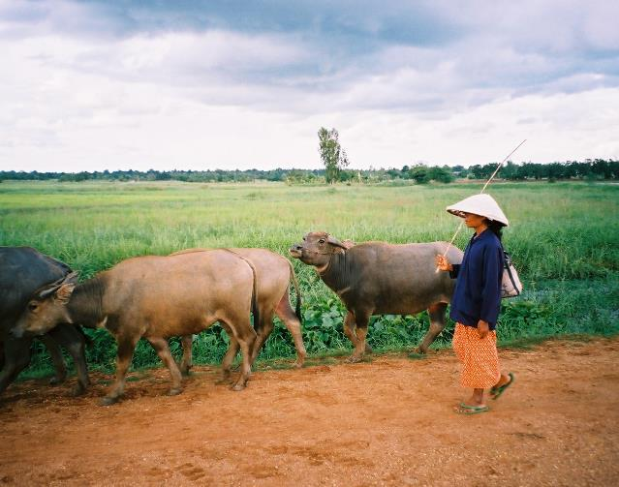
Priority areas for policy reform include…
eliminating discrimination against women in access to agricultural resources, education, extension and financial service, and labor markets;
investing in labor-saving and productivity-enhancing technologies and infrastructure to free women’s time for more productive activities;
facilitating the participation of women in flexible, efficient, and fair rural labor markets.
“Herding water buffalo in Chaiyaphum Province” by Chiba007 is licensed by Creative Commons Attribution 2.5 Generic.

Slide 11
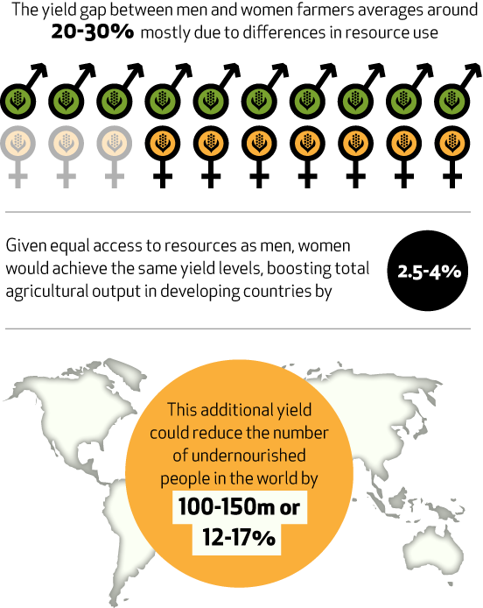
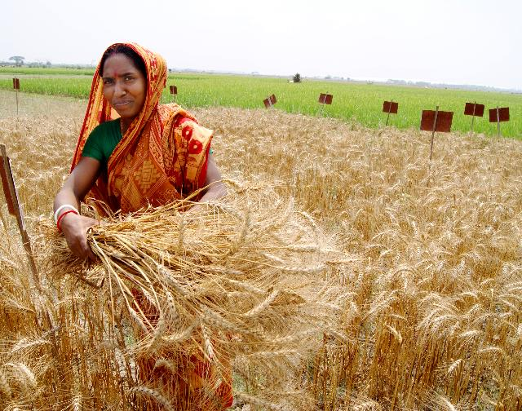
[©FAO] [2015] [The Female Face of Farming] [http://www.fao.org/gender/infographic/en/] [Downloaded November 2015]

